Slide 1
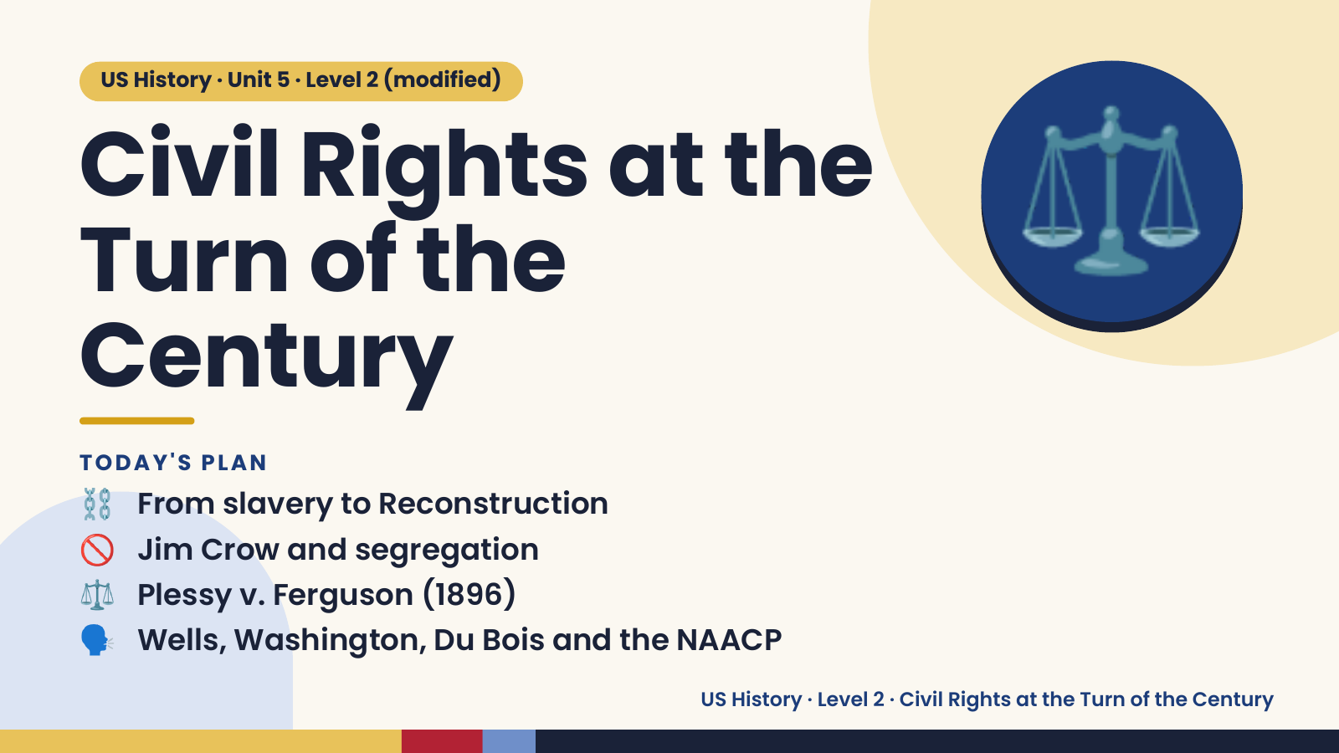
Notes:
US History · Unit 5 · Level 2 (modified)
Civil Rights at the
Turn of the
Century
⚖️
⛓️ From slavery to Reconstruction
TODAY'S PLAN
🚫 Jim Crow and segregation
⚖️ Plessy v. Ferguson (1896)
🗣️ Wells, Washington, Du Bois and the NAACP
US History · Level 2 · Civil Rights at the Turn of the Century

Slide 2
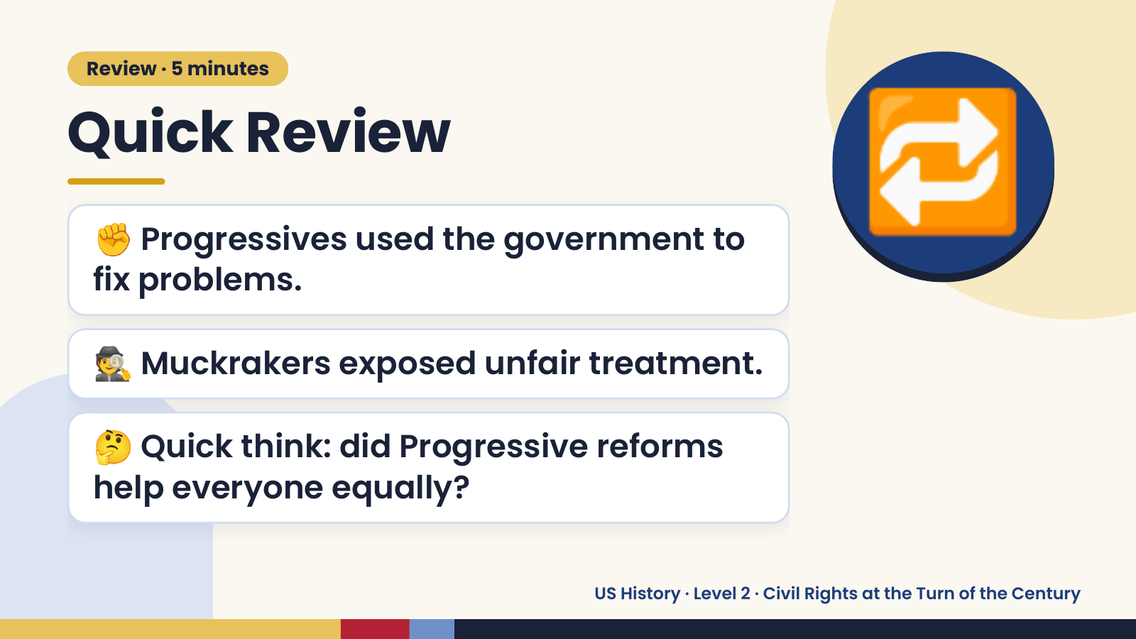
Notes:
Review · 5 minutes
Quick Review
✊ Progressives used the government to
fix problems.
🔁
🕵️ Muckrakers exposed unfair treatment.
🤔 Quick think: did Progressive reforms
help everyone equally?
US History · Level 2 · Civil Rights at the Turn of the Century

Slide 3
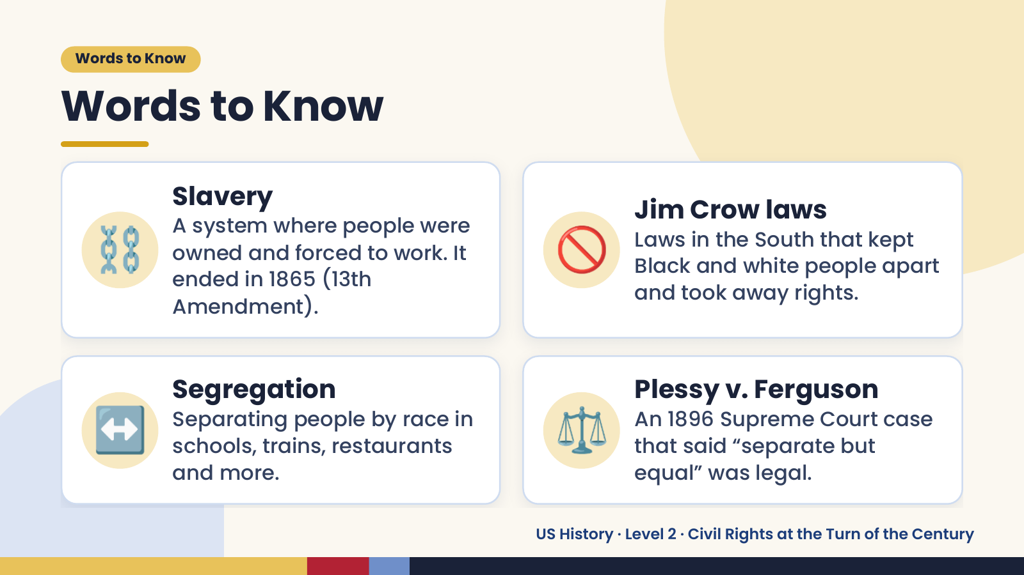
Notes:
Words to Know
Words to Know
⛓️ 🚫
Slavery
Jim Crow laws
A system where people were
Laws in the South that kept
owned and forced to work. It
Black and white people apart
ended in 1865 (13th
and took away rights.
Amendment).
↔️ Segregation
Separating people by race in
schools, trains, restaurants
and more.
⚖️ Plessy v. Ferguson
An 1896 Supreme Court case
that said “separate but
equal” was legal.
US History · Level 2 · Civil Rights at the Turn of the Century

Slide 4
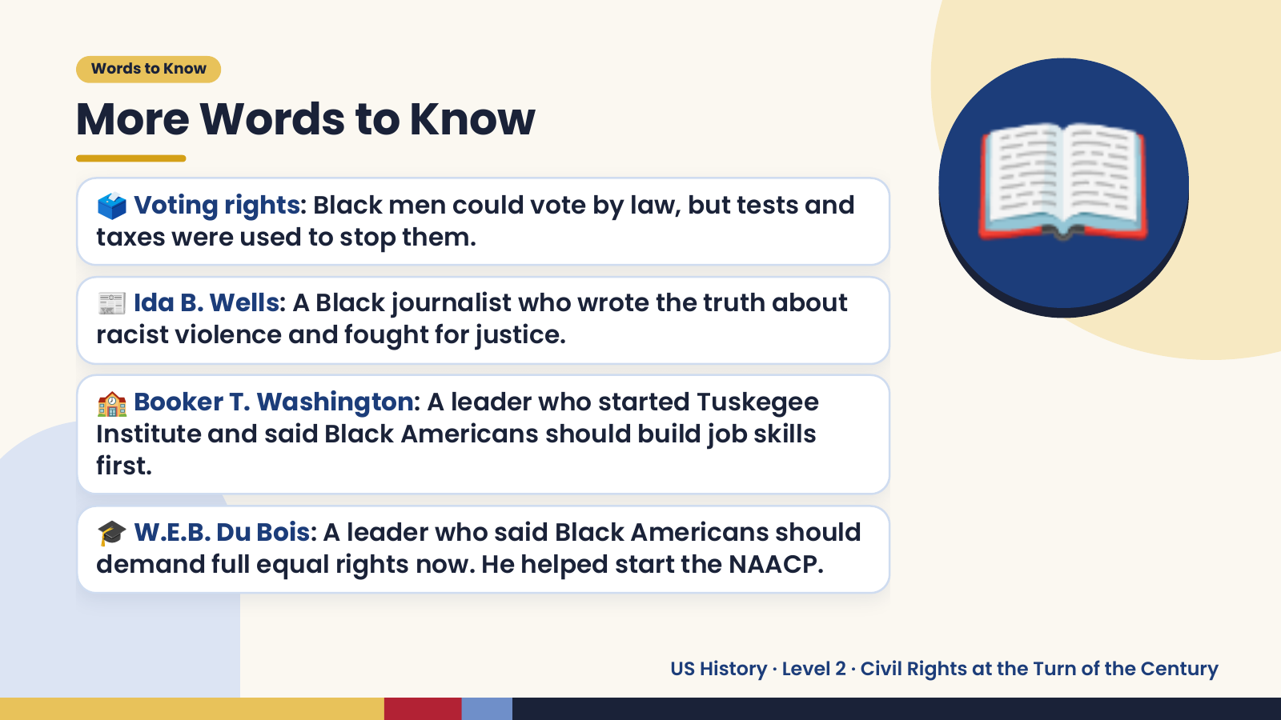
Notes:
Words to Know
More Words to Know
🗳️ Voting rights: Black men could vote by law, but tests and
taxes were used to stop them.
📰 Ida B. Wells: A Black journalist who wrote the truth about
racist violence and fought for justice.
🏫 Booker T. Washington: A leader who started Tuskegee
📖
Institute and said Black Americans should build job skills
first.
🎓 W.E.B. Du Bois: A leader who said Black Americans should
demand full equal rights now. He helped start the NAACP.
US History · Level 2 · Civil Rights at the Turn of the Century

Slide 5
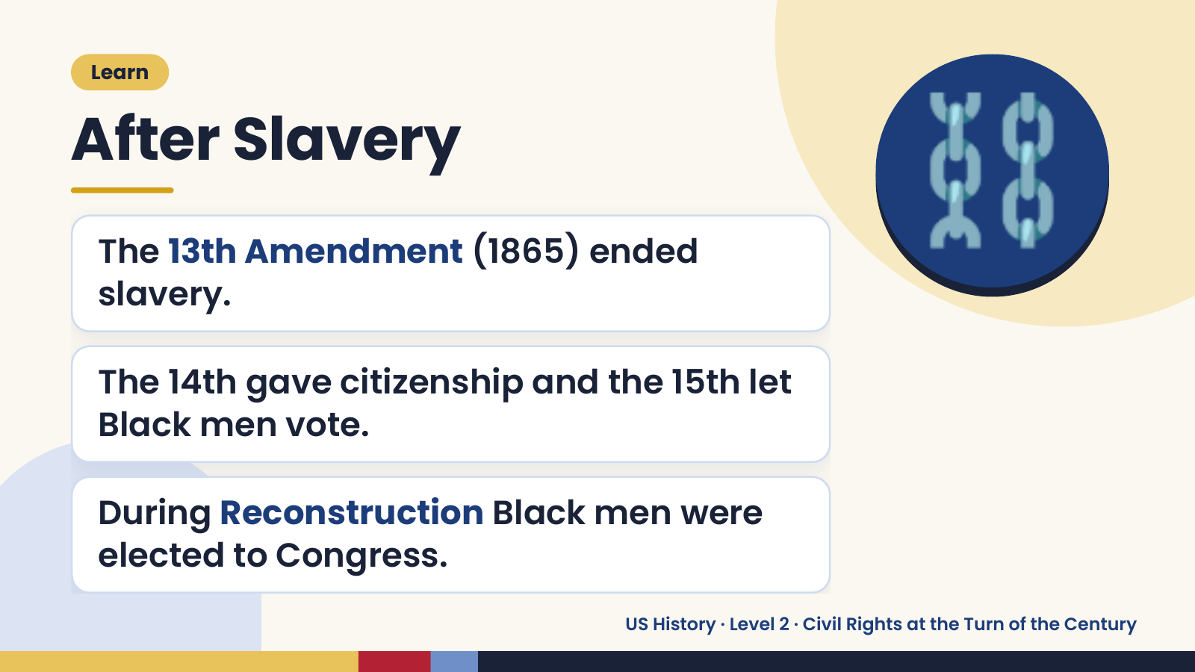
Notes:
Learn
After Slavery
The 13th Amendment (1865) ended
slavery.
⛓️
The 14th gave citizenship and the 15th let
Black men vote.
During Reconstruction Black men were
elected to Congress.
US History · Level 2 · Civil Rights at the Turn of the Century

Slide 6
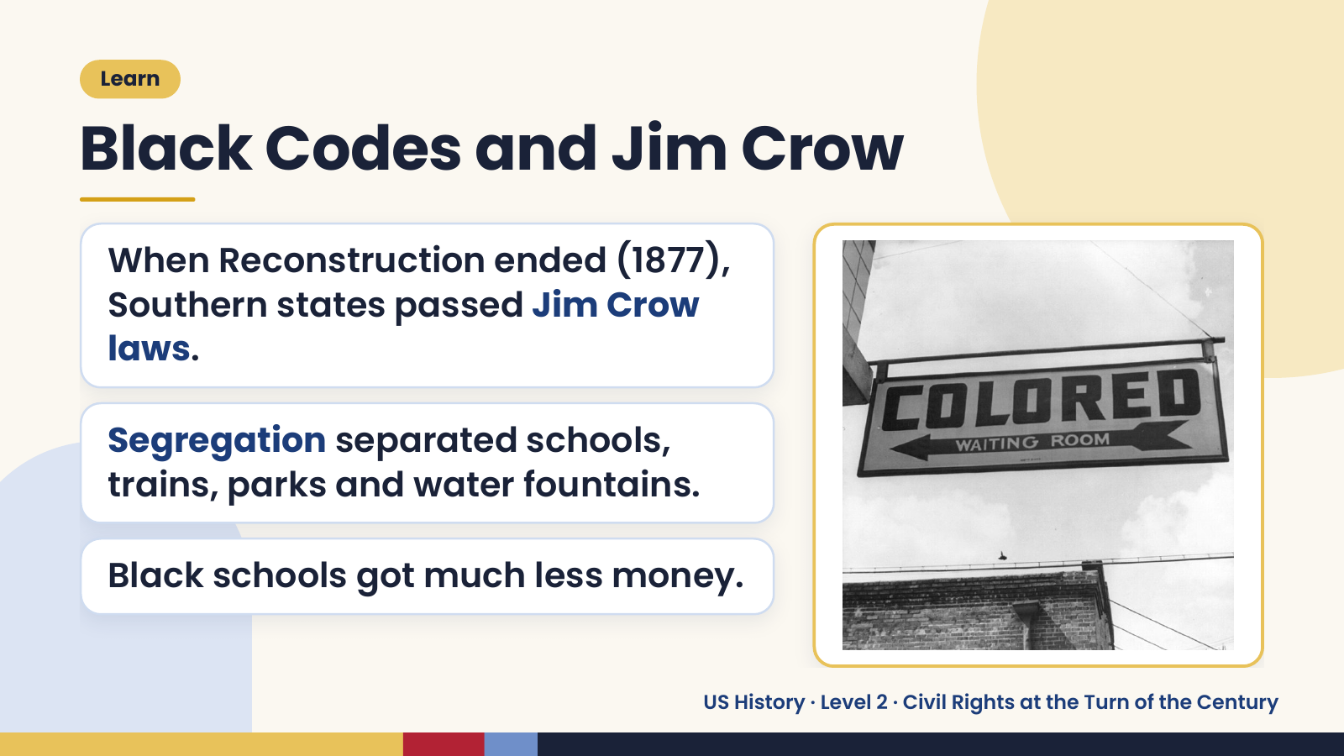
Notes:
Learn
Black Codes and Jim Crow
When Reconstruction ended (1877),
Southern states passed Jim Crow
laws.
Segregation separated schools,
trains, parks and water fountains.
Black schools got much less money.
US History · Level 2 · Civil Rights at the Turn of the Century

Slide 7
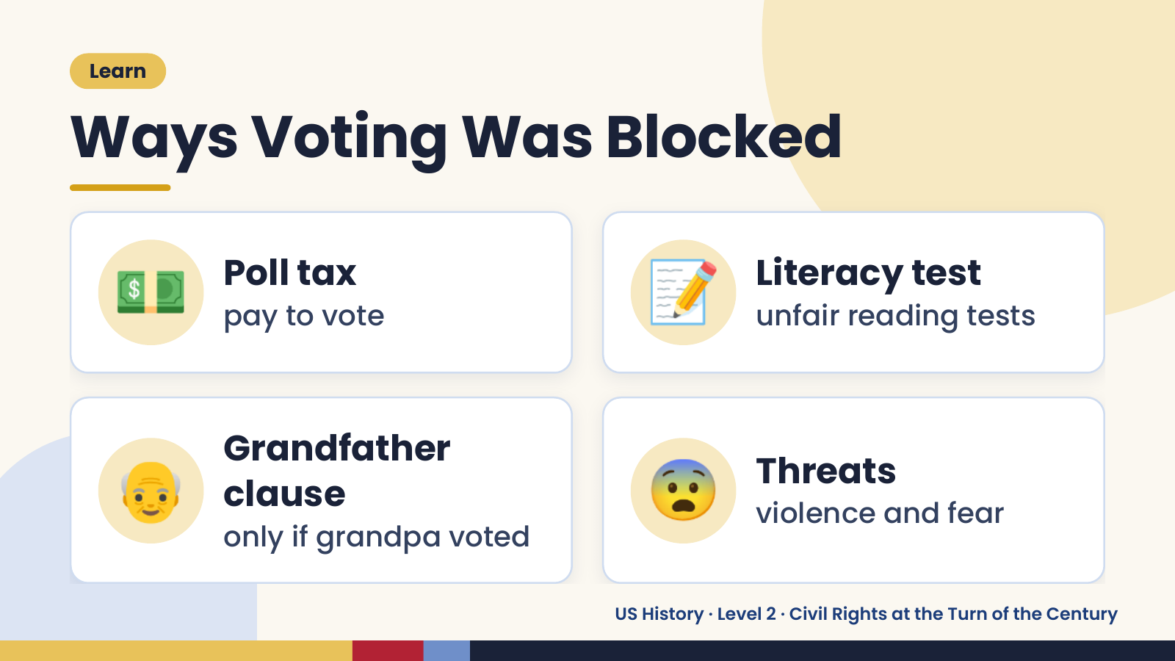
Notes:
Learn
Ways Voting Was Blocked
💵 Poll tax
pay to vote 📝 Literacy test
unfair reading tests
👴 Grandfather
clause
only if grandpa voted
😨 Threats
violence and fear
US History · Level 2 · Civil Rights at the Turn of the Century

Slide 8
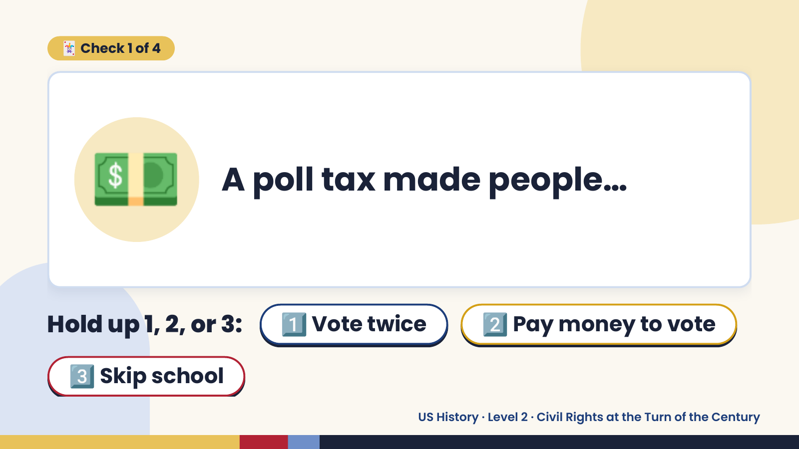
Notes:
🃏 Check 1 of 4
💵 A poll tax made people…
Hold up 1, 2, or 3: 1️⃣ Vote twice 2️⃣ Pay money to vote
3️⃣ Skip school
US History · Level 2 · Civil Rights at the Turn of the Century

Slide 9
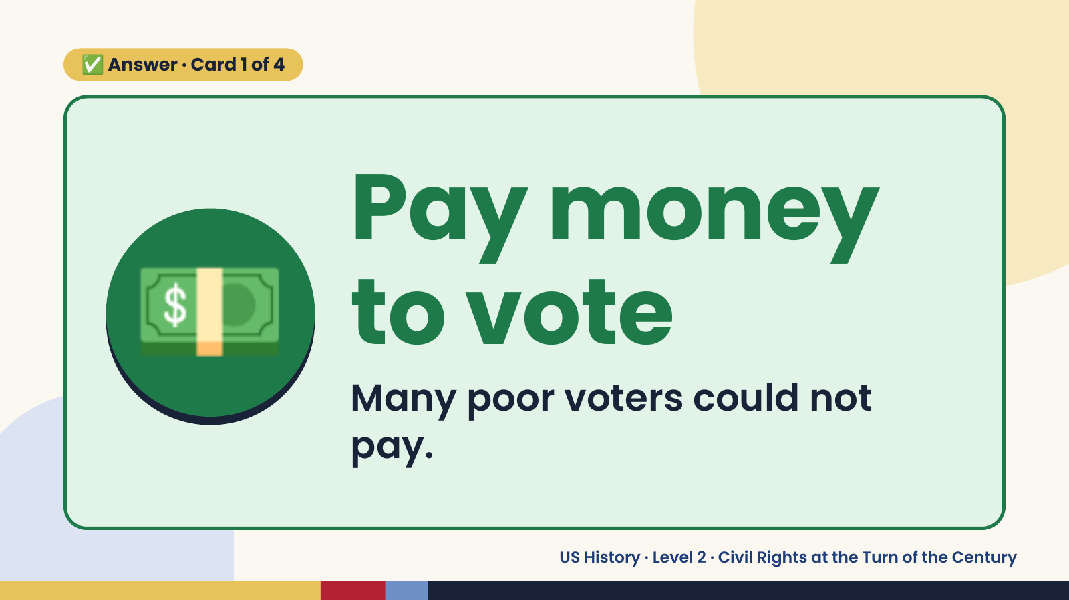
Notes:
✅ Answer · Card 1 of 4
💵 Pay money
to vote
Many poor voters could not
pay.
US History · Level 2 · Civil Rights at the Turn of the Century

Slide 10
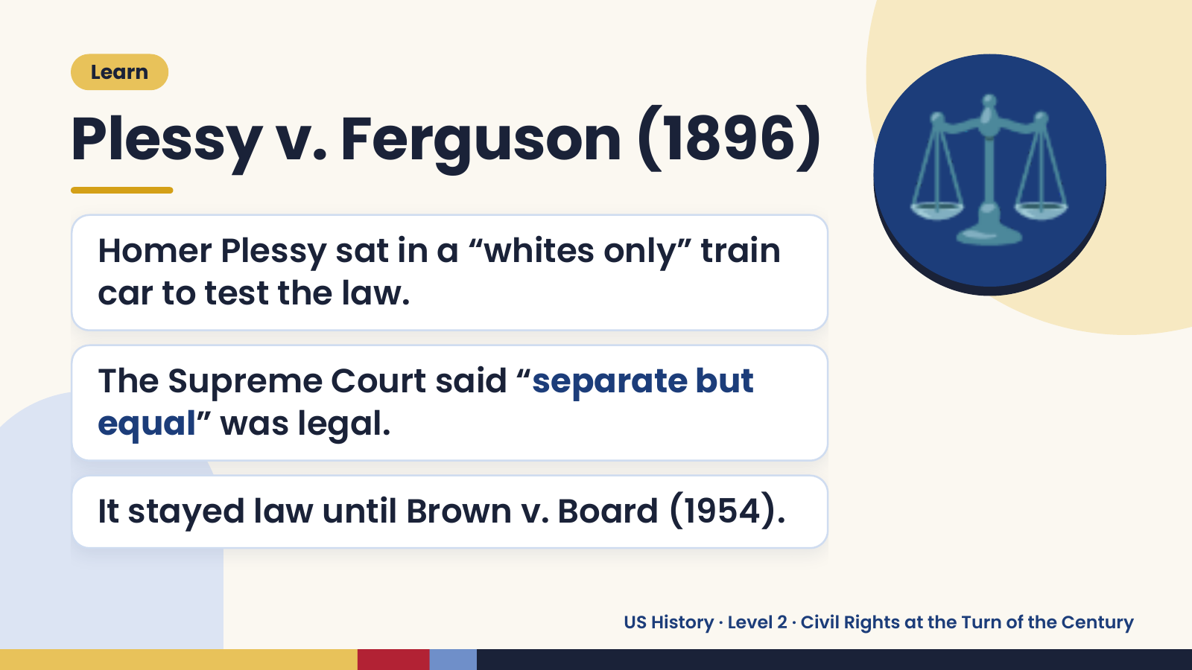
Notes:
Learn
Plessy v. Ferguson (1896)
Homer Plessy sat in a “whites only” train
car to test the law.
⚖️
The Supreme Court said “separate but
equal” was legal.
It stayed law until Brown v. Board (1954).
US History · Level 2 · Civil Rights at the Turn of the Century

Slide 11
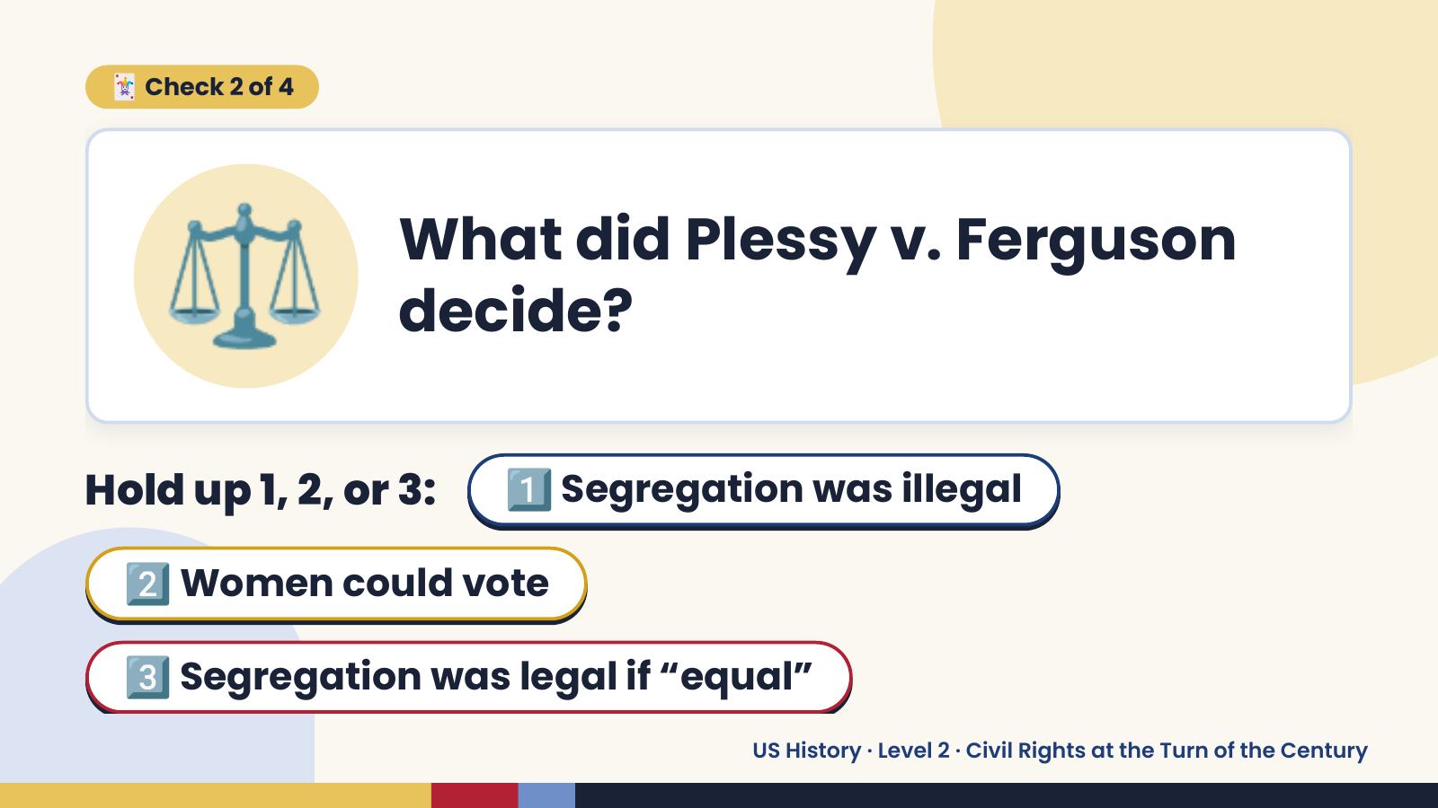
Notes:
⚖️
🃏 Check 2 of 4
What did Plessy v. Ferguson
decide?
Hold up 1, 2, or 3: 1️⃣ Segregation was illegal
2️⃣ Women could vote
3️⃣ Segregation was legal if “equal”
US History · Level 2 · Civil Rights at the Turn of the Century

Slide 12
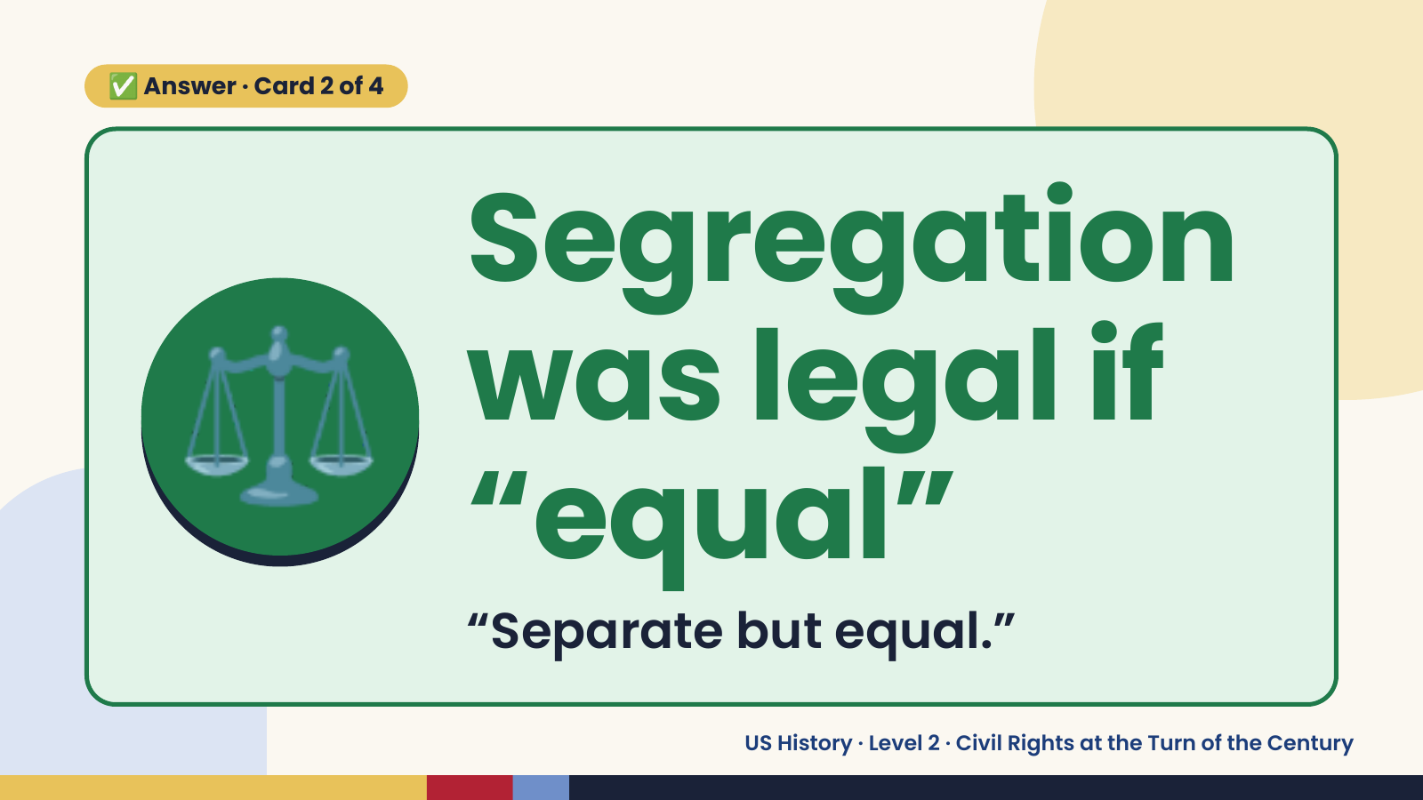
Notes:
✅ Answer · Card 2 of 4
⚖️ Segregation
was legal if
“equal”
“Separate but equal.”
US History · Level 2 · Civil Rights at the Turn of the Century

Slide 13
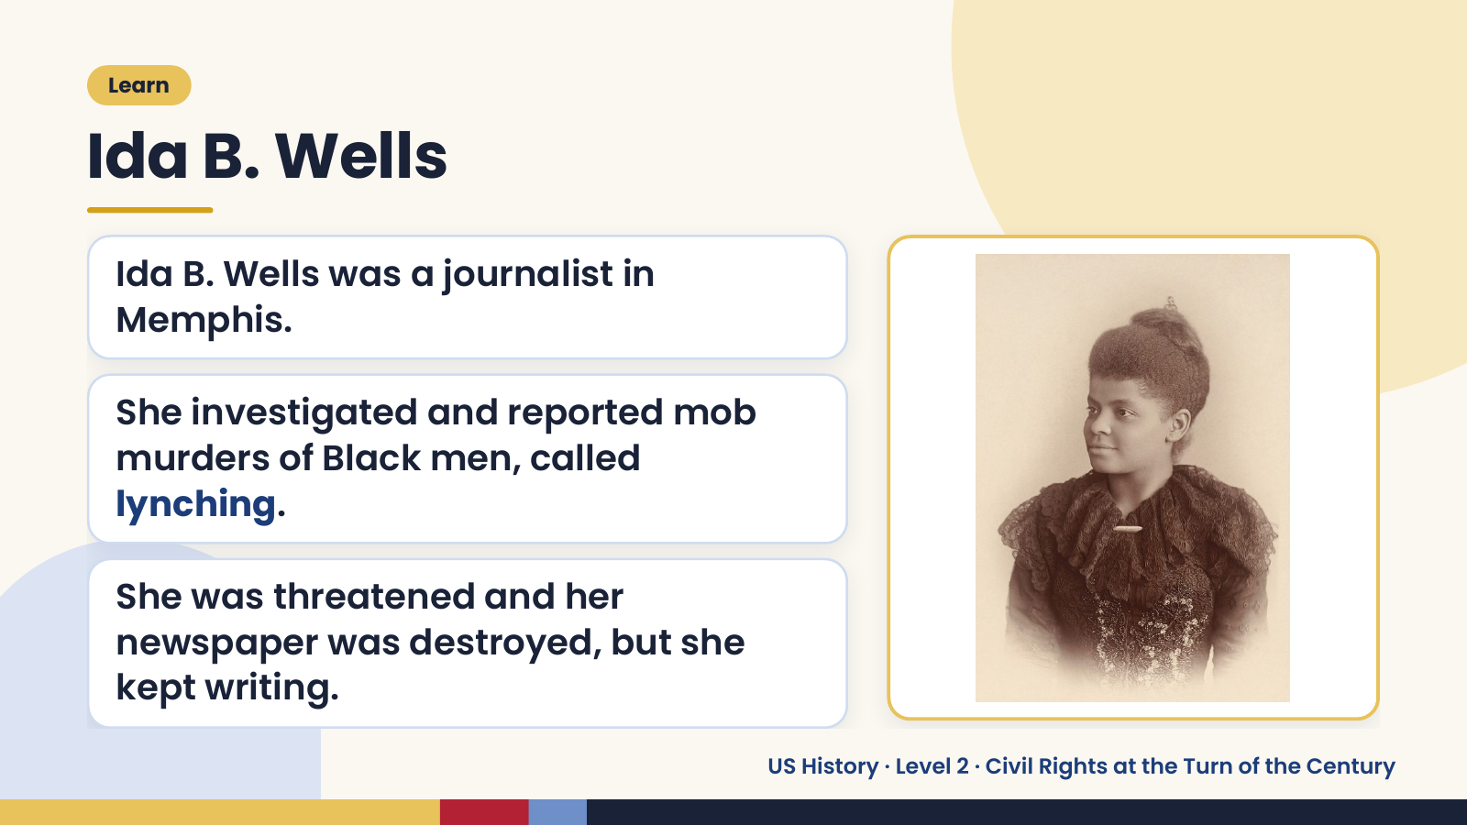
Notes:
Learn
Ida B. Wells
Ida B. Wells was a journalist in
Memphis.
She investigated and reported mob
murders of Black men, called
lynching.
She was threatened and her
newspaper was destroyed, but she
kept writing.
US History · Level 2 · Civil Rights at the Turn of the Century

Slide 14
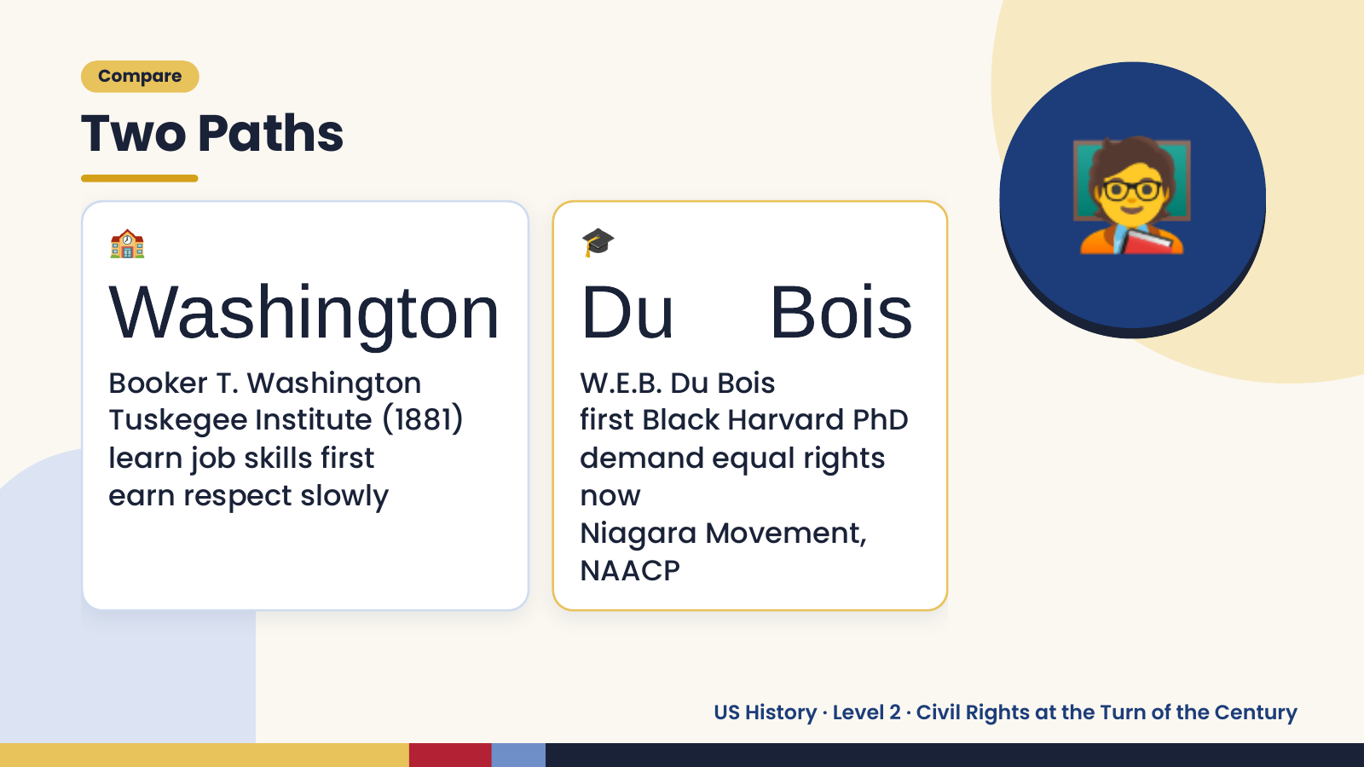
Notes:
🧑‍🏫
Compare
Two Paths
🏫 🎓
Washington Du Bois
Booker T. Washington W.E.B. Du Bois
Tuskegee Institute (1881) first Black Harvard PhD
learn job skills first demand equal rights
earn respect slowly now
Niagara Movement,
NAACP
US History · Level 2 · Civil Rights at the Turn of the Century

Slide 15
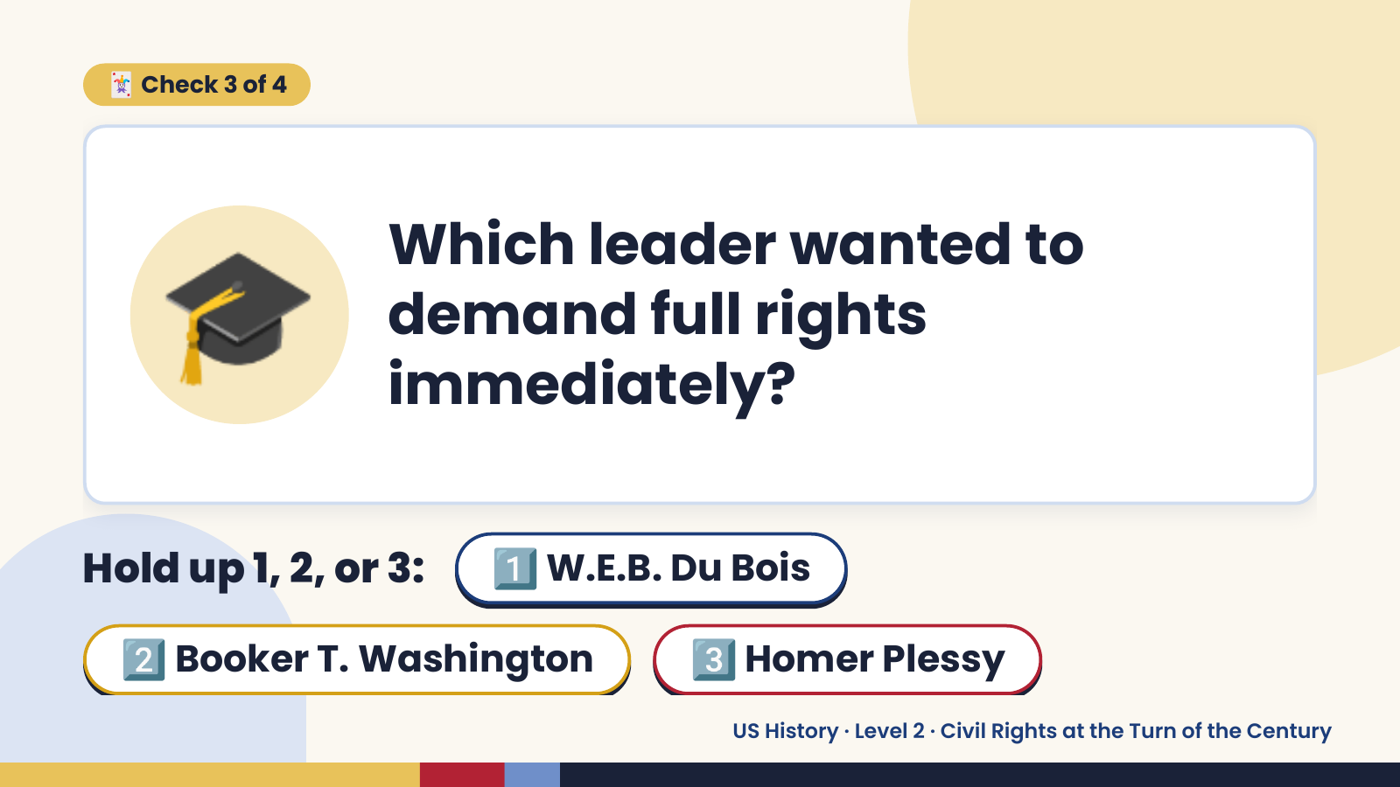
Notes:
🃏 Check 3 of 4
🎓 Which leader wanted to
demand full rights
immediately?
Hold up 1, 2, or 3: 1️⃣ W.E.B. Du Bois
2️⃣ Booker T. Washington 3️⃣ Homer Plessy
US History · Level 2 · Civil Rights at the Turn of the Century

Slide 16
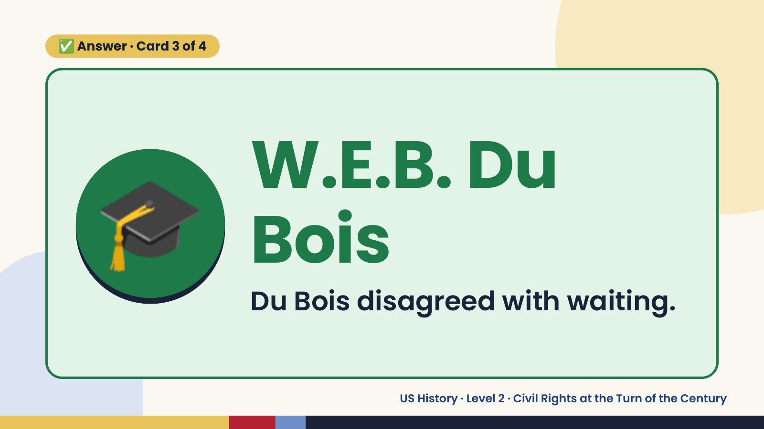
Notes:
✅ Answer · Card 3 of 4
🎓 W.E.B. Du
Bois
Du Bois disagreed with waiting.
US History · Level 2 · Civil Rights at the Turn of the Century

Slide 17
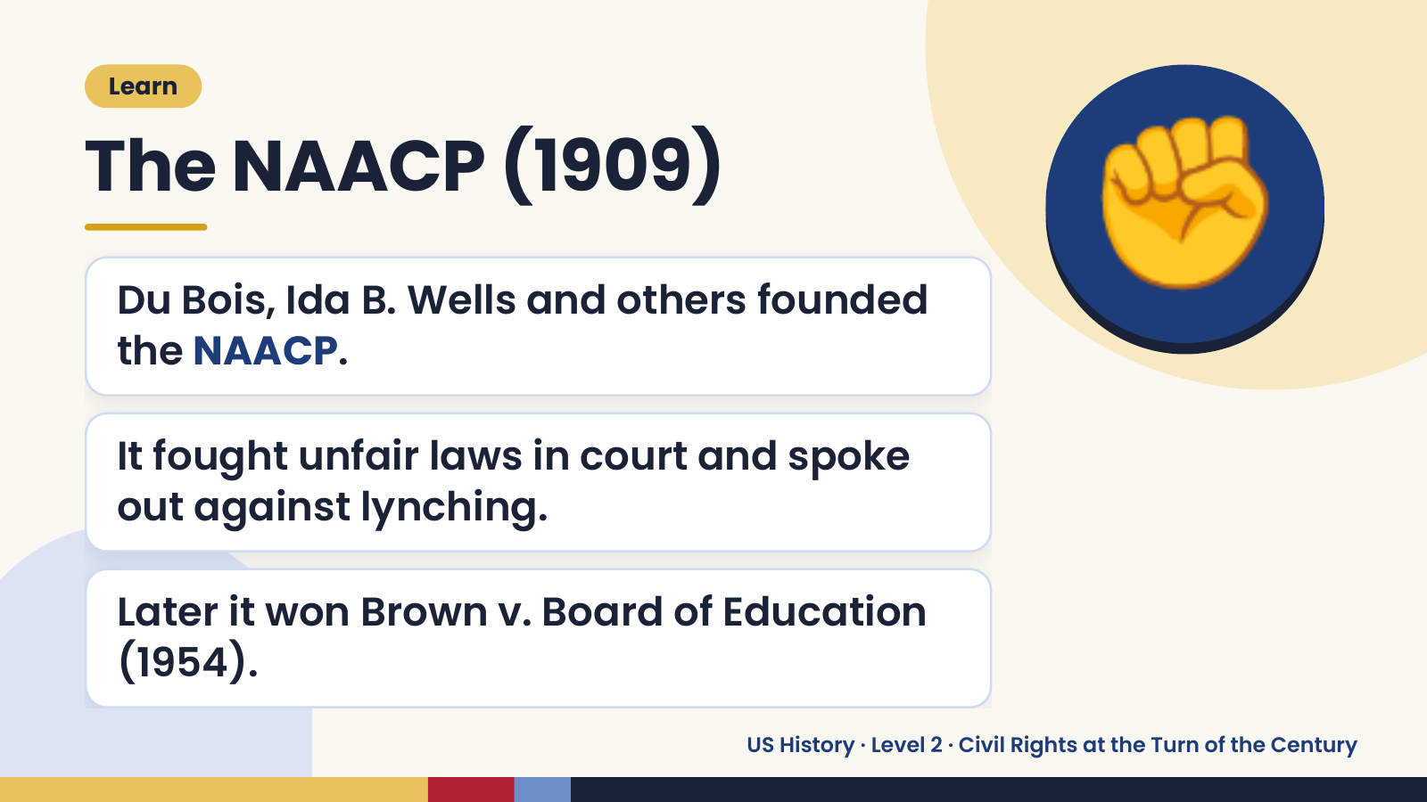
Notes:
Learn
The NAACP (1909)
Du Bois, Ida B. Wells and others founded
the NAACP.
✊
It fought unfair laws in court and spoke
out against lynching.
Later it won Brown v. Board of Education
(1954).
US History · Level 2 · Civil Rights at the Turn of the Century

Slide 18
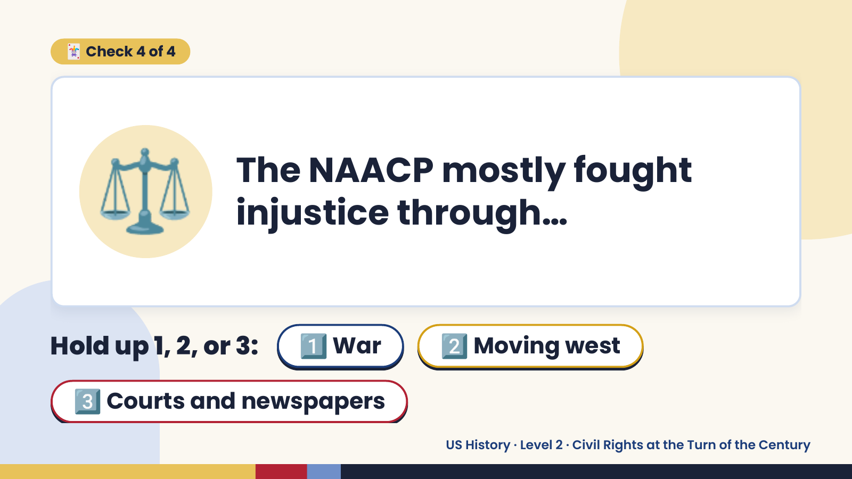
Notes:
🃏 Check 4 of 4
⚖️ The NAACP mostly fought
injustice through…
Hold up 1, 2, or 3: 1️⃣ War 2️⃣ Moving west
3️⃣ Courts and newspapers
US History · Level 2 · Civil Rights at the Turn of the Century

Slide 19
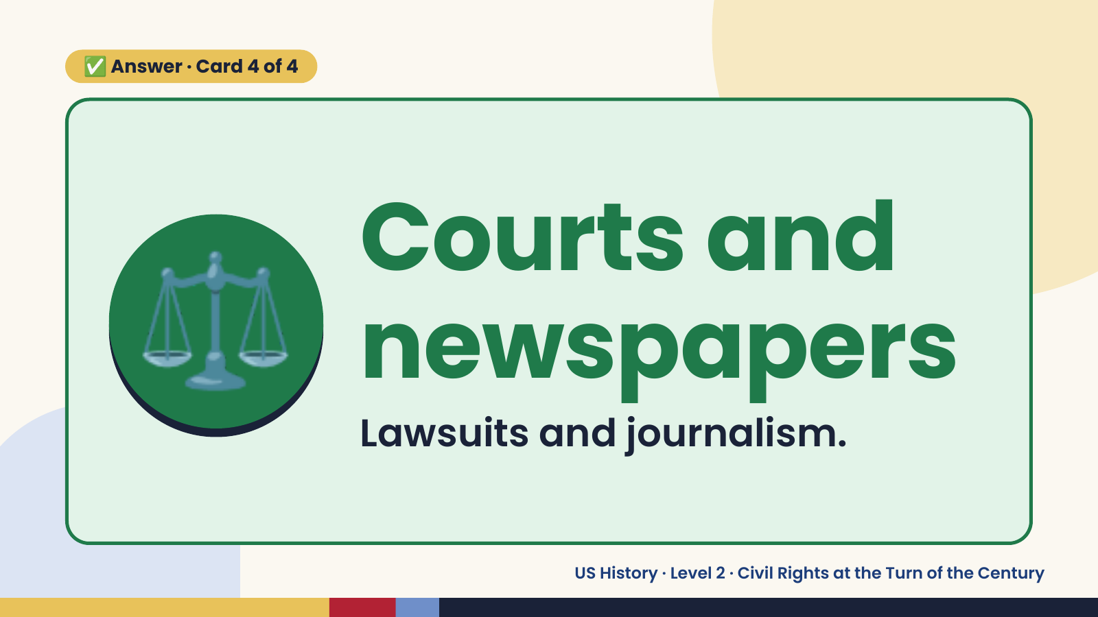
Notes:
✅ Answer · Card 4 of 4
⚖️ Courts and
newspapers
Lawsuits and journalism.
US History · Level 2 · Civil Rights at the Turn of the Century

Slide 20
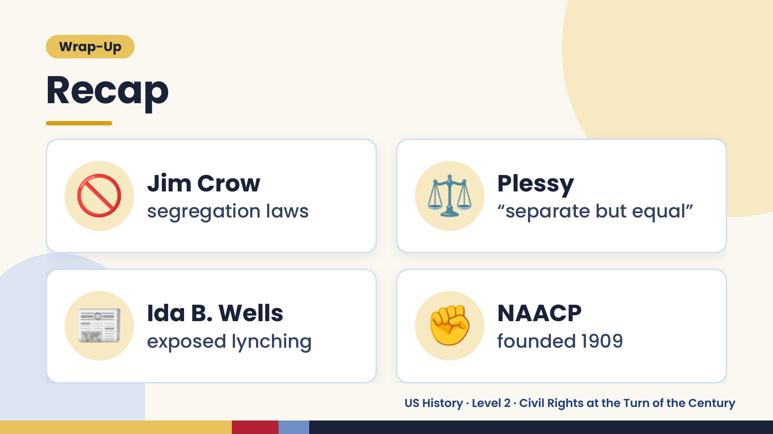
Notes:
Wrap-Up
Recap
🚫 Jim Crow
segregation laws ⚖️ Plessy
“separate but equal”
📰 Ida B. Wells
exposed lynching ✊ NAACP
founded 1909
US History · Level 2 · Civil Rights at the Turn of the Century

Slide 21
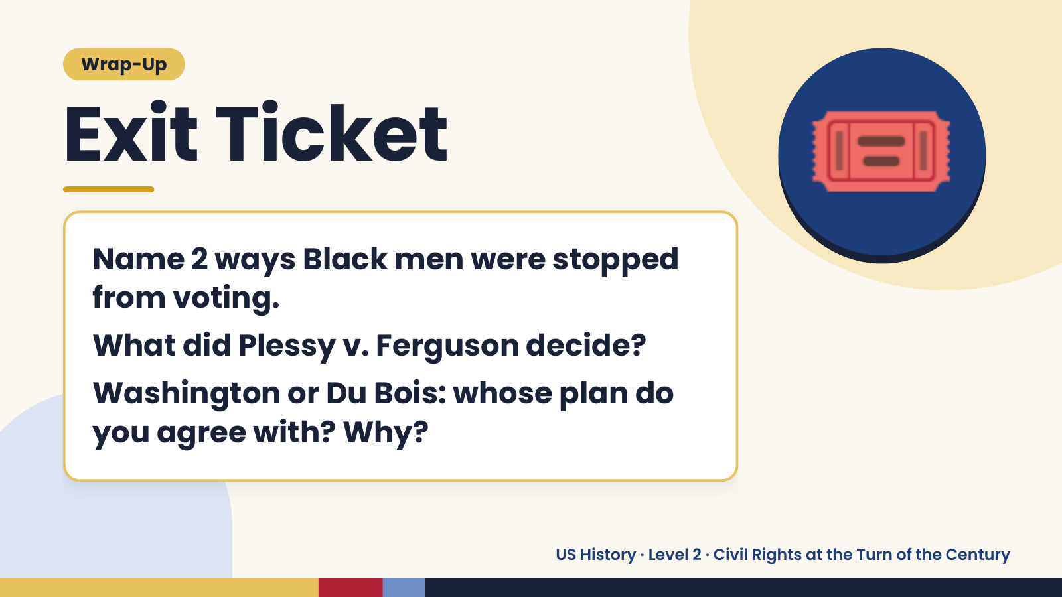
Notes:
Wrap-Up
Exit Ticket
Name 2 ways Black men were stopped
from voting.
🎟️
What did Plessy v. Ferguson decide?
Washington or Du Bois: whose plan do
you agree with? Why?
US History · Level 2 · Civil Rights at the Turn of the Century

