Slide 1
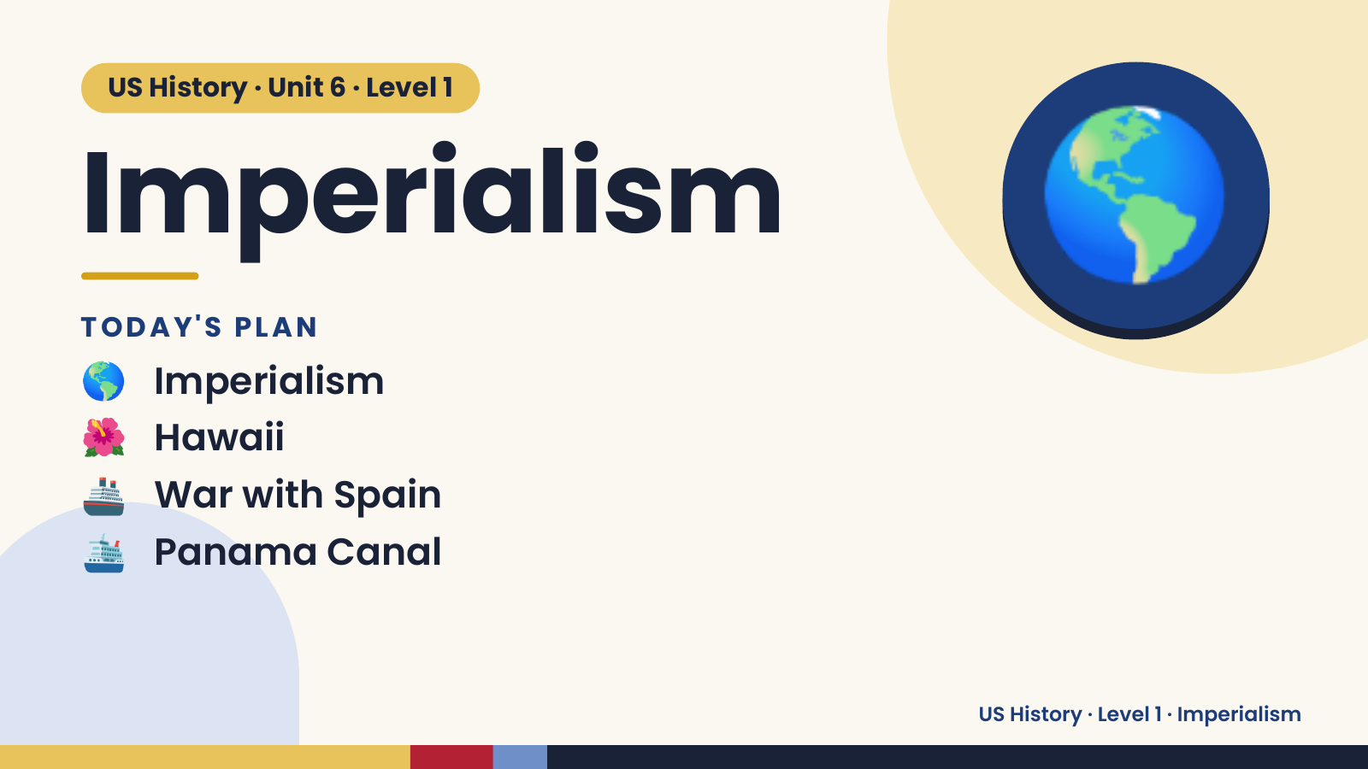
Notes:
US History · Unit 6 · Level 1
Imperialism
TODAY'S PLAN
🌎 Imperialism
🌎
🌺 Hawaii
🚢 War with Spain
🛳️ Panama Canal
US History · Level 1 · Imperialism

Slide 2
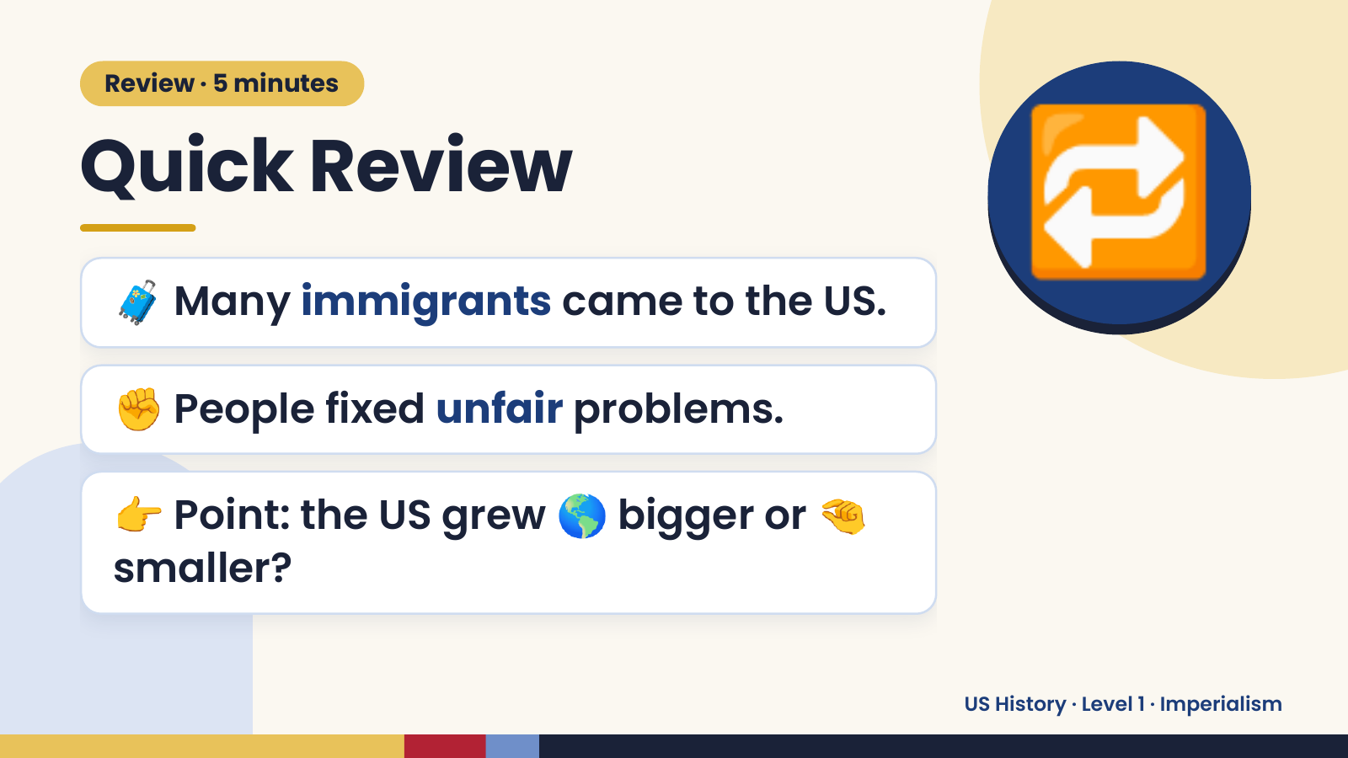
Notes:
Review · 5 minutes
Quick Review
🧳 Many immigrants came to the US.
✊ People fixed unfair problems.
🔁
👉 Point: the US grew 🌎 bigger or 🤏
smaller?
US History · Level 1 · Imperialism

Slide 3
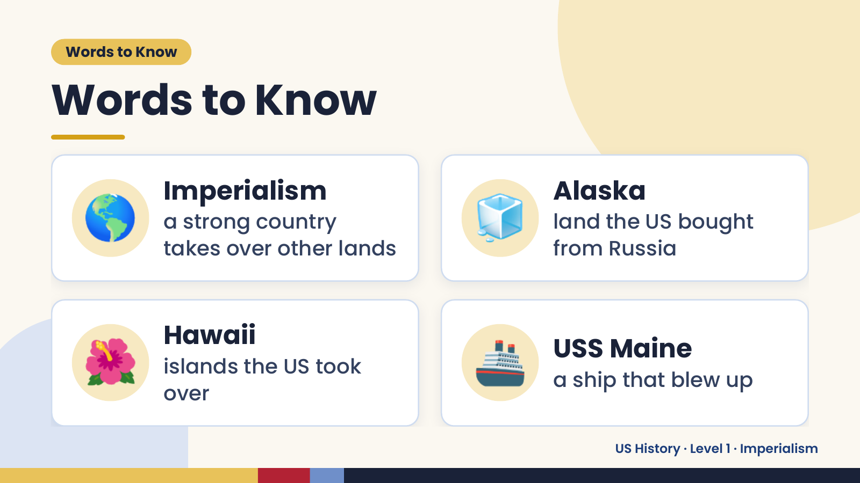
Notes:
Words to Know
Words to Know
🌎 Imperialism
a strong country
takes over other lands
🧊 Alaska
land the US bought
from Russia
🌺 Hawaii
islands the US took
over
🚢 USS Maine
a ship that blew up
US History · Level 1 · Imperialism

Slide 4
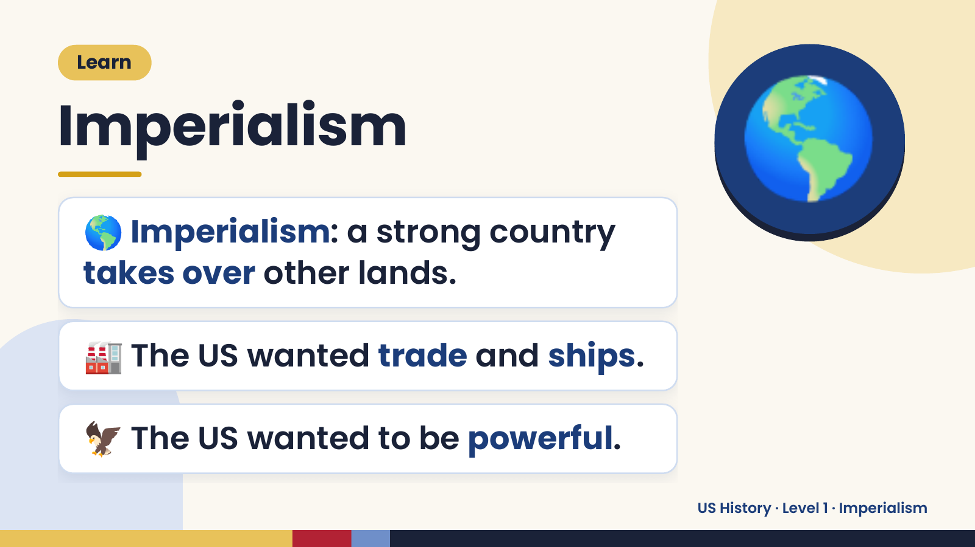
Notes:
Learn
Imperialism
🌎 Imperialism: a strong country
takes over other lands.
🌎
🏭 The US wanted trade and ships.
🦅 The US wanted to be powerful.
US History · Level 1 · Imperialism

Slide 5
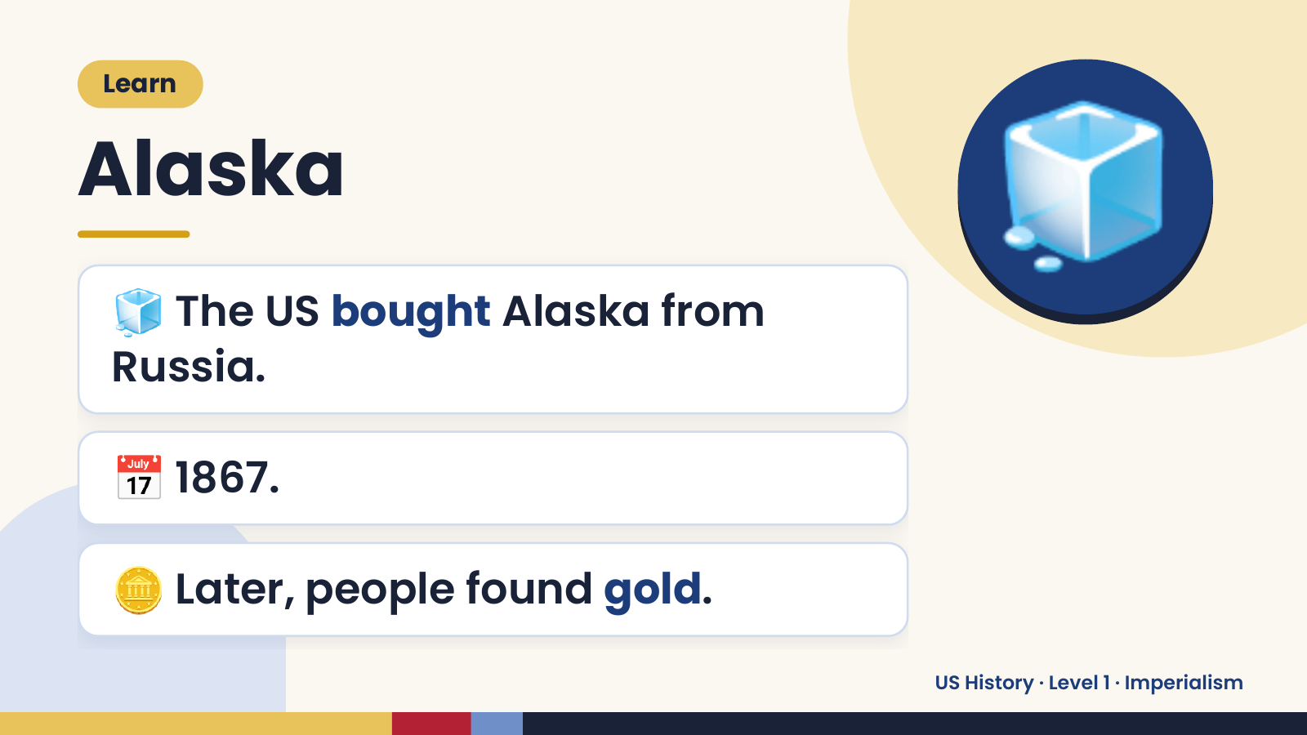
Notes:
Learn
Alaska
🧊 The US bought Alaska from
Russia.
🧊
📅 1867.
🪙 Later, people found gold.
US History · Level 1 · Imperialism

Slide 6
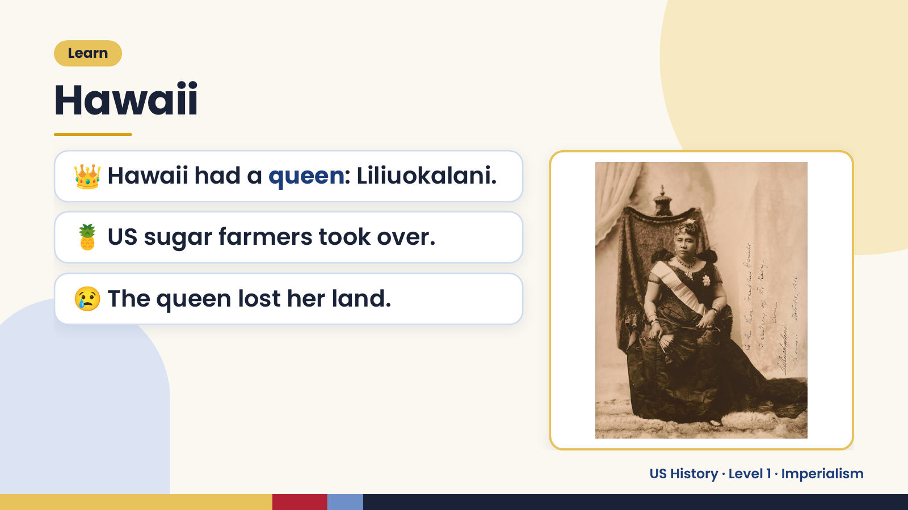
Notes:
Learn
Hawaii
👑 Hawaii had a queen: Liliuokalani.
🍍 US sugar farmers took over.
😢 The queen lost her land.
US History · Level 1 · Imperialism

Slide 7
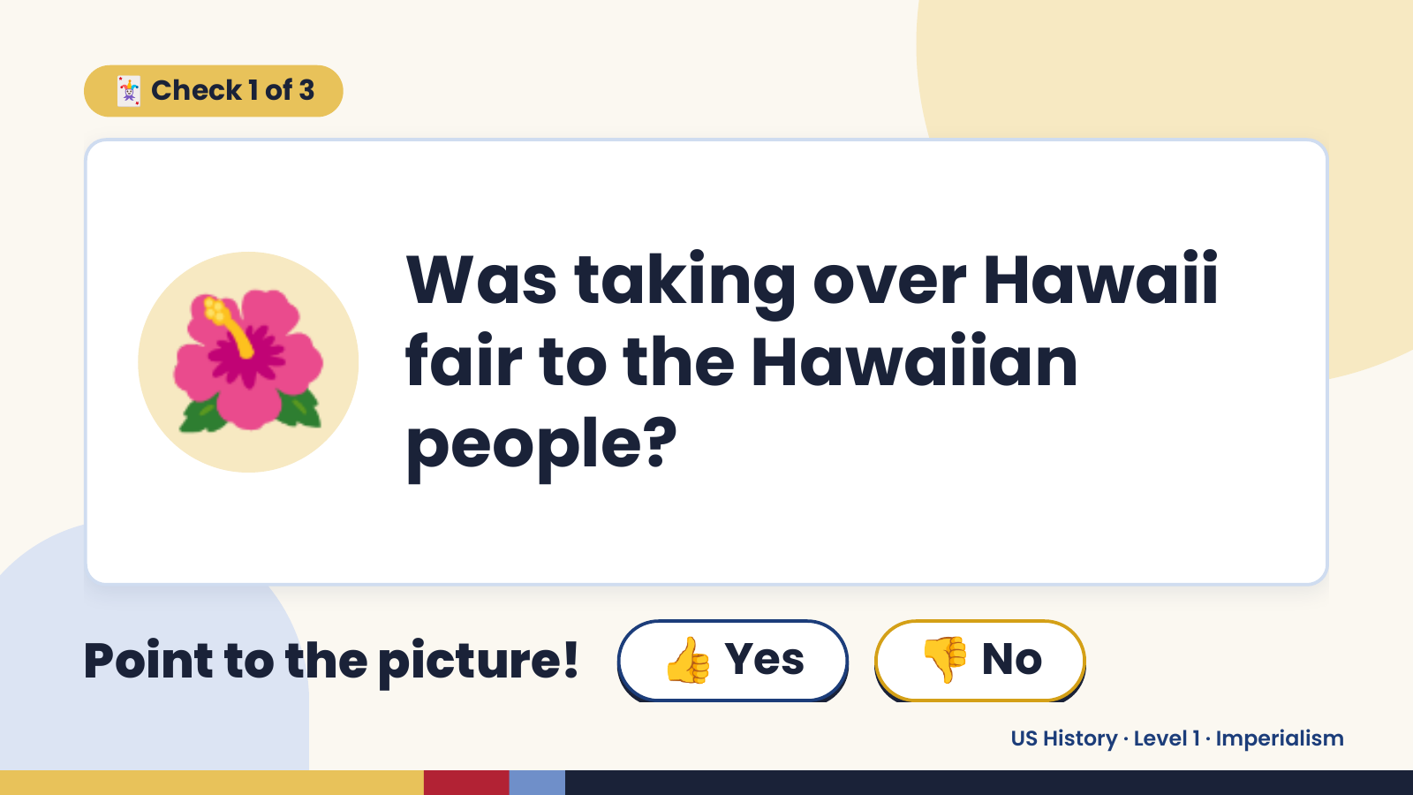
Notes:
🃏 Check 1 of 3
🌺 Was taking over Hawaii
fair to the Hawaiian
people?
Point to the picture! 👍 Yes 👎 No
US History · Level 1 · Imperialism

Slide 8
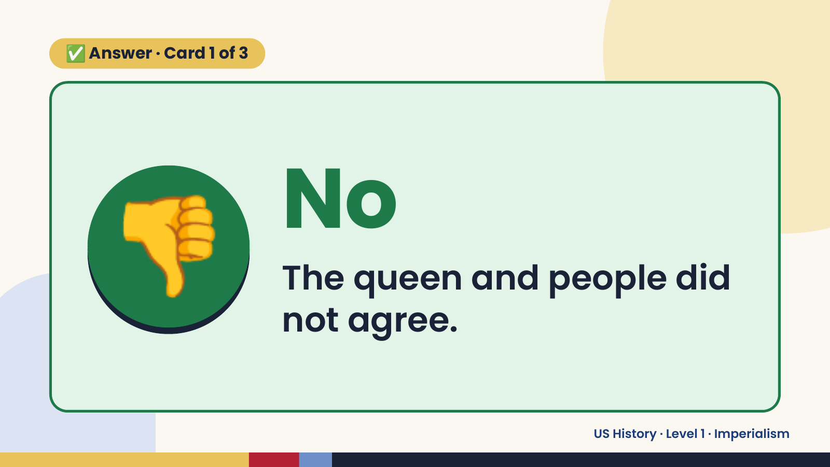
Notes:
✅ Answer · Card 1 of 3
👎 No
The queen and people did
not agree.
US History · Level 1 · Imperialism

Slide 9
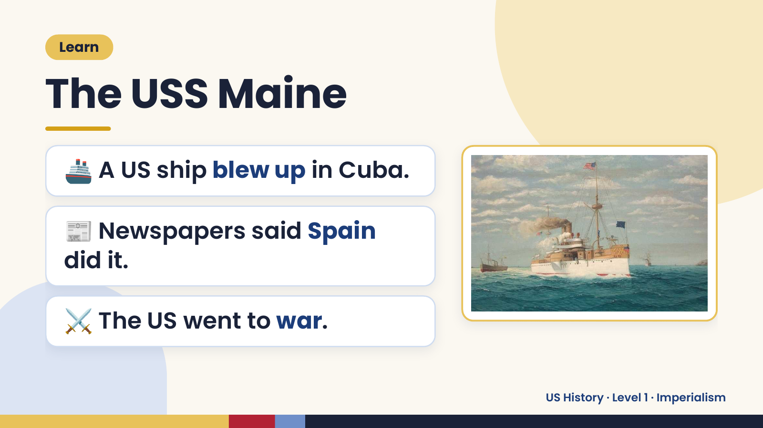
Notes:
Learn
The USS Maine
🚢 A US ship blew up in Cuba.
📰 Newspapers said Spain
did it.
⚔️ The US went to war.
US History · Level 1 · Imperialism

Slide 10
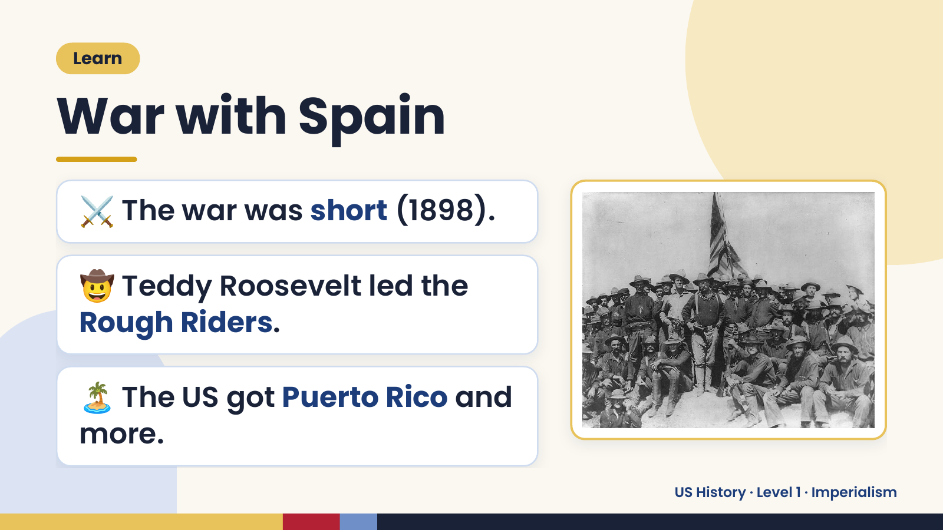
Notes:
Learn
War with Spain
⚔️ The war was short (1898).
🤠 Teddy Roosevelt led the
Rough Riders.
🏝️ The US got Puerto Rico and
more.
US History · Level 1 · Imperialism

Slide 11
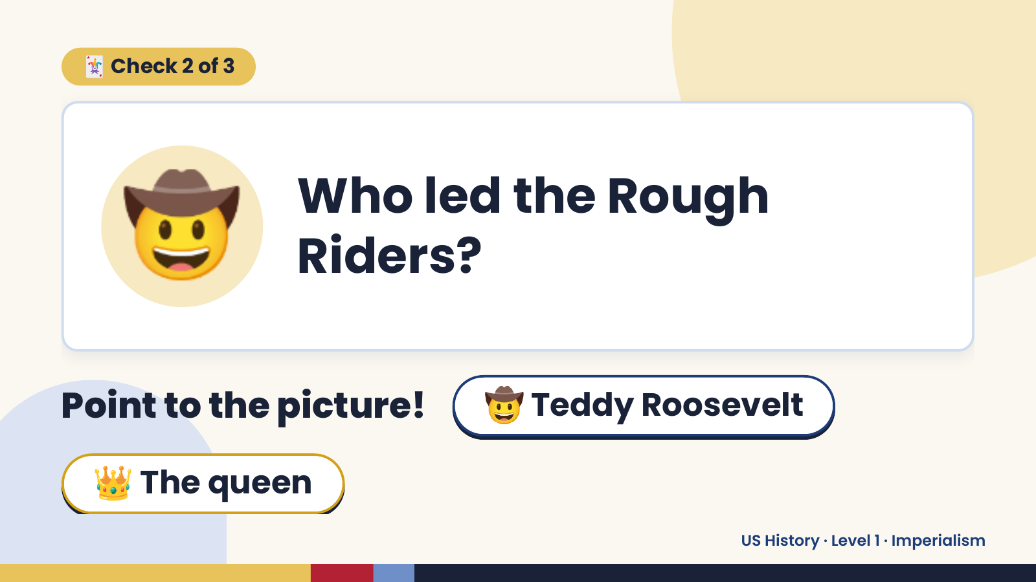
Notes:
🃏 Check 2 of 3
🤠 Who led the Rough
Riders?
Point to the picture! 🤠 Teddy Roosevelt
👑 The queen
US History · Level 1 · Imperialism

Slide 12
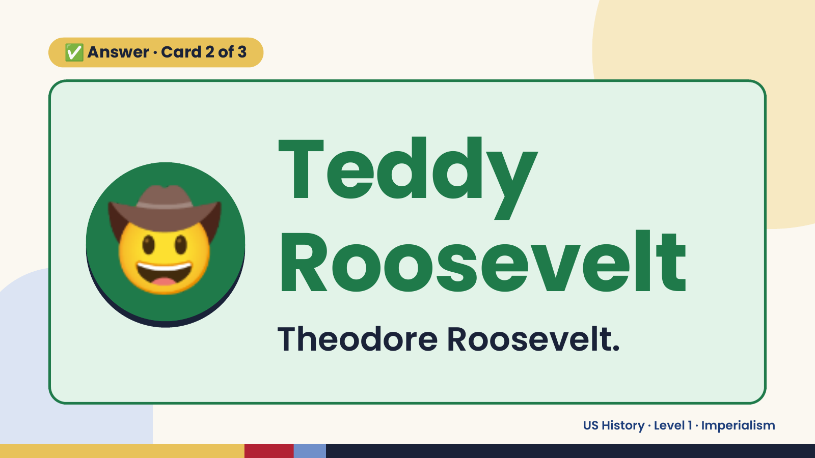
Notes:
✅ Answer · Card 2 of 3
🤠 Teddy
Roosevelt
Theodore Roosevelt.
US History · Level 1 · Imperialism

Slide 13
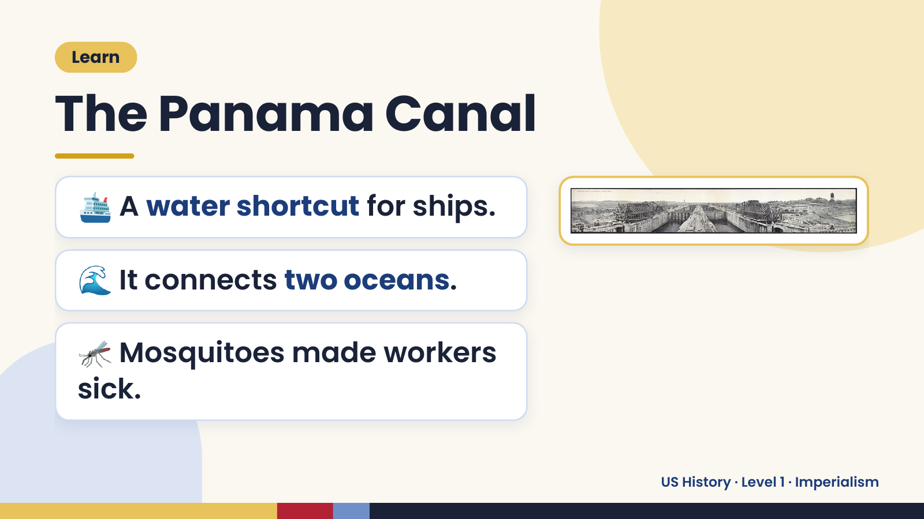
Notes:
Learn
The Panama Canal
🛳️ A water shortcut for ships.
🌊 It connects two oceans.
🦟 Mosquitoes made workers
sick.
US History · Level 1 · Imperialism

Slide 14
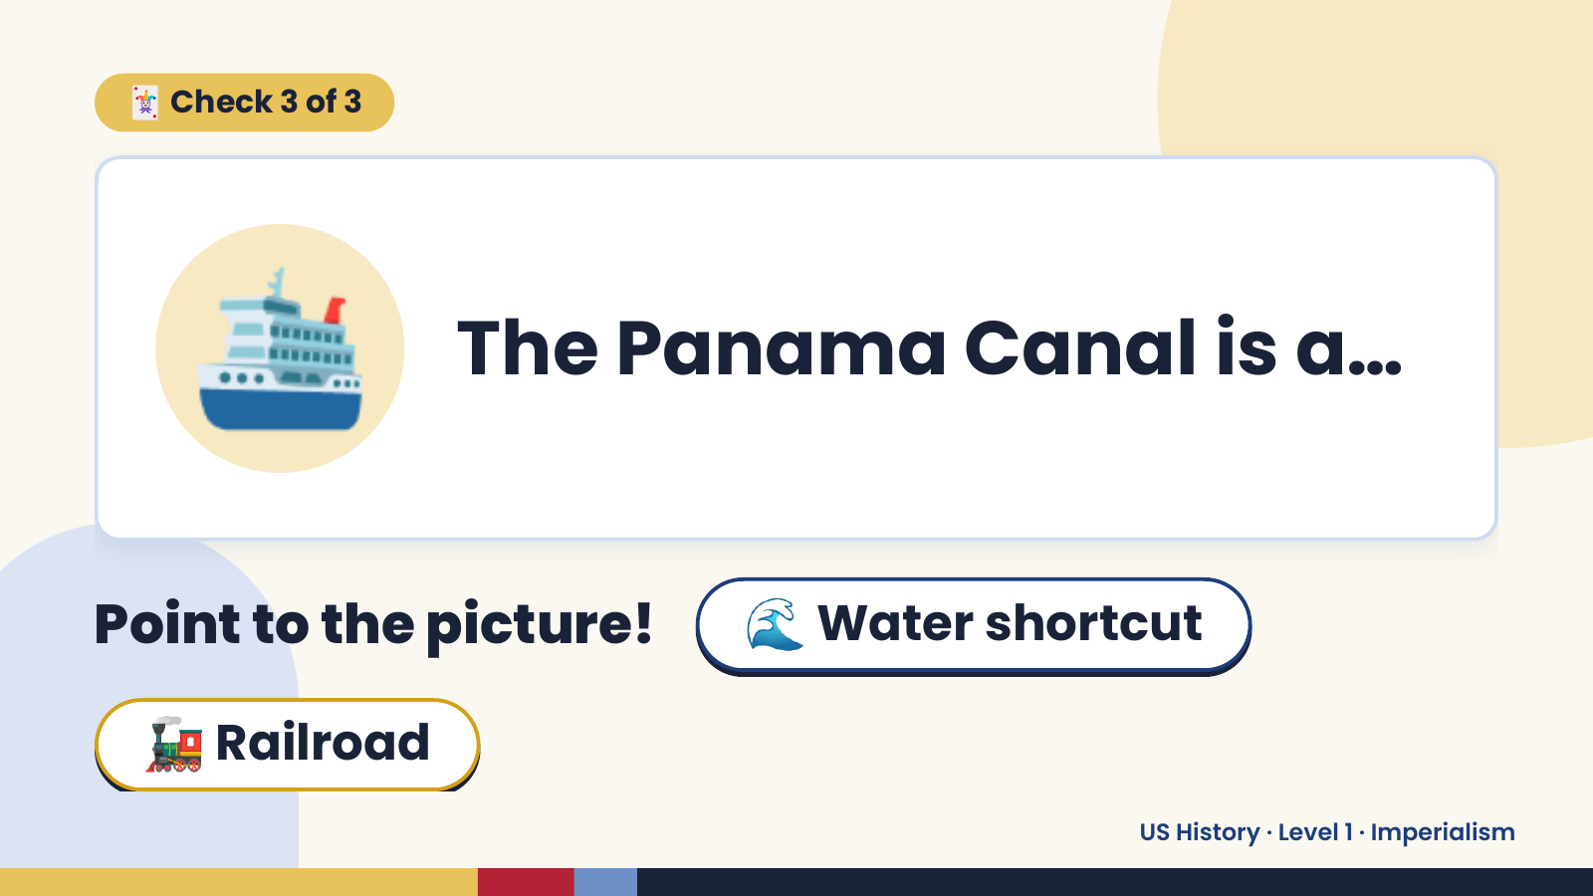
Notes:
🃏 Check 3 of 3
🛳️ The Panama Canal is a…
Point to the picture! 🌊 Water shortcut
🚂 Railroad
US History · Level 1 · Imperialism

Slide 15
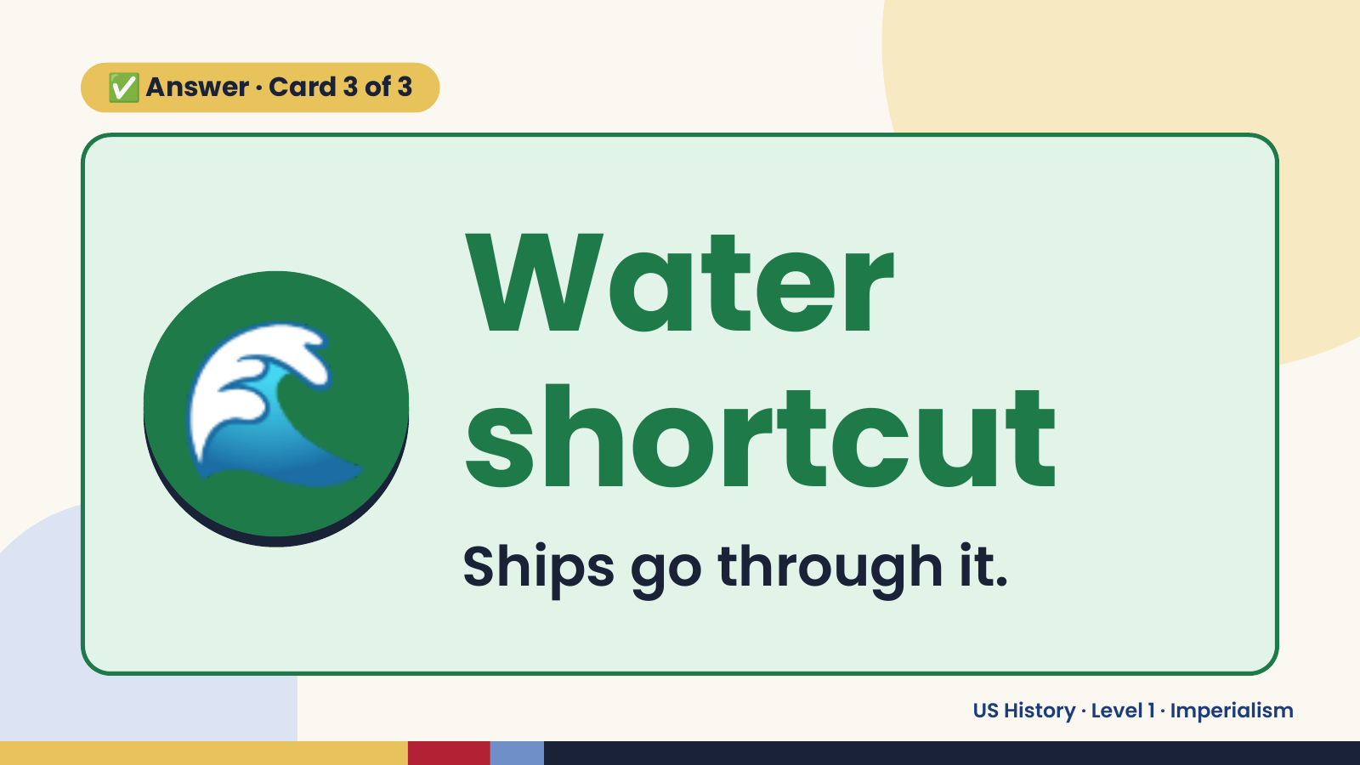
Notes:
✅ Answer · Card 3 of 3
🌊 Water
shortcut
Ships go through it.
US History · Level 1 · Imperialism

Slide 16
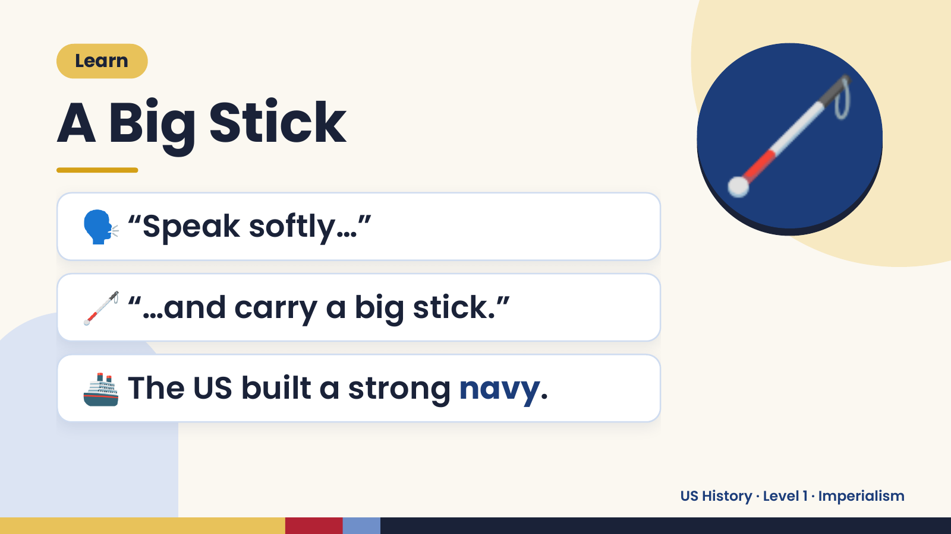
Notes:
Learn
A Big Stick
🗣️ “Speak softly…”
🦯
🦯 “…and carry a big stick.”
🚢 The US built a strong navy.
US History · Level 1 · Imperialism

Slide 17
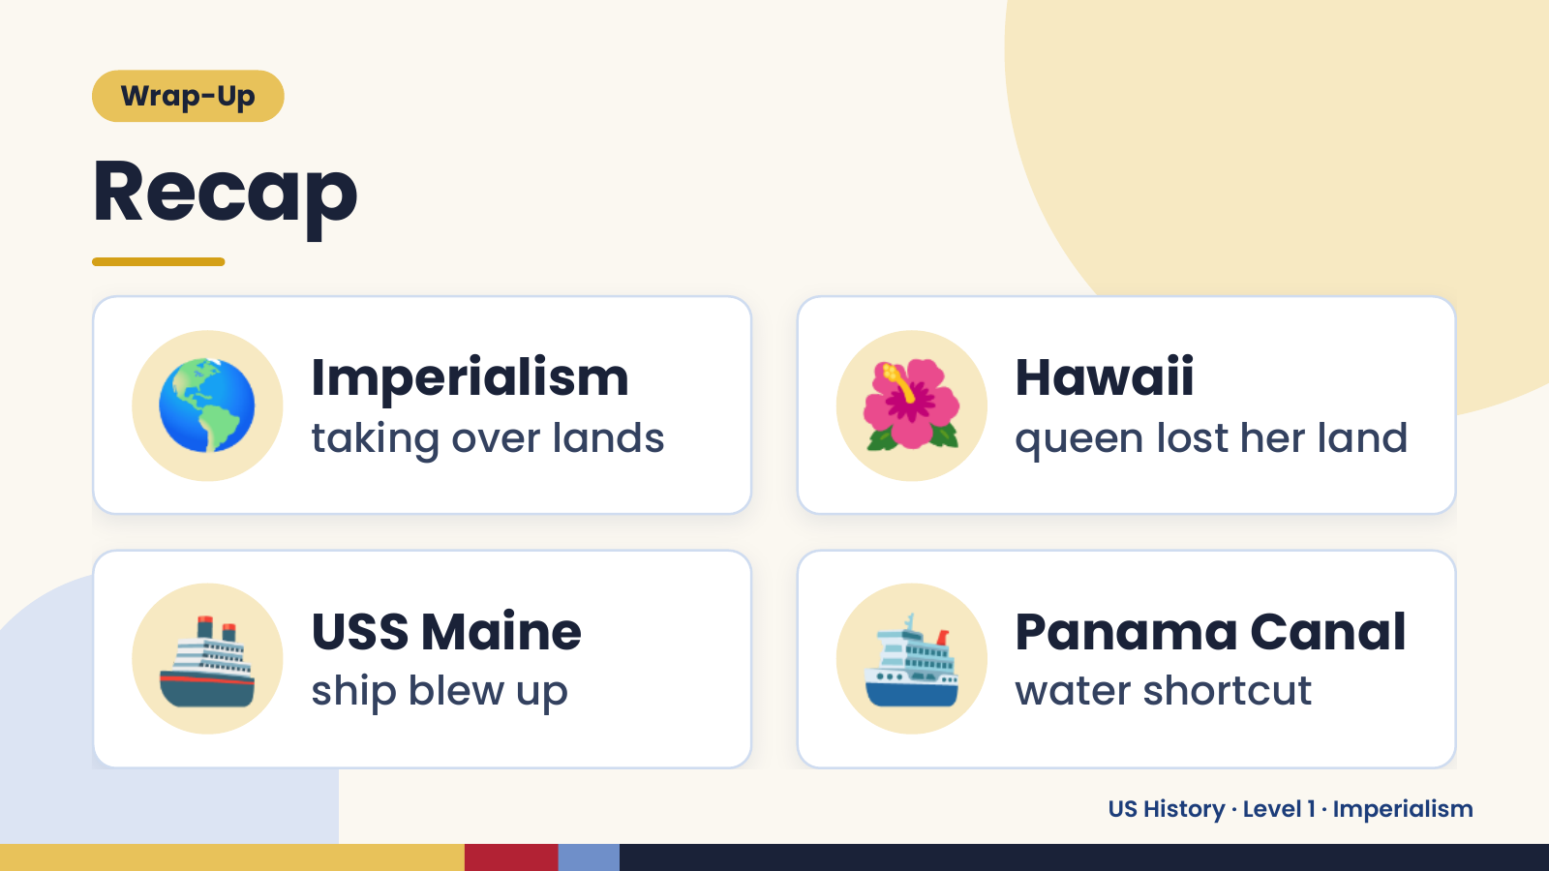
Notes:
Wrap-Up
Recap
🌎 Imperialism
taking over lands 🌺 Hawaii
queen lost her land
🚢 USS Maine
ship blew up 🛳️ Panama Canal
water shortcut
US History · Level 1 · Imperialism

Slide 18
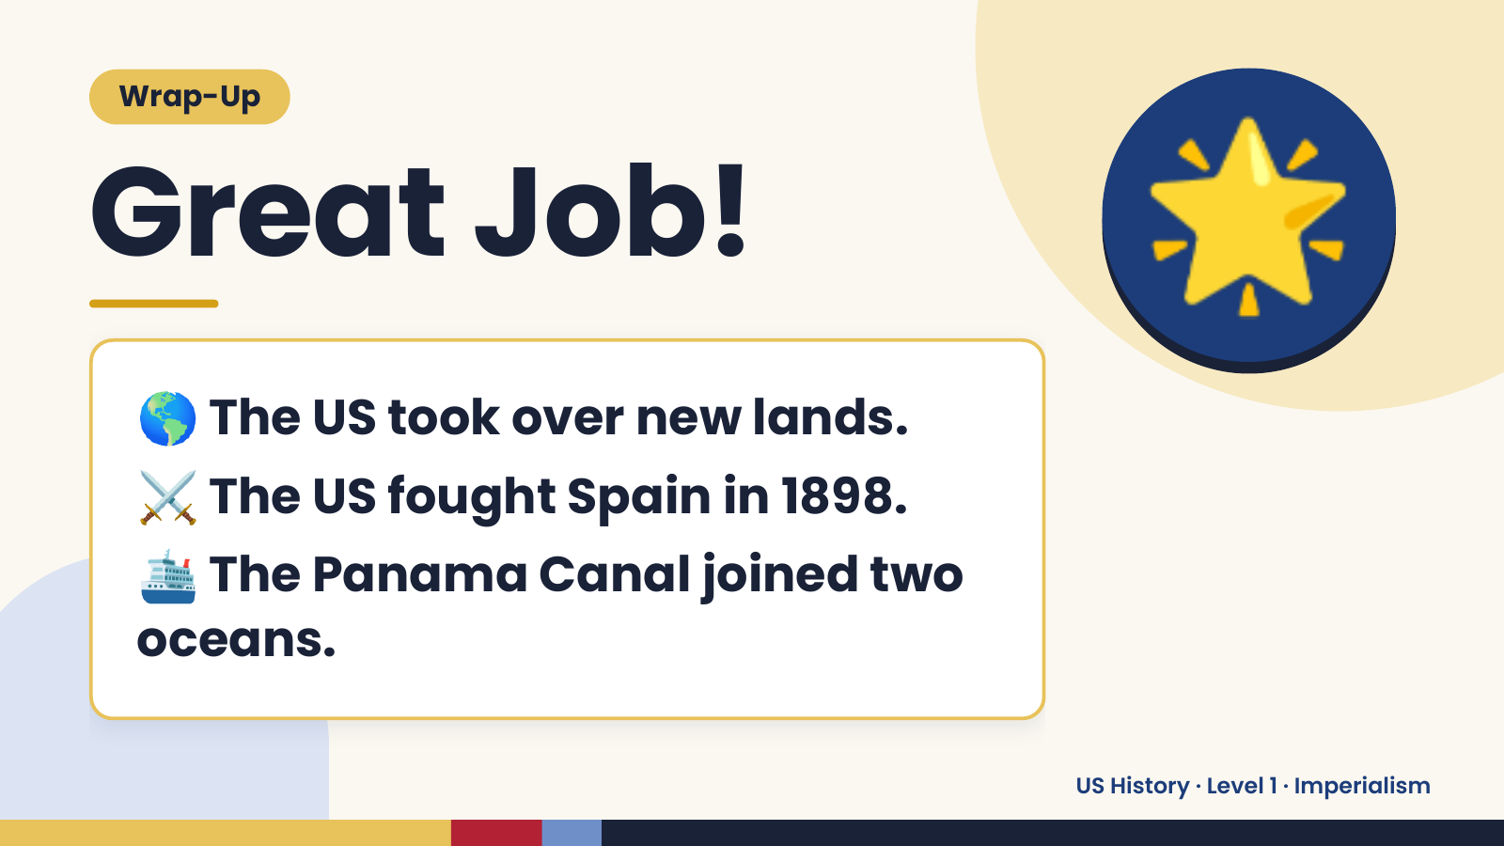
Notes:
Wrap-Up
Great Job!
🌎 The US took over new lands.
🌟
⚔️ The US fought Spain in 1898.
🛳️
The Panama Canal joined two
oceans.
US History · Level 1 · Imperialism

