Slide 1
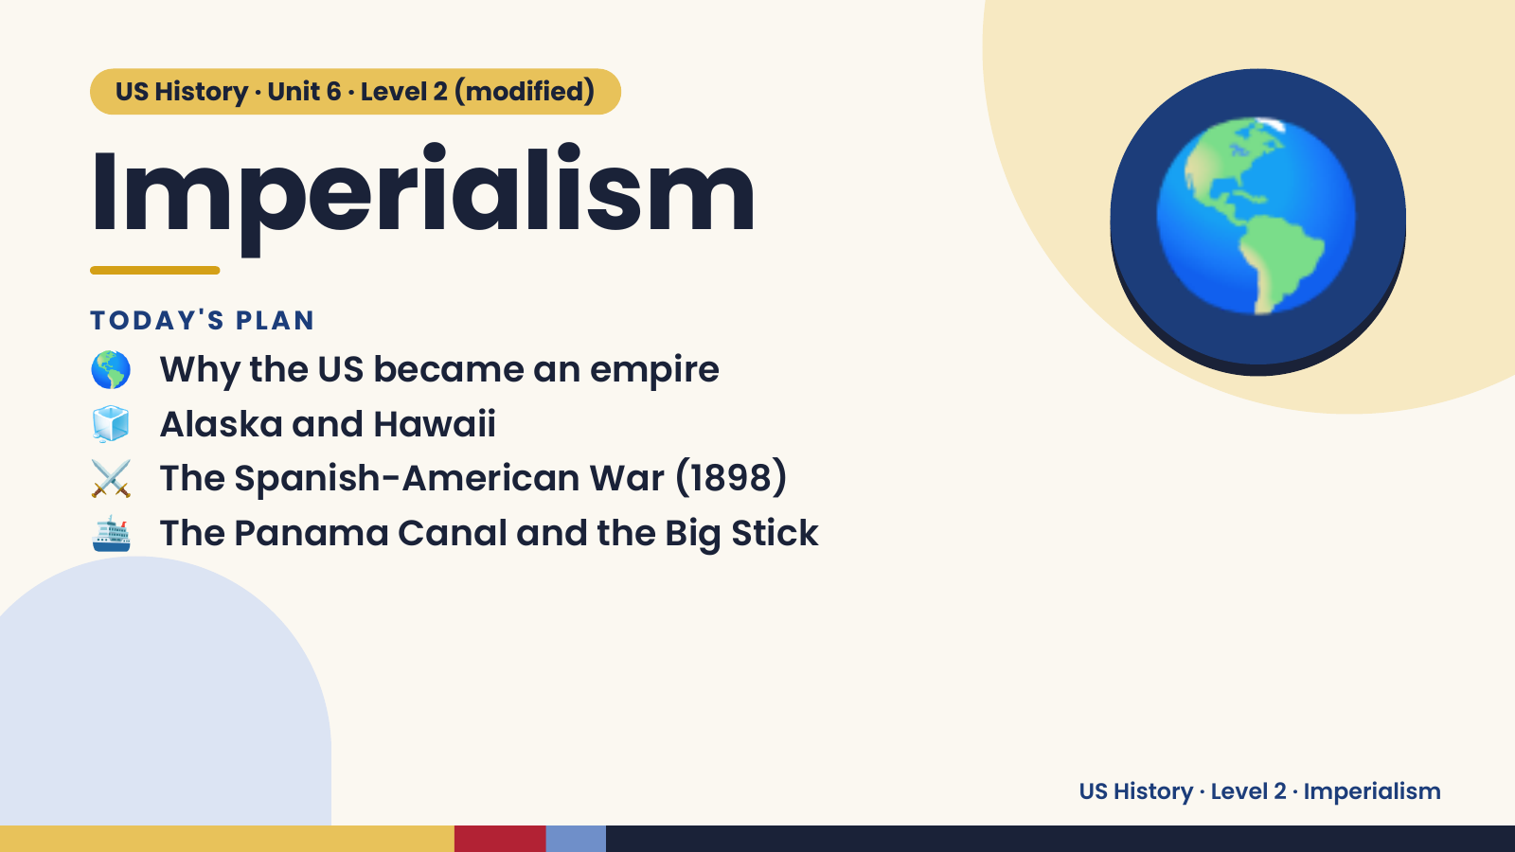
Notes:
US History · Unit 6 · Level 2 (modified)
Imperialism
🌎 Why the US became an empire
TODAY'S PLAN
🧊 Alaska and Hawaii
⚔️ The Spanish-American War (1898)
🌎
🛳️ The Panama Canal and the Big Stick
US History · Level 2 · Imperialism

Slide 2
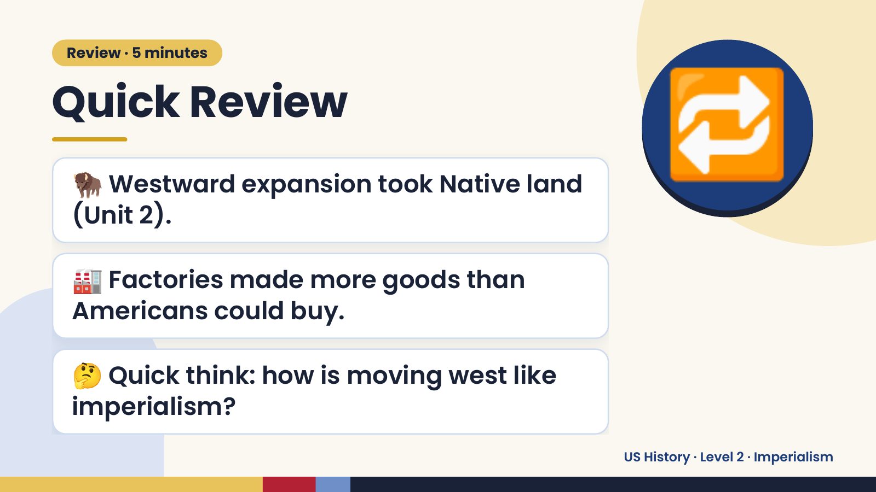
Notes:
Review · 5 minutes
Quick Review
🦬 Westward expansion took Native land
(Unit 2).
🔁
🏭 Factories made more goods than
Americans could buy.
🤔 Quick think: how is moving west like
imperialism?
US History · Level 2 · Imperialism

Slide 3
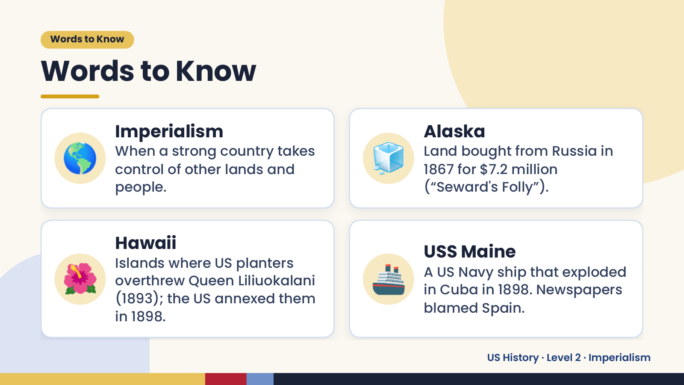
Notes:
Words to Know
Words to Know
🌎 Imperialism
When a strong country takes
control of other lands and
people.
🧊 Alaska
Land bought from Russia in
1867 for $7.2 million
(“Seward's Folly”).
🌺 🚢
Hawaii USS Maine
Islands where US planters
A US Navy ship that exploded
overthrew Queen Liliuokalani
in Cuba in 1898. Newspapers
(1893); the US annexed them
blamed Spain.
in 1898.
US History · Level 2 · Imperialism

Slide 4
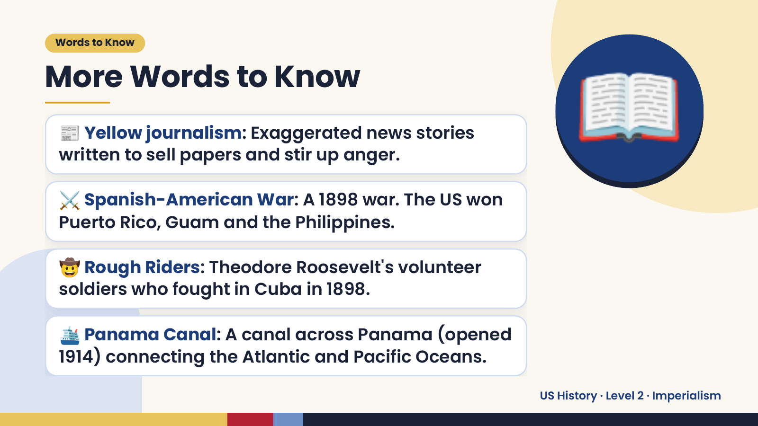
Notes:
Words to Know
More Words to Know
📰 Yellow journalism: Exaggerated news stories
written to sell papers and stir up anger.
⚔️ Spanish-American War: A 1898 war. The US won
Puerto Rico, Guam and the Philippines.
📖
🤠 Rough Riders: Theodore Roosevelt's volunteer
soldiers who fought in Cuba in 1898.
🛳️ Panama Canal: A canal across Panama (opened
1914) connecting the Atlantic and Pacific Oceans.
US History · Level 2 · Imperialism

Slide 5
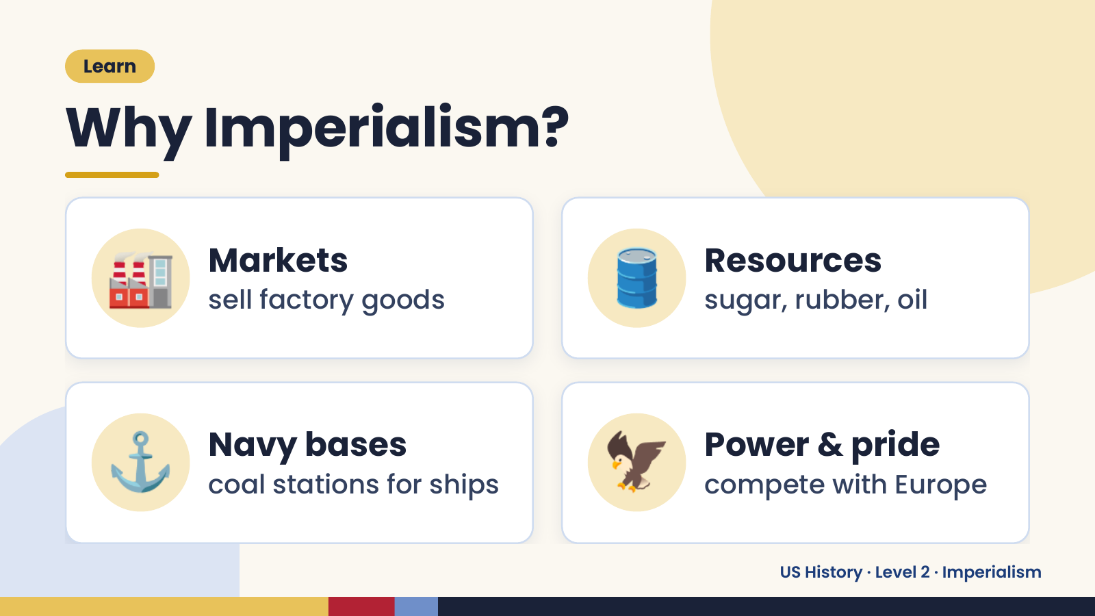
Notes:
Learn
Why Imperialism?
🏭 Markets
sell factory goods 🛢️ Resources
sugar, rubber, oil
⚓ Navy bases
coal stations for ships 🦅 Power & pride
compete with Europe
US History · Level 2 · Imperialism

Slide 6
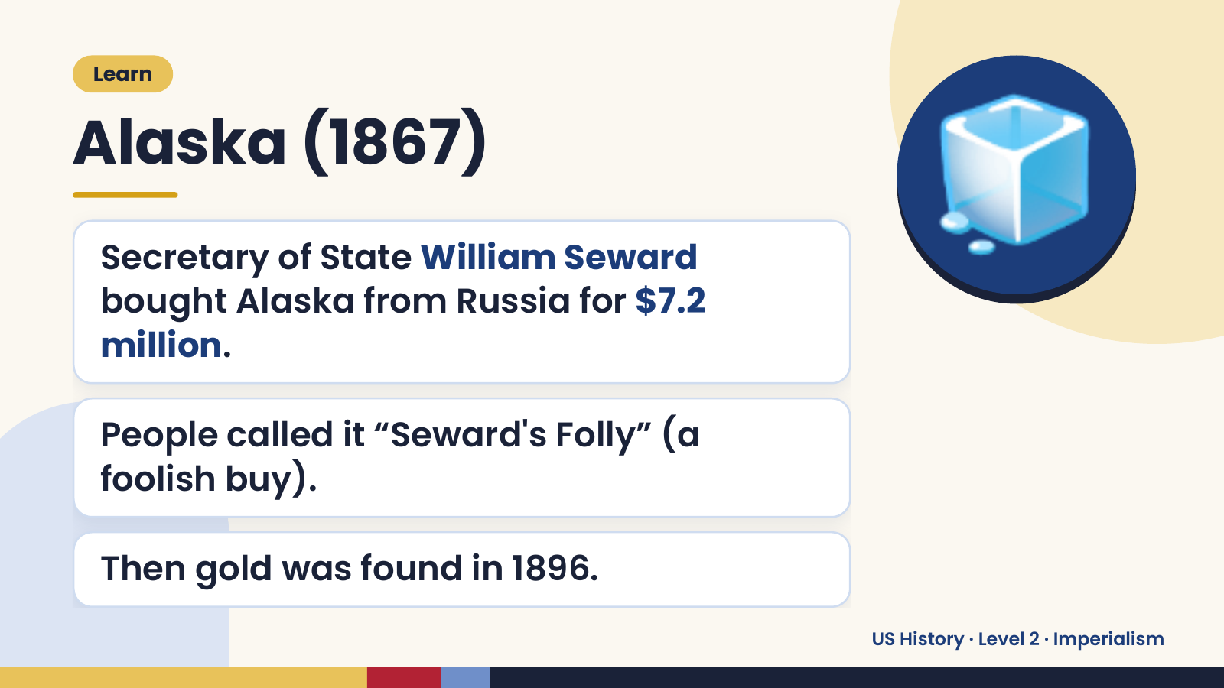
Notes:
Learn
Alaska (1867)
Secretary of State William Seward
bought Alaska from Russia for $7.2
million.
🧊
People called it “Seward's Folly” (a
foolish buy).
Then gold was found in 1896.
US History · Level 2 · Imperialism

Slide 7
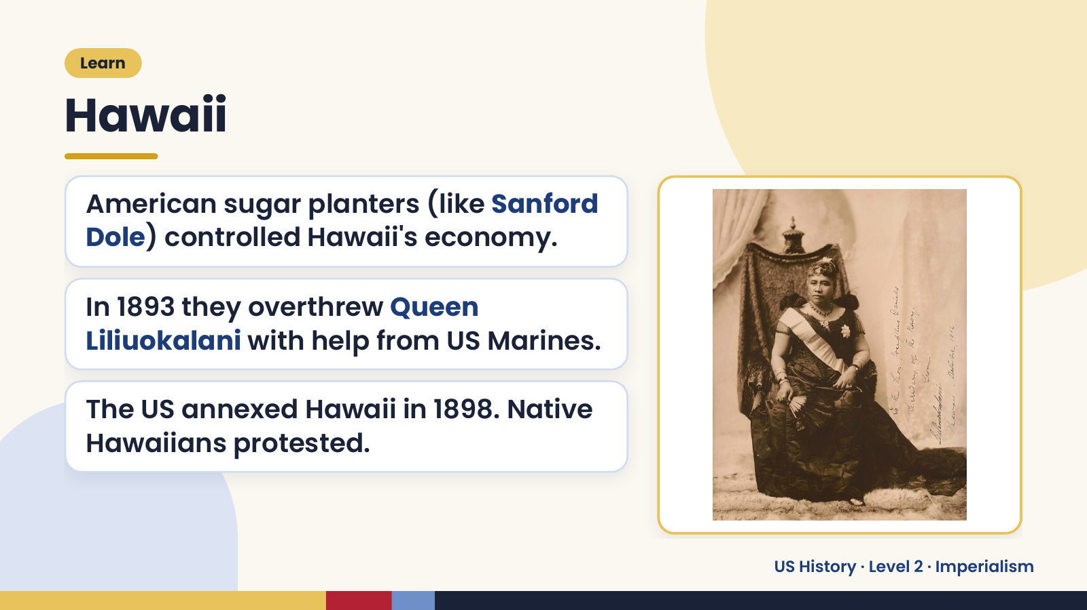
Notes:
Learn
Hawaii
American sugar planters (like Sanford
Dole) controlled Hawaii's economy.
In 1893 they overthrew Queen
Liliuokalani with help from US Marines.
The US annexed Hawaii in 1898. Native
Hawaiians protested.
US History · Level 2 · Imperialism

Slide 8
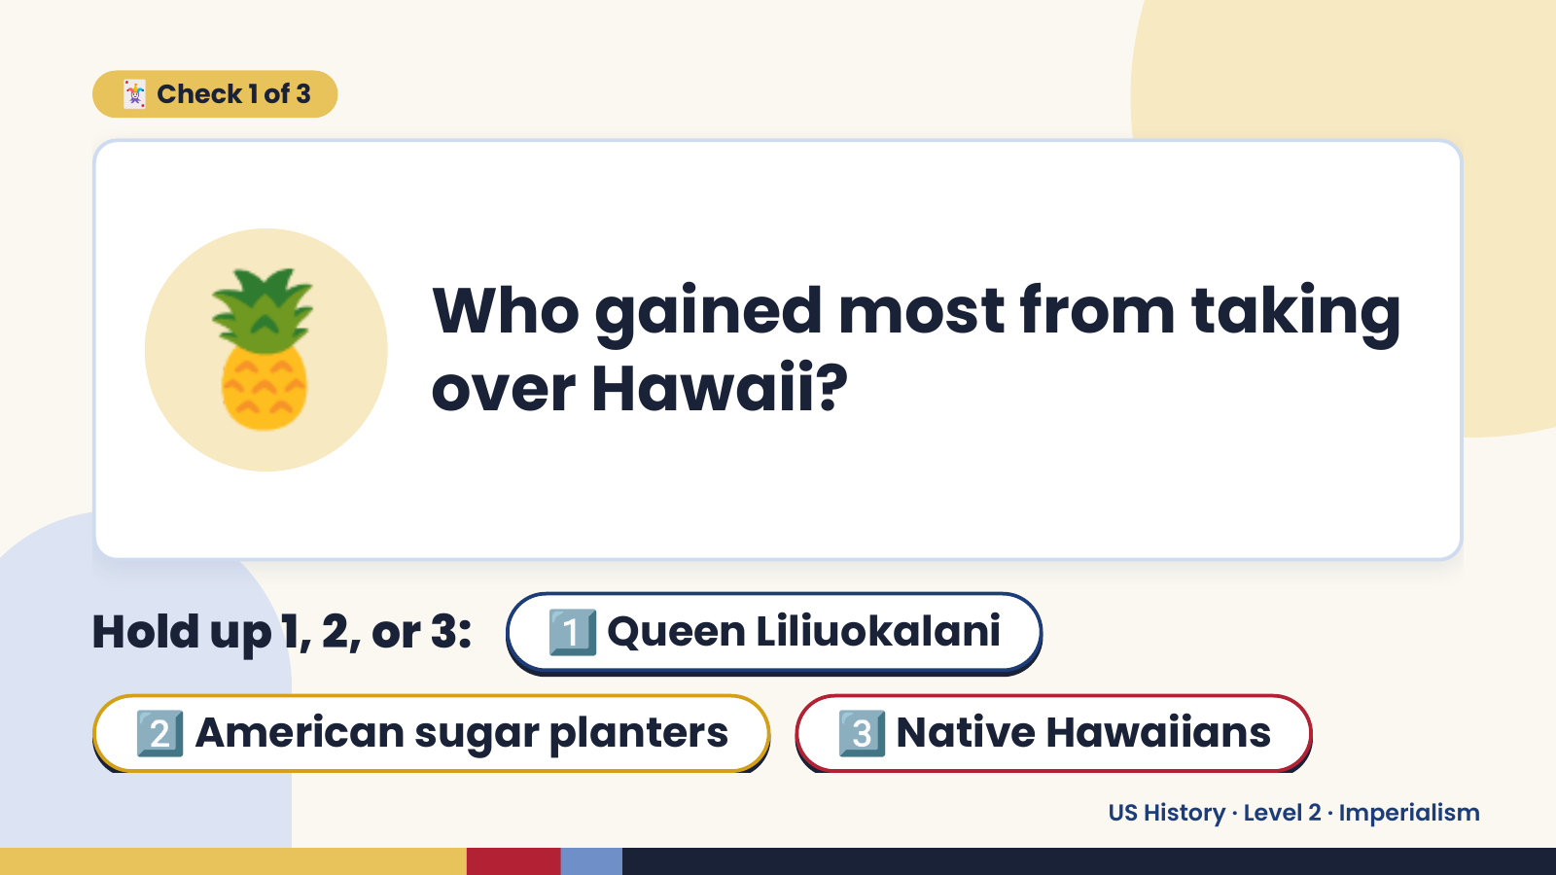
Notes:
🃏 Check 1 of 3
🍍 Who gained most from taking
over Hawaii?
Hold up 1, 2, or 3: 1️⃣ Queen Liliuokalani
2️⃣ American sugar planters 3️⃣ Native Hawaiians
US History · Level 2 · Imperialism

Slide 9
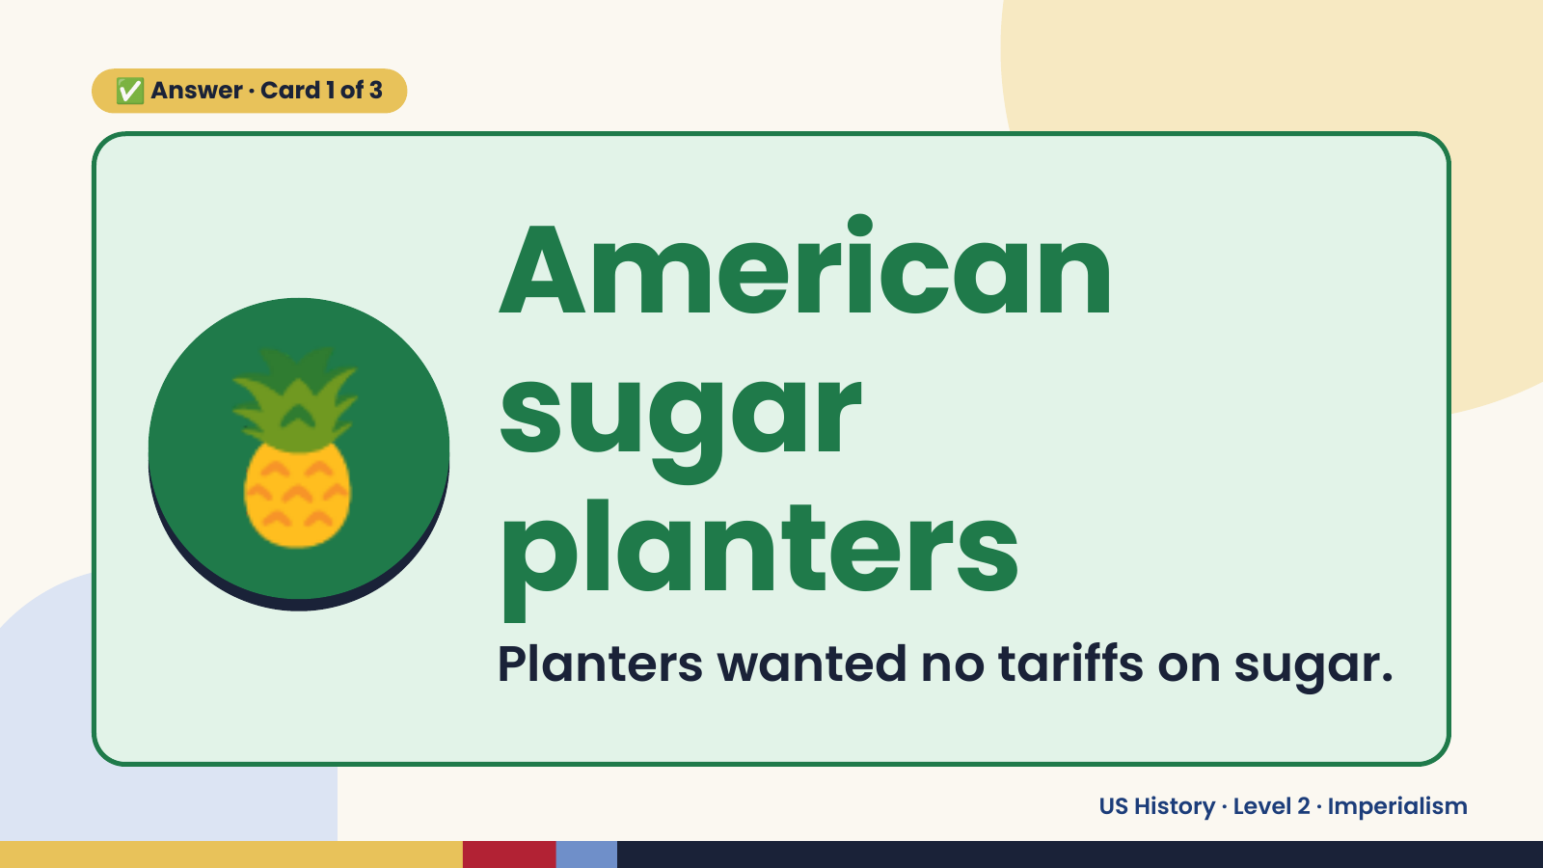
Notes:
✅ Answer · Card 1 of 3
🍍 American
sugar
planters
Planters wanted no tariffs on sugar.
US History · Level 2 · Imperialism

Slide 10
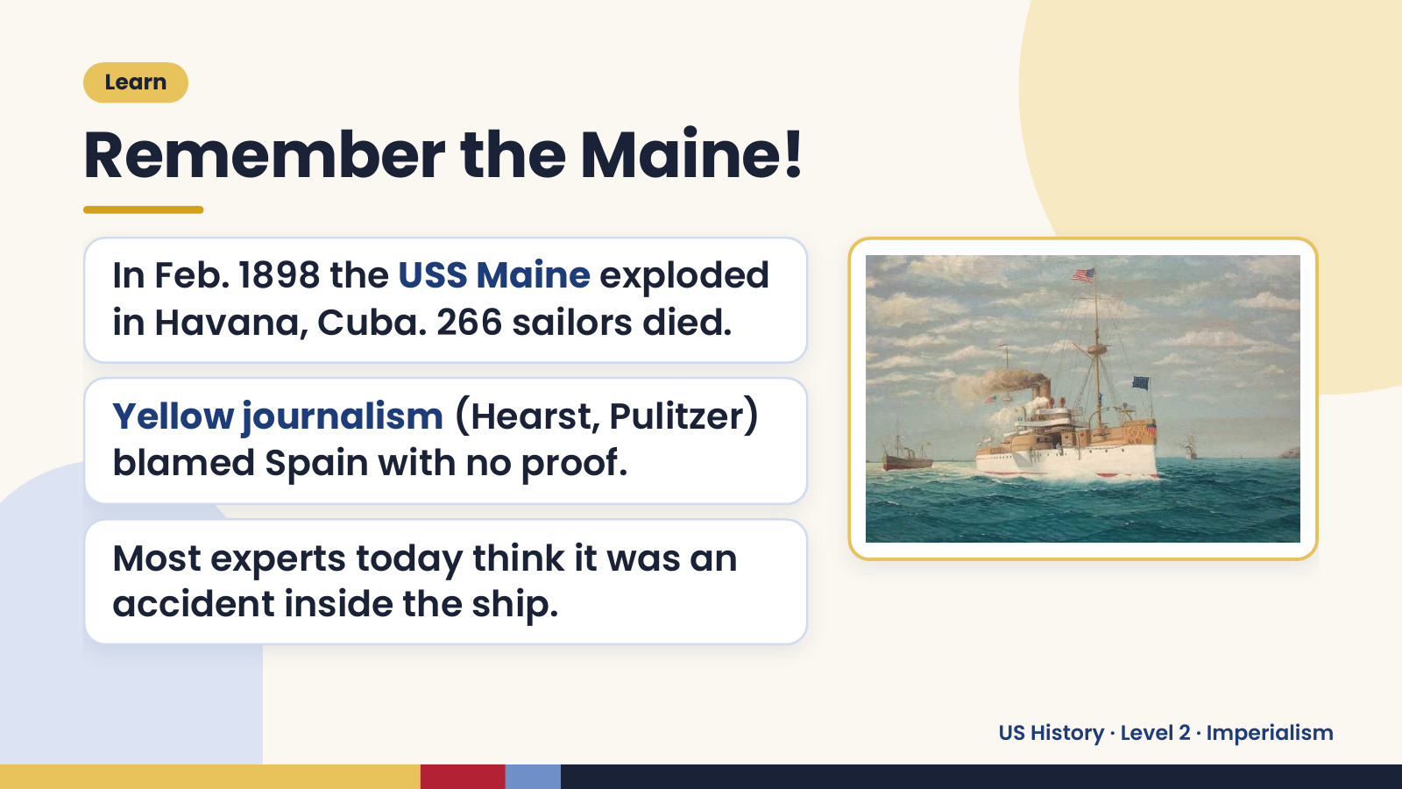
Notes:
Learn
Remember the Maine!
In Feb. 1898 the USS Maine exploded
in Havana, Cuba. 266 sailors died.
Yellow journalism (Hearst, Pulitzer)
blamed Spain with no proof.
Most experts today think it was an
accident inside the ship.
US History · Level 2 · Imperialism

Slide 11
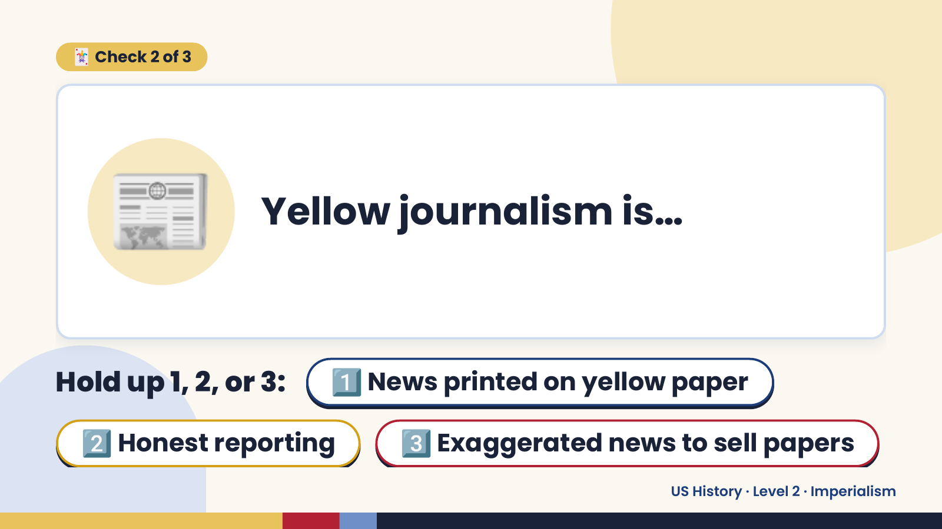
Notes:
🃏 Check 2 of 3
📰 Yellow journalism is…
Hold up 1, 2, or 3: 1️⃣ News printed on yellow paper
2️⃣ Honest reporting 3️⃣ Exaggerated news to sell papers
US History · Level 2 · Imperialism

Slide 12
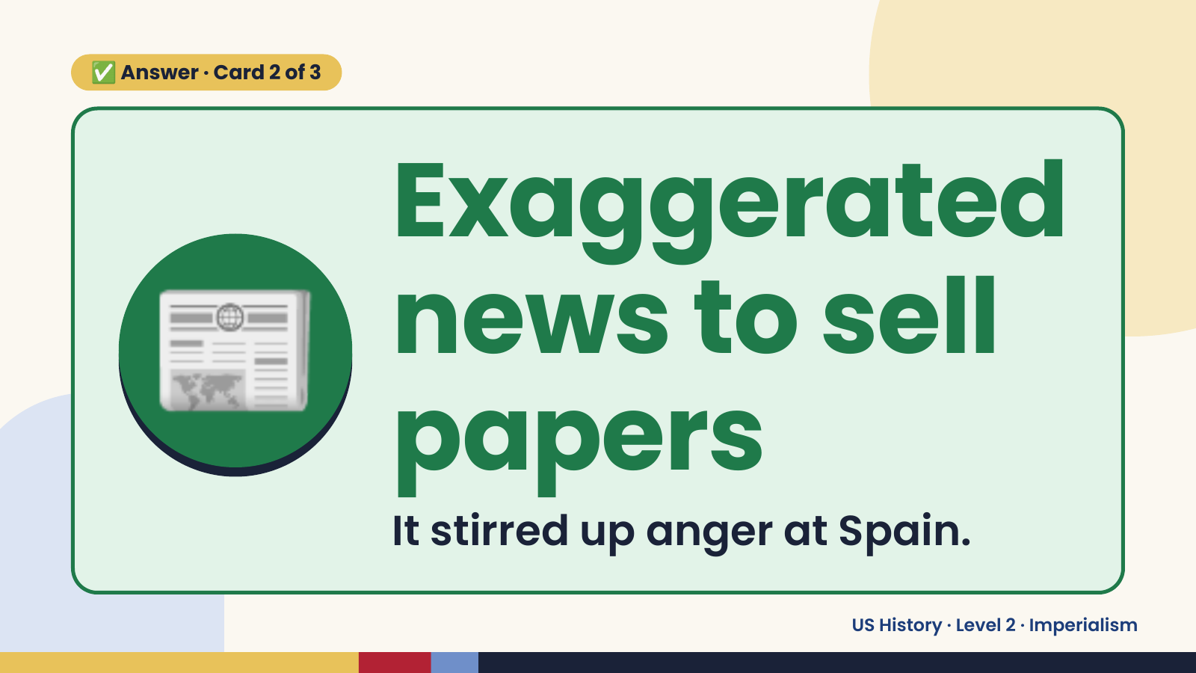
Notes:
✅ Answer · Card 2 of 3
📰 Exaggerated
news to sell
papers
It stirred up anger at Spain.
US History · Level 2 · Imperialism

Slide 13
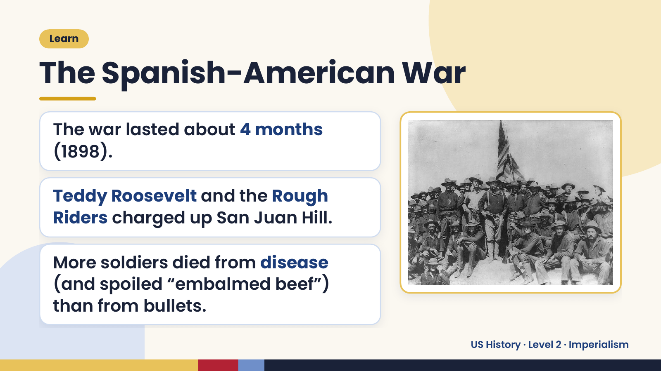
Notes:
Learn
The Spanish-American War
The war lasted about 4 months
(1898).
Teddy Roosevelt and the Rough
Riders charged up San Juan Hill.
More soldiers died from disease
(and spoiled “embalmed beef”)
than from bullets.
US History · Level 2 · Imperialism

Slide 14
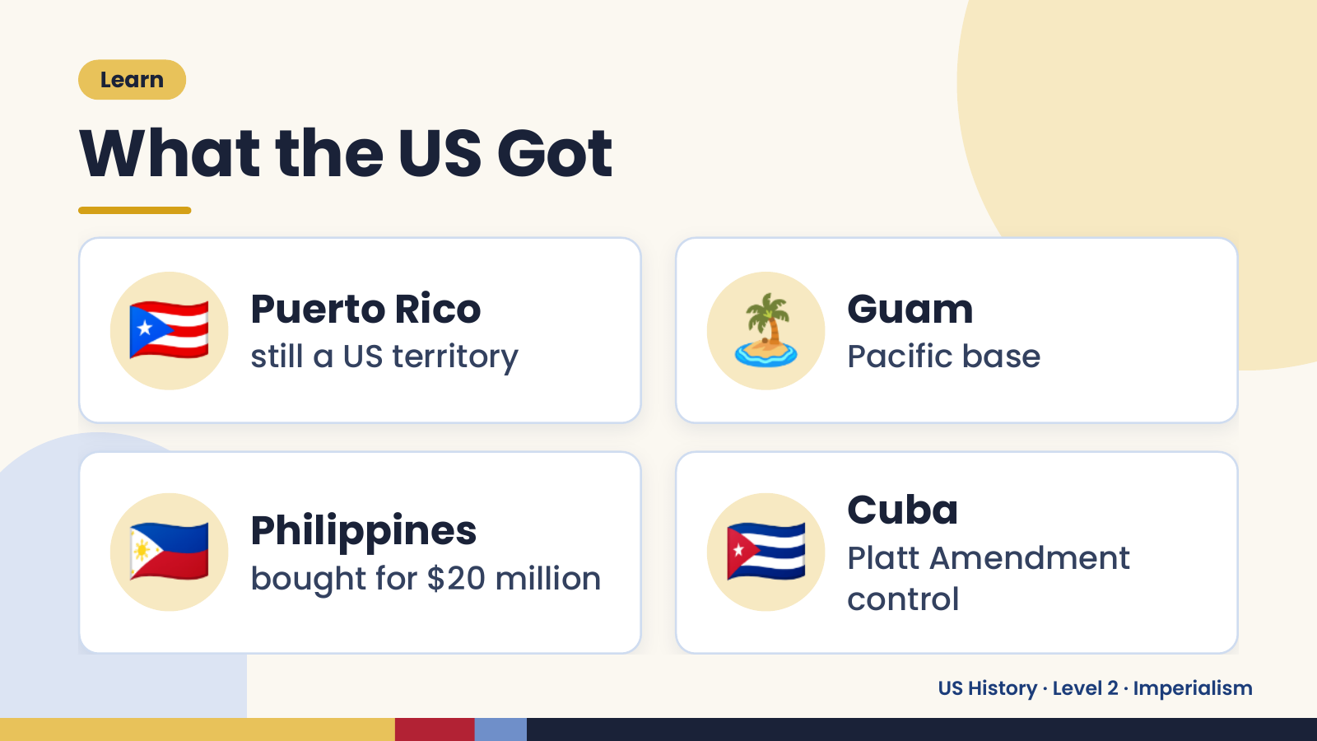
Notes:
Learn
What the US Got
🇵🇷 Puerto Rico
still a US territory 🏝️ Guam
Pacific base
🇵🇭 Philippines
bought for $20 million 🇨🇺 Cuba
Platt Amendment
control
US History · Level 2 · Imperialism

Slide 15
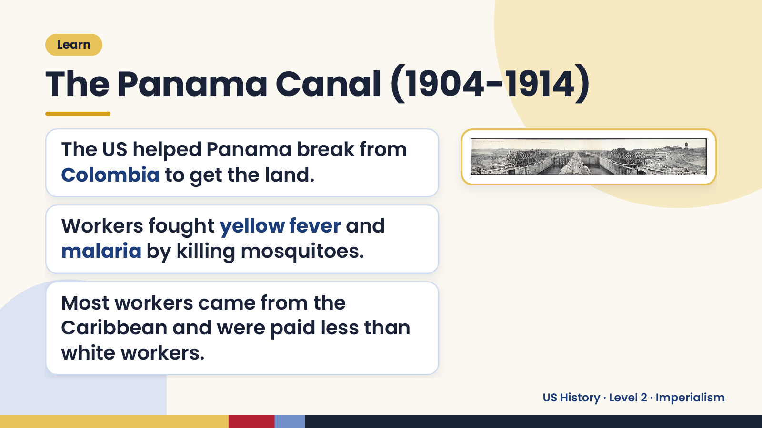
Notes:
Learn
The Panama Canal (1904-1914)
The US helped Panama break from
Colombia to get the land.
Workers fought yellow fever and
malaria by killing mosquitoes.
Most workers came from the
Caribbean and were paid less than
white workers.
US History · Level 2 · Imperialism

Slide 16
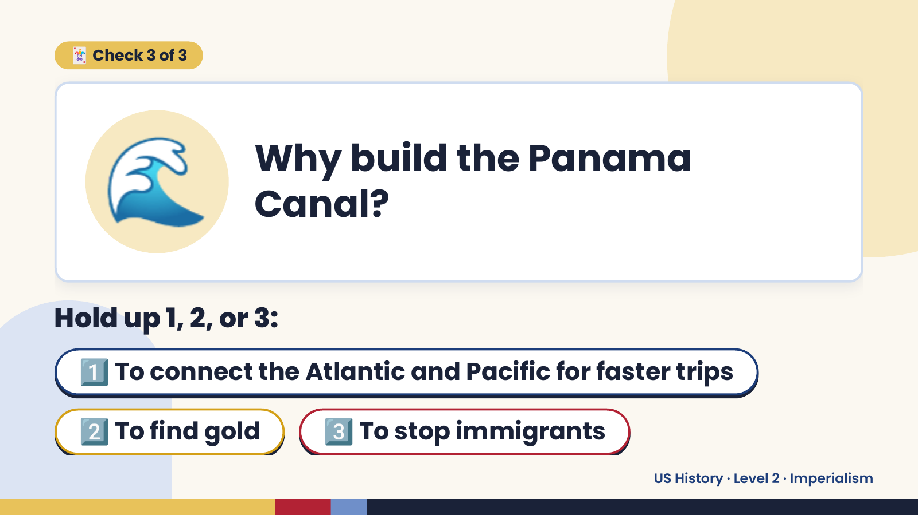
Notes:
🌊
🃏 Check 3 of 3
Why build the Panama
Canal?
Hold up 1, 2, or 3:
1️⃣ To connect the Atlantic and Pacific for faster trips
2️⃣ To find gold 3️⃣ To stop immigrants
US History · Level 2 · Imperialism

Slide 17
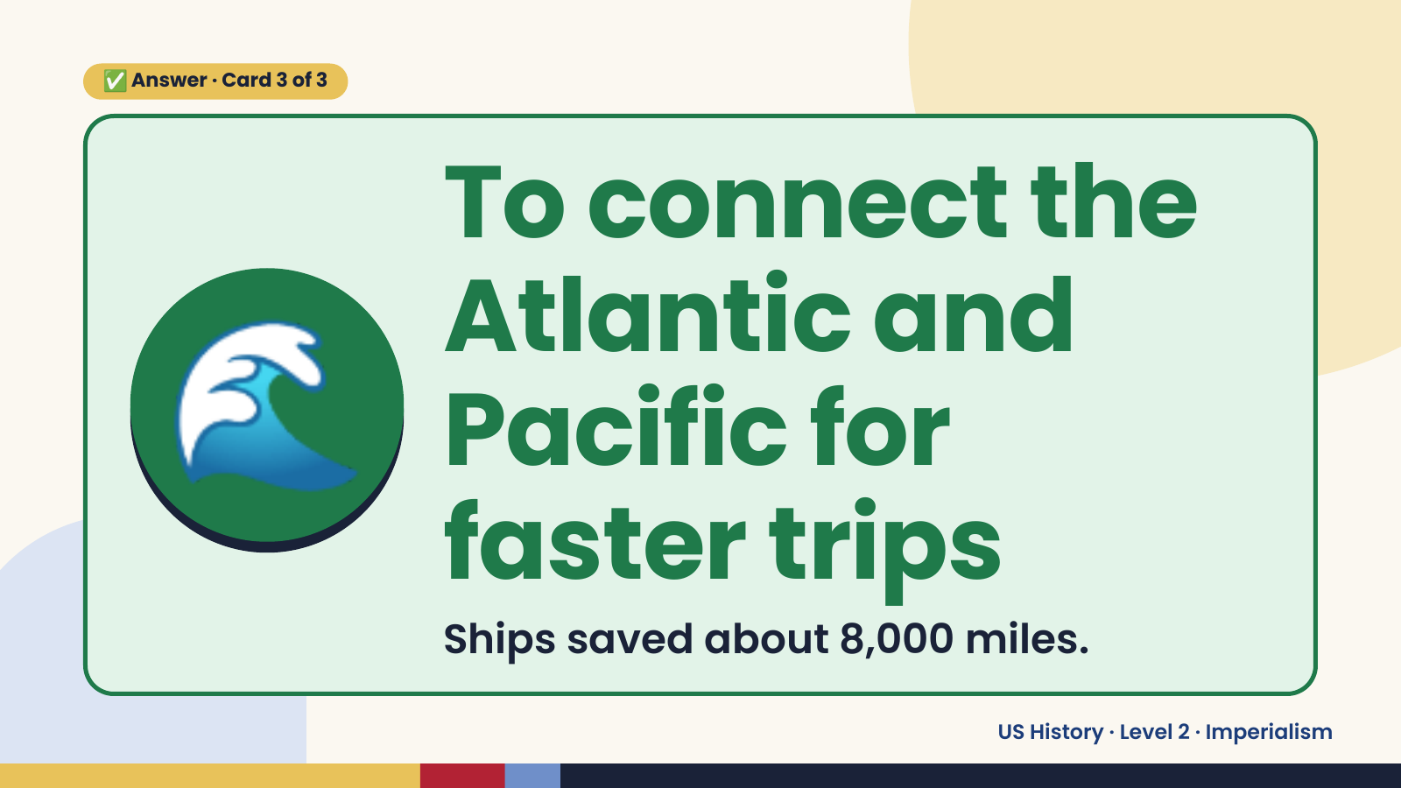
Notes:
✅ Answer · Card 3 of 3
🌊
To connect the
Atlantic and
Pacific for
faster trips
Ships saved about 8,000 miles.
US History · Level 2 · Imperialism

Slide 18
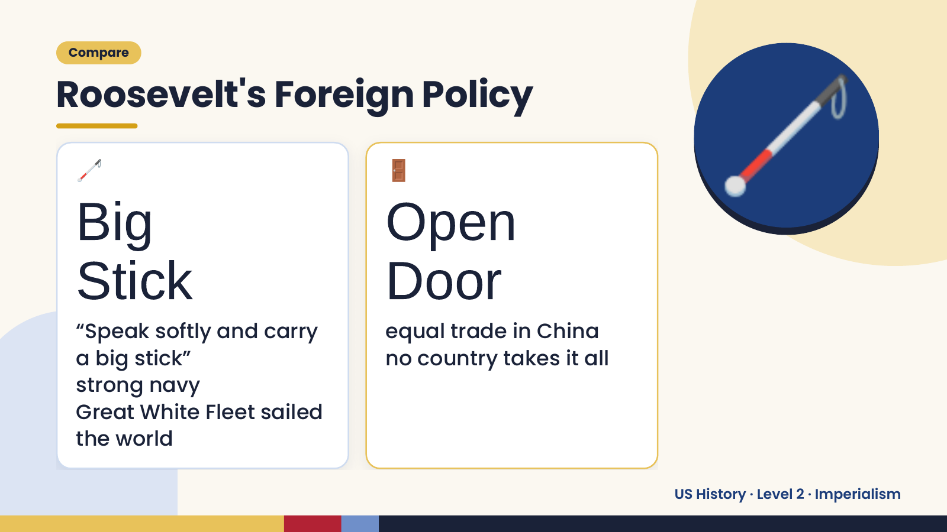
Notes:
Compare
Roosevelt's Foreign Policy
🦯
Big
Stick
🚪
Open
Door
🦯
“Speak softly and carry equal trade in China
a big stick” no country takes it all
strong navy
Great White Fleet sailed
the world
US History · Level 2 · Imperialism

Slide 19
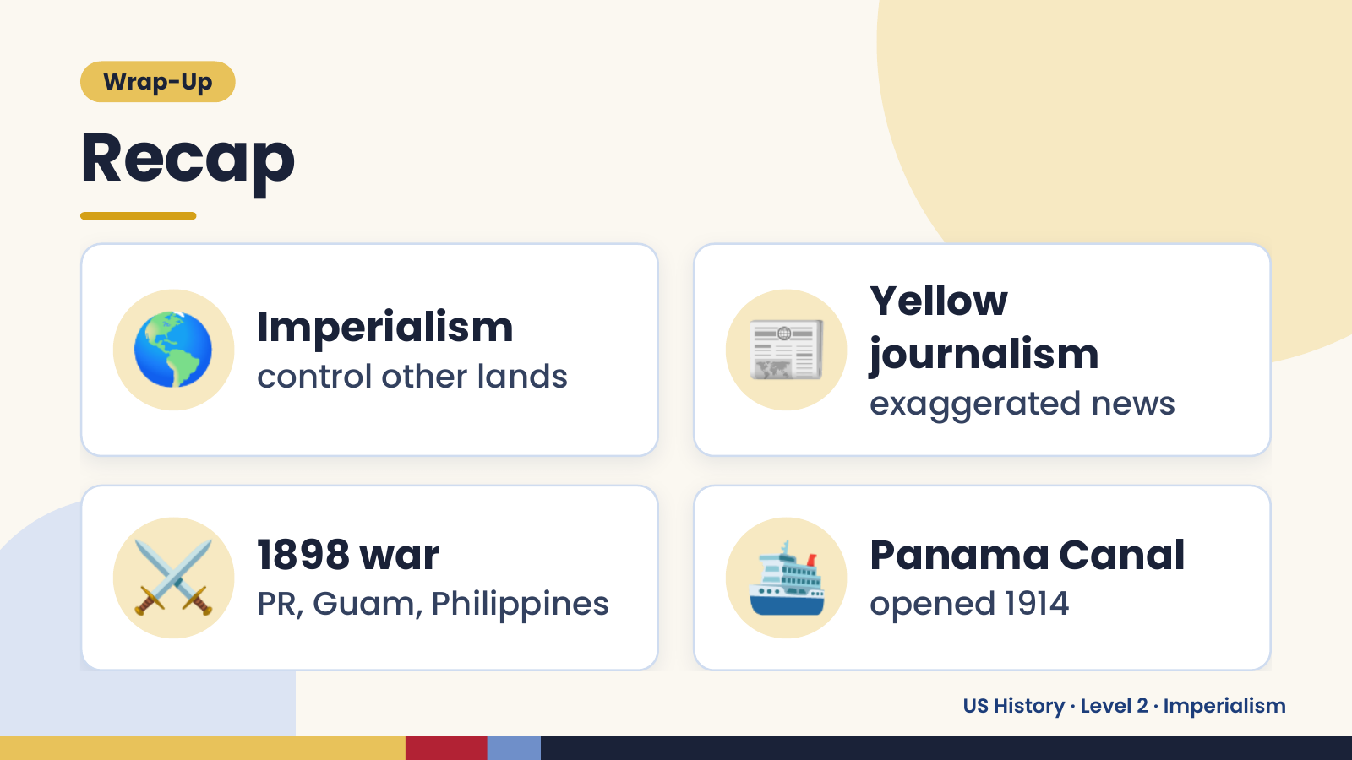
Notes:
Wrap-Up
Recap
🌎 Imperialism
control other lands 📰 Yellow
journalism
exaggerated news
⚔️ 1898 war
PR, Guam, Philippines 🛳️ Panama Canal
opened 1914
US History · Level 2 · Imperialism

Slide 20
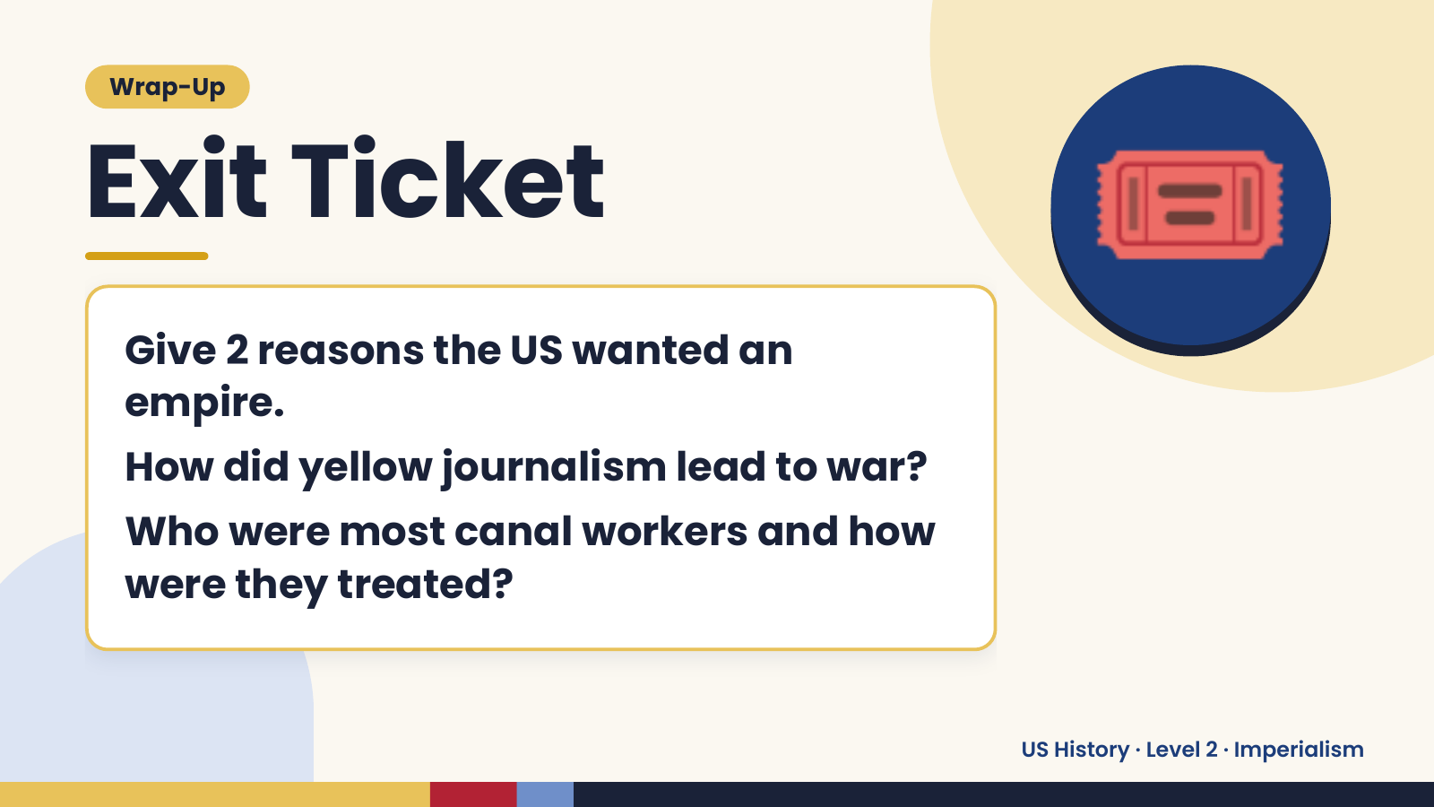
Notes:
Wrap-Up
Exit Ticket
Give 2 reasons the US wanted an
empire.
🎟️
How did yellow journalism lead to war?
Who were most canal workers and how
were they treated?
US History · Level 2 · Imperialism

