Slide 1
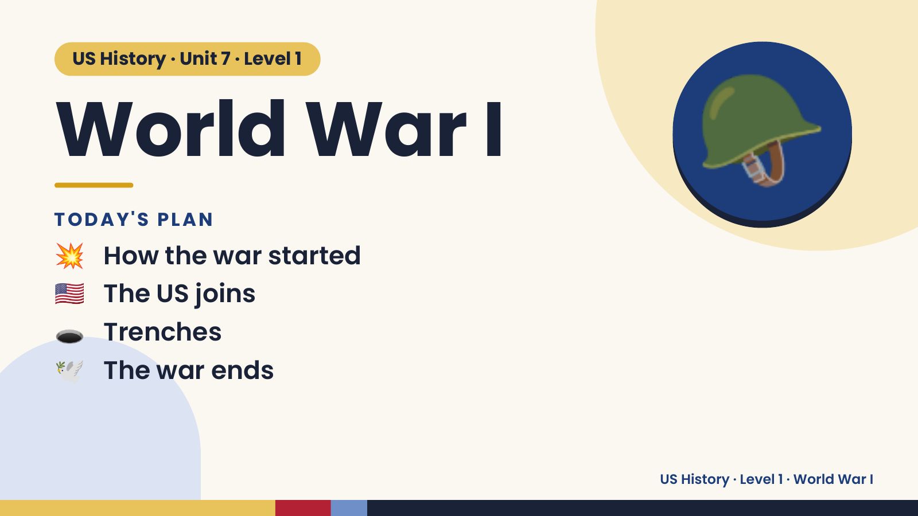
Notes:
US History · Unit 7 · Level 1
World War I
TODAY'S PLAN
💥 How the war started
🪖
🇺🇸 The US joins
🕳️ Trenches
🕊️ The war ends
US History · Level 1 · World War I

Slide 2
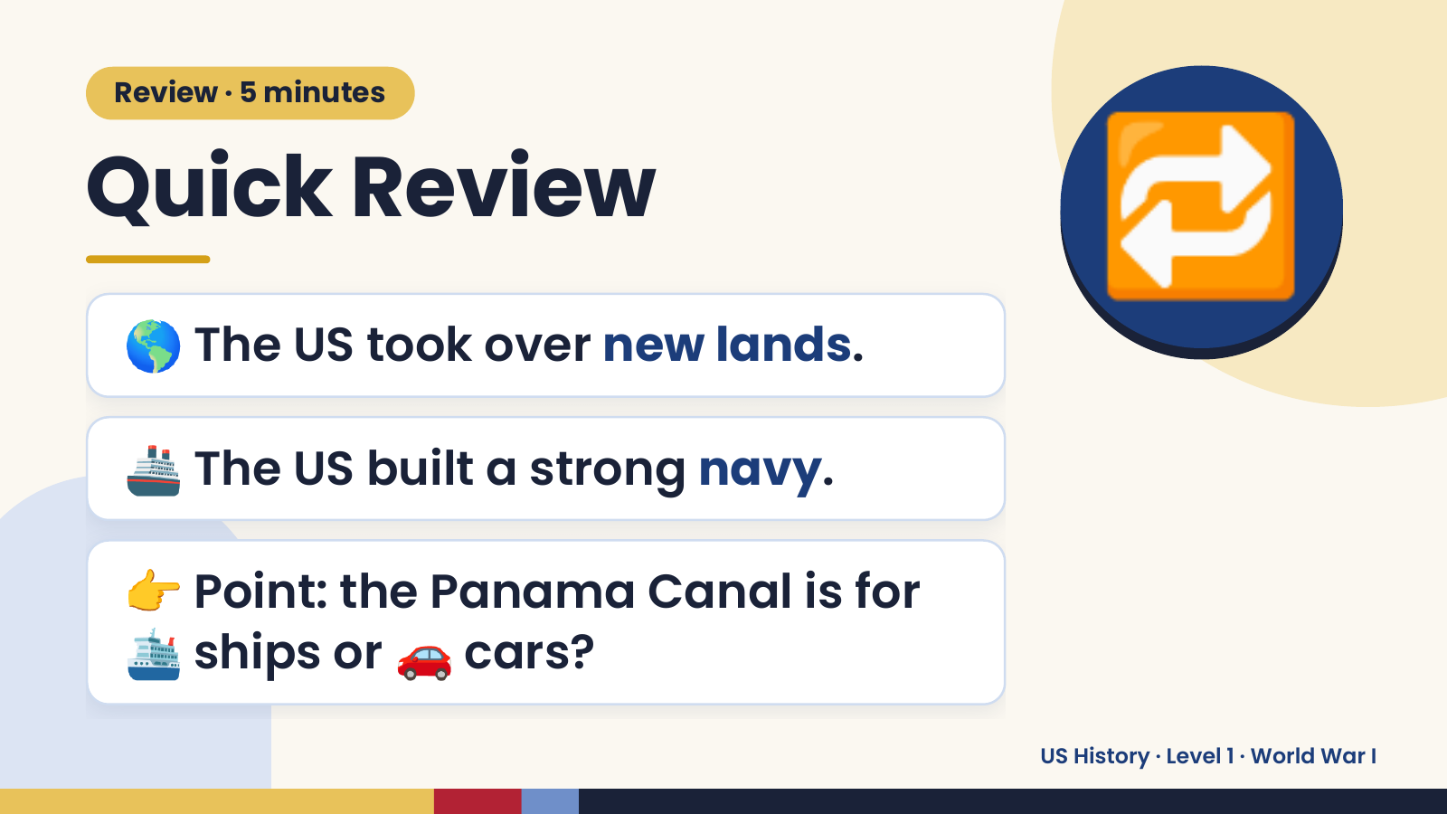
Notes:
Review · 5 minutes
Quick Review
🌎 The US took over new lands.
🔁
🚢 The US built a strong navy.
👉 Point: the Panama Canal is for
🛳️ ships or 🚗 cars?
US History · Level 1 · World War I

Slide 3
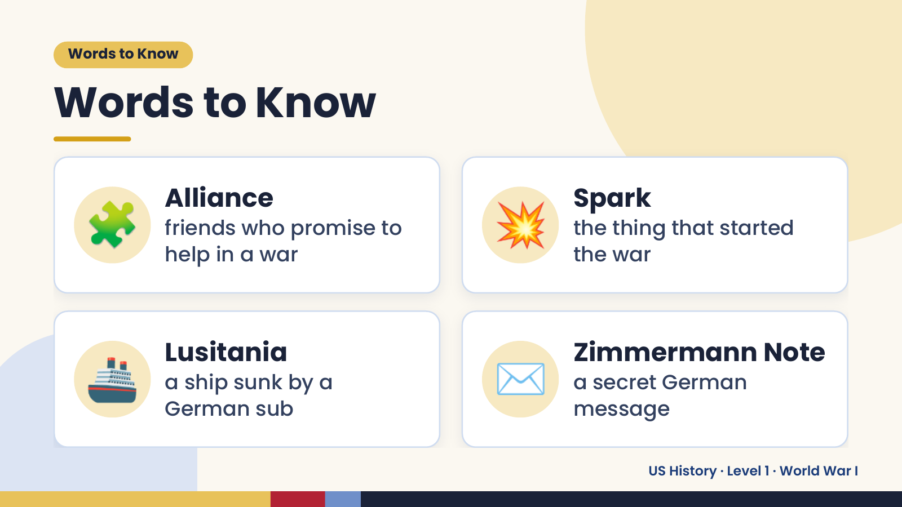
Notes:
Words to Know
Words to Know
🧩 Alliance
friends who promise to
help in a war
💥 Spark
the thing that started
the war
🚢 Lusitania
a ship sunk by a
German sub
✉️ Zimmermann Note
a secret German
message
US History · Level 1 · World War I

Slide 4
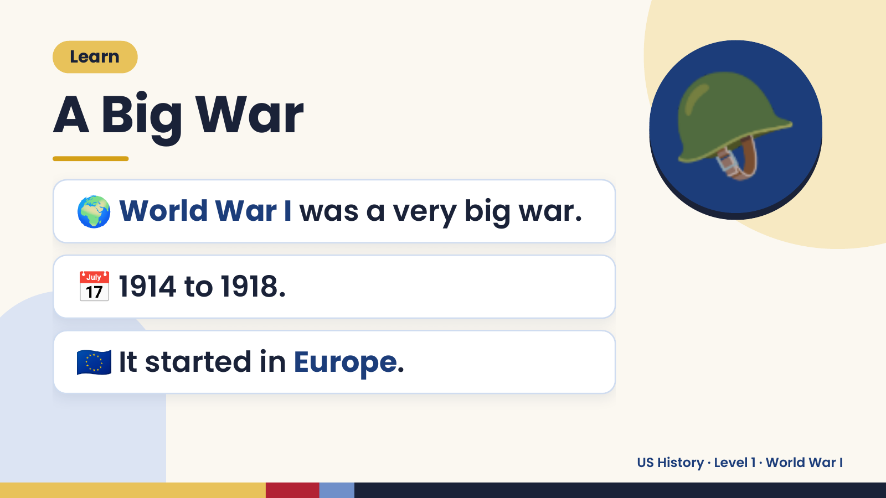
Notes:
Learn
A Big War
🌍 World War I was a very big war.
🪖
📅 1914 to 1918.
🇪🇺 It started in Europe.
US History · Level 1 · World War I

Slide 5
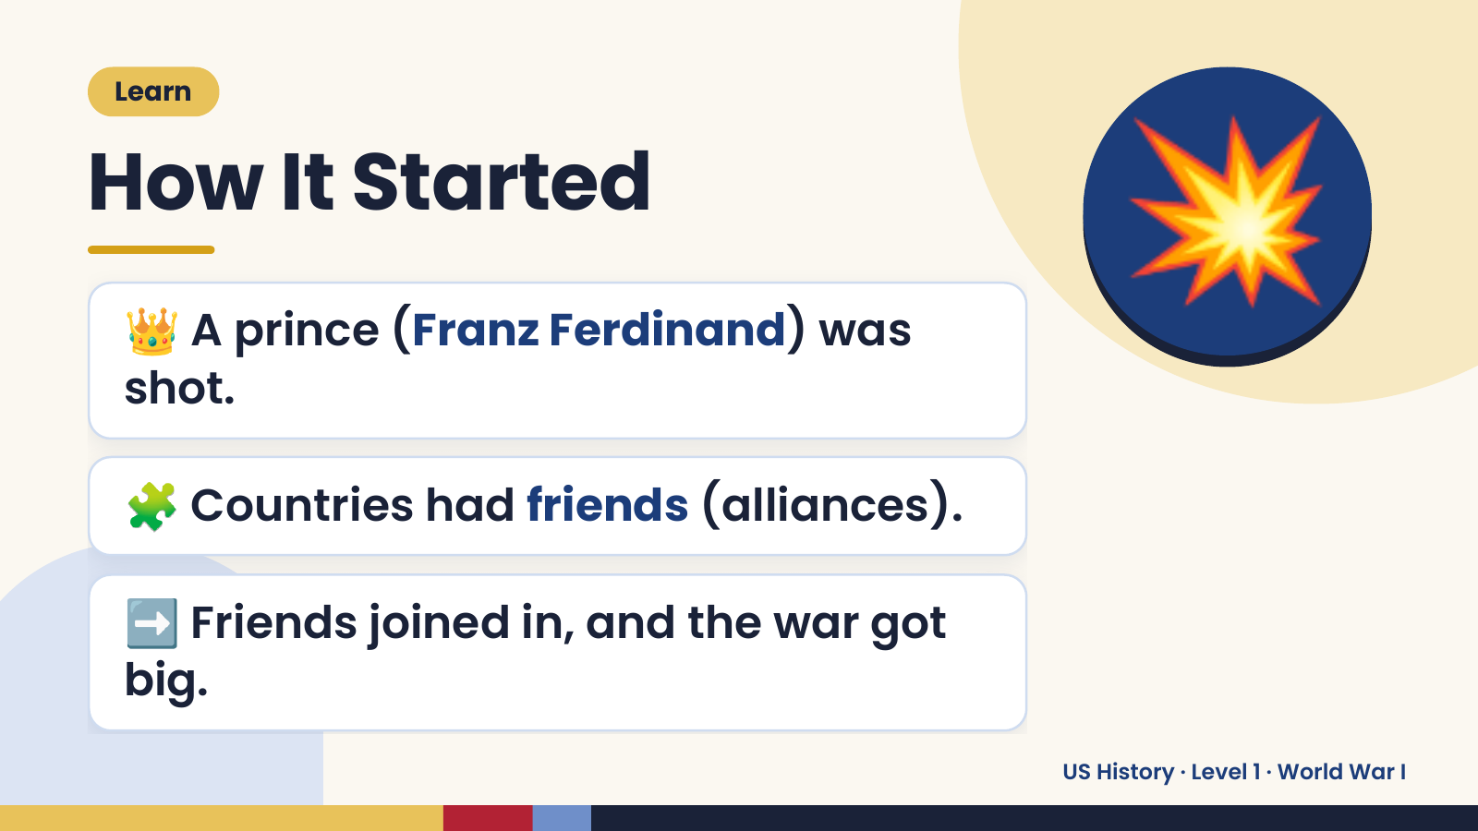
Notes:
Learn
How It Started
👑 A prince (Franz Ferdinand) was
shot.
💥
🧩 Countries had friends (alliances).
➡️ Friends joined in, and the war got
big.
US History · Level 1 · World War I

Slide 6
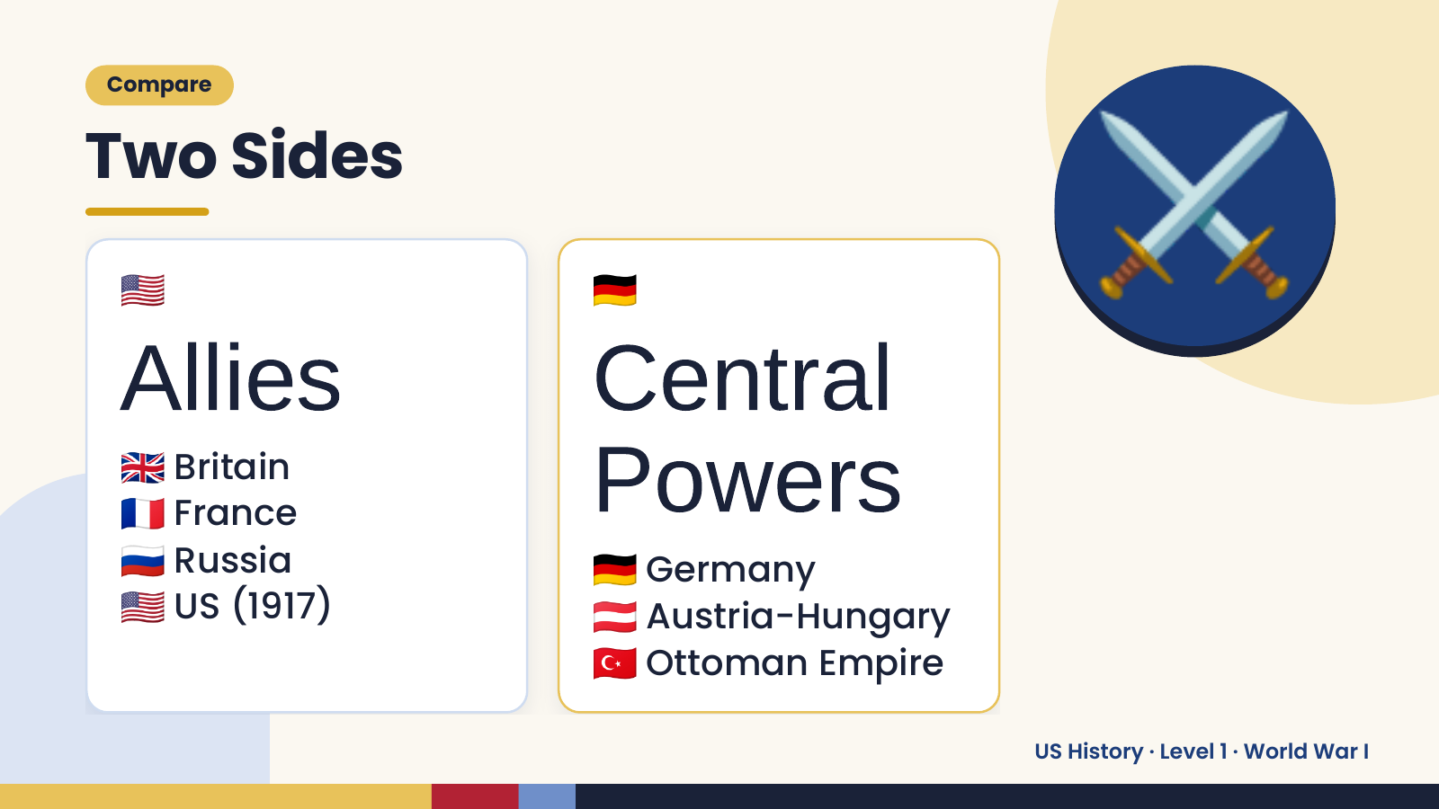
Notes:
Compare
Two Sides
🇺🇸
Allies
🇩🇪
Central
⚔️
🇬🇧
🇫🇷
🇷🇺
Britain
France Powers
🇩🇪
🇺🇸
Russia
🇦🇹
Germany
US (1917)
🇹🇷
Austria-Hungary
Ottoman Empire
US History · Level 1 · World War I

Slide 7
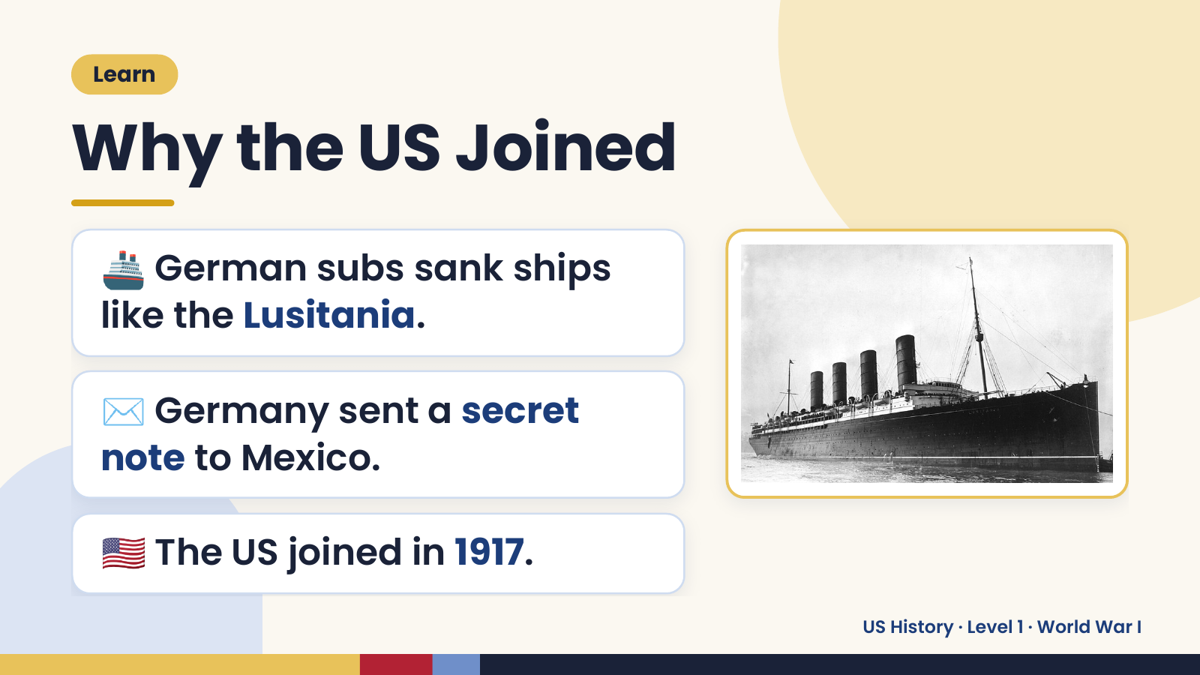
Notes:
Learn
Why the US Joined
🚢 German subs sank ships
like the Lusitania.
✉️ Germany sent a secret
note to Mexico.
🇺🇸 The US joined in 1917.
US History · Level 1 · World War I

Slide 8
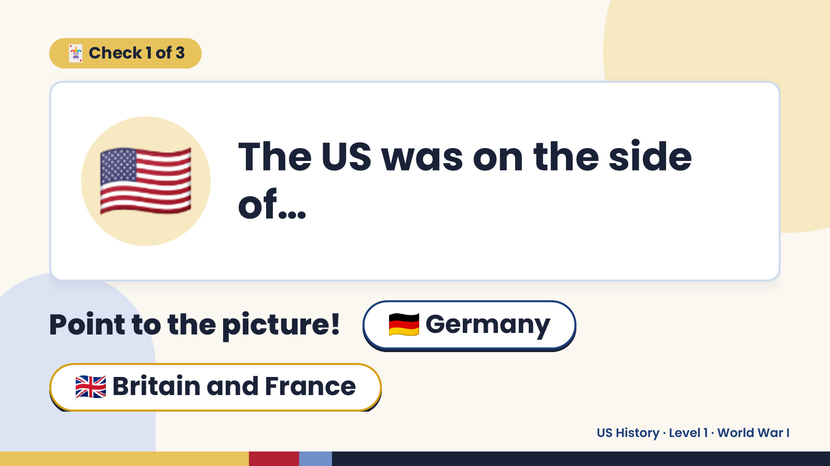
Notes:
🃏 Check 1 of 3
🇺🇸 The US was on the side
of…
Point to the picture! 🇩🇪 Germany
🇬🇧 Britain and France
US History · Level 1 · World War I

Slide 9
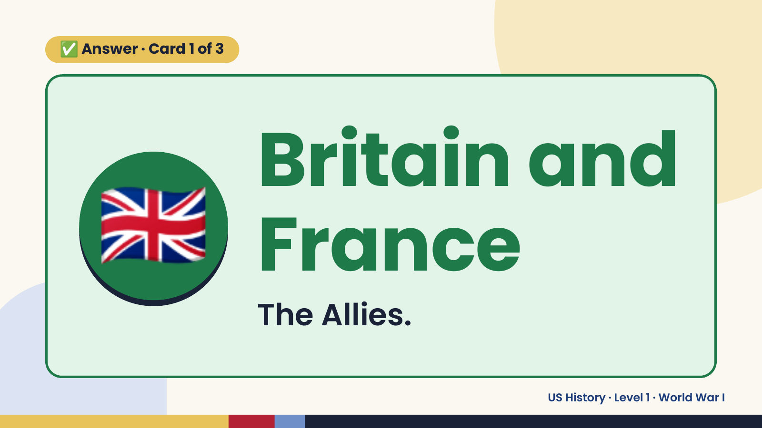
Notes:
✅ Answer · Card 1 of 3
🇬🇧 Britain and
France
The Allies.
US History · Level 1 · World War I

Slide 10
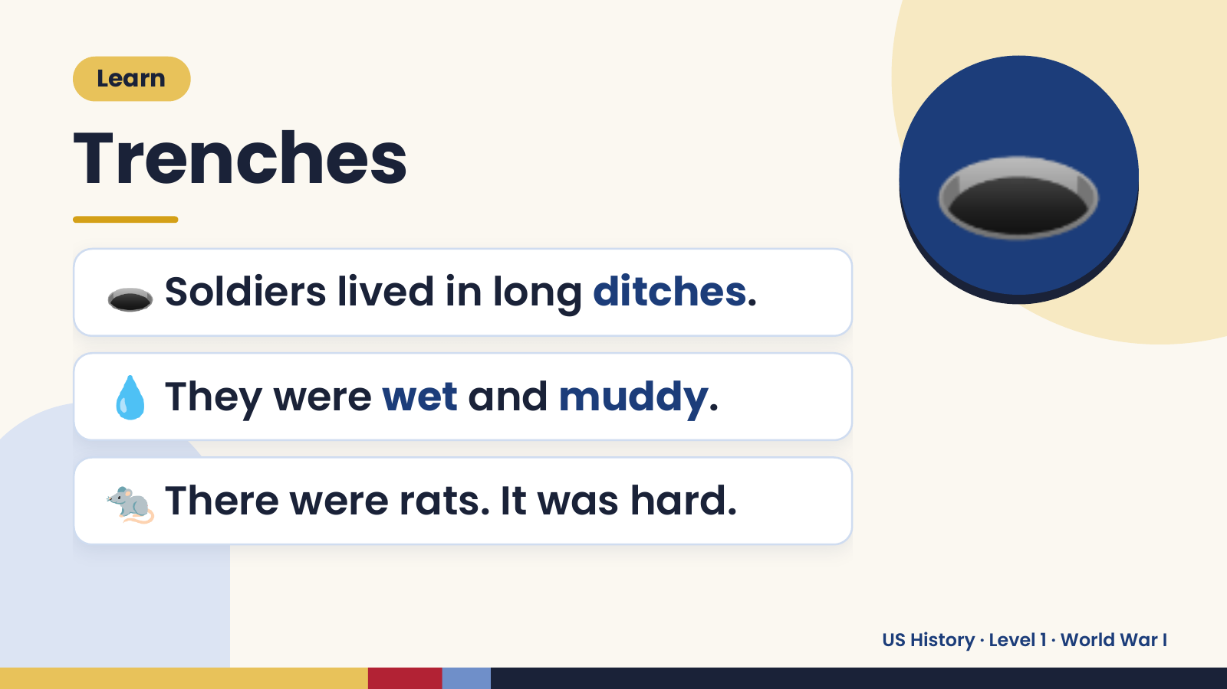
Notes:
Learn
Trenches
🕳️ Soldiers lived in long ditches.
🕳️
💧 They were wet and muddy.
🐀 There were rats. It was hard.
US History · Level 1 · World War I

Slide 11
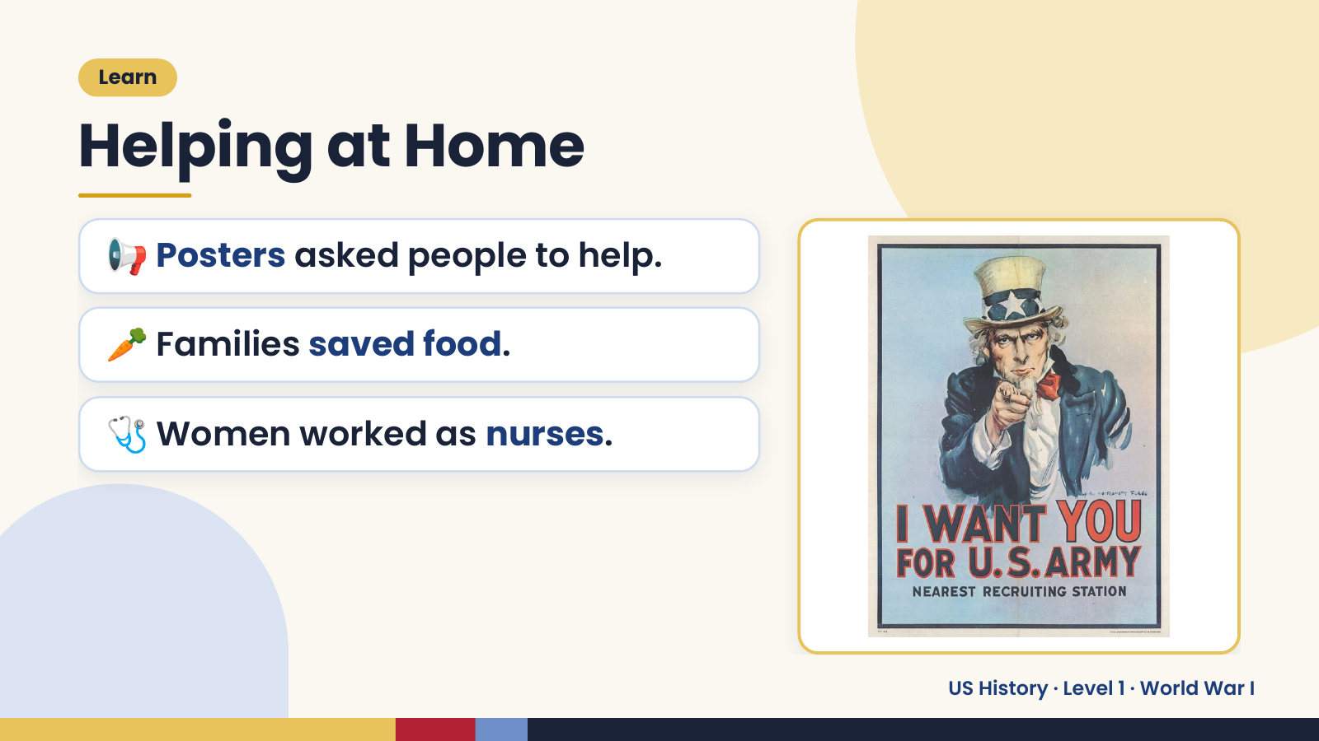
Notes:
Learn
Helping at Home
📢 Posters asked people to help.
🥕 Families saved food.
🩺 Women worked as nurses.
US History · Level 1 · World War I

Slide 12
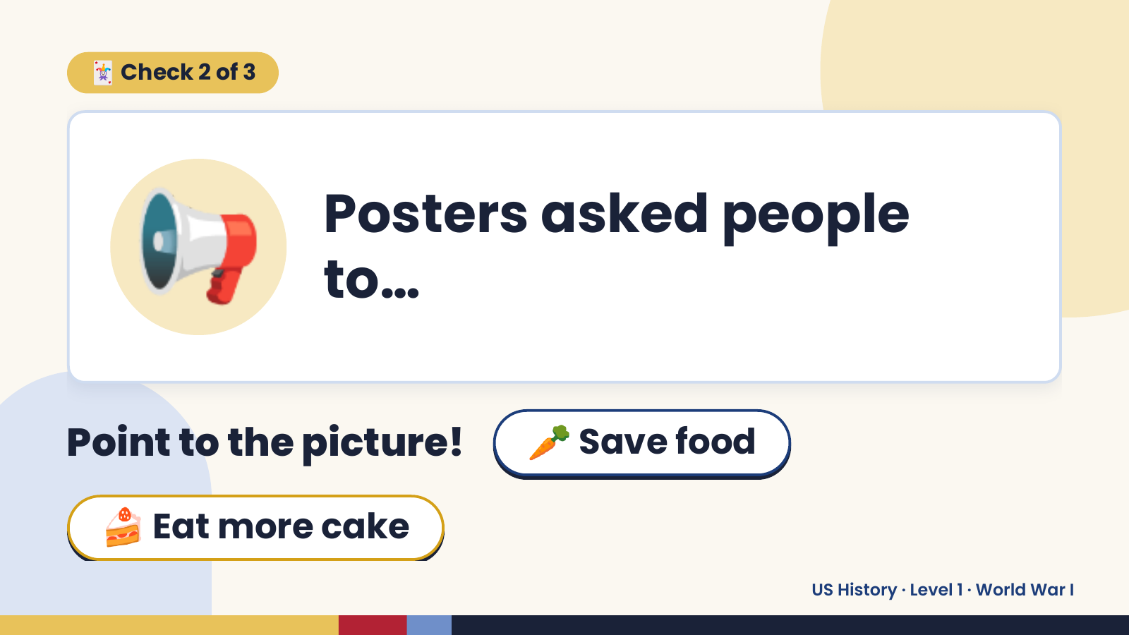
Notes:
🃏 Check 2 of 3
📢 Posters asked people
to…
Point to the picture! 🥕 Save food
🍰 Eat more cake
US History · Level 1 · World War I

Slide 13
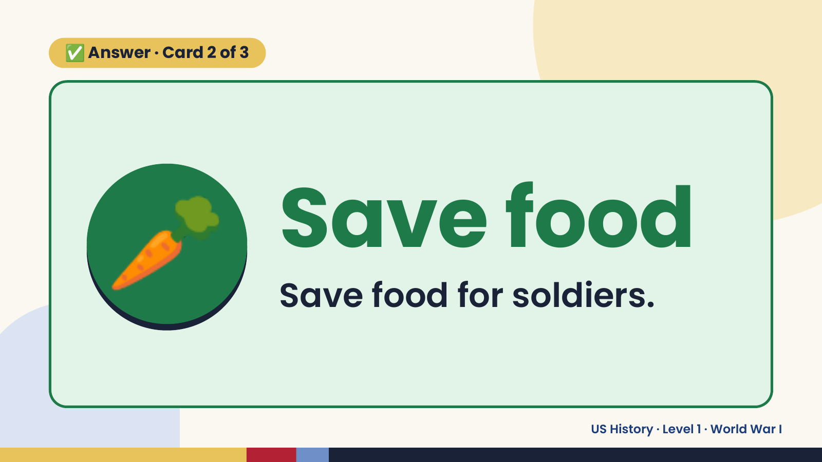
Notes:
✅ Answer · Card 2 of 3
🥕 Save food
Save food for soldiers.
US History · Level 1 · World War I

Slide 14
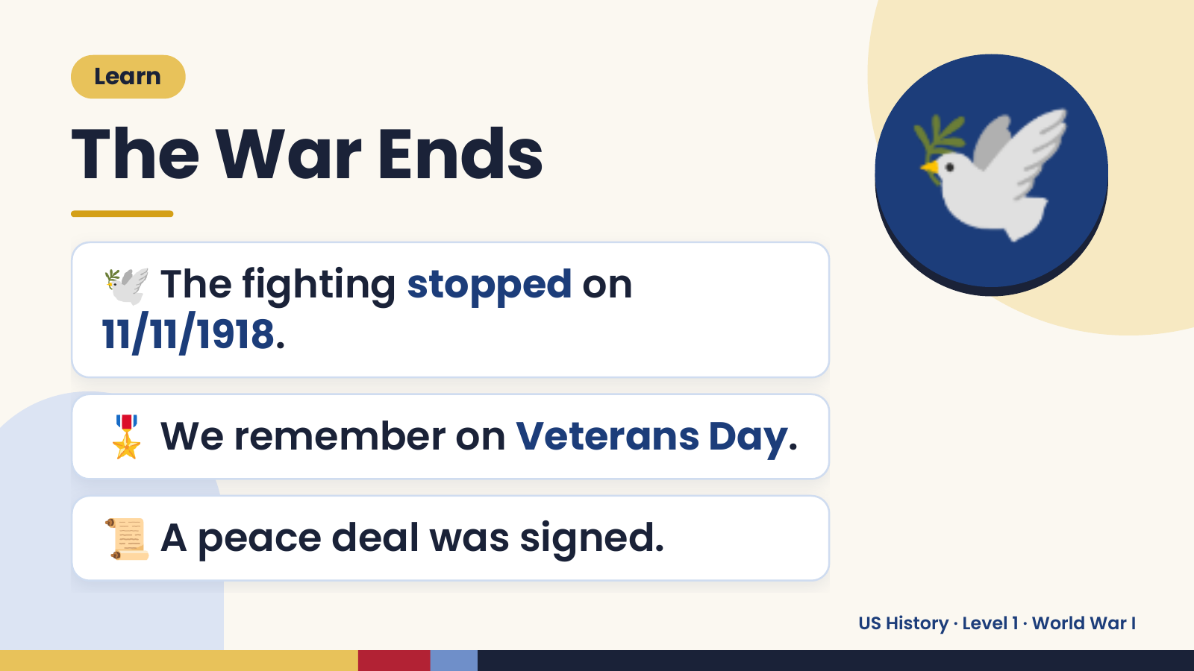
Notes:
Learn
The War Ends
🕊️ The fighting stopped on
11/11/1918.
🕊️
🎖️ We remember on Veterans Day.
📜 A peace deal was signed.
US History · Level 1 · World War I

Slide 15
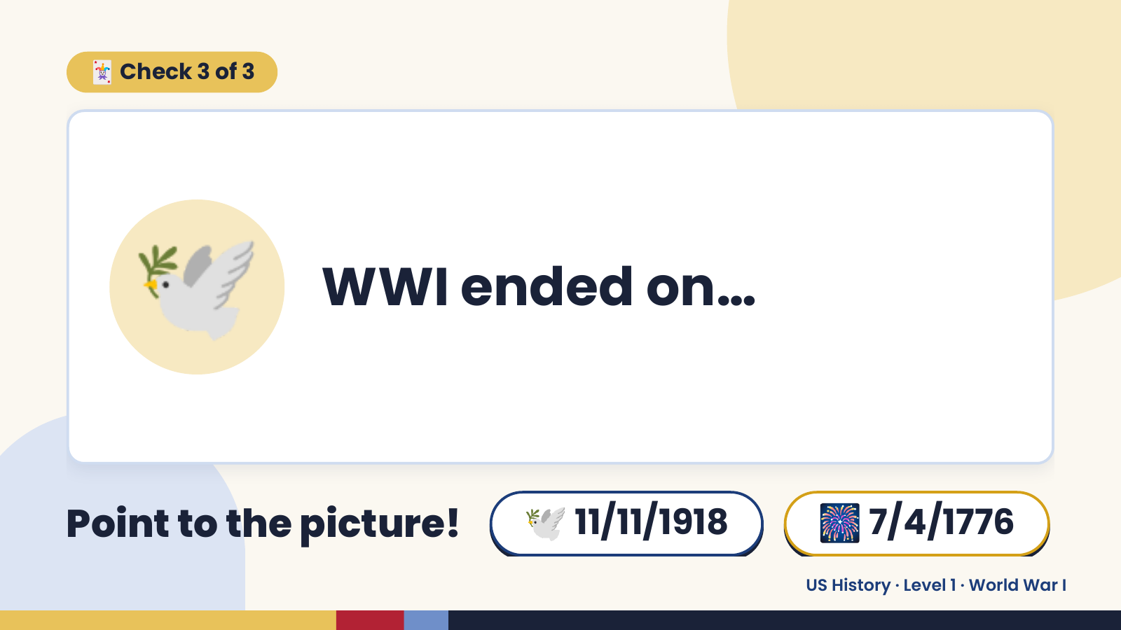
Notes:
🃏 Check 3 of 3
🕊️ WWI ended on…
Point to the picture! 🕊️ 11/11/1918 🎆 7/4/1776
US History · Level 1 · World War I

Slide 16
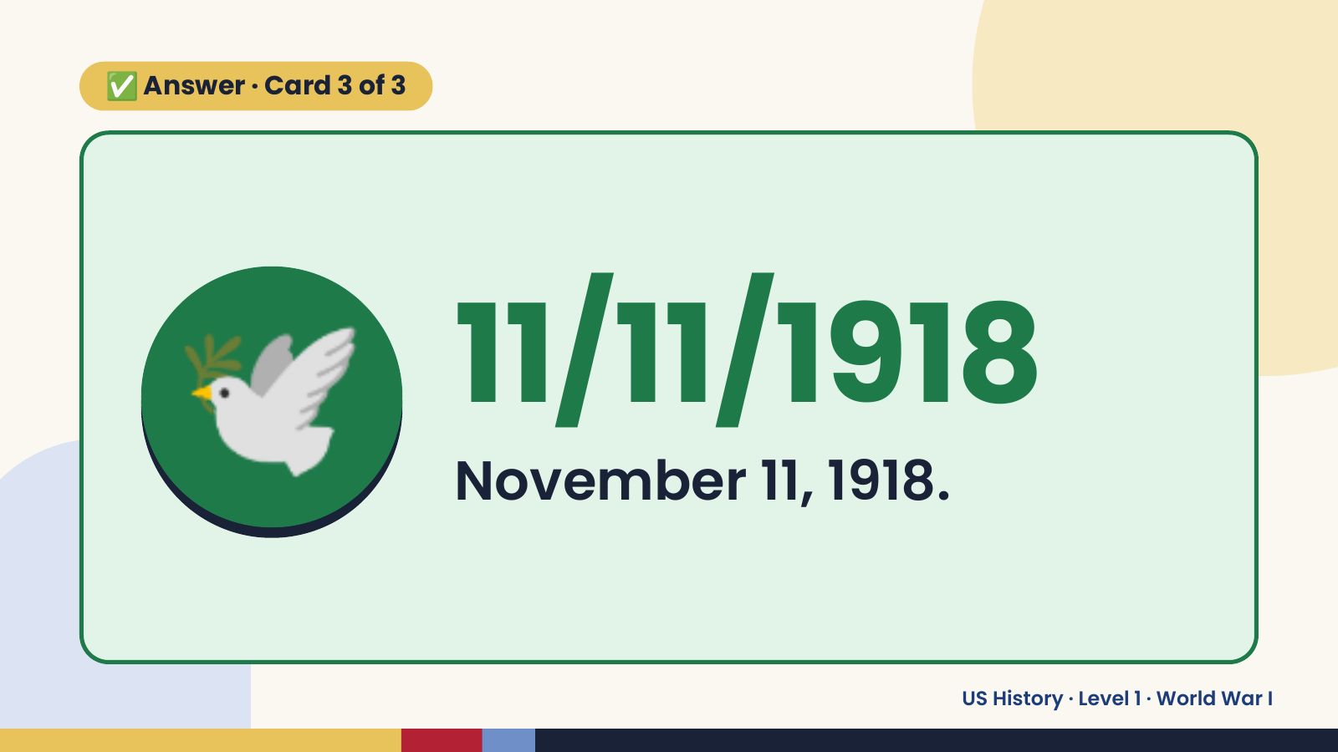
Notes:
✅ Answer · Card 3 of 3
🕊️ 11/11/1918
November 11, 1918.
US History · Level 1 · World War I

Slide 17
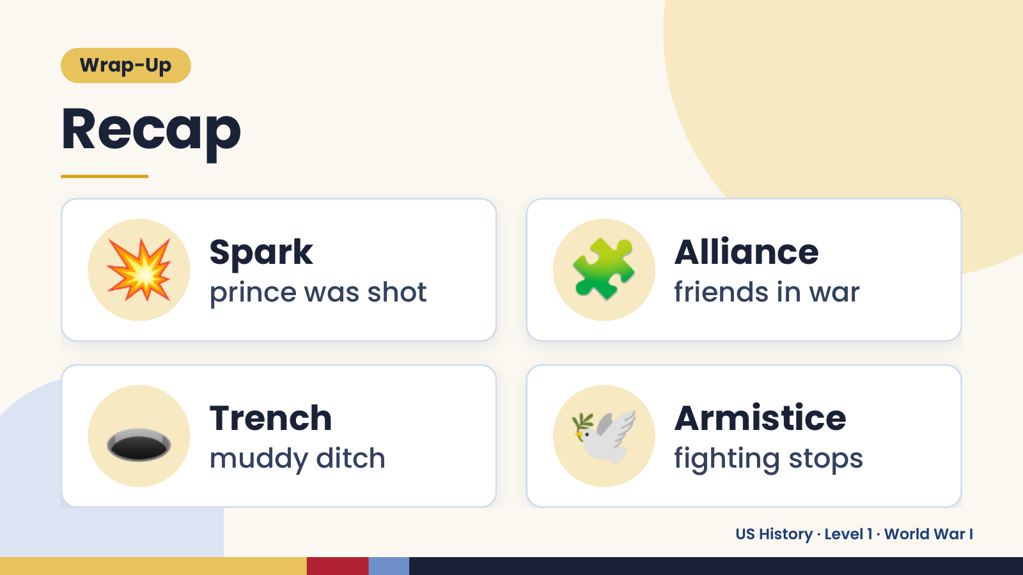
Notes:
Wrap-Up
Recap
💥 Spark
prince was shot 🧩 Alliance
friends in war
🕳️ Trench
muddy ditch 🕊️ Armistice
fighting stops
US History · Level 1 · World War I

Slide 18
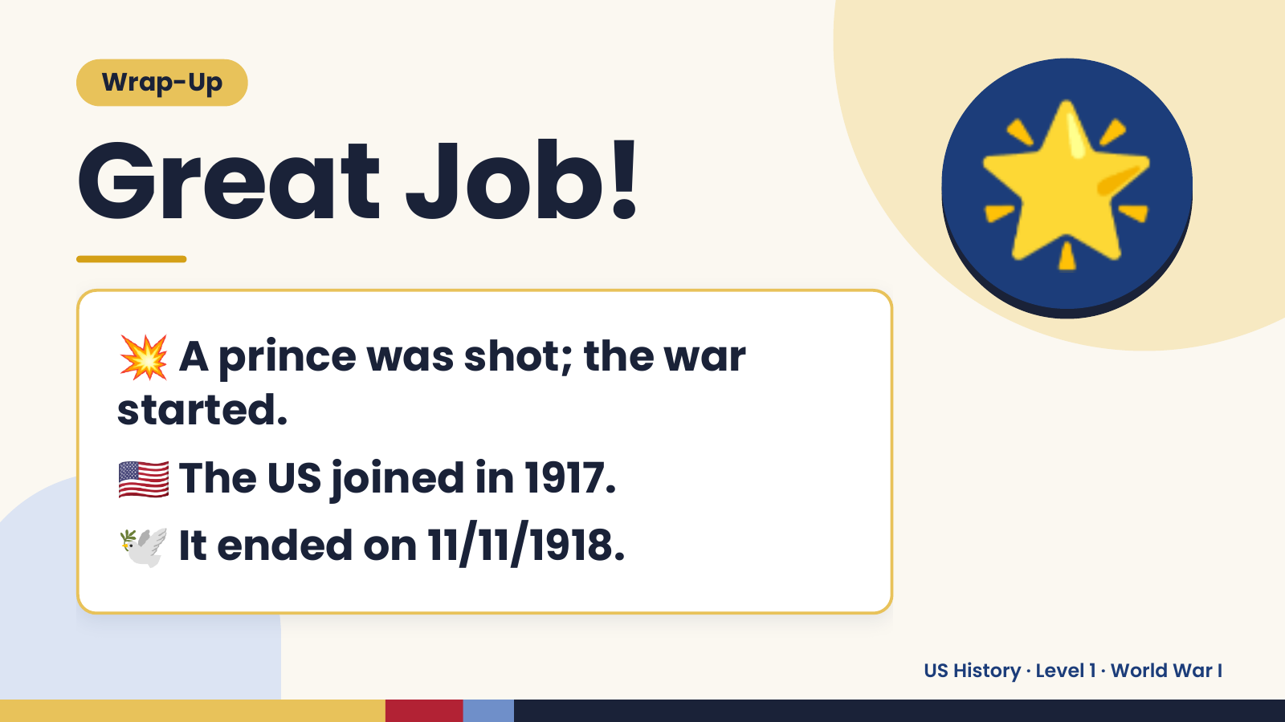
Notes:
Wrap-Up
Great Job!
💥 A prince was shot; the war
🌟
started.
🇺🇸 The US joined in 1917.
🕊️ It ended on 11/11/1918.
US History · Level 1 · World War I

