Slide 1
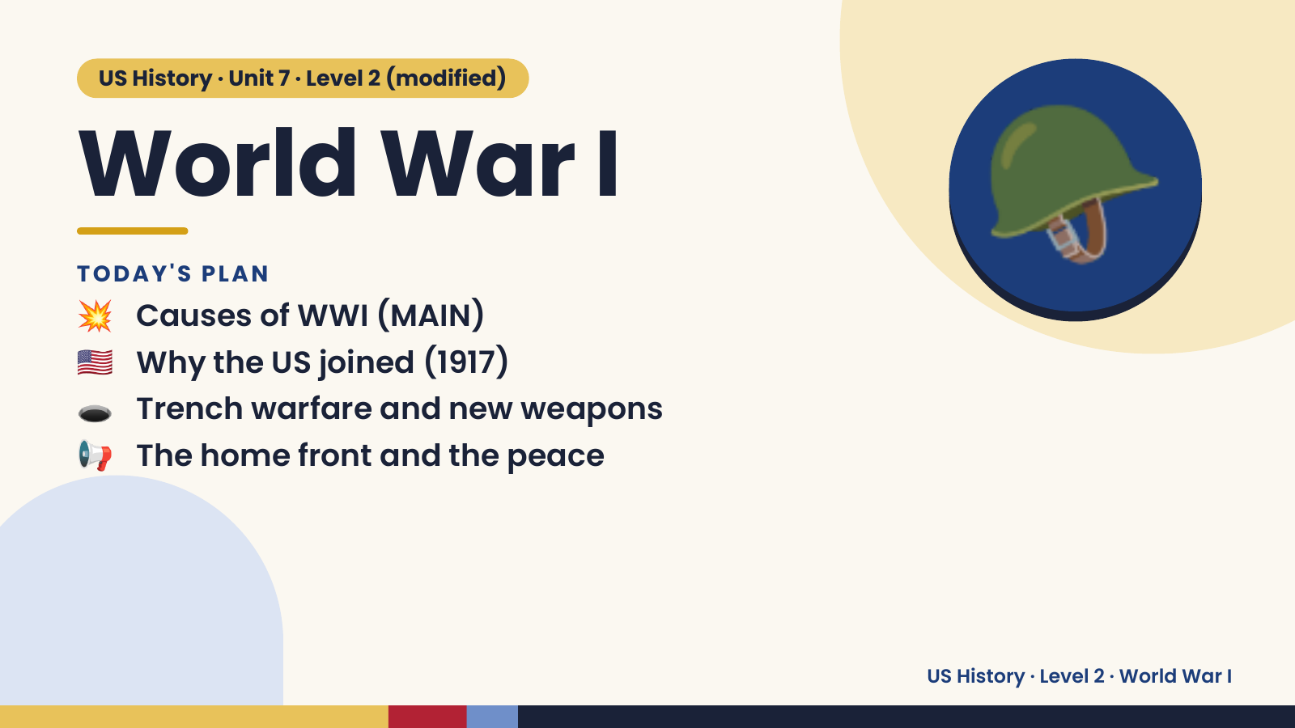
Notes:
US History · Unit 7 · Level 2 (modified)
World War I
💥 Causes of WWI (MAIN)
TODAY'S PLAN
🇺🇸 Why the US joined (1917)
🕳️ Trench warfare and new weapons
🪖
📢 The home front and the peace
US History · Level 2 · World War I

Slide 2
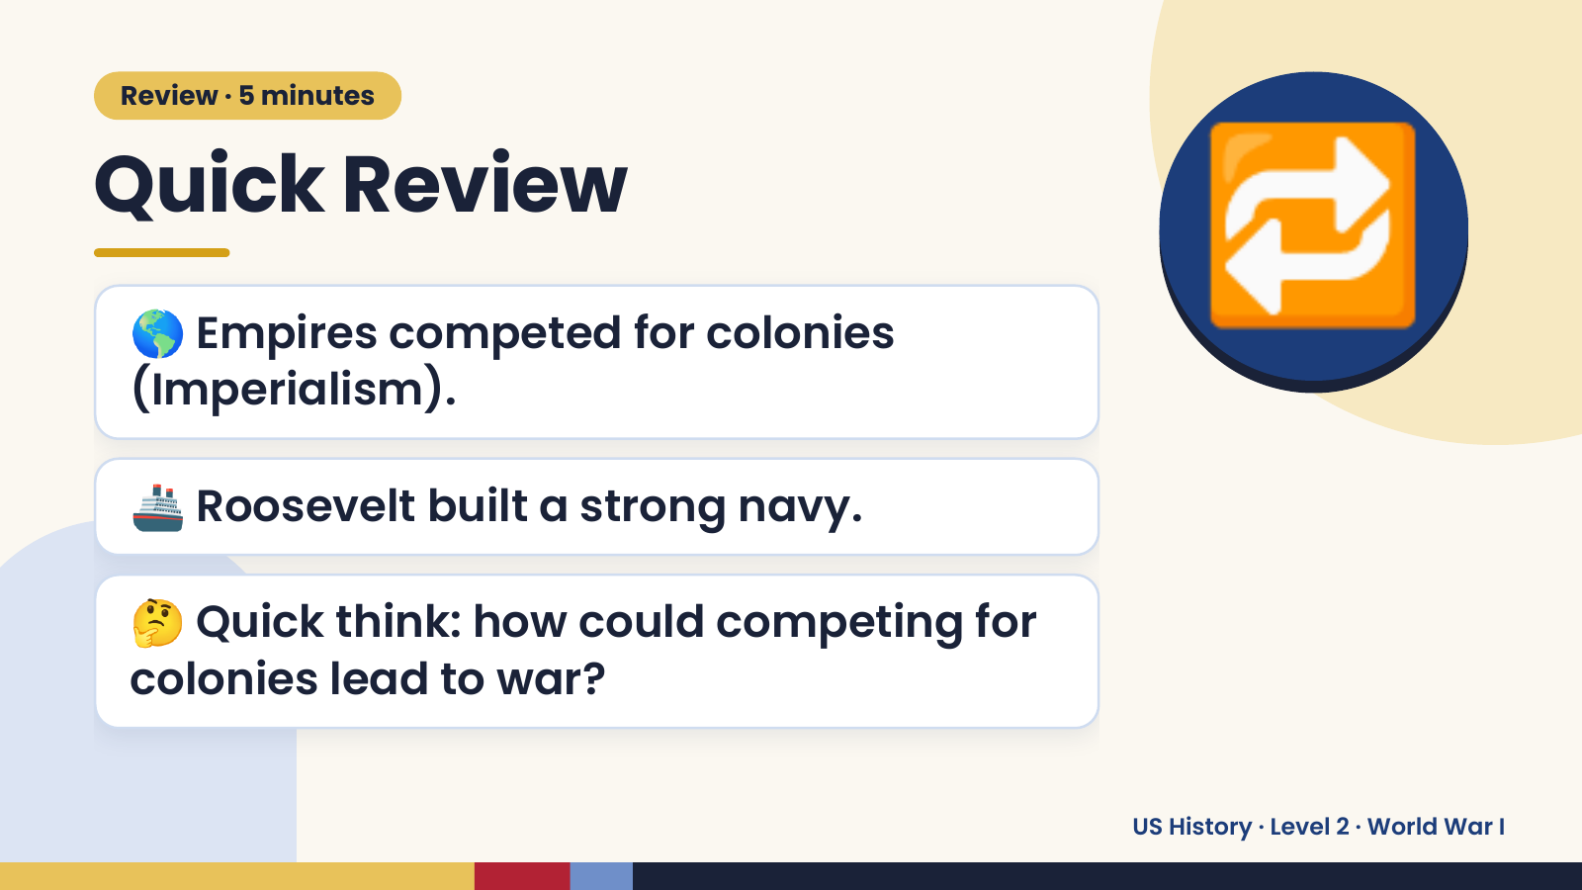
Notes:
Review · 5 minutes
Quick Review
🌎 Empires competed for colonies
(Imperialism).
🔁
🚢 Roosevelt built a strong navy.
🤔 Quick think: how could competing for
colonies lead to war?
US History · Level 2 · World War I

Slide 3
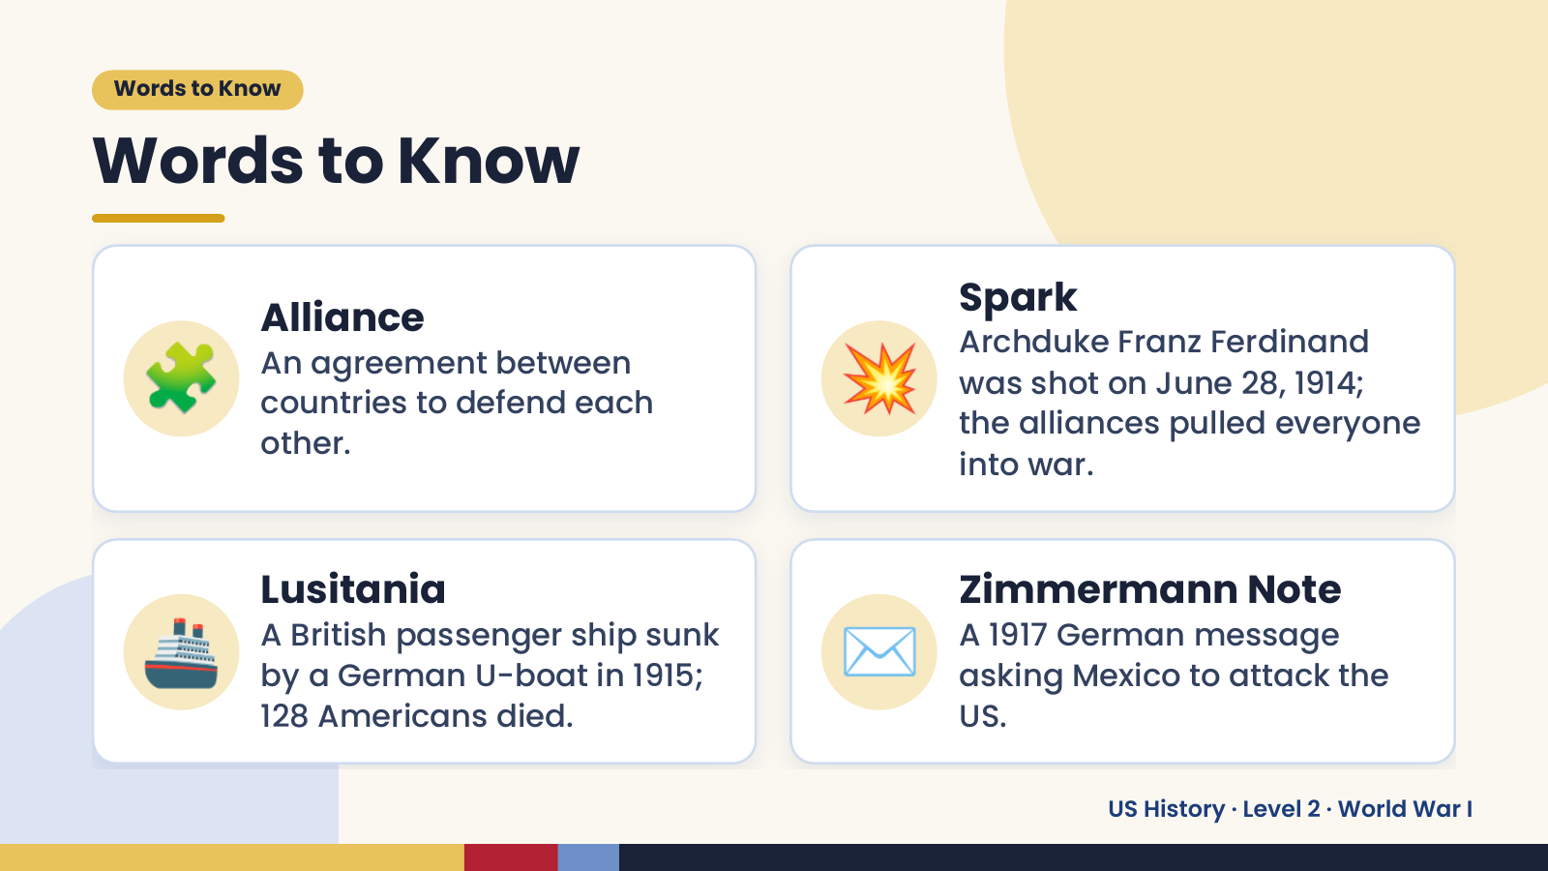
Notes:
Words to Know
Words to Know
🧩 💥
Spark
Alliance
Archduke Franz Ferdinand
An agreement between
was shot on June 28, 1914;
countries to defend each
the alliances pulled everyone
other.
into war.
🚢 Lusitania
A British passenger ship sunk
by a German U-boat in 1915;
128 Americans died.
✉️ Zimmermann Note
A 1917 German message
asking Mexico to attack the
US.
US History · Level 2 · World War I

Slide 4
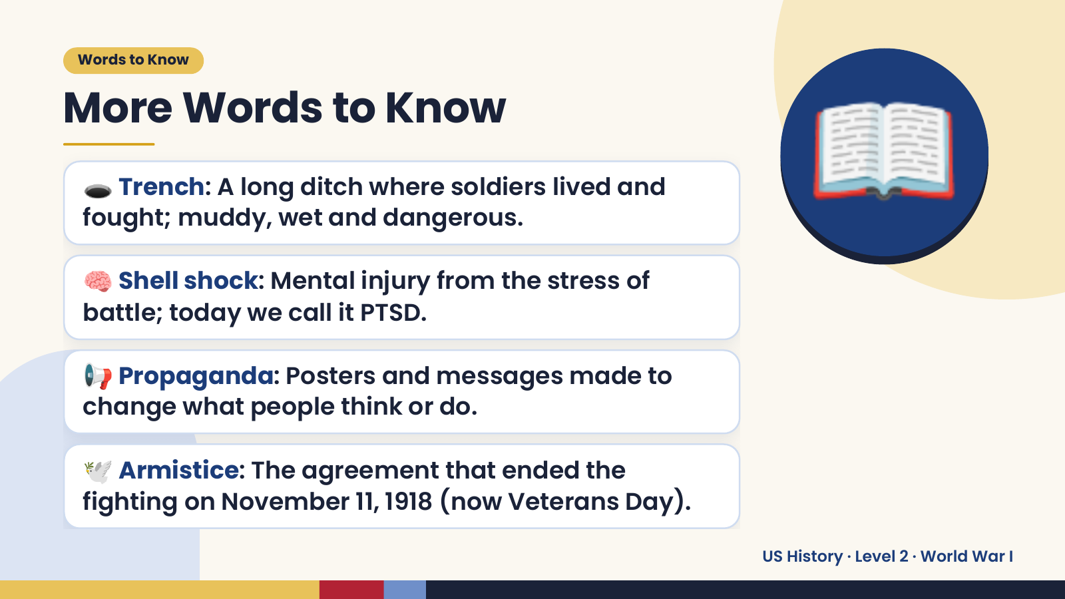
Notes:
Words to Know
More Words to Know
🕳️ Trench: A long ditch where soldiers lived and
fought; muddy, wet and dangerous.
🧠 Shell shock: Mental injury from the stress of
battle; today we call it PTSD.
📖
📢 Propaganda: Posters and messages made to
change what people think or do.
🕊️ Armistice: The agreement that ended the
fighting on November 11, 1918 (now Veterans Day).
US History · Level 2 · World War I

Slide 5
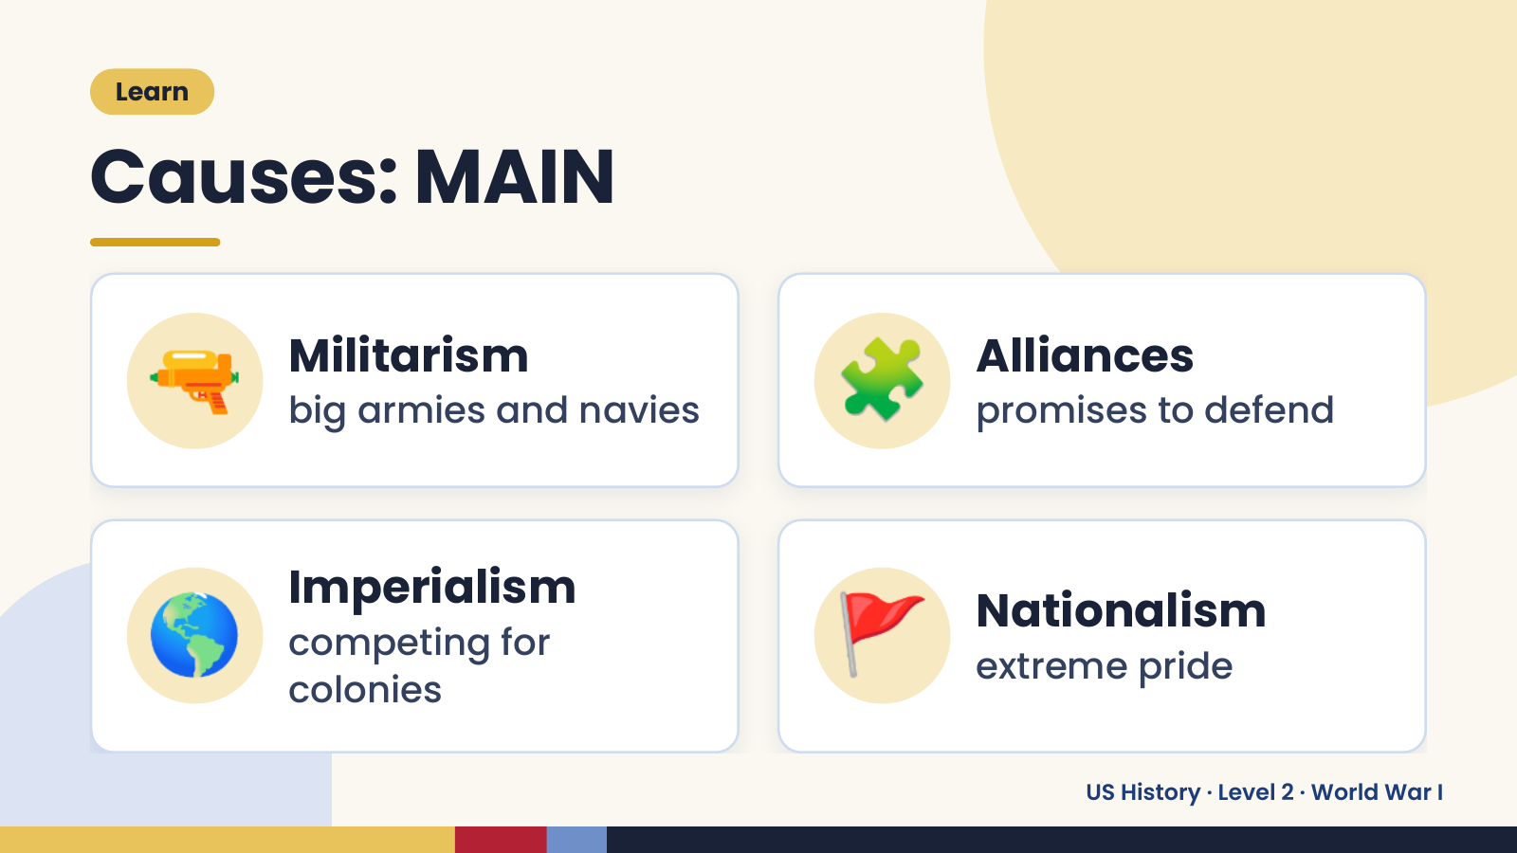
Notes:
Learn
Causes: MAIN
🔫 Militarism
big armies and navies 🧩 Alliances
promises to defend
🌎 Imperialism
competing for
colonies
🚩 Nationalism
extreme pride
US History · Level 2 · World War I

Slide 6
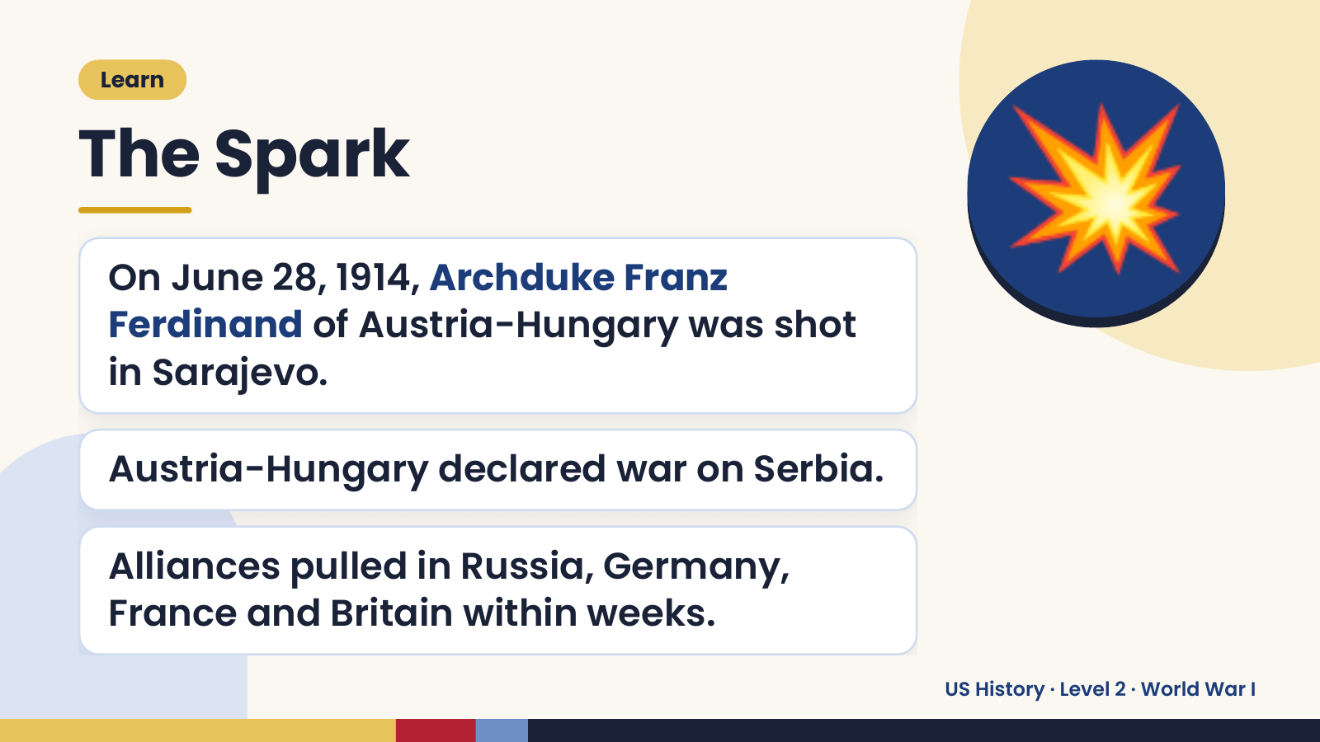
Notes:
Learn
The Spark
On June 28, 1914, Archduke Franz
Ferdinand of Austria-Hungary was shot
in Sarajevo.
💥
Austria-Hungary declared war on Serbia.
Alliances pulled in Russia, Germany,
France and Britain within weeks.
US History · Level 2 · World War I

Slide 7
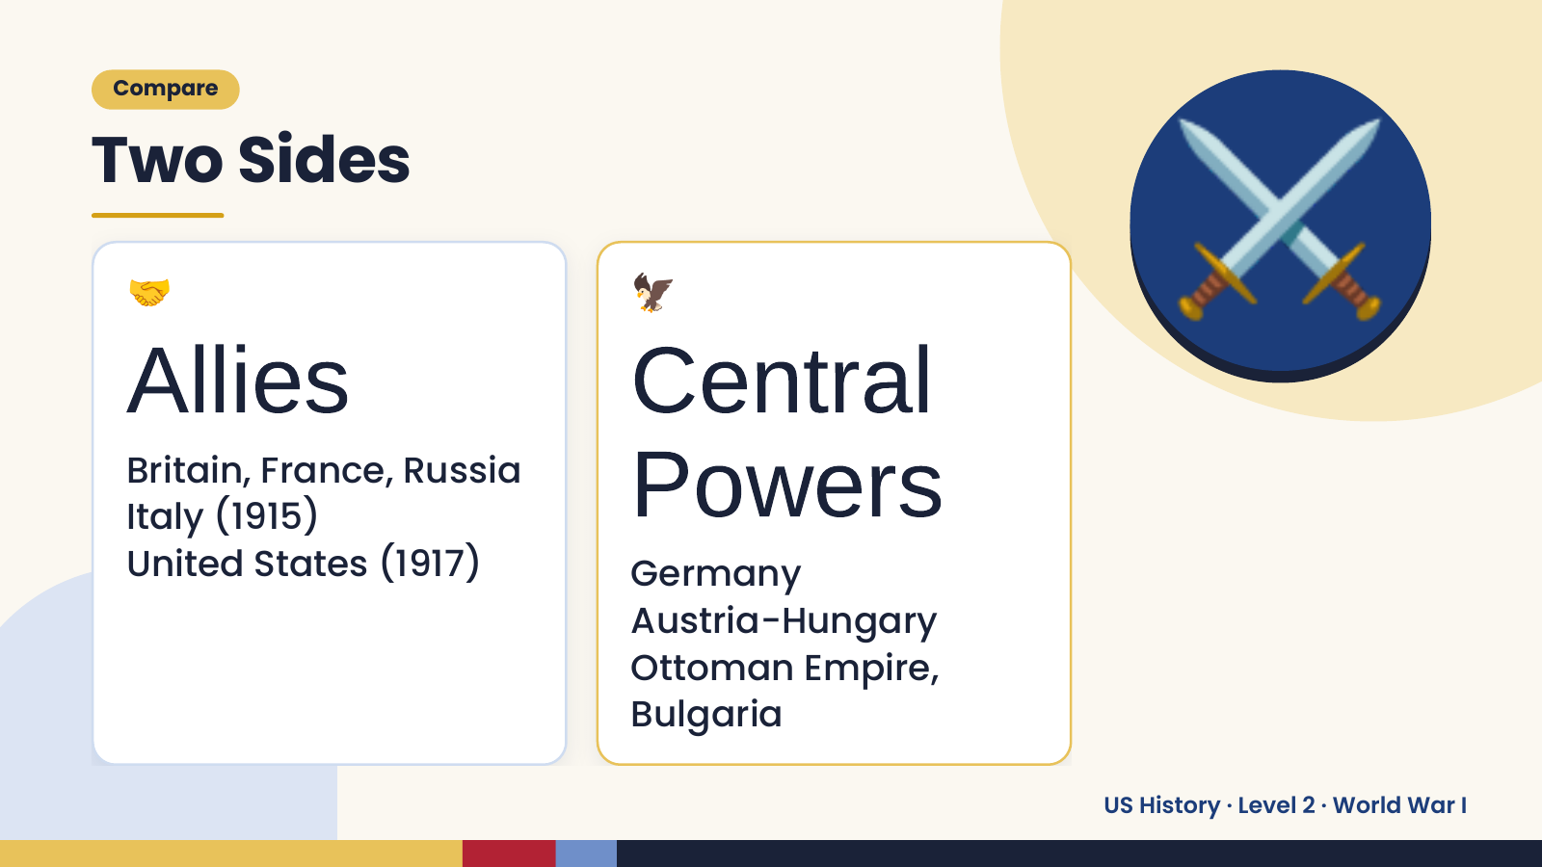
Notes:
Compare
Two Sides
🤝
Allies
🦅
Central
⚔️
Britain, France, Russia
Italy (1915)
United States (1917)
Powers
Germany
Austria-Hungary
Ottoman Empire,
Bulgaria
US History · Level 2 · World War I

Slide 8
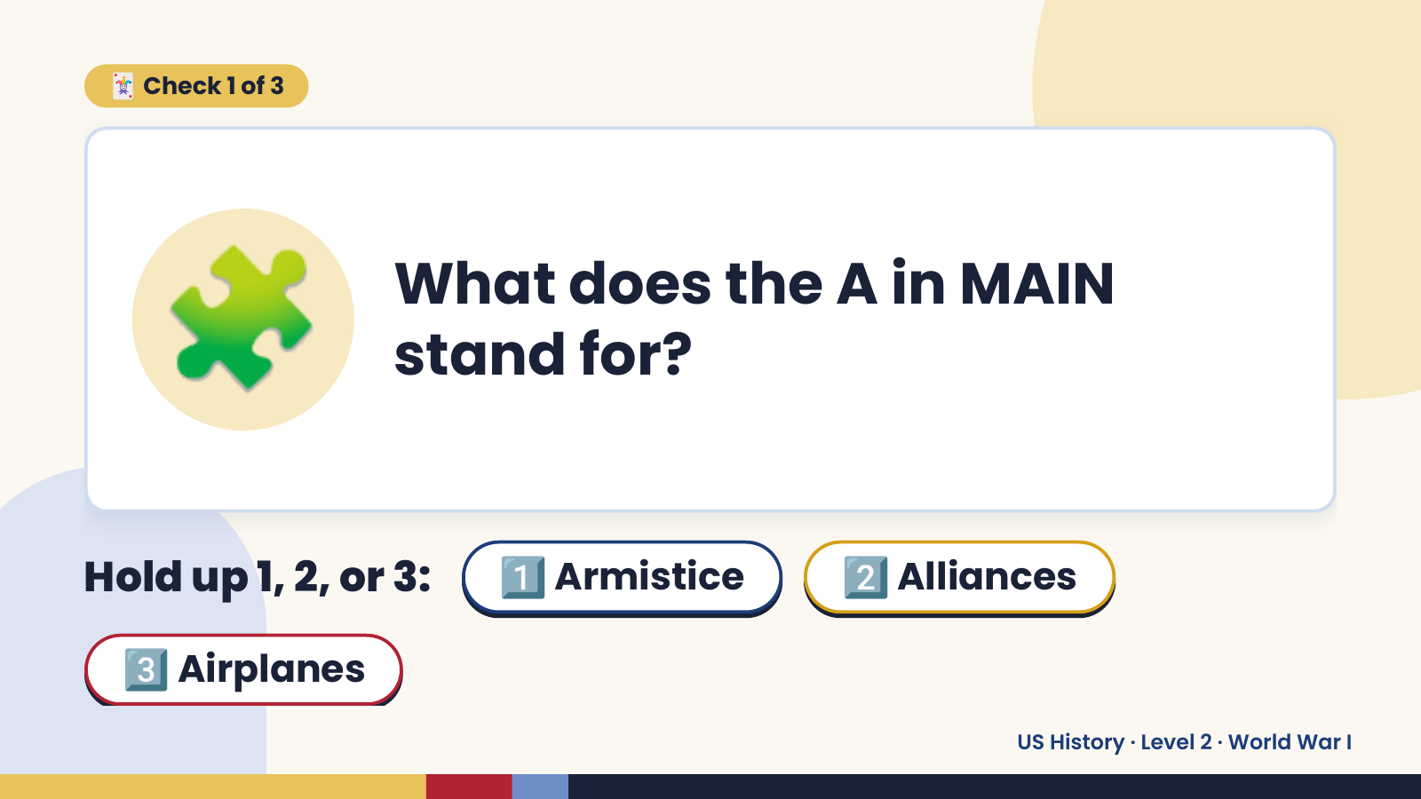
Notes:
🃏 Check 1 of 3
🧩 What does the A in MAIN
stand for?
Hold up 1, 2, or 3: 1️⃣ Armistice 2️⃣ Alliances
3️⃣ Airplanes
US History · Level 2 · World War I

Slide 9
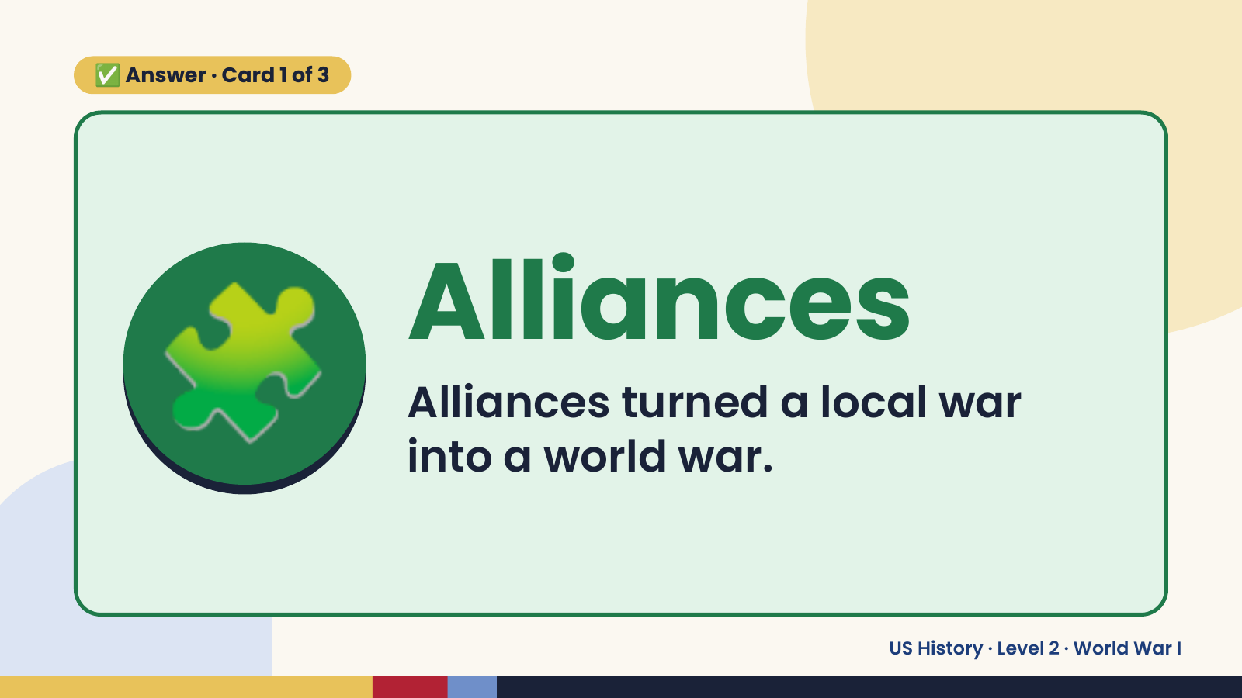
Notes:
✅ Answer · Card 1 of 3
🧩 Alliances
Alliances turned a local war
into a world war.
US History · Level 2 · World War I

Slide 10
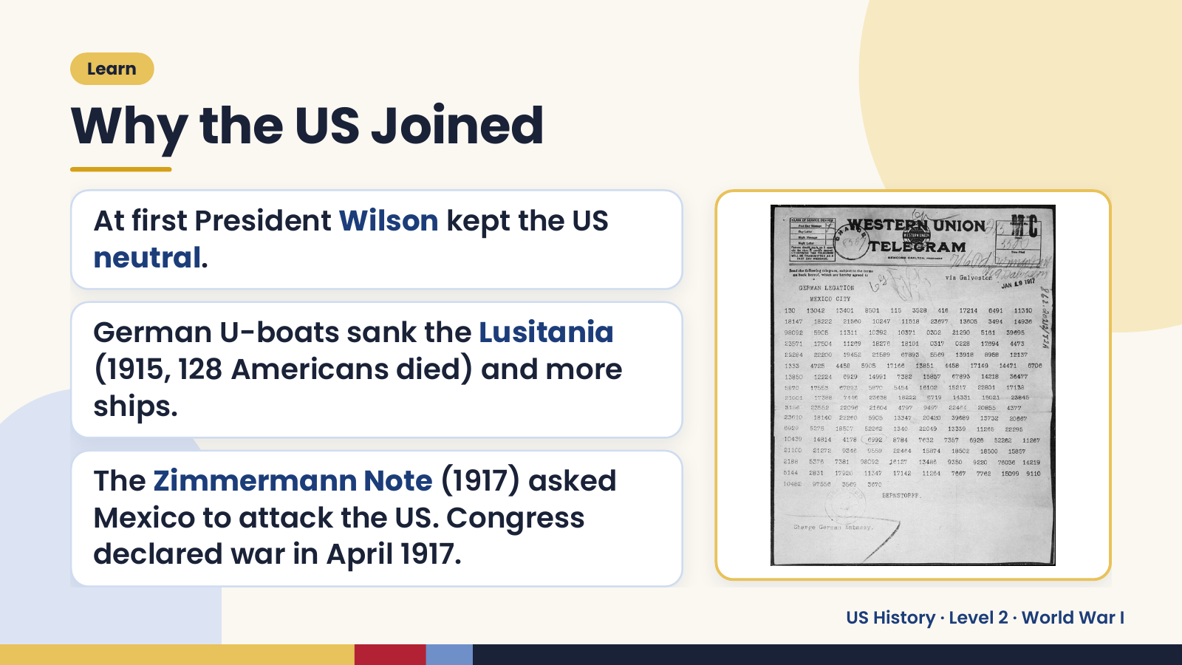
Notes:
Learn
Why the US Joined
At first President Wilson kept the US
neutral.
German U-boats sank the Lusitania
(1915, 128 Americans died) and more
ships.
The Zimmermann Note (1917) asked
Mexico to attack the US. Congress
declared war in April 1917.
US History · Level 2 · World War I

Slide 11
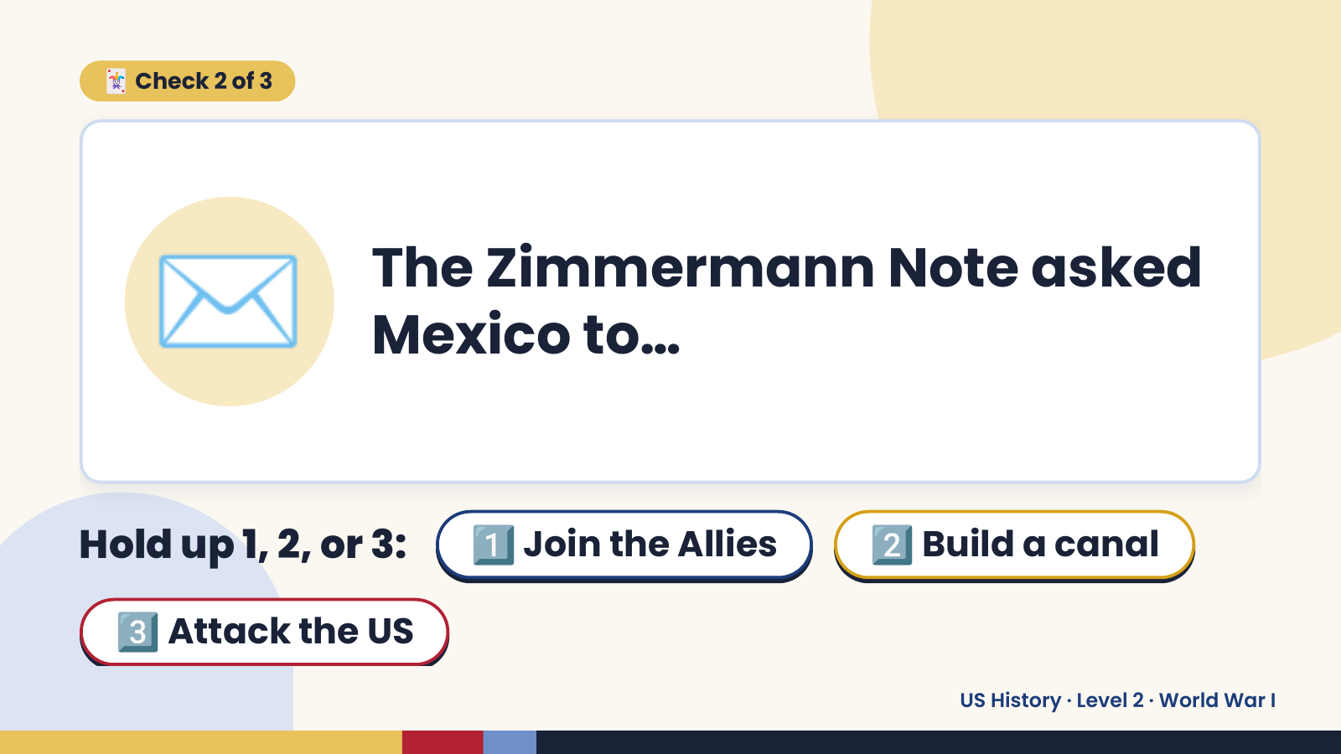
Notes:
🃏 Check 2 of 3
✉️ The Zimmermann Note asked
Mexico to…
Hold up 1, 2, or 3: 1️⃣ Join the Allies 2️⃣ Build a canal
3️⃣ Attack the US
US History · Level 2 · World War I

Slide 12
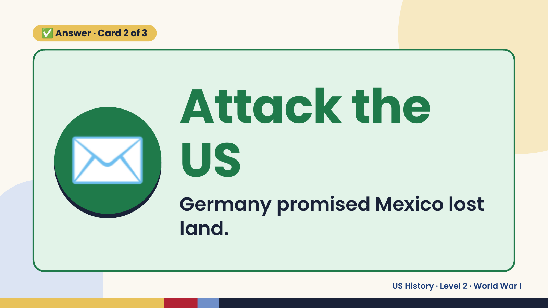
Notes:
✅ Answer · Card 2 of 3
✉️ Attack the
US
Germany promised Mexico lost
land.
US History · Level 2 · World War I

Slide 13
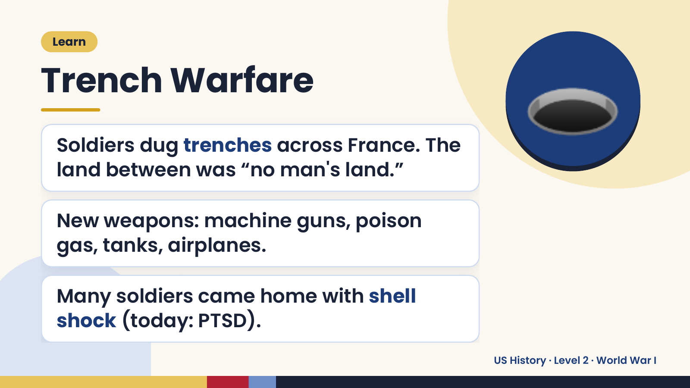
Notes:
Learn
Trench Warfare
Soldiers dug trenches across France. The
land between was “no man's land.”
🕳️
New weapons: machine guns, poison
gas, tanks, airplanes.
Many soldiers came home with shell
shock (today: PTSD).
US History · Level 2 · World War I

Slide 14
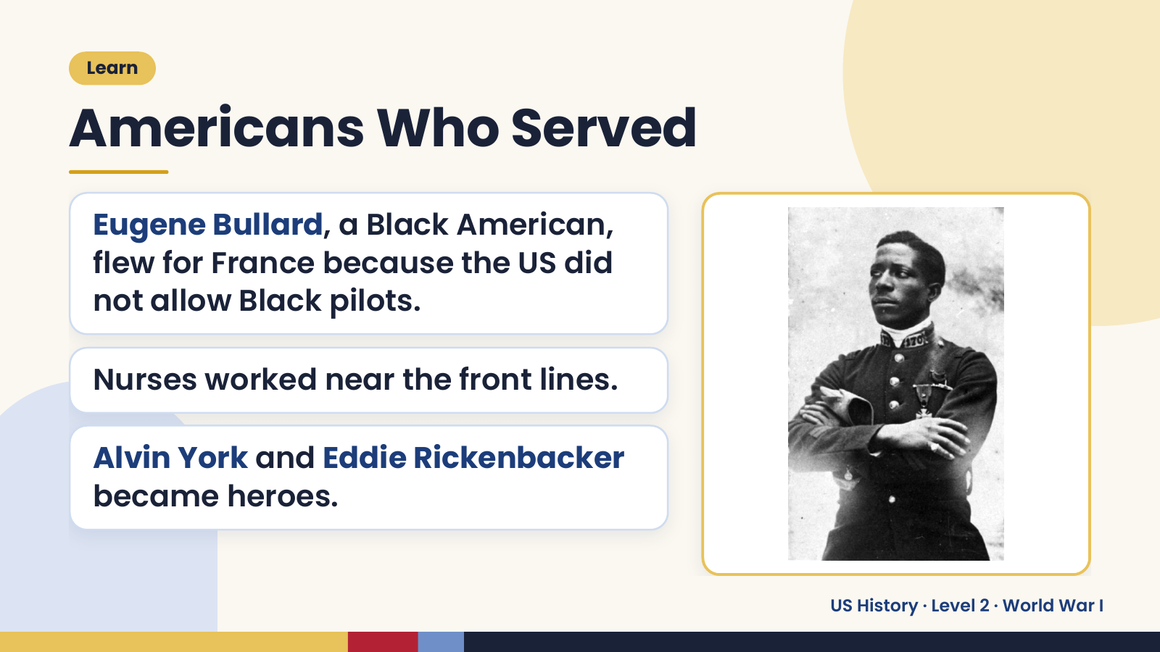
Notes:
Learn
Americans Who Served
Eugene Bullard, a Black American,
flew for France because the US did
not allow Black pilots.
Nurses worked near the front lines.
Alvin York and Eddie Rickenbacker
became heroes.
US History · Level 2 · World War I

Slide 15
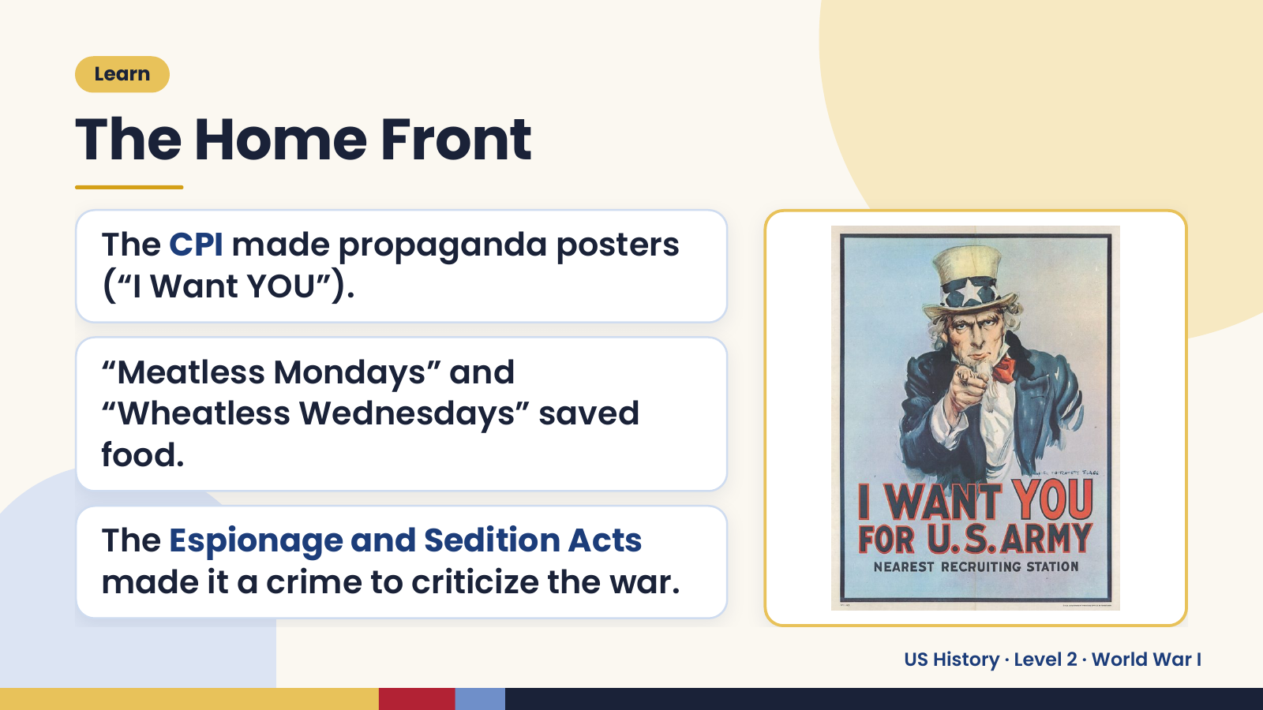
Notes:
Learn
The Home Front
The CPI made propaganda posters
(“I Want YOU”).
“Meatless Mondays” and
“Wheatless Wednesdays” saved
food.
The Espionage and Sedition Acts
made it a crime to criticize the war.
US History · Level 2 · World War I

Slide 16
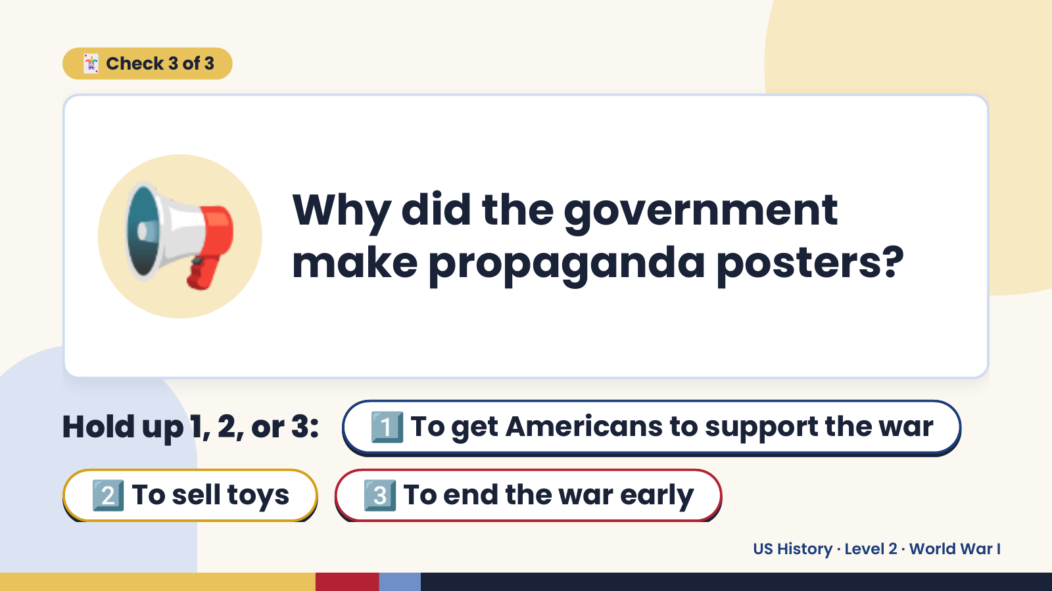
Notes:
🃏 Check 3 of 3
📢 Why did the government
make propaganda posters?
Hold up 1, 2, or 3: 1️⃣ To get Americans to support the war
2️⃣ To sell toys 3️⃣ To end the war early
US History · Level 2 · World War I

Slide 17
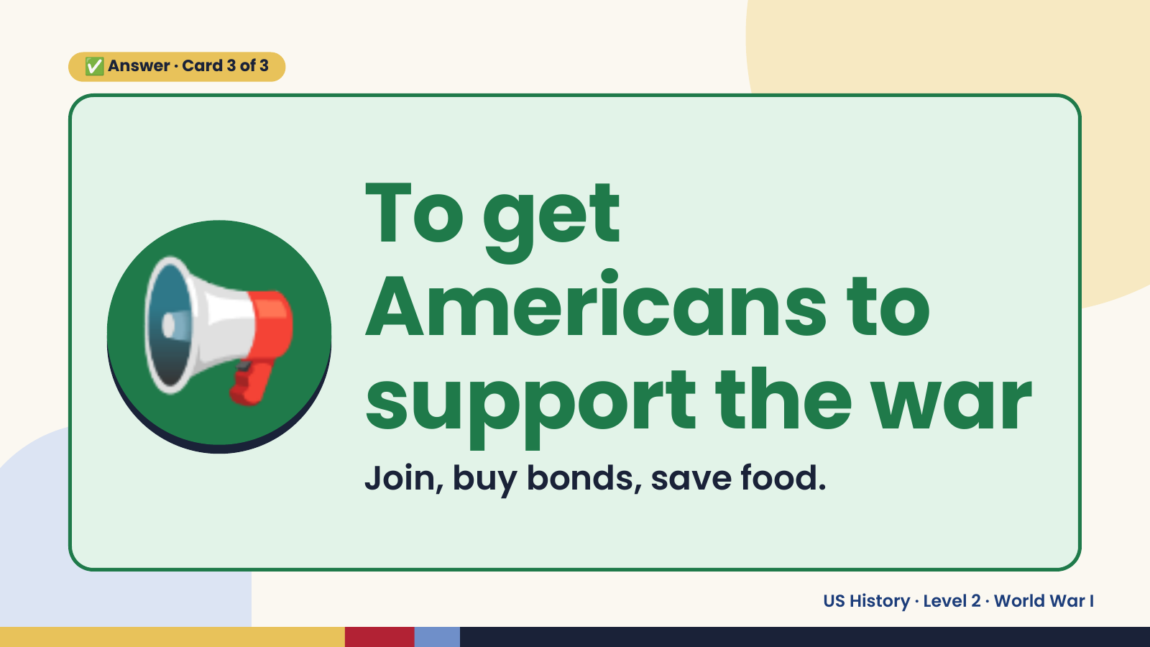
Notes:
✅ Answer · Card 3 of 3
📢 To get
Americans to
support the war
Join, buy bonds, save food.
US History · Level 2 · World War I

Slide 18
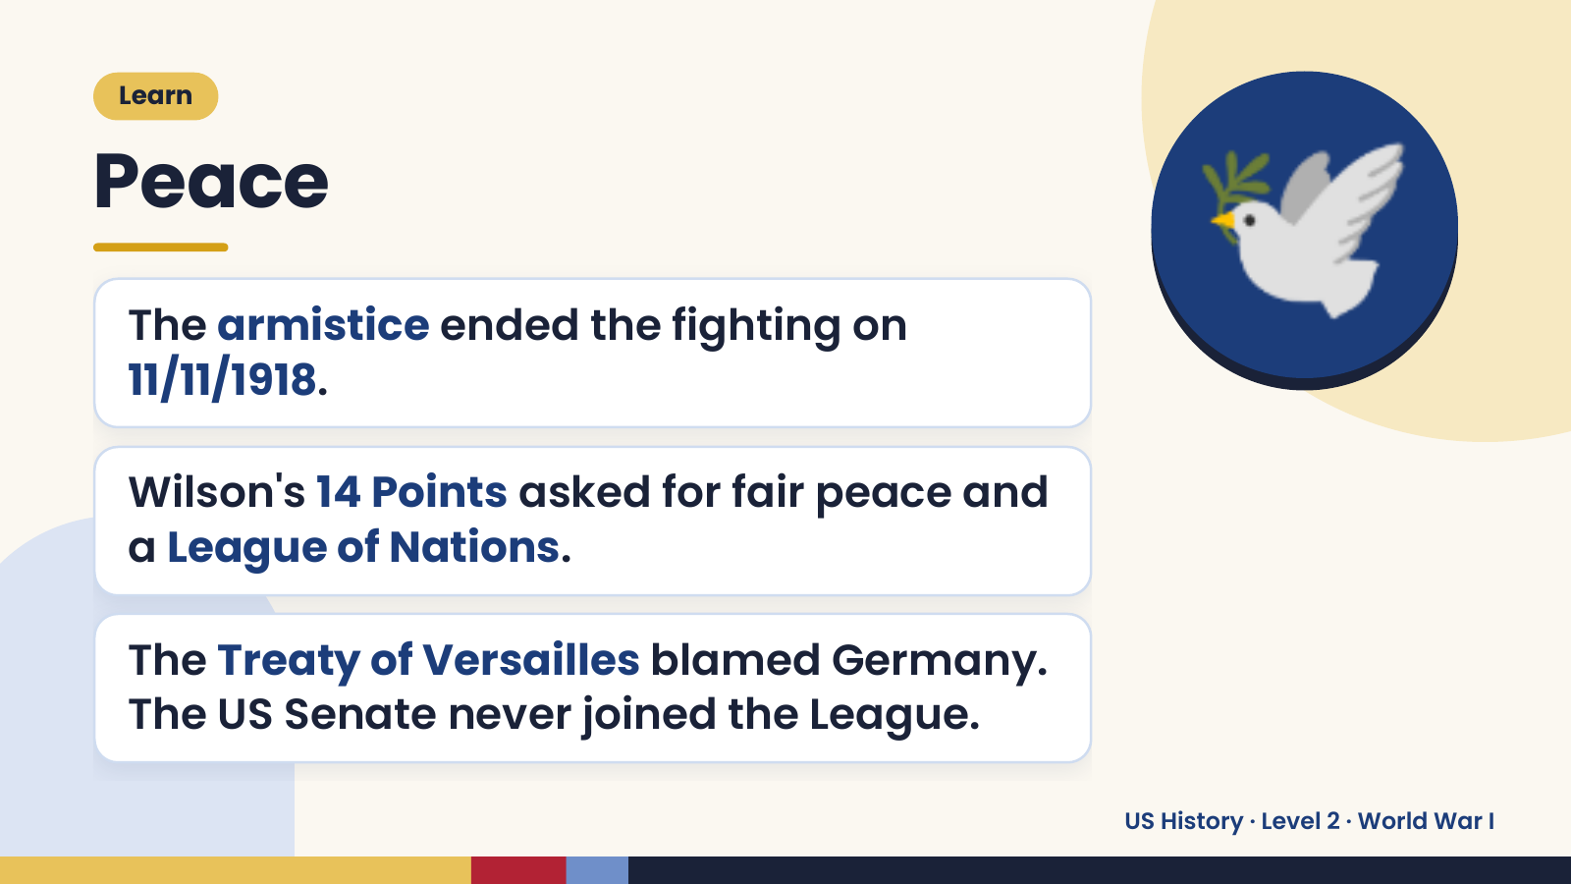
Notes:
Learn
Peace
The armistice ended the fighting on
11/11/1918.
Wilson's 14 Points asked for fair peace and
🕊️
a League of Nations.
The Treaty of Versailles blamed Germany.
The US Senate never joined the League.
US History · Level 2 · World War I

Slide 19
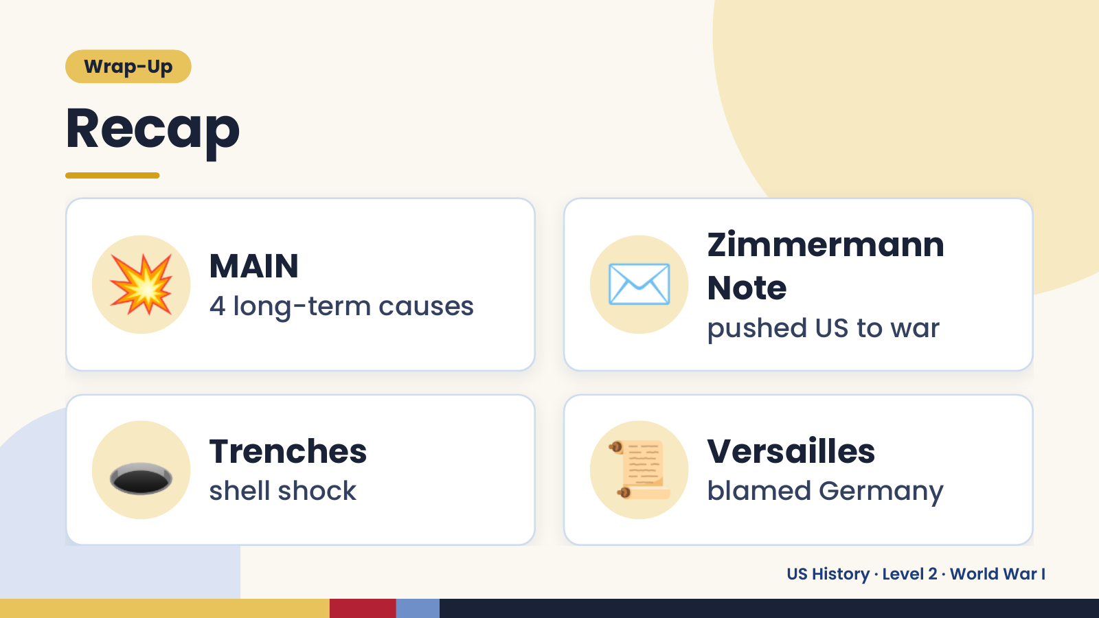
Notes:
Wrap-Up
Recap
💥 MAIN
4 long-term causes ✉️ Zimmermann
Note
pushed US to war
🕳️ Trenches
shell shock 📜 Versailles
blamed Germany
US History · Level 2 · World War I

Slide 20
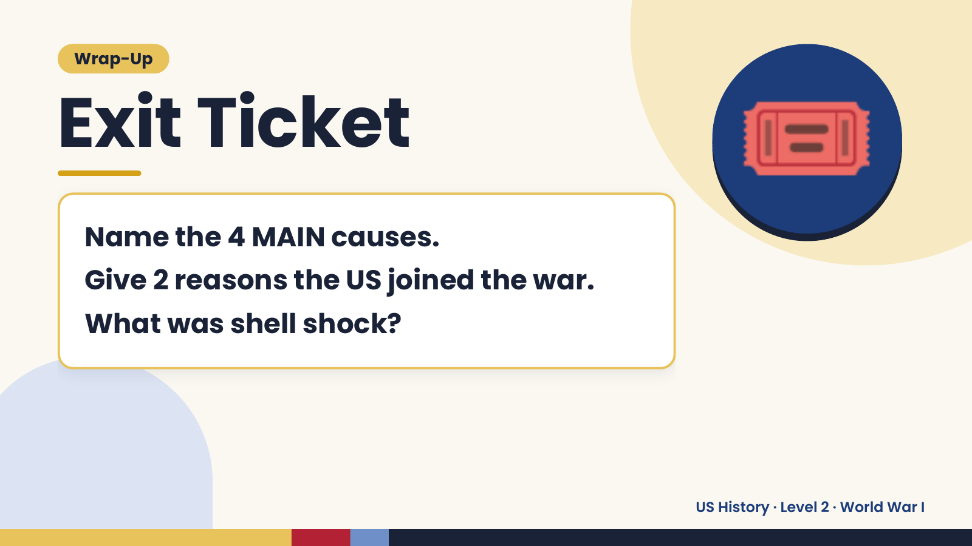
Notes:
Wrap-Up
Exit Ticket
Name the 4 MAIN causes.
Give 2 reasons the US joined the war.
🎟️
What was shell shock?
US History · Level 2 · World War I

