Slide 1
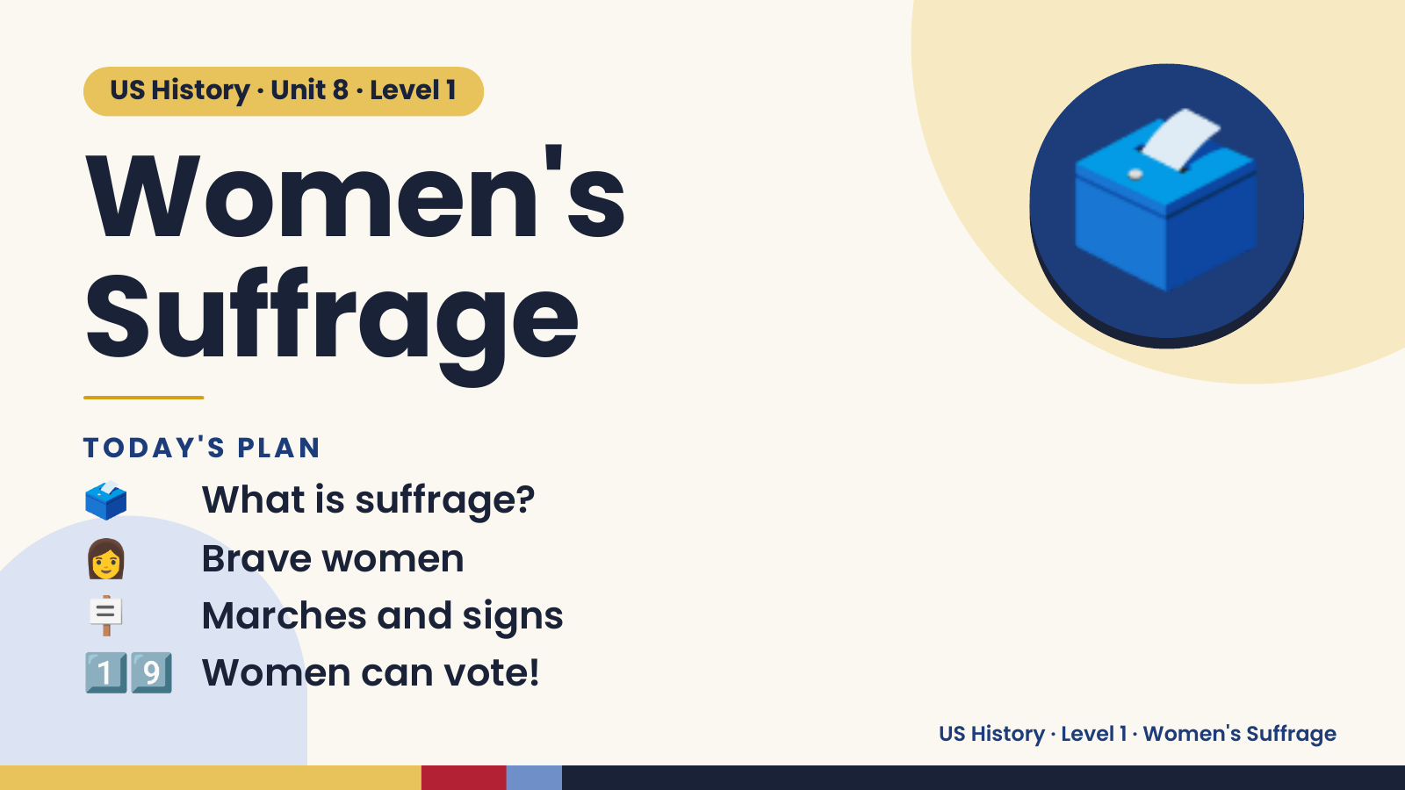
Notes:
US History · Unit 8 · Level 1
Women's
Suffrage
🗳️
🗳️ What is suffrage?
TODAY'S PLAN
👩 Brave women
🪧 Marches and signs
1️⃣9️⃣ Women can vote!
US History · Level 1 · Women's Suffrage

Slide 2
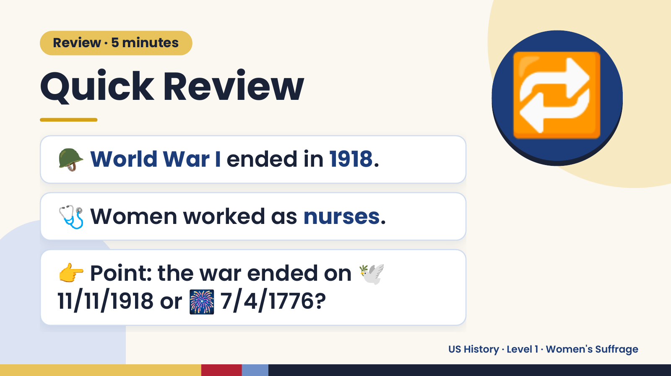
Notes:
Review · 5 minutes
Quick Review
🪖 World War I ended in 1918.
🔁
🩺 Women worked as nurses.
👉 Point: the war ended on 🕊️
11/11/1918 or 🎆 7/4/1776?
US History · Level 1 · Women's Suffrage

Slide 3
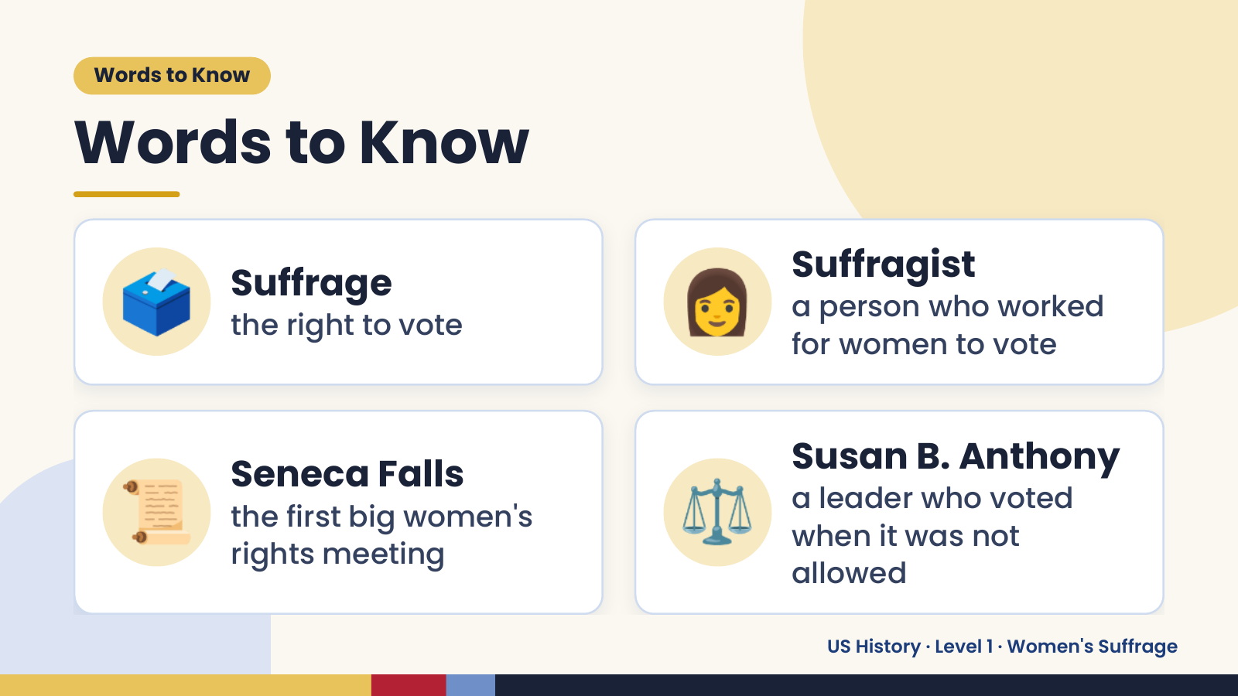
Notes:
Words to Know
Words to Know
🗳️ Suffrage
the right to vote 👩 Suffragist
a person who worked
for women to vote
📜 Seneca Falls
the first big women's
rights meeting
⚖️ Susan B. Anthony
a leader who voted
when it was not
allowed
US History · Level 1 · Women's Suffrage

Slide 4
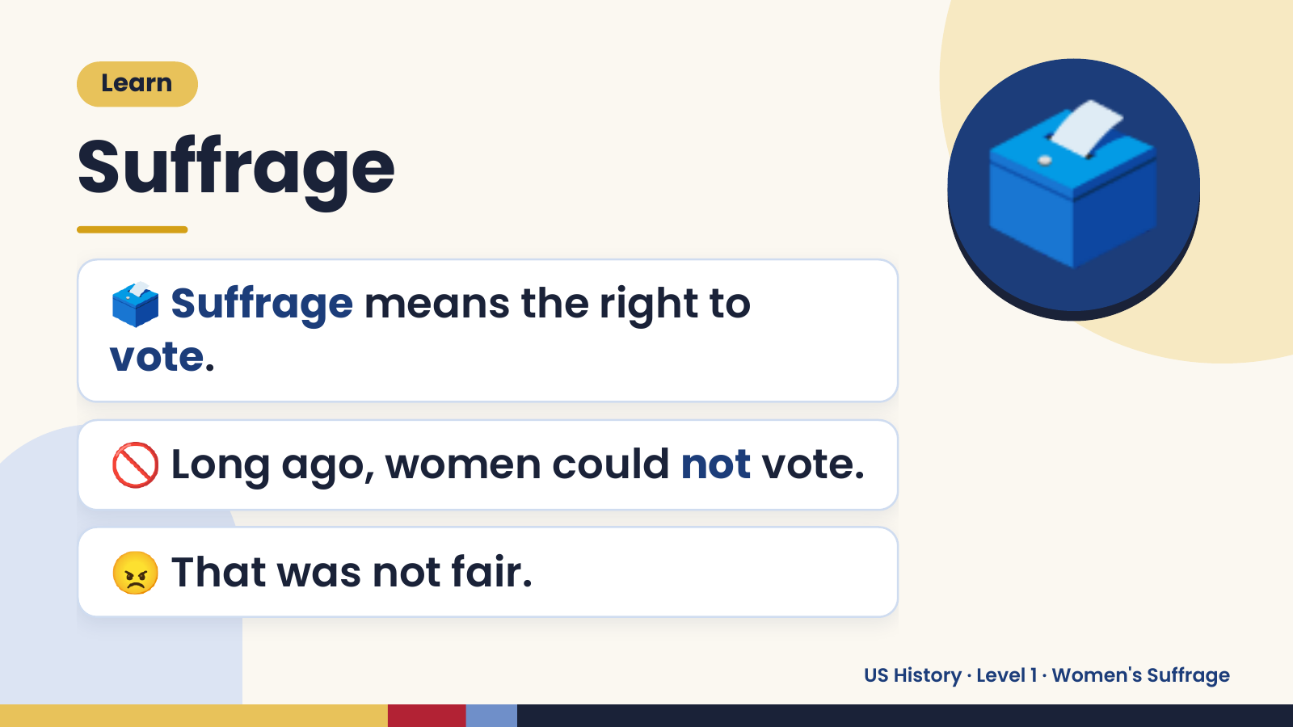
Notes:
Learn
Suffrage
🗳️ Suffrage means the right to
vote.
🗳️
🚫 Long ago, women could not vote.
😠 That was not fair.
US History · Level 1 · Women's Suffrage

Slide 5
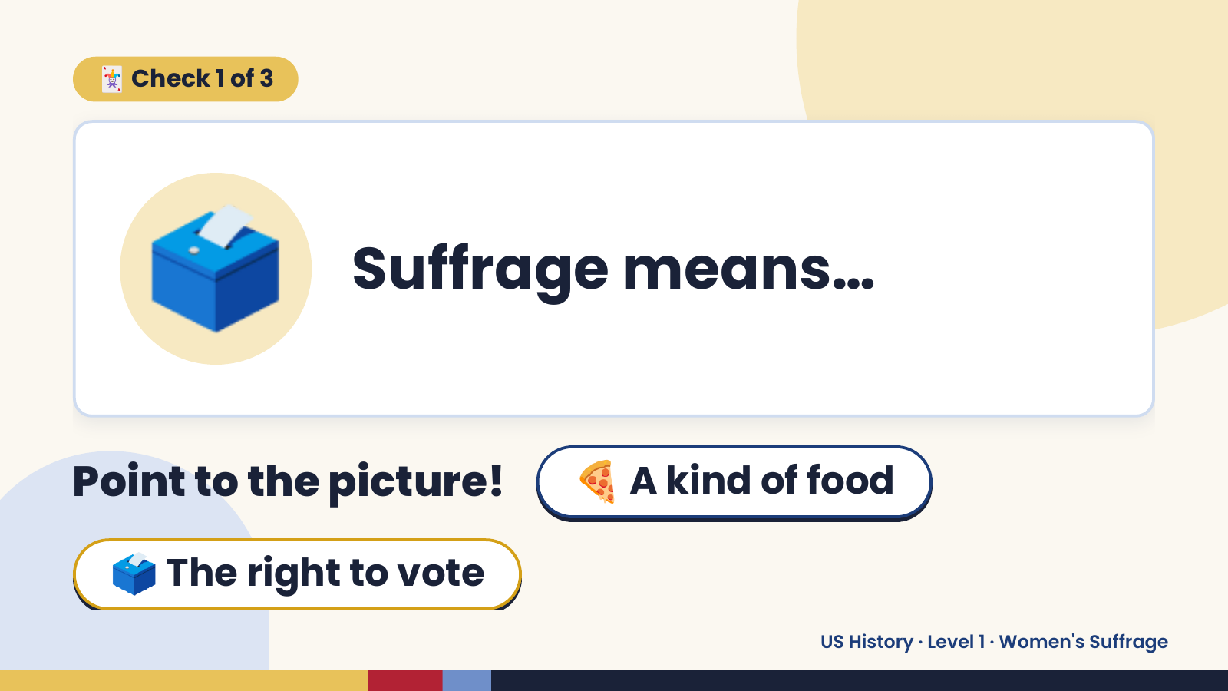
Notes:
🃏 Check 1 of 3
🗳️ Suffrage means…
Point to the picture! 🍕 A kind of food
🗳️ The right to vote
US History · Level 1 · Women's Suffrage

Slide 6
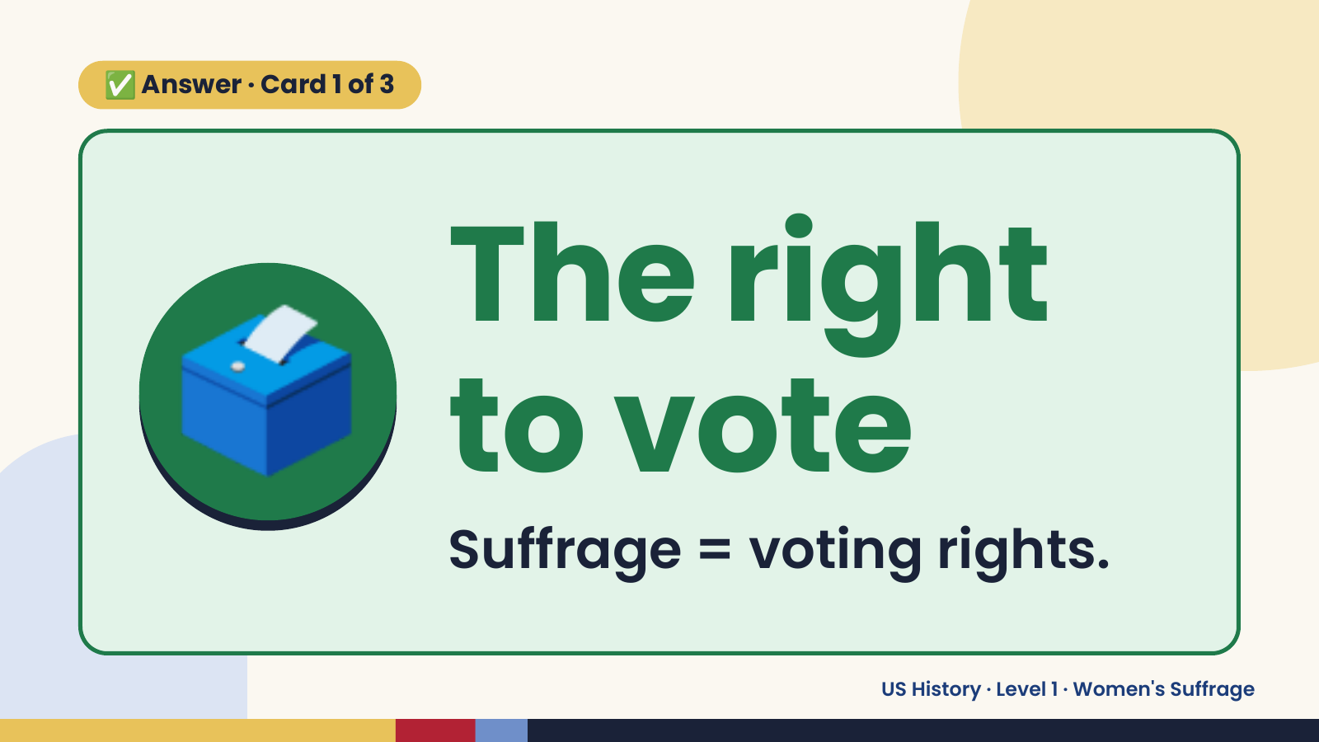
Notes:
✅ Answer · Card 1 of 3
🗳️ The right
to vote
Suffrage = voting rights.
US History · Level 1 · Women's Suffrage

Slide 7
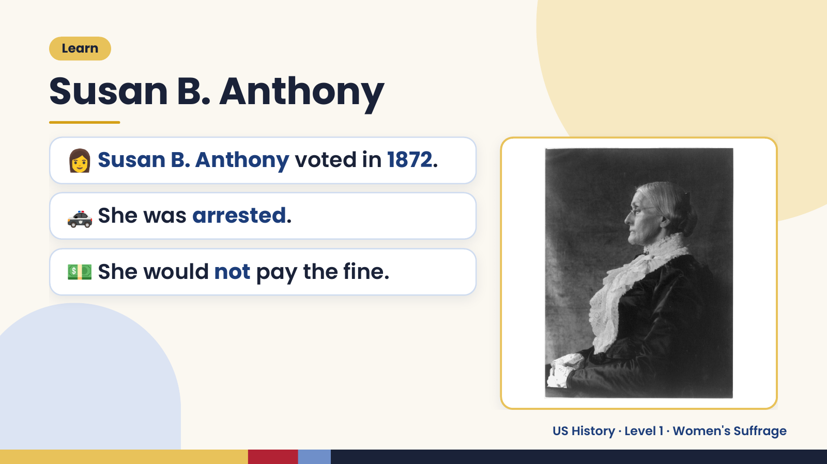
Notes:
Learn
Susan B. Anthony
👩 Susan B. Anthony voted in 1872.
🚓 She was arrested.
💵 She would not pay the fine.
US History · Level 1 · Women's Suffrage

Slide 8
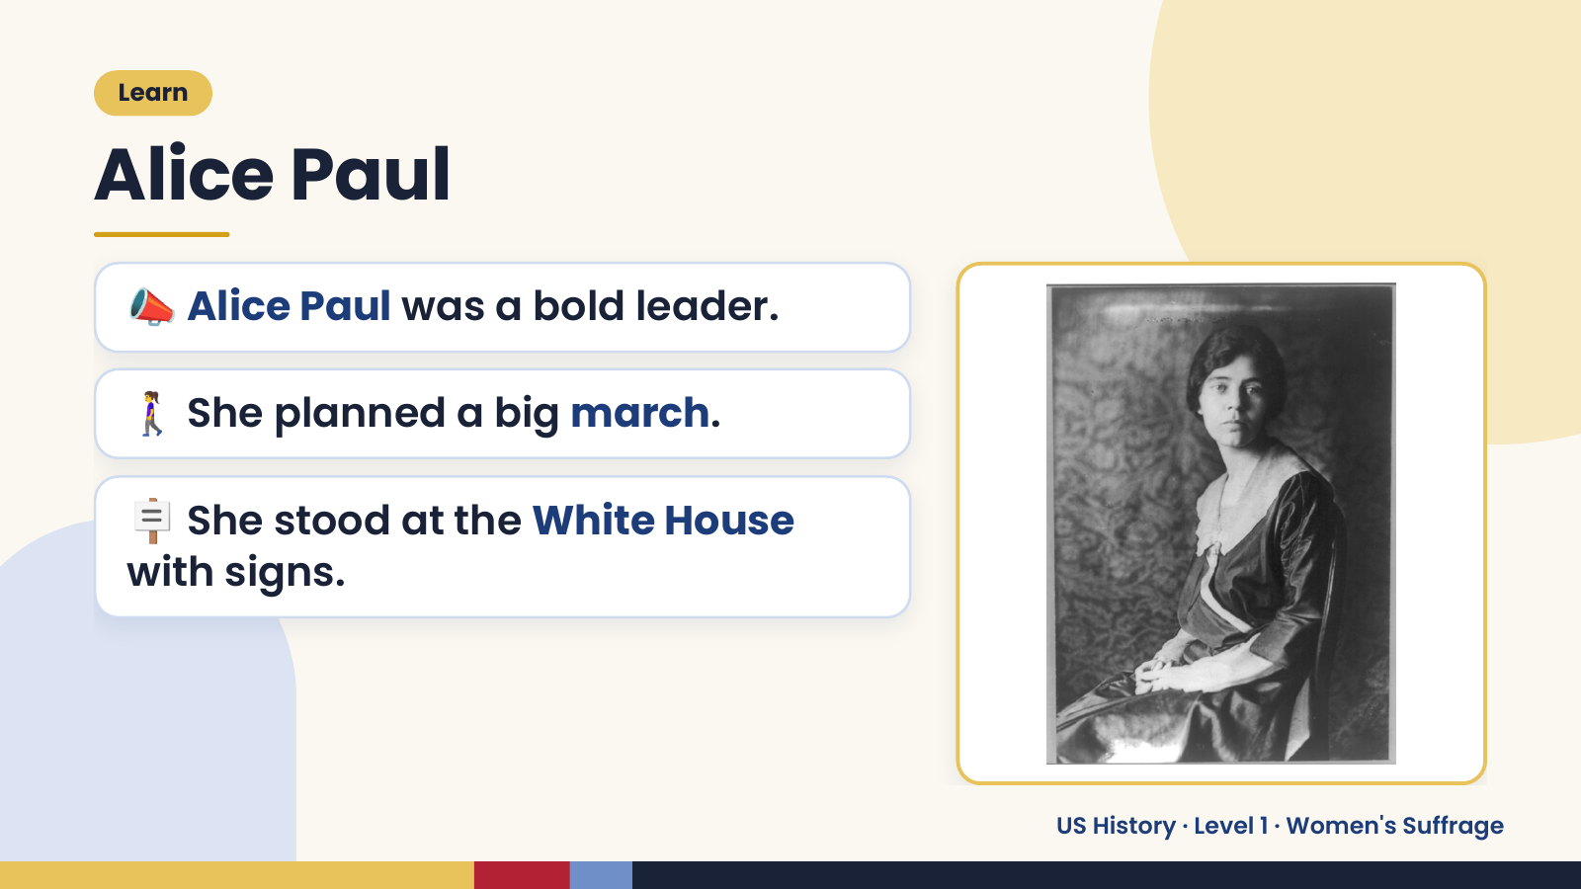
Notes:
Learn
Alice Paul
📣 Alice Paul was a bold leader.
🚶‍♀️ She planned a big march.
🪧 She stood at the White House
with signs.
US History · Level 1 · Women's Suffrage

Slide 9
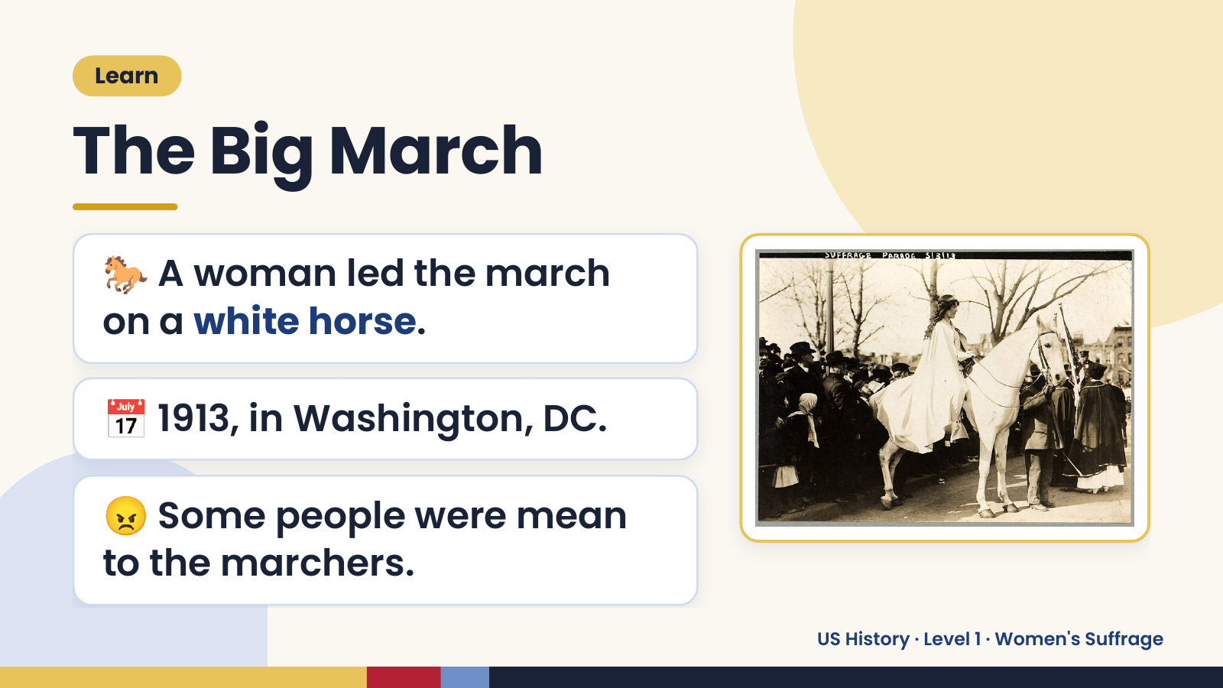
Notes:
Learn
The Big March
🐎 A woman led the march
on a white horse.
📅 1913, in Washington, DC.
😠 Some people were mean
to the marchers.
US History · Level 1 · Women's Suffrage

Slide 10
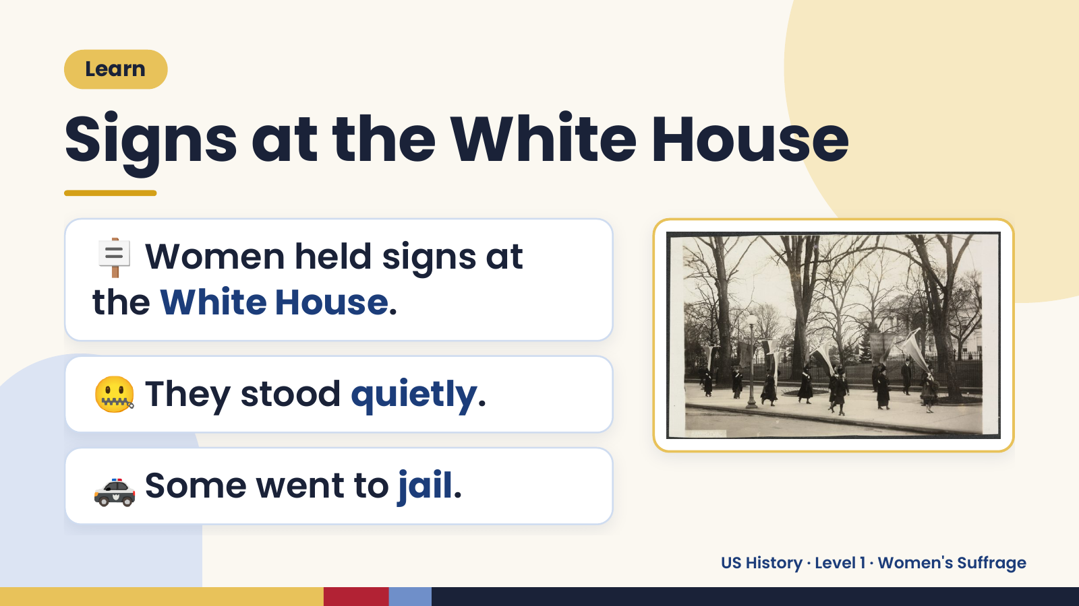
Notes:
Learn
Signs at the White House
🪧 Women held signs at
the White House.
🤐 They stood quietly.
🚓 Some went to jail.
US History · Level 1 · Women's Suffrage

Slide 11
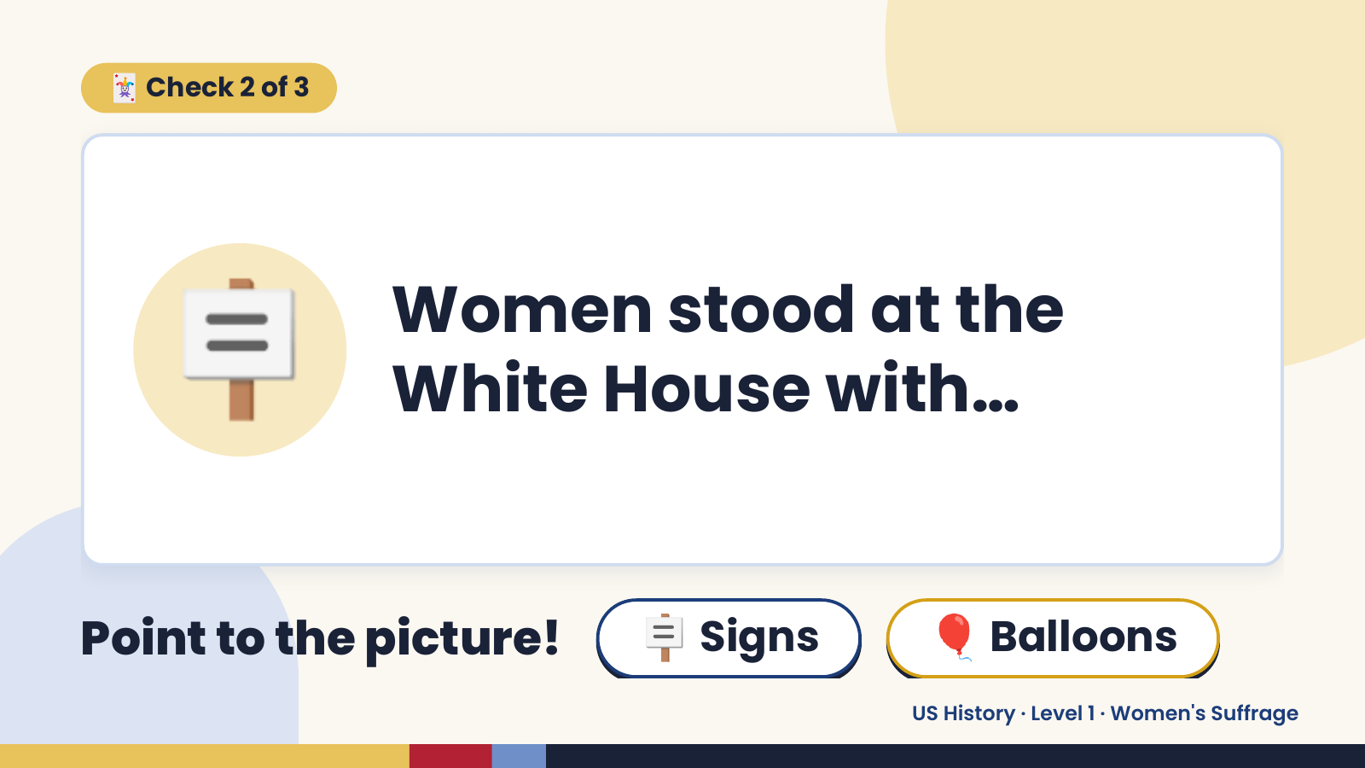
Notes:
🃏 Check 2 of 3
🪧 Women stood at the
White House with…
Point to the picture! 🪧 Signs 🎈 Balloons
US History · Level 1 · Women's Suffrage

Slide 12
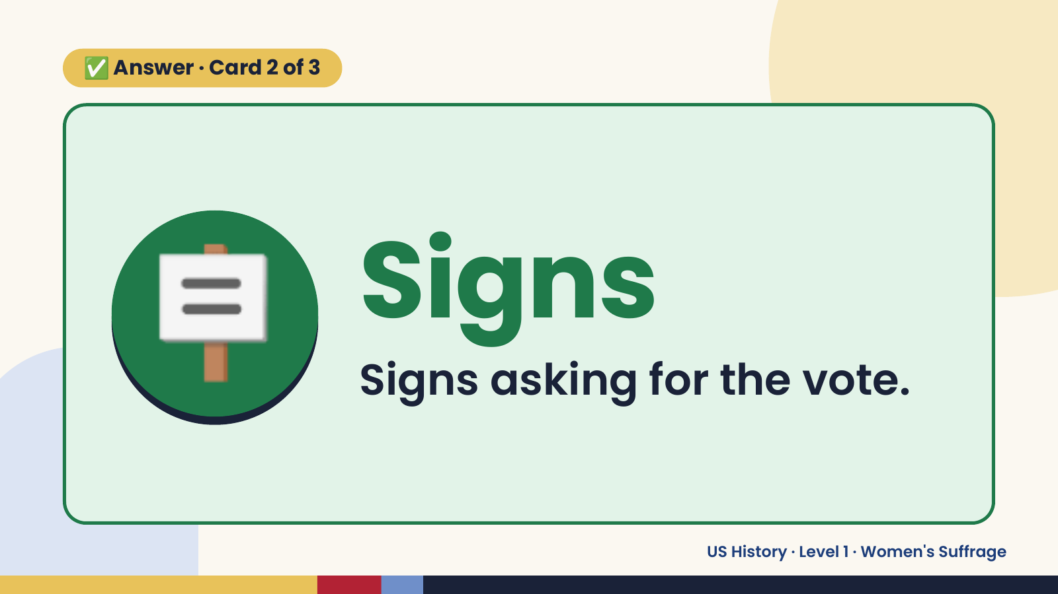
Notes:
✅ Answer · Card 2 of 3
🪧 Signs
Signs asking for the vote.
US History · Level 1 · Women's Suffrage

Slide 13
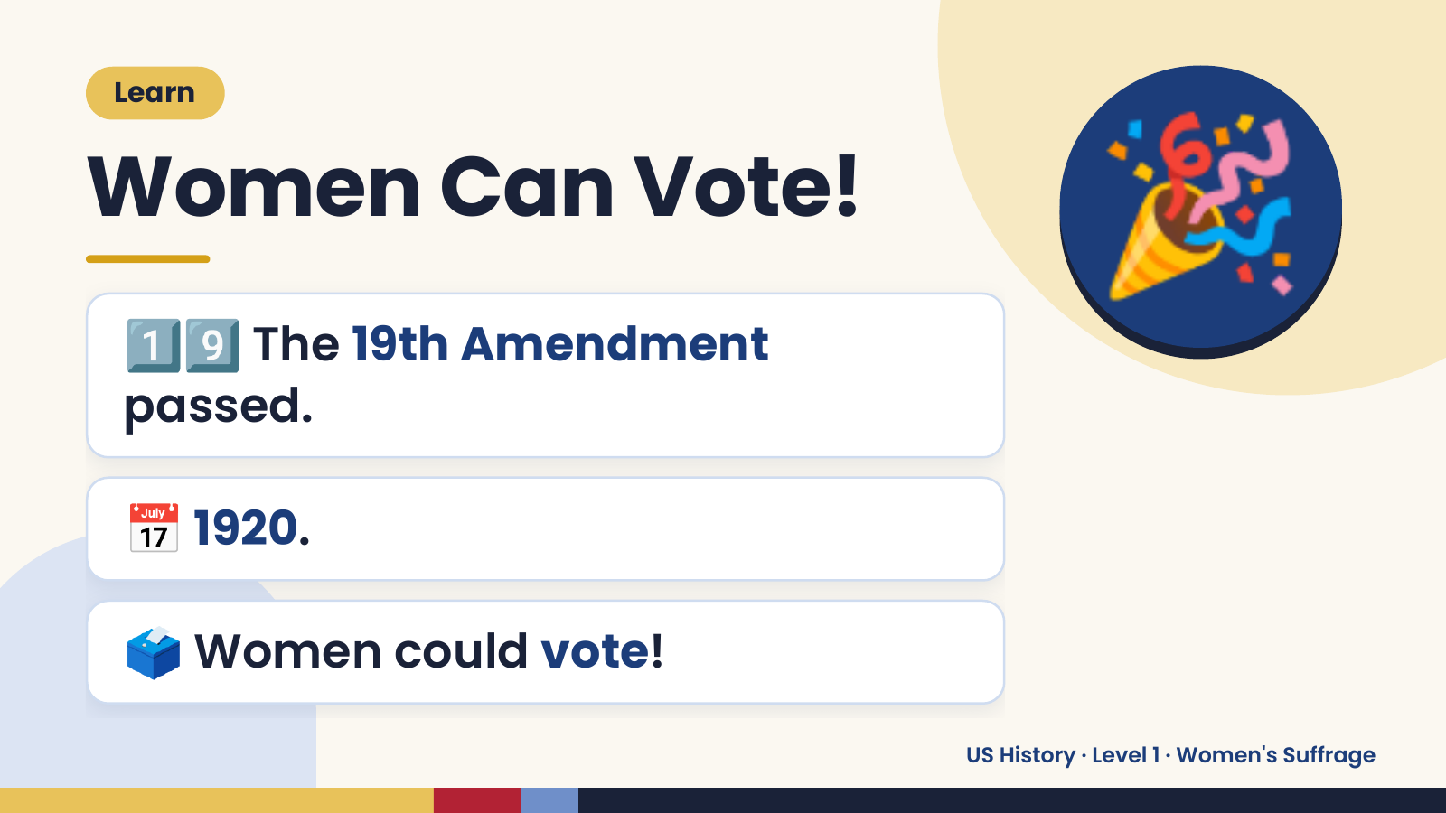
Notes:
Learn
Women Can Vote!
1️⃣9️⃣ The 19th Amendment
passed.
🎉
📅 1920.
🗳️ Women could vote!
US History · Level 1 · Women's Suffrage

Slide 14
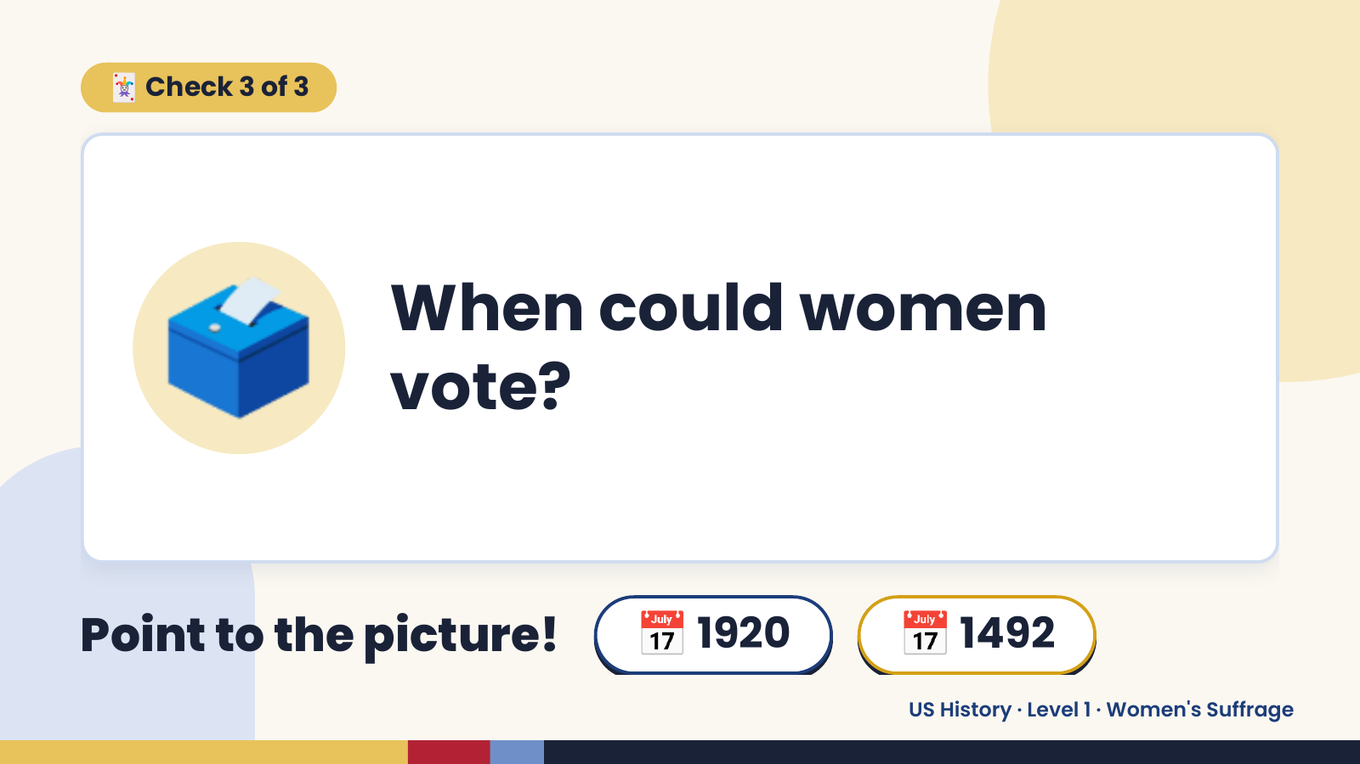
Notes:
🃏 Check 3 of 3
🗳️ When could women
vote?
Point to the picture! 📅 1920 📅 1492
US History · Level 1 · Women's Suffrage

Slide 15
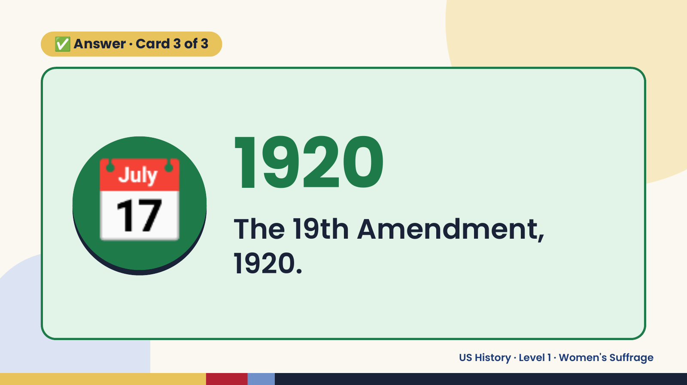
Notes:
✅ Answer · Card 3 of 3
📅 1920
The 19th Amendment,
1920.
US History · Level 1 · Women's Suffrage

Slide 16
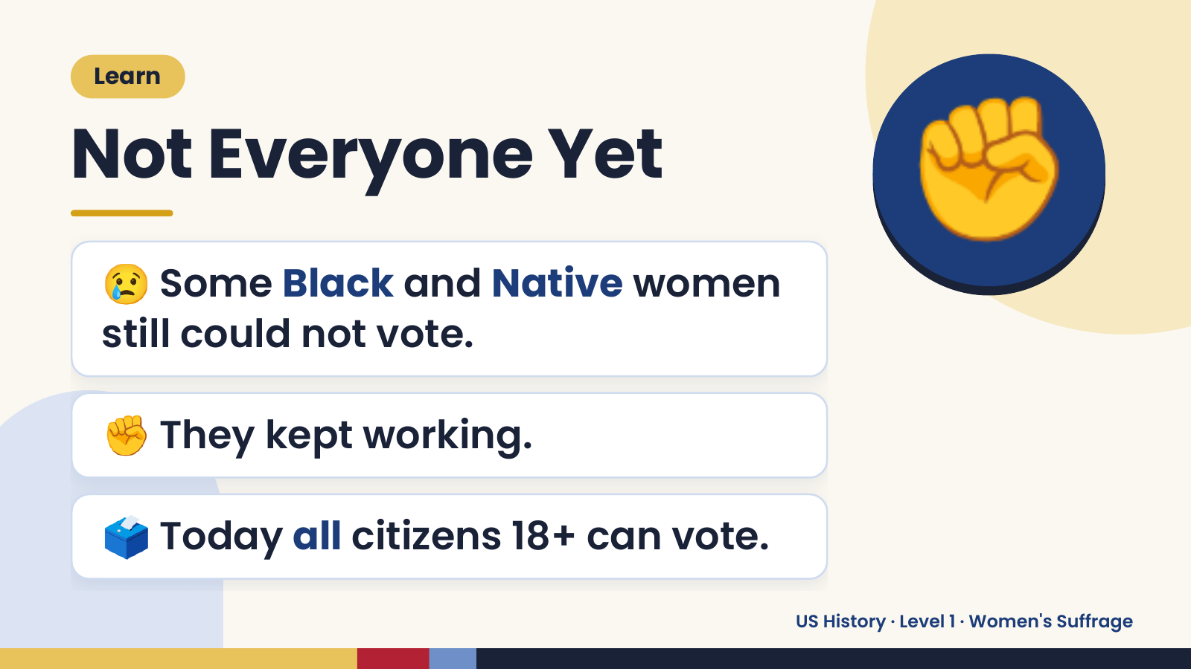
Notes:
Learn
Not Everyone Yet
😢 Some Black and Native women
still could not vote.
✊
✊ They kept working.
🗳️ Today all citizens 18+ can vote.
US History · Level 1 · Women's Suffrage

Slide 17
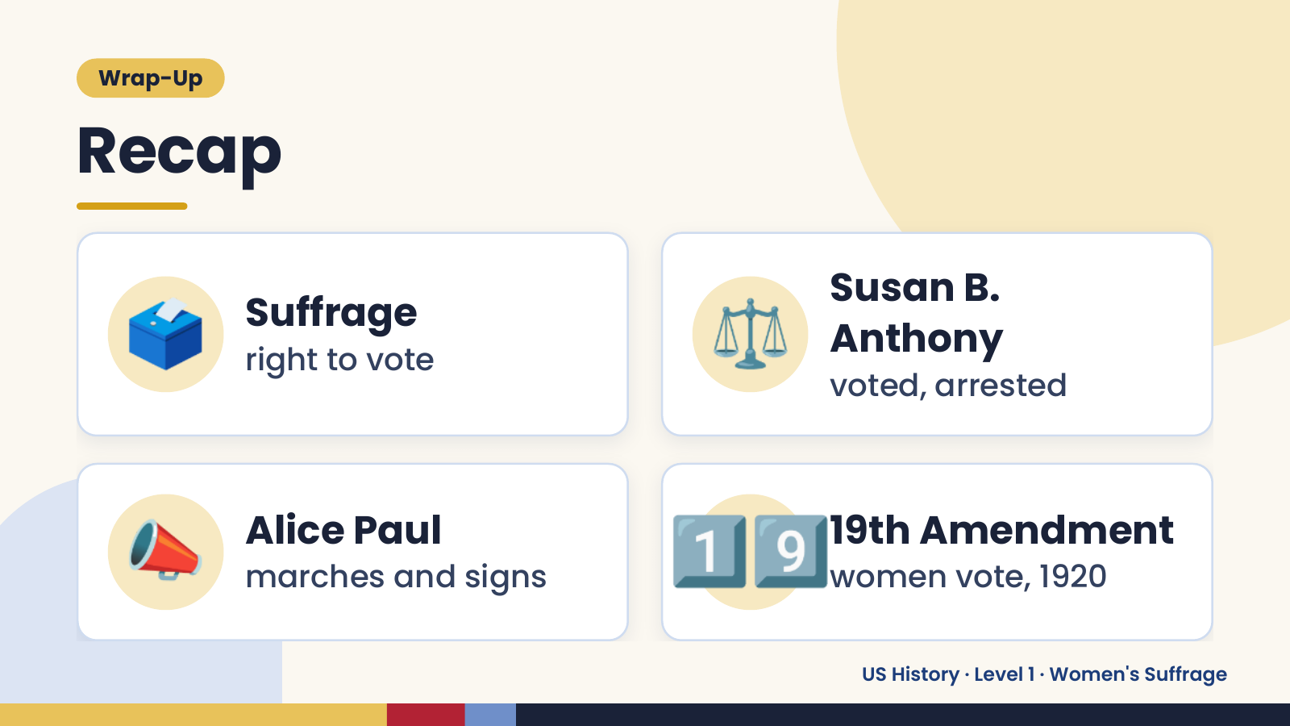
Notes:
Wrap-Up
Recap
🗳️ Suffrage
right to vote ⚖️ Susan B.
Anthony
voted, arrested
📣 Alice Paul
marches and signs 1️⃣9️⃣
19th Amendment
women vote, 1920
US History · Level 1 · Women's Suffrage

Slide 18
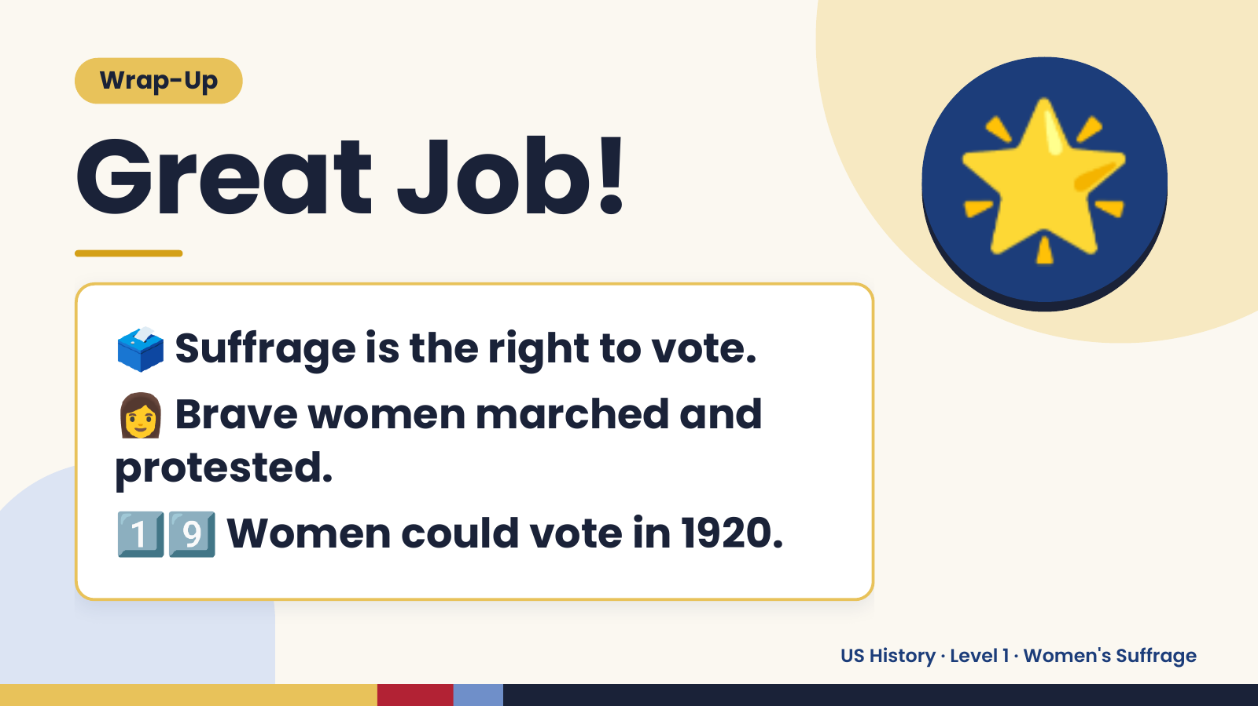
Notes:
Wrap-Up
Great Job!
🗳️ Suffrage is the right to vote.
🌟
👩 Brave women marched and
protested.
1️⃣9️⃣ Women could vote in 1920.
US History · Level 1 · Women's Suffrage

