Slide 1
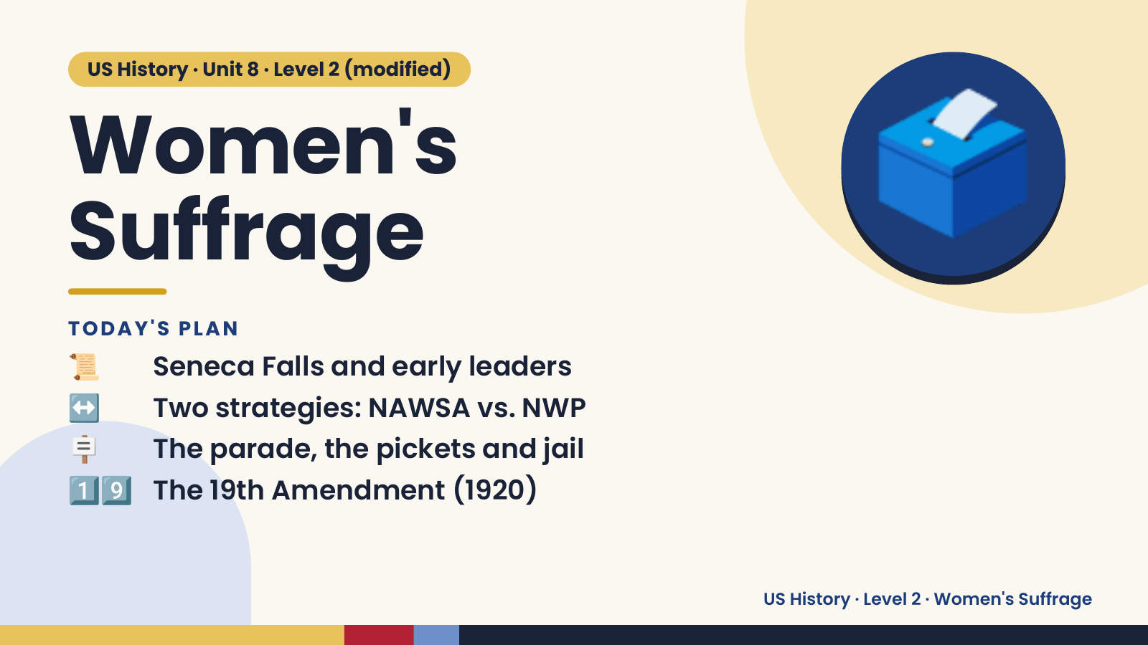
Notes:
US History · Unit 8 · Level 2 (modified)
Women's
Suffrage
📜 Seneca Falls and early leaders
TODAY'S PLAN
🗳️
↔️ Two strategies: NAWSA vs. NWP
🪧 The parade, the pickets and jail
1️⃣9️⃣ The 19th Amendment (1920)
US History · Level 2 · Women's Suffrage

Slide 2
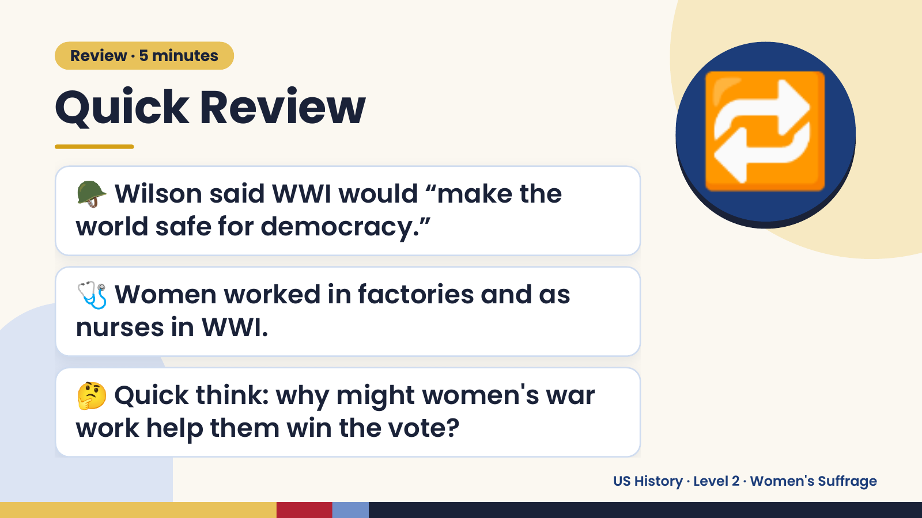
Notes:
Review · 5 minutes
Quick Review
🪖 Wilson said WWI would “make the
world safe for democracy.”
🔁
🩺 Women worked in factories and as
nurses in WWI.
🤔 Quick think: why might women's war
work help them win the vote?
US History · Level 2 · Women's Suffrage

Slide 3
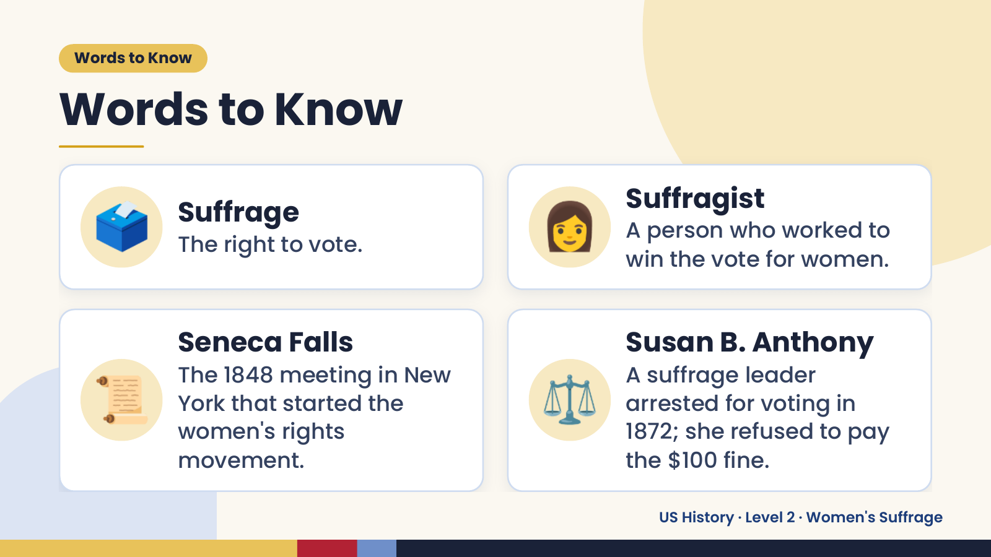
Notes:
Words to Know
Words to Know
🗳️ Suffrage
The right to vote. 👩 Suffragist
A person who worked to
win the vote for women.
📜 ⚖️
Seneca Falls Susan B. Anthony
The 1848 meeting in New A suffrage leader
York that started the arrested for voting in
women's rights 1872; she refused to pay
movement. the $100 fine.
US History · Level 2 · Women's Suffrage

Slide 4
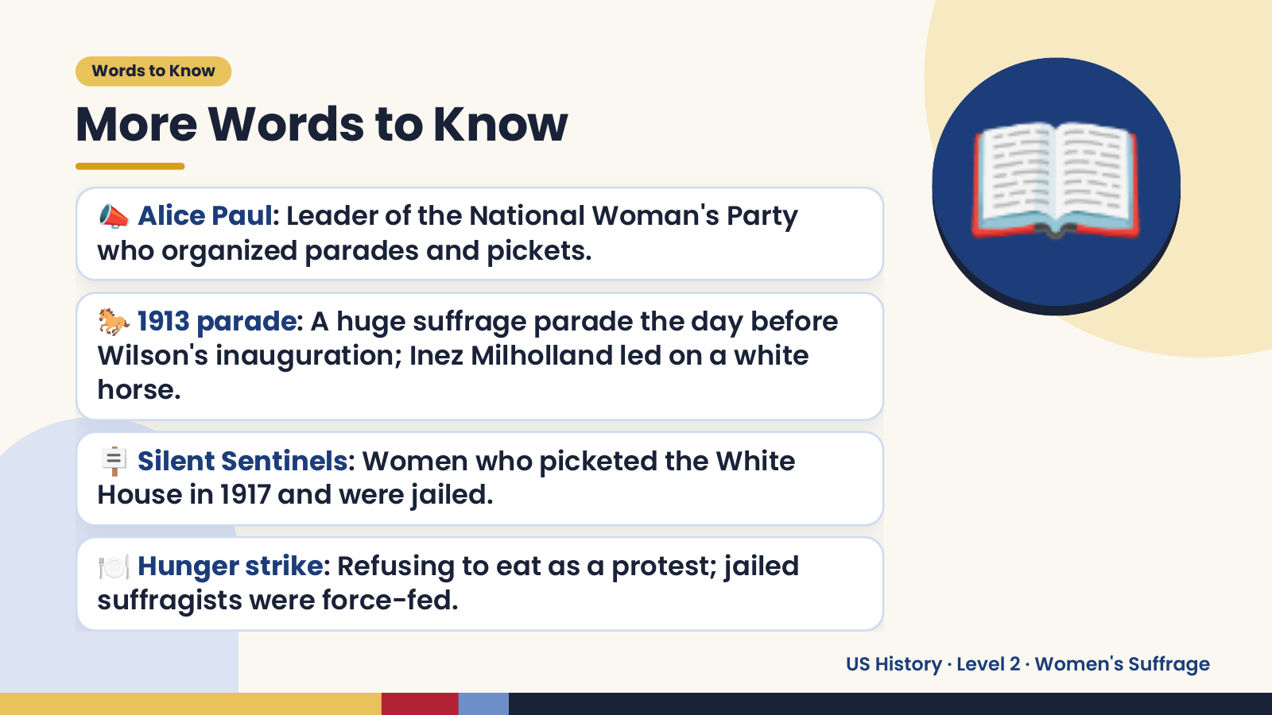
Notes:
Words to Know
More Words to Know
📣 Alice Paul: Leader of the National Woman's Party
who organized parades and pickets.
🐎 1913 parade: A huge suffrage parade the day before
Wilson's inauguration; Inez Milholland led on a white
horse.
📖
🪧 Silent Sentinels: Women who picketed the White
House in 1917 and were jailed.
🍽️ Hunger strike: Refusing to eat as a protest; jailed
suffragists were force-fed.
US History · Level 2 · Women's Suffrage

Slide 5
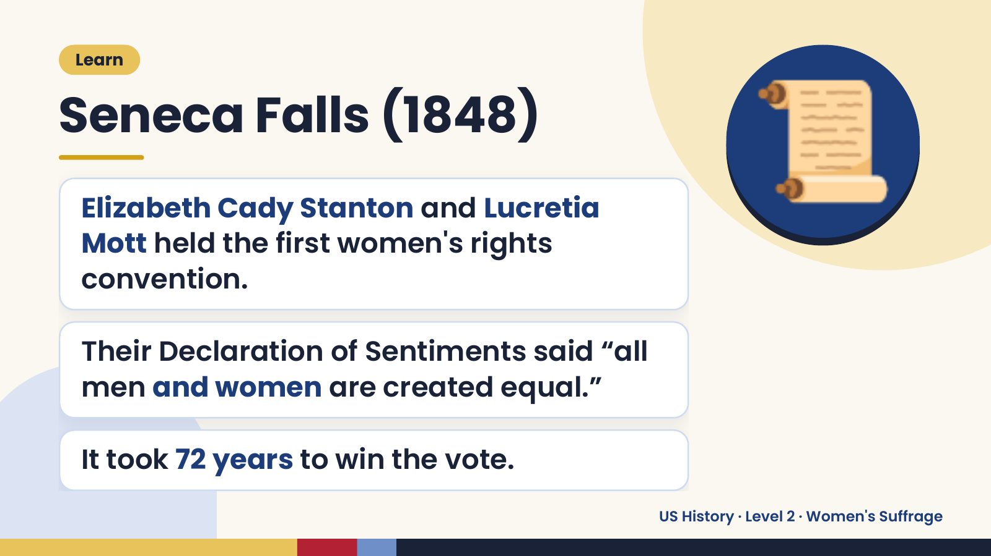
Notes:
Learn
Seneca Falls (1848)
Elizabeth Cady Stanton and Lucretia
Mott held the first women's rights
convention.
📜
Their Declaration of Sentiments said “all
men and women are created equal.”
It took 72 years to win the vote.
US History · Level 2 · Women's Suffrage

Slide 6
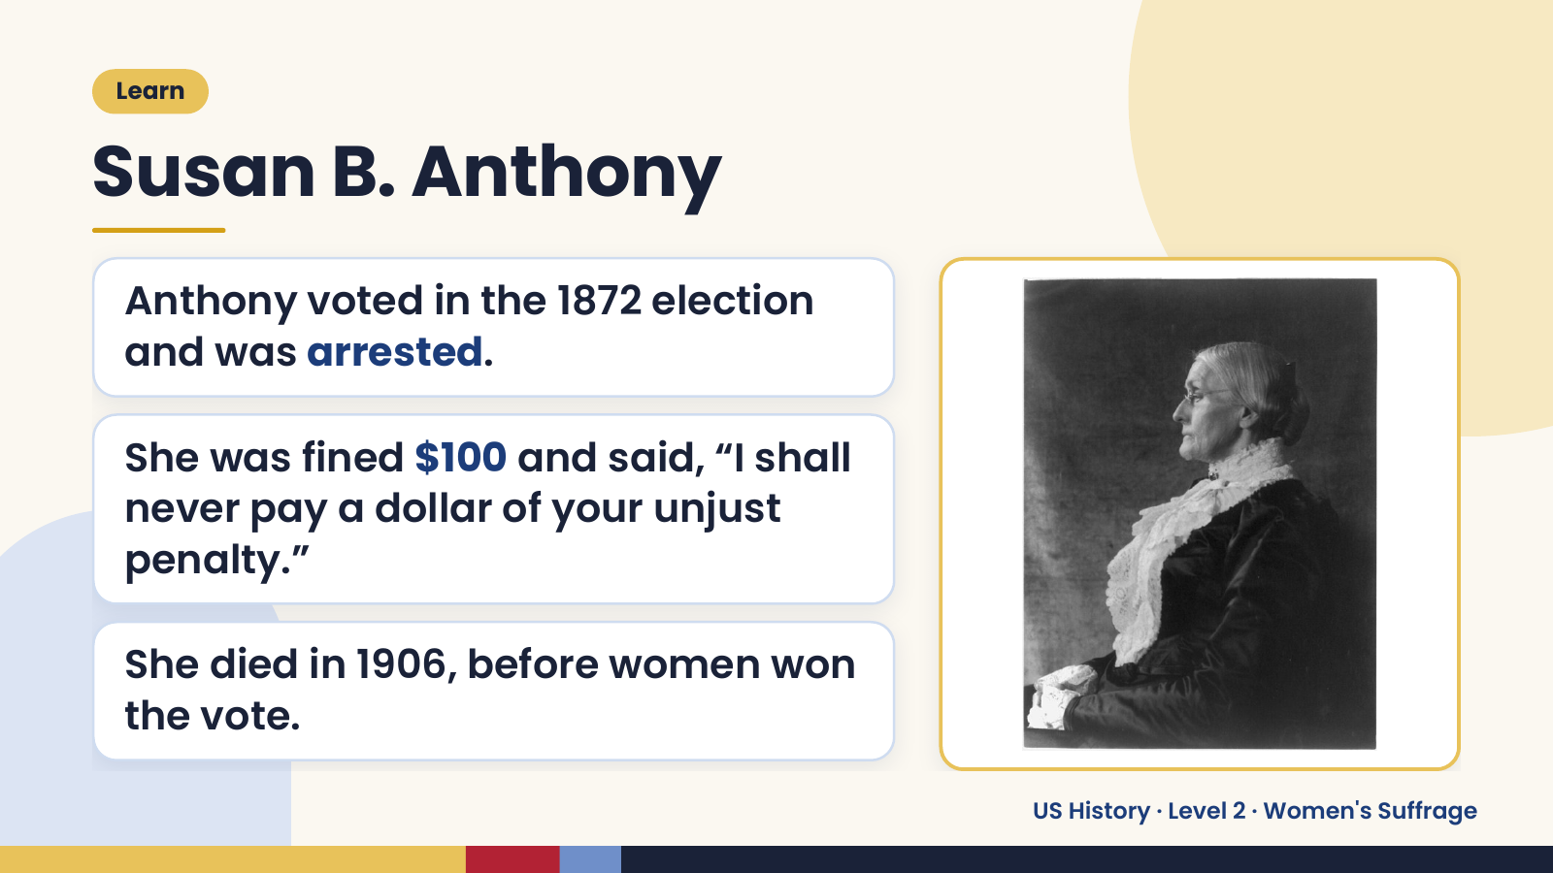
Notes:
Learn
Susan B. Anthony
Anthony voted in the 1872 election
and was arrested.
She was fined $100 and said, “I shall
never pay a dollar of your unjust
penalty.”
She died in 1906, before women won
the vote.
US History · Level 2 · Women's Suffrage

Slide 7
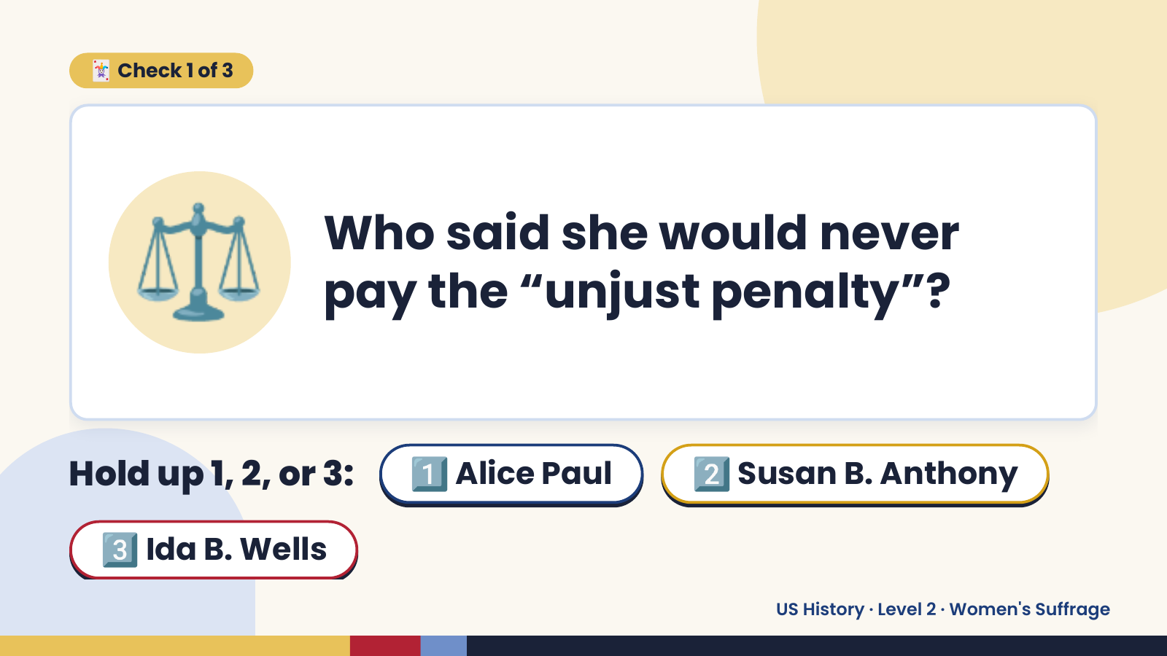
Notes:
🃏 Check 1 of 3
⚖️ Who said she would never
pay the “unjust penalty”?
Hold up 1, 2, or 3: 1️⃣ Alice Paul 2️⃣ Susan B. Anthony
3️⃣ Ida B. Wells
US History · Level 2 · Women's Suffrage

Slide 8
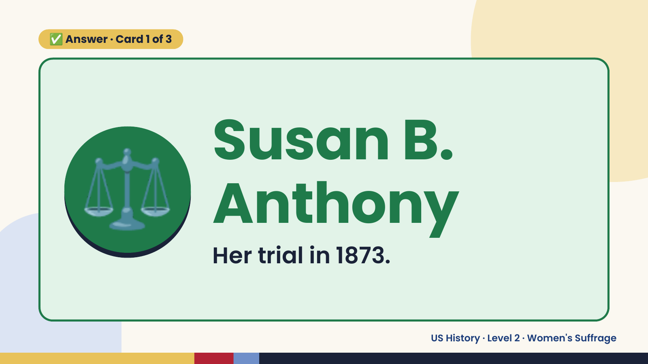
Notes:
✅ Answer · Card 1 of 3
⚖️ Susan B.
Anthony
Her trial in 1873.
US History · Level 2 · Women's Suffrage

Slide 9
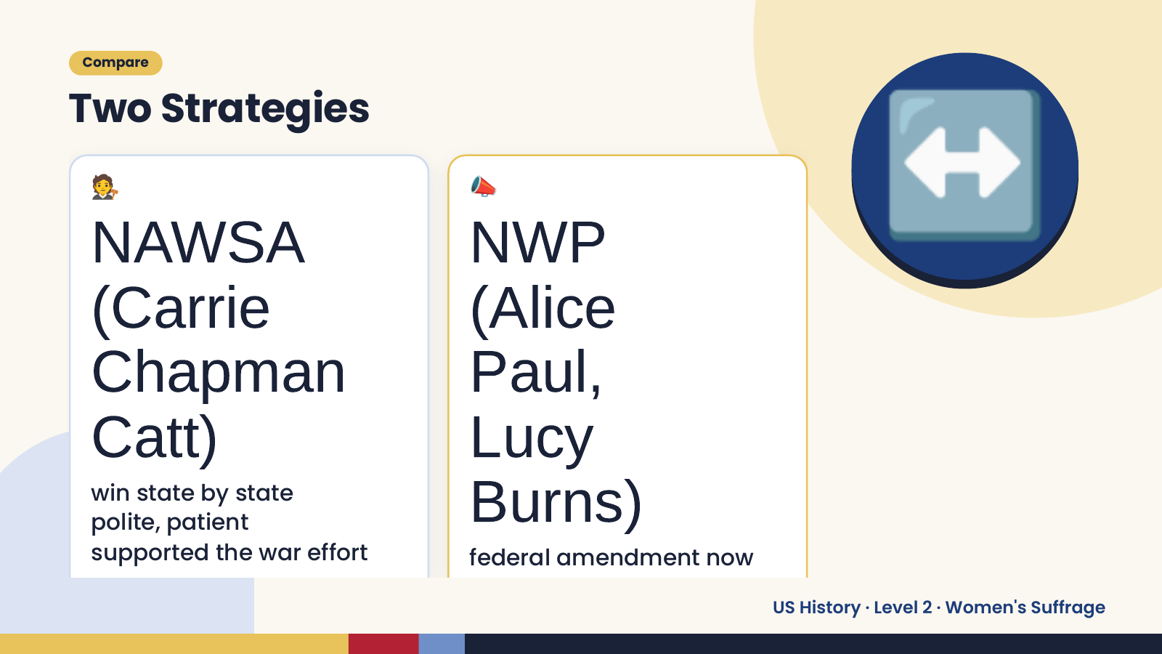
Notes:
Compare
Two Strategies
🧑‍⚖️
NAWSA
(Carrie
📣
NWP
(Alice
↔️
Chapman Paul,
Catt) Lucy
win state by state
polite, patient
supported the war effort
Burns)
federal amendment now
US History · Level 2 · Women's Suffrage

Slide 10
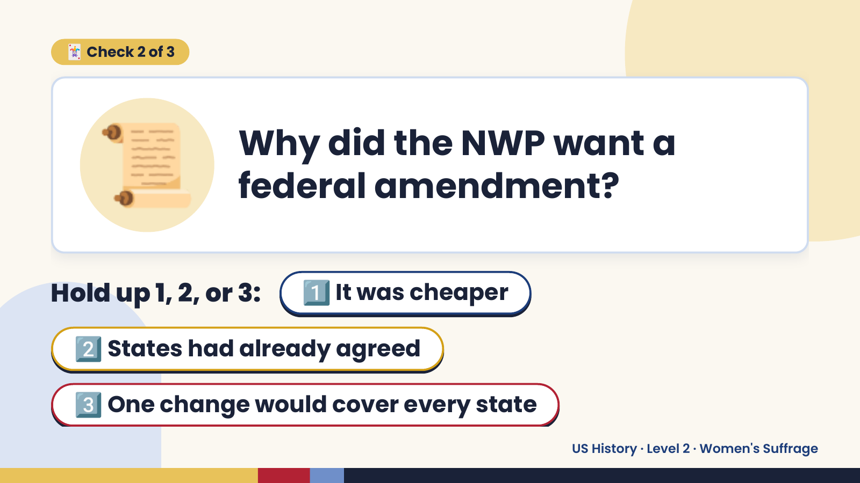
Notes:
📜
🃏 Check 2 of 3
Why did the NWP want a
federal amendment?
Hold up 1, 2, or 3: 1️⃣ It was cheaper
2️⃣ States had already agreed
3️⃣ One change would cover every state
US History · Level 2 · Women's Suffrage

Slide 11
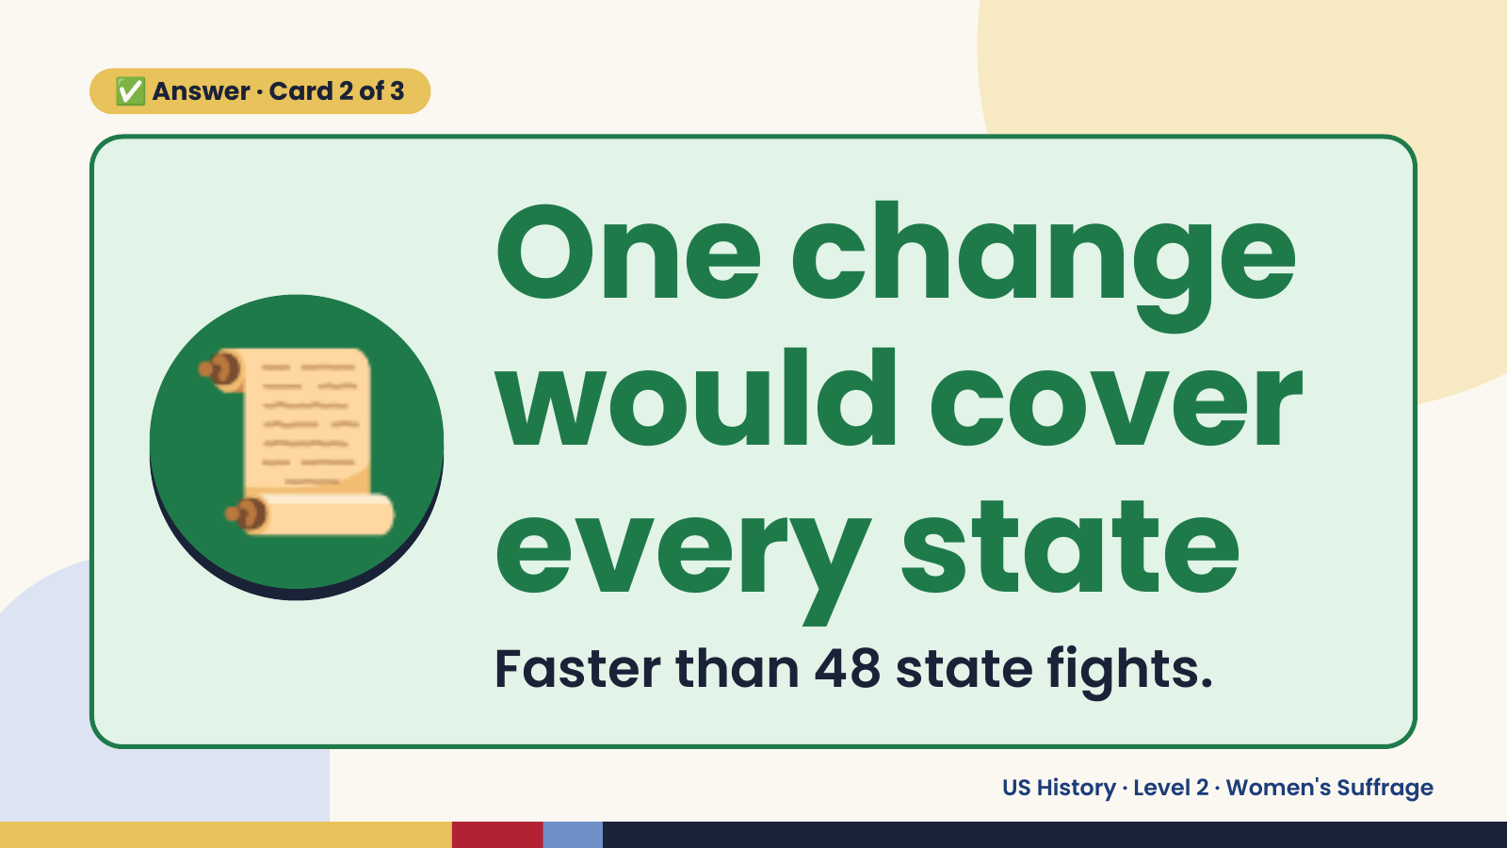
Notes:
✅ Answer · Card 2 of 3
📜 One change
would cover
every state
Faster than 48 state fights.
US History · Level 2 · Women's Suffrage

Slide 12
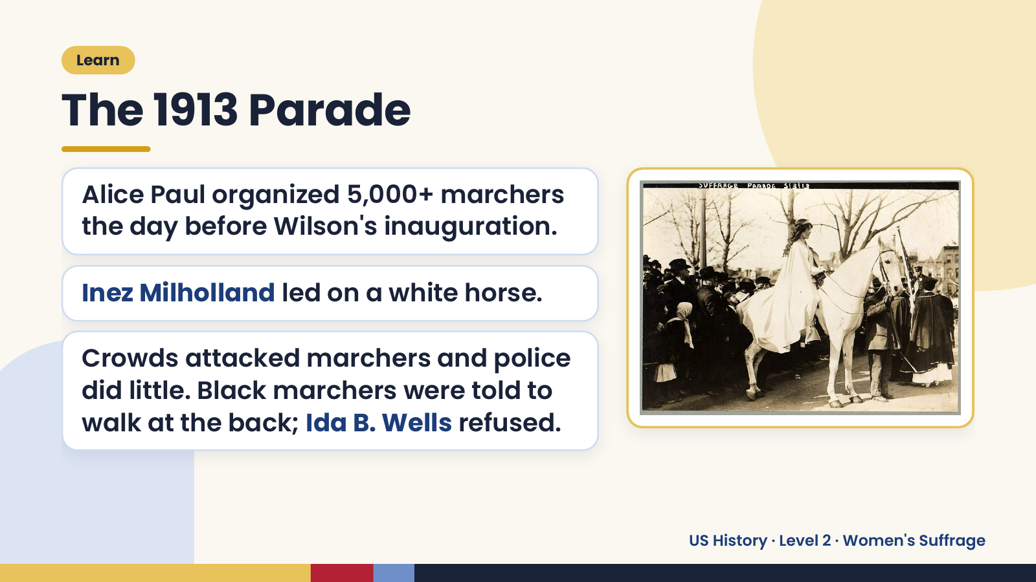
Notes:
Learn
The 1913 Parade
Alice Paul organized 5,000+ marchers
the day before Wilson's inauguration.
Inez Milholland led on a white horse.
Crowds attacked marchers and police
did little. Black marchers were told to
walk at the back; Ida B. Wells refused.
US History · Level 2 · Women's Suffrage

Slide 13
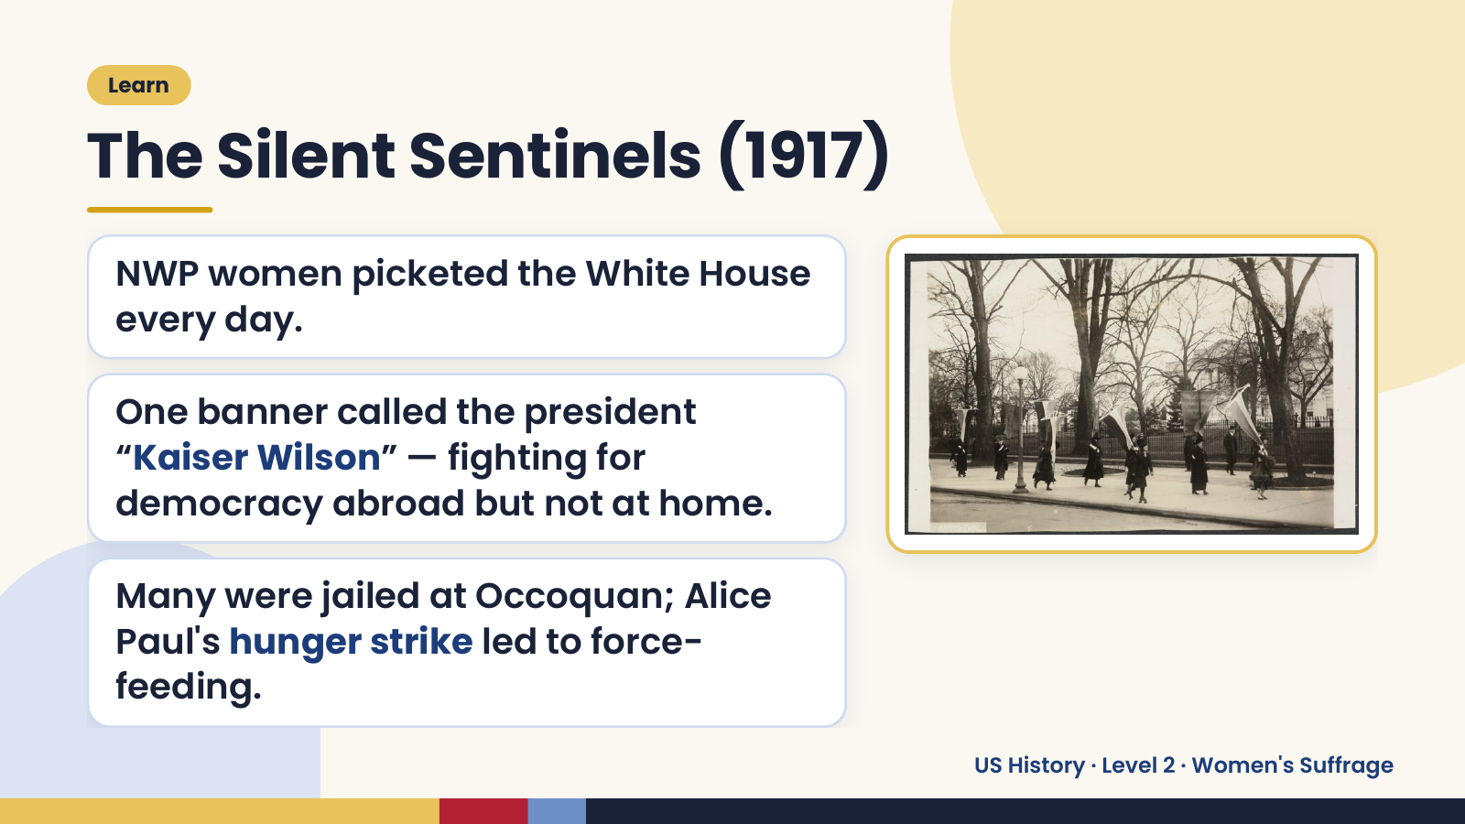
Notes:
Learn
The Silent Sentinels (1917)
NWP women picketed the White House
every day.
One banner called the president
“Kaiser Wilson” — fighting for
democracy abroad but not at home.
Many were jailed at Occoquan; Alice
Paul's hunger strike led to force-
feeding.
US History · Level 2 · Women's Suffrage

Slide 14
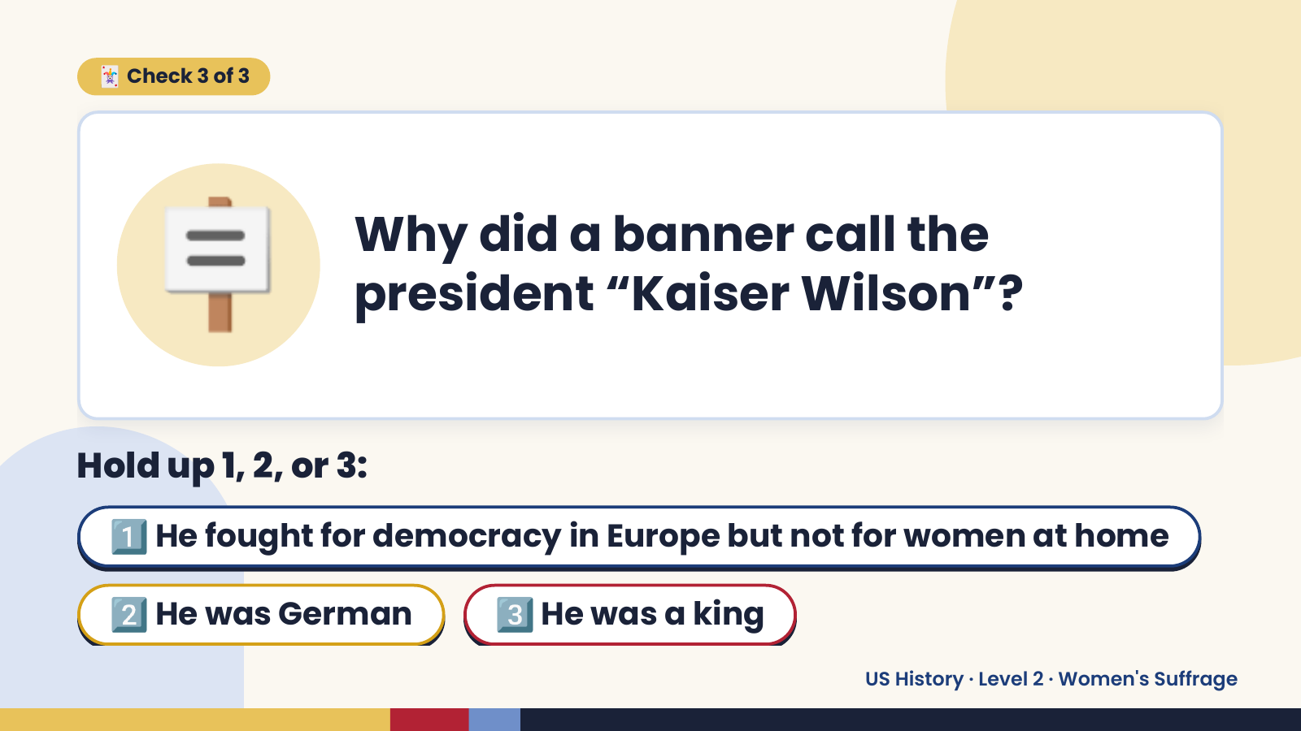
Notes:
🪧
🃏 Check 3 of 3
Why did a banner call the
president “Kaiser Wilson”?
Hold up 1, 2, or 3:
1️⃣ He fought for democracy in Europe but not for women at home
2️⃣ He was German 3️⃣ He was a king
US History · Level 2 · Women's Suffrage

Slide 15
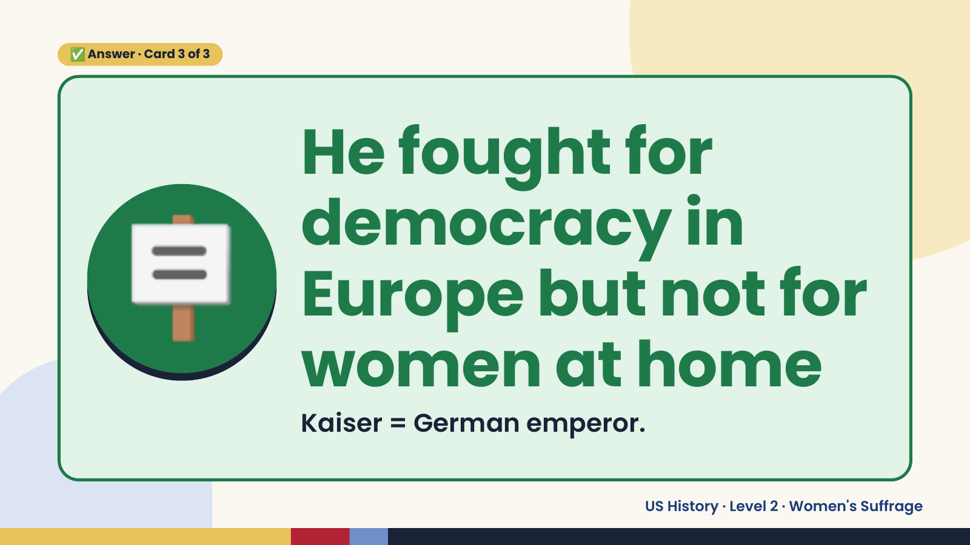
Notes:
✅ Answer · Card 3 of 3
🪧
He fought for
democracy in
Europe but not for
women at home
Kaiser = German emperor.
US History · Level 2 · Women's Suffrage

Slide 16
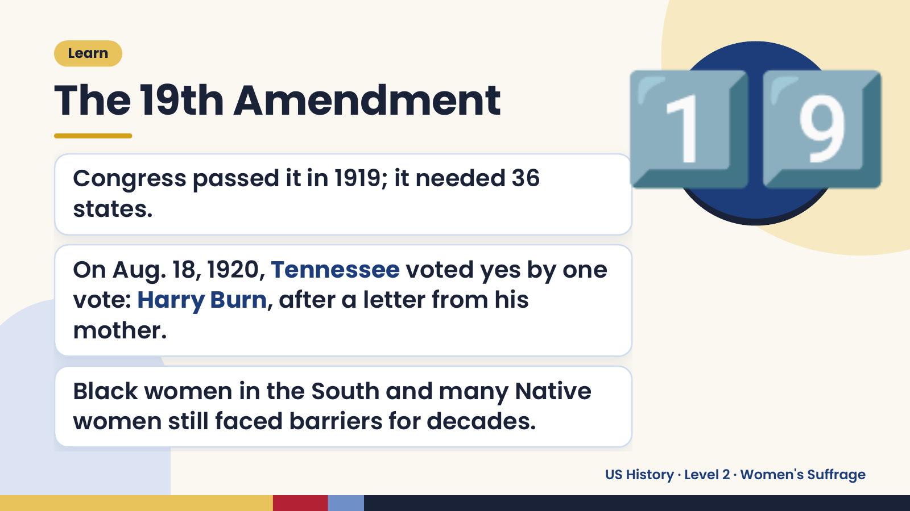
Notes:
Learn
The 19th Amendment
Congress passed it in 1919; it needed 36
states.
On Aug. 18, 1920, Tennessee voted yes by one
1️⃣9️⃣
vote: Harry Burn, after a letter from his
mother.
Black women in the South and many Native
women still faced barriers for decades.
US History · Level 2 · Women's Suffrage

Slide 17

Notes:
🎬 Video
School House Rock: Sufferin' Till Suffrage
👀 Watch for: the dates and leaders you know
💬 Captions on
https://www.youtube.com/watch?v=Cfl4FEx2qIY
Scan to watch
US History · Level 2 · Women's Suffrage

Slide 18
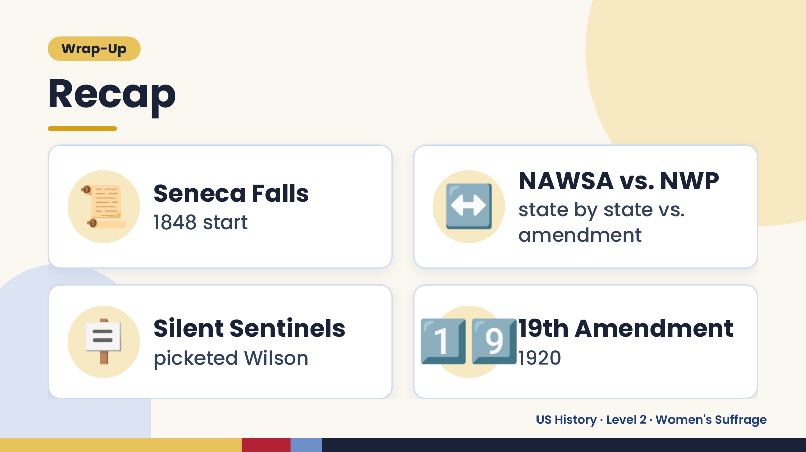
Notes:
Wrap-Up
Recap
📜 Seneca Falls
1848 start ↔️ NAWSA vs. NWP
state by state vs.
amendment
🪧 Silent Sentinels
picketed Wilson 1️⃣9️⃣
19th Amendment
1920
US History · Level 2 · Women's Suffrage

Slide 19
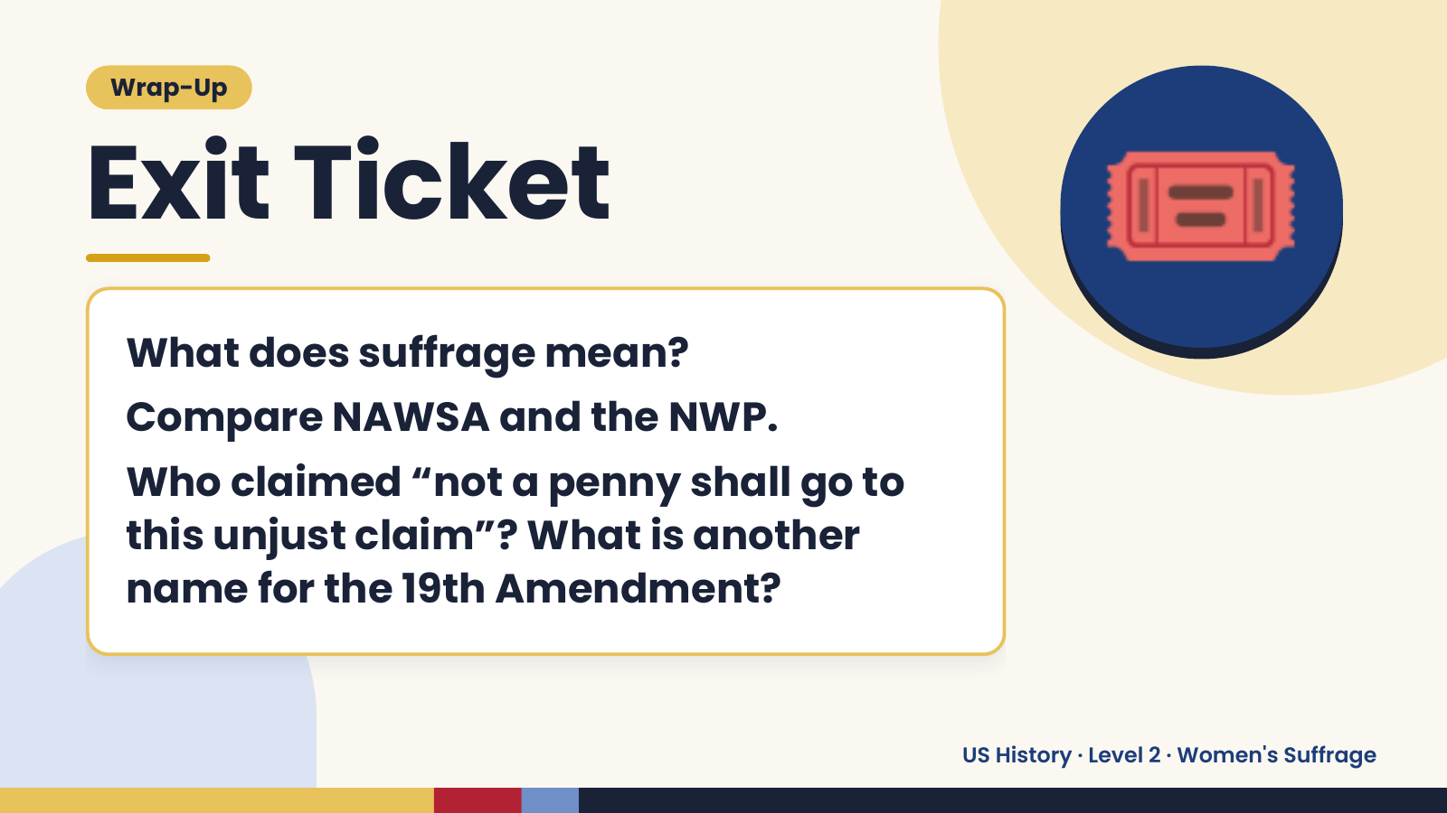
Notes:
Wrap-Up
Exit Ticket
What does suffrage mean?
Compare NAWSA and the NWP.
🎟️
Who claimed “not a penny shall go to
this unjust claim”? What is another
name for the 19th Amendment?
US History · Level 2 · Women's Suffrage

