Slide 1
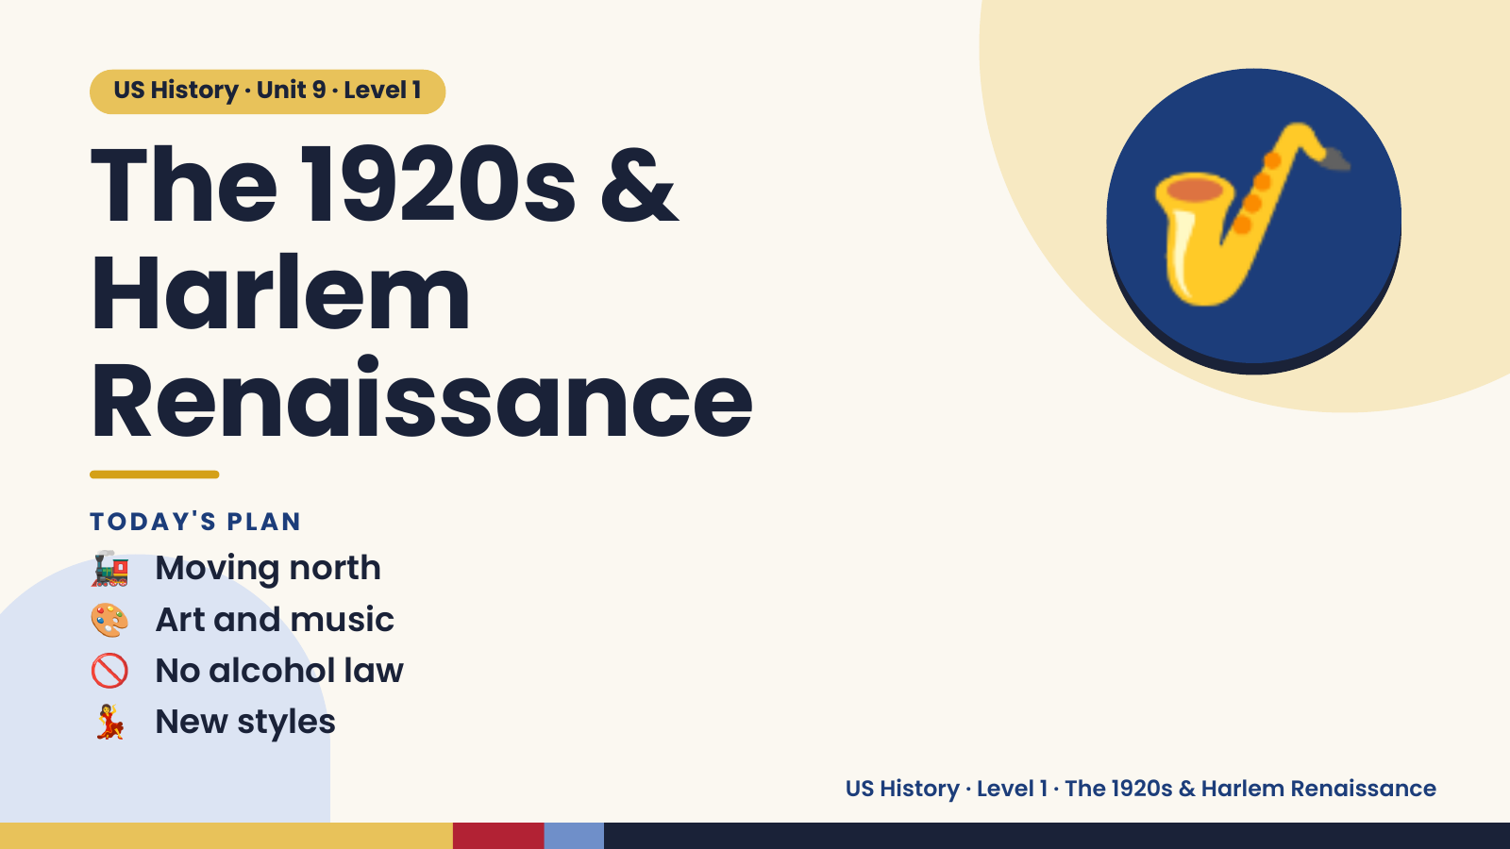
Notes:
US History · Unit 9 · Level 1
The 1920s &
Harlem
Renaissance
🎷
🚂 Moving north
TODAY'S PLAN
🎨 Art and music
🚫 No alcohol law
💃 New styles
US History · Level 1 · The 1920s & Harlem Renaissance

Slide 2
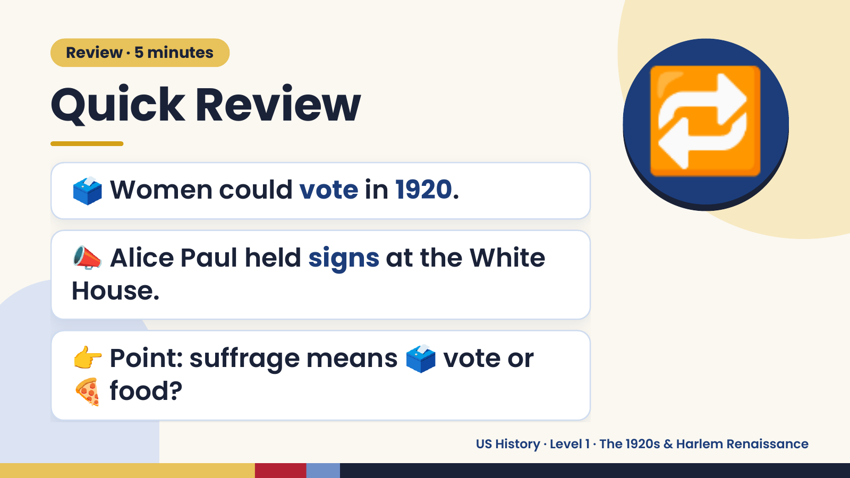
Notes:
Review · 5 minutes
Quick Review
🗳️ Women could vote in 1920.
📣 Alice Paul held signs at the White
🔁
House.
👉 Point: suffrage means 🗳️ vote or
🍕 food?
US History · Level 1 · The 1920s & Harlem Renaissance

Slide 3
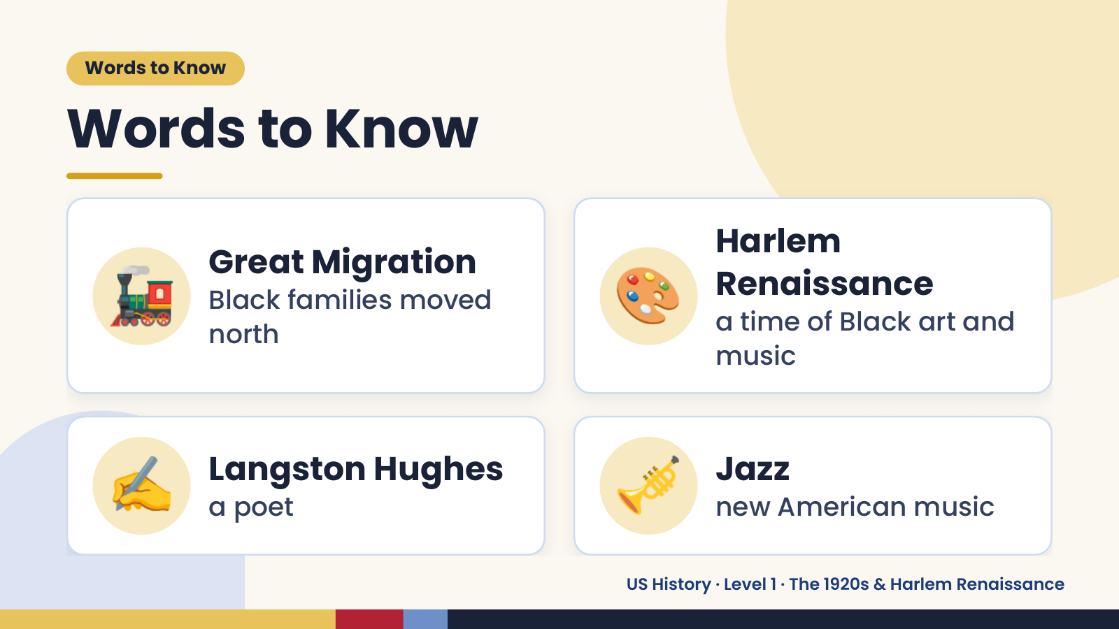
Notes:
Words to Know
Words to Know
🚂 Great Migration
Black families moved
north
🎨 Harlem
Renaissance
a time of Black art and
music
✍️ Langston Hughes
a poet 🎺 Jazz
new American music
US History · Level 1 · The 1920s & Harlem Renaissance

Slide 4
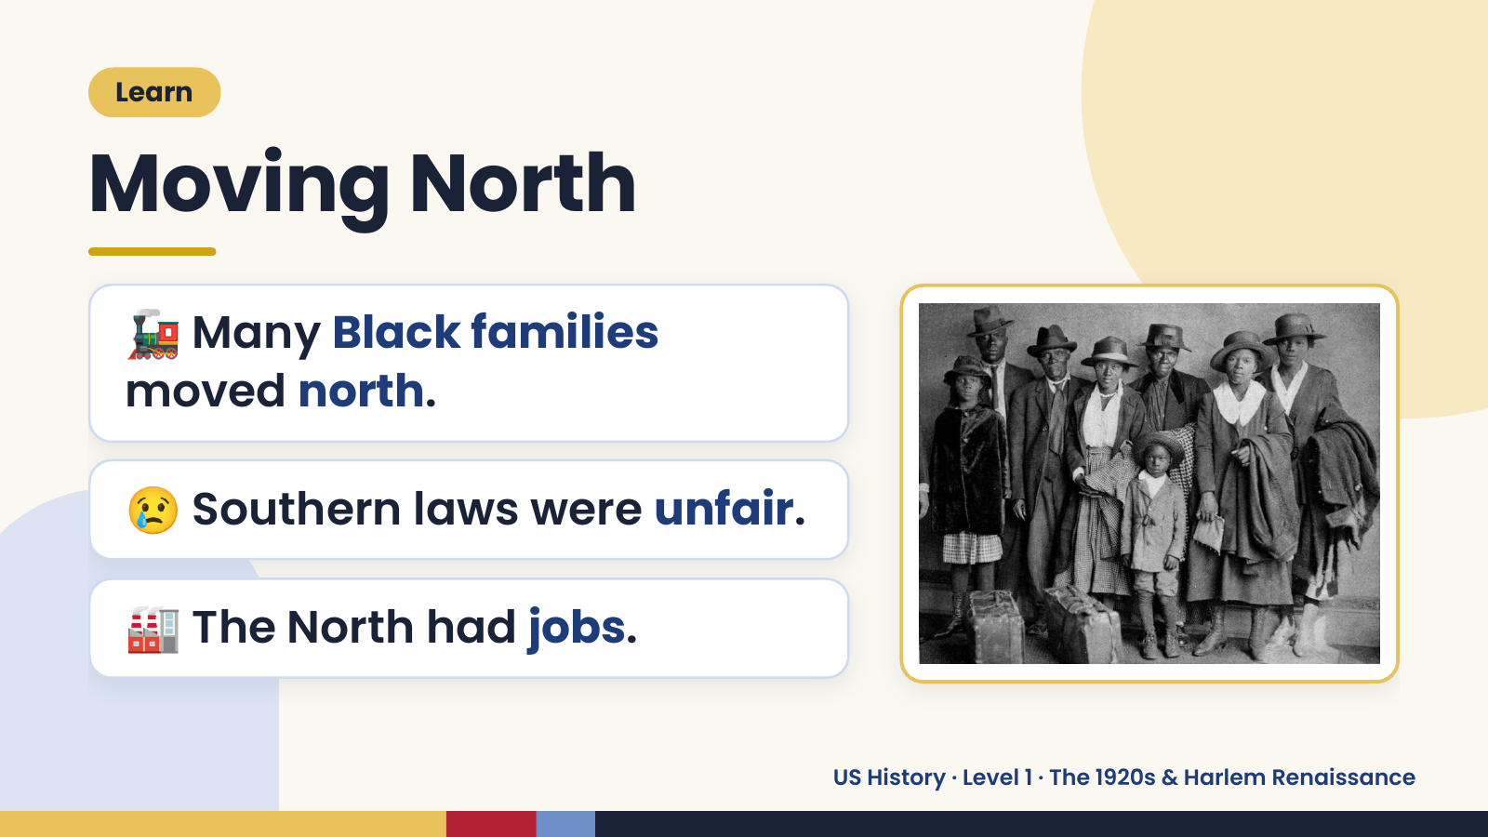
Notes:
Learn
Moving North
🚂 Many Black families
moved north.
😢 Southern laws were unfair.
🏭 The North had jobs.
US History · Level 1 · The 1920s & Harlem Renaissance

Slide 5
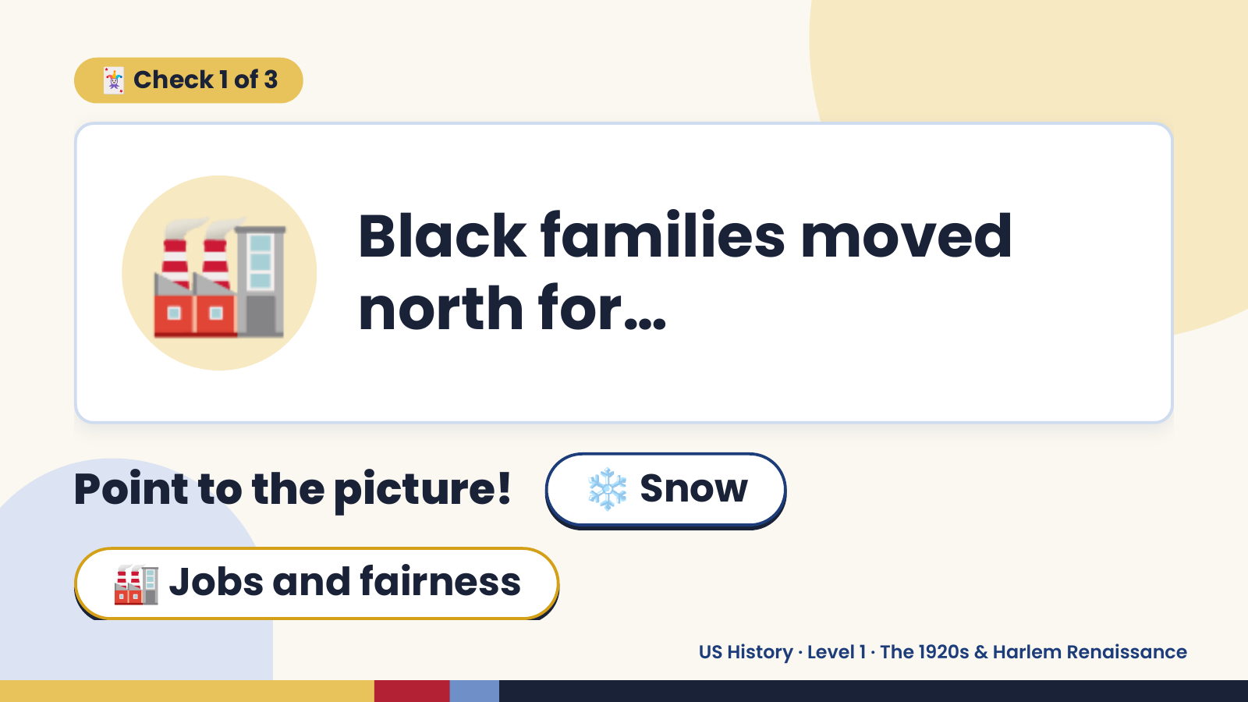
Notes:
🃏 Check 1 of 3
🏭 Black families moved
north for…
Point to the picture! ❄️ Snow
🏭 Jobs and fairness
US History · Level 1 · The 1920s & Harlem Renaissance

Slide 6
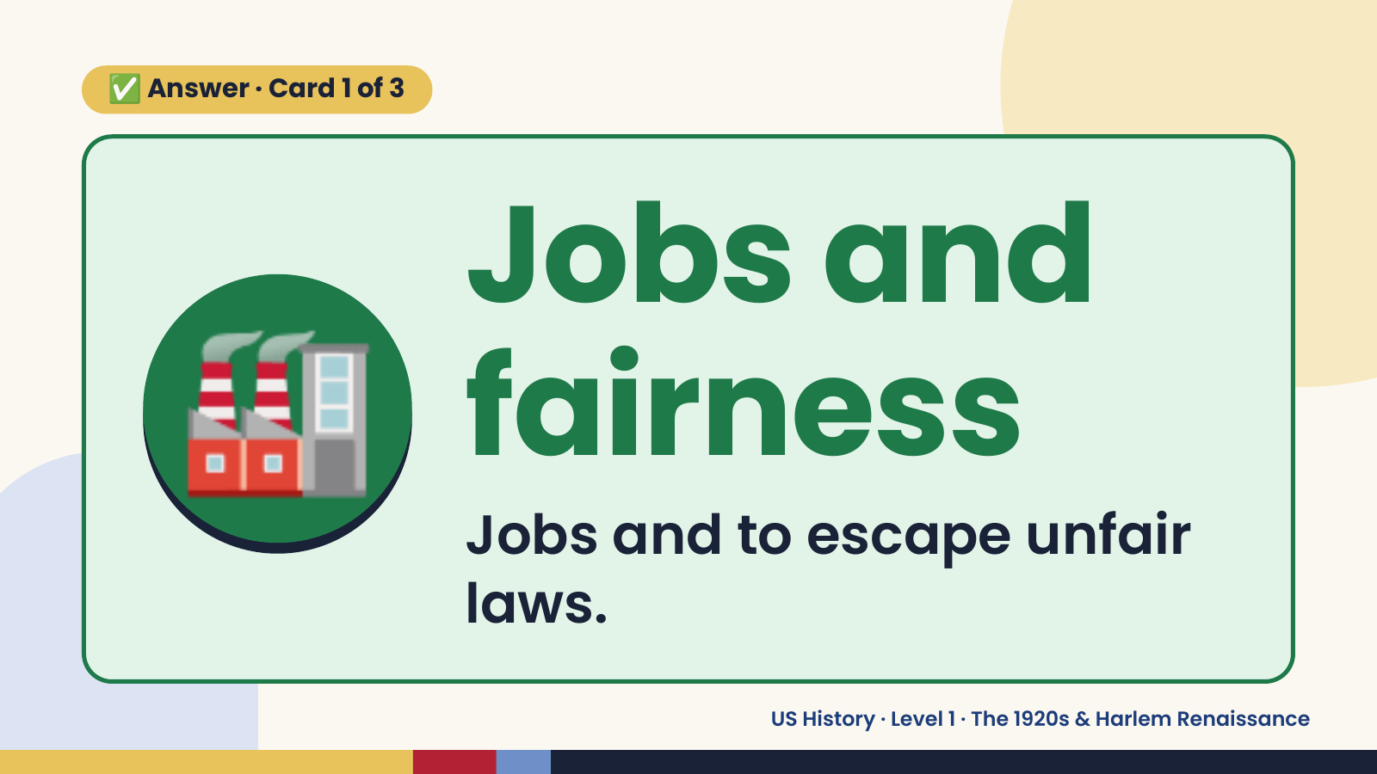
Notes:
✅ Answer · Card 1 of 3
🏭 Jobs and
fairness
Jobs and to escape unfair
laws.
US History · Level 1 · The 1920s & Harlem Renaissance

Slide 7
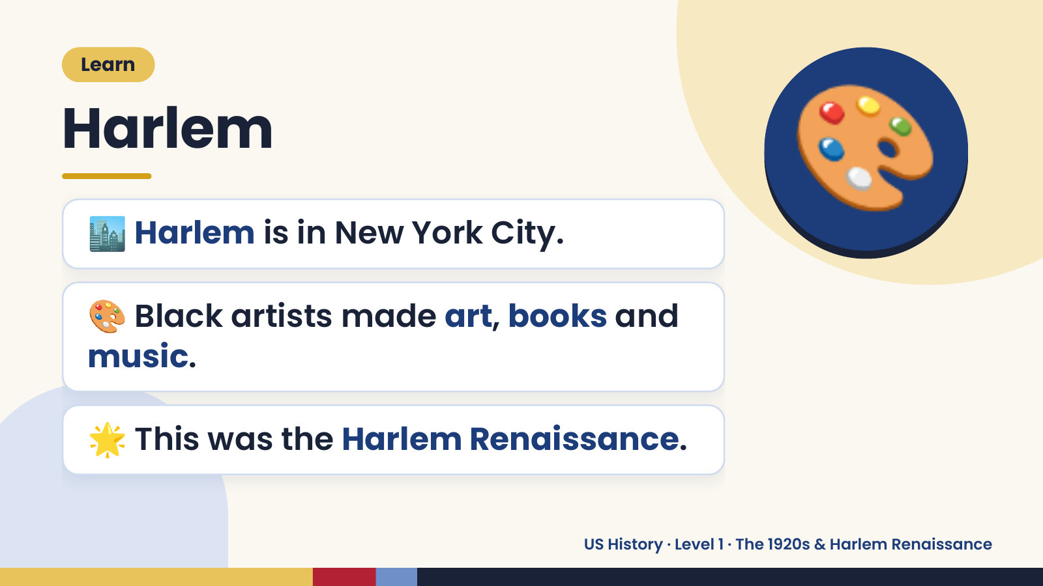
Notes:
Learn
Harlem
🏙️ Harlem is in New York City.
🎨 Black artists made art, books and
🎨
music.
🌟 This was the Harlem Renaissance.
US History · Level 1 · The 1920s & Harlem Renaissance

Slide 8
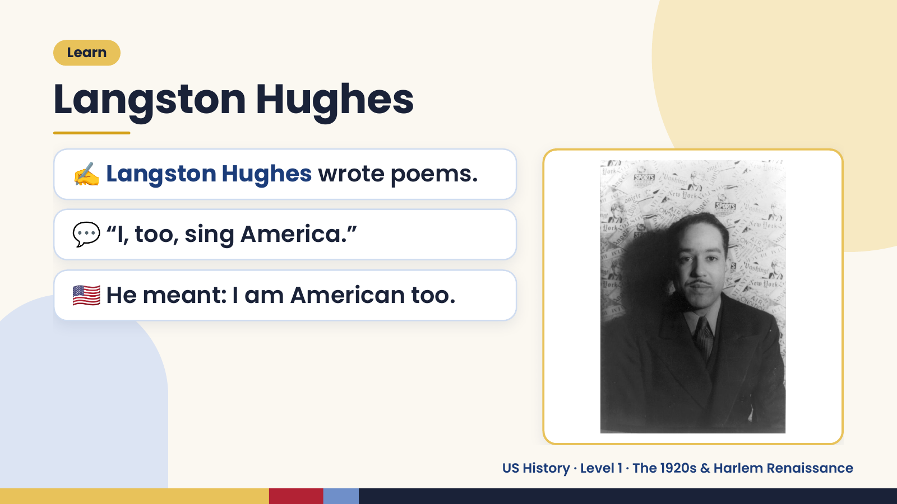
Notes:
Learn
Langston Hughes
✍️ Langston Hughes wrote poems.
💬 “I, too, sing America.”
🇺🇸 He meant: I am American too.
US History · Level 1 · The 1920s & Harlem Renaissance

Slide 9
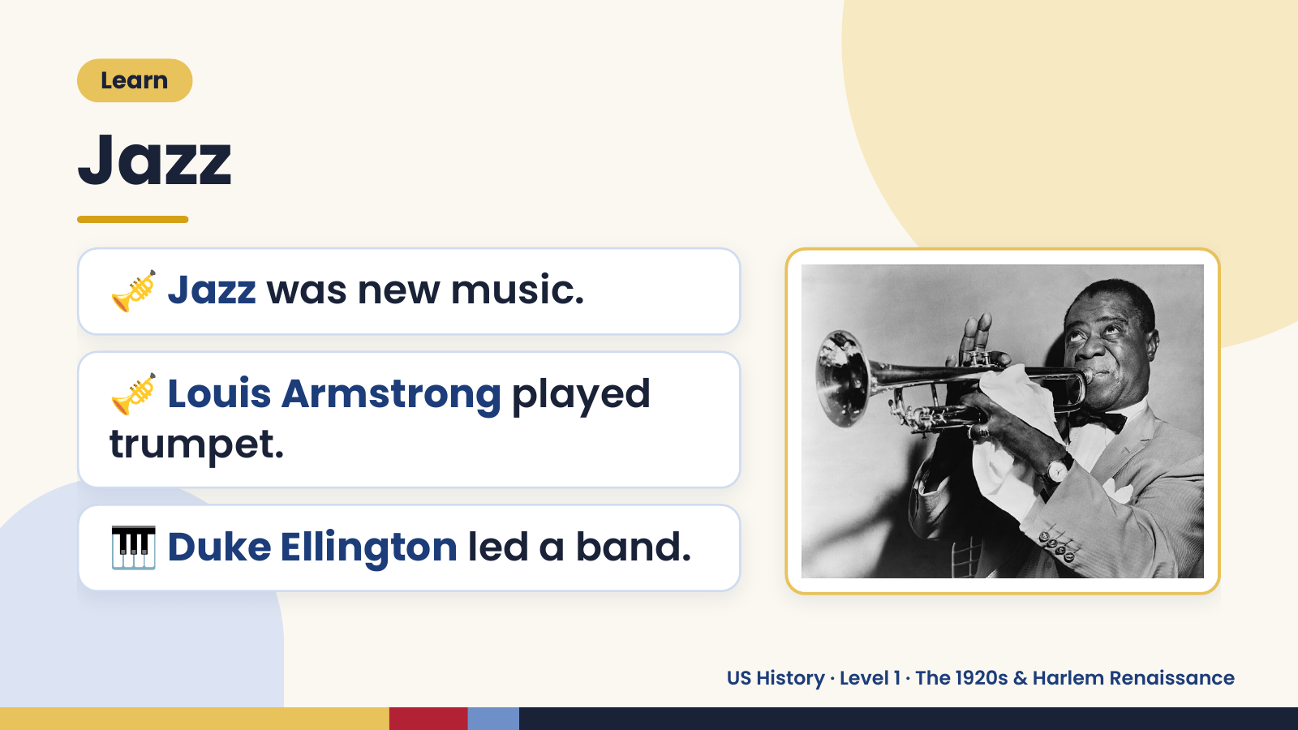
Notes:
Learn
Jazz
🎺 Jazz was new music.
🎺 Louis Armstrong played
trumpet.
🎹 Duke Ellington led a band.
US History · Level 1 · The 1920s & Harlem Renaissance

Slide 10
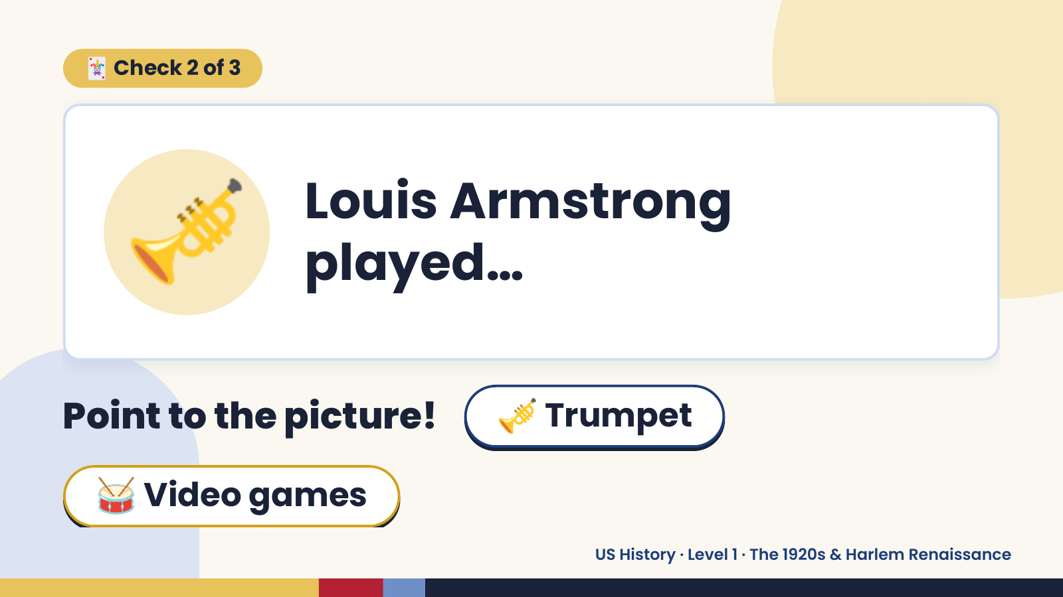
Notes:
🃏 Check 2 of 3
🎺 Louis Armstrong
played…
Point to the picture! 🎺 Trumpet
🥁 Video games
US History · Level 1 · The 1920s & Harlem Renaissance

Slide 11
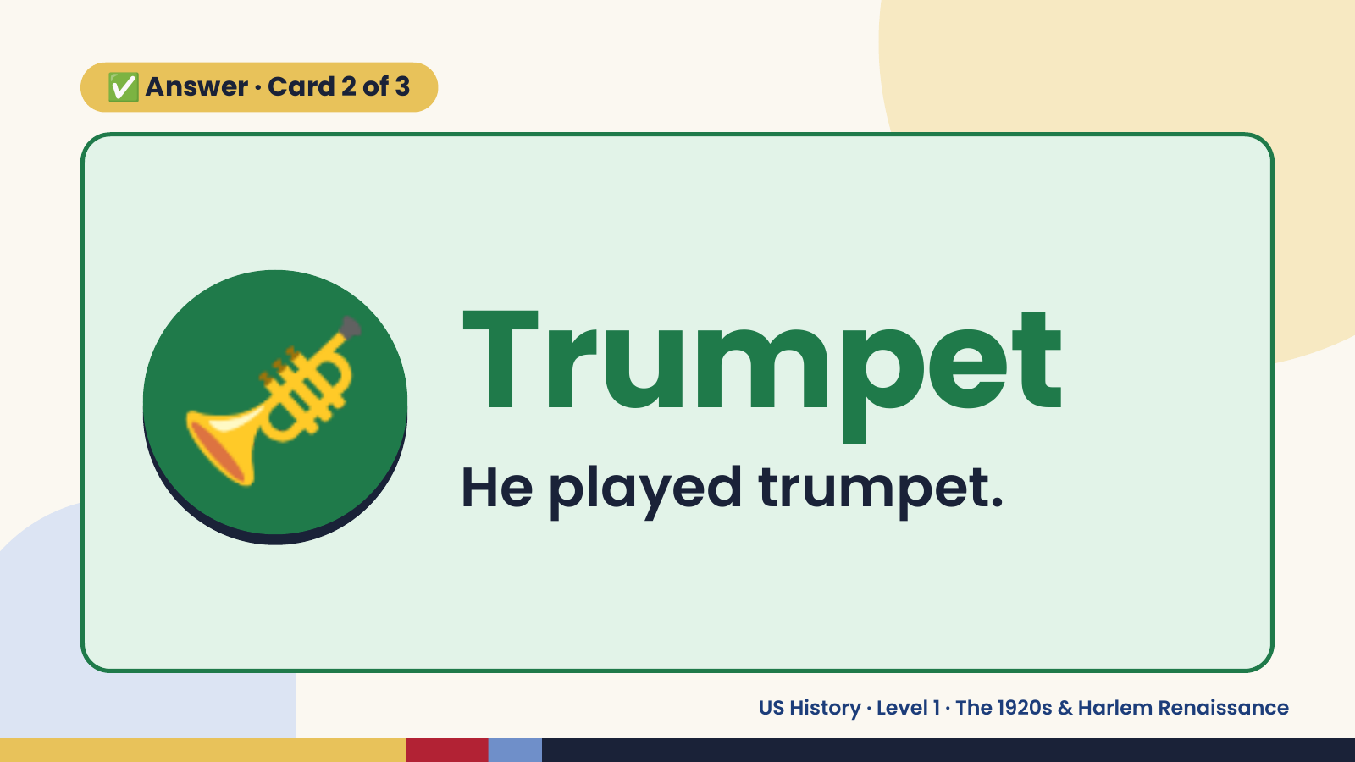
Notes:
✅ Answer · Card 2 of 3
🎺 Trumpet
He played trumpet.
US History · Level 1 · The 1920s & Harlem Renaissance

Slide 12
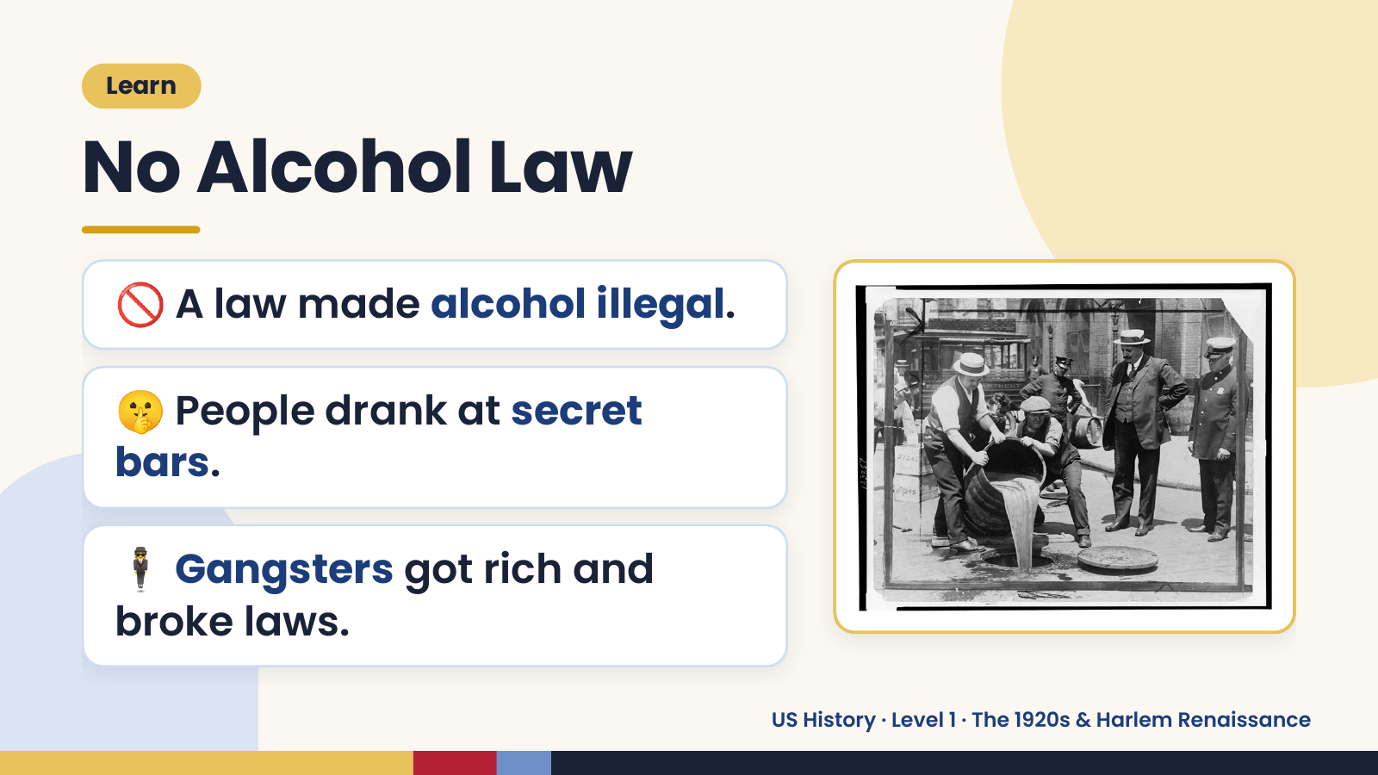
Notes:
Learn
No Alcohol Law
🚫 A law made alcohol illegal.
🤫 People drank at secret
bars.
🕴️ Gangsters got rich and
broke laws.
US History · Level 1 · The 1920s & Harlem Renaissance

Slide 13
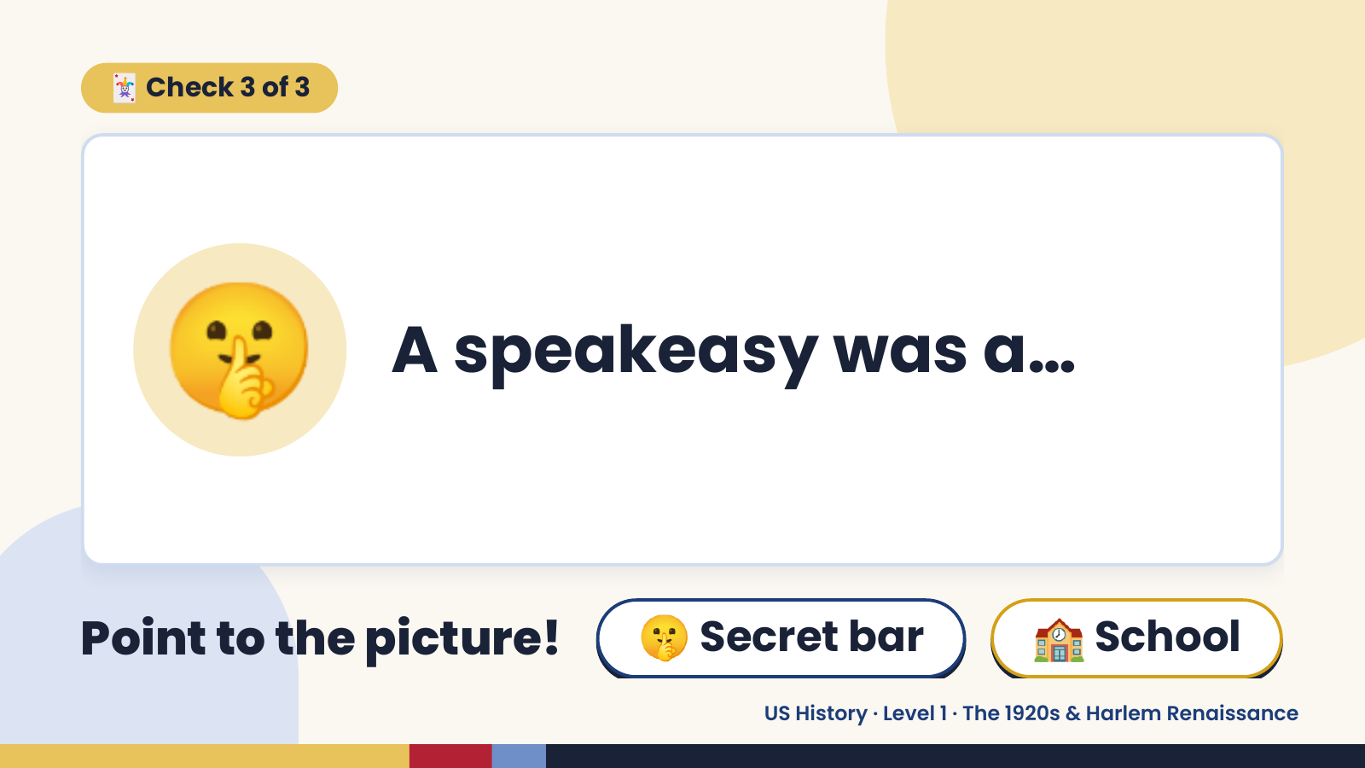
Notes:
🃏 Check 3 of 3
🤫 A speakeasy was a…
Point to the picture! 🤫 Secret bar 🏫 School
US History · Level 1 · The 1920s & Harlem Renaissance

Slide 14
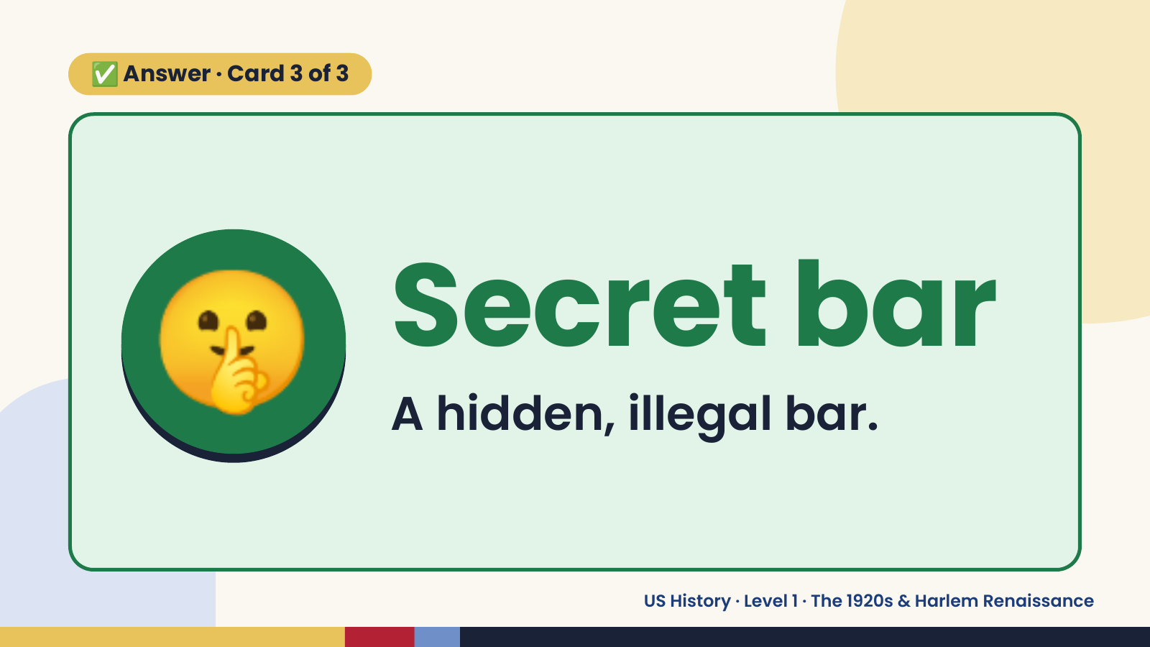
Notes:
✅ Answer · Card 3 of 3
🤫 Secret bar
A hidden, illegal bar.
US History · Level 1 · The 1920s & Harlem Renaissance

Slide 15
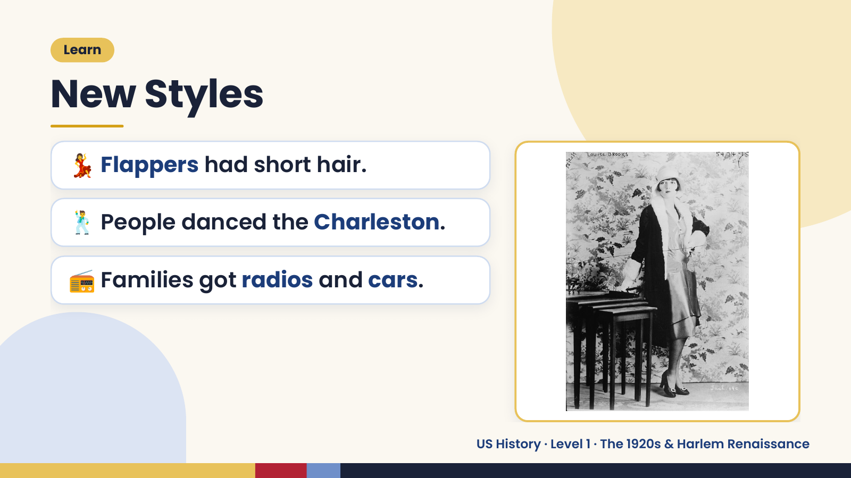
Notes:
Learn
New Styles
💃 Flappers had short hair.
🕺 People danced the Charleston.
📻 Families got radios and cars.
US History · Level 1 · The 1920s & Harlem Renaissance

Slide 16
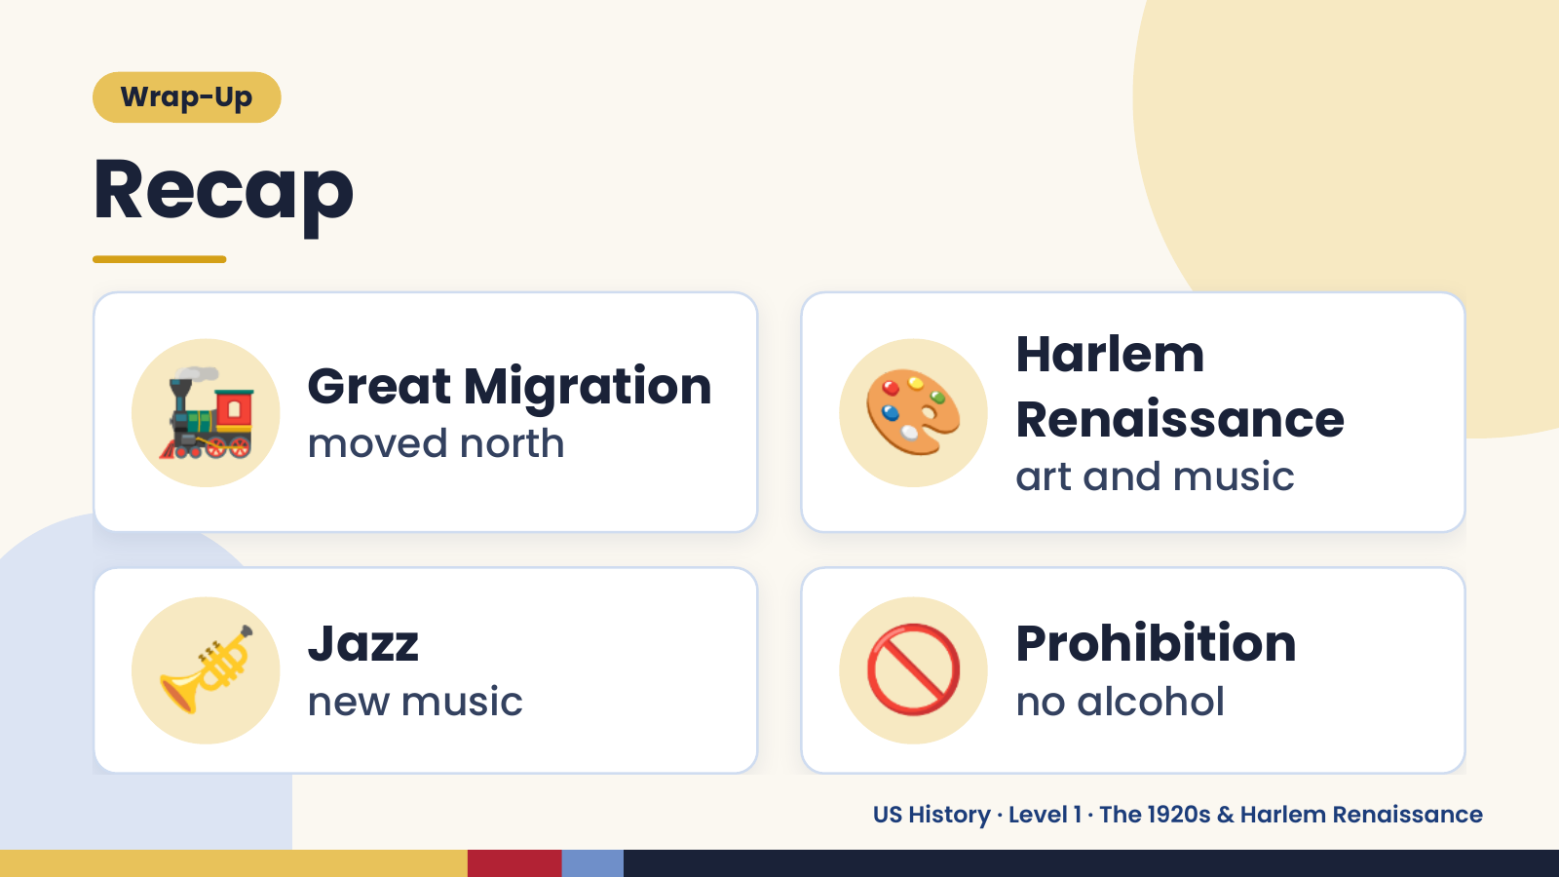
Notes:
Wrap-Up
Recap
🚂 Great Migration
moved north 🎨 Harlem
Renaissance
art and music
🎺 Jazz
new music 🚫 Prohibition
no alcohol
US History · Level 1 · The 1920s & Harlem Renaissance

Slide 17
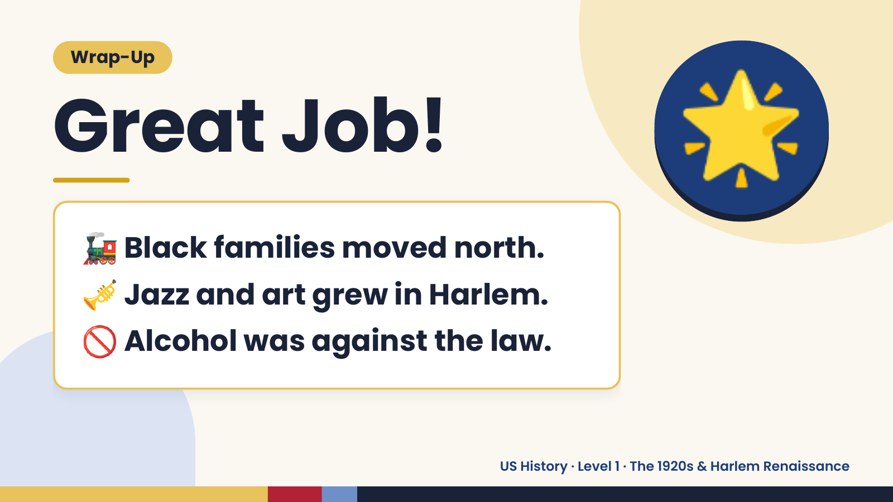
Notes:
Wrap-Up
Great Job!
🚂 Black families moved north.
🌟
🎺 Jazz and art grew in Harlem.
🚫 Alcohol was against the law.
US History · Level 1 · The 1920s & Harlem Renaissance

