Slide 1
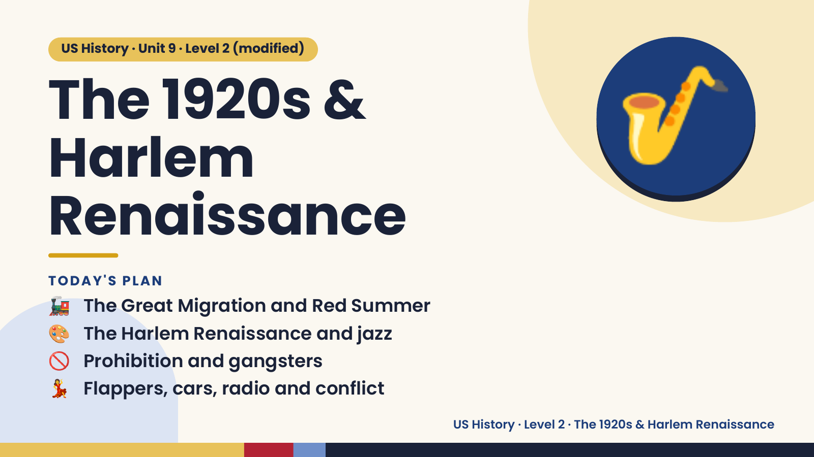
Notes:
US History · Unit 9 · Level 2 (modified)
The 1920s &
Harlem
Renaissance
🎷
🚂 The Great Migration and Red Summer
TODAY'S PLAN
🎨 The Harlem Renaissance and jazz
🚫 Prohibition and gangsters
💃 Flappers, cars, radio and conflict
US History · Level 2 · The 1920s & Harlem Renaissance

Slide 2
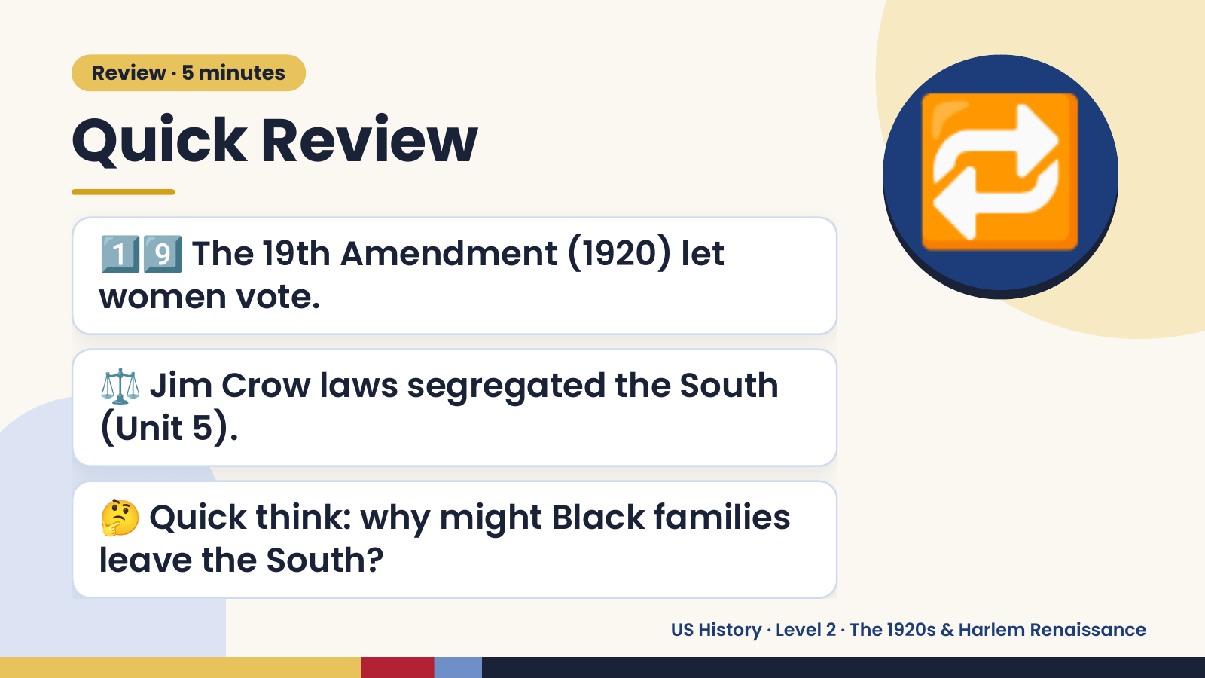
Notes:
Review · 5 minutes
Quick Review
1️⃣9️⃣ The 19th Amendment (1920) let
women vote.
🔁
⚖️ Jim Crow laws segregated the South
(Unit 5).
🤔 Quick think: why might Black families
leave the South?
US History · Level 2 · The 1920s & Harlem Renaissance

Slide 3
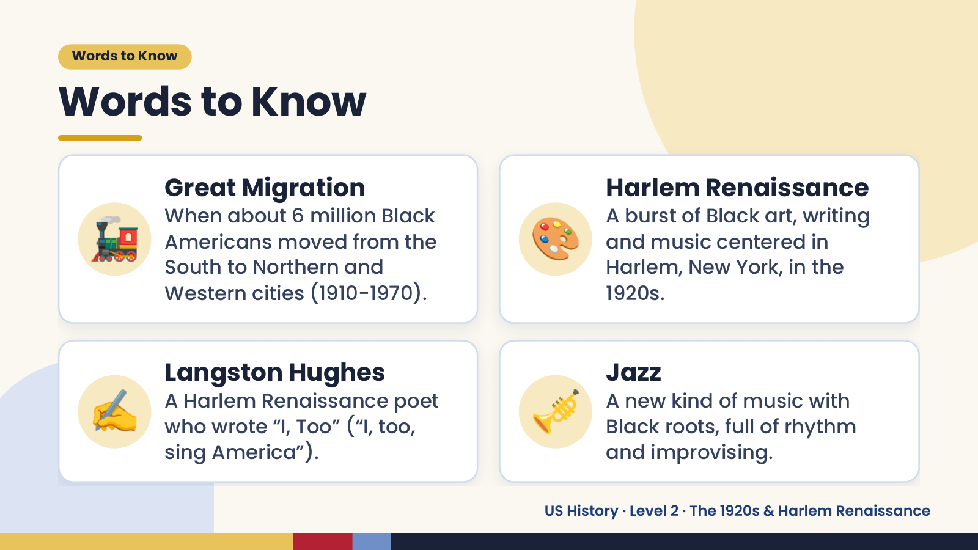
Notes:
Words to Know
Words to Know
🚂 🎨
Great Migration Harlem Renaissance
When about 6 million Black A burst of Black art, writing
Americans moved from the and music centered in
South to Northern and Harlem, New York, in the
Western cities (1910-1970). 1920s.
✍️ Langston Hughes
A Harlem Renaissance poet
who wrote “I, Too” (“I, too,
sing America”).
🎺 Jazz
A new kind of music with
Black roots, full of rhythm
and improvising.
US History · Level 2 · The 1920s & Harlem Renaissance

Slide 4
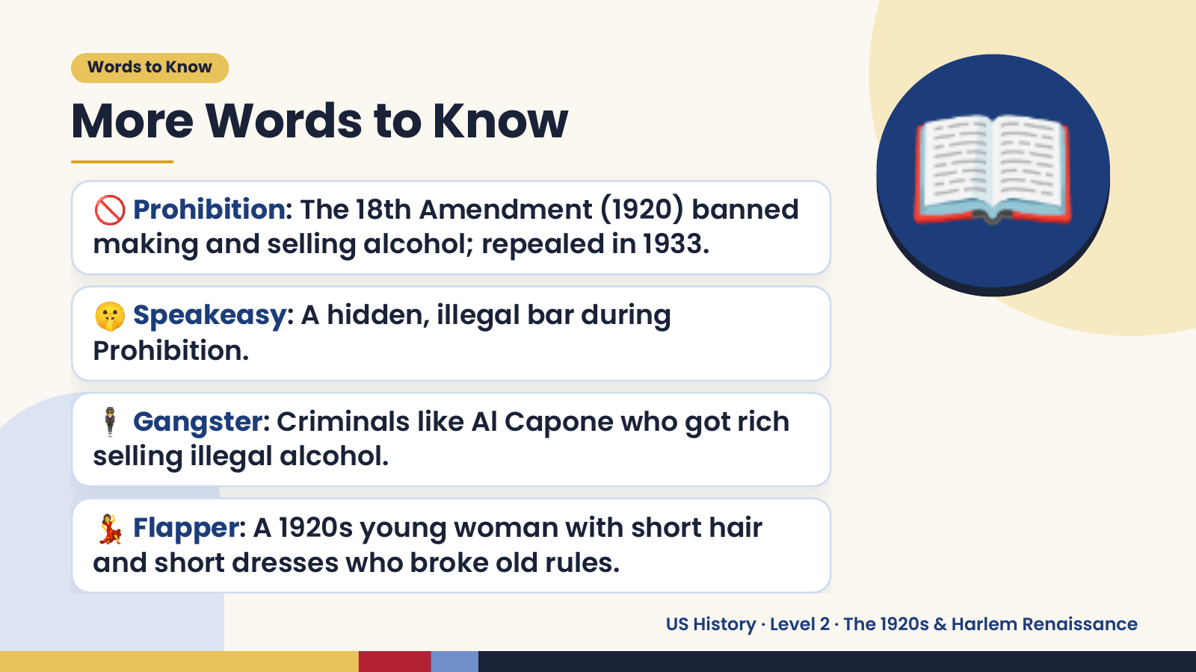
Notes:
Words to Know
More Words to Know
🚫 Prohibition: The 18th Amendment (1920) banned
making and selling alcohol; repealed in 1933.
🤫 Speakeasy: A hidden, illegal bar during
Prohibition.
📖
🕴️ Gangster: Criminals like Al Capone who got rich
selling illegal alcohol.
💃 Flapper: A 1920s young woman with short hair
and short dresses who broke old rules.
US History · Level 2 · The 1920s & Harlem Renaissance

Slide 5
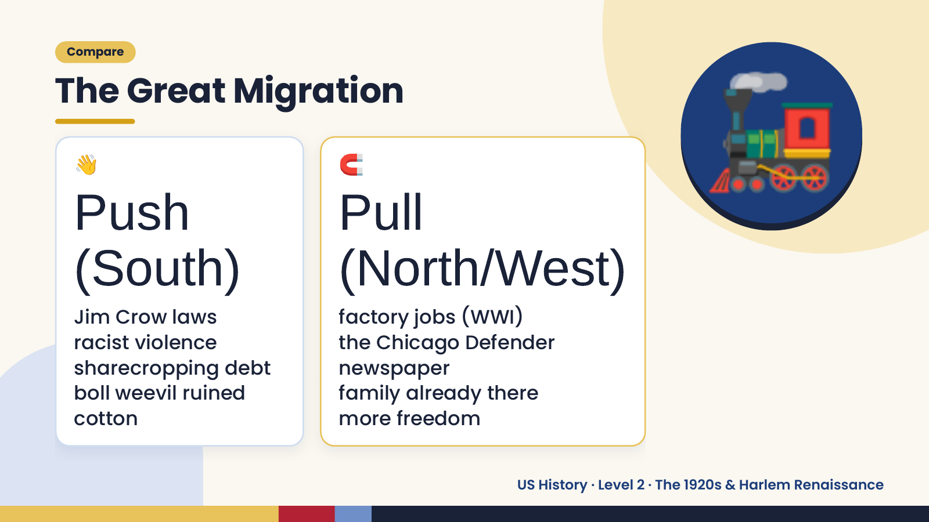
Notes:
Compare
The Great Migration
👋
Push
(South)
🧲
Pull
(North/West)
🚂
Jim Crow laws factory jobs (WWI)
racist violence the Chicago Defender
sharecropping debt newspaper
boll weevil ruined family already there
cotton more freedom
US History · Level 2 · The 1920s & Harlem Renaissance

Slide 6
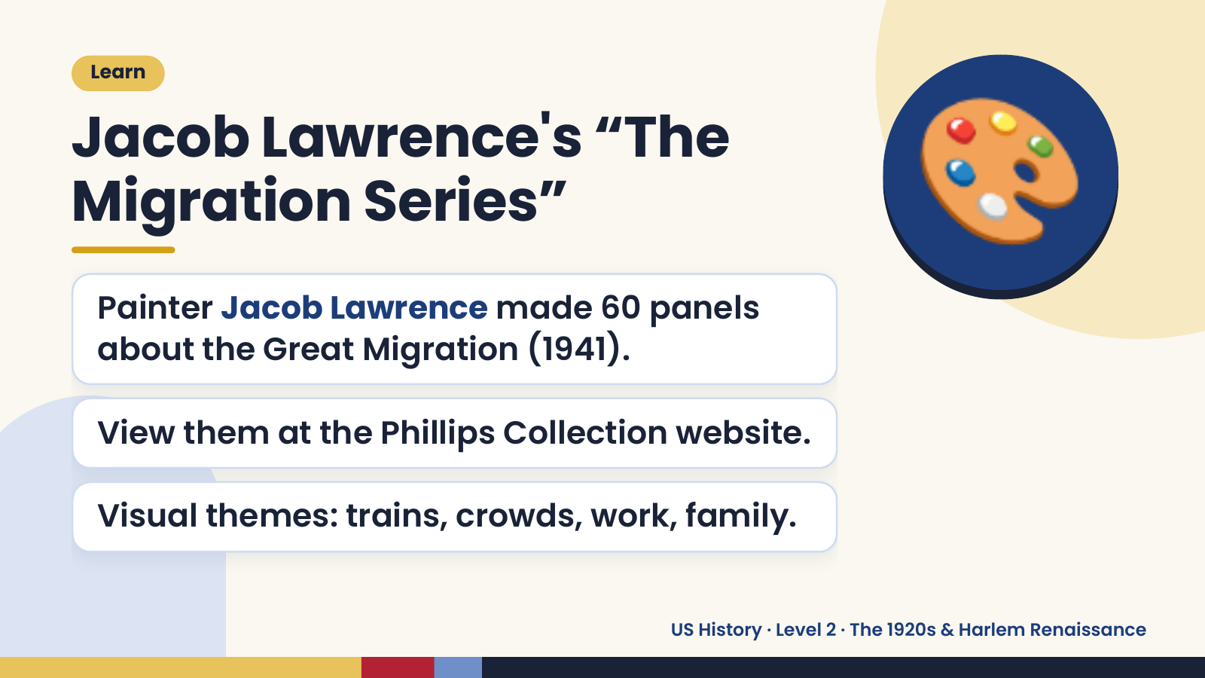
Notes:
Learn
Jacob Lawrence's “The
Migration Series”
Painter Jacob Lawrence made 60 panels
about the Great Migration (1941).
🎨
View them at the Phillips Collection website.
Visual themes: trains, crowds, work, family.
US History · Level 2 · The 1920s & Harlem Renaissance

Slide 7
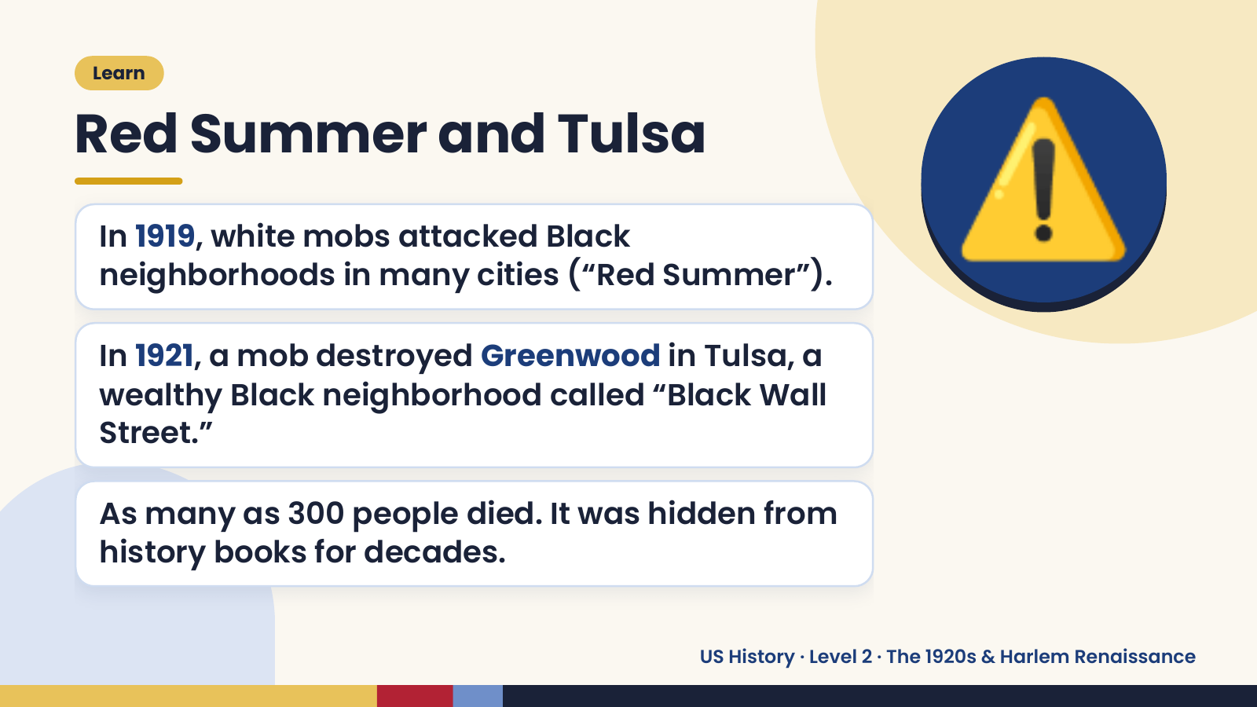
Notes:
Learn
Red Summer and Tulsa
In 1919, white mobs attacked Black
neighborhoods in many cities (“Red Summer”).
In 1921, a mob destroyed Greenwood in Tulsa, a
wealthy Black neighborhood called “Black Wall
⚠️
Street.”
As many as 300 people died. It was hidden from
history books for decades.
US History · Level 2 · The 1920s & Harlem Renaissance

Slide 8
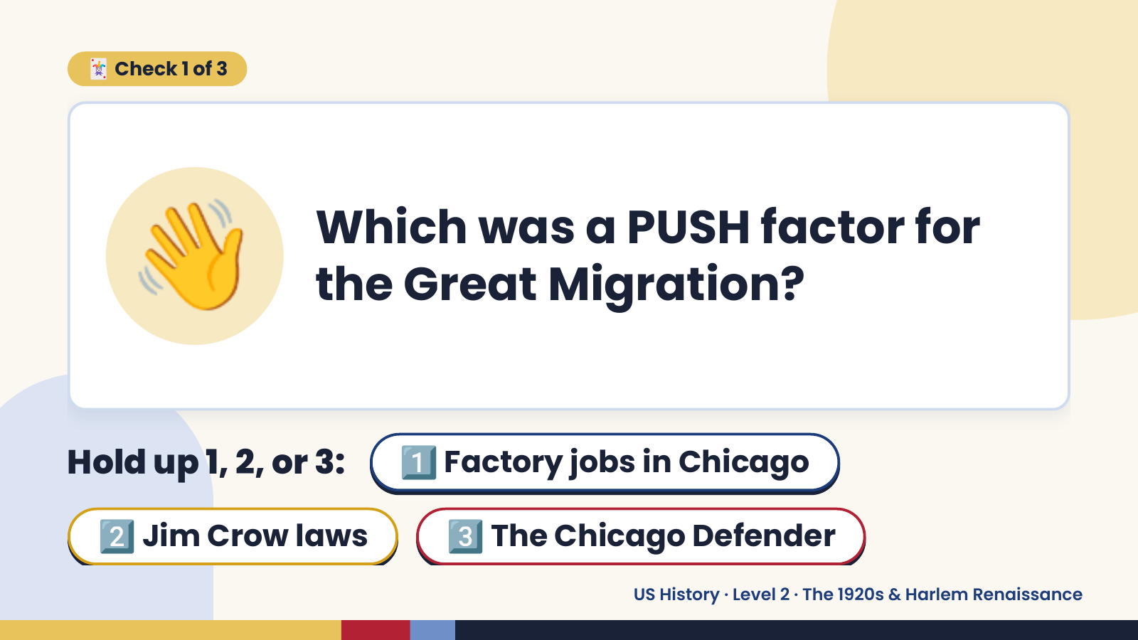
Notes:
🃏 Check 1 of 3
👋 Which was a PUSH factor for
the Great Migration?
Hold up 1, 2, or 3:1️⃣ Factory jobs in Chicago
2️⃣ Jim Crow laws 3️⃣ The Chicago Defender
US History · Level 2 · The 1920s & Harlem Renaissance

Slide 9
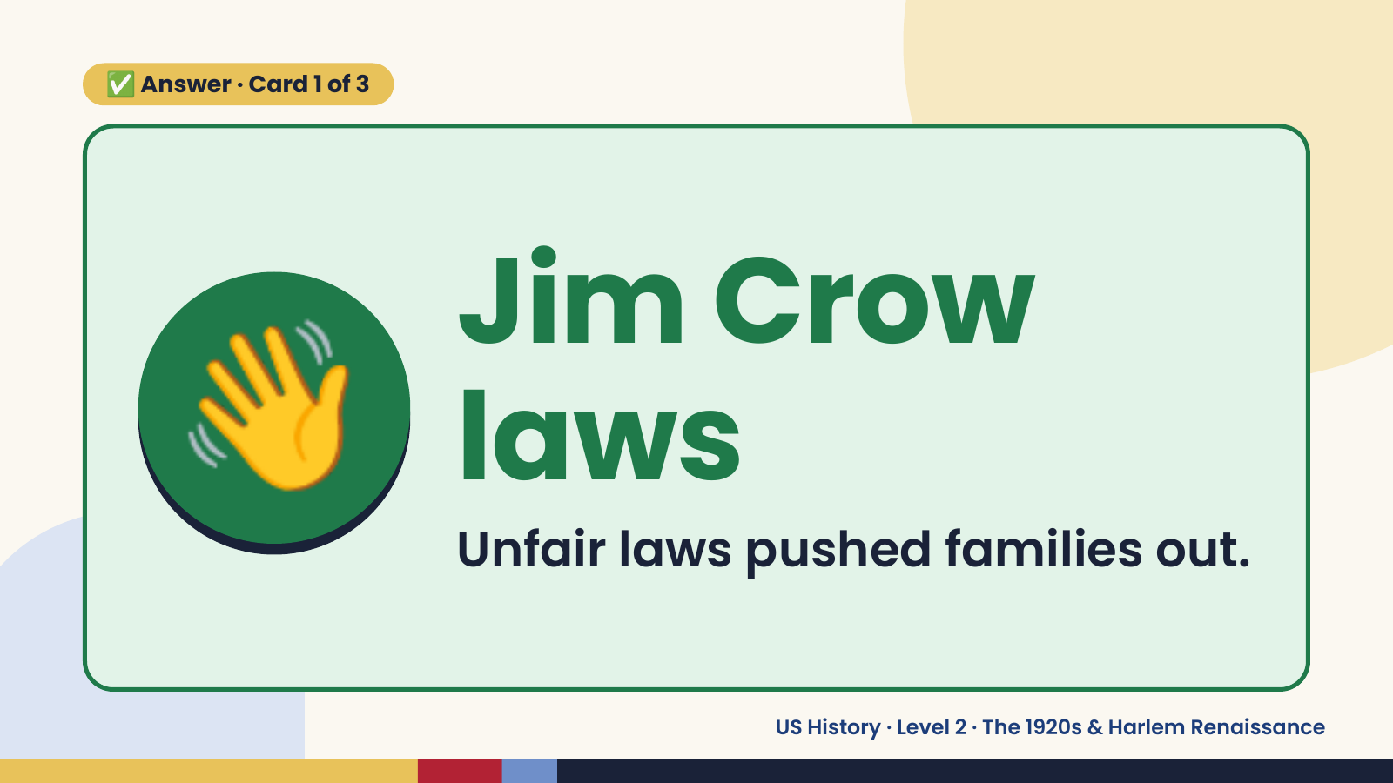
Notes:
✅ Answer · Card 1 of 3
👋 Jim Crow
laws
Unfair laws pushed families out.
US History · Level 2 · The 1920s & Harlem Renaissance

Slide 10
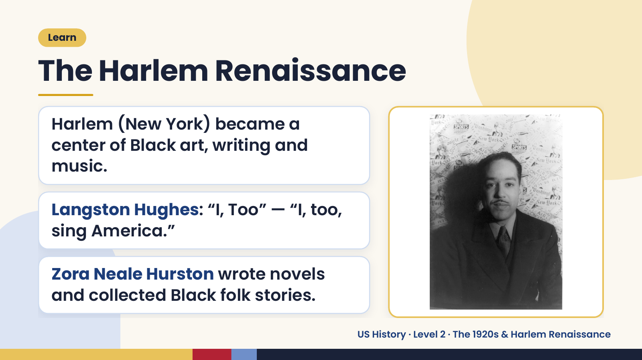
Notes:
Learn
The Harlem Renaissance
Harlem (New York) became a
center of Black art, writing and
music.
Langston Hughes: “I, Too” — “I, too,
sing America.”
Zora Neale Hurston wrote novels
and collected Black folk stories.
US History · Level 2 · The 1920s & Harlem Renaissance

Slide 11
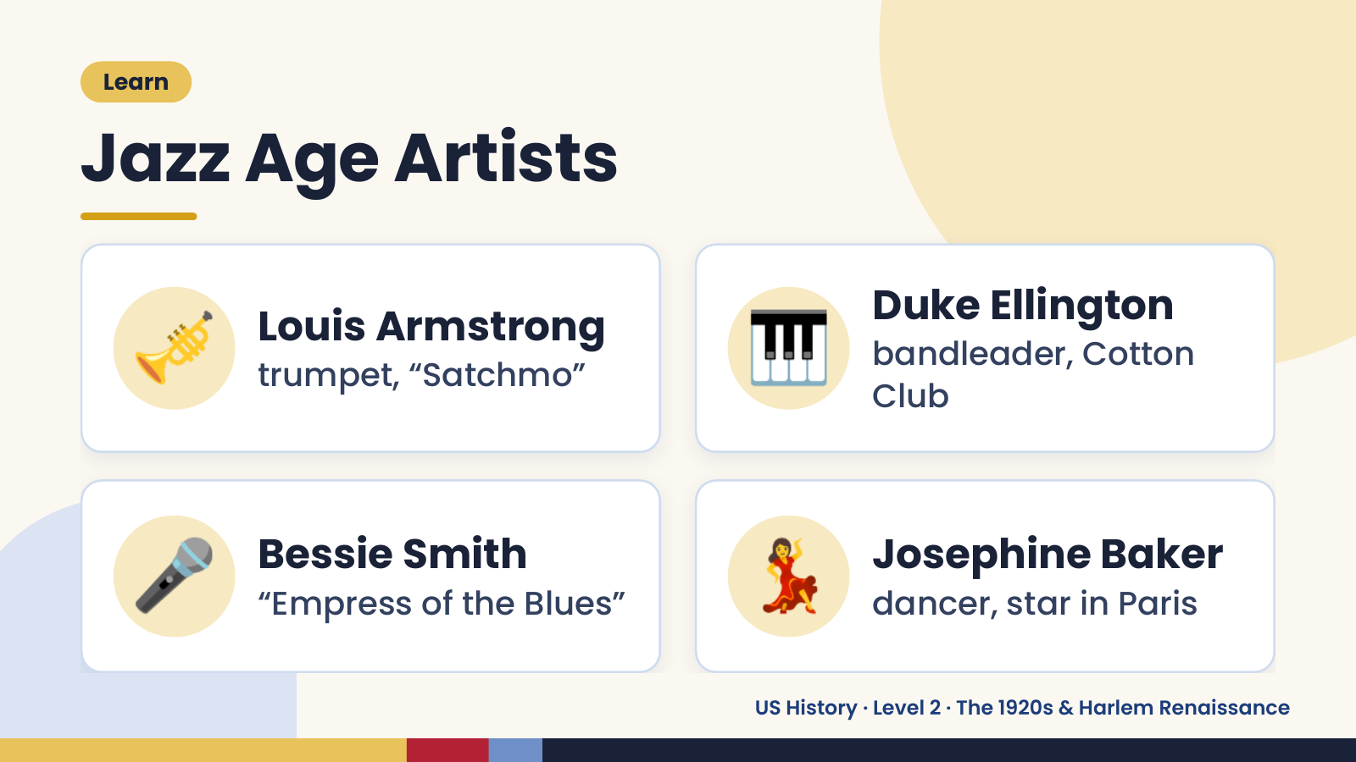
Notes:
Learn
Jazz Age Artists
🎺 Louis Armstrong
trumpet, “Satchmo” 🎹 Duke Ellington
bandleader, Cotton
Club
🎤 Bessie Smith
“Empress of the Blues” 💃 Josephine Baker
dancer, star in Paris
US History · Level 2 · The 1920s & Harlem Renaissance

Slide 12
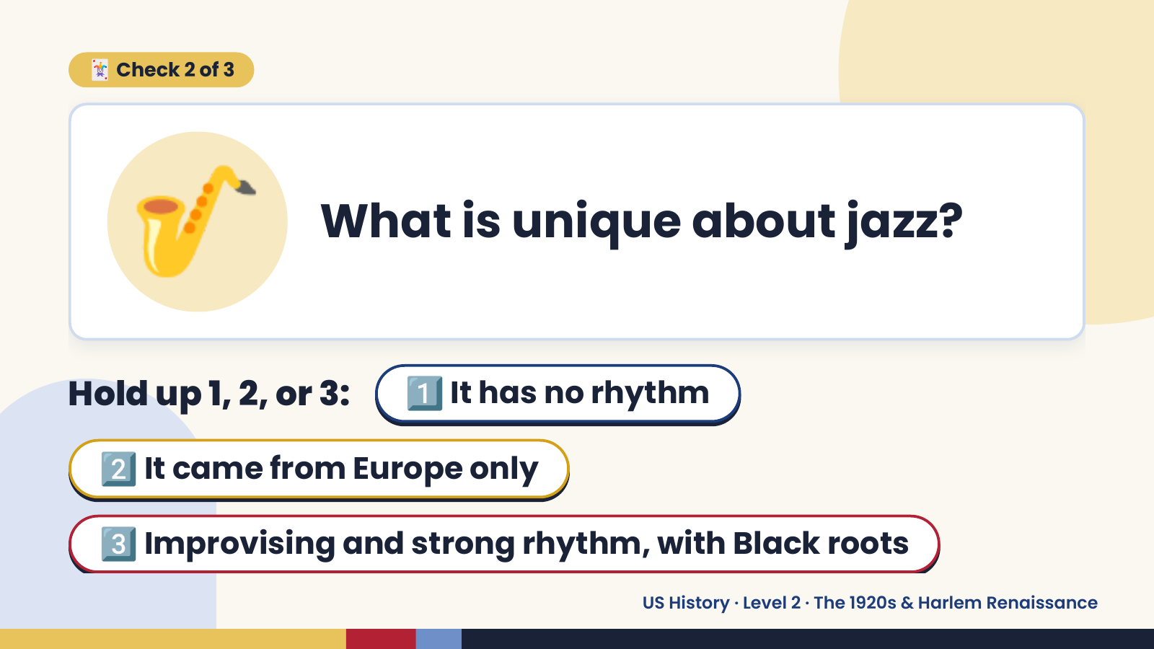
Notes:
🎷
🃏 Check 2 of 3
What is unique about jazz?
Hold up 1, 2, or 3: 1️⃣ It has no rhythm
2️⃣ It came from Europe only
3️⃣ Improvising and strong rhythm, with Black roots
US History · Level 2 · The 1920s & Harlem Renaissance

Slide 13
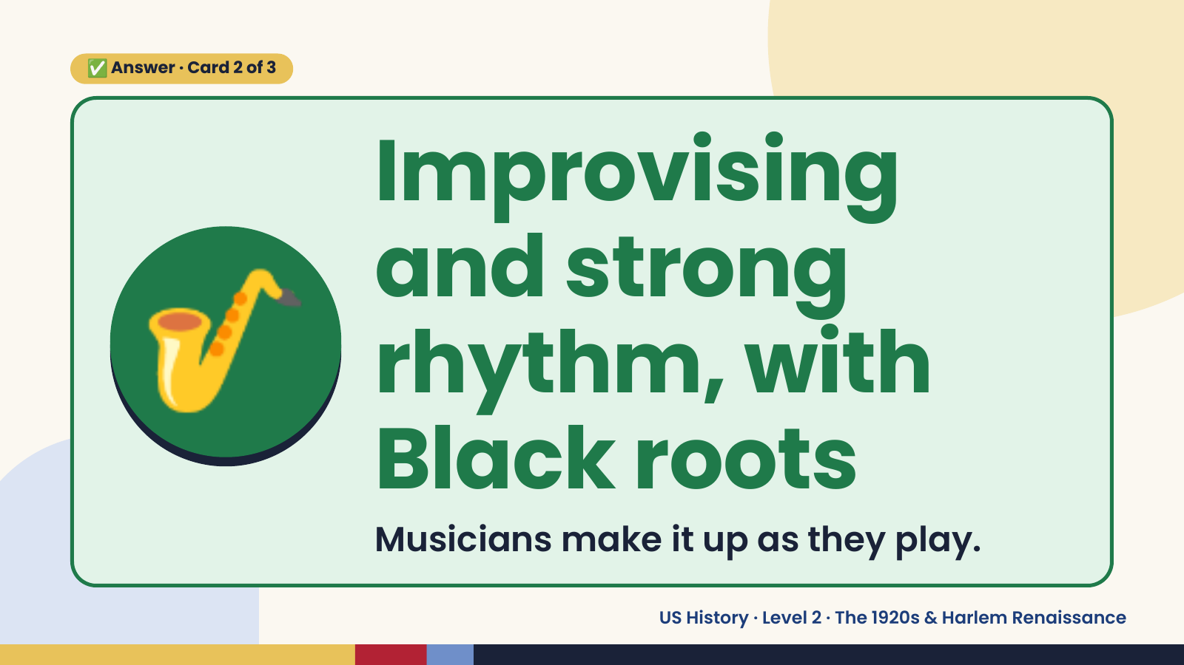
Notes:
✅ Answer · Card 2 of 3
🎷
Improvising
and strong
rhythm, with
Black roots
Musicians make it up as they play.
US History · Level 2 · The 1920s & Harlem Renaissance

Slide 14
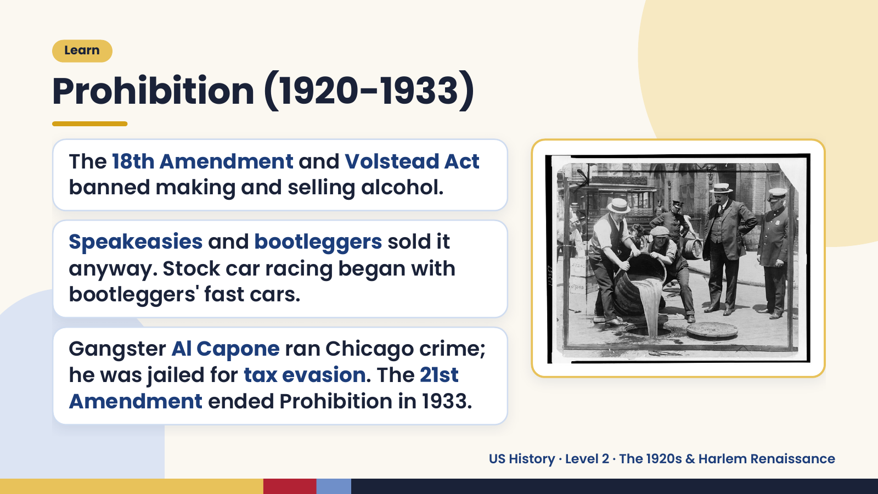
Notes:
Learn
Prohibition (1920-1933)
The 18th Amendment and Volstead Act
banned making and selling alcohol.
Speakeasies and bootleggers sold it
anyway. Stock car racing began with
bootleggers' fast cars.
Gangster Al Capone ran Chicago crime;
he was jailed for tax evasion. The 21st
Amendment ended Prohibition in 1933.
US History · Level 2 · The 1920s & Harlem Renaissance

Slide 15
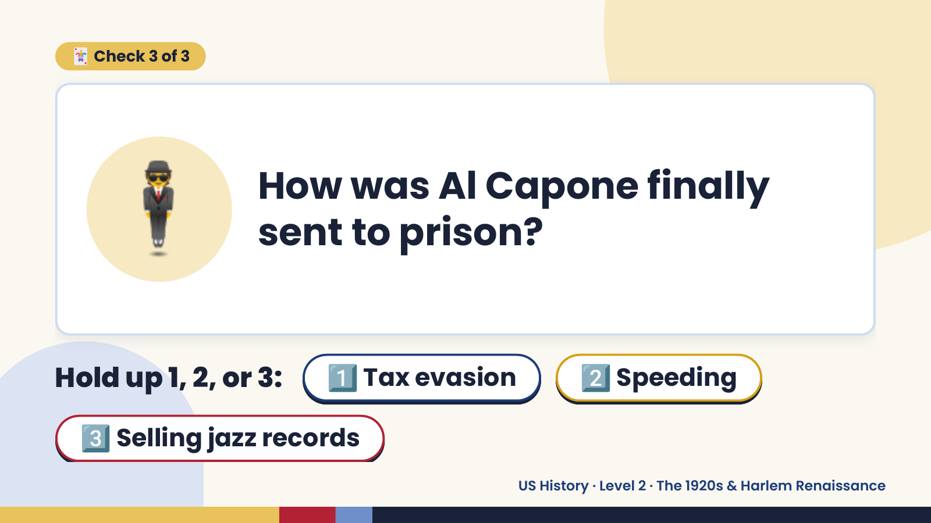
Notes:
🃏 Check 3 of 3
🕴️ How was Al Capone finally
sent to prison?
Hold up 1, 2, or 3: 1️⃣ Tax evasion 2️⃣ Speeding
3️⃣ Selling jazz records
US History · Level 2 · The 1920s & Harlem Renaissance

Slide 16
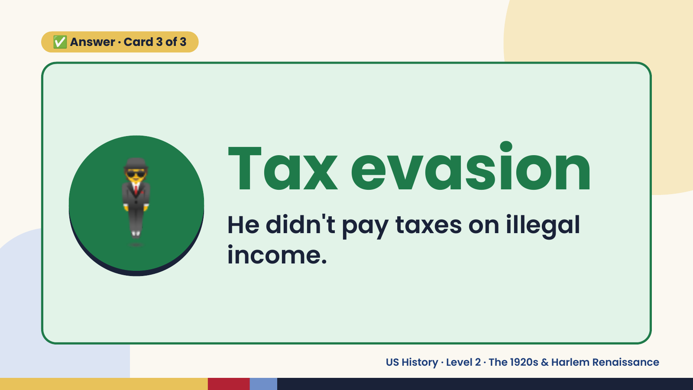
Notes:
✅ Answer · Card 3 of 3
🕴️ Tax evasion
He didn't pay taxes on illegal
income.
US History · Level 2 · The 1920s & Harlem Renaissance

Slide 17
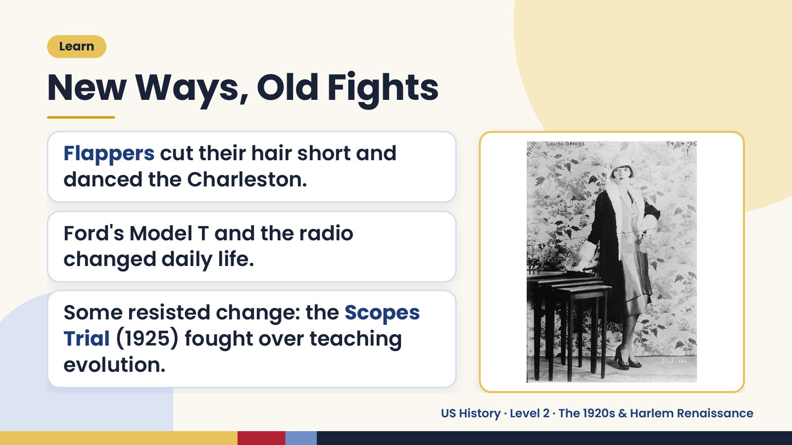
Notes:
Learn
New Ways, Old Fights
Flappers cut their hair short and
danced the Charleston.
Ford's Model T and the radio
changed daily life.
Some resisted change: the Scopes
Trial (1925) fought over teaching
evolution.
US History · Level 2 · The 1920s & Harlem Renaissance

Slide 18
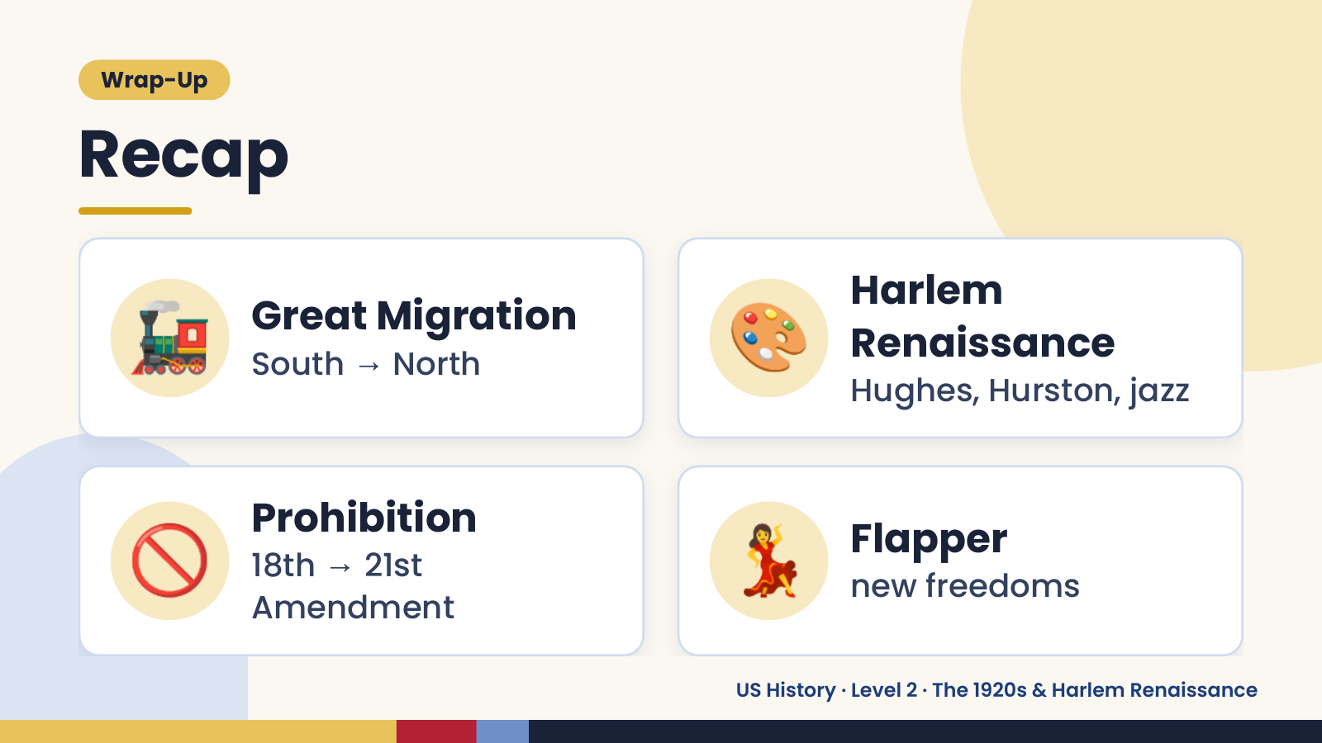
Notes:
Wrap-Up
Recap
🚂 Great Migration
South → North 🎨 Harlem
Renaissance
Hughes, Hurston, jazz
🚫 Prohibition
18th → 21st
Amendment
💃 Flapper
new freedoms
US History · Level 2 · The 1920s & Harlem Renaissance

Slide 19
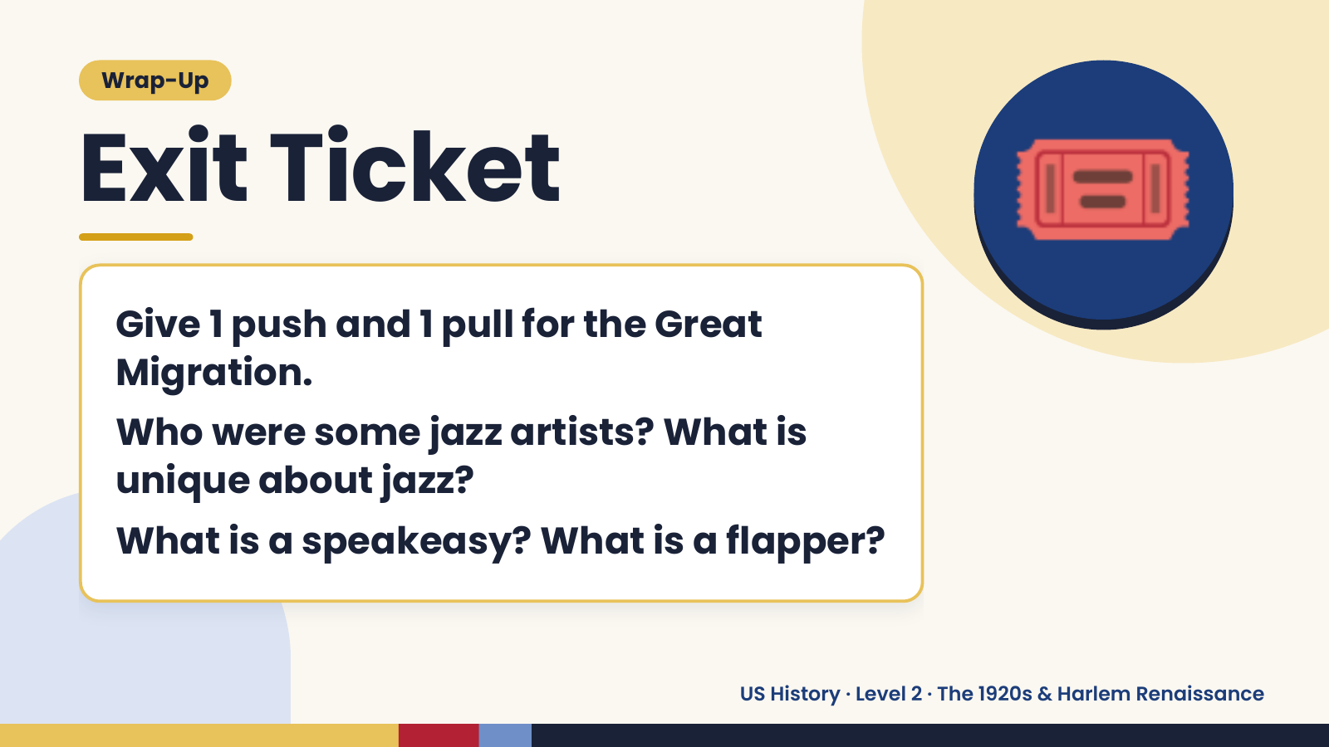
Notes:
Wrap-Up
Exit Ticket
Give 1 push and 1 pull for the Great
Migration.
🎟️
Who were some jazz artists? What is
unique about jazz?
What is a speakeasy? What is a flapper?
US History · Level 2 · The 1920s & Harlem Renaissance

