Slide 1
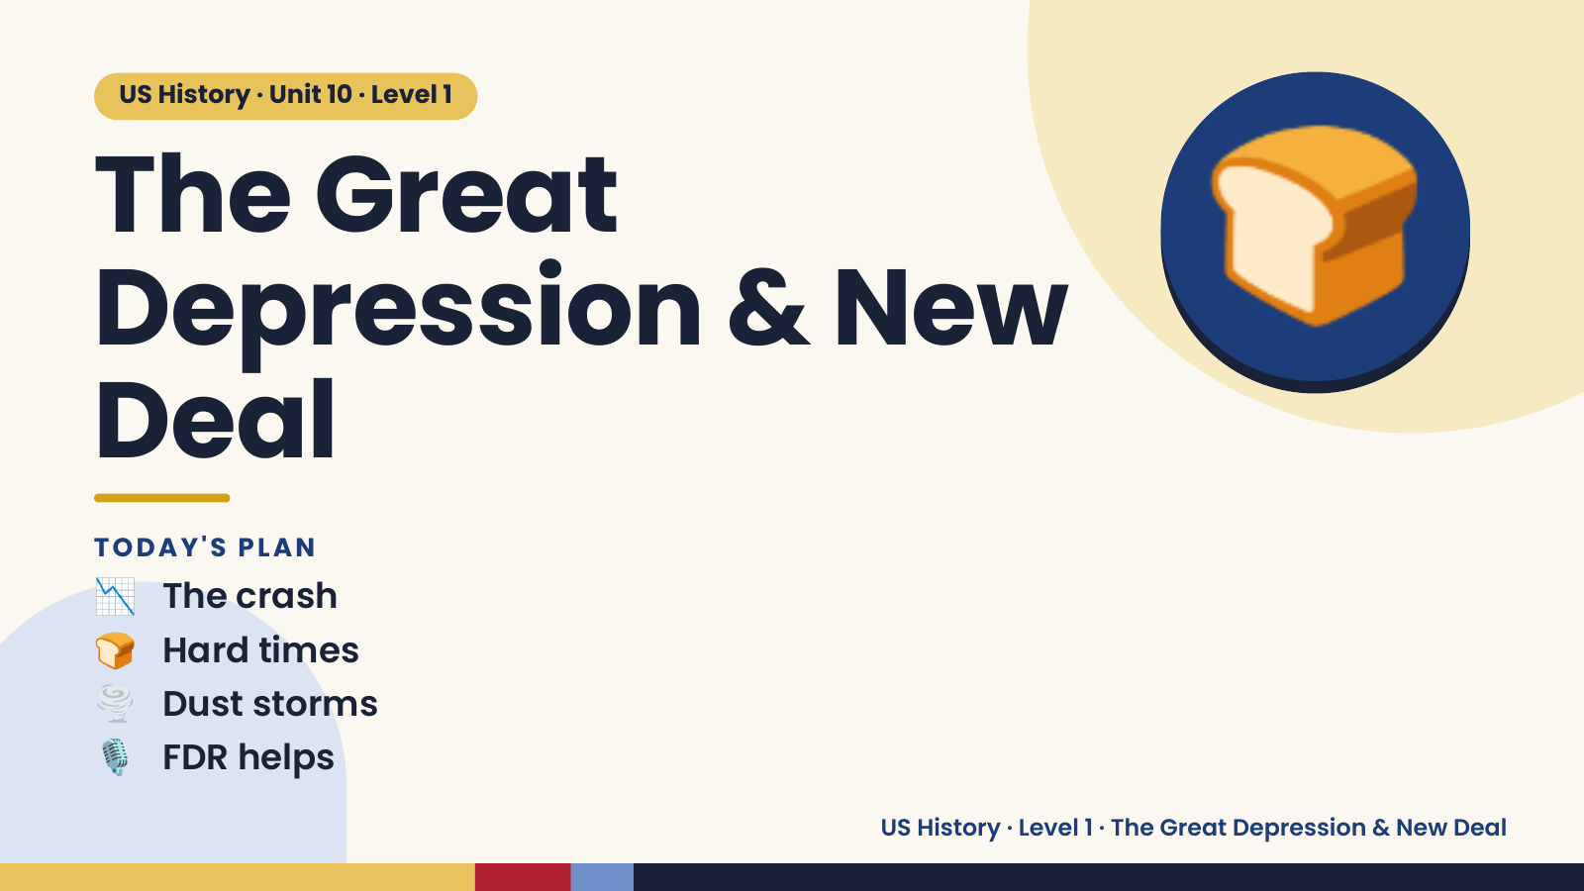
Notes:
US History · Unit 10 · Level 1
The Great
Depression & New
Deal
🍞
📉 The crash
TODAY'S PLAN
🍞 Hard times
🌪️ Dust storms
🎙️ FDR helps
US History · Level 1 · The Great Depression & New Deal

Slide 2
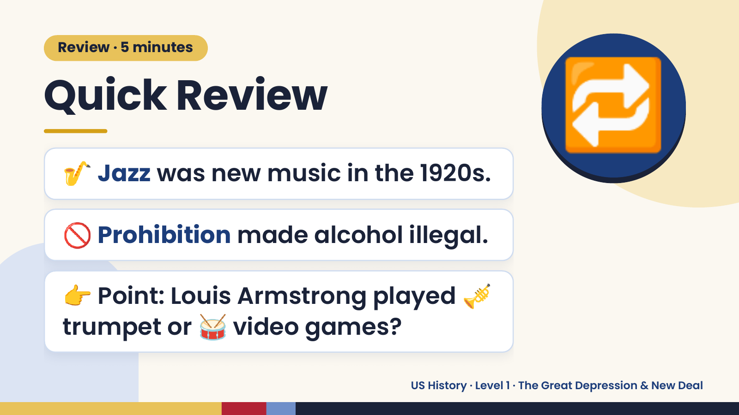
Notes:
Review · 5 minutes
Quick Review
🎷 Jazz was new music in the 1920s.
🔁
🚫 Prohibition made alcohol illegal.
👉 Point: Louis Armstrong played 🎺
trumpet or 🥁 video games?
US History · Level 1 · The Great Depression & New Deal

Slide 3
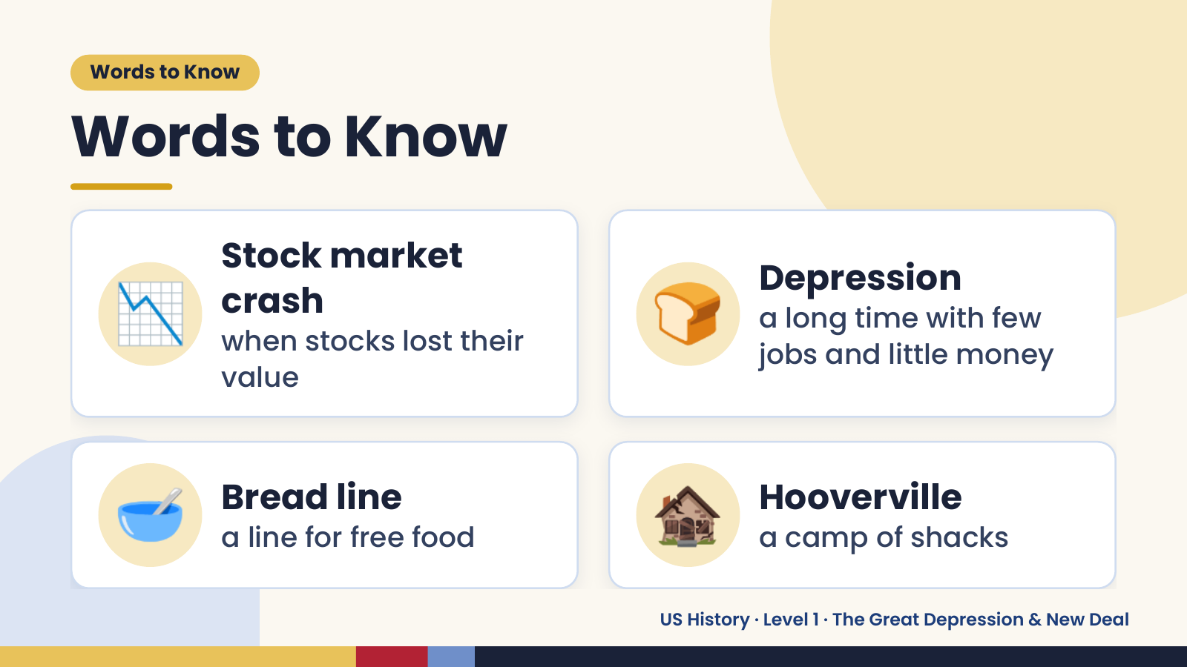
Notes:
Words to Know
Words to Know
📉 Stock market
crash
when stocks lost their
value
🍞 Depression
a long time with few
jobs and little money
🥣 Bread line
a line for free food 🏚️ Hooverville
a camp of shacks
US History · Level 1 · The Great Depression & New Deal

Slide 4
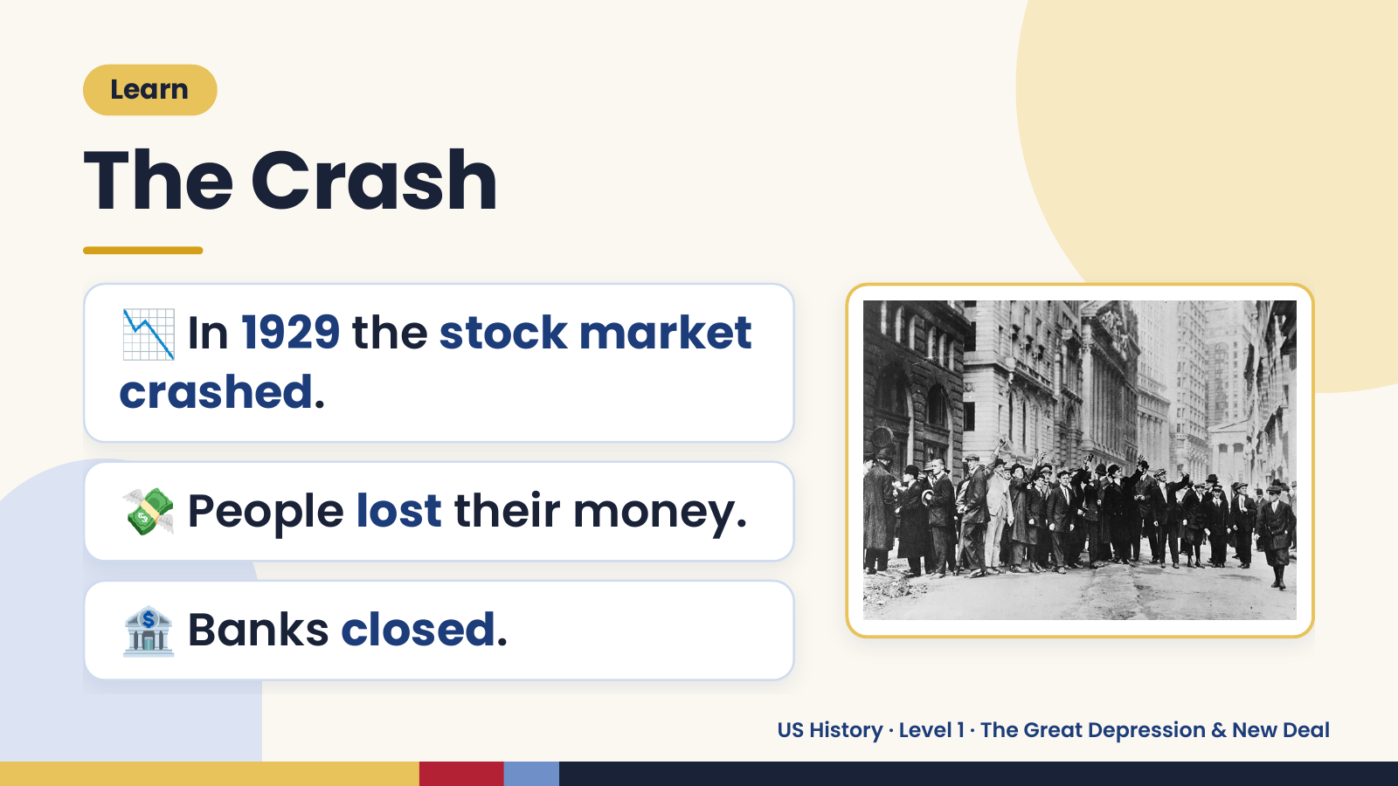
Notes:
Learn
The Crash
📉 In 1929 the stock market
crashed.
💸 People lost their money.
🏦 Banks closed.
US History · Level 1 · The Great Depression & New Deal

Slide 5
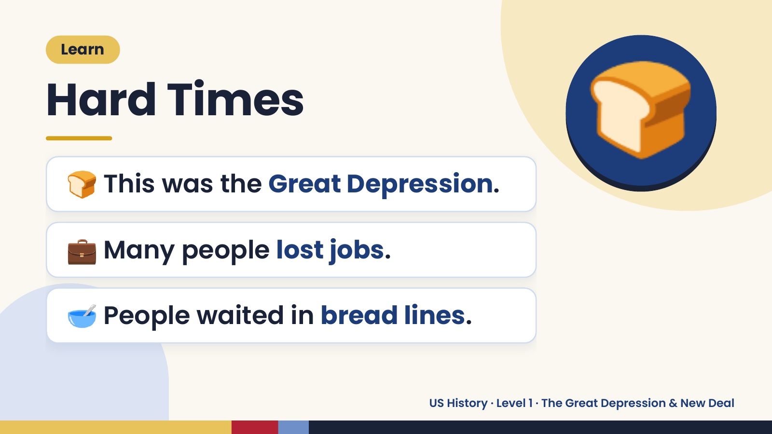
Notes:
Learn
Hard Times
🍞 This was the Great Depression.
🍞
💼 Many people lost jobs.
🥣 People waited in bread lines.
US History · Level 1 · The Great Depression & New Deal

Slide 6
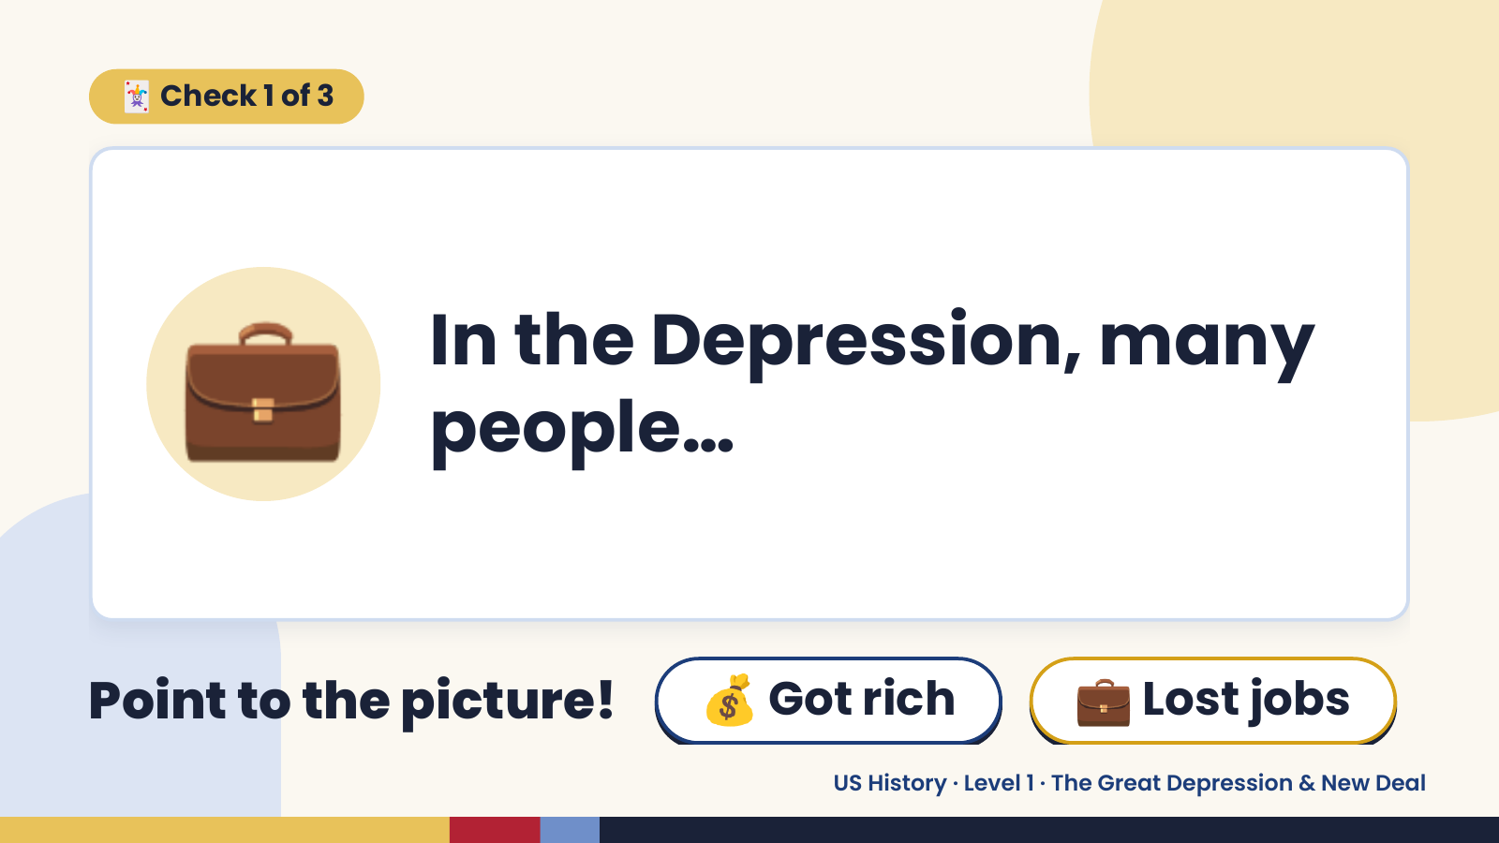
Notes:
🃏 Check 1 of 3
💼 In the Depression, many
people…
Point to the picture! 💰 Got rich 💼 Lost jobs
US History · Level 1 · The Great Depression & New Deal

Slide 7
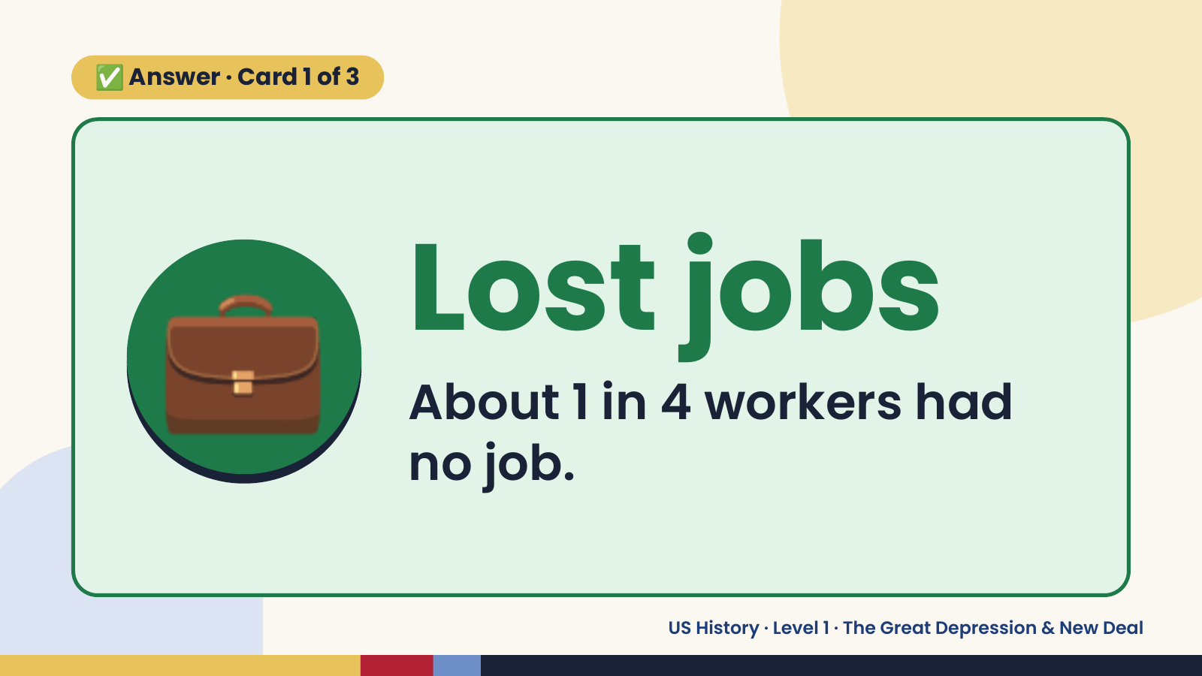
Notes:
✅ Answer · Card 1 of 3
💼 Lost jobs
About 1 in 4 workers had
no job.
US History · Level 1 · The Great Depression & New Deal

Slide 8
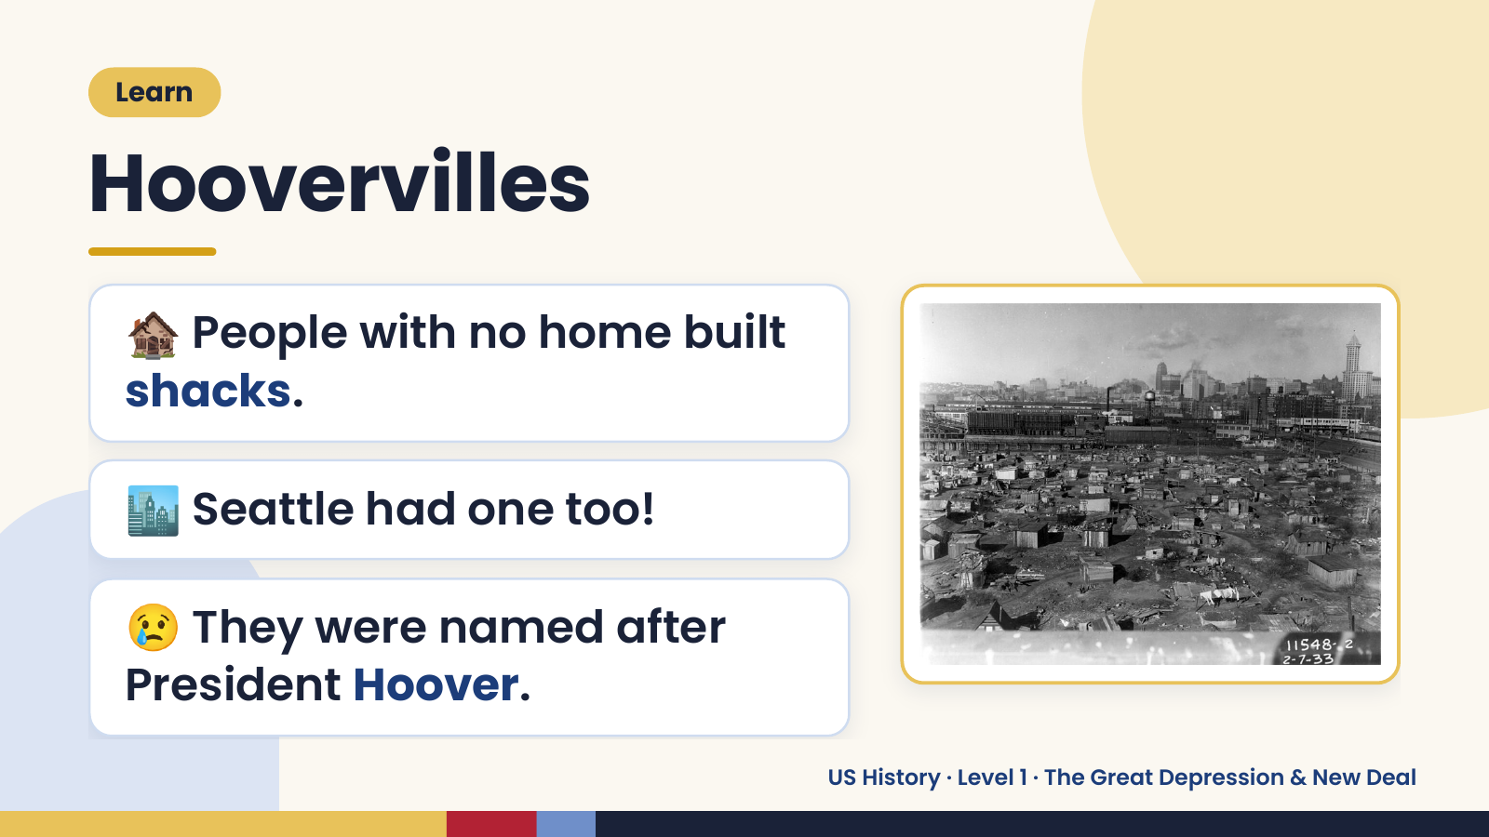
Notes:
Learn
Hoovervilles
🏚️ People with no home built
shacks.
🏙️ Seattle had one too!
😢 They were named after
President Hoover.
US History · Level 1 · The Great Depression & New Deal

Slide 9
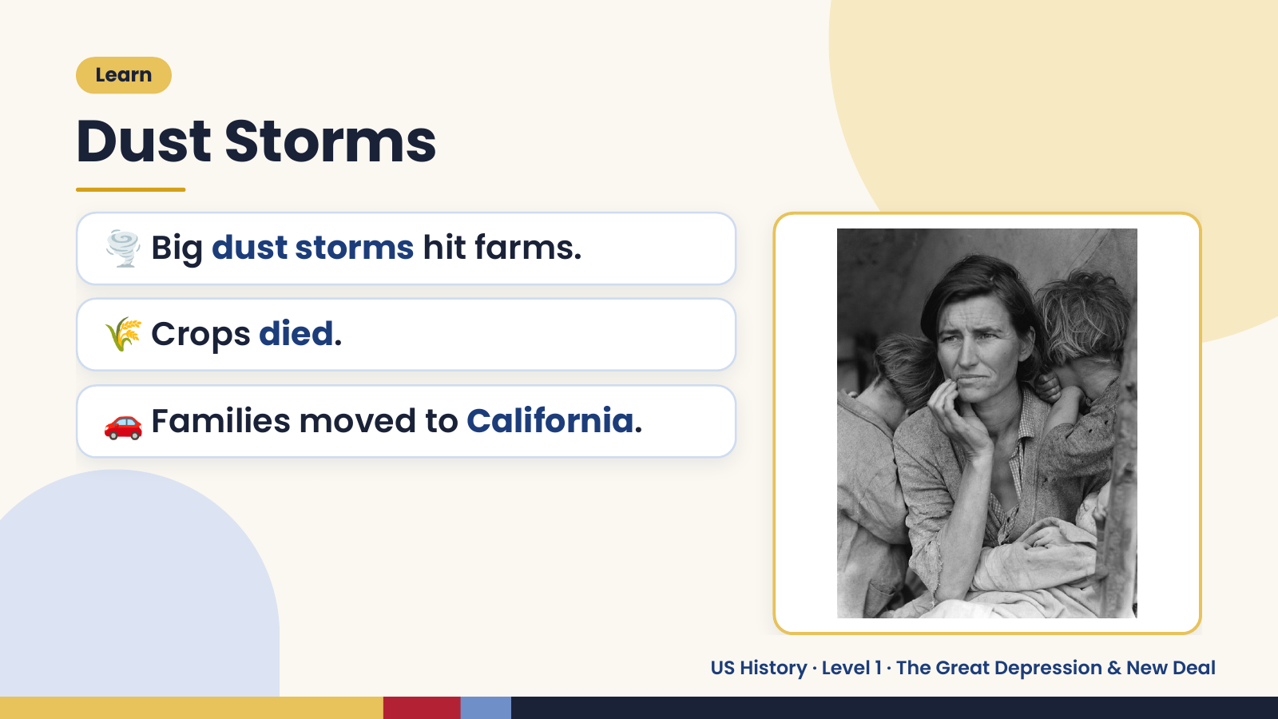
Notes:
Learn
Dust Storms
🌪️ Big dust storms hit farms.
🌾 Crops died.
🚗 Families moved to California.
US History · Level 1 · The Great Depression & New Deal

Slide 10
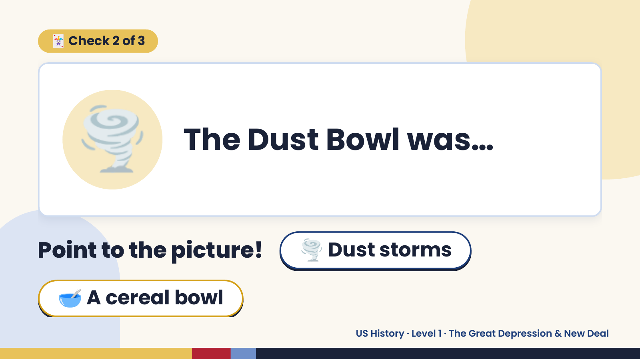
Notes:
🃏 Check 2 of 3
🌪️ The Dust Bowl was…
Point to the picture! 🌪️ Dust storms
🥣 A cereal bowl
US History · Level 1 · The Great Depression & New Deal

Slide 11
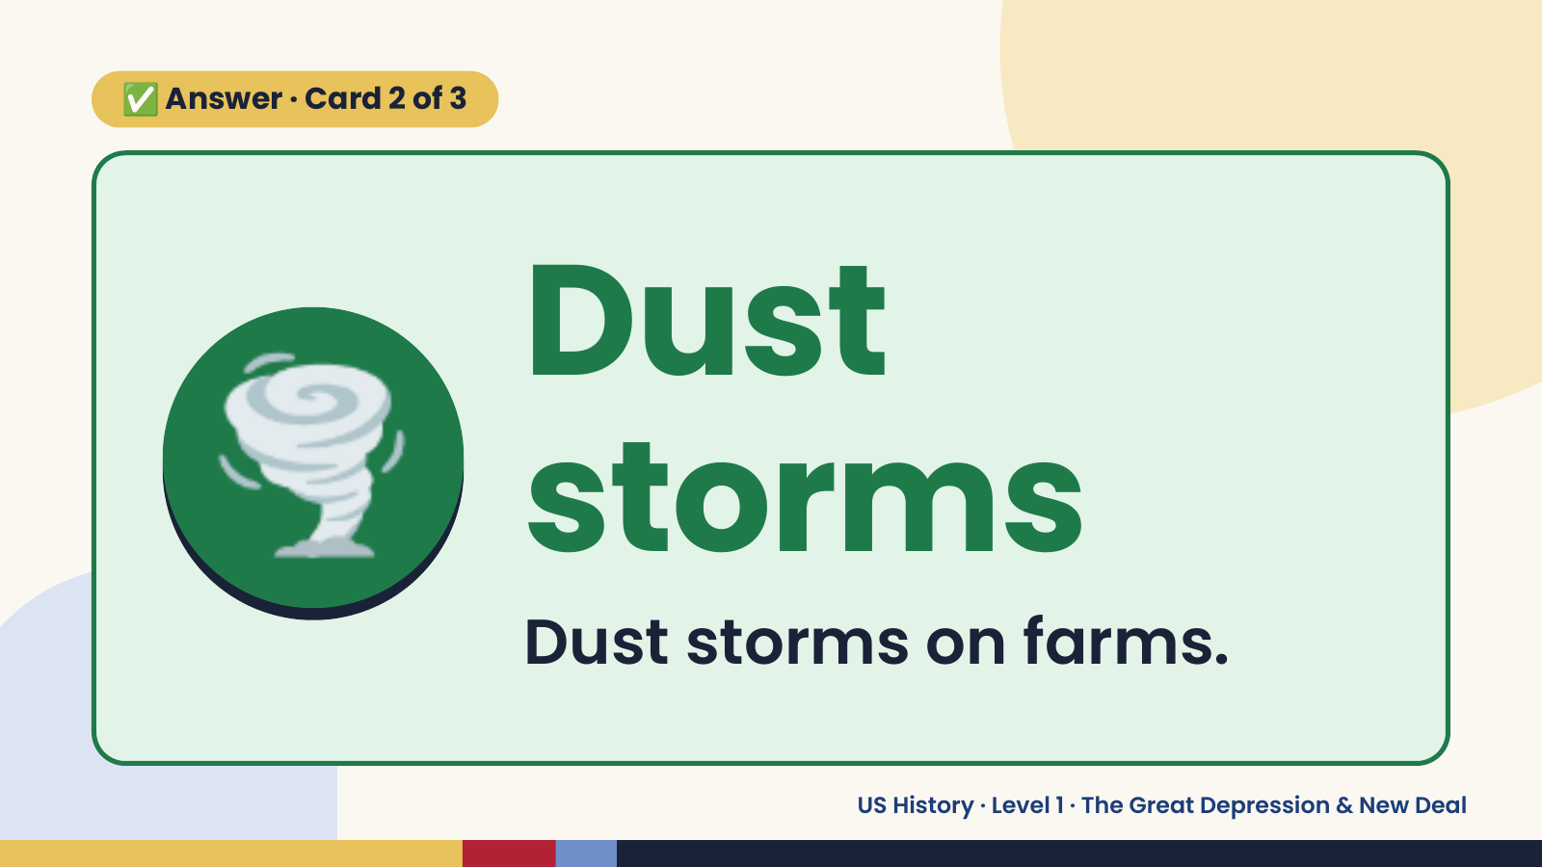
Notes:
✅ Answer · Card 2 of 3
🌪️ Dust
storms
Dust storms on farms.
US History · Level 1 · The Great Depression & New Deal

Slide 12
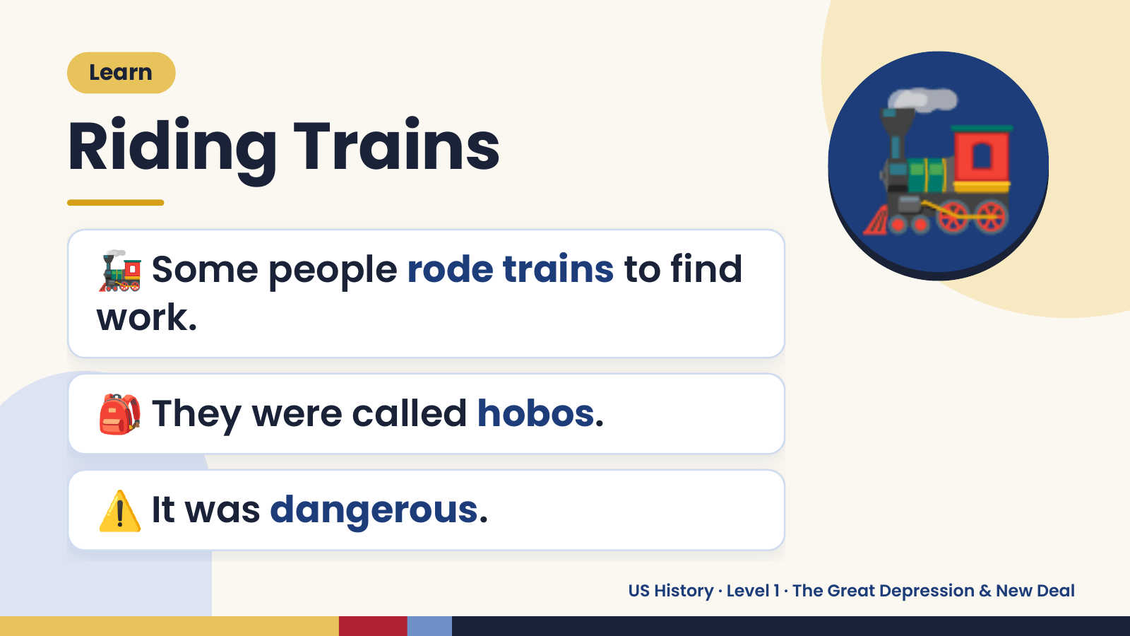
Notes:
Learn
Riding Trains
🚂 Some people rode trains to find
work.
🚂
🎒 They were called hobos.
⚠️ It was dangerous.
US History · Level 1 · The Great Depression & New Deal

Slide 13
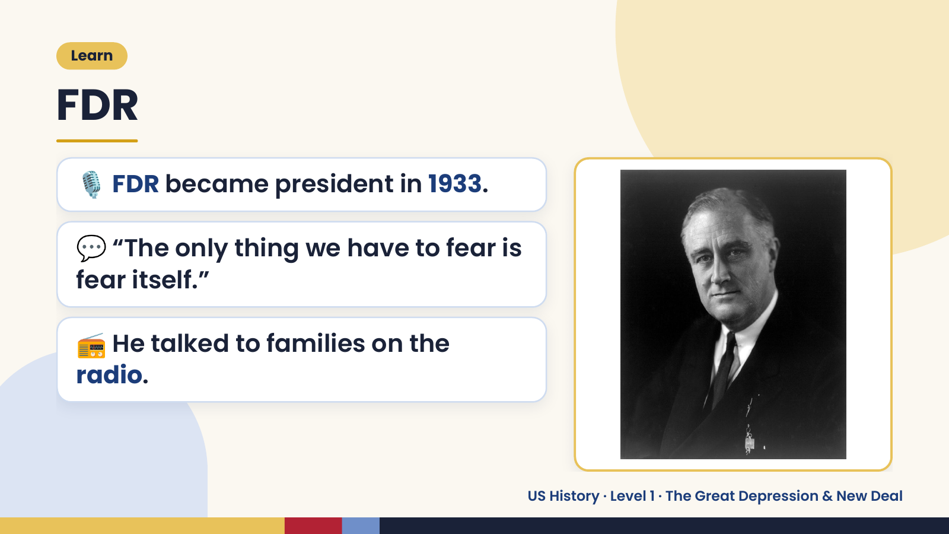
Notes:
Learn
FDR
🎙️ FDR became president in 1933.
💬 “The only thing we have to fear is
fear itself.”
📻 He talked to families on the
radio.
US History · Level 1 · The Great Depression & New Deal

Slide 14
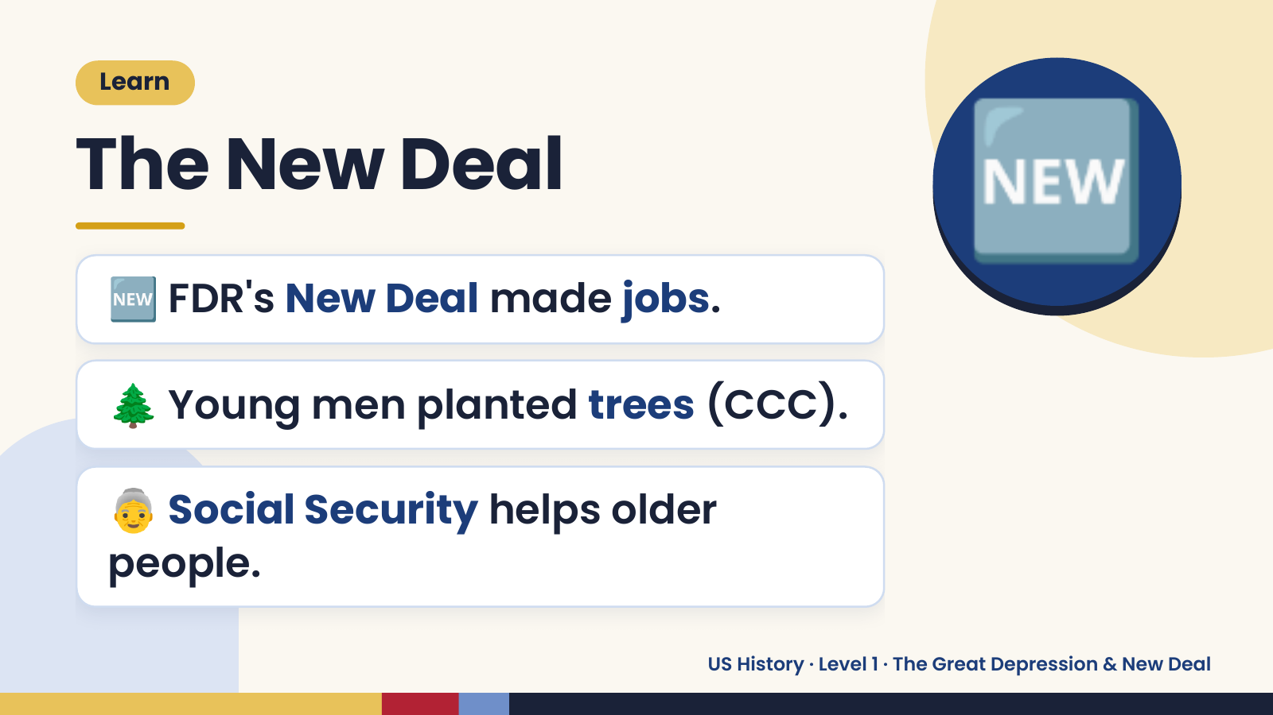
Notes:
Learn
The New Deal
🆕 FDR's New Deal made jobs.
🆕
🌲 Young men planted trees (CCC).
👵 Social Security helps older
people.
US History · Level 1 · The Great Depression & New Deal

Slide 15
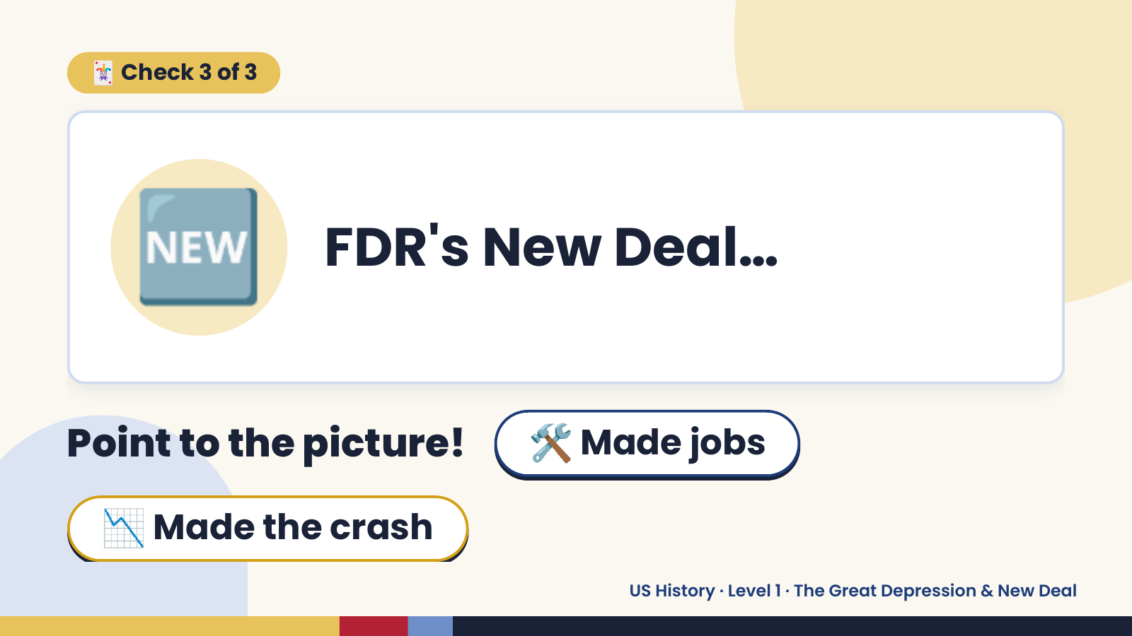
Notes:
🃏 Check 3 of 3
🆕 FDR's New Deal…
Point to the picture! 🛠️ Made jobs
📉 Made the crash
US History · Level 1 · The Great Depression & New Deal

Slide 16
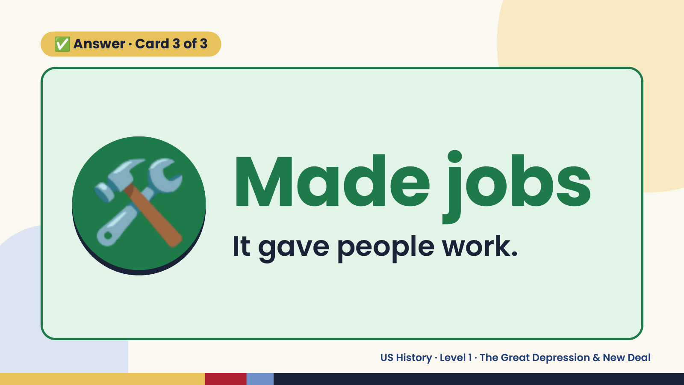
Notes:
✅ Answer · Card 3 of 3
🛠️ Made jobs
It gave people work.
US History · Level 1 · The Great Depression & New Deal

Slide 17
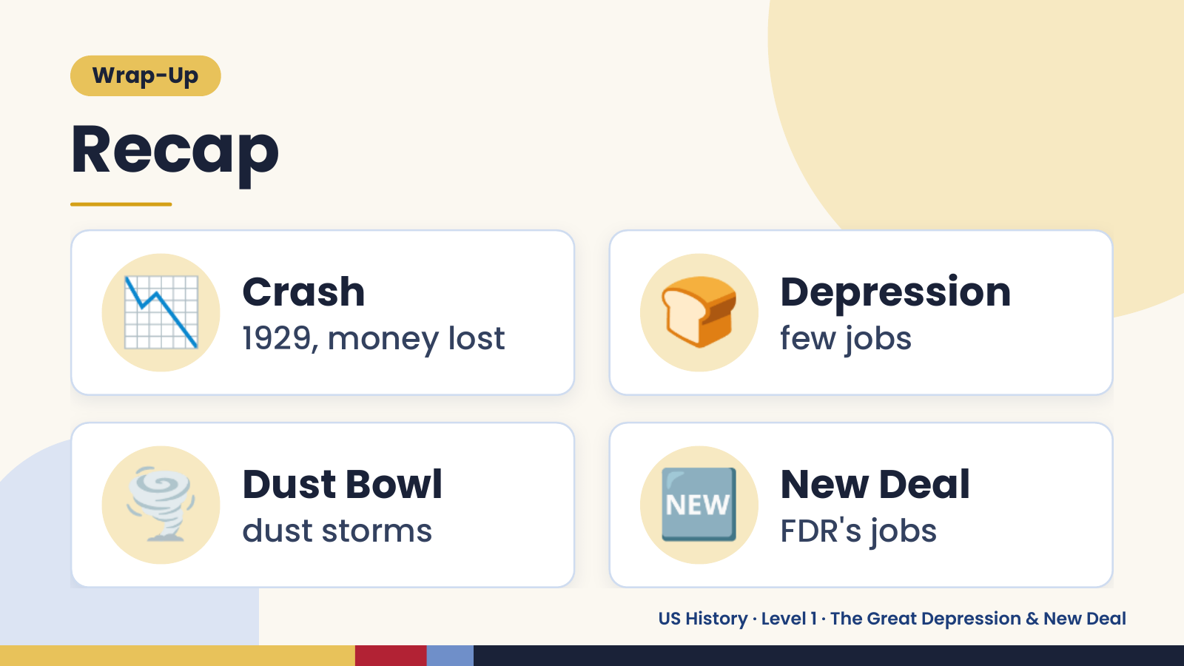
Notes:
Wrap-Up
Recap
📉 Crash
1929, money lost 🍞 Depression
few jobs
🌪️ Dust Bowl
dust storms 🆕 New Deal
FDR's jobs
US History · Level 1 · The Great Depression & New Deal

Slide 18
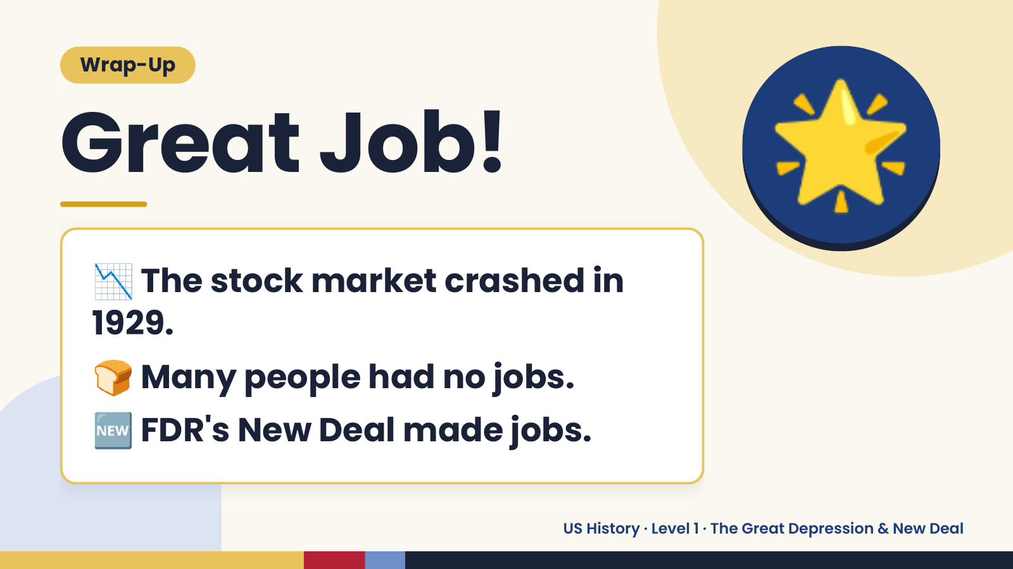
Notes:
Wrap-Up
Great Job!
📉 The stock market crashed in
🌟
1929.
🍞 Many people had no jobs.
🆕 FDR's New Deal made jobs.
US History · Level 1 · The Great Depression & New Deal

