Slide 1
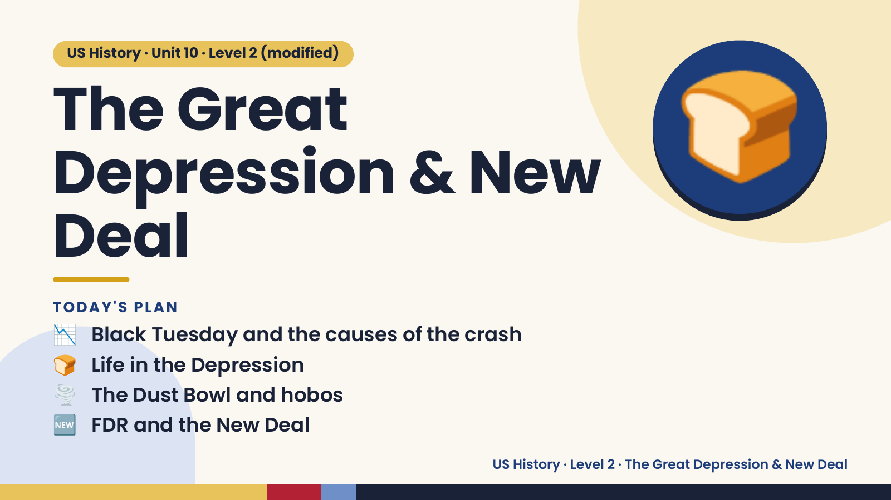
Notes:
US History · Unit 10 · Level 2 (modified)
The Great
Depression & New
Deal
🍞
📉 Black Tuesday and the causes of the crash
TODAY'S PLAN
🍞 Life in the Depression
🌪️ The Dust Bowl and hobos
🆕 FDR and the New Deal
US History · Level 2 · The Great Depression & New Deal

Slide 2
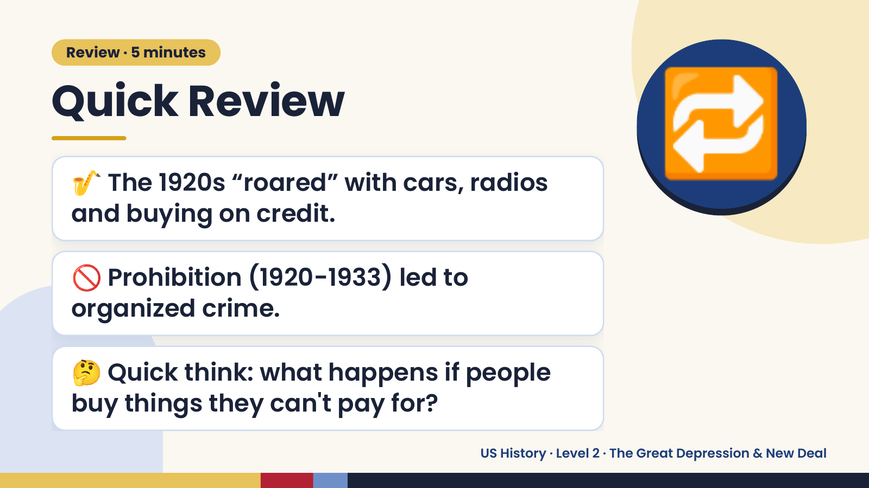
Notes:
Review · 5 minutes
Quick Review
🎷 The 1920s “roared” with cars, radios
and buying on credit.
🔁
🚫 Prohibition (1920-1933) led to
organized crime.
🤔 Quick think: what happens if people
buy things they can't pay for?
US History · Level 2 · The Great Depression & New Deal

Slide 3
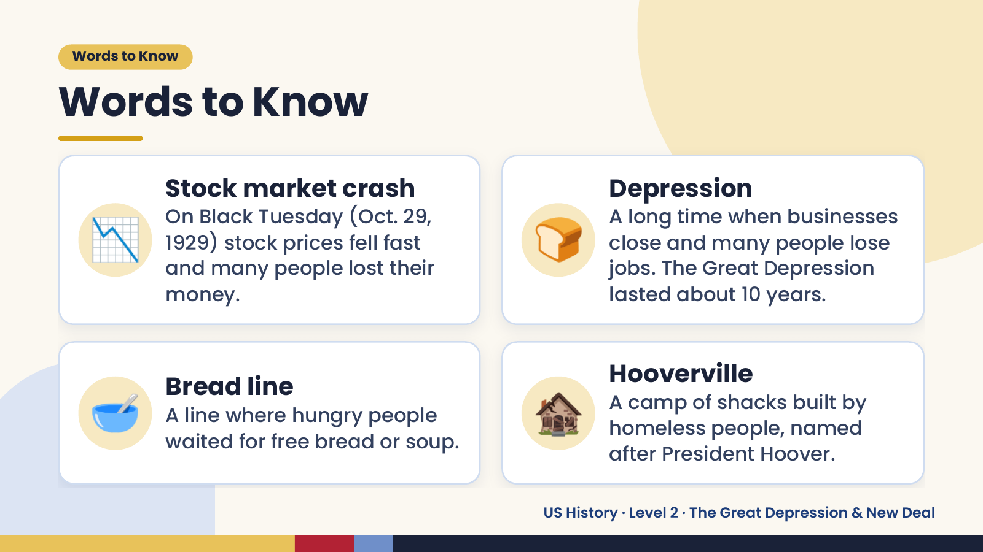
Notes:
Words to Know
Words to Know
📉 🍞
Stock market crash Depression
On Black Tuesday (Oct. 29, A long time when businesses
1929) stock prices fell fast close and many people lose
and many people lost their jobs. The Great Depression
money. lasted about 10 years.
🥣 Bread line
A line where hungry people
waited for free bread or soup.
🏚️ Hooverville
A camp of shacks built by
homeless people, named
after President Hoover.
US History · Level 2 · The Great Depression & New Deal

Slide 4
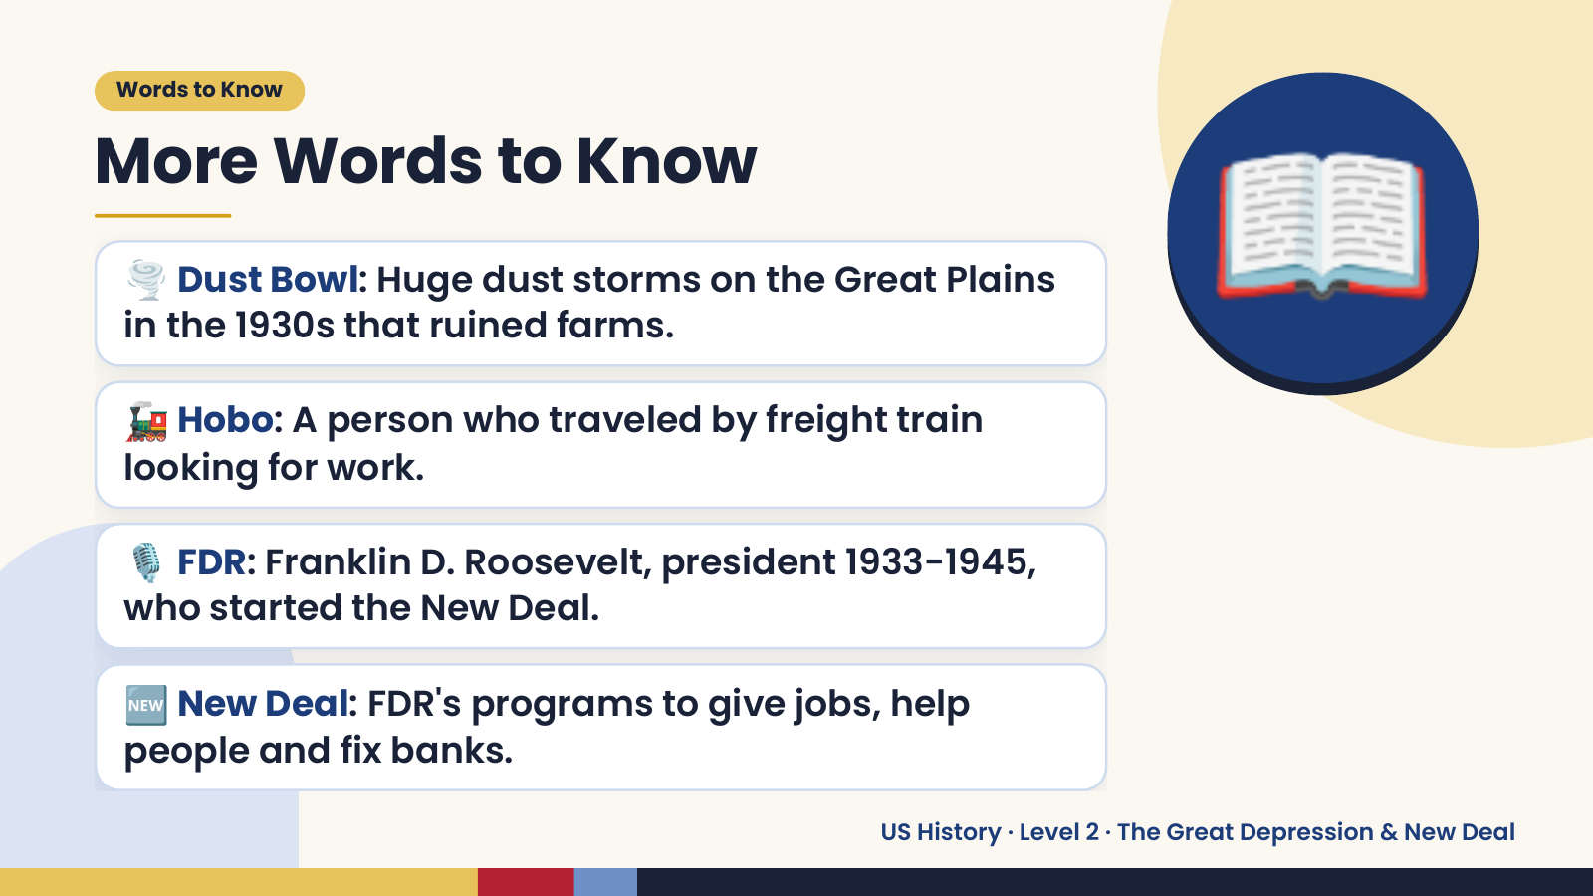
Notes:
Words to Know
More Words to Know
🌪️ Dust Bowl: Huge dust storms on the Great Plains
in the 1930s that ruined farms.
🚂 Hobo: A person who traveled by freight train
looking for work.
📖
🎙️ FDR: Franklin D. Roosevelt, president 1933-1945,
who started the New Deal.
🆕 New Deal: FDR's programs to give jobs, help
people and fix banks.
US History · Level 2 · The Great Depression & New Deal

Slide 5
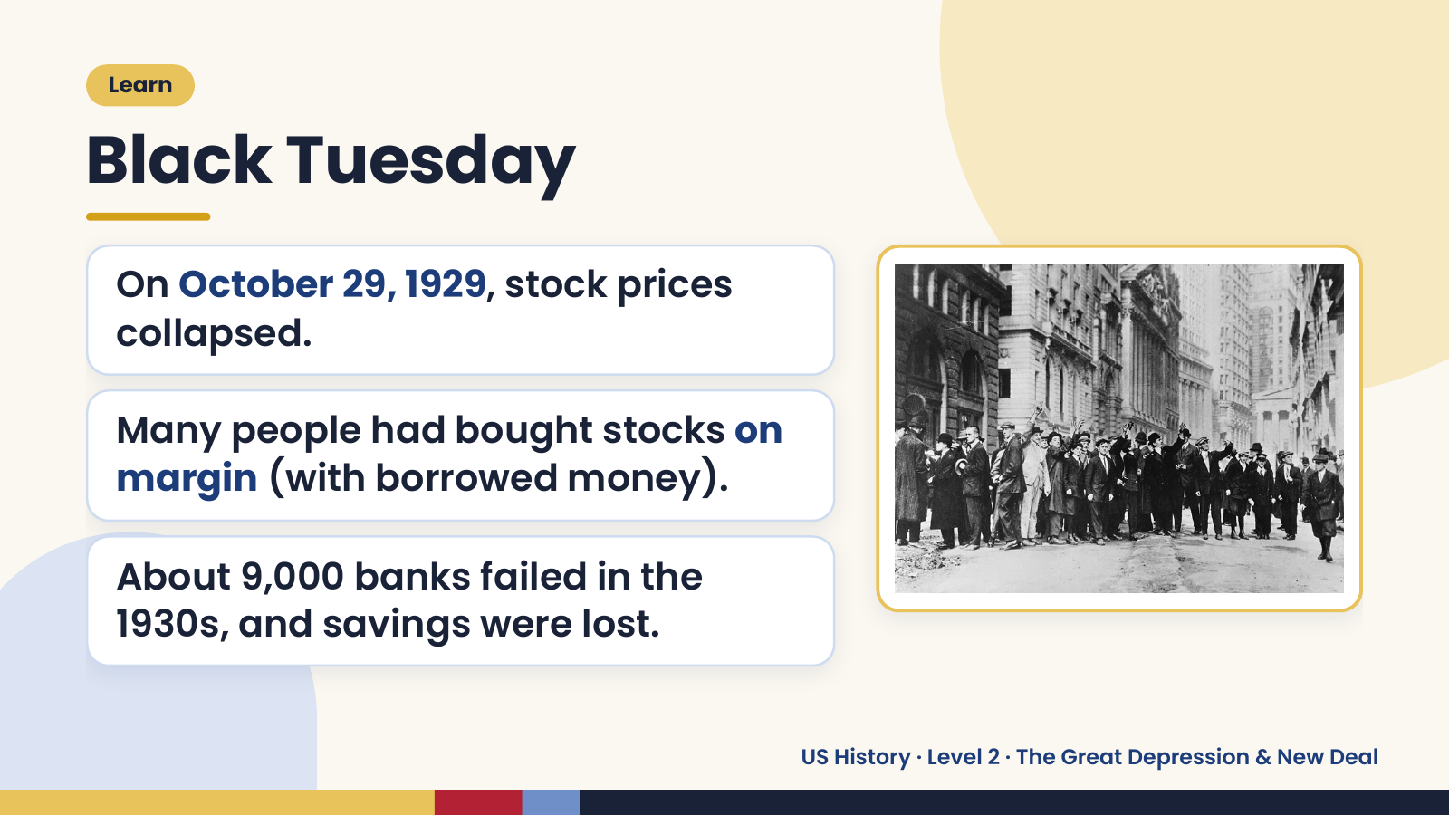
Notes:
Learn
Black Tuesday
On October 29, 1929, stock prices
collapsed.
Many people had bought stocks on
margin (with borrowed money).
About 9,000 banks failed in the
1930s, and savings were lost.
US History · Level 2 · The Great Depression & New Deal

Slide 6
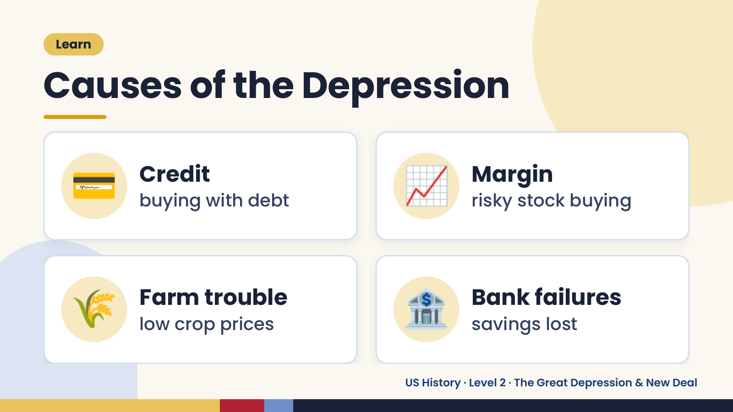
Notes:
Learn
Causes of the Depression
💳 Credit
buying with debt 📈 Margin
risky stock buying
🌾 Farm trouble
low crop prices 🏦 Bank failures
savings lost
US History · Level 2 · The Great Depression & New Deal

Slide 7
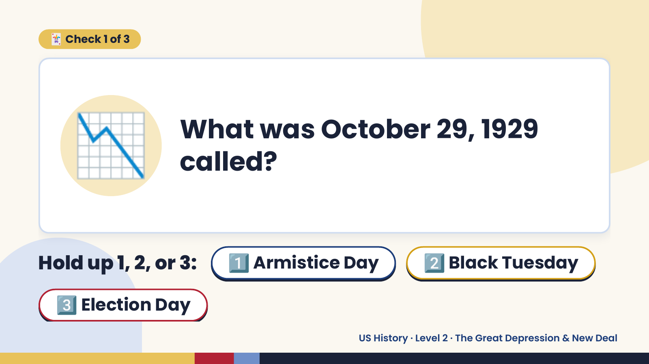
Notes:
🃏 Check 1 of 3
📉 What was October 29, 1929
called?
Hold up 1, 2, or 3: 1️⃣ Armistice Day 2️⃣ Black Tuesday
3️⃣ Election Day
US History · Level 2 · The Great Depression & New Deal

Slide 8
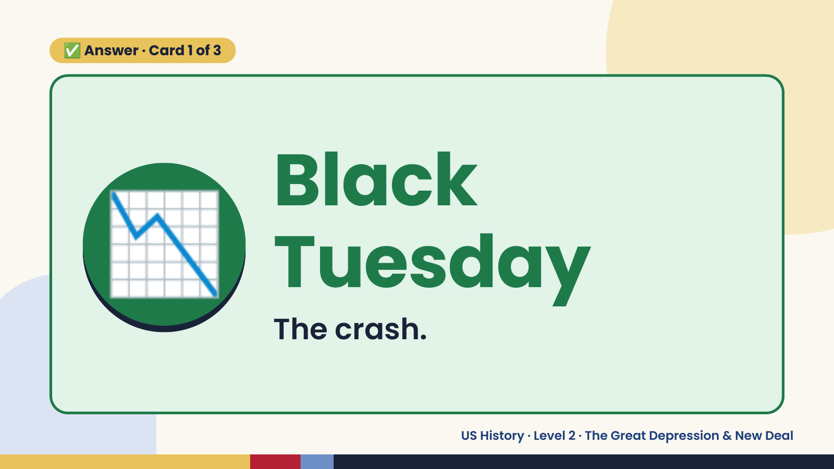
Notes:
✅ Answer · Card 1 of 3
📉 Black
Tuesday
The crash.
US History · Level 2 · The Great Depression & New Deal

Slide 9
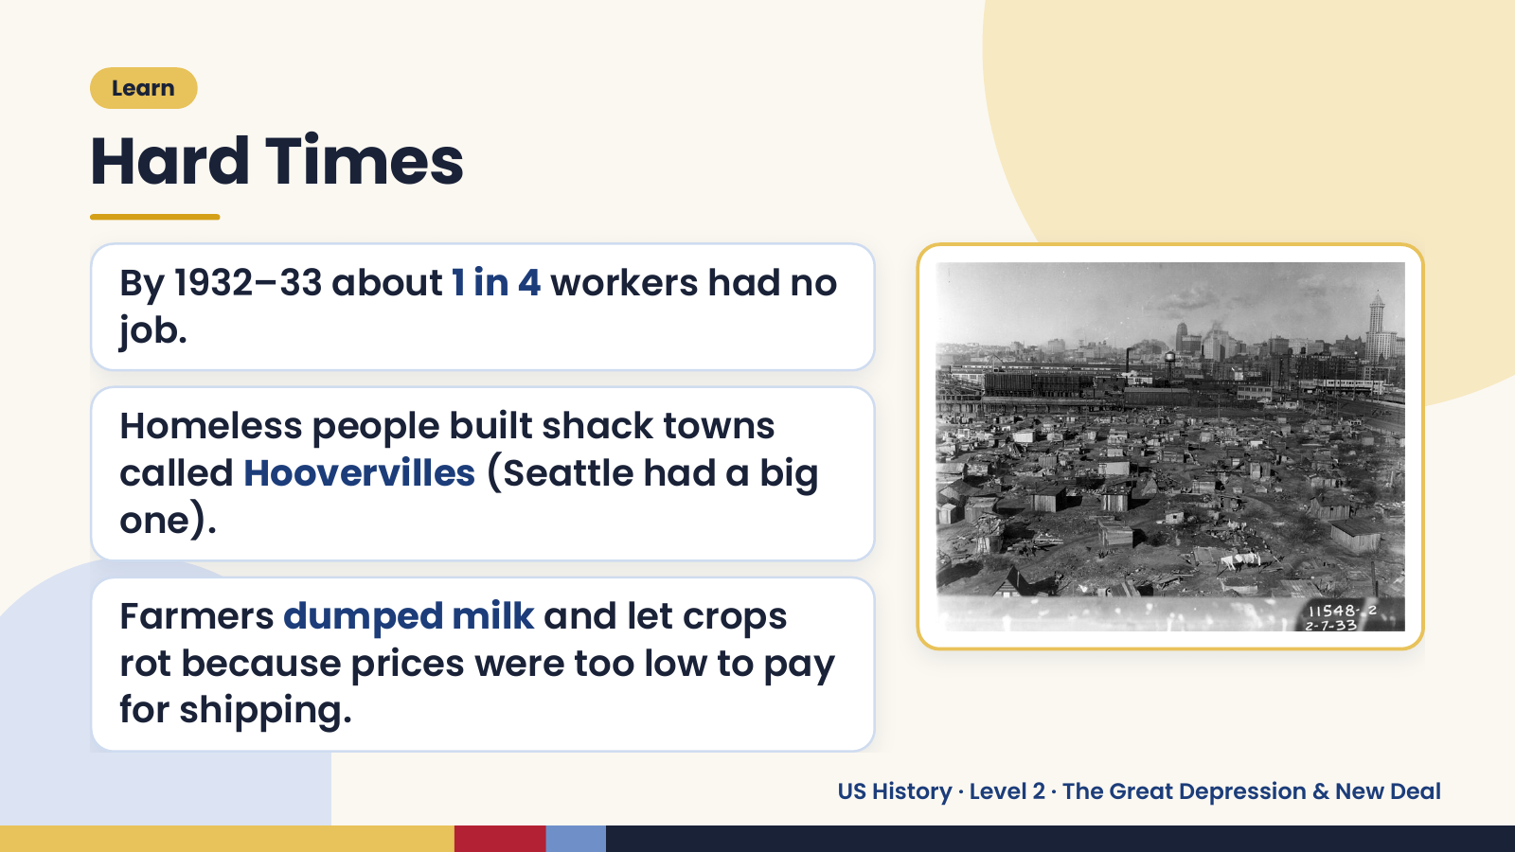
Notes:
Learn
Hard Times
By 1932–33 about 1 in 4 workers had no
job.
Homeless people built shack towns
called Hoovervilles (Seattle had a big
one).
Farmers dumped milk and let crops
rot because prices were too low to pay
for shipping.
US History · Level 2 · The Great Depression & New Deal

Slide 10
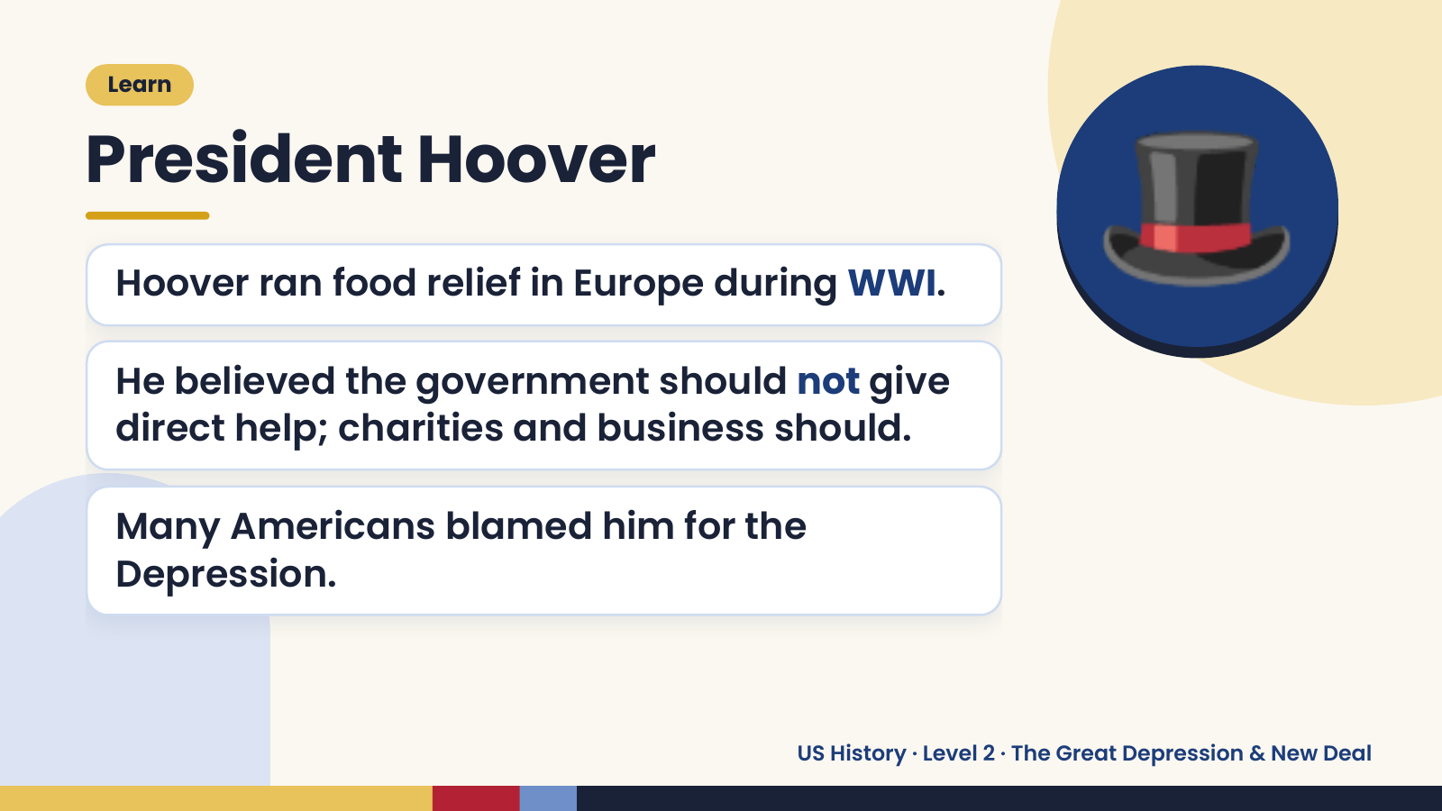
Notes:
Learn
President Hoover
Hoover ran food relief in Europe during WWI.
He believed the government should not give
direct help; charities and business should.
🎩
Many Americans blamed him for the
Depression.
US History · Level 2 · The Great Depression & New Deal

Slide 11
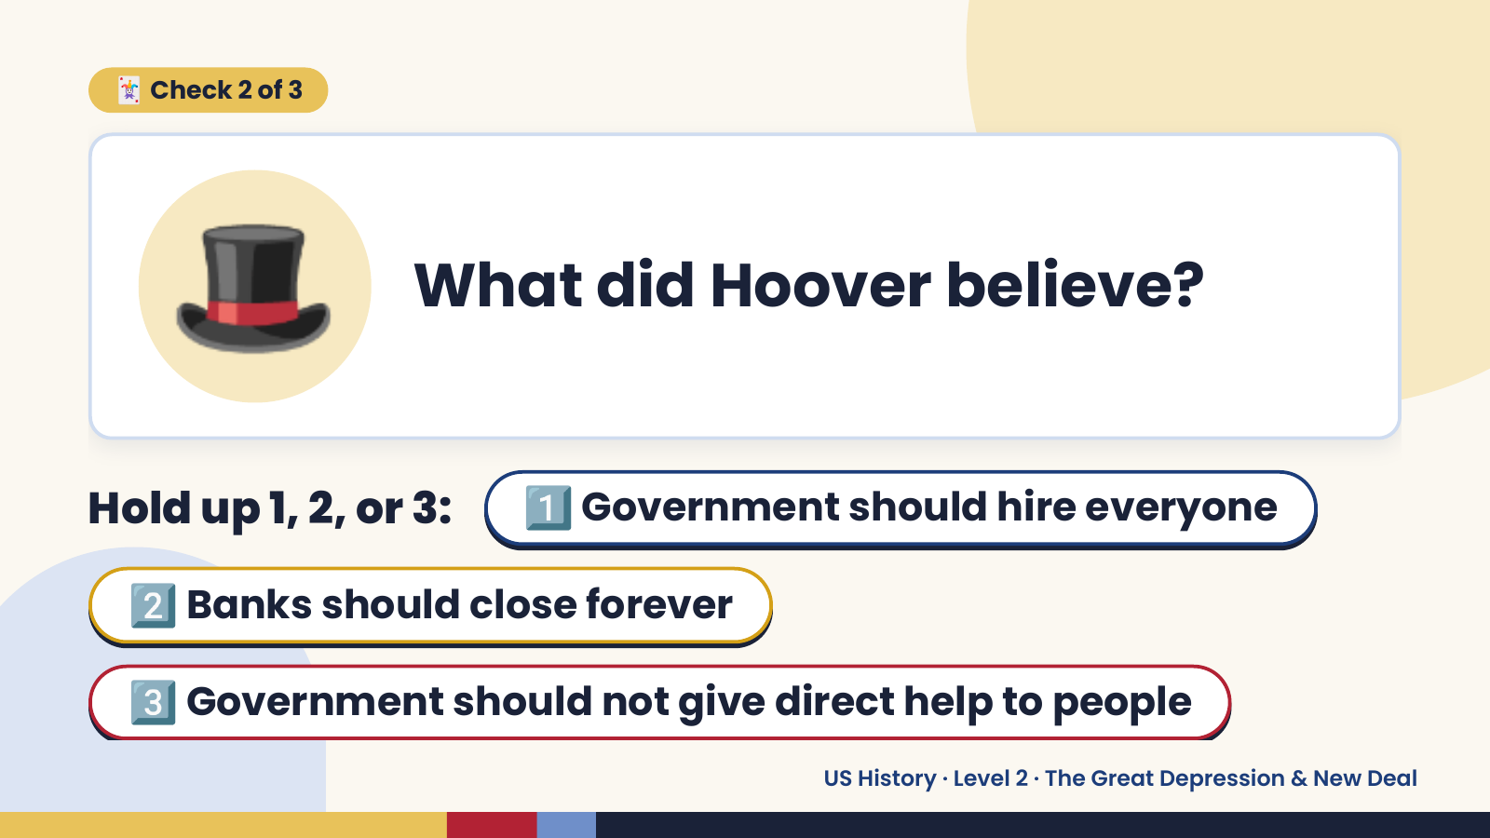
Notes:
🎩
🃏 Check 2 of 3
What did Hoover believe?
Hold up 1, 2, or 3: 1️⃣ Government should hire everyone
2️⃣ Banks should close forever
3️⃣ Government should not give direct help to people
US History · Level 2 · The Great Depression & New Deal

Slide 12
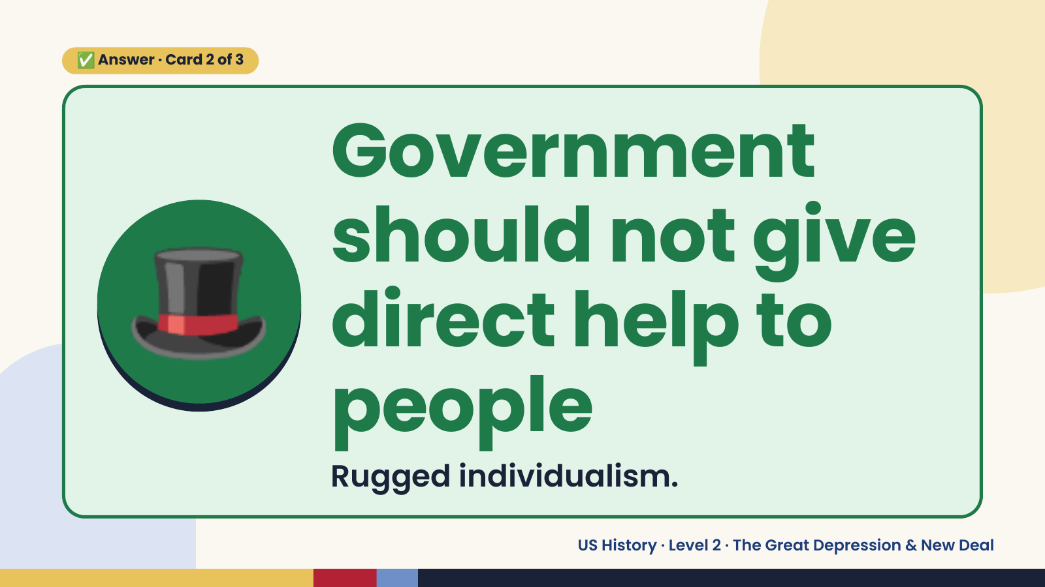
Notes:
✅ Answer · Card 2 of 3
🎩
Government
should not give
direct help to
people
Rugged individualism.
US History · Level 2 · The Great Depression & New Deal

Slide 13
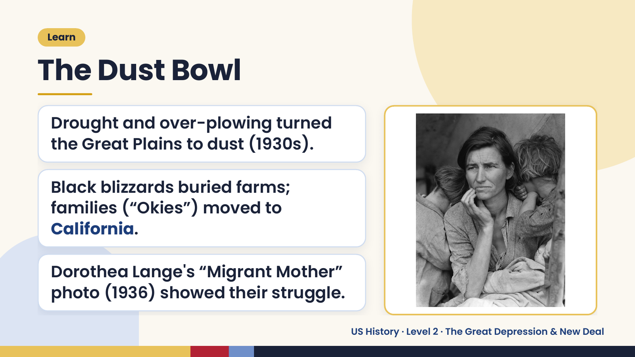
Notes:
Learn
The Dust Bowl
Drought and over-plowing turned
the Great Plains to dust (1930s).
Black blizzards buried farms;
families (“Okies”) moved to
California.
Dorothea Lange's “Migrant Mother”
photo (1936) showed their struggle.
US History · Level 2 · The Great Depression & New Deal

Slide 14
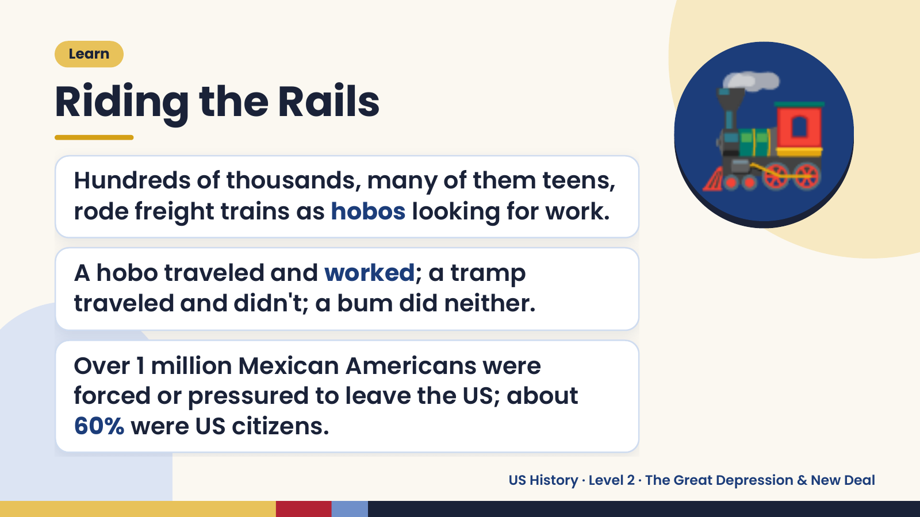
Notes:
Learn
Riding the Rails
Hundreds of thousands, many of them teens,
rode freight trains as hobos looking for work.
A hobo traveled and worked; a tramp
🚂
traveled and didn't; a bum did neither.
Over 1 million Mexican Americans were
forced or pressured to leave the US; about
60% were US citizens.
US History · Level 2 · The Great Depression & New Deal

Slide 15
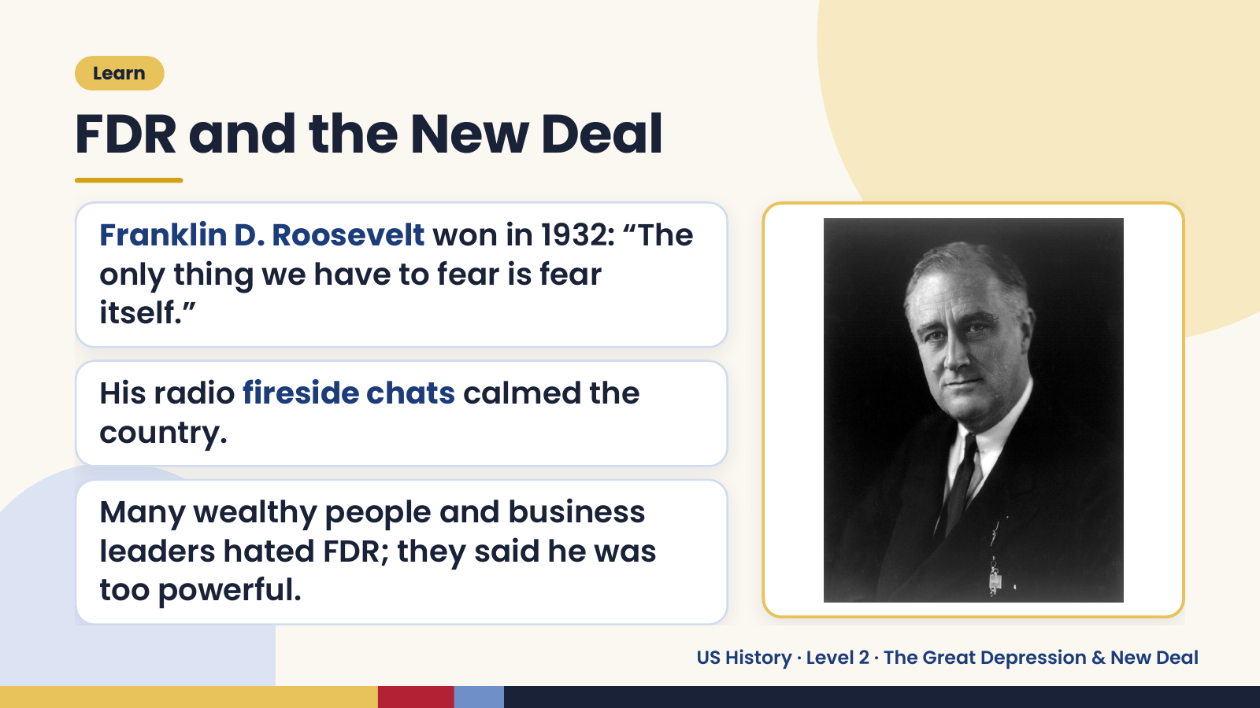
Notes:
Learn
FDR and the New Deal
Franklin D. Roosevelt won in 1932: “The
only thing we have to fear is fear
itself.”
His radio fireside chats calmed the
country.
Many wealthy people and business
leaders hated FDR; they said he was
too powerful.
US History · Level 2 · The Great Depression & New Deal

Slide 16
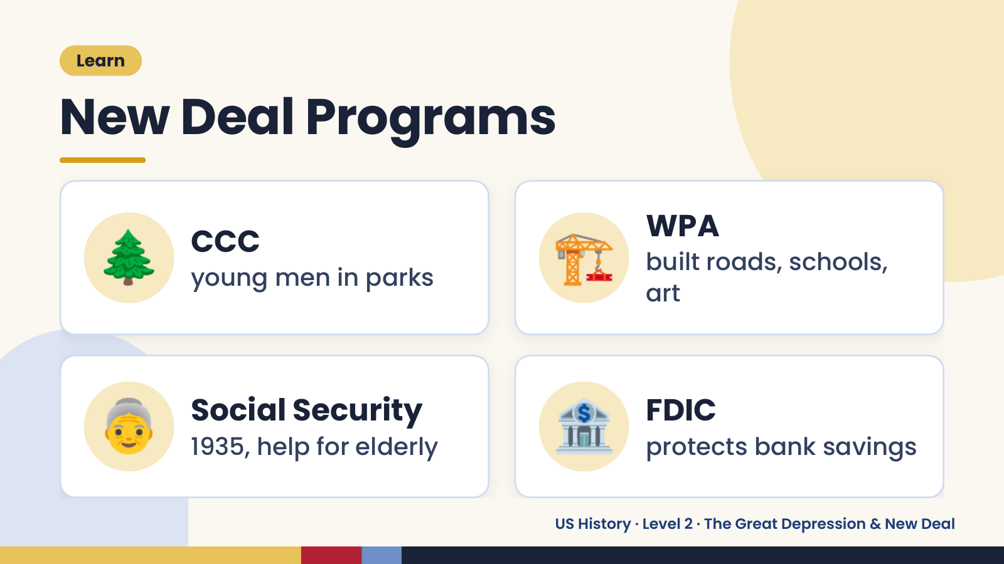
Notes:
Learn
New Deal Programs
🌲 CCC
young men in parks 🏗️ WPA
built roads, schools,
art
👵 Social Security
1935, help for elderly 🏦 FDIC
protects bank savings
US History · Level 2 · The Great Depression & New Deal

Slide 17
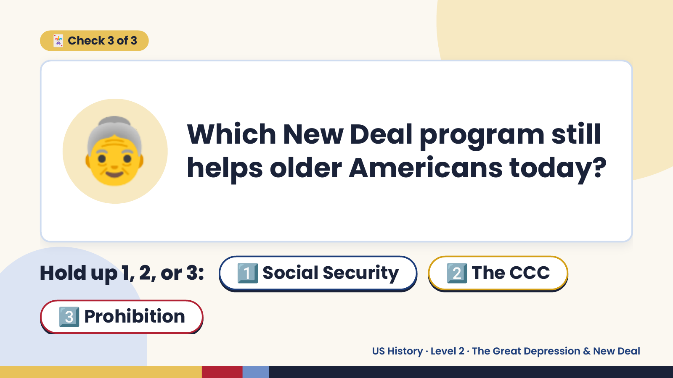
Notes:
🃏 Check 3 of 3
👵 Which New Deal program still
helps older Americans today?
Hold up 1, 2, or 3: 1️⃣ Social Security 2️⃣ The CCC
3️⃣ Prohibition
US History · Level 2 · The Great Depression & New Deal

Slide 18
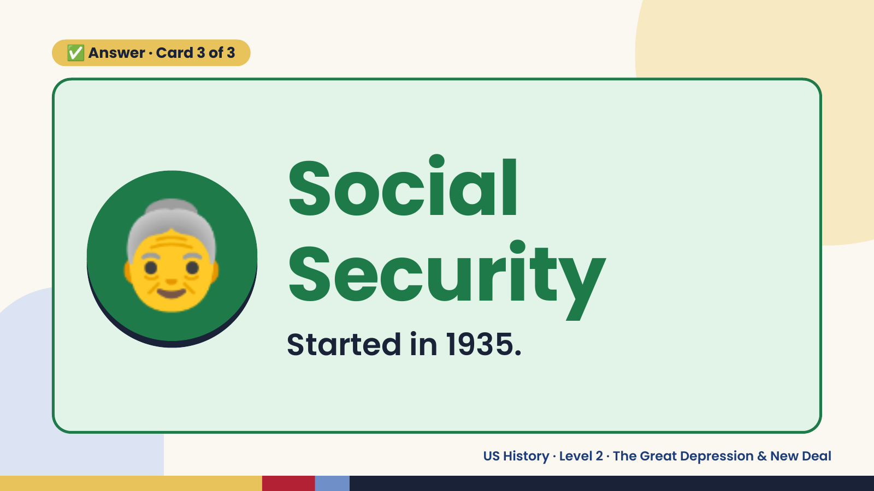
Notes:
✅ Answer · Card 3 of 3
👵 Social
Security
Started in 1935.
US History · Level 2 · The Great Depression & New Deal

Slide 19
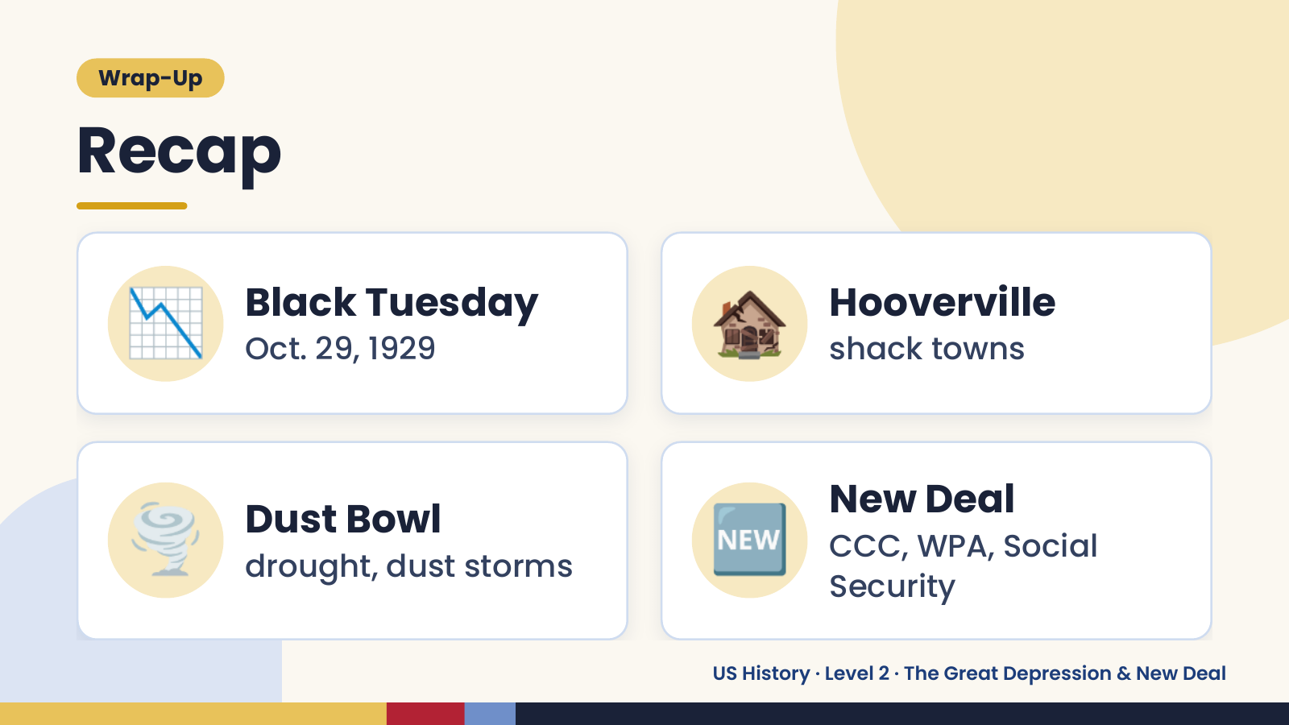
Notes:
Wrap-Up
Recap
📉 Black Tuesday
Oct. 29, 1929 🏚️ Hooverville
shack towns
🌪️ Dust Bowl
drought, dust storms 🆕 New Deal
CCC, WPA, Social
Security
US History · Level 2 · The Great Depression & New Deal

Slide 20
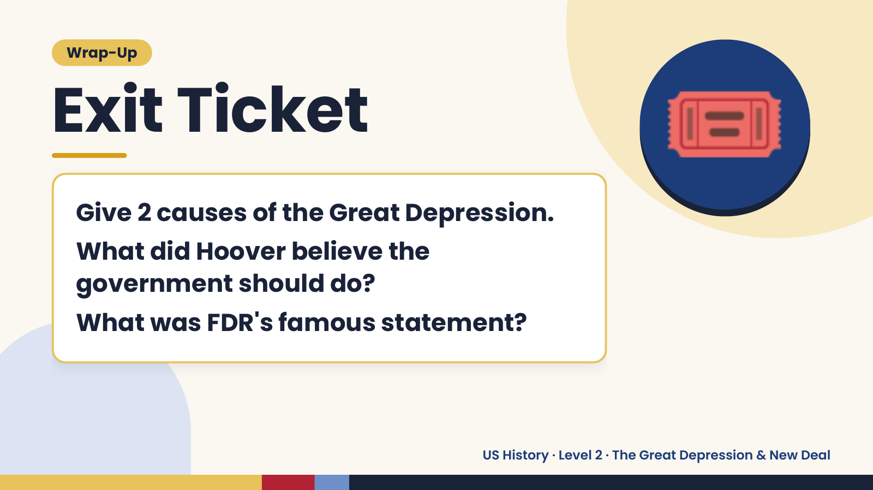
Notes:
Wrap-Up
Exit Ticket
Give 2 causes of the Great Depression.
What did Hoover believe the
🎟️
government should do?
What was FDR's famous statement?
US History · Level 2 · The Great Depression & New Deal

