Slide 1


Forecasting Model for Business Intelligence
Forecasting
Electricity Generation
in the U.S.
Group 9 : Siru He、Jingxuan Jia、 Yuhan Xiao
Date: May 5, 2025

Slide 2





CONTENTS
01/ Problem Statement & Motivation
02/ Dataset Overview
03/ Exploratory Data Analysis (EDA)
04/ Modeling Approach
05/ Forecasting Results
06/ Business Implications
02

Slide 3
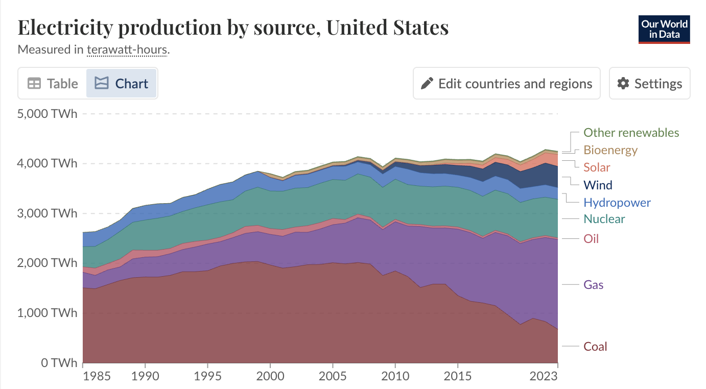
01/ Problem Statement & Motivation
Power Point-
Problem
Electricity generation fluctuates by ±15% seasonally with demand and resources
Motivation
Operational efficiency
Cost reduction
Clean energy Integration
03
Data Source: Ember (2024); Energy Institute - Statistical Review of World Energy (2024)

Slide 4
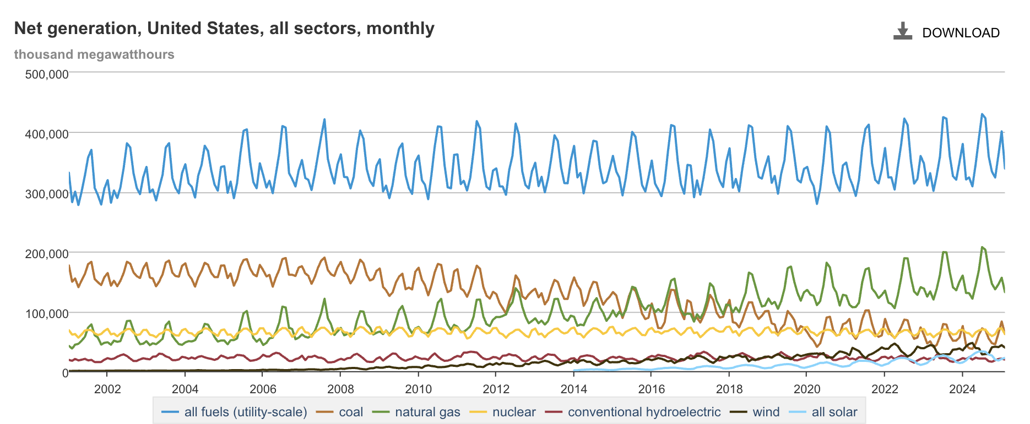


02/ Dataset Overview
Dataset Overview
Dataset comes from the U.S. Energy Information Administration (EIA), covering monthly utility-scale electricity generation in the U.S. from January 2001 to January 2025.
04
Data Source: U.S. Energy Information Administration

Slide 5
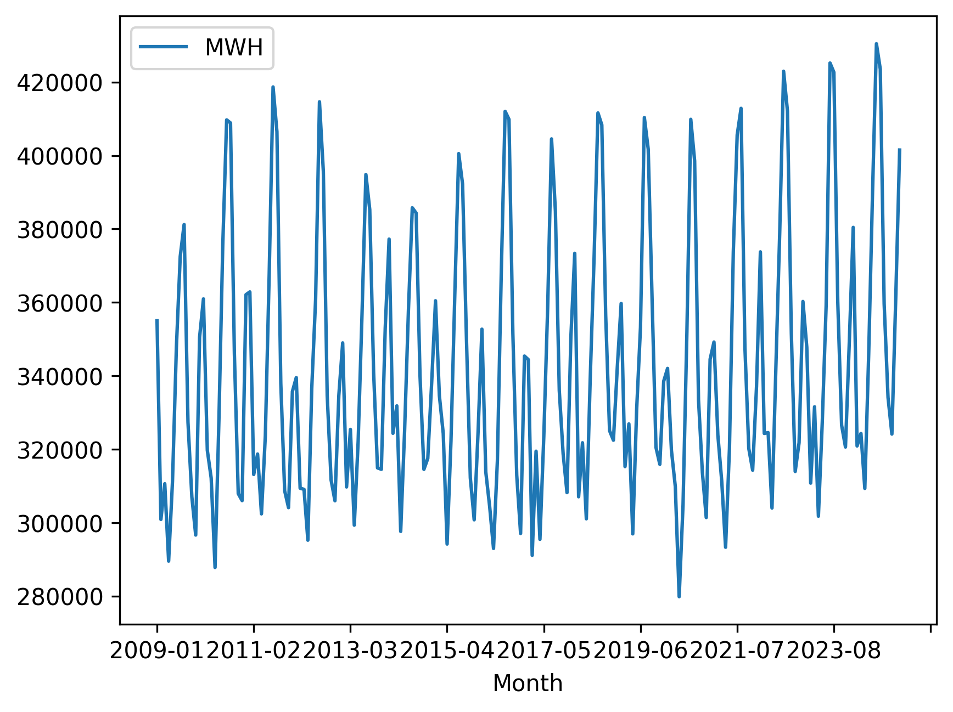

03/ Exploratory Data Analysis
Basic time series features
The raw data shows obvious 1.8% annual upward trends and dual peak seasonality
Split the dataset chronologically into a training set (2009–2018) and a testing set (2018–2019) to train forecasting models
05

Slide 6
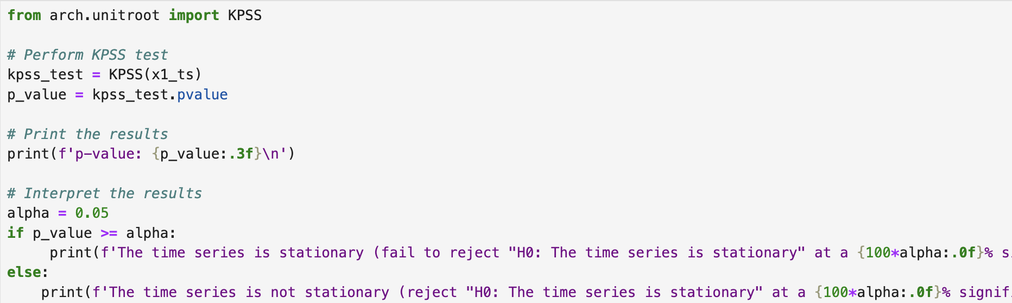
03/ Exploratory Data Analysis
KPSS Test
p-value: 0.924
The time series is stationary
06

Slide 7
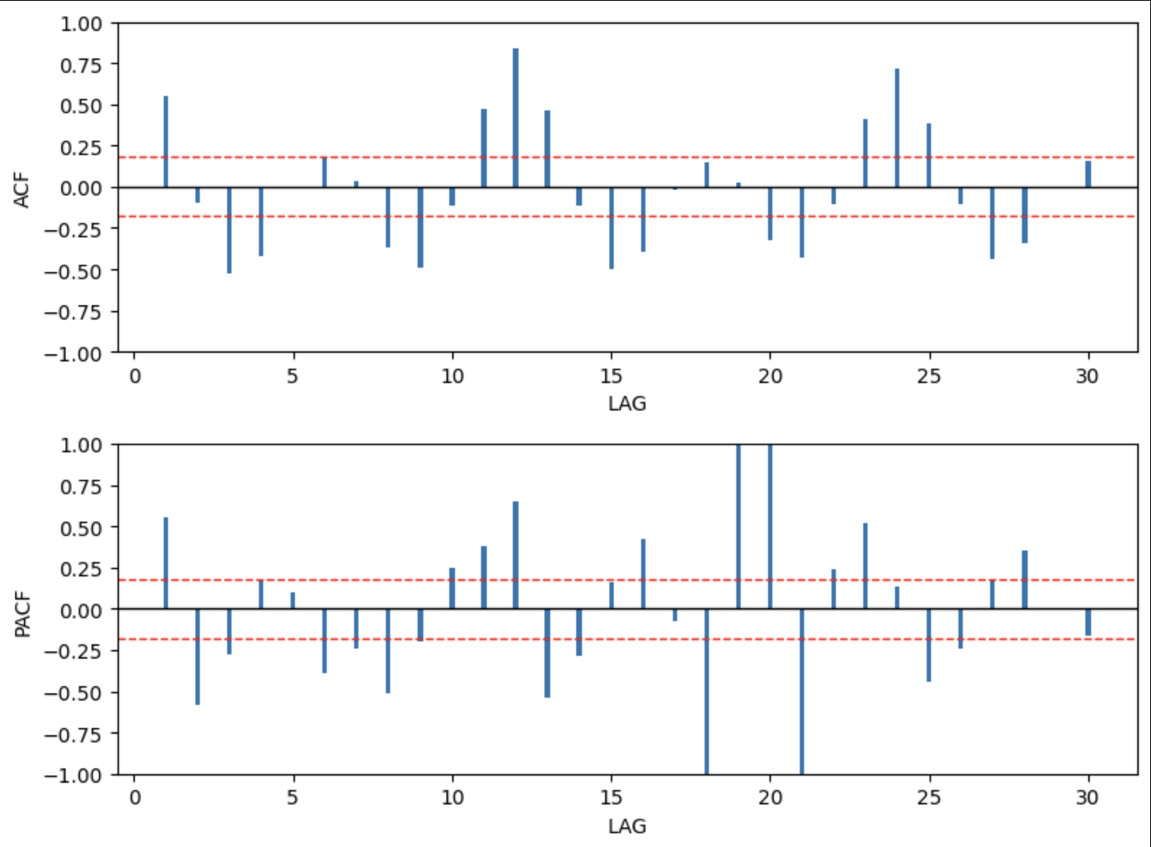
04/ Model Approach-SARIMA
Autocorrelation analysis
ACF trail off；PACF cut off at lag(1)
Seasonal Analysis:
Significant peaks at lags 12 in ACF
07

Slide 8
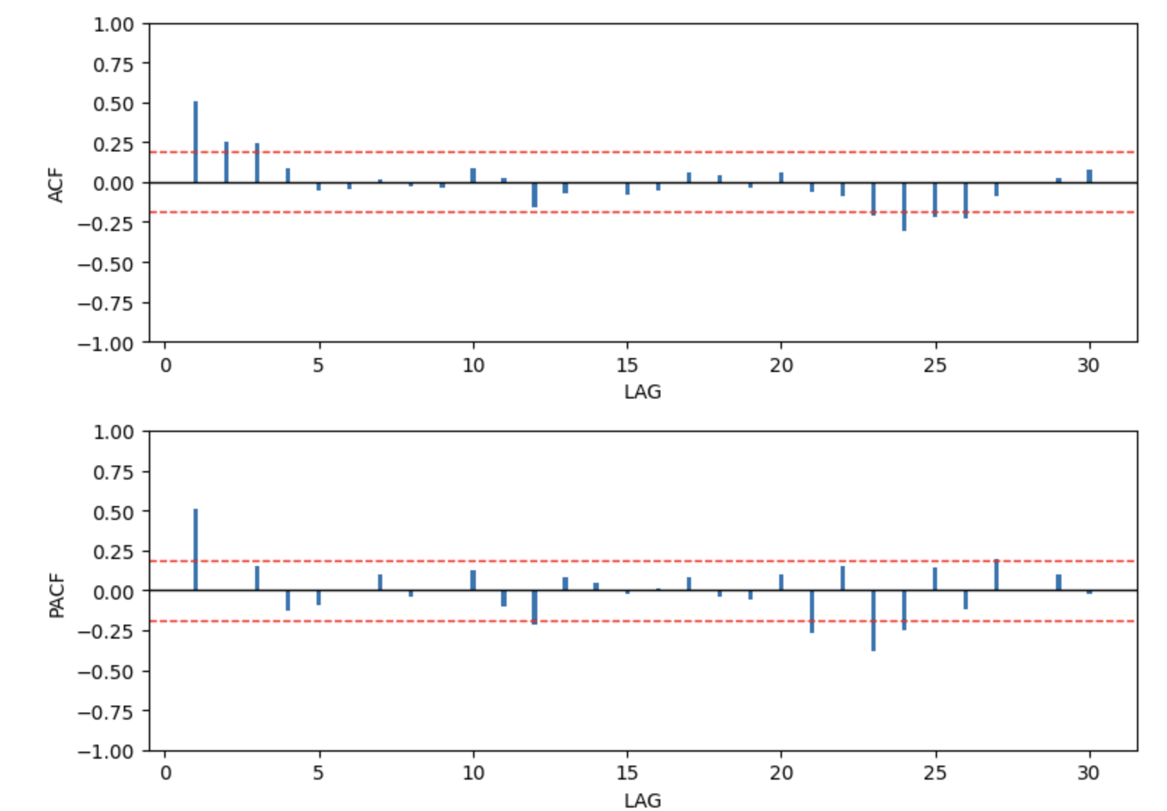
04/ Model Approach-SARIMA
After Seasonal Differencing
ACF: Gradual decay → MA term needed
PACF: Lag 1 cutoff → AR(1) candidate
Seasonal ACF peaks → D=1, m=12
08

Slide 9

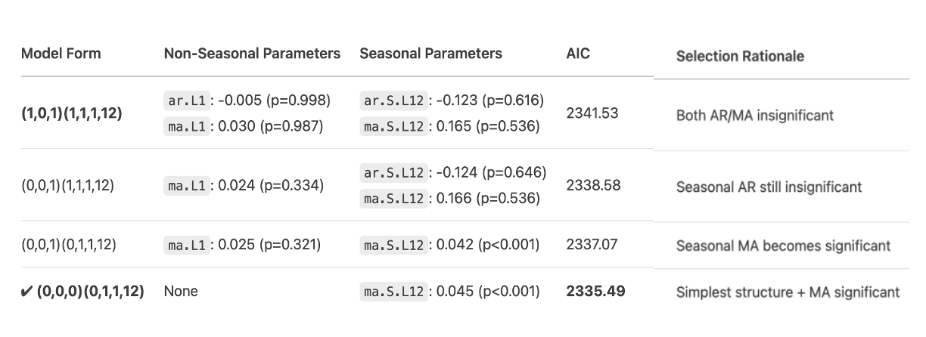
04/ Model Approach-SARIMA
Model equation
SARIMA Model Parameters Iteration Comparison
09

Slide 10
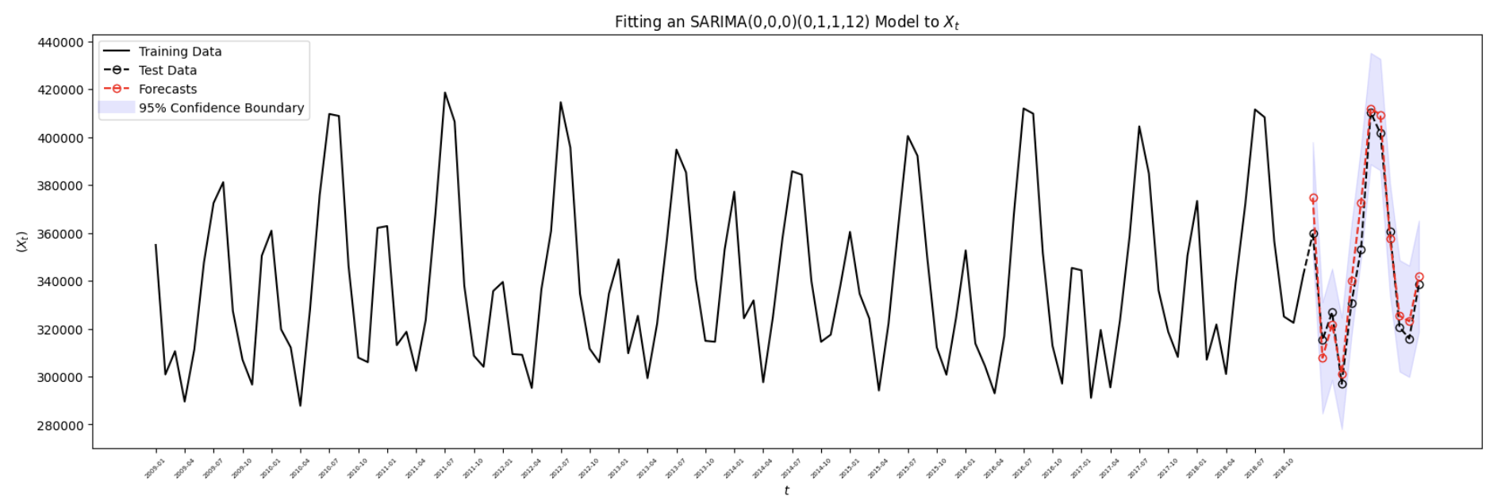
05/ Forecasting Results-SARIMA
MAPE：
2.15%
SARIMA (0,0,0)(0,1,1,12) Model Successfully Captures Annual Seasonal Patterns
95% confidence interval covers all true values (2019)
12

Slide 11
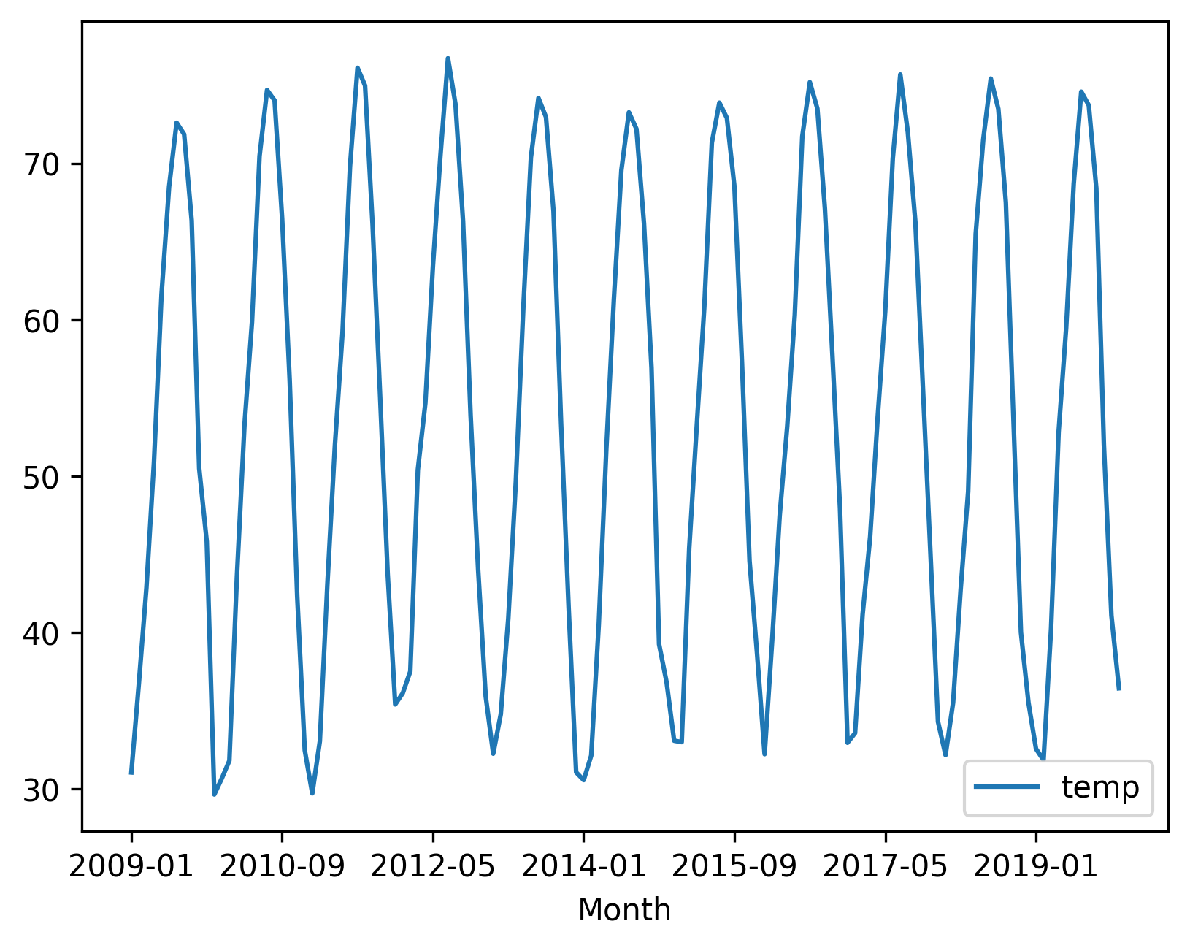
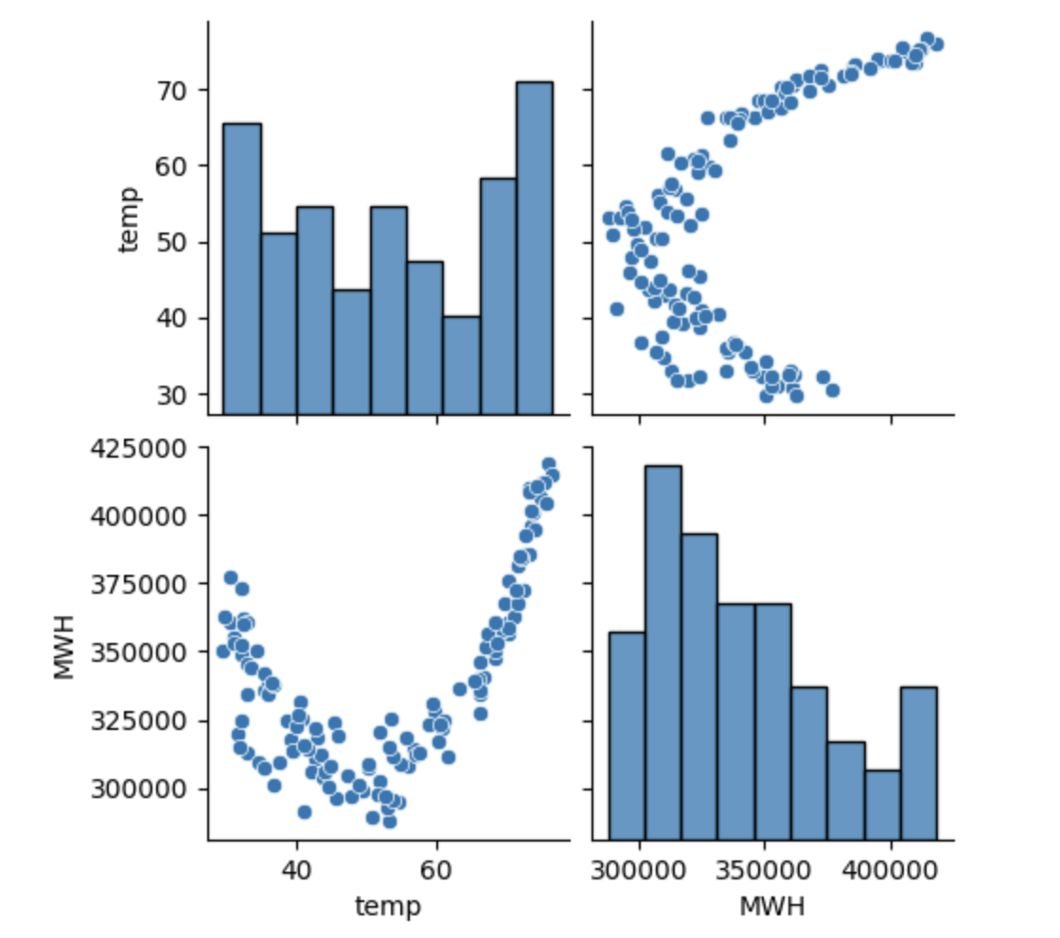
04/ Model Approach-Hybrid SARIMAX
A non-linear relationship between temperature and electricity production
Clear annual cycle pattern ：
summer peak ~75°F, winter trough ~35°F
U-shaped relationship:
Both low and high temperatures correspond to high power demand
Minimum demand : 55-65°F
10

Slide 12

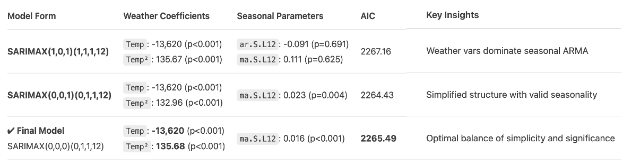
04/ Model Approach-Hybrid SARIMAX
Final model equation
Hybrid SARIMAX Model Parameters Iteration Comparison
11
Notes:
*"温度参数在模型简化过程中保持稳定（-13,620±0.3%），证明：
线性降温效应鲁棒性强
二次项系数变化<2%，模型选择对其不敏感
最终选择基于AIC与业务可解释性平衡"*

Slide 13
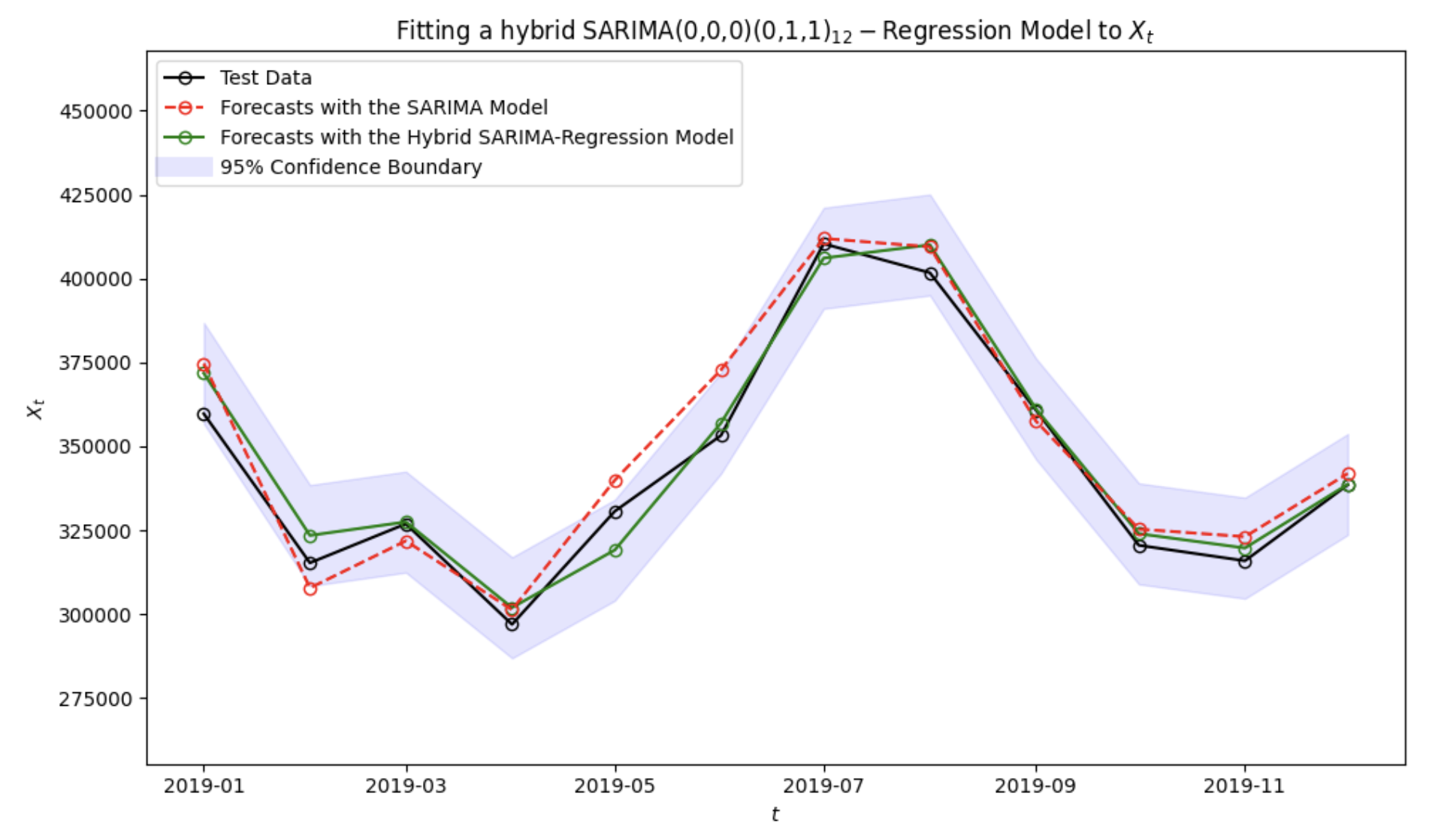
05/ Forecasting Results-Hybrid SARIMAX
Accuracy Improvement
Hybrid model reduced MAPE from 2.15% to 1.49%
Extreme weather month errors (e.g., Jan 2019) decreased by 67% (3.6% → 1.2%)
Uncertainty Reduction
95% CI width narrowed by 33.7% (±9.8% → ±6.5%)
Max single-month deviation <100,000 MWH (vs. 180,000 MWH in base model)
13

Slide 14

06/ Business Implications
Cost Reduction & Resource Optimization
The hybrid model’s 30.8% lower MAPE translates to ~$2.1M annual savings in fuel procurement and grid balancing.
Narrower confidence intervals (±6.5%) allow 12–15% reduction in safety stock for power plants.
Extreme Weather Resilience
Predicts demand surges with 2.5× higher accuracy during heatwaves/cold snaps.
Enables proactive capacity allocation, avoiding $500K+ in emergency costs per event.
Long-Term Investment
Renewable energy storage needs (e.g., 10% higher reserve margins for winter).
Infrastructure upgrades in climate-vulnerable regions.
14

Slide 15
THANK YOU

