Slide 1

Topic: Application Of Machine Learning Algorithms For Covid-19 Predictions
Submitted by: Granthik Anjara
KU ID: K2169338
Supervisor: David F. Wertheim

Slide 2
Background And Motivation
The outbreak of COVID-19 has had a significant impact on global health and economy. The rapid spread of the virus has highlighted the need for efficient methods for managing the spread of the disease.
The ability to accurately predict the spread of COVID-19 can help to mitigate its impact on society, by providing early warning of outbreaks and enabling more effective use of resources.
The use of Machine Learning algorithms in predicting the spread of COVID-19 can provide valuable insights for public health officials and policymakers to make informed decisions.
Additionally, the use of ML algorithms in COVID-19 prediction can lead to the development of more effective public health strategies in response to future pandemics.

Slide 3
Aims And Objectives
To develop a predictive model using machine learning algorithms to forecast the spread of COVID-19 around the globe.
To evaluate the performance of different machine learning algorithms in predicting COVID-19 cases.
To collect and preprocess relevant data on COVID-19 cases and deaths.
To apply different machine learning algorithms, such as Polynomial Regression, Bayesian Ridge and SVM to the data and compare their performance.
To evaluate the performance of the developed model using metrics such as MAE and MSE.
To provide insights and recommendations for public health officials and policymakers to make informed decisions based on the predictions generated by the model.

Slide 4


Environment
Software: Python has been used for programming the Machine learning model and develop the required supporting environment for ML model training and testing because of it’s open source environment and many libraries and frameworks which are capable of handling large scale operations and computations.
Platform: Jupyter Notebook has been used to conduct the practical implementation of the study because of it’s easy to use interface for implementing and experimenting with different algoirthms and to visualise and analise the results.

Slide 5
Flow Of The Research Paper
Step 1: Gather the datasets from a trusted source like JHU.
Step 2: Perform data pre-processing to annotate the data.
Step 3: Perform EDA to explore, understand and analyse the data better.
Step 4: Splitting the dataset into training and testing sets.
Step 5: Applying model parameter settings for different models (Polynomial,Bayesian Ridge, SVM)
Step 6: Evaluating the model on the testing data.
Step 7: Comparing MAE and MSE for different models.
Step 8: Using the trained model to predict the cases in future.

Slide 6
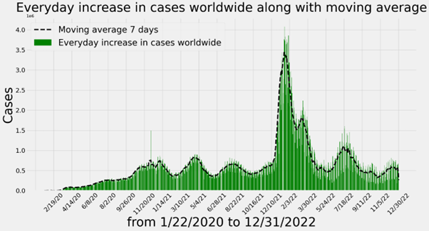
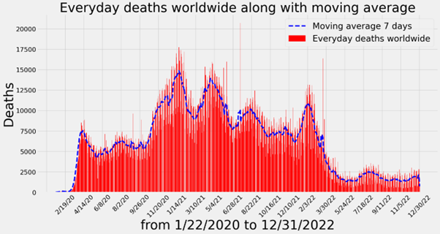
Everyday Increase In The Number Of Cases And Deaths Worldwide

Slide 7

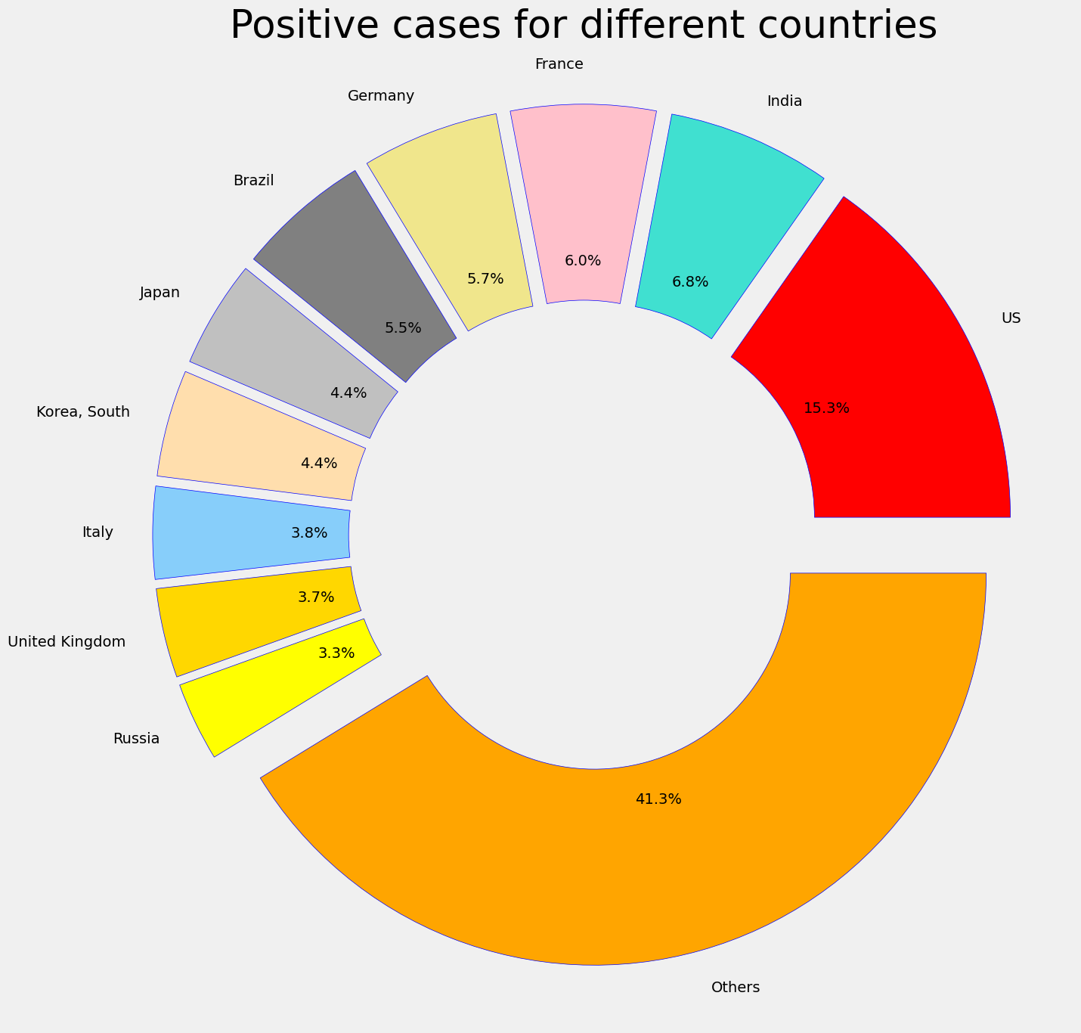



Countries With Highest Number Of Coronavirus Cases

Slide 8
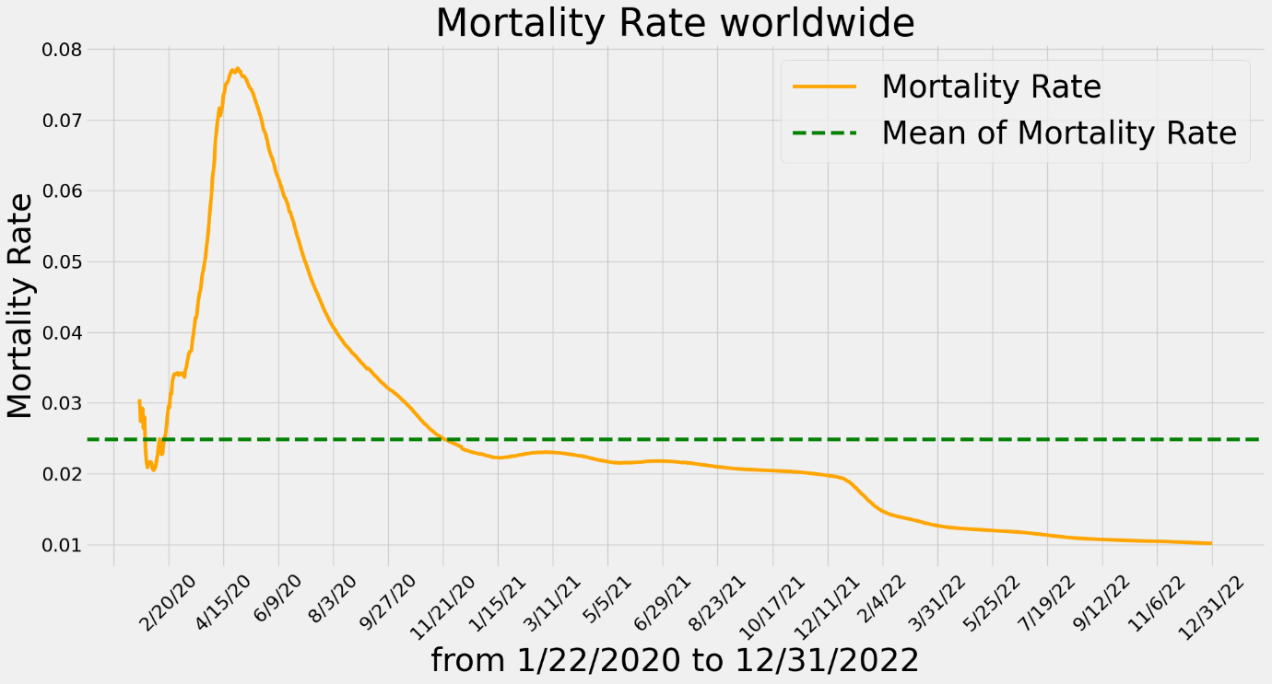
Worldwide Mortality Rate

Slide 9
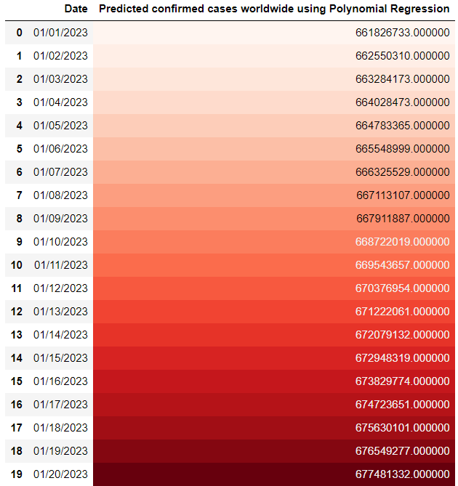
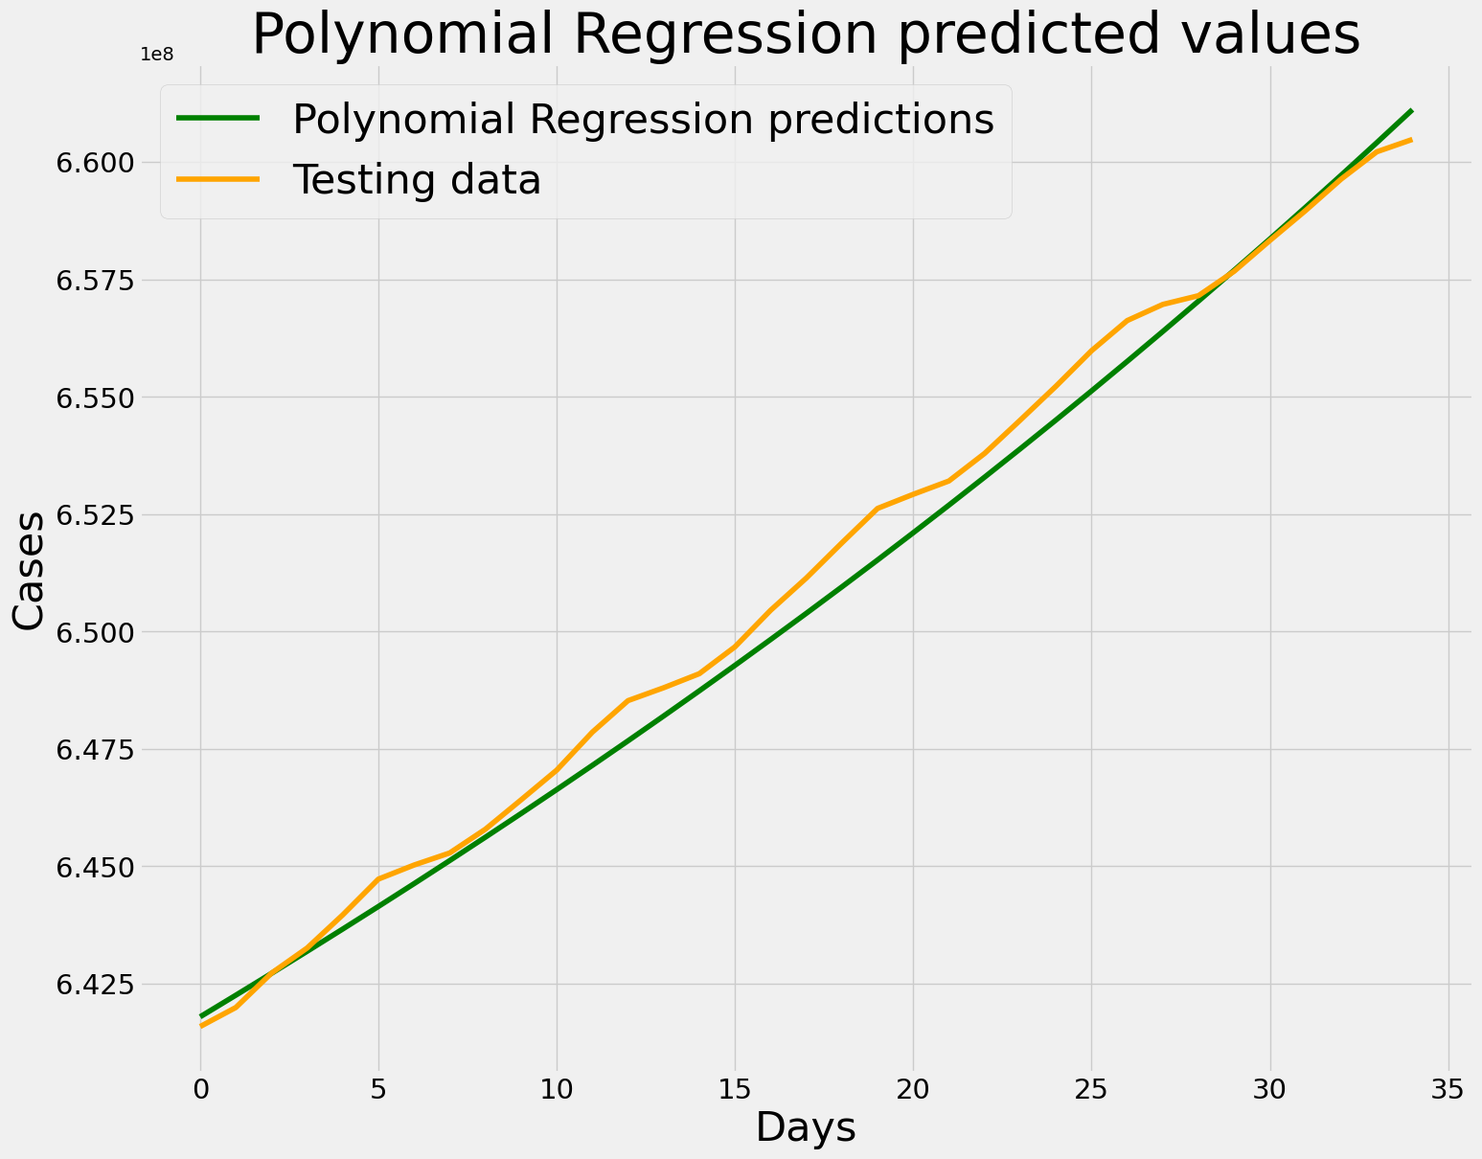
Polynomial Regression Model And Future Predictions
Polynomial regression is a type of regression analysis in which the relationship between the independent variable x and the dependent variable y is modeled as an nth degree polynomial.

Slide 10
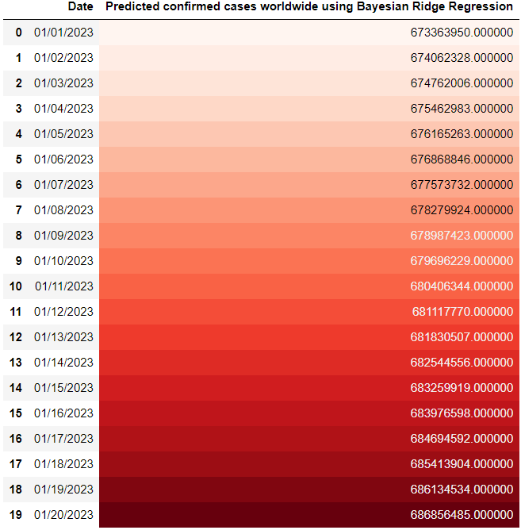
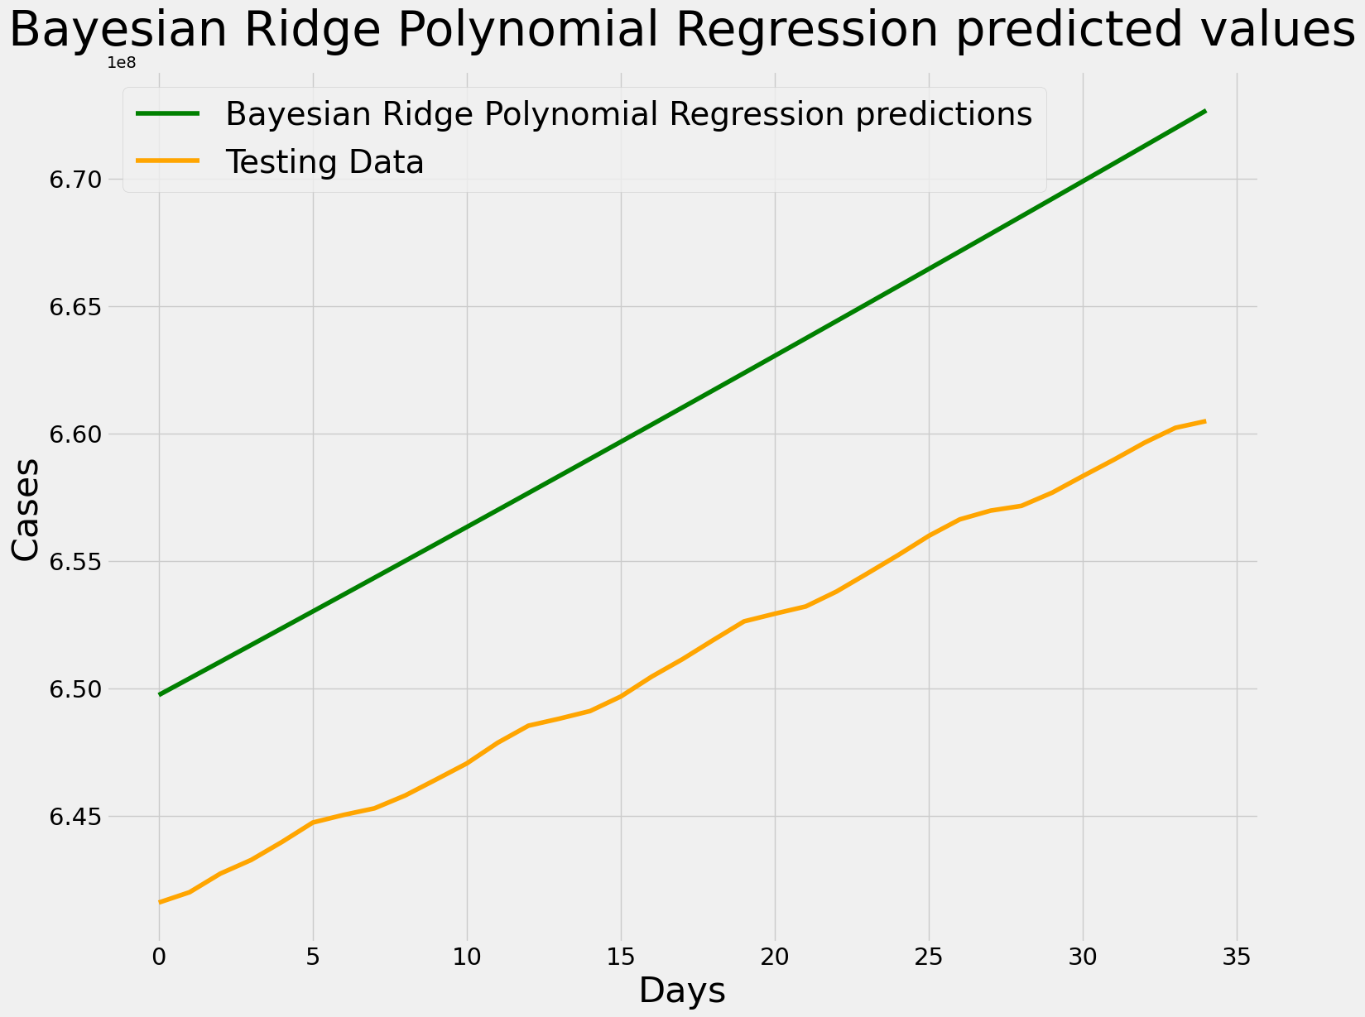
Bayesian Ridge Model And Future Predictions
Bayesian Ridge Regression is a regularized linear regression method that uses Bayesian inference to estimate the model parameters, which allows for the inclusion of prior information about the parameters.

Slide 11
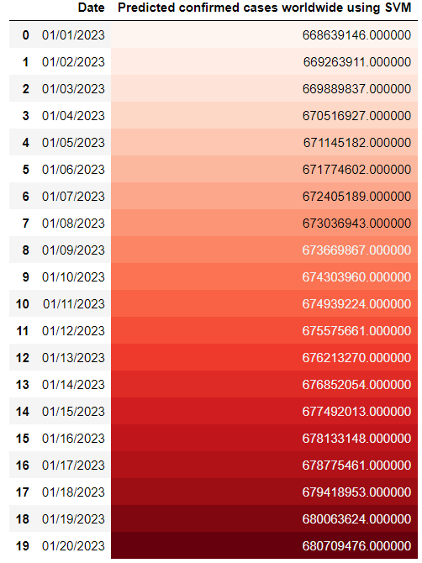
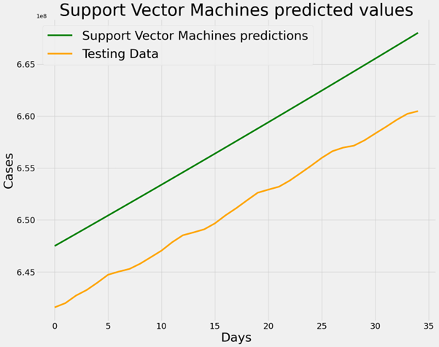
Support Vector Machines (SVM) Model And Future Predictions
SVM is a supervised machine learning algorithm which is used for classification. It finds the best hyperplane which separates the data into different classes or predicts the target value.

Slide 12
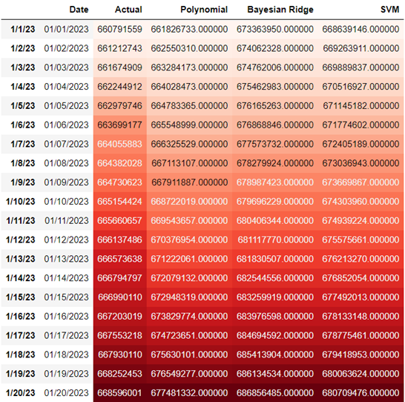
Comparing Different Models
Mean Absolute Error (MAE) and Mean Squared Error (MSE) are both used as metrics to evaluate the performance of a regression model.
MAE is the average of the absolute errors between the predicted and actual values, while MSE is the average of the squared errors between the predicted and actual values. Lower the MAE and MSE, better the model.
Polynomial Regression model has the lowest mean absolute error and mean squared error values as compared to Bayesian Ridge and Support Vector Machine models. Also, the values predicted by them are closest to the actual values.
Sr. No. | Model | MAE | MSE
1 | Polynomial | 451832.86442587717 | 294329520918.9113
2 | Bayesian Ridge | 9949144.572066076 | 100286372600178.38
3 | SVM | 6519254.72971799 | 42706579393991.33

Slide 13
Conclusion
Machine learning models can only predict the future based on the patterns and relationships found in the historical data. If there is a change in the underlying dynamics of the disease transmission, the model may not be able to capture it and make accurate predictions.
Even though there is a huge difference between the predicted values and the actual values, the predictions done by Polynomial Regression Model were the closest to the actual values.
Some important factors that influence the spread of the disease, such as changes in public behavior and government policies, are hard to predict. Thus, the model's ability to predict future cases may be limited.
Predictions on the progression of COVID-19 are provisional, but the eventual outcome will likely involve a combination of social preventative measures, new medications to alleviate symptoms and a vaccine.
A vaccine is the only long-term option for controlling the outbreak and its development may take months or even years. Without access to the vaccine globally, the virus will likely continue to spread to those who have not yet been affected.

Slide 14
Future Work
Incorporating more data: More data can be used to train the model, such as data on travel patterns, economic conditions, and demographics. This can help the model to make more accurate predictions.
Ensemble models: Using an ensemble of different models can help to improve the overall accuracy of the predictions. This is because different models can capture different patterns and relationships in the data.
Incorporating causal inference: Incorporating causal inference techniques can help to understand the underlying mechanisms that drive the spread of the disease, which can lead to better predictions.
Incorporating domain knowledge: Incorporating domain knowledge about the disease, such as the biology of the virus and the epidemiology of the disease, can help to improve the accuracy of the predictions.
Incorporating real-time data: Incorporating real-time data such as social media data and news articles can help to capture the changing dynamics of the disease spread and improve predictions in near future.

Slide 15
Ethical, Legal And Professional Considerations
This is a student project. Therefore, neither the student nor Kingston University makes any warranty.
Open access data from John Hopin’s University is used for conducting these predictions, thus there are no legal or ethical considerations associated with the issue.
These predictions are not infallible and must be interpreted with caution.
The data itself is not sensitive in nature there is no personal threat associated for the participants.
No informed consent was required from the participants as the data was already made public by them.

Slide 16

Thank You!

