Slide 1

SpamGuard
Multilingual SMS Spam Detection Using NLP
Hemlata Parmar · Raghuraj Singh Chouhan · Granth Joshi
Manipal University Jaipur

Slide 2


The SMS Spam Problem
What Is SMS Spam?
Unsolicited messages — ads, scams, phishing — sent in bulk without consent.
Key Risks
Phishing attacks, financial fraud, and privacy violations through malicious links.
India's Challenge
Messages in Hindi, English, and Hinglish (code-mixed) defeat English-only models.
Real-World Impact
India's SMS traffic is massive and growing — spam detection is a critical need.

Slide 3


PROBLEM STATEMENT
Why Existing Solutions Fall Short
English-Only Bias
Most models are trained exclusively on English corpora, failing on regional Indian languages.
Code-Mixed Blindness
Hinglish and mixed-script messages are misclassified or ignored entirely.
No Real-Time Inference
Existing tools lack lightweight, deployable architectures for live, on-device prediction.
Core Gap: No unified solution for multilingual, real-time, scalable SMS spam detection.

Slide 4
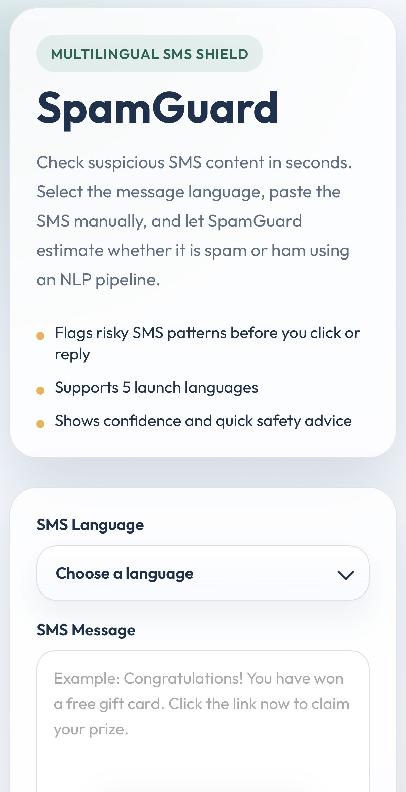



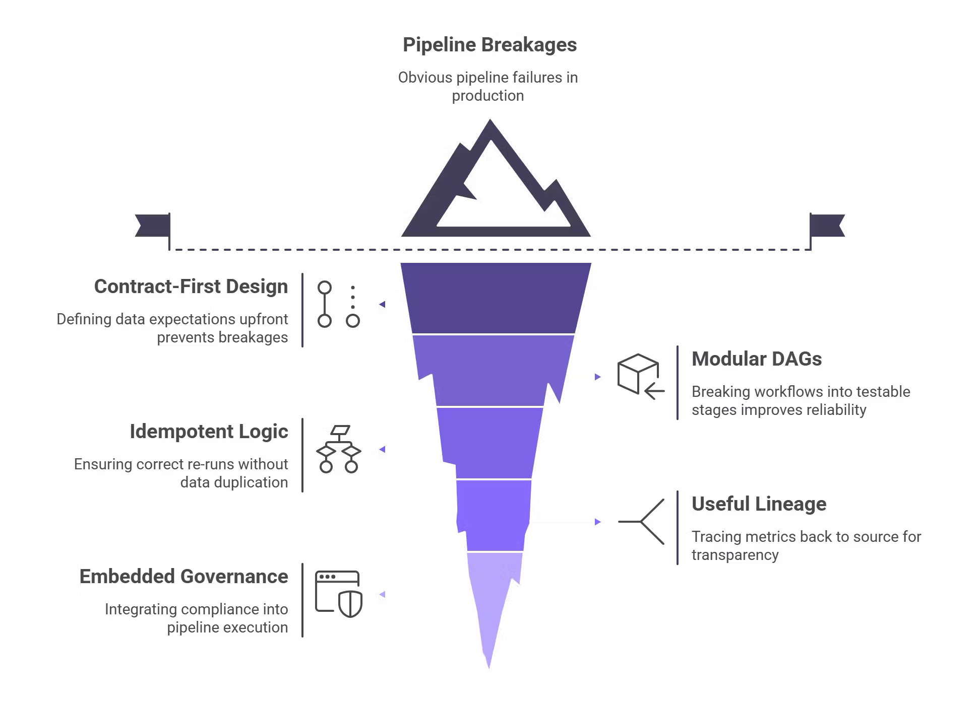
PROPOSED SOLUTION
Introducing SpamGuard
Multilingual Support
Translates Hindi, Spanish,French, etc languages to English before classification.
NLP + ML Pipeline
TF-IDF feature extraction paired with Multinomial Naive Bayes for robust classification.
Real-Time Web App
Flask-based backend delivers instant predictions through a clean, minimal frontend.
Simple Architecture
Lightweight, modular design — easy to deploy, maintain, and extend.

Slide 5
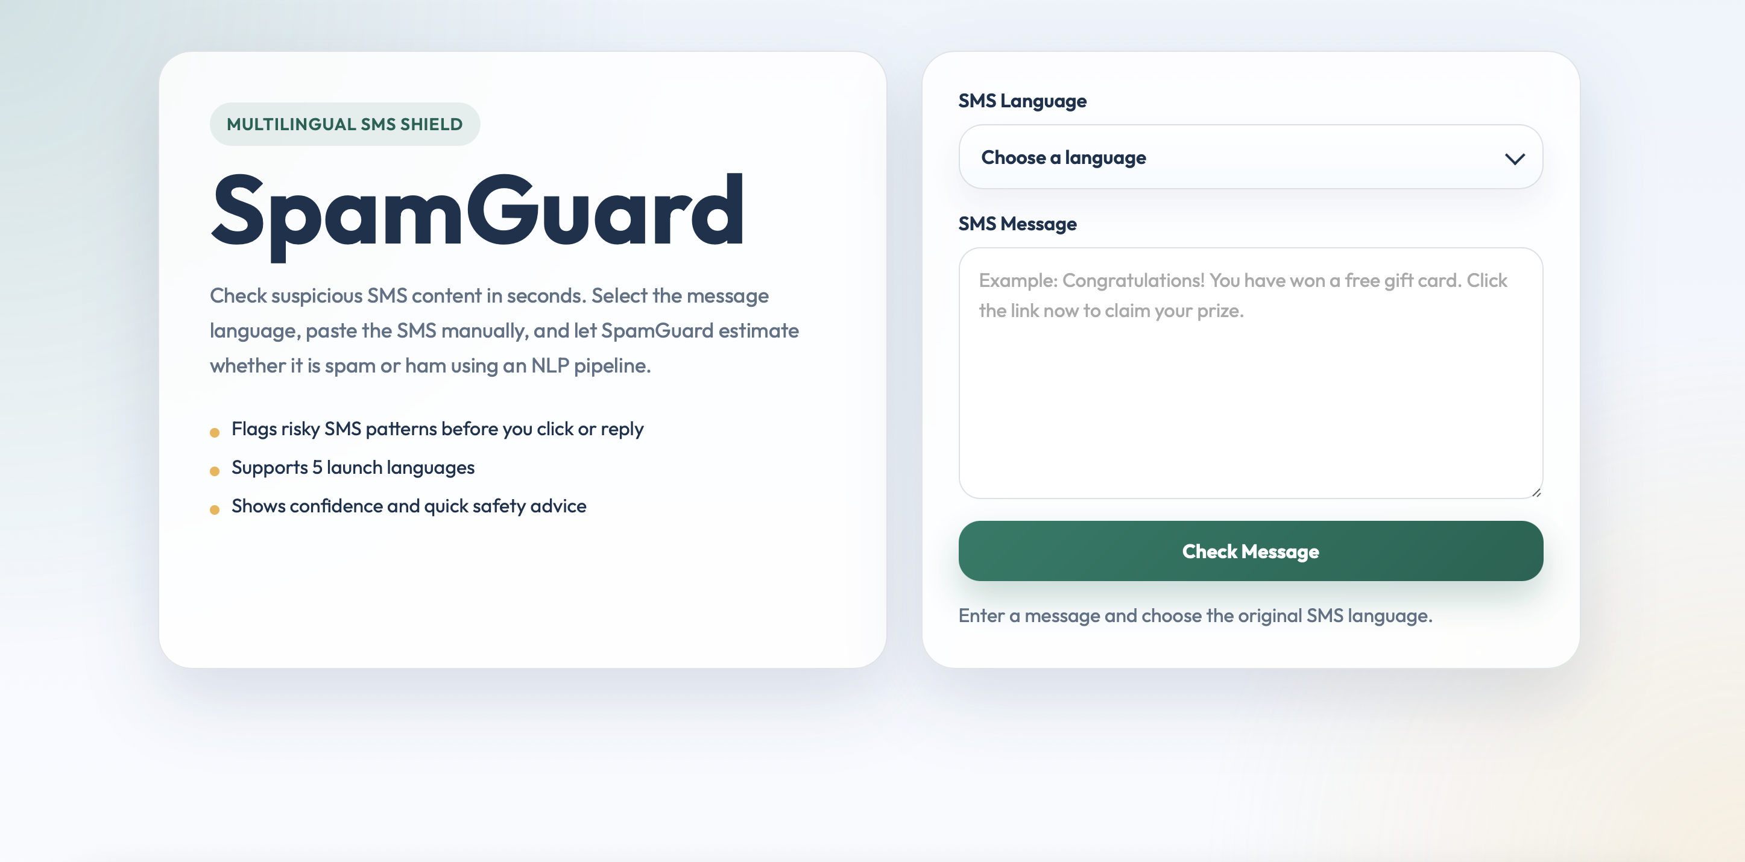

Slide 6
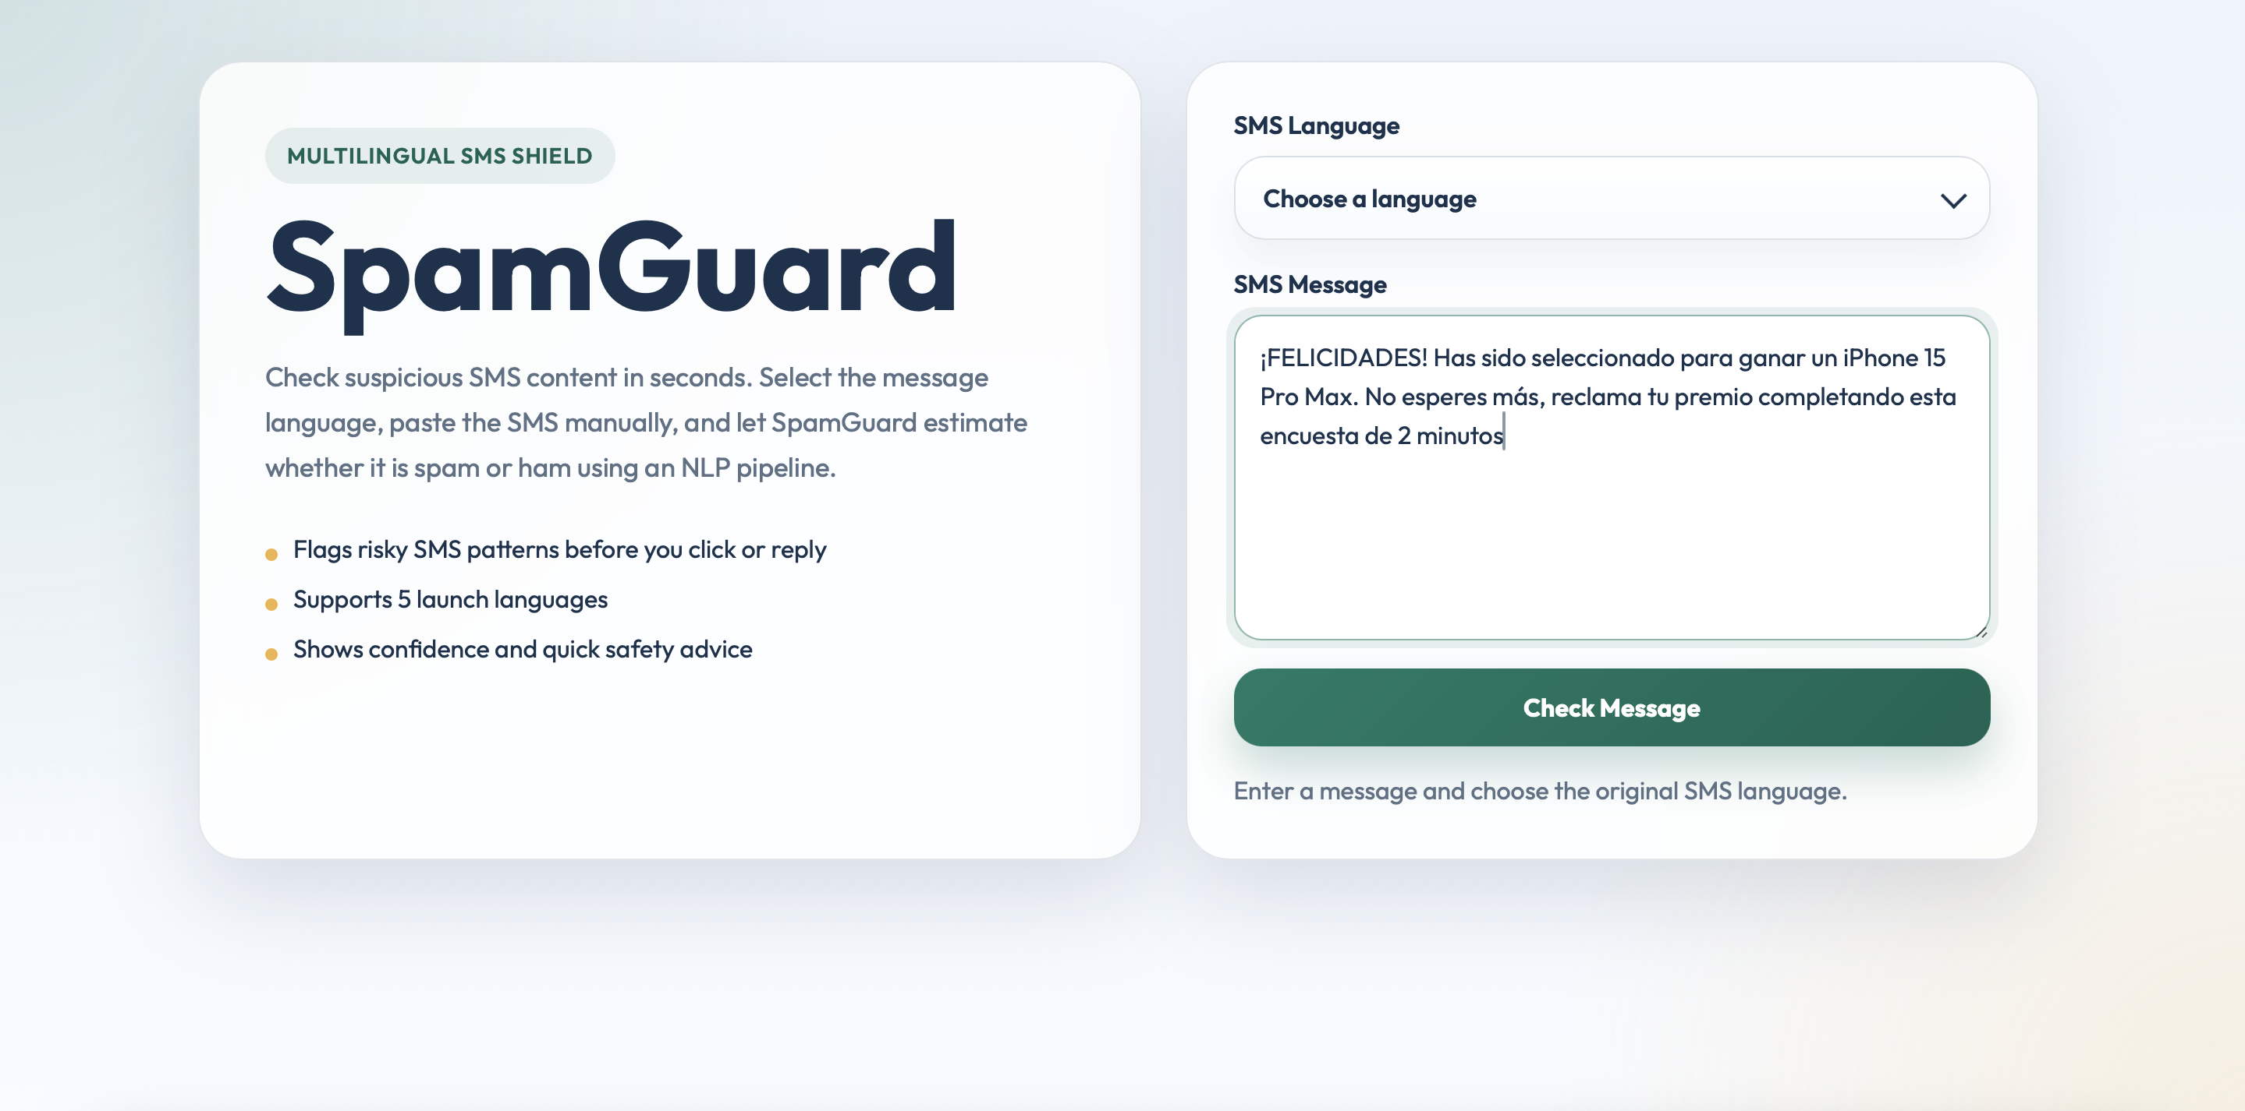

Slide 7
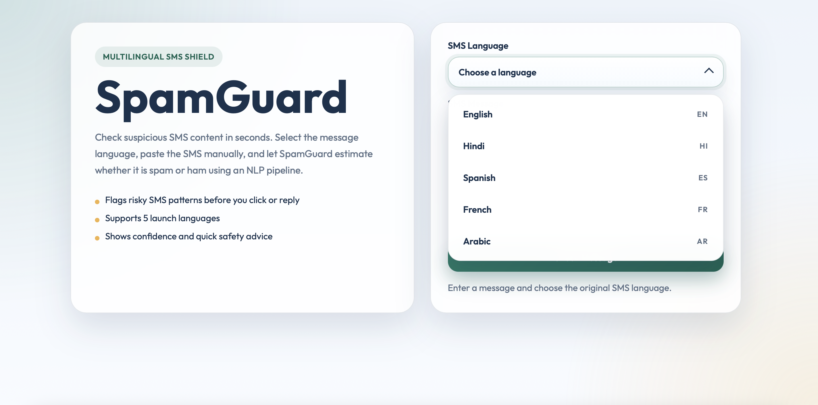

Slide 8
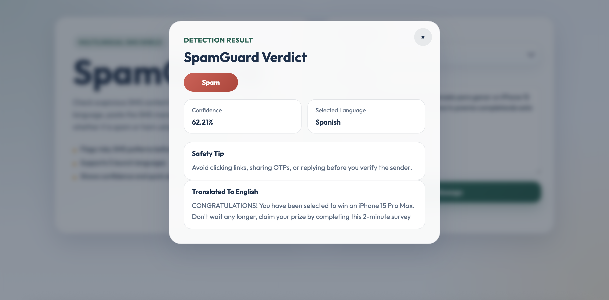

Slide 9
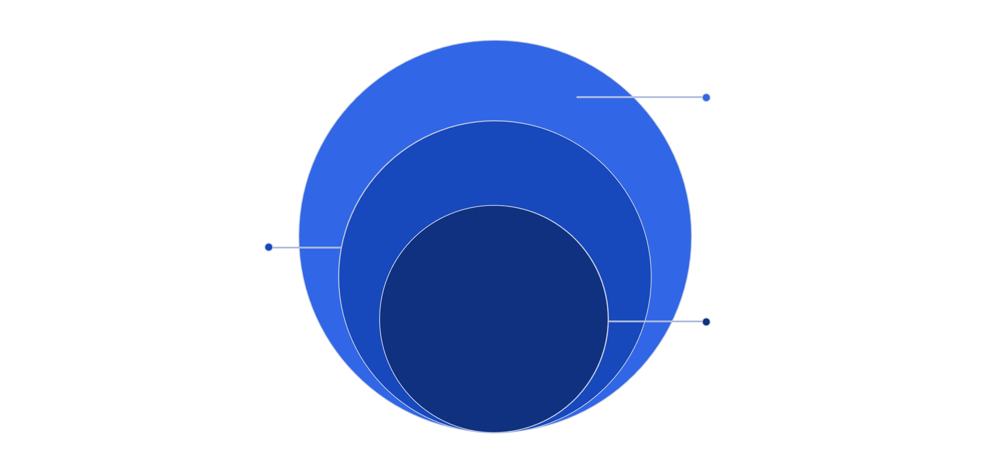
ARCHITECTURE
SpamGuard System Architecture
Presentation & Data
Web UI for input; datasets, models, language resources
Application Layer
Flask APIs for routing and request handling
Core: NLP Pipeline
Translation, preprocessing, TF-IDF, Naive Bayes
SpamGuard uses a clean 4-layer architecture — separating concerns across presentation, application logic, NLP processing, and data storage for modularity and scalability.

Slide 10

WORKING PIPELINE
End-to-End Classification Flow
Preprocessing
User Input
Translation
TF-IDF
Naive Bayes
Each message flows through six stages — from raw multilingual input to a labeled prediction with a confidence score, all in under a second.

Slide 11
METHODOLOGY
How the Model Was Built
Data & Preprocessing
Feature Extraction & Model
Dataset: Labeled SMS corpus (spam vs. ham)
TF-IDF Vectorization
Multinomial Naive Bayes
Lowercasing — normalize text casing
Converts text to weighted numerical vectors, emphasizing discriminative terms.
Probabilistic classifier — fast, interpretable, and ideal for sparse text data.
Stopword Removal — filter noise words
Tokenization — split into word units

Slide 12
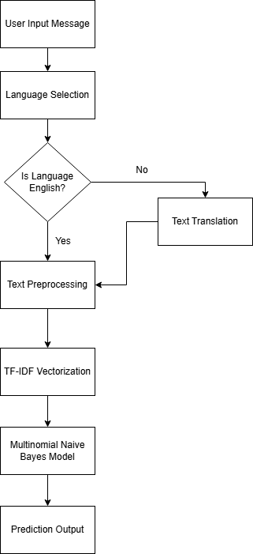

Slide 13

RESULTS
Performance Metrics
97.13%
Overall Accuracy
On held-out test data
Key Findings
High precision — minimal false positives
High recall — catches most spam messages
Strong generalization on multilingual test samples
Confusion matrix confirms balanced class performance

Slide 14
Design Decision
Our design focused on efficiency, scalability, and real-time performance.
We used Multinomial Naive Bayes with TF-IDF because they work well with text data and are computationally lightweight.
For multilingual support, we adopted a translation-first approach, allowing a single model instead of multiple language-specific models.
We designed a layered architecture with a Flask backend to enable modularity and real-time API-based predictions.
Overall, we prioritized a simple, fast, and deployable system over complex models.

Slide 15

CONCLUSION & FUTURE WORK
What's Next for SpamGuard
01
Proven Foundation
SpamGuard achieves 97.13% accuracy with a simple, interpretable NLP pipeline — validating the core approach.
02
Upgrade to Transformers
Integrate BERT / mBERT for deeper semantic understanding and better multilingual generalization.
03
Auto Language Detection
Add langdetect to automatically route messages — removing manual language selection.
04
Cloud Deployment
Deploy on AWS / GCP with a REST API for scalable, production-grade inference.
Thank You — Any Questions?

