Slide 1
Low TE Customization Portfolio Construction
Grant Irvine-Smith
October 2025

Slide 2
The Naive View
Scale active bets
Alpha
TE

Slide 3
The Problem …
Scaling down introduces new positions
Scaling up introduces short positions
Weight
Not held
BM Weight Rank
Short

Slide 4
The Naive View
Unconstrained
Scale active bets
150 / 50
Alpha
130 / 30
Long Only
TE

Slide 5
Solution 1: Portable Alpha
Beta
Alpha
+
W
*
ETF / Future
Market Neutral
Vary W to scale TE up/down
Swap out ETF/Future for different benchmarks
Elegant but not always cost efficient

Slide 6





Solution 2: Optimized Portfolio Construction
Constraints
Expected Returns
Optimizer
Portfolio Weights
Risk Model

Slide 7
Let’s have a go at Expected Returns
What do we have to work with?
ESR – works better on short side than long side
Analyst recommendations
Sparse coverage
Practically no sells
Conviction rankings
Limited coverage
PM Overlay ? – catch all

Slide 8
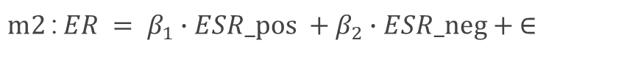

Possible Models
Fit to 6m fwd returns
$$m1: ER = β∙ESR + ∈$$
$m2$: $ER = β_{1}∙ESR_pos +β_{2}∙ESR_neg + ∈$
$$m3: ER = β_{1}∙ESR_pos +β_{2}∙ESR_neg +β_{3}∙rec + ∈$$
$$m4: ER = β_{1}∙ESR_pos +β_{2}∙ESR_neg +β_{3}∙buy +β_{4}∙sell + ∈$$
$m5$: $ER = β_{1}∙ESR_pos +β_{2}∙ESR_neg +β_{3}∙buy +β_{4}∙sell + conv + ∈$

Slide 9
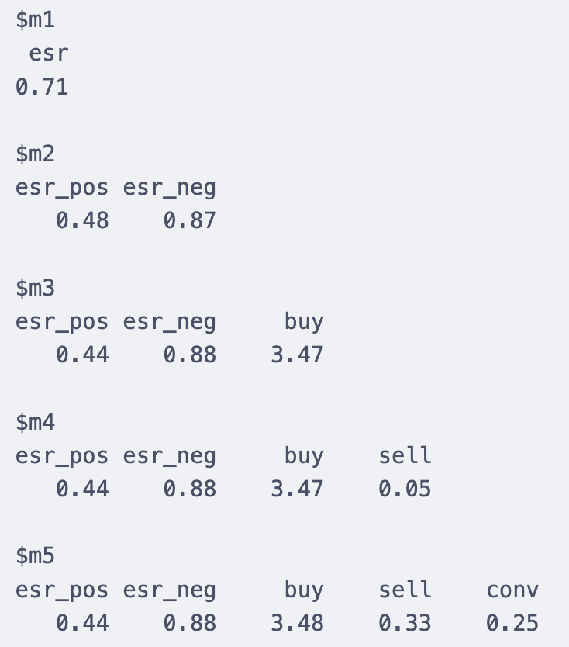
Results
Example:
ESR = 10%, buy rated
Using m3: ER = 0.44 (10%) + 3.47% = 4.44% + 3.47%
= 7.91%

Slide 10
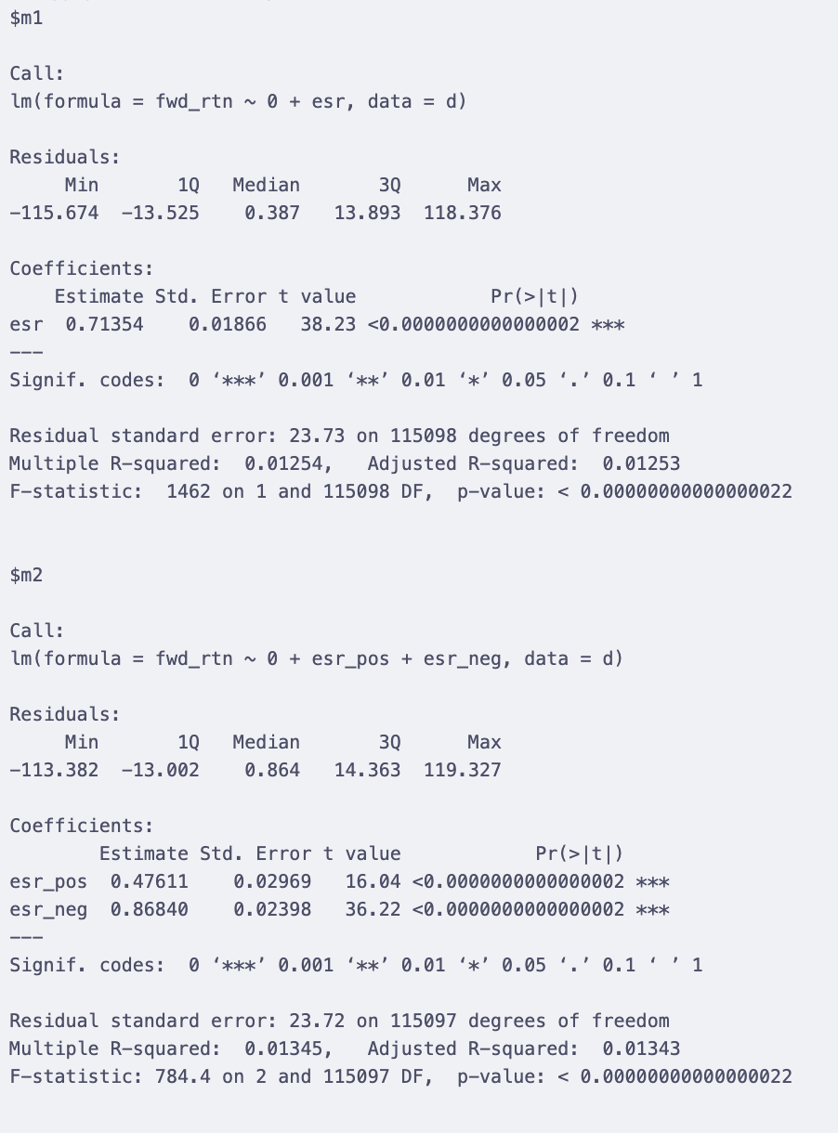
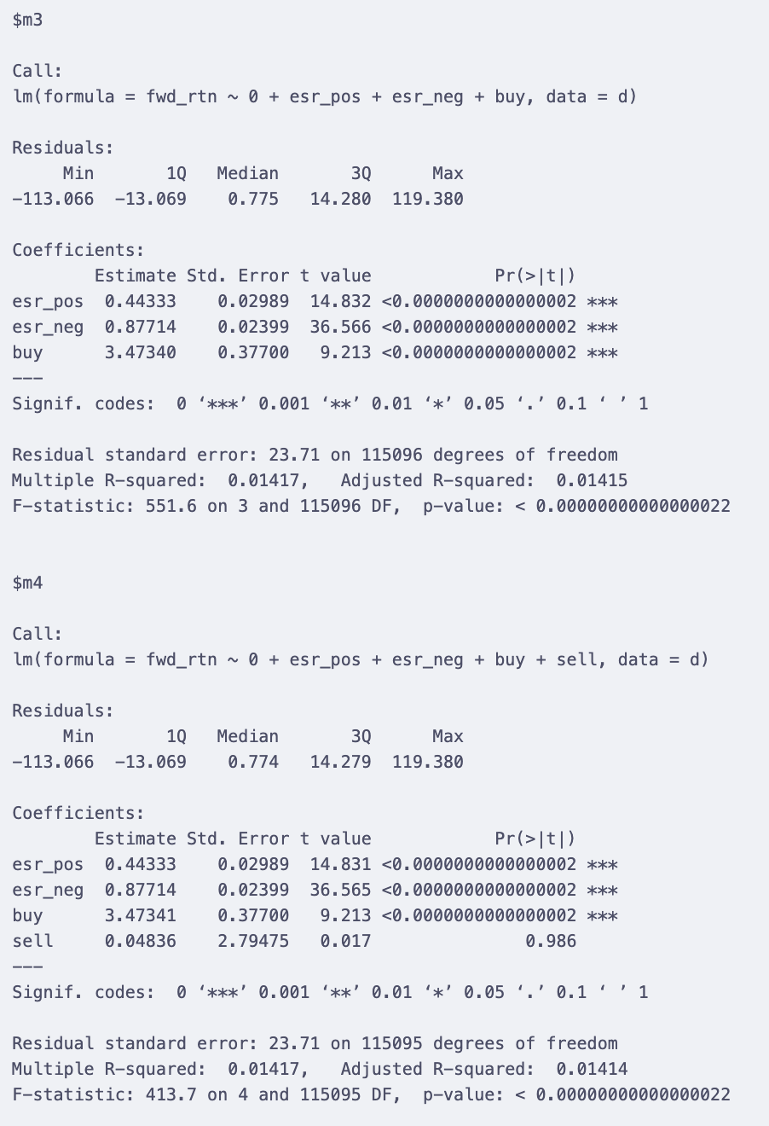
Detailed model summaries

Slide 11
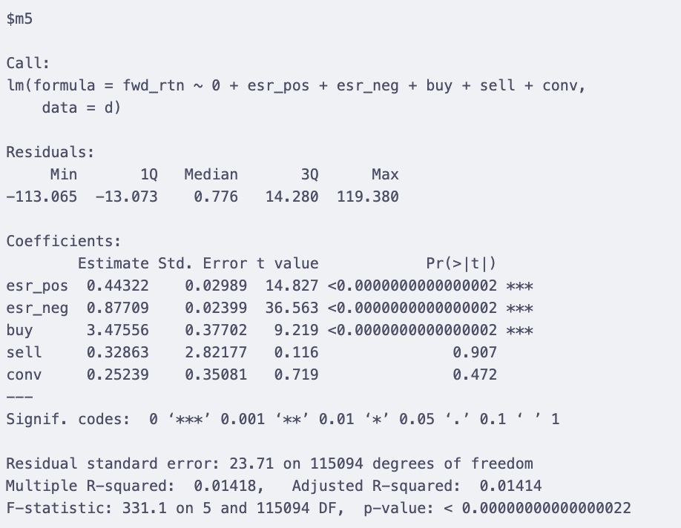
Detailed model summaries

Slide 12
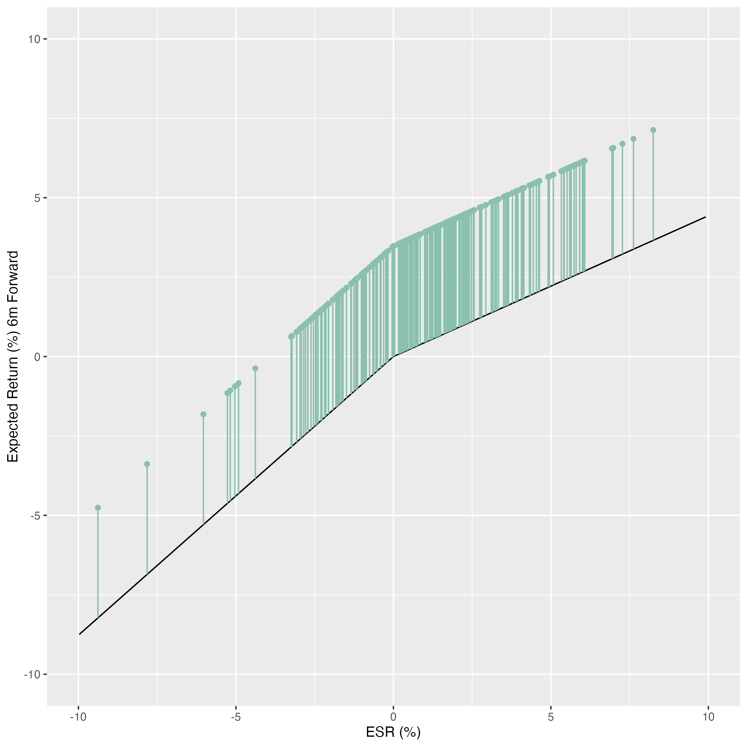
Graphically

Slide 13
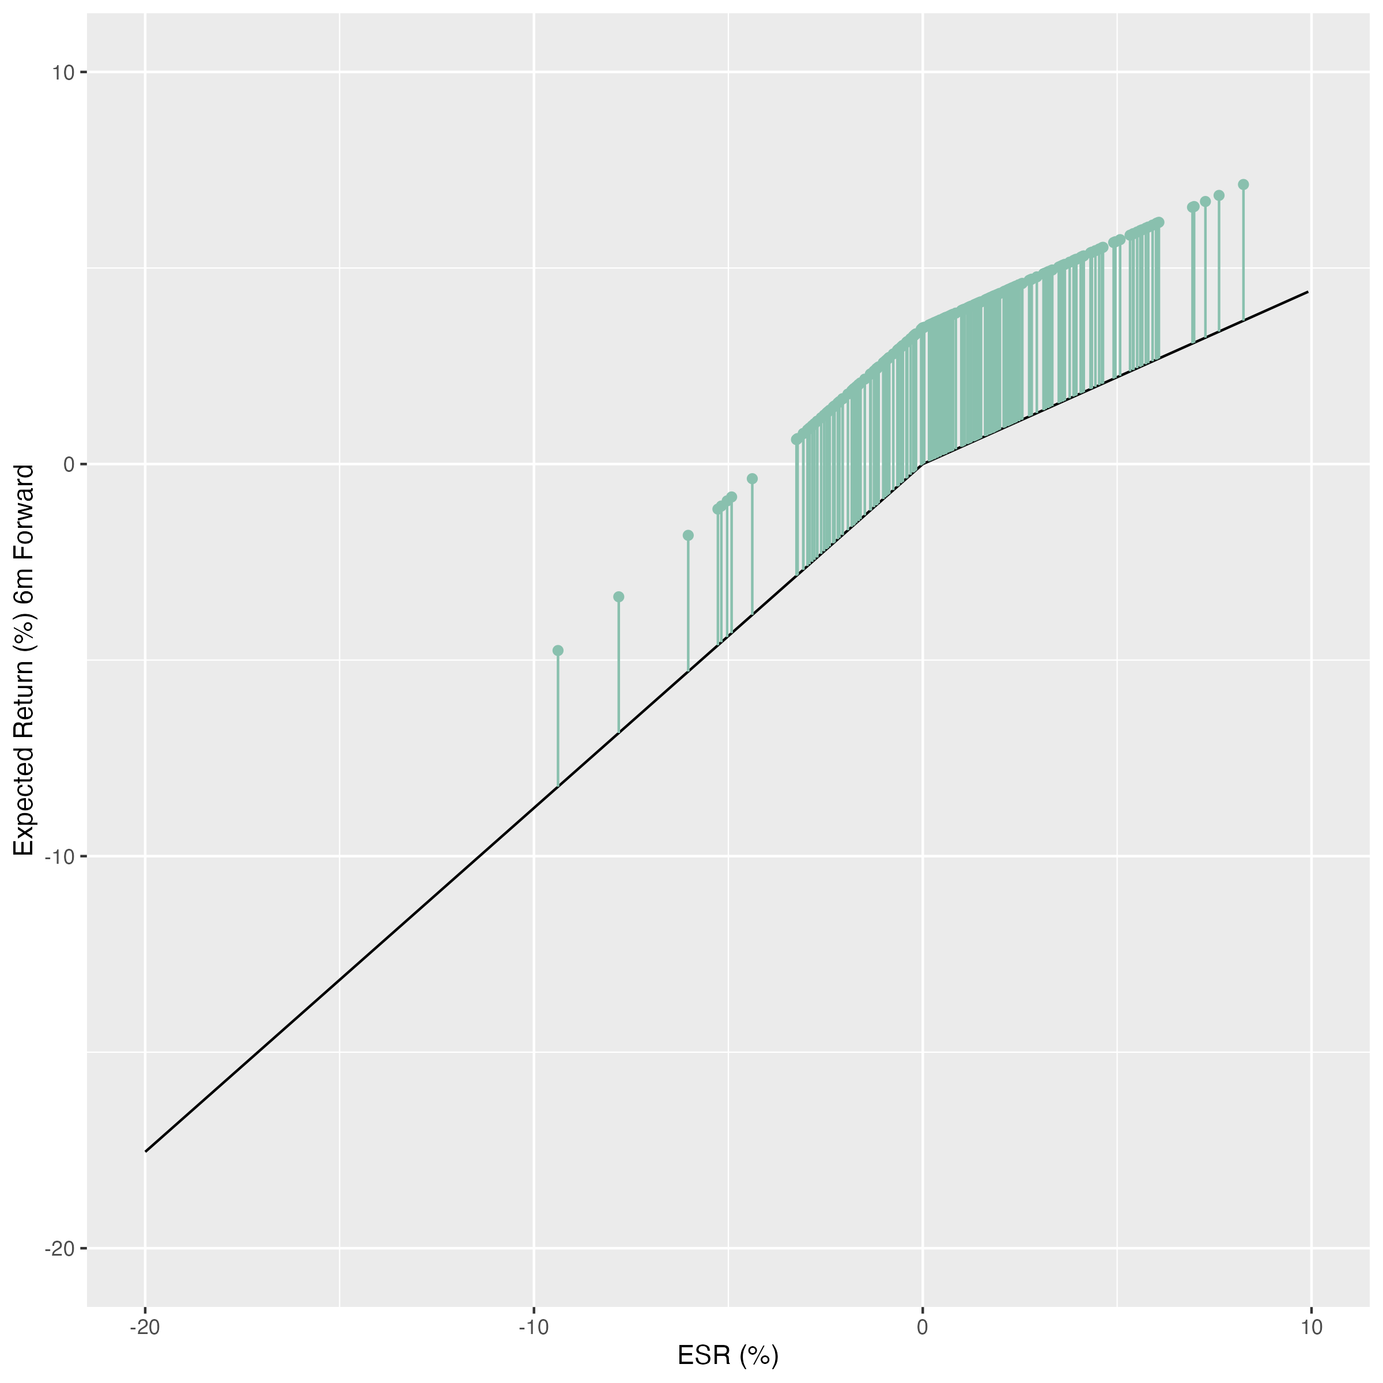
Graphically

