Slide 1

WebGL - Fun
A “Funday” Project
From Workiva
By Grant Nelson

Slide 2
Introduction
All code and data can be found at github.com/grantnelson-wf/webgl-fun
Cube maps from www.humus.name/index.php?page=Textures
Other images found via Google image search.
Some diagrams in this document are from Wikipedia.
These slides are not meant to teach shaders with but is an outline for the presentation on the research project.

Slide 3
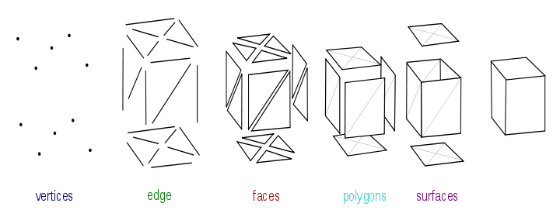
Data View
Data: Pos, Clr3, Clr4, Norm, Txt, Cube, Binm, Wght, Adj1, Adj2
Math: objMat, viewMat, projMat
Creating shapes and render targets.
This presentation is focused on the shaders.

Slide 4
Color
Vertex Shader
0 1 2 3 4 5 6 7 8 9 10 11 12 13 | uniform mat4 objMat; uniform mat4 viewMat; uniform mat4 projMat; attribute vec3 posAttr; attribute vec3 clr3Attr; varying vec4 vColor; void main() { gl_Position = projMat*viewMat*objMat*vec4(posAttr, 1.0); vColor = vec4(clr3Attr, 1.0); }

Slide 5
Color
Fragment Shader
0 1 2 3 4 5 6 7 | precision mediump float; varying vec4 vColor; void main() { gl_FragColor = vColor; }

Slide 6
Fog
Vertex Shader
0 1 2 3 4 5 6 7 8 9 10 11 12 13 | uniform mat4 objMat; uniform mat4 viewMat; uniform mat4 projMat; attribute vec3 posAttr; varying float depth; void main() { vec4 pos = viewMat*objMat*vec4(posAttr, 1.0); depth = pos.z; gl_Position = projMat*pos; }

Slide 7
Fog
Fragment Shader
0 1 2 3 4 5 6 7 8 9 10 11 12 13 14 | precision mediump float; uniform vec3 objClr; uniform vec3 fogClr; uniform float fogStart; uniform float fogStop; varying float depth; void main() { float factor = (depth-fogStop)/(fogStart-fogStop); factor = clamp(factor, 0.0, 1.0); gl_FragColor = vec4(mix(fogClr, objClr, factor), 1.0); }

Slide 8
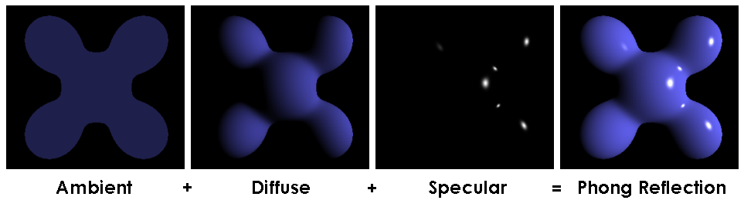
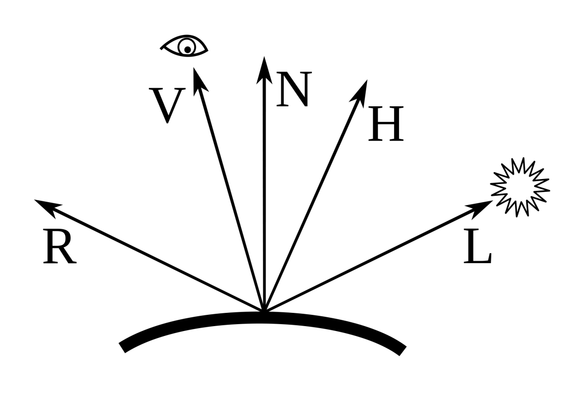
Directional Light

Slide 9
Directional Light
Vertex Shader
0 1 2 3 4 5 6 7 8 9 10 11 12 13 14 15 16 17 18 | uniform mat4 objMat; uniform mat4 viewMat; uniform mat4 projMat; uniform vec3 lightVec; attribute vec3 posAttr; attribute vec3 normAttr; varying vec3 normal; varying vec3 litVec; varying vec3 camPos; void main() { camPos = (viewMat*vec4(0.0, 0.0, 0.0, -1.0)).xyz; normal = normalize(objMat*vec4(normAttr, 0.0)).xyz; litVec = normalize((viewMat*vec4(lightVec, 0.0)).xyz); gl_Position = projMat*viewMat*objMat*vec4(posAttr, 1.0); }

Slide 10
Directional Light
Fragment Shader
0 1 2 3 4 5 6 7 8 9 10 | precision mediump float; uniform vec3 ambientClr; uniform vec3 diffuseClr; uniform vec3 specularClr; uniform float shininess; varying vec3 normal; varying vec3 litVec; varying vec3 camPos;
25 26 27 28 29 30 31 32 | void main() { vec3 norm = normalize(normal); gl_FragColor = vec4(ambientClr + diffuse(norm) + specular(norm), 1.0); }

Slide 11
Directional Light
Fragment Shader |  | continued
10 11 12 13 14 15 16 17 17 18 19 20 21 22 23 24 25 | vec3 diffuse(vec3 norm) { float scalar = dot(norm, litVec); return diffuseClr*max(scalar, 0.0); } vec3 specular(vec3 norm) { vec3 lightRef = normalize(reflect(-litVec, norm)); float scalar = dot(lightRef, normalize(camPos)); if(scalar > 0.0) return specularClr*max(pow(scalar, shininess), 0.0); else return vec3(0.0, 0.0, 0.0); }

Slide 12
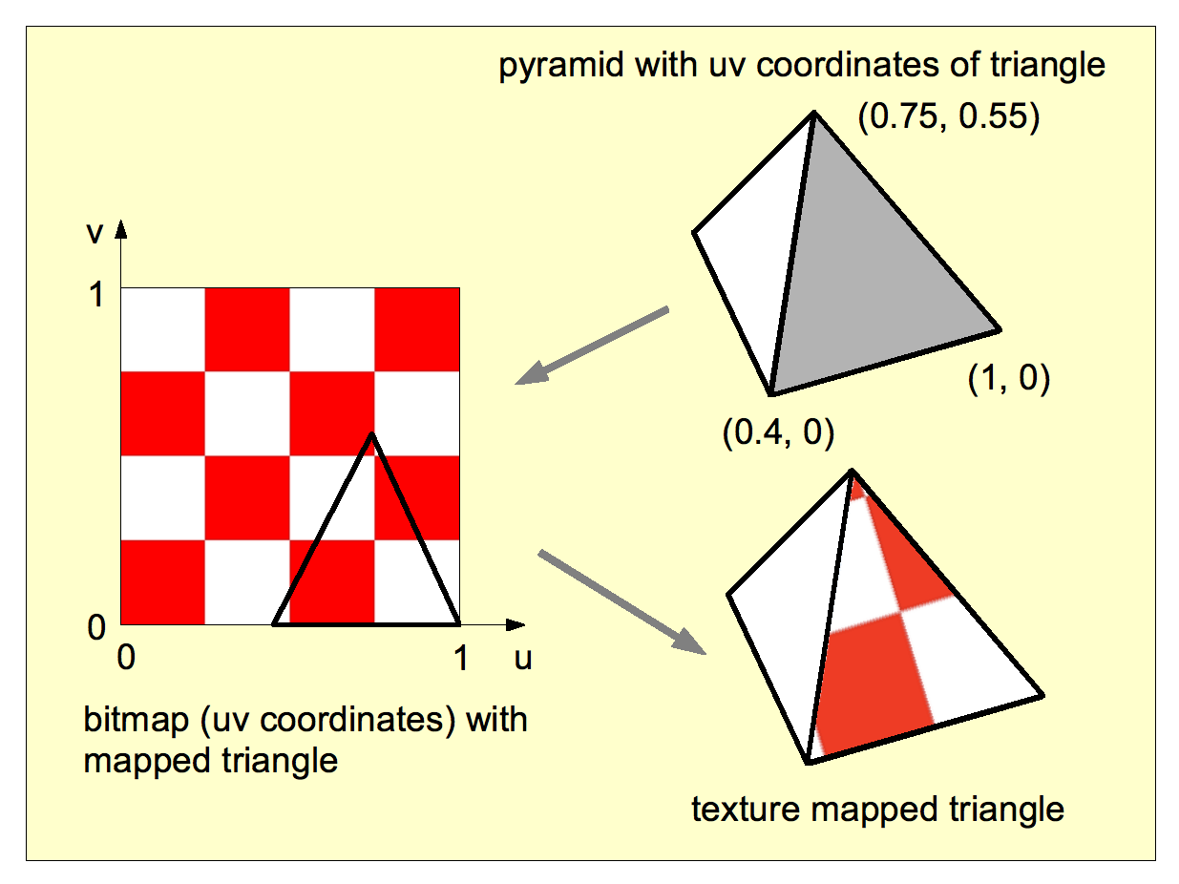
Texture 2D

Slide 13
Texture 2D
Vertex Shader
0 1 2 3 4 5 6 7 8 9 10 11 12 13 | uniform mat4 objMat; uniform mat4 viewMat; uniform mat4 projMat; attribute vec3 posAttr; attribute vec2 txtAttr; varying vec2 vTxt; void main() { gl_Position = projMat*viewMat*objMat*vec4(posAttr, 1.0); vTxt = txtAttr; }

Slide 14
Texture 2D
Fragment Shader
0 1 2 3 4 5 6 7 8 9 | precision mediump float; varying vec2 vTxt; uniform sampler2D txtSampler; void main() { gl_FragColor = texture2D(txtSampler, vTxt); }

Slide 15
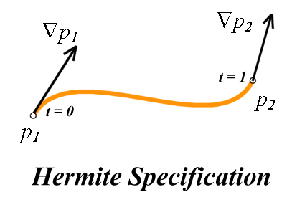
Texture Flatten
Vertex manipulation between two positions.

Slide 16
Texture Flatten
Vertex Shader
0 1 2 3 4 5 6 7 8 9 10 11 12 13 14 15 16 17 18 19 20 21 22 23 24 25 26 | uniform mat4 viewMat, projMat; uniform float flatten, magnifier; attribute vec3 posAttr, normAttr; attribute vec2 txtAttr; varying vec2 vTxt; void main() { mat4 hermite = mat4( 2.0, -3.0, 0.0, 1.0, -2.0, 3.0, 0.0, 0.0, 1.0, -2.0, 1.0, 0.0, 1.0, -1.0, 0.0, 0.0); float flatten2 = flatten*flatten; float flatten3 = flatten2*flatten; vec4 iter = vec4(flatten3, flatten2, flatten, 1.0); float flatx = txtAttr.x*2.0-1.0; float flatz = txtAttr.y*2.0-1.0; mat4 pov = mat4(posAttr.x, flatx, normAttr.x*magnifier, 0.0, posAttr.y, 0.0, normAttr.y*magnifier, magnifier, posAttr.z, flatz, normAttr.z*magnifier, 0.0, 1.0, 1.0, 0.0, 0.0); vec4 final = iter*hermite*pov; gl_Position = projMat*viewMat*objMat*final; vTxt = txtAttr; }

Slide 17
Texture Flatten
Vertex Shader
0 1 2 3 4 5 6 7 8 9 | precision mediump float; varying vec2 vTxt; uniform sampler2D txtSampler; void main() { gl_FragColor = texture2D(txtSampler, vTxt); }

Slide 18
SkyBox
Vertex Shader
0 1 2 3 4 5 6 7 8 9 10 11 12 13 | uniform mat4 objMat; uniform mat4 viewMat; uniform mat4 projMat; attribute vec3 posAttr; attribute vec3 cubeAttr; varying vec3 vCube; void main() { gl_Position = projMat*viewMat*objMat*vec4(posAttr, 1.0); vCube = cubeAttr; }

Slide 19
SkyBox
Fragment Shader
0 1 2 3 4 5 6 7 8 9 10 11 | precision mediump float; varying vec3 vCube; uniform samplerCube txtSampler; void main() { gl_FragColor = textureCube(txtSampler, vCube); }

Slide 20
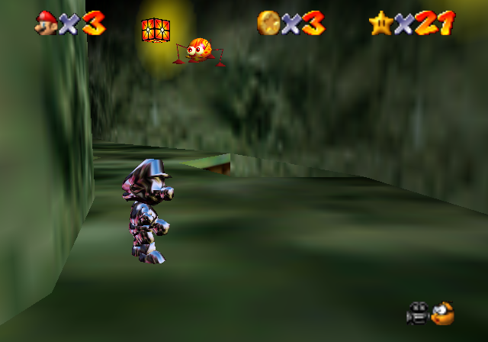
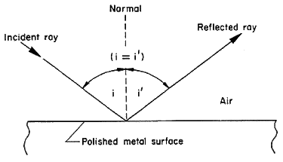
Metal

Slide 21
Metal
Vertex Shader
0 1 2 3 4 5 6 7 8 9 10 11 12 13 14 15 16 | uniform mat4 objMat; uniform mat4 viewMat; uniform mat4 projMat; attribute vec3 posAttr; attribute vec3 normAttr; varying vec3 vNorm; varying vec3 vView; void main() { vec4 eyeCoords = viewMat*objMat*vec4(posAttr, 1.0); gl_Position = projMat*eyeCoords; vView = -vec3(eyeCoords); vNorm = vec3(viewMat*objMat*vec4(normAttr, 0.0)); }

Slide 22
Metal
Fragment Shader
0 1 2 3 4 5 6 7 8 9 10 11 12 13 | precision mediump float; uniform mat4 invViewMat; uniform samplerCube txtSampler; varying vec3 vNorm; varying vec3 vView; void main() { vec3 refl = reflect(normalize(vView), normalize(vNorm)); refl = vec3(invViewMat*vec4(refl, 0.0)); gl_FragColor = textureCube(txtSampler, refl); }

Slide 23
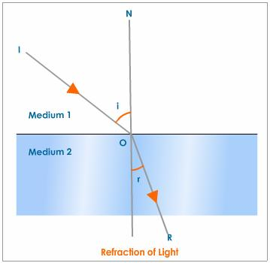
Glass

Slide 24
Glass
Vertex Shader
0 1 2 3 4 5 6 7 8 9 10 11 12 13 14 15 16 | uniform mat4 objMat; uniform mat4 viewMat; uniform mat4 projMat; attribute vec3 posAttr; attribute vec3 normAttr; varying vec3 vNorm; varying vec3 vView; void main() { vec4 eyeCoords = viewMat*objMat*vec4(posAttr, 1.0); gl_Position = projMat*eyeCoords; vView = vec3(eyeCoords); vNorm = -vec3(viewMat*objMat*vec4(normAttr, 0.0)); }

Slide 25
Glass
Fragment Shader
0 1 2 3 4 5 6 7 8 9 10 11 12 13 14 15 | precision mediump float; uniform mat4 invViewMat; uniform samplerCube txtSampler; uniform float reflWeight; varying vec3 vNorm; varying vec3 vView; void main() { vec3 refr = reflect(normalize(vView), normalize(vNorm)); refr = mix(refr, -vView, reflWeight); refr = vec3(invViewMat*vec4(refr, 0.0)); gl_FragColor = textureCube(txtSampler, refr); }

Slide 26
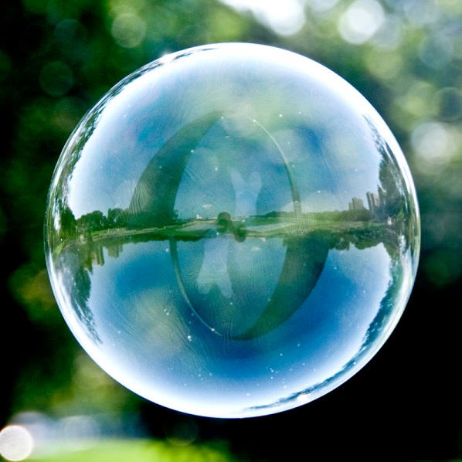
Bubble
A mix of a vertex shader which “wobbles” the vertices and a fragment shader which combines reflection and refraction.

Slide 27
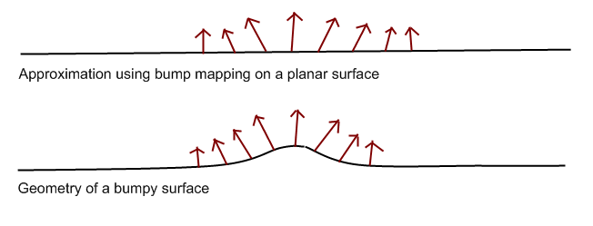
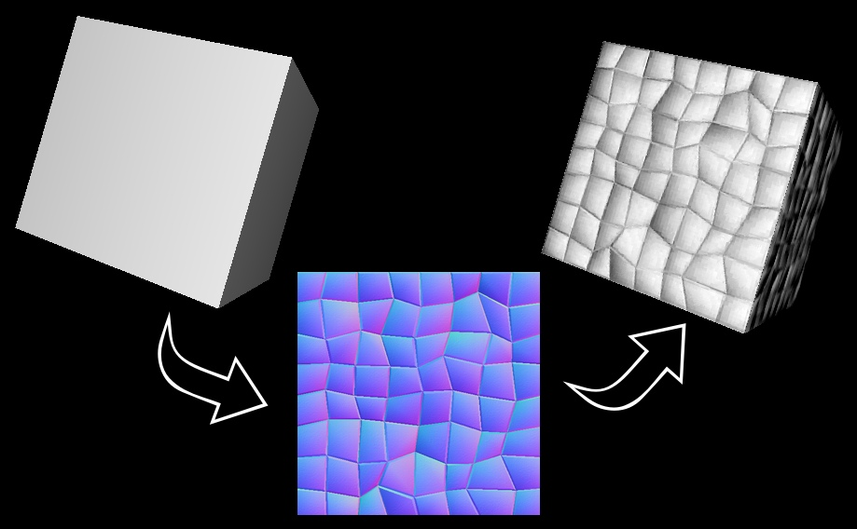
Bump Map

Slide 28
Bump Map
Vertex Shader
0 1 2 3 4 5 6 7 8 9 10 11 12 13 14 15 16 17 | uniform mat4 objMat; uniform mat4 viewMat; uniform mat4 projMat; attribute vec3 posAttr, normAttr, binmAttr, txtAttr; varying vec3 vView, vNorm, vBinm; varying vec2 vTxt; void main() { vec4 eyeCoords = viewMat*objMat*vec4(posAttr, 1.0); vView = -(eyeCoords.xyz); vNorm = (viewMat*objMat*vec4(normAttr, 0.0)).xyz; vBinm = (viewMat*objMat*vec4(binmAttr, 0.0)).xyz; vTxt = txtAttr; gl_Position = projMat*eyeCoords; }

Slide 29
Bump Map
Fragment Shader
0 1 2 3 4 5 6 7 8 9 10 11 12 13 14 15 16 17 18 19 20 21 22 23 24 | precision mediump float; uniform mat4 invViewMat; uniform samplerCube cubeSampler; uniform sampler2D bumpSampler; varying vec3 vView, vNorm, vBinm; varying vec2 vTxt; void main() { vec3 n = normalize(vNorm); vec3 b = normalize(vBinm); vec3 c = -cross(n, b); b = -cross(c, n); mat3 m = mat3(c.x, c.y, c.z, n.x, n.y, n.z, b.x, b.y, b.z); vec3 bump = texture2D(bumpSampler, vTxt).rbg; bump = m * normalize(2.0*bump - 1.0); vec3 refl = reflect(normalize(vView), bump); refl = vec3(invViewMat*vec4(refl, 0.0)); gl_FragColor = textureCube(cubeSampler, refl); }

Slide 30
Height Map
Vertex Shader
0 1 2 3 4 5 6 7 8 9 10 11 12 13 14 15 16 17 18 | uniform mat4 objMat, viewMat, projMat; uniform float maxHeight; attribute vec3 posAttr; attribute vec3 normAttr; attribute vec2 txtAttr; varying vec4 color; uniform sampler2D txtSampler; void main() { color = texture2D(txtSampler, txtAttr); float height = (color.x + color.y + color.z)/3.0; vec4 pos = height*vec4(normAttr, 0.0)*maxHeight + vec4(posAttr, 1.0); gl_Position = projMat*viewMat*objMat*pos; }

Slide 31
Height Map
Fragment Shader
0 1 2 3 4 5 6 7 | precision mediump float; varying vec4 color; void main() { gl_FragColor = color; }

Slide 32
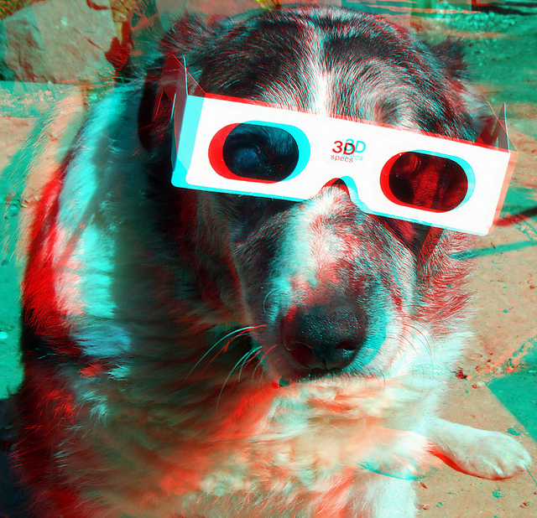
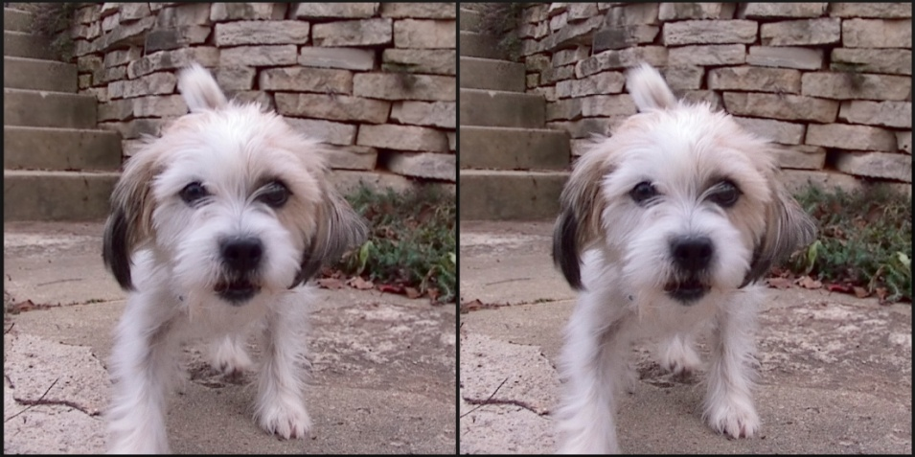
Red/Blue Image
A multi-pass shader.

Slide 33
Red/Blue Image
Vertex Shader
0 1 2 3 4 5 6 7 8 9 10 11 12 13 14 15 16 | uniform float dx; uniform float dv; uniform float width; uniform float height; uniform float aspect; attribute vec3 posAttr; attribute vec2 txtAttr; varying vec2 vTxt; void main() { gl_Position = vec4((posAttr.x*width + dx)*aspect, posAttr.y*height, posAttr.z, 1.0); vTxt = vec2(txtAttr.x*0.5 + dv, txtAttr.y); }

Slide 34
Red/Blue Image
Fragment Shader
0 1 2 3 4 5 6 7 8 9 10 11 | precision mediump float; uniform vec3 color; varying vec2 vTxt; uniform sampler2D txtSampler; void main() { gl_FragColor = texture2D(txtSampler, vTxt) * vec4(color, 1.0); }

Slide 35

Cartoon

Slide 36
Cartoon - Filler
Vertex Shader
0 1 2 3 4 5 6 7 8 9 10 11 12 13 14 15 16 | uniform mat4 objMat; uniform mat4 viewMat; uniform mat4 projMat; uniform vec3 lightVec; attribute vec3 posAttr; attribute vec3 normAttr; varying vec3 normal; varying vec3 litVec; void main() { normal = normalize(objMat*vec4(normAttr, 0.0)).xyz; litVec = normalize((viewMat*vec4(lightVec, 0.0)).xyz); gl_Position = projMat*viewMat*objMat*vec4(posAttr, 1.0); }

Slide 37
Cartoon - Filler
Fragment Shader
0 1 2 3 4 5 6 7 8 9 10 11 12 13 14 15 16 17 18 | precision mediump float; uniform float ambient; uniform float diffuse; uniform vec3 lightClr; uniform vec3 darkClr; uniform float slices; varying vec3 normal; varying vec3 litVec; void main() { vec3 norm = normalize(normal); float diff = diffuse*max(dot(norm, litVec), 0.0); float shade = 1.0 - clamp(ambient + diff, 0.0, 1.0); shade = floor(shade * (slices+1.0)) / (slices+1.0); gl_FragColor = vec4(mix(lightClr, darkClr, shade), 1.0); }

Slide 38
Cartoon - Outline
Vertex Shader
0 1 2 3 4 5 6 7 8 9 10 11 12 13 14 15 16 17 18 19 20 21 22 23 24 25 26 27 28 29 | uniform mat4 objMat, viewMat, projMat; uniform float thickness, edgeLimit; attribute vec3 posAttr, normAttr; attribute vec3 adj1Attr, adj2Attr; attribute float wghtAttr; void main() { mat4 viewObjMat = viewMat*objMat; if (wghtAttr < 0.5) { gl_Position = projMat*viewObjMat*vec4(posAttr, 1.0); } else { vec4 pos = viewObjMat*vec4(posAttr, 1.0); vec4 norm = viewObjMat*vec4(normAttr, 0.0); vec4 faceNorm1 = viewObjMat*vec4(adj1Attr, 0.0); vec4 faceNorm2 = viewObjMat*vec4(adj2Attr, 0.0); if (dot(faceNorm1, faceNorm2) <= edgeLimit) { pos += norm*thickness; } else { float dot1 = dot(pos, faceNorm1); float dot2 = dot(pos, faceNorm2); if ((dot1 * dot2) < 0.0) { pos += norm*thickness; } } gl_Position = projMat*pos; } }

Slide 39
Cartoon - Outline
Fragment Shader
0 1 2 3 4 5 6 7 | precision mediump float; uniform vec3 color; void main() { gl_FragColor = vec4(color, 1.0); }

Slide 40
Fireflies
Multiple point lights via multiple passes, multiple shapes, and bump mapping with textures and diffuse lighting.

Slide 41
Questions

