Slide 1
Brand X tracker deck

Slide 2
Table 1: Awareness of Brand X by gender (column %)
Response | Total | Male | Female
Yes | 60% | 64% | 56%
No | 35% | 31% | 39%
Don't know | 5% | 5% | 5%
Base | 1000 | 480 | 520

Slide 3
Very satisfied by gender (%)

Slide 4
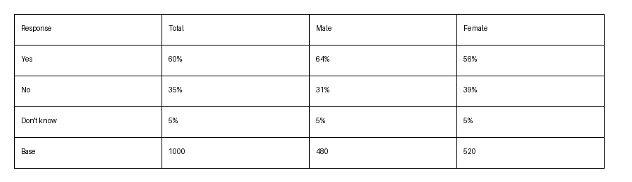
Awareness (picture of a table)

