Slide 1
HRC Anomaly Recovery
HRC-I voltage ramp-up and detector checkout
Dan Patnaude, Ralph Kraft, Paul Nulsen, Grant Tremblay, Tom Gauron, and Almus Kenter

Slide 2
Anomaly and Recovery Review:
On DOY 237:13:45, the HRC came up in an out of nominal state, with the +/- 15V LVPS reading red-limit values
After powering down the HRC +5V, the instrument LVPSs were turned back on DOY 240:00:05 UT (CAP 1541). The instrument appeared nominal for 11 hours, before the anomaly reappeared in telemetry at 240:11:43:18 UT, followed by a commanded shutdown at DOY 240:21:37:43 UT
On DOY 244:17:40 UT, a procedure was executed (CAP 1543) to switch the HRC to the B-side electronics powered by the redundant bus. This activity was successful
After 1 week of monitoring the HRC side B electronics, the HRC PMT#2 was manually ramped up and monitored, beginning with the comm on DOY 251:23:45 UT (CAP 1545A)
The PMT#2 has been operating nominally for more than 2 weeks, including execution of radmon enable and disable commanding
B-side electronics are functioning nominally, with all voltages and temperatures within allowable limits. Observed variations are due to changes in spacecraft attitude
The only significant difference from A-side operations is that the HRC current is more sensitive to temperature

Slide 3
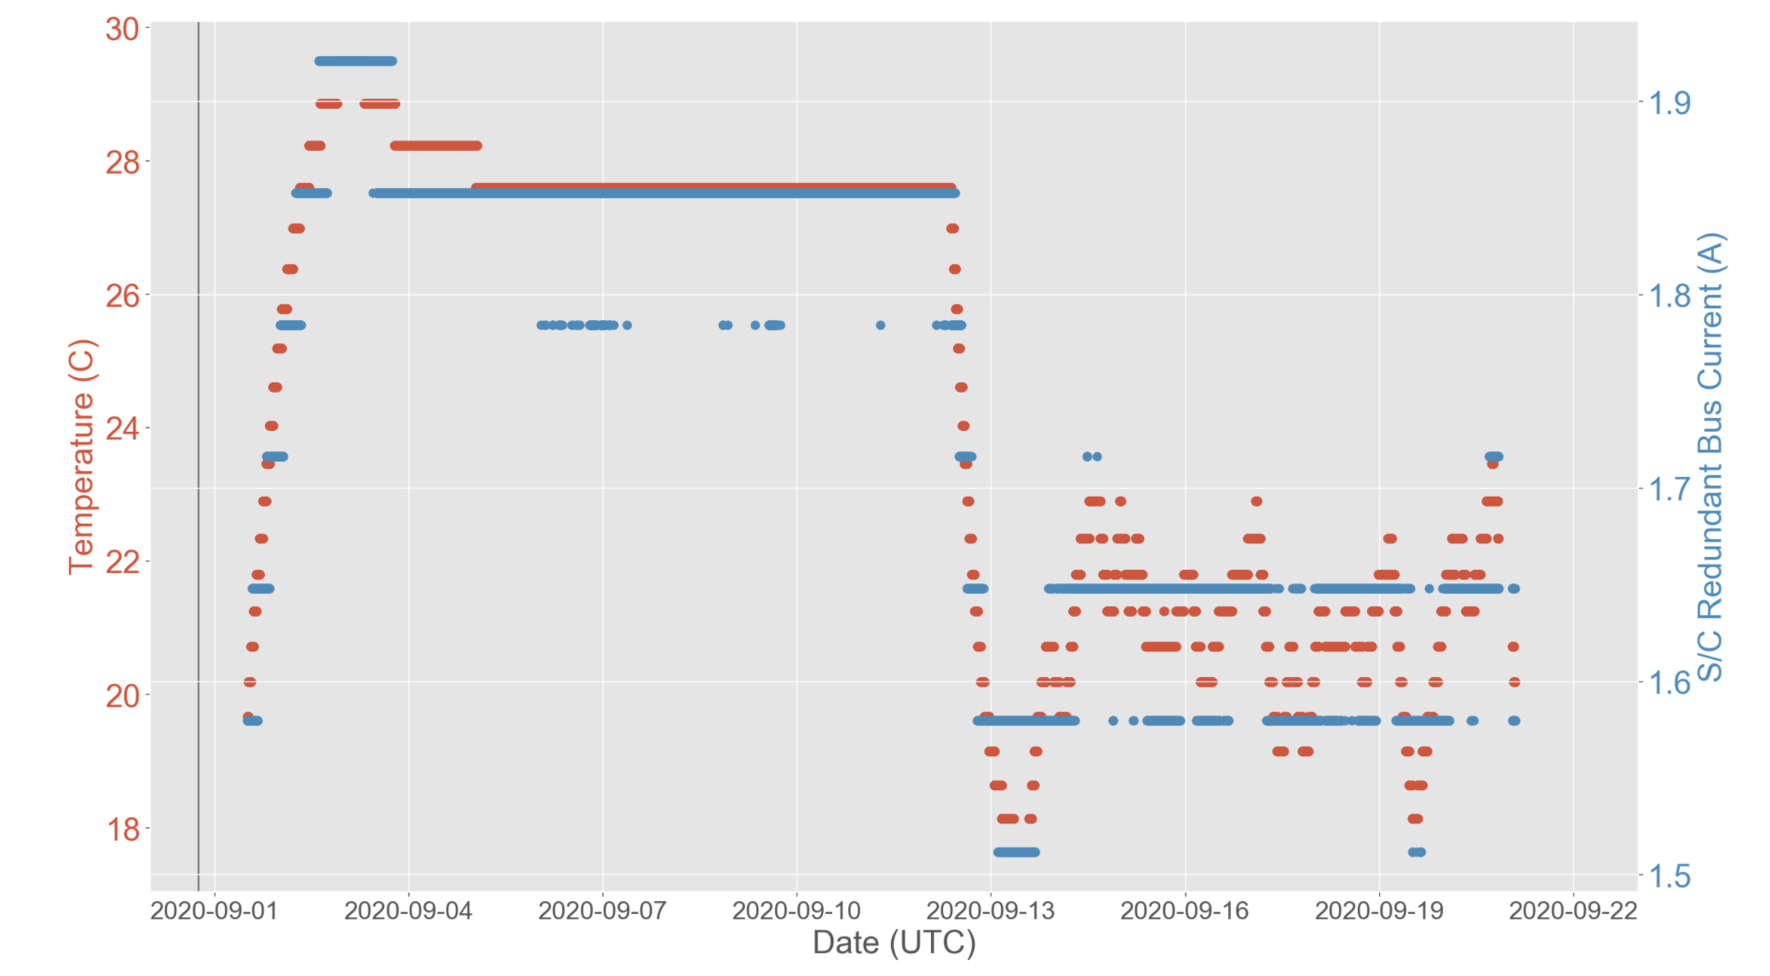

Slide 4
HRC-I manual voltage ramp up:
As the next step towards resuming normal science operations with the HRC, the HRC team proposes an activity to bring the HRC-I from 0 volts to the nominal operating settings, with 2 additional optional steps beyond nominal, in order to evaluate the voltage stepping electronics and B-side electronics in the Front end Electronics Assembly-B (FEA-B).
This activity is modeled on the initial HRC-I voltage ramp up which was performed during OAC, as well as activities in 2012 to adjust the nominal voltage settings for the HRC, in order to address the HRC gain drop
Activity involves manually ramping up to half voltage (with intermediary steps), followed by a slow ramp up to nominal operating voltage
At nominal settings, dwell on target (AR Lac) for 30 min
Perform two additional optional observations at +1 and +2 steps/plate, and dwell for 30 min at each step increase

Slide 5
Activity requirements:
Activity requires a real time comm of ~ 3 hour duration. Activity takes ~ 2.5 hours to complete, with 1.5 hours devoted to collecting science data
Deadman timers to set HRC-I HV to 0 steps need to be activated in case of loss of comm
SCS 87 and 89 need to be disabled
Like all HRC observations, we need to be in FMT1
Slew to AR Lac, set ER ID (to be provided by SOT/HRC), and setup for HRC dithering needs to be commanded in the daily loads
SCS 87 needs to be activated in the daily load, 10 min prior to the end of comm
Data needs to be processed immediately by automated processing, so that analysis can begin the following day

Slide 6
Real time activity goals:
Evaluate instrument performance
Voltage increases are sent as steps, and returned as monitor values
Evaluate detector count rate
Using a known, well observed calibration source, we expect a source rate of ~ 5 c/s, with a total field rate, including background, of ~ 130 c/s.
Realtime monitoring of the image in detector coordinates will allow us to measure the source and background rates
Realtime monitoring of detector engineering data as the plate voltages are ramped up
Evaluate onboard event processing electronics in both the FEA-B and CEA-B

Slide 7
Real time activity goals:
HRC-I AR Lac count rate (2000-2020). Proposed activity will occur at a phase of < 0.9, and will occur during the phase marked by the grey box (Courtesy of CXC Calibration group).

Slide 8
Post activity analysis goals:
While the detector plates, crossed grid charge detector, and power supply are not changed, the B side preamplifiers need to be evaluated:
Evaluate PHA spectrum of source and background (independently)
Imaging quality of the detector
Background uniformity
Detector gain and gain map
Evaluate detector degap map (though this may require a separate observation of a more extended source)
We expect that the Calibration group will provide support and an independent analysis of these data

Slide 9
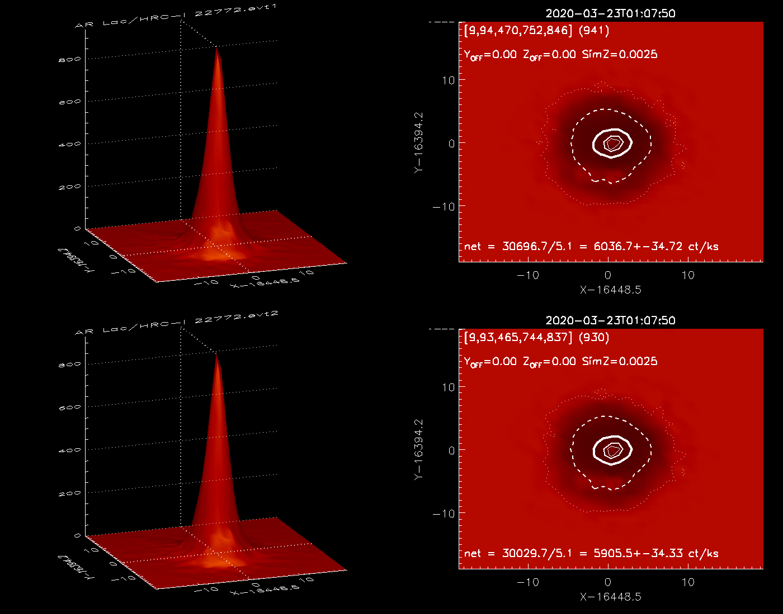
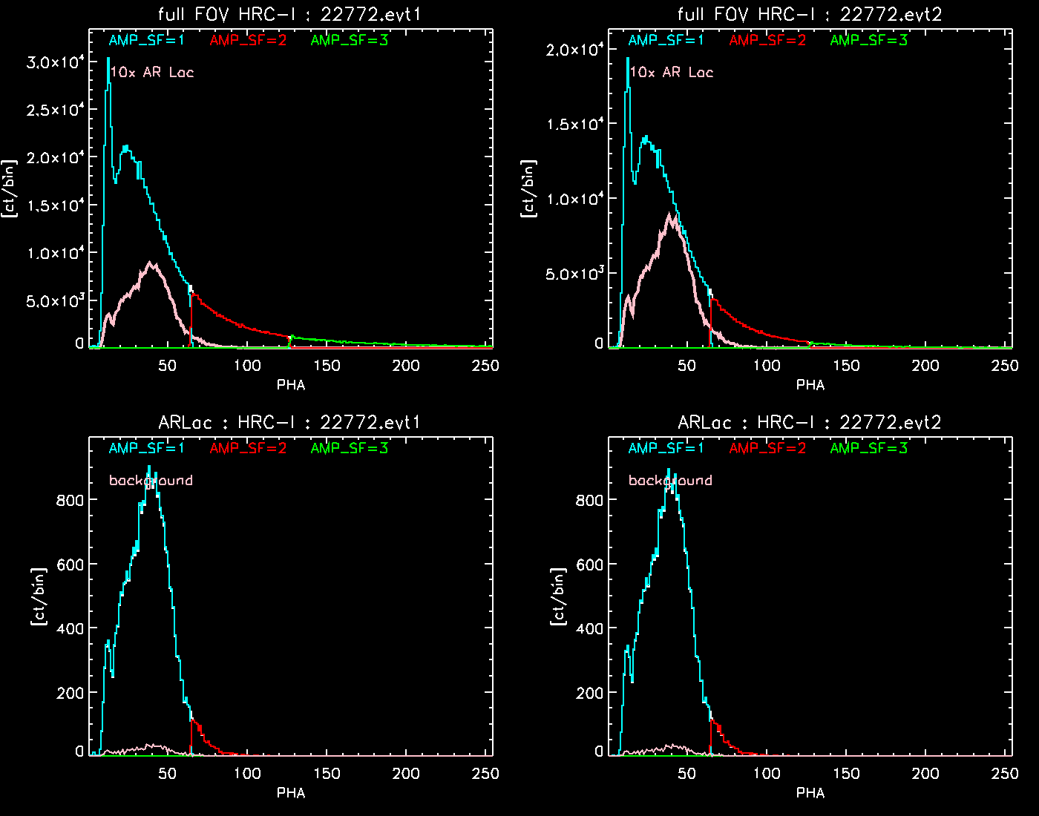
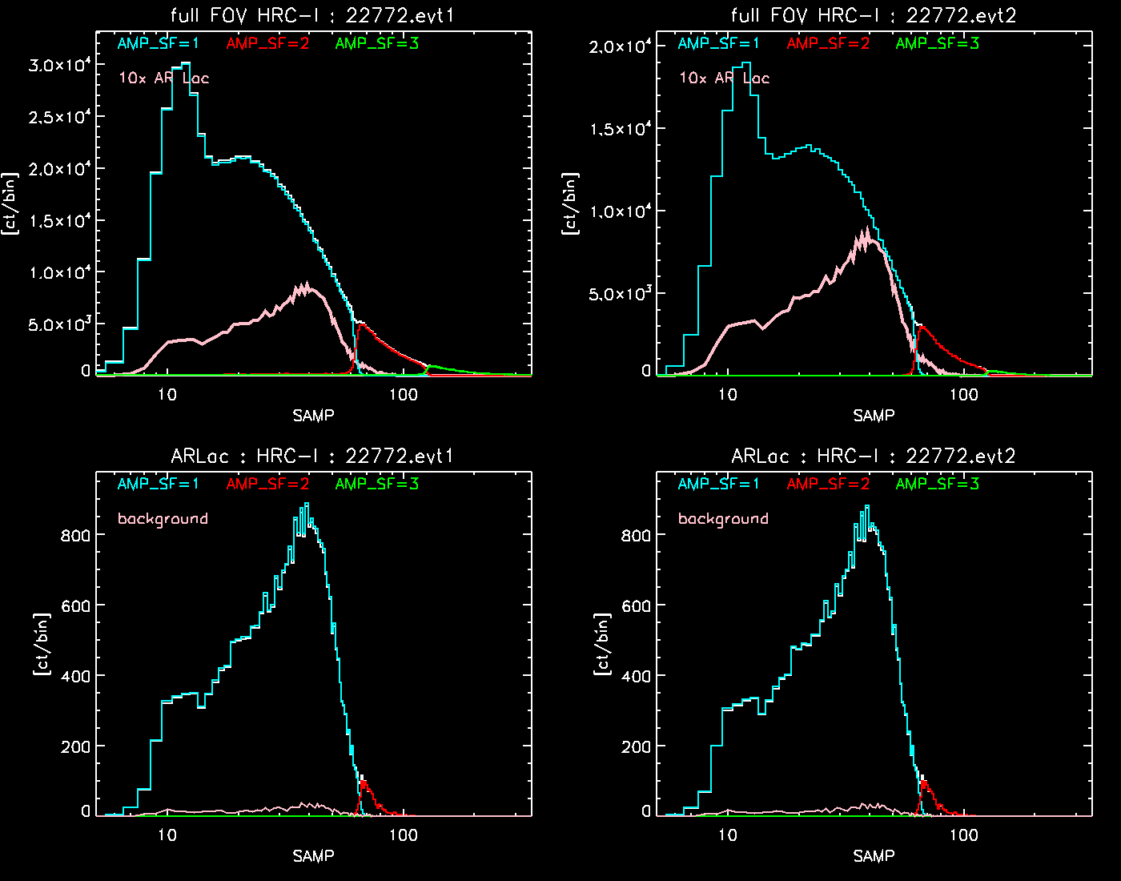
Post activity analysis goals:
The CXC Calibration group has provided analysis of previous 2020 HRC-I AR Lac observations and will be able to provide input on any changes in image quality (left panel), detector PHA (middle panel), and detector SUMAMPS (right panel).

Slide 10
Risk assessment:
The high voltage supplies for the detectors are supplied almost directly from the spacecraft +28V bus. These supplies are the same as were used on the A side, though they run through different power filtering boards
+/-15V, +5V, and +24V LVPS buses are electrically isolated through back to back 100V diodes. Therefore, with the A side being powered off, there can be no electrical interaction with the A side
There is no additional risk in activating the processing electronics in the FEA-B and CEA-B. Logic and commanding circuitry have been powered on since the successful execution of CAP 1543
Thermal analysis is on-going, but preliminary analysis suggests that no A-side components exceeded their operating temperatures during the anomaly

Slide 11
Supplemental Material

Slide 12
HRC CEA-A Preliminary Fault Tree
Courtesy K. Gage/T. Gauron

