Slide 1
What is machine learning?
And why is it useful (for science)?
Grant Vagle, Jeremiah Shrovnal, Lynn Waterhouse

Slide 2
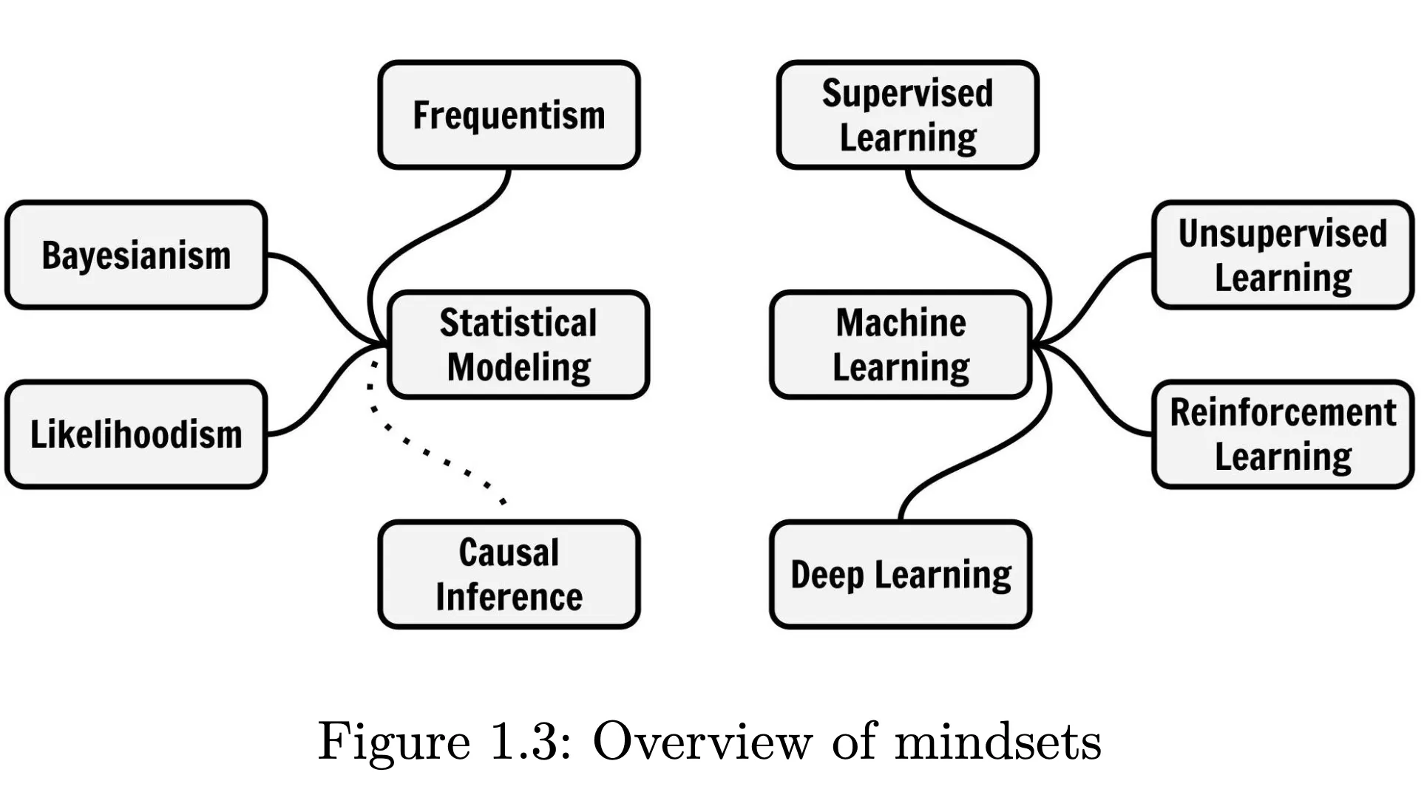
Modeling mindsets:
Molnar, C. 2023. Modeling mindsets: the many cultures of learning from data.

Slide 3
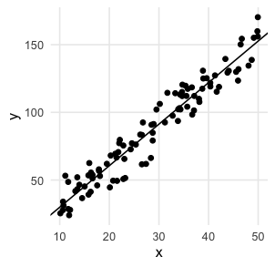
The same “model” can fit into multiple mindsets
A frequentist can use a linear regression to test a hypothesis
A Bayesian can measure the posterior distribution of a linear coefficient
A machine learner can use a linear regression to predict unobserved data

Slide 4
Modeling mindsets:
Molnar, C. 2023. Modeling mindsets: the many cultures of learning from data.

Slide 5
Modeling mindsets:
Molnar, C. 2023. Modeling mindsets: the many cultures of learning from data.

Slide 6
Modeling mindsets:
X
NATURE
Y
Molnar, C. 2023. Modeling mindsets: the many cultures of learning from data.

Slide 7
Modeling mindsets:
X
NATURE
Y
Statistical model: approximate how nature gets from X to Y by mimicking the data generating process
X
STATISTICAL
MODEL
Y
Molnar, C. 2023. Modeling mindsets: the many cultures of learning from data.

Slide 8
Modeling mindsets:
Molnar, C. 2023. Modeling mindsets: the many cultures of learning from data.

Slide 9
Modeling mindsets:
Molnar, C. 2023. Modeling mindsets: the many cultures of learning from data.

Slide 10
Modeling mindsets:
Machine learning: use algorithms to solve a task
Molnar, C. 2023. Modeling mindsets: the many cultures of learning from data.

Slide 11
Modeling mindsets:
Make 6 groups based on these data
Machine learning: use algorithms to solve a task
Molnar, C. 2023. Modeling mindsets: the many cultures of learning from data.

Slide 12
Modeling mindsets:
Make 6 groups based on these data
Machine learning: use algorithms to solve a task
Get better at chess
Molnar, C. 2023. Modeling mindsets: the many cultures of learning from data.

Slide 13
Modeling mindsets:
Make 6 groups based on these data
Machine learning: use algorithms to solve a task
Get better at chess
Identify things in images
Molnar, C. 2023. Modeling mindsets: the many cultures of learning from data.

Slide 14
Modeling mindsets:
Machine learning: use algorithms to solve a task
Molnar, C. 2023. Modeling mindsets: the many cultures of learning from data.

Slide 15
Modeling mindsets:
X
NATURE
Y
Machine learning: use algorithms to solve a task
Supervised machine learning: use algorithms to mimic the outputs of nature
X
Y
MODEL
Molnar, C. 2023. Modeling mindsets: the many cultures of learning from data.

Slide 16
In science, we often have multiple aims
Observe the world
Generate hypotheses
Test a hypothesis
Estimate a value
Predict something about the world

Slide 17
In science, we often have multiple aims
Supervised machine learning can help!
Observe the world
Generate hypotheses
Test a hypothesis
Estimate a value
Predict something about the world
Observe: Classify trail camera images to identify animals at scale
Generate: Identify patterns and suggest important variables for future experiments
Predict: Forecast the future distribution or abundance of a plant

Slide 18
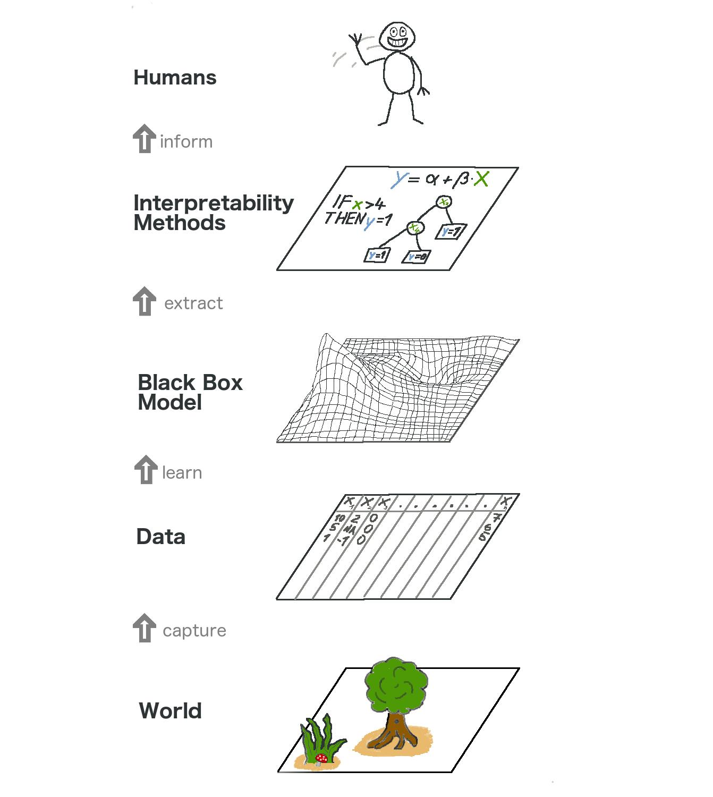
But we can’t understand black box models?
Well, sort of…
Many algorithms used to make predictions are very complex and difficult (impossible?) to understand
But post-hoc approaches can identify how the model is using variables to make predictions
FREE BOOK: https://christophm.github.io/interpretable-ml-book

Slide 19
Some terminology differences…
Statistical modeling | Machine learning
Fit a model | Train a model
Dependent variable; Response variable | Response variable; Target variable
Independent variable; Predictor variable | Feature variable; Predictor variable
Examine the coefficients | “Interpret” or “Explain” the model

Slide 20
Today, we’ll focus on supervised machine learning and tree-based algorithms
We’ll cover:
Model evaluation and cross-validation approaches
Handling correlated variables
Class-balancing
Model tuning
Model interpretation
Classification and regression trees (CART)
Random forests / bagging
Boosted regression trees
We won’t cover:
K-means clustering
Dimensionality reduction / PCA
Neural networks / deep learning
Natural language processing
Image processing
Bayesian Additive Regression Trees
All the possible interpretation methods

