Slide 1

Model evaluation and cross validation
Grant Vagle, Jeremiah Shrovnal, Lynn Waterhouse

Slide 2
Overview of this section
Understanding how well a model is performing
Performance metrics
Evaluation / cross-validation
Introduce Classification and Regression Trees (CART)
Hands-on coding example

Slide 3
How do we measure how well a model mimics the outputs of nature?
Model performance metrics – what we calculate
Model validation – which data we use to make the calculation
X
NATURE
Y
X
Y
MODEL
Molnar, C. 2023. Modeling mindsets: the many cultures of learning from data.

Slide 4
Model performance metrics - classification
Many (most?) performance metrics for classification come from the confusion matrix
Let’s say we have a model that predicts a yes or no response
 | Observed response | Predicted response
1 | Yes | Yes
2 | No | Yes
3 | Yes | Yes
…
100 | Yes | No
Notes:
- [link to accuracy metrics](https://developers.google.com/machine-learning/crash-course/classification/accuracy-precision-recall)
- [link to ROC and AUC](https://developers.google.com/machine-learning/crash-course/classification/roc-and-auc)

Slide 5
Model performance metrics - classification
Many (most?) performance metrics for classification come from the confusion matrix
Let’s say we have a model that predicts a yes or no response
 | Observed response | Predicted response
1 | Yes | Yes
2 | No | Yes
3 | Yes | Yes
…
100 | Yes | No
Confusion matrix:
 | Predicted Yes | Predicted No
Observed Yes
Observed No
Notes:
- [link to accuracy metrics](https://developers.google.com/machine-learning/crash-course/classification/accuracy-precision-recall)
- [link to ROC and AUC](https://developers.google.com/machine-learning/crash-course/classification/roc-and-auc)

Slide 6
Model performance metrics - classification
Many (most?) performance metrics for classification come from the confusion matrix
Let’s say we have a model that predicts a yes or no response
 | Observed response | Predicted response
1 | Yes | Yes
2 | No | Yes
3 | Yes | Yes
…
100 | Yes | No
Confusion matrix:
 | Predicted Yes | Predicted No
Observed Yes | 42 | 4
Observed No | 18 | 36
Notes:
- [link to accuracy metrics](https://developers.google.com/machine-learning/crash-course/classification/accuracy-precision-recall)
- [link to ROC and AUC](https://developers.google.com/machine-learning/crash-course/classification/roc-and-auc)

Slide 7
Model performance metrics - classification
 | Predicted Yes | Predicted No
Observed Yes | 42 | 18
Observed No | 4 | 36

Slide 8
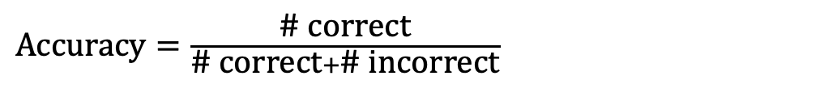
Model performance metrics - classification
 | Predicted Yes | Predicted No
Observed Yes | 42 | 18
Observed No | 4 | 36
$\text{Accuracy}=\frac{\text{\# }\text{correct}}{\text{\# }\text{correct}+\text{\# }\text{incorrect}}$ = (42+36) / 100 = 78%

Slide 9
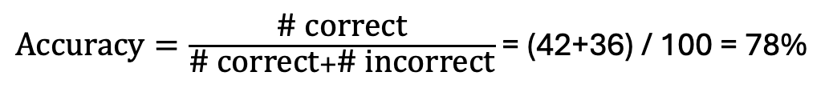
Model performance metrics - classification
 | Predicted Yes | Predicted No
Observed Yes | 42 | 18
Observed No | 4 | 36
$\text{Accuracy}=\frac{\text{\# }\text{correct}}{\text{\# }\text{correct}+\text{\# }\text{incorrect}}$ = (42+36) / 100 = 78%

Slide 10
Model performance metrics - classification
 | Predicted Yes | Predicted No
Observed Yes | 42 | 18
Observed No | 4 | 36
Elements of the confusion matrix are not created equal:
Suppose “Yes” means an email is spam
Suppose “Yes” means testing positive for Covid19
Model performance metrics can get at different components of the confusion matrix
$\text{Accuracy}=\frac{\text{\# }\text{correct}}{\text{\# }\text{correct}+\text{\# }\text{incorrect}}$ = (42+36) / 100 = 78%

Slide 11
Model performance metrics - classification
 | Predicted Yes | Predicted No
Observed Yes | 42 | 18
Observed No | 4 | 36
Elements of the confusion matrix are not created equal:
Suppose “Yes” means an email is spam
Suppose “Yes” means testing positive for Covid19
Model performance metrics can get at different components of the confusion matrix
$\text{Accuracy}=\frac{\text{\# }\text{correct}}{\text{\# }\text{correct}+\text{\# }\text{incorrect}}$ = (42+36) / 100 = 78%

Slide 12
Model performance metrics - classification
 | Predicted Yes | Predicted No
Observed Yes | 42 | 18
Observed No | 4 | 36
Elements of the confusion matrix are not created equal:
Suppose “Yes” means an email is spam
Suppose “Yes” means testing positive for Covid19
Model performance metrics can get at different components of the confusion matrix
$\text{Accuracy}=\frac{\text{\# }\text{correct}}{\text{\# }\text{correct}+\text{\# }\text{incorrect}}$ = (42+36) / 100 = 78%

Slide 13
Model performance metrics - classification
 | Predicted Yes | Predicted No
Observed Yes | 42 | 18
Observed No | 4 | 36
Elements of the confusion matrix are not created equal:
Suppose “Yes” means an email is spam
Suppose “Yes” means testing positive for Covid19
Some model performance metrics can get at different components of the confusion matrix
$\text{Accuracy}=\frac{\text{\# }\text{correct}}{\text{\# }\text{correct}+\text{\# }\text{incorrect}}$ = (42+36) / 100 = 78%

Slide 14
Model performance metrics - classification
 | Predicted Yes | Predicted No
Observed Yes | 42 | 18
Observed No | 4 | 36
Elements of the confusion matrix are not created equal:
Suppose “Yes” means an email is spam
Suppose “Yes” means testing positive for Covid19
Some model performance metrics can get at different components of the confusion matrix
$\text{Accuracy}=\frac{\text{\# }\text{correct}}{\text{\# }\text{correct}+\text{\# }\text{incorrect}}$ = (42+36) / 100 = 78%
Metrics from confusion matrix: https://www.geeksforgeeks.org/machine-learning/confusion-matrix-machine-learning/
Metrics for classification:
https://developers.google.com/machine-learning/crash-course/classification/accuracy-precision-recall
Link to ROC and AUC details: https://developers.google.com/machine-learning/crash-course/classification/roc-and-auc

Slide 15
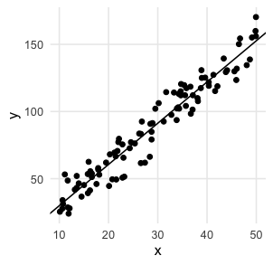
Model performance metrics - regression
Most ask in some way: how big are the residuals?
Root mean squared error (RMSE)
Mean absolute error
…
Many are related to R²
Predicted
Observed
Notes:
[*] [stack exchange discussion on RMSE and R-squared](https://datascience.stackexchange.com/questions/100605/rmse-vs-r-squared)
[**] [link to article with many other evaluation metrics](https://towardsai.net/p/artificial-intelligence/the-essential-guide-to-ml-evaluation-metrics-for-regression)

Slide 16
Model performance metrics - regression
Most ask in some way: how big are the residuals?
Root mean squared error (RMSE)
Mean absolute error
Many more
Many are related to R²
Predicted
Observed
Notes:
[*] [stack exchange discussion on RMSE and R-squared](https://datascience.stackexchange.com/questions/100605/rmse-vs-r-squared)
[**] [link to article with many other evaluation metrics](https://towardsai.net/p/artificial-intelligence/the-essential-guide-to-ml-evaluation-metrics-for-regression)

Slide 17
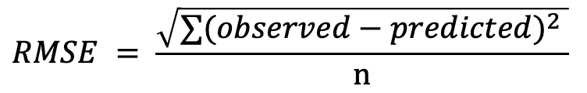
Model performance metrics - regression
Most ask in some way: how big are the residuals?
Root mean squared error (RMSE)
Mean absolute error
Many more
Many are related to R²
Predicted
Observed
$$RMSE = \frac{\sqrt{∑{(observed−predicted)}^{2} }}{n}$$
Notes:
[*] [stack exchange discussion on RMSE and R-squared](https://datascience.stackexchange.com/questions/100605/rmse-vs-r-squared)
[**] [link to article with many other evaluation metrics](https://towardsai.net/p/artificial-intelligence/the-essential-guide-to-ml-evaluation-metrics-for-regression)

Slide 18
Model performance metrics - regression
Most ask in some way: how big are the residuals?
Root mean squared error (RMSE)
Mean absolute error
Many more
Many are related to R²
Predicted
Observed
$$RMSE = \frac{\sqrt{∑{(observed−predicted)}^{2} }}{n}$$
Notes:
[*] [stack exchange discussion on RMSE and R-squared](https://datascience.stackexchange.com/questions/100605/rmse-vs-r-squared)
[**] [link to article with many other evaluation metrics](https://towardsai.net/p/artificial-intelligence/the-essential-guide-to-ml-evaluation-metrics-for-regression)

Slide 19
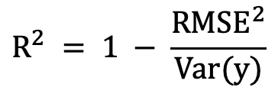
Model performance metrics - regression
Most ask in some way: how big are the residuals?
Root mean squared error (RMSE)
Mean absolute error
Many more
Many are related to R²
Predicted
Observed
RMSE vs R²
https://datascience.stackexchange.com/questions/100605/rmse-vs-r-squared
$$RMSE = \frac{\sqrt{∑{(observed−predicted)}^{2} }}{n}$$
$$R^{2} = 1 − \frac{{RMSE}^{2}}{Var(y)}$$
Notes:
[*] [stack exchange discussion on RMSE and R-squared](https://datascience.stackexchange.com/questions/100605/rmse-vs-r-squared)
[**] [link to article with many other evaluation metrics](https://towardsai.net/p/artificial-intelligence/the-essential-guide-to-ml-evaluation-metrics-for-regression)

Slide 20
Model performance metrics - regression
Many metrics compute some sort of “average” to get at overall performance
Some metrics:
Are more sensitive to extremes
consider over-estimation differently than under-estimation
Etc.

Slide 21
Model performance metrics - regression
Many metrics compute some sort of “average” to get at overall performance
Some metrics:
Are more sensitive to extremes
Consider over-estimation differently than under-estimation
Etc.

Slide 22
Model performance metrics - regression
Many metrics compute some sort of “average” to get at overall performance
Some metrics:
Are more sensitive to extremes
Consider over-estimation differently than under-estimation
Etc.
Here’s a link with lots of metrics that can be calculated, with some practical examples:
https://towardsai.net/p/artificial-intelligence/the-essential-guide-to-ml-evaluation-metrics-for-regression

Slide 23
Model performance metrics – key takeaways

Slide 24
Model performance metrics – key takeaways
Model performance metrics are:
Diverse and variable
Able to change your perception of the model
Deserving of thoughtful consideration – costs and benefits to each decision
Because the model is completely focused on mimicking the outputs, how you measure how well it mimics them is highly important

Slide 25
Model performance metrics – key takeaways
Model performance metrics are:
Diverse and variable
Able to change your perception of the model
Deserving of thoughtful consideration – costs and benefits to each decision
Because the model is completely focused on mimicking the outputs, how you measure how well it mimics them is highly important
X
Y
MODEL

Slide 26
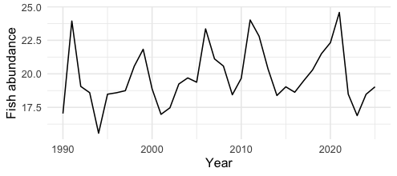
An example…
We build a model to predict a lake’s fish abundance over time based on fishing pressure and weather.
We train the model using data from 1990-2025
It predicts those years perfectly.
Is this a good model?

Slide 27
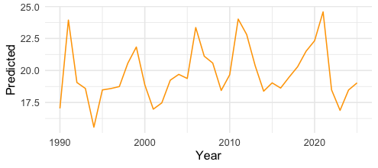
An example…
We build a model to predict a lake’s fish abundance over time based on fishing pressure and weather.
We train the model using data from 1990-2025
It predicts those years perfectly.
Is this a good model?

Slide 28
An example…
We build a model to predict a lake’s fish abundance over time based on fishing pressure and weather.
We train the model using data from 1990-2025
It predicts those years perfectly.
Is this a good model?

Slide 29
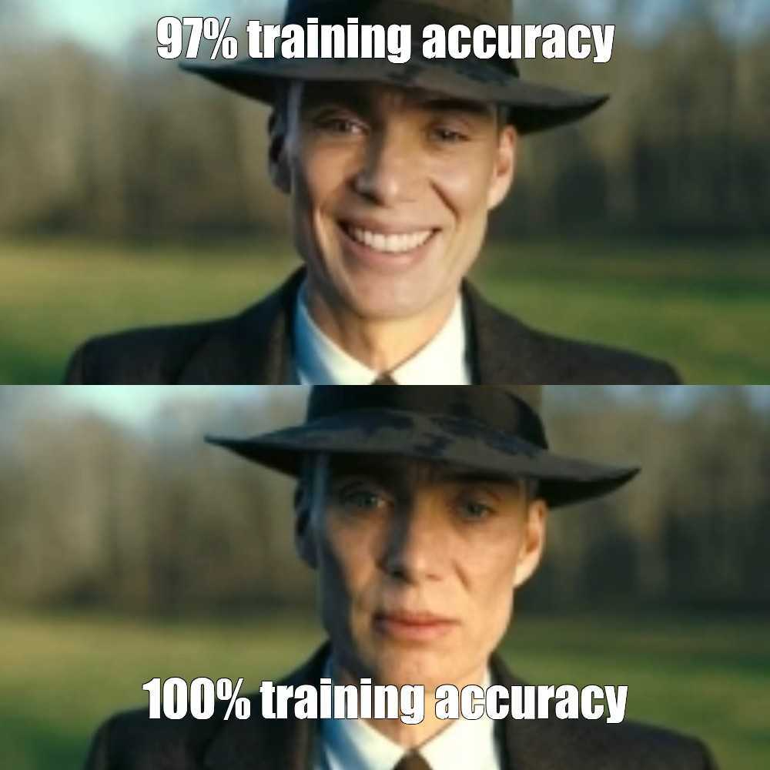
An example…
We build a model to predict a lake’s fish abundance over time based on fishing pressure and weather.
We train the model using data from 1990-2025
It predicts those years perfectly.
Is this a good model?

Slide 30
3 sets of data
Training set: used to train the model
Validation set: used by the model/researcher to adjust parameters
Test set: used to evaluate the model performance
Training
Validation
Test

Slide 31
3 sets of data
Often handled internally in the code packages that build the models
Training set: used to train the model
Validation set: used by the model/researcher to adjust parameters
Test set: used to evaluate the model performance
Training
Validation
Test

Slide 32
You should always evaluate your model with an independent test set
The simplest option is to:
Hold out 20% of your dataset as the test set
Train your model on the 80% training set
Calculate performance metrics on the test set
Model training and validation
Test
Sometimes, sample size makes this impractical or requires alternatives for a specific application...we'll talk about those later.

Slide 33
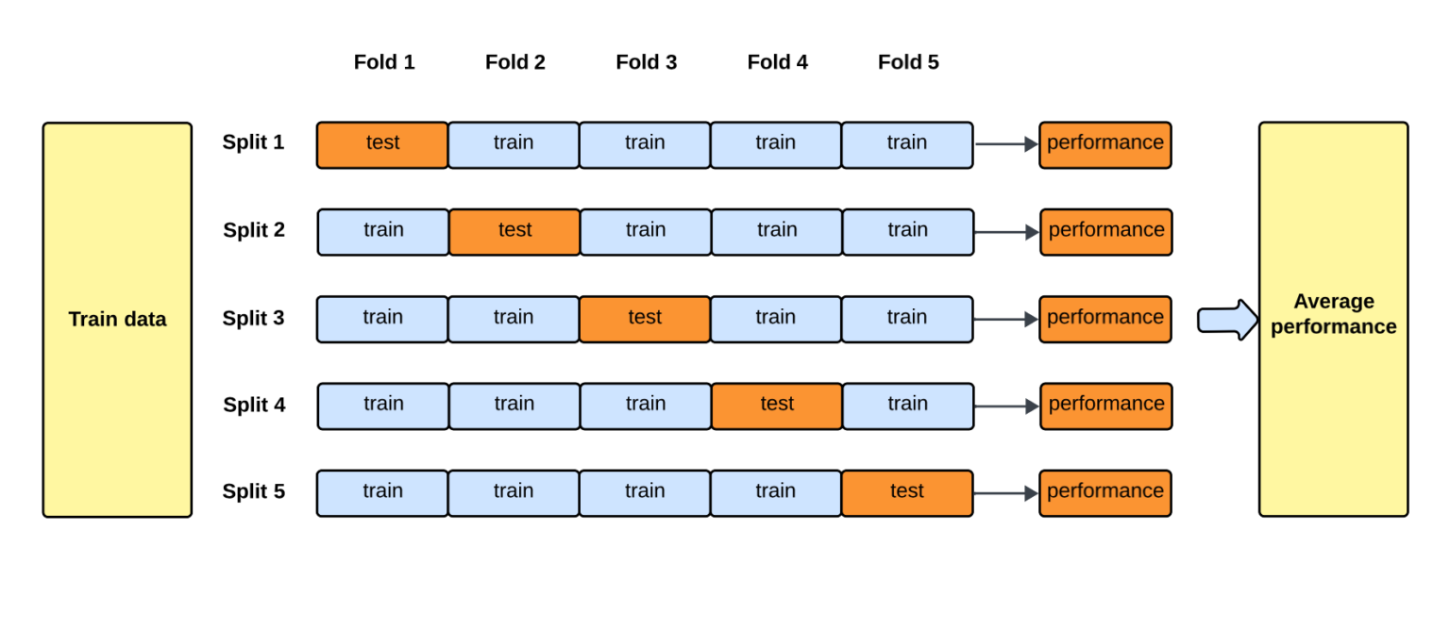
K-fold cross-validation
Randomly split your training data into k subsets (“folds”)
For k = 5:
When k = number of rows, it’s a leave-one-out cross validation
https://towardsdatascience.com/how-to-cross-validation-with-time-series-data-9802a06272c6/

Slide 34
Model evaluation should reflect the structure of your prediction problem

Slide 35
Model evaluation should reflect the structure of your prediction problem
For our fish example, we might be most interested in predicting the future
Training
Test
More options for time series: https://towardsdatascience.com/how-to-cross-validation-with-time-series-data-9802a06272c6/

Slide 36
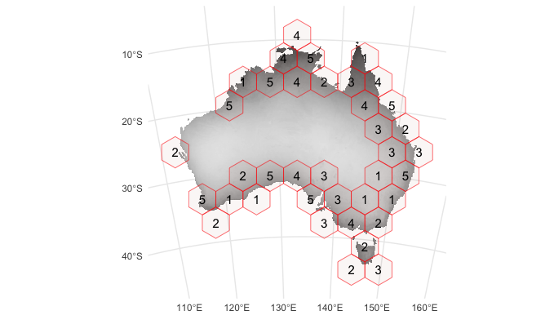
Model evaluation should reflect the structure of your prediction problem
For our fish example, we might be most interested in predicting the future
If our prediction problem is spatial, we should probably consider space in the model evaluation
Training
Test
More options for time series: https://towardsdatascience.com/how-to-cross-validation-with-time-series-data-9802a06272c6/
blockCV: https://github.com/rvalavi/blockcv

Slide 37
Some thoughts on what constitutes a “final model”
If you’re interested in making predictions outside the available dataset…
you probably want to make final predictions using all of the available data…
but using all of the data doesn’t leave any available for model evaluation…

Slide 38
Some thoughts on what constitutes a “final model”
If you’re interested in making predictions outside the available dataset…
you probably want to make final predictions using all of the available data…
but using all of the data doesn’t leave any available for model evaluation…

Slide 39
Some thoughts on what constitutes a “final model”
If you’re interested in making predictions outside the available dataset…
you probably want to make final predictions using all of the available data…
but using all of the data doesn’t leave any available for model evaluation…

Slide 40
Some thoughts on what constitutes a “final model”
If you’re interested in making predictions outside the available dataset…
you probably want to make final predictions using all of the available data…
but using all of the data doesn’t leave any available for model evaluation…
One way that works:
Build a model using the training set(s)
Evaluate the model using the test set(s)
Re-build the model
Full dataset
Same parameters
“Final model”
Make predictions using the final model

Slide 41
Classification and Regression Trees (CART)
Until a stopping condition is met
Evaluate best split for each predictor
Select the optimal split
Create new nodes
Stopping conditions:
Maximum tree depth
Minimum number of samples per node
No improvement in performance
Node is all one class / value

Slide 42
Classification and Regression Trees (CART)
Until a stopping condition is met
Evaluate best split for each predictor
Select the optimal split
Create new nodes
Stopping conditions:
Maximum tree depth
Minimum number of samples per node
No improvement in performance
Node is all one class / value

Slide 43
Classification and Regression Trees (CART)
Example:
Penguin species ~ flipper length + body mass
Penguin species | Flipper length | Body mass
Adelie | 90 | 80
Gentoo | 75 | 20
Gentoo | 77 | 32
Chinstrap | 76 | 12

Slide 44
Classification and Regression Trees (CART)
Until a stopping condition is met
Evaluate best split for each predictor
Select the optimal split
Create new nodes
Penguin species | Flipper length | Body mass
Adelie | 90 | 80
Gentoo | 75 | 20
Gentoo | 77 | 32
Chinstrap | 76 | 12
Adelie
Gentoo
Gentoo
Chinstrap

Slide 45
Classification and Regression Trees (CART)
Until a stopping condition is met
Evaluate best split for each predictor
Select the optimal split
Create new nodes
Flipper length > 80
Penguin species | Flipper length | Body mass
Adelie | 90 | 80
Gentoo | 75 | 20
Gentoo | 77 | 32
Chinstrap | 76 | 12
Gentoo
Gentoo
Chinstrap

Slide 46
Classification and Regression Trees (CART)
Until a stopping condition is met
Evaluate best split for each predictor
Select the optimal split
Create new nodes
Flipper length > 80
Penguin species | Flipper length | Body mass
Adelie | 90 | 80
Gentoo | 75 | 20
Gentoo | 77 | 32
Chinstrap | 76 | 12
Adelie
Gentoo
Gentoo
Chinstrap

Slide 47
Classification and Regression Trees (CART)
Until a stopping condition is met
Evaluate best split for each predictor
Select the optimal split
Create new nodes
Flipper length > 80
Penguin species | Flipper length | Body mass
Adelie | 90 | 80
Gentoo | 75 | 20
Gentoo | 77 | 32
Chinstrap | 76 | 12
Adelie
Body mass > 18
Chinstrap

Slide 48
Classification and Regression Trees (CART)
Until a stopping condition is met
Evaluate best split for each predictor
Select the optimal split
Create new nodes
Flipper length > 80
Penguin species | Flipper length | Body mass
Adelie | 90 | 80
Gentoo | 75 | 20
Gentoo | 77 | 32
Chinstrap | 76 | 12
Adelie
Body mass > 18

Slide 49
Classification and Regression Trees (CART)
Until a stopping condition is met
Evaluate best split for each predictor
Select the optimal split
Create new nodes
Flipper length > 80
Penguin species | Flipper length | Body mass
Adelie | 90 | 80
Gentoo | 75 | 20
Gentoo | 77 | 32
Chinstrap | 76 | 12
Adelie
Body mass > 18
Gentoo
Gentoo
Chinstrap
All nodes are “pure” so we stop

Slide 50
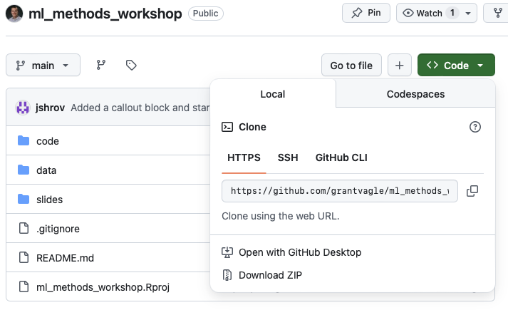
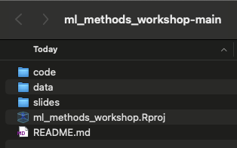
Now to a hands-on coding example…
Go to: https://github.com/grantvagle/ml_methods_workshop
Click the green “Code” button
Download the .zip file
Unzip the folder
Click to open the .Rproj file
Once you’re set up, work through the 01_cart_examples.qmd file in the code folder

