Slide 1
What’s in the bag?: Random forests
Jeremiah Shrovnal, Grant Vagle, Lynn Waterhouse

Slide 2
Overview of this section
Bagging
Algorithm overview
Random forest models
Algorithm overview, with hyper parameters
Intro to model tuning
Variable importance - intention and calculation
Partial dependence - how it's calculated and how to interpret
Considerations with correlated predictors
Introduce the coding examples
Hands-on coding example

Slide 3
Reducing variance
What if we had many independent observations of what we’d like to model?
We could grow a tree on each training set and then take the average tree
Generally, not practical because we won’t have access to multiple training sets…

Slide 4
Bagging
We can bootstrap!
Take repeated samples (with replacement) from the (single) training set
This bootstrap aggregation, known as bagging, allows us to reduce variance by producing a whole bunch of trees and averaging over them

Slide 5
Bagging, explained
obs
Generate B different bootstrapped training sets, all coming from a single data set, to create pseudo training sets
Train on the bth bootstrapped training set to get a prediction
Average over all of the predictions (regression) or take the majority vote (classification)
1
B
…
…

Slide 6
Bagging – some new concepts
Previous methods pruned the trees to help reduce variance
When you prune a tree you introduce bias by making it coarser
Large bushy trees tend to have less bias but more variance
Averaging over a bunch of large bushy trees can reduce variance
We do not need to worry about pruning the trees with bagging!

Slide 7
Out-of-bag error
A very nice and straightforward way to estimate test error of a bagged model
Bagging involves building trees from bootstrapped subsets, which uses about 2/3 of the observations
Remaining 1/3 not sued to fit a given tree is referred to as out-of-bag (OOB)
Can predict the response for OOB observations that we can average, giving around B/3 predictions per observation
Essentially a free leave-one-out cross-validation

Slide 8
Random forest
Improvement over bagged trees
Include a small tweak that decorrelates the trees
This then reduces the variance when we average over lots of bushy trees

Slide 9
Random forest, explained
Predictors
…
1, 2, 3, 4, 5, 6, … p
Build a number of decision trees on bootstrapped training samples (as with bagging)
When building a tree, each time a split in the tree is considered: a random selection of m predictors is chosen as potential split candidates from the full set of p predictors
The split is allowed to use only one of those m predictors
A new set of m predictors is taken at each split
…
…

Slide 10
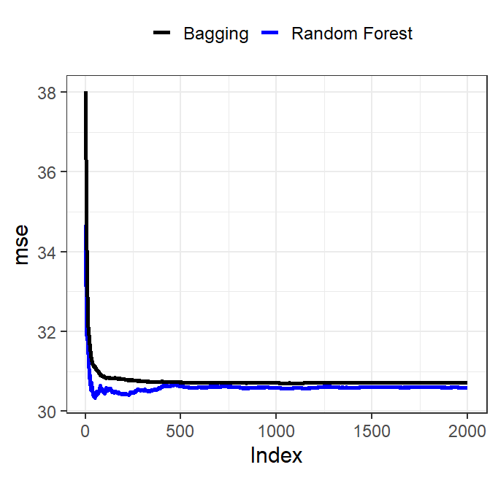
How many trees to plant in the forest?
A benefit of these two methods is that you can’t overfit by growing too many trees
The benefit of adding more trees is it brings the variance down
At some point the variance will stop decreasing
When you reach this point, adding more trees won’t help you
But it also won’t hurt you!

Slide 11
Variable importance
Predictors
…
1, 2, 3, 4, 5, 6, … p
Find variables that influence the outcome
Start with some baseline measure of fit (OOB error)
Shuffle the value (one at a time) for each of the p predictors
Pass these randomly permuted values of a single p back through the tree
Compare resulting shift in accuracy across forest
Original values
p=1
Permuted values
New p
Importance
OOB
Accuracy
-
Average

