Slide 1

Real-time Target Speech Extraction
MSc in Machine Learning & AI, Stellenbosch University, Smart Operator
Grant Booysen
25849646

Slide 2
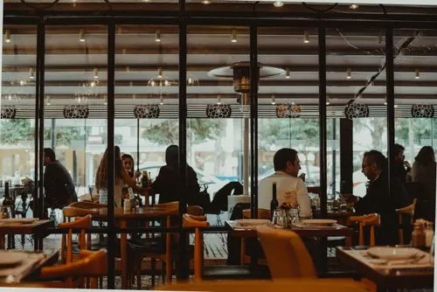
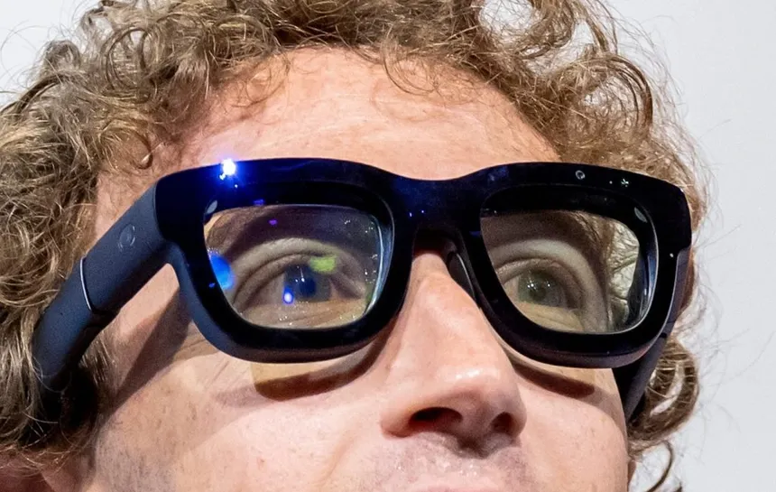

Context of the Problem
01 / HUMAN FOCUS
Innate Human Ability
Humans naturally focus on a single speaker in noisy environments, like a crowded restaurant.
02 / EDGE HARDWARE
Edge AI Integration
Expanding into everyday devices like smart glasses and hearables to better analyze environmental context.
03 / LIVE EXTRACTION
Real-Time AI Transcription
Applying extraction to live AI tools (e.g., Gemini Live) for robust voice understanding in chaotic environments.

Slide 3
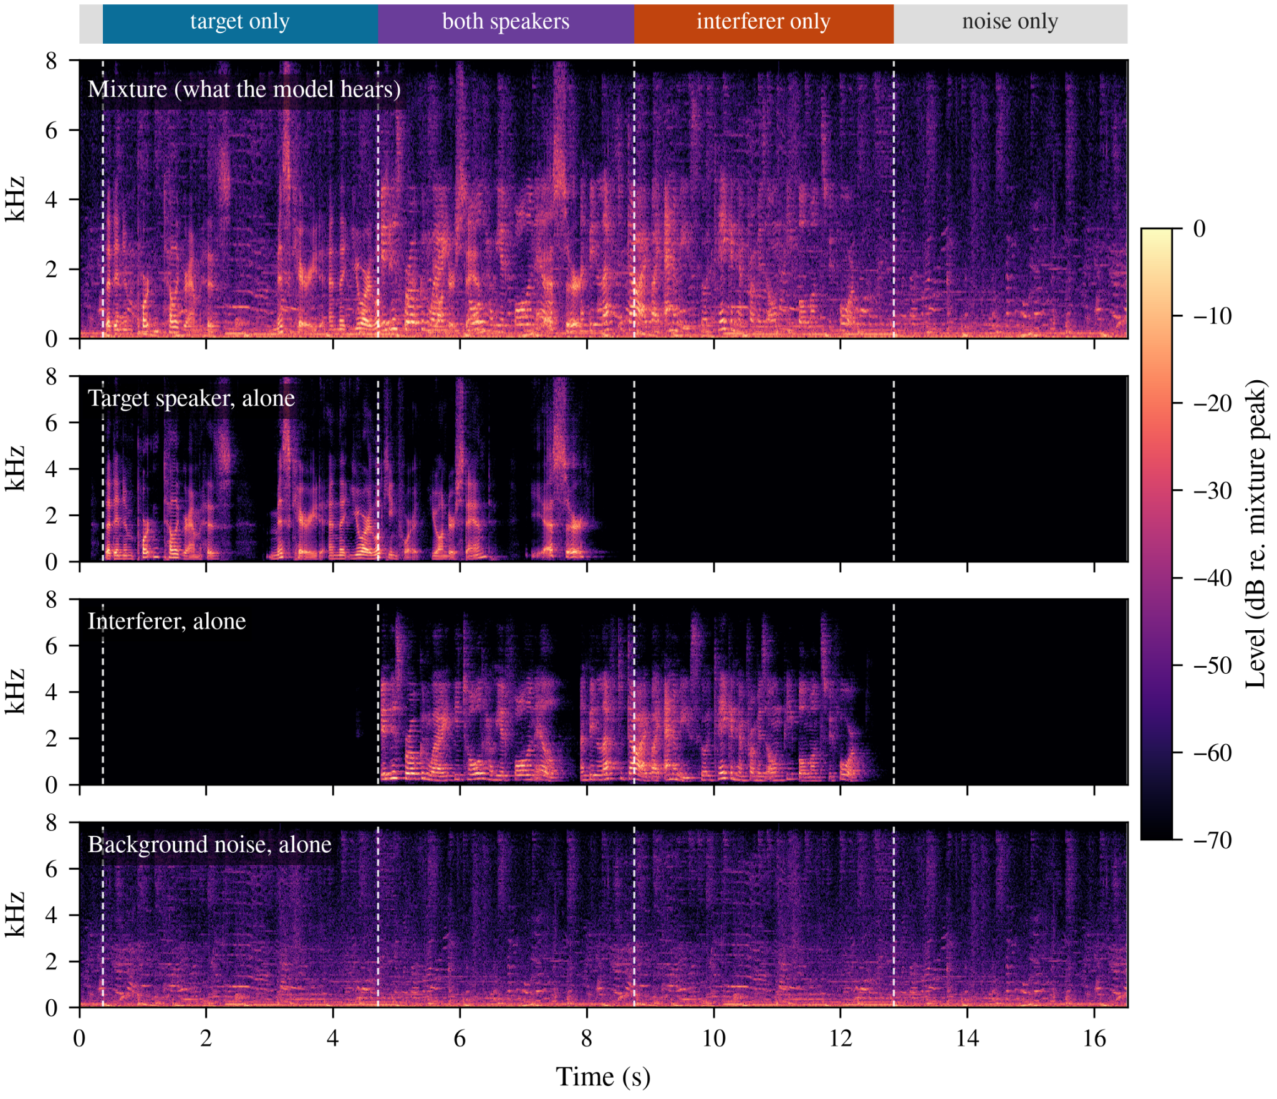
Problem Formulation
PROBLEM FORMULATION
Mixture Audio = Target Speaker + Interfering Speakers + Background Noise
TECHNICAL CHALLENGES
Transforming speech representations and conditioning models with limited target information.
HARDWARE CONSTRAINTS
Balance performance with edge storage limits and strict latency budgets for streaming.
PRIMARY OBJECTIVE
Isolate the target speaker to maximize downstream live AI speech transcription accuracy.
Optimize for AI transcription, remain silent when the target isn't speaking, and suppress noise.

Slide 4
Current Project State
storage
graphic_eq
analytics
01 // PILLAR
Dataset Construction
Building a dedicated dataset for realistic, noisy multi-speaker use cases.
Multi-speaker mix scenarios
Controlled acoustic noise
Realistic speech benchmarks
02 // PILLAR
Baseline Signal Extraction
Evaluating architectures that mask mixture audio to establish baselines.
Target speech isolation
Time-domain masking
Baseline performance curves
03 // PILLAR
Holistic Metric Suite
Developing evaluation metrics tailored for speech transcription performance.
AI hallucination tracking
Interference leakage
Streaming latency budgets
Perceptual audio quality

