Slide 1

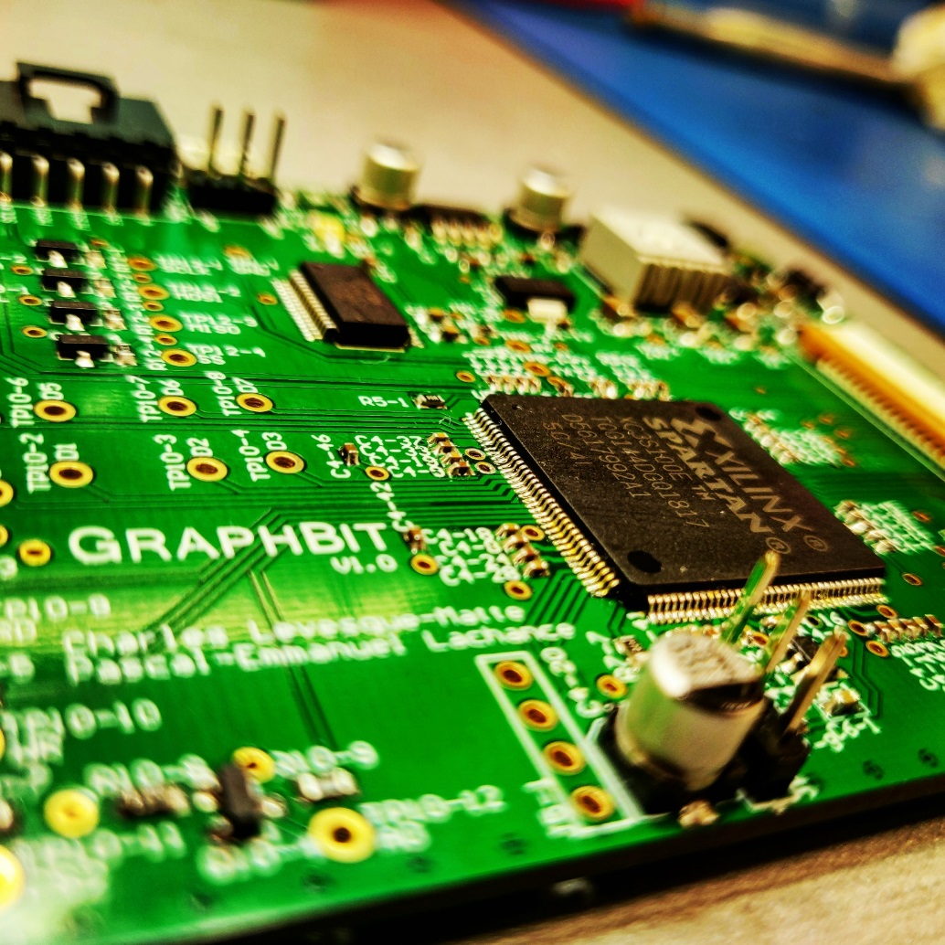
ContrOleur d’Ecran LCD
CHARLES LEVESQUE MATTE
Pascal Emmanuel LachancE

Slide 2

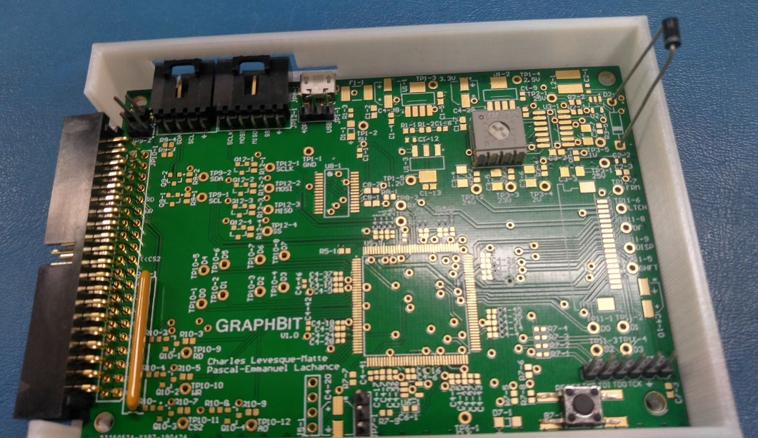
DEFI ET KIT ETUDIANT
2009
2011
2012
2013
Mode graphique & texte
Versatile
Pour Dallas & STM
Facile à utiliser
Student-proof
MISRA:C Compliant
2019

Slide 3
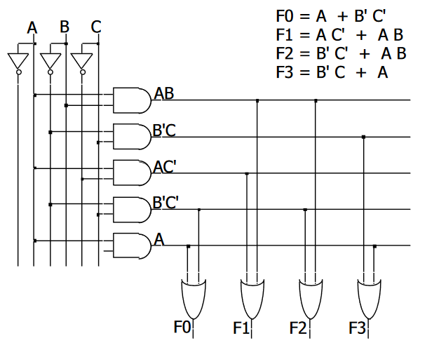
Field Programmable Gate Array (FPGA)
1
0
1
Groupes de circuits configurables
Portes logiques (AND, OR, XOR, NOT ect.)
Flip-Flops & Latches
RAM
Entrées/Sorties
Clocks
Interconnections
100k portes logiques (Xilinx Spartan 3E) – 50 million (Xilinx UltraScale)
1
0
1
1

Slide 4
MICROCONTROLEUR
FPGA
Opération séquentielle
Instructions lues depuis une mémoire
Très versatile
Opérations parallèles
Instructions codées sous formes de portes logiques
Utile pour des utilisations très spécifiques
Il est possible de programmer un microcontrôleur complet à l’intérieur d’un FPGA

Slide 5
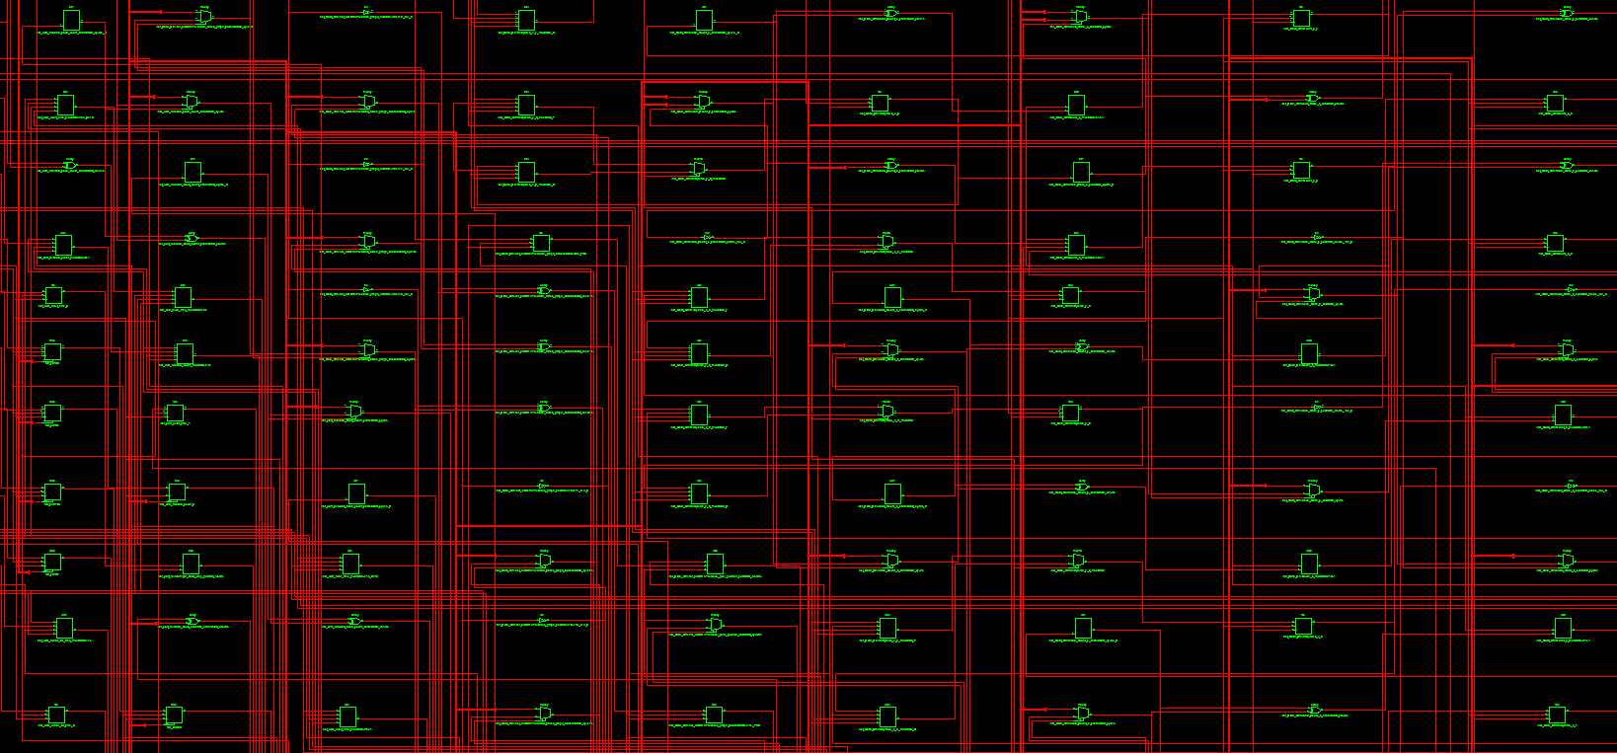
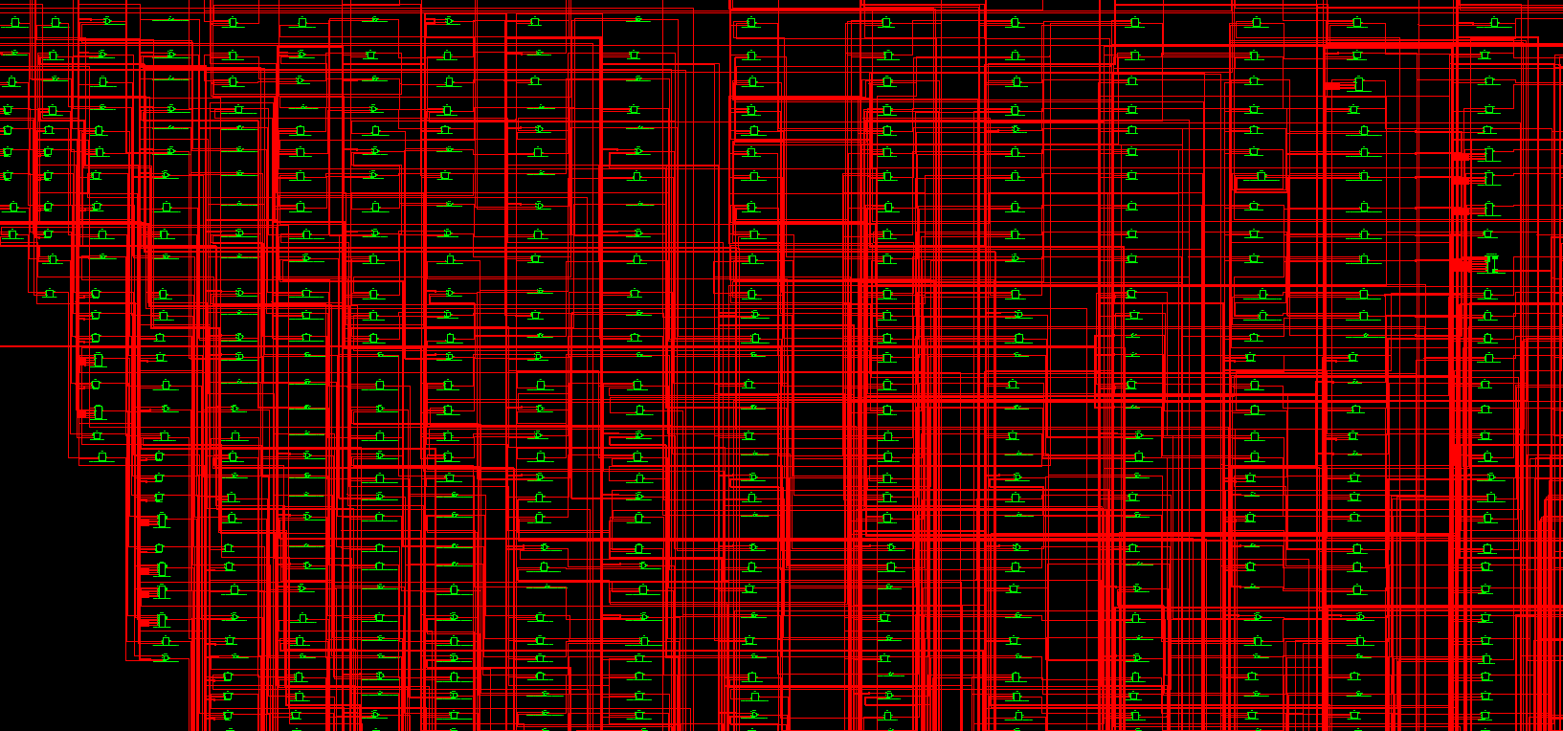
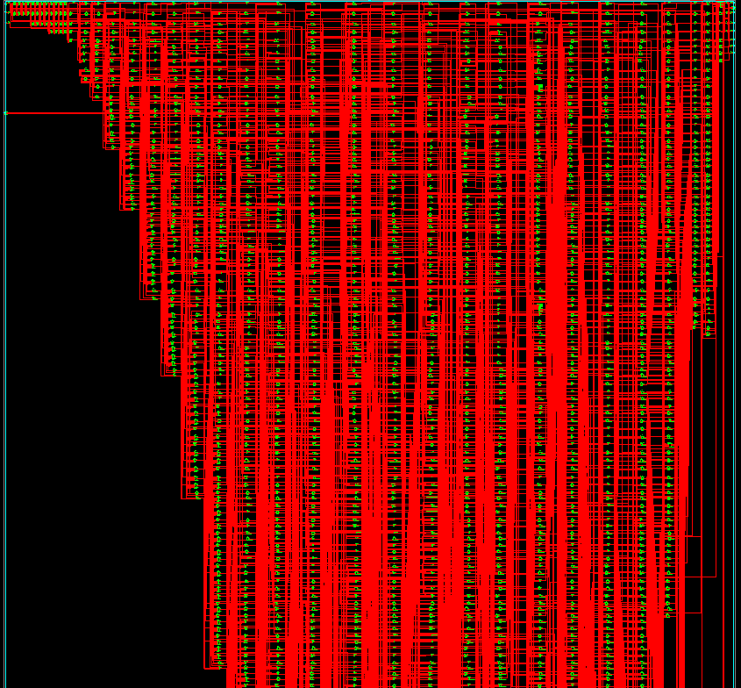

Slide 6
MATERIEL
4 couches
Stencil
Niveaux de tensions

Slide 7

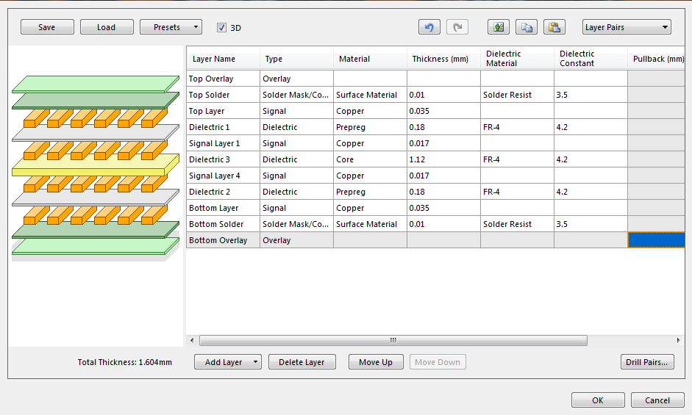
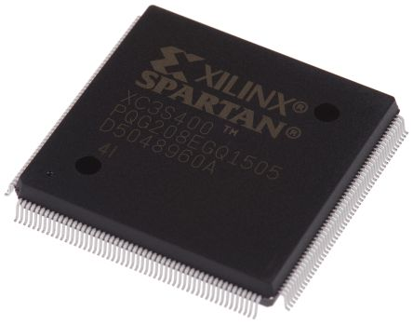
DEFIS
1V
1.2V
2V
2.5V
3.3V
5V
23V
24V
25V
28V
FPGA
VHDL
Carte 4 couches
Manque d’outils de debug
Conformité MISRA-C
Traitement d’images
Peu / trop de documentation
Nombreux niveaux de tension
architecture Behavioral of GraphBit is
COMPONENT PARALLELE
PORT(
CLK : IN std_logic;
A0 : IN std_logic;
DATA_FROM_CPU : IN std_logic_vector(7 downto 0);
CS : IN std_logic;
A0_OUT : OUT std_logic;
DATA_PARALLELE : OUT std_logic_vector(7 downto 0);
FLAG_PARALLELE : OUT std_logic
);
END COMPONENT;
COMPONENT NEW_UART_RX
PORT(
RxD : IN std_logic;
mclk : IN std_logic;
rdrf : OUT std_logic;
rx_data : OUT std_logic_vector(7 downto 0)
);
END COMPONENT;
COMPONENT Mux_Comm
PORT(
DATA_PARALLELE : IN std_logic_vector(7 downto 0);
DATA_UART : IN std_logic_vector(7 downto 0);
CLK : IN std_logic;
FLAG_PARALLELE : IN std_logic;
FLAG_UART : IN std_logic;
FLAG_COM : OUT std_logic;
DOUT : OUT std_logic_vector(7 downto 0)
);
END COMPONENT;
COMPONENT New_Data_Ctrl
PORT(
CLK : IN std_logic;
DINB : IN std_logic_vector(7 downto 0);
DATA : IN std_logic_vector(7 downto 0);
FLAG : IN std_logic;
CLKB : OUT std_logic;
DATA_DP : OUT std_logic_vector(7 downto 0);
MADDRB : OUT std_logic_vector(12 downto 0);
MWEB : OUT std_logic;
SUPP : out std_logic_vector(3 downto 0)
);
END COMPONENT;
COMPONENT Timing_LCD
PORT(
CLK : IN std_logic;
LATCH : BUFFER std_logic;
SHIFT : BUFFER std_logic;
FRM : OUT std_logic;
DF : OUT std_logic;
DISPLAYOFF : BUFFER std_logic;
VEE_ON : BUFFER std_logic;
MADDRA : BUFFER std_logic_vector(13 downto 0)
);
END COMPONENT;
COMPONENT DualPort
PORT(
CLK_Shift : IN std_logic;
DATA_IN : IN std_logic_vector(7 downto 0);
MWEB : IN std_logic;
CLKB : IN std_logic;
MADDRA : IN std_logic_vector(13 downto 0);
MADDRB : IN std_logic_vector(12 downto 0);
DATA_OUT : OUT std_logic_vector(3 downto 0);
DATA_READ : OUT std_logic_vector(7 downto 0)
);
END COMPONENT;
signal Flag : STD_LOGIC;
signal Data : STD_LOGIC_VECTOR(7 downto 0);
signal Flag_Parallel : STD_LOGIC;
signal Data_Parallel : STD_LOGIC_VECTOR (7 downto 0);
signal Flag_UART : STD_LOGIC;
signal Data_UART : STD_LOGIC_VECTOR(7 downto 0);
signal DataOut_s : STD_LOGIC_VECTOR (3 downto 0);
signal Shift_s : STD_LOGIC;
signal Latch_s : STD_LOGIC;
signal unconnectedDisplayOff_s : STD_LOGIC;
signal unconnectedVEEOn_s : STD_LOGIC;
signal unconnectedA0 : STD_LOGIC;
signal unconnectedFlag : STD_LOGIC;
signal DP_in_s : STD_LOGIC_VECTOR (7 downto 0);
signal DINB_s : STD_LOGIC_VECTOR (7 downto 0);
signal CLKB_s : STD_LOGIC;
signal MWEB_S : STD_LOGIC;
signal addra : STD_LOGIC_VECTOR (13 downto 0); -- addresse du port A
signal addrb : STD_LOGIC_VECTOR (12 downto 0); -- addresse du port a
begin
DATA_OUT <= DataOut_s;
SHIFT <= Shift_s;
LATCH <= Latch_s;
DISP <= '1';
SHDN <= '1';
Inst_PARALLELE: PARALLELE PORT MAP(
CLK => CLK,
A0 => '0',
DATA_FROM_CPU => DATA_FROM_CPU,
CS => CS_CPU,
A0_OUT => unconnectedA0,
DATA_PARALLELE => Data_Parallel,
FLAG_PARALLELE => Flag_Parallel
);
Inst_uart_rx: new_UART_RX PORT MAP(
RxD => RX,
mclk => CLK,
rdrf => Flag_UART,
rx_data => Data_UART
);
Inst_Mux_Comm: Mux_Comm PORT MAP(
FLAG_PARALLELE => Flag_Parallel,
DATA_PARALLELE => Data_Parallel,
FLAG_UART => Flag_UART,
DATA_UART => Data_UART,
FLAG_COM => Flag,
DOUT => Data,
CLK => CLK
);
SUPP <= Flag;
Inst_Data_Ctrl: New_Data_Ctrl PORT MAP(
CLK => CLK,
DATA => Data,
FLAG => Flag,
DINB => DINB_s,
CLKB => CLKB_s,
DATA_DP => DP_in_s,
MADDRB => addrb,
MWEB => MWEB_S
--SUPP => SUPP
);
Inst_Timing_LCD: Timing_LCD PORT MAP(
LATCH => Latch_s,
SHIFT => Shift_s,
FRM => FRM,
DF => DF,
CLK => CLK,
DISPLAYOFF => unconnectedDisplayOff_s,
VEE_ON => unconnectedVEEOn_s,
MADDRA => addra
);
Inst_DualPort: DualPort PORT MAP(
CLK_Shift => Shift_s,
DATA_IN => DP_In_s,
DATA_OUT => DataOut_s,
MWEB => MWEB_S,
CLKB => CLKB_s,
MADDRA => addra,
MADDRB => addrb,
DATA_READ => DINB_s
);
end Behavioral;4

Slide 8


LOGICIEL PC
AVANT
APRES
Image originale, 901x604, couleurs 24-bits
Image convertie, 240x160 , noir & blanc

Slide 9

SITE WEB

Slide 10
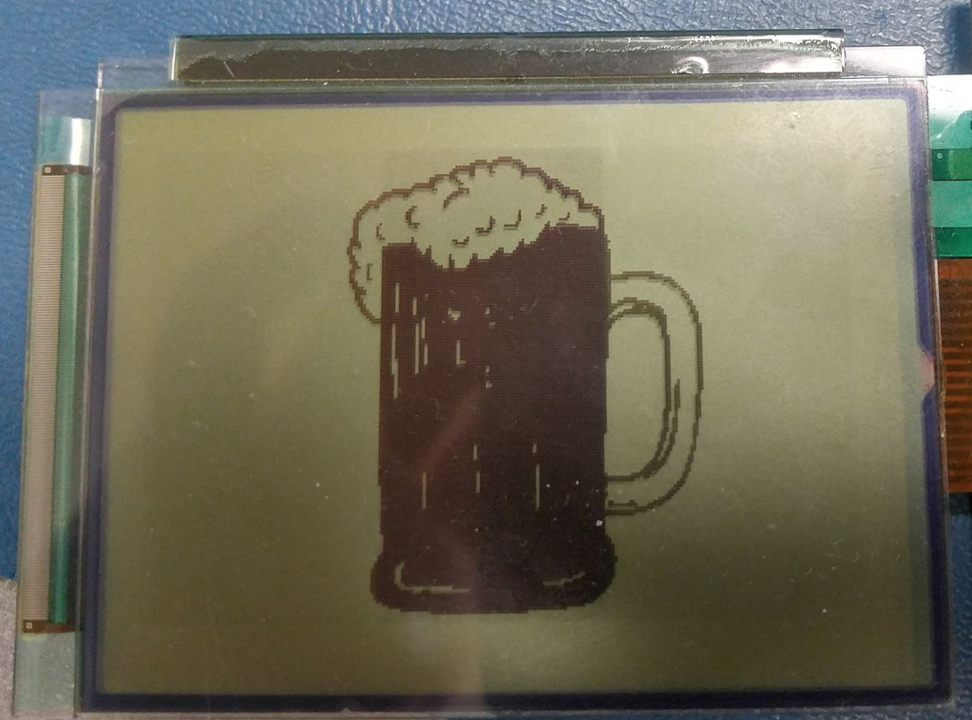
MERCI!

