Slide 1

Adolescents' Receipt of Sex Education in a Nationally Representative Sample, 2011–2019
Laura D. Lindberg, Ph.D., Leslie M. Kantor, Ph.D., M.P.H.
Journal of Adolescent Health
Volume 70 Issue 2 Pages 290-297 (February 2022)
DOI: 10.1016/j.jadohealth.2021.08.027
Copyright © 2021 Society for Adolescent Health and Medicine Terms and Conditions

Slide 2
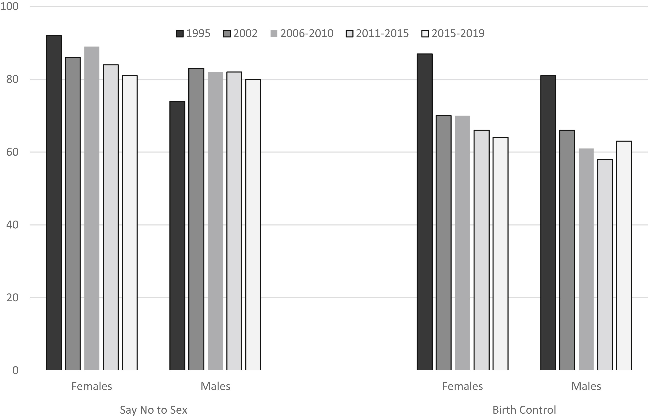
Figure 2
90
70
Journal of Adolescent Health 2022 70290-297DOI: (10.1016/j.jadohealth.2021.08.027)
Copyright © 2021 Society for Adolescent Health and Medicine Terms and Conditions
Notes:
Percentage of females and males aged 15–19 years who received instruction on specific sex education topics before the age of 18 years, by survey year, the National Survey of Family Growth.
Source: Estimates for 1995 and 2002 are from Lindberg LD, Santelli JS, Singh S. Changes in formal sex education: 1995–2002. Perspectives on Sexual and Reproductive Health. 2006;38(4):182-189. Estimates for 2006–2010 are from Lindberg LD, Maddow-Zimet I, Boonstra H. Changes in Adolescents’ Receipt of Sex Education, 2006–2013. Journal of Adolescent Health. 2016;58(6):621-627. Estimates for 2011–2015 and 2015–2019 are from Table 2 of this paper.

