Slide 1
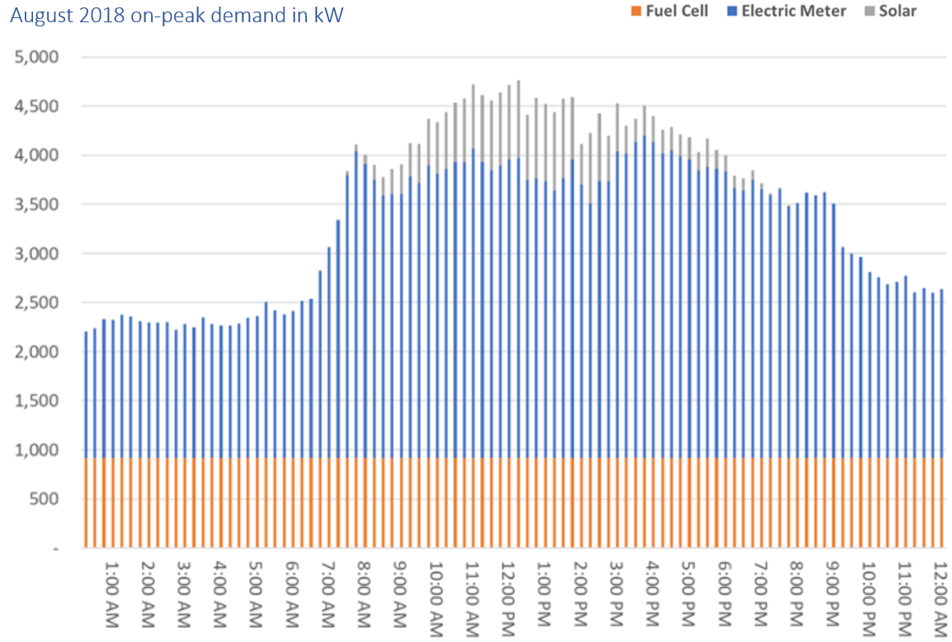
One day in August
12:15 am
midnight
Measure kW every 15 minutes

Slide 2
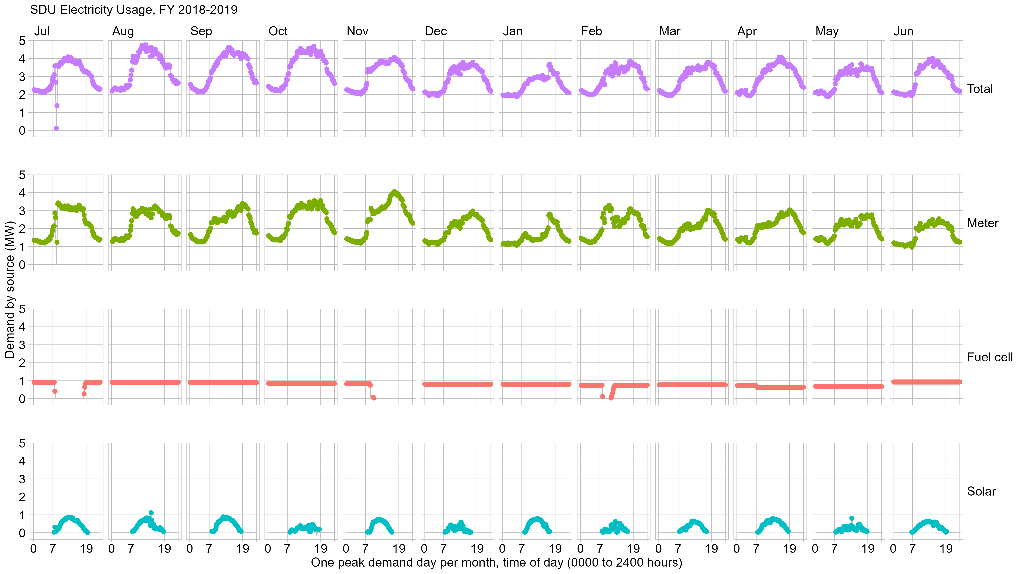

Slide 3
We have four time-dependent variables
“7” is 7 am
“19” is 7 pm
The report appendix has one of these charts for each billing month.
7:00 am
7:00 pm
midnight

Slide 4


Slide 5
Respond to the prompts in the handout.

Slide 6
Explore
The data can be organized in a different way

Slide 7
First hour only,
every month,
average of the
readings in that hour

Slide 8
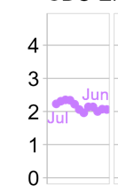
July 2018
January 2019
June 2019
First hour only,
every month,
average of the
readings in that hour.
Plot the sequence of monthly values for this one hour
Hour “1”
July 2018 thru June 2019

Slide 9
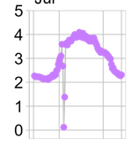
0015
2400
one day
Month 1
… Month 2 … Month 3 … etc.

Slide 10

July 2018
June 2019
one year
Hour 1
… Hour 2 … Hour 3 … etc.

Slide 11
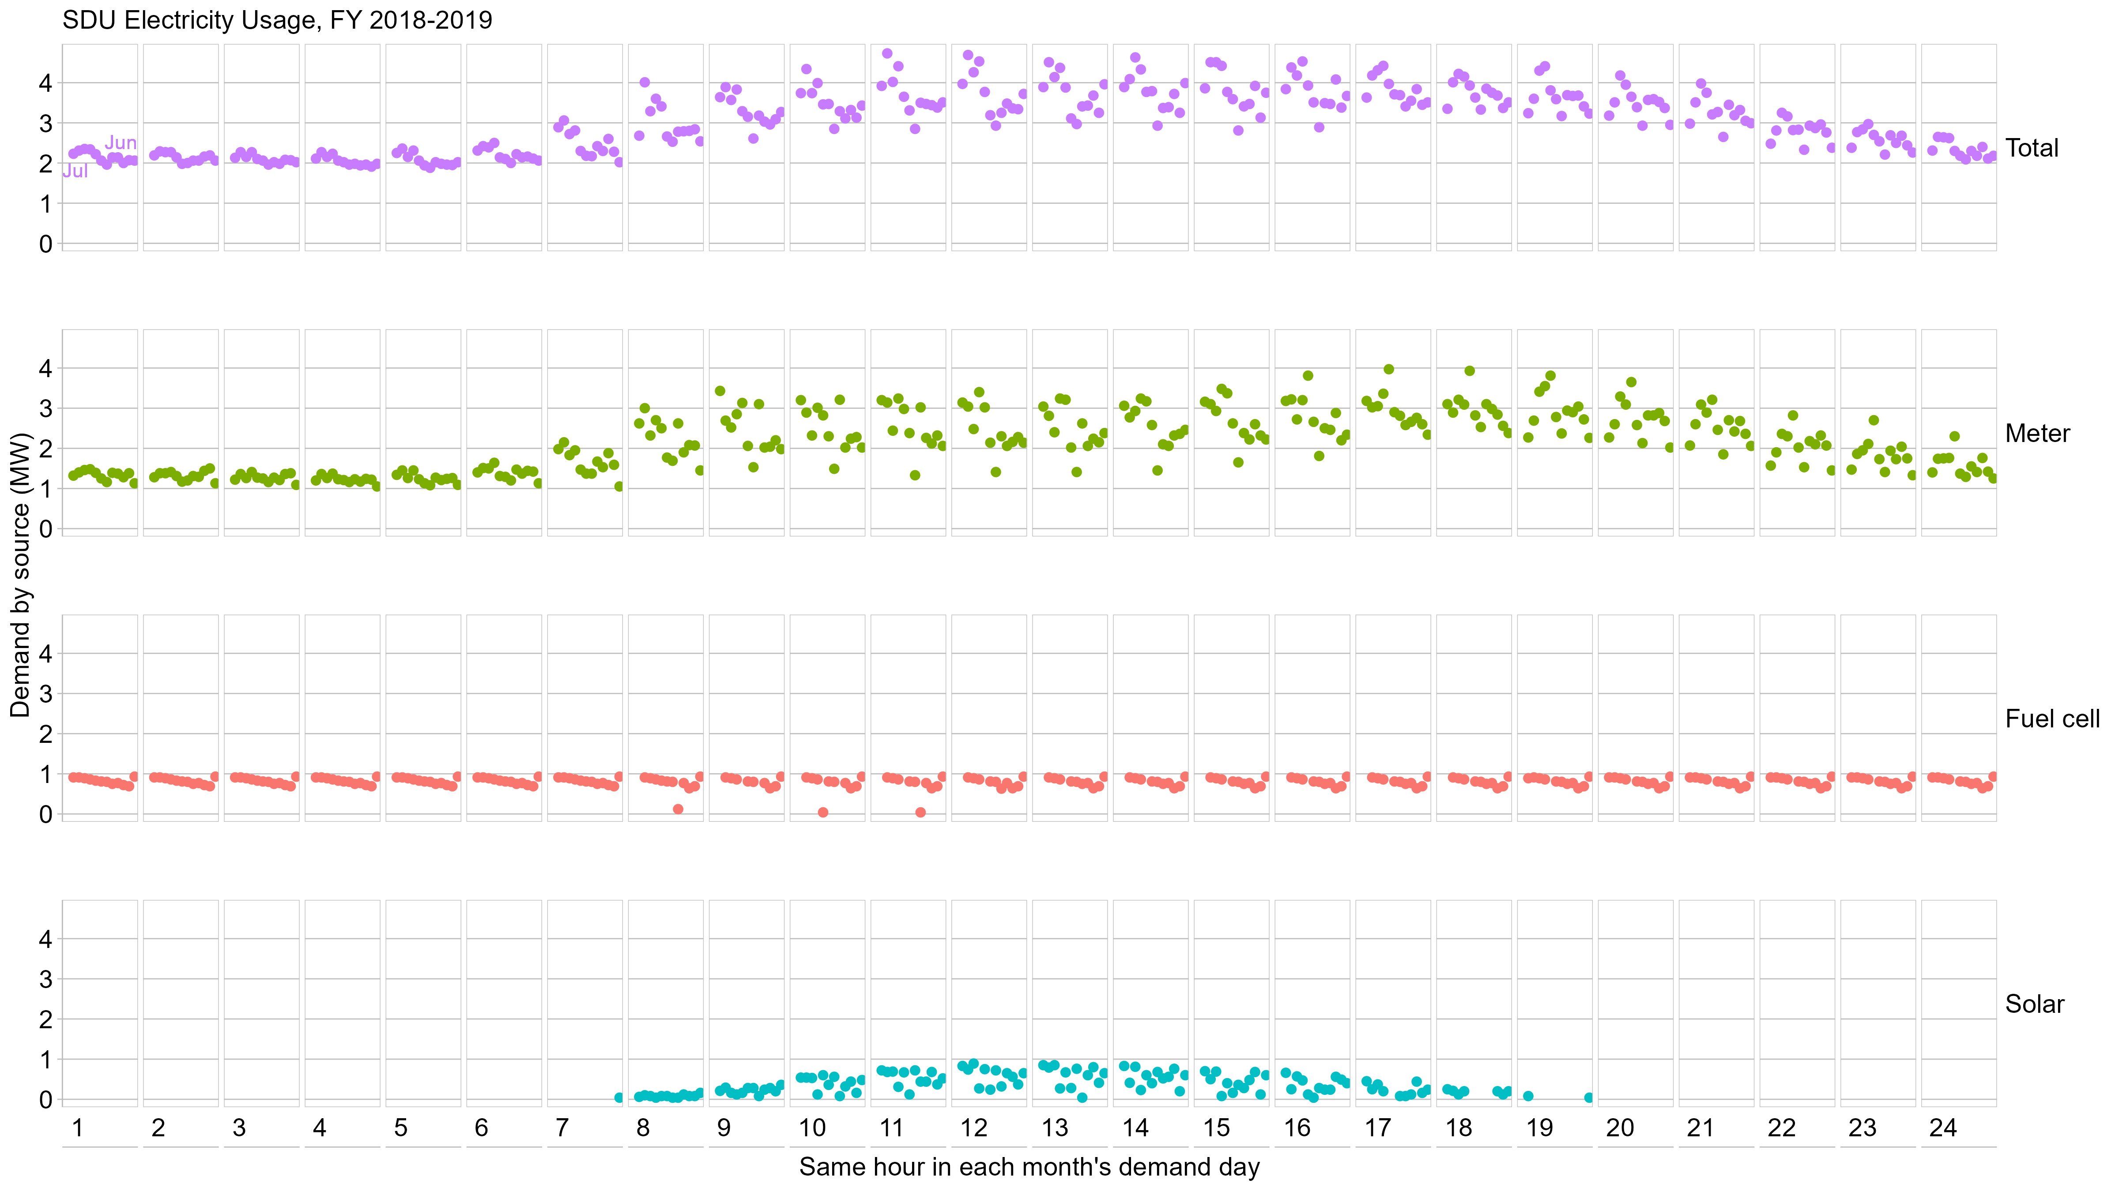
Repeat for each hour

Slide 12


Slide 13
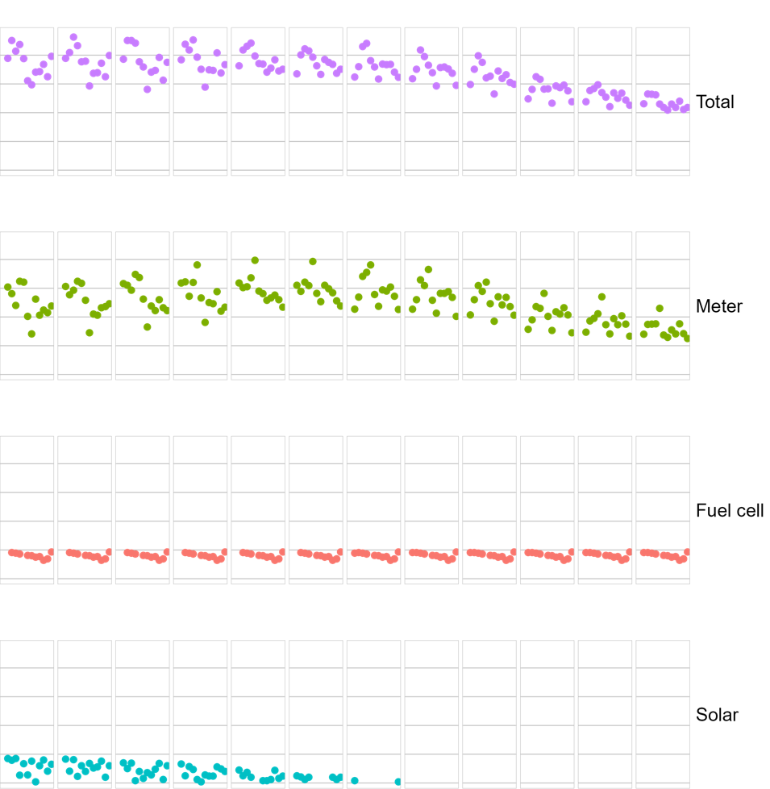



as a percentage = $100×\frac{\text{Meter}}{\text{Total}}$
as a percentage = $100×\frac{\text{Fuel} \text{cell}}{\text{Total}}$
as a percentage = $100×\frac{\text{Solar}}{\text{Total}}$

Slide 14
Respond to the prompts in the handout.

