Slide 1
Aligning the design to the story
Redesign a chart to find what stories might be in the data

Slide 2
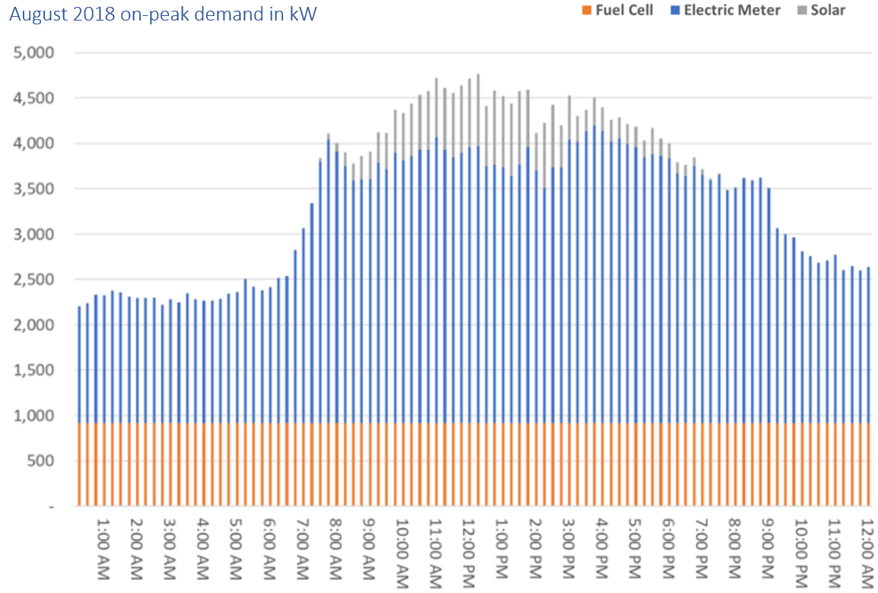
One day, at USD…

Slide 3
Reading every 15 minutes
midnight
12:15 am

Slide 4
Reading every 15 minutes
Bar height = total demand in kW
midnight
12:15 am

Slide 5
Reading every 15 minutes
Bar height = total demand in kW
midnight
12:15 am
We have four time-dependent variables

Slide 6
Reading every 15 minutes
Bar height = total demand in kW
midnight
12:15 am
We have four time-dependent variables

Slide 7
Reading every 15 minutes
Bar height = total demand in kW
midnight
12:15 am
We have four time-dependent variables.
One chart like this for each month (12 total).
Consider the prompts in the handout.

Slide 8
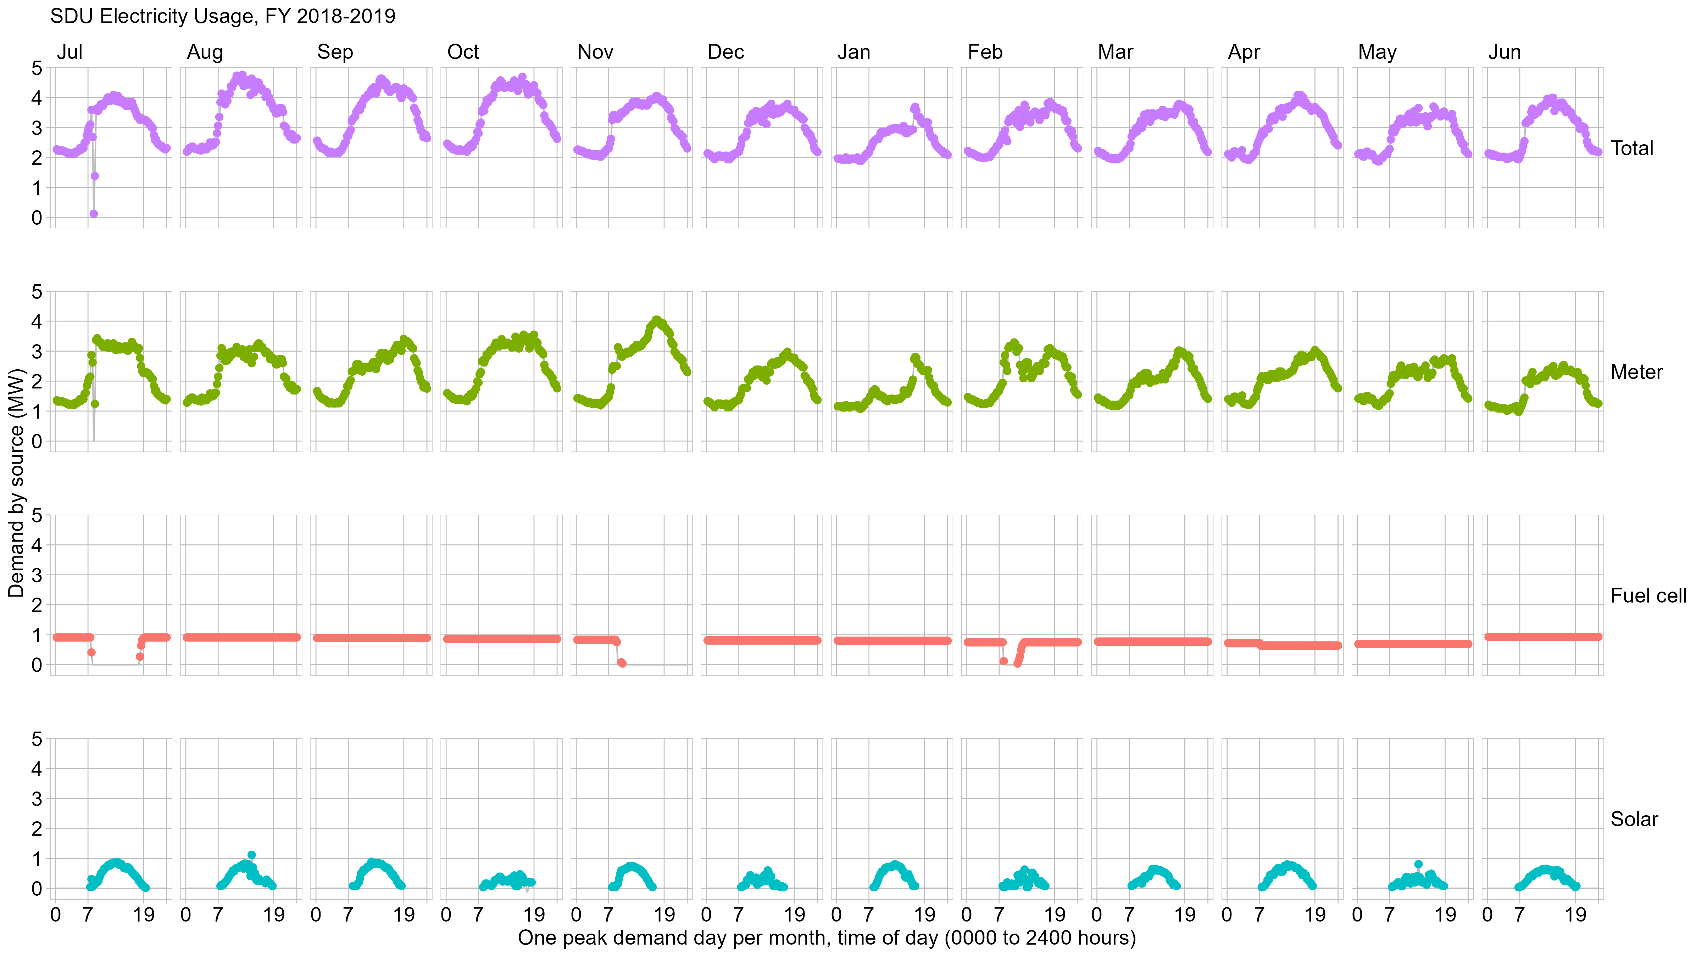
We have four time-dependent variables.

Slide 9
We have four time-dependent variables
“7” is 7 am
“19” is 7 pm
The report appendix has one of these charts for each billing month.
7:00 am
7:00 pm
midnight

Slide 10


Slide 11
Respond to the prompts in the handout.

Slide 12
Explore
The data can be organized in a different way

Slide 13
First hour only,
every month,
average of the
readings in that hour

Slide 14
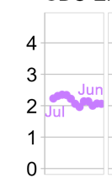
July 2018
January 2019
June 2019
First hour only,
every month,
average of the
readings in that hour.
Plot the sequence of monthly values for this one hour
Hour “1”
July 2018 thru June 2019

Slide 15
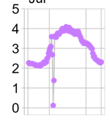

0015
July 2018
2400
June 2019
one day
one year
Hour 1
… Hour 2 … Hour 3 … etc.
Month 1
… Month 2 … Month 3 … etc.

Slide 16
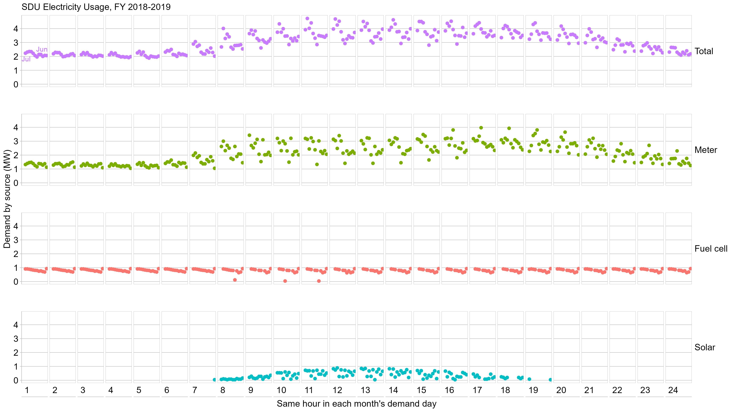
Repeat for each hour

Slide 17


Slide 18
Respond to the prompts in the handout.

