Slide 1
Design and Implementation of a Geographic Search Engine
Alexander Markowetz
Yen-Yu Chen
Torsten Suel
Xiaohui Long
Bernhard Seeger

Slide 2
The Internet is so big
Most web search returns hundreds of thousands of results
Most are not that interesting
The interesting ones might be buried inside the iceberg
Adding just more terms to the query is probably no solution

Slide 3
Geography is a useful constraint
It is one of the two fundamental human conditions:
  Space
  Time
It allows intuitive constraints
  It reflects our everyday perception of the world

Slide 4
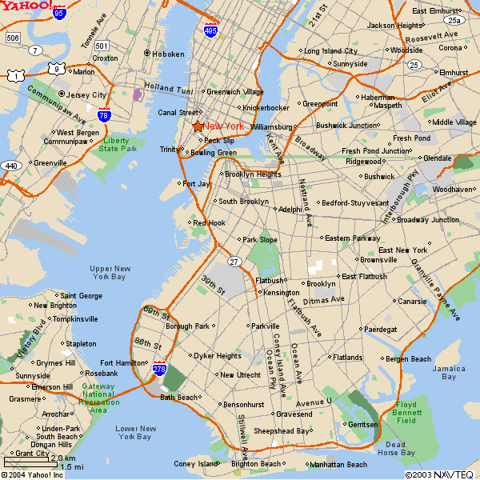
Many of us already search geographically
By adding terms with a geographic meaning:
  Yoga “New York”
  Yoga Brooklyn
  Yoga “Park Slope”
  Yoga Queens
But this is
far from perfect

Slide 5
Problems
Multiple queries for the same search task
  Many results have to be seen over and over
User needs to know the geographic surrounding
Many geographic hints are ignored:
  Telephone numbers, zip code, etc.
  Link structure
No concept of continuous space

Slide 6
Applications
Location-based services
Locally targeted web advertising
Mining geographic properties
  Market research

Slide 7
Related Work
L. Gravano. Geosearch
http://geosearch.cs.columbia.edu
Divine Inc. Northern Light Geosearch.
Eventax GmbH.
http://www.umkreisfinder.de
Yahoo Local Search
http://local.yahoo.com
Google Local Search
http://local.google.com
K. McCurley. “Geo Coding”
Ding, Gravano, Shivakumar. “Geo Scope”
Raber Information Management GmbH
http://www.search.ch
Open GIS Consortium
http://www.opengis.org
Daviel. http://geotags.com

Slide 8
Our Contributions
Actual implementation of large-scale geographic web search
Combining known and new techniques for deriving geographic data from the web
Efficient query execution in large geographic search engines

Slide 9
Structure of Engine
Crawler to gather pages
  We crawled 31 million pages in .de domain
Build text inverted index
Calculate global ranking (i.e. PageRank)
Preprocess geographic information
Running a search engine on top of these

Slide 10
Geo Coding
Three steps
Geo extraction
  Find all elements that might indicate a location
Geo matching
  Map elements to actual locations/coordinates
Geo propagation
  Increase quality and coverage of the geo coding

Slide 11
Geo Extraction
Reduce a document to the subset of its terms that have geographic meaning.
  Town names
  Phone numbers
  Zip codes
strong terms vs. weak terms
killer terms and validator terms

Slide 12
Geo Matching
Geo-geo ambiguity
Two assumptions:
  Single source of discourse
  The author most likely meant the largest town with that name
Measuring geo matching
  Number of matched terms
  Fraction of matched terms

Slide 13
Matching Strategy
Best of the Big towns First algorithm
Group towns into several categories according to their size
Start with the category of the largest towns
Determine the subset of all towns from this category that contain at least one term in found-strong
Rank them according to a mix of the measures
Add the best matched town to the result
Remove all terms found in this town name from the set
Start over at 3, as long as there are new results
If there are no new results, repeat the algorithm for the next category

Slide 14
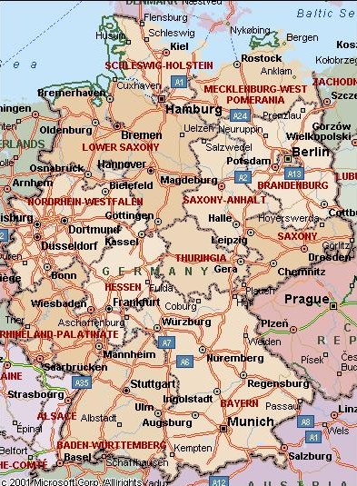
Geographic Footprints of Web Pages
Raster data model
Representing geographic footprint of a page as a bitmap on an underlying 1024x1024 grid of Germany
Each point on the grid has an integer amplitude
Bitmaps are kept as quad tree structures

Slide 15
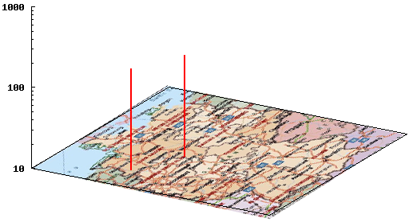
Geographic Footprints of Web Pages
Two advantages:
  Aggregation and other operations are efficient
  Highly compressed
    less than 100 bytes on average after simplification
0-badewanne.baby--shop.de

Slide 16
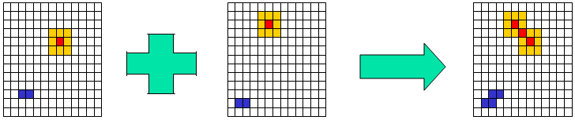
Geo Propagation
Links: propagation of footprints through forward and backward links
  Radius-one hypothesis
  Radius-two hypothesis (Co-Citation)
Sites: aggregation of bitmaps across site

Slide 17
Geographic Query Processing
Traditional Search
Geographic Search
User enters key words
User enters key words and geographic position
Boolean operations on inverted index.
Boolean operations on inv. index and Footprints
Ranking according to subject-relevance
Ranking according to subject-relevance and Distance

Slide 18
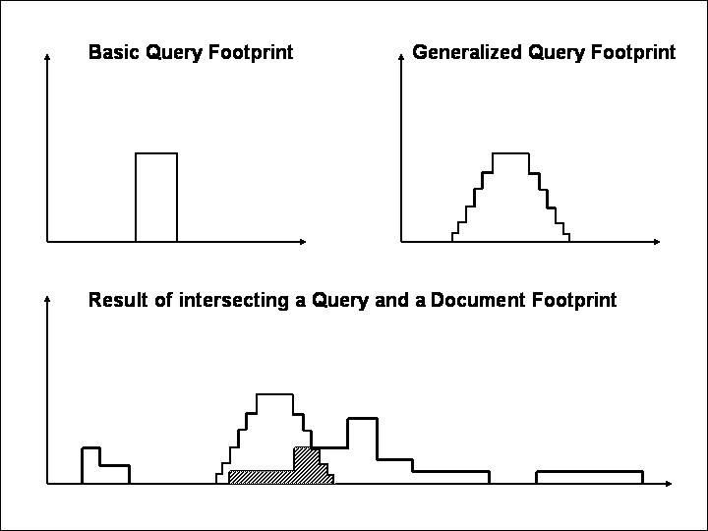
Geographic Ranking
Customizable query footprint
Intersection part is the idea of the geographic score
Combined with PageRank, term-based score

Slide 19
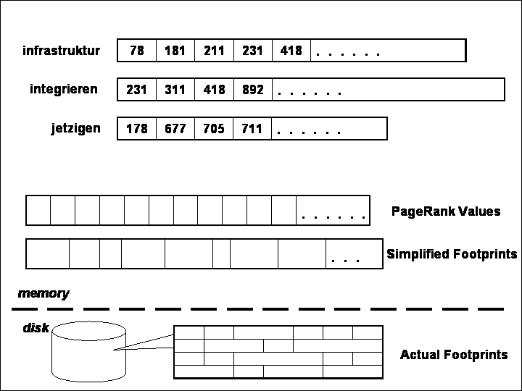
Efficient Geo Query Processing
Intersection from inverted index
Calculate approximate geo score
For top k results, calculate precise geo scores

Slide 20
Conclusion and Future Work
Automatically identify and exploit geographic terms through the use of data mining techniques.
Optimized geographic query processing algorithms.
Focused crawling to a given geographic area.
Mining geographic properties

Slide 21
Thank You

