Slide 1

Petroleum
Software Audio Synthesizer Optimized for Game Audio Creation
23BCE2281-Rayan Vishal Madan

Slide 2
Need For the Project
Game development has three pillars: visuals, audio and behaviour.
Visual and behaviour tools scale from small to large projects.
Audio has no equivalent - nothing bridges simple and complex.

Slide 3
Objectives
Scale from hackathon projects to multi-year productions.
Replace skeuomorphic synth design with a flat UI.
Combine sfxr/bfxr simplicity with advanced sound design.
Support additive, subtractive and FM modular synthesis.
Support microtonality.

Slide 4
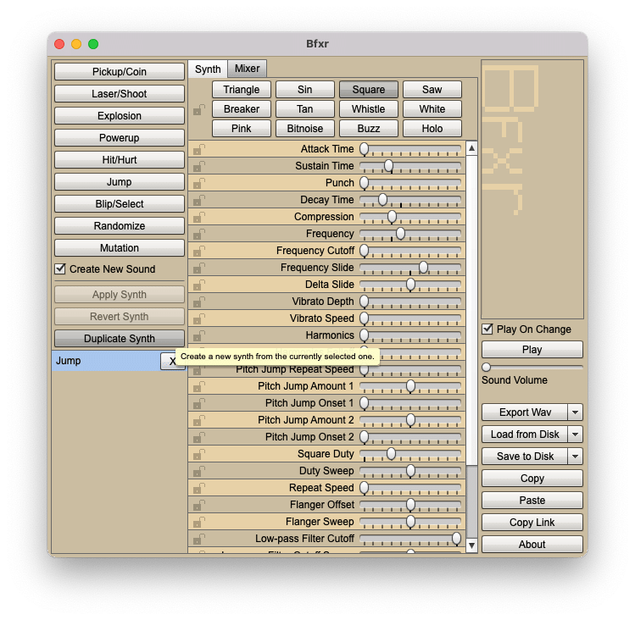
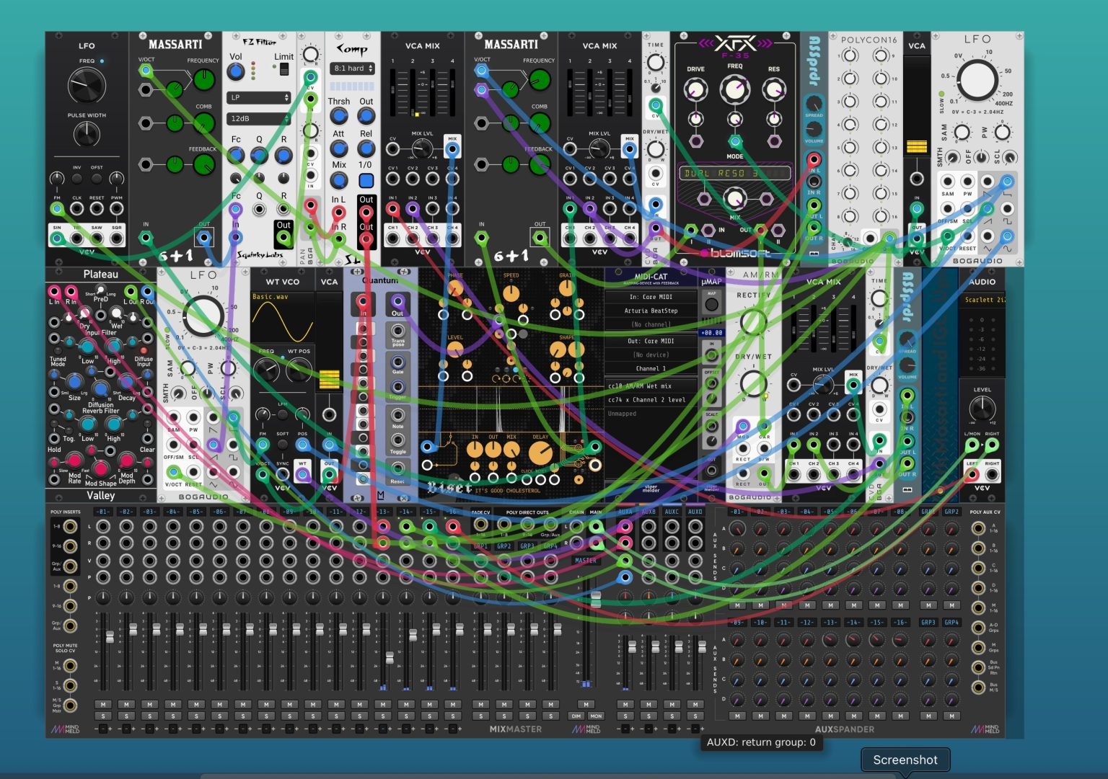
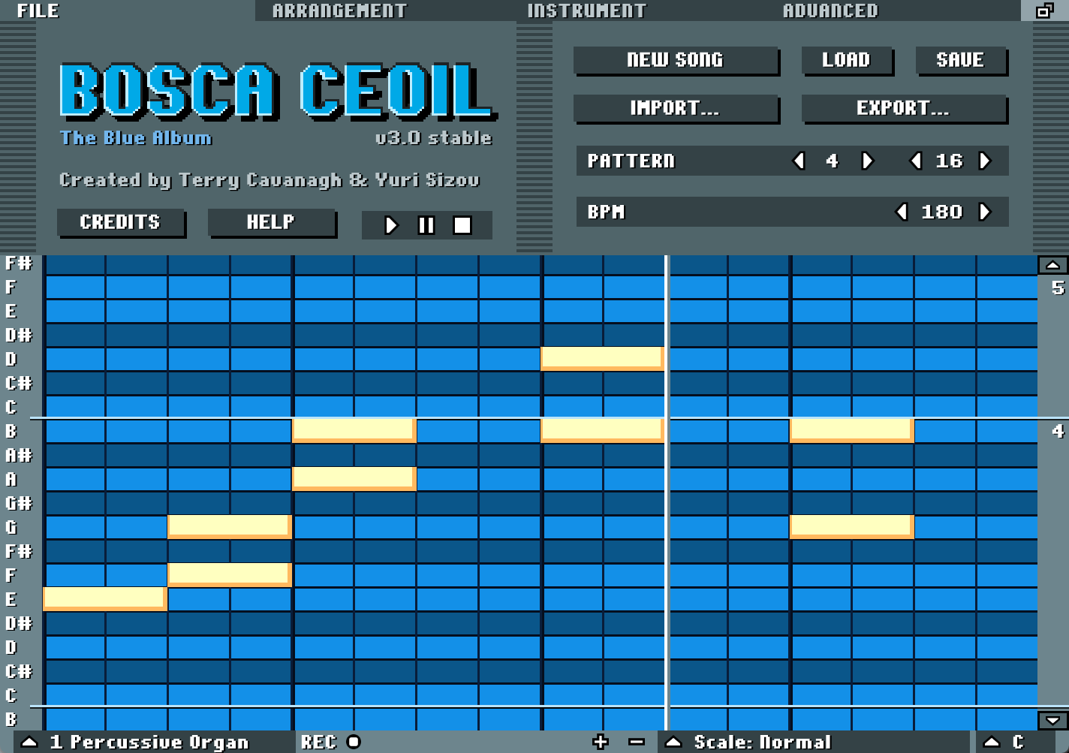
Existing Programs
VCV Rack: Bad UX, Complex.
BFXR: Simple, Easy to use, limited. Music not possible.
Bosca Ceoil: Simple, Easy, limited. Cannot make sound effects.

Slide 5
Limitations in Current Implementations
Poor user experience.
Tools are either too limited or too overwhelming.
Most assume the 12-note chromatic scale, blocking microtonal work.
Knob-based UIs are awkward with a mouse and keyboard.

Slide 6
Methodology
Quick sound generation that outputs an editable patch.
Node-graph workflow for non-destructive editing.
Context menus over toolbars, with a flat UI.
JavaFX for the UI; javax.sound.sampled for audio.
Factory pattern for creating nodes.

Slide 7
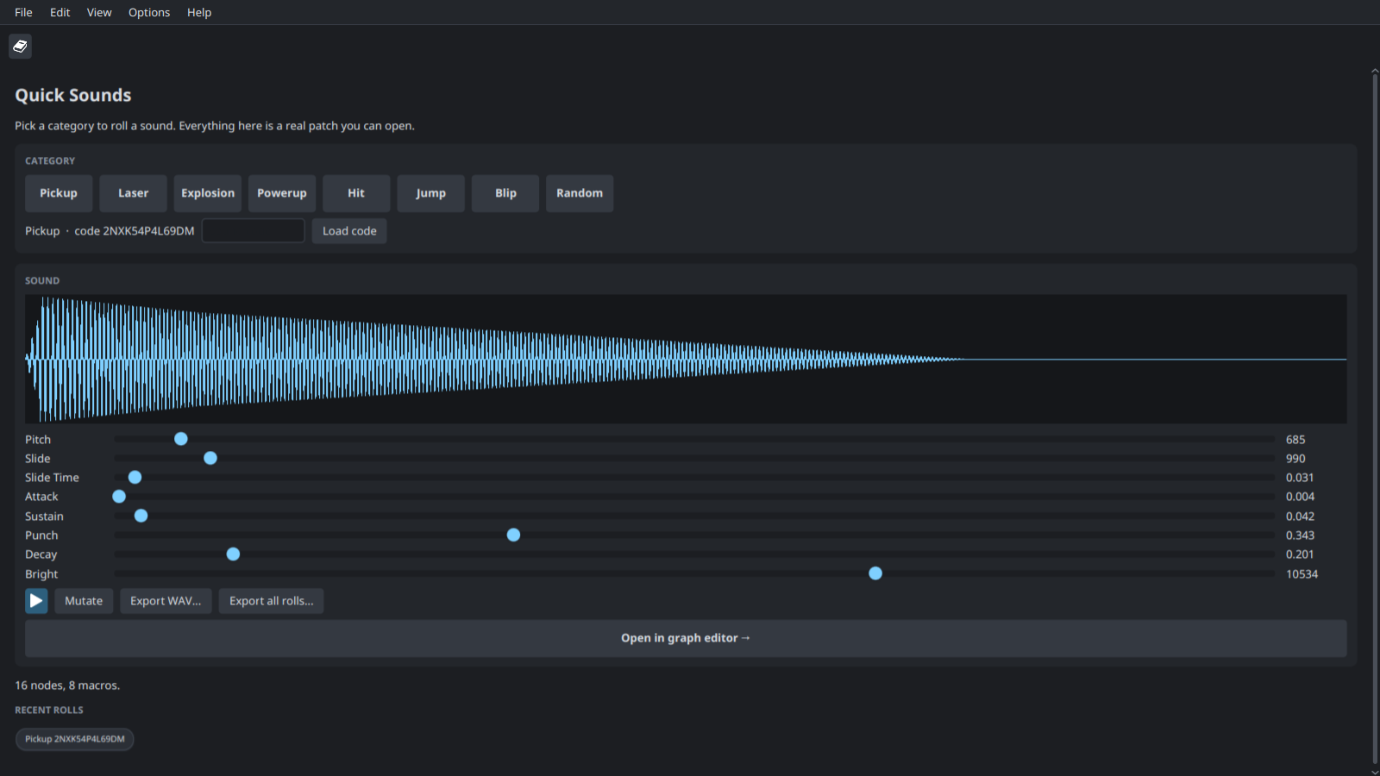
Quick Sounds
bfxr-style categories: Pickup, Laser, Explosion and more.
Every roll is a real patch, not a preset.
One click opens it in the graph editor.

Slide 8
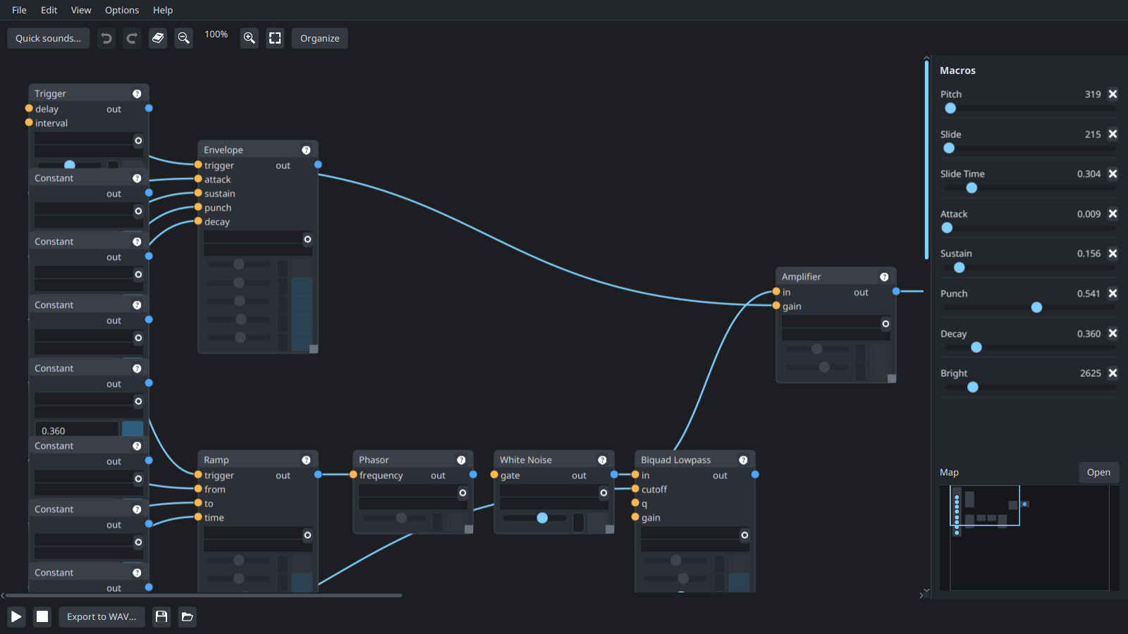
Graph Editor
Nodes wired on a canvas; edits are non-destructive.
Macros expose key parameters as sliders.
Right-click to add any node.

Slide 9
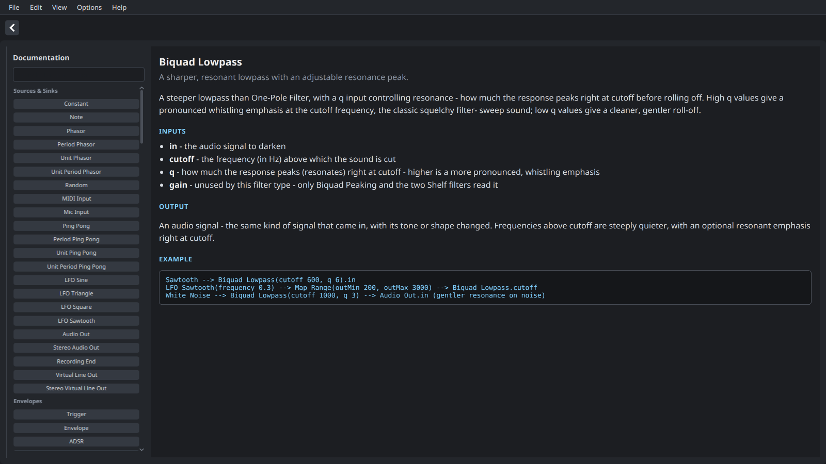
Built-in Documentation
An article and a wiring example for every node.
Opened from each node's "?" button.
Searchable index.

Slide 10
Key Features
151 node types: filters, effects, granular, spectral and physical.
Saved patches can be reused as nodes.
Fully microtonal: pitch is carried in Hz.
Multisample instruments from imported WAVs.
Many ways to reach the same sound.

Slide 11
System Architecture
Node graph with named input and output ports.
Patch engine: topological sort, block-based rendering.
Realtime-safe: no memory allocation in the audio path.
Self-contained .ptr files with embedded samples.

Slide 12
Results
One tool from quick SFX to multi-channel music.
Flat, node-based UI instead of racks and knobs.
Additive, subtractive, FM, granular, spectral and physical synthesis.
Microtonality built in: nothing assumes the 12-note scale.
Sound variations exported in one batch.
WAV export with configurable sample rate, bit depth and trimming.
Native installers for Windows, macOS and Linux.
JavaFX is the only third-party dependency.

Slide 13
Future Work
A domain-specific language (DSL) so it is programmatically possible to control Petroleum.
  Plain text describing nodes, connections and values.
  Agents build and render patches without the GUI.
VST support
Node Based approach conducive to live collaboration

