Slide 1
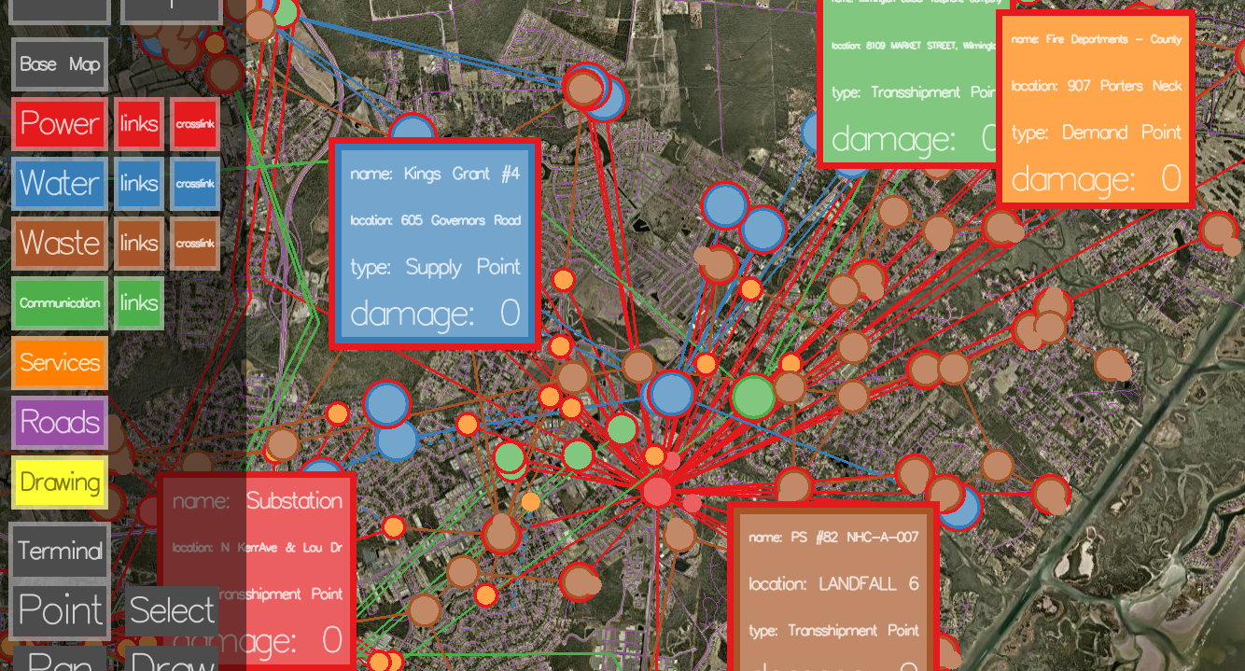
Augmented Reality & Data Visualization
Barb Cutler, Associate Professor, Computer Science
Tyler Sammann, Sean Kim, Joshua Nasman, Pat Phipps, Andrew Dolce, Ryan Baltazar
David Mendonça, Associate Professor, Industrial and Systems Engineering
William Al Wallace, Professor, Industrial and Systems Engineering

Slide 2
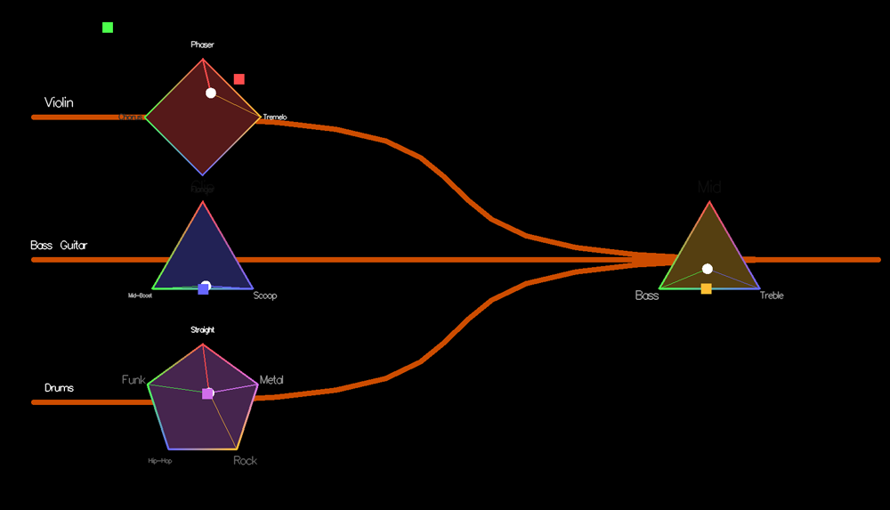
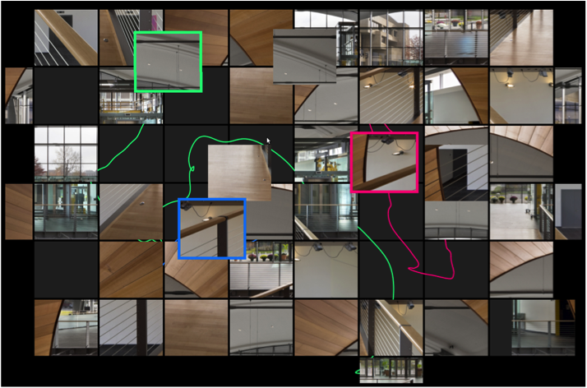
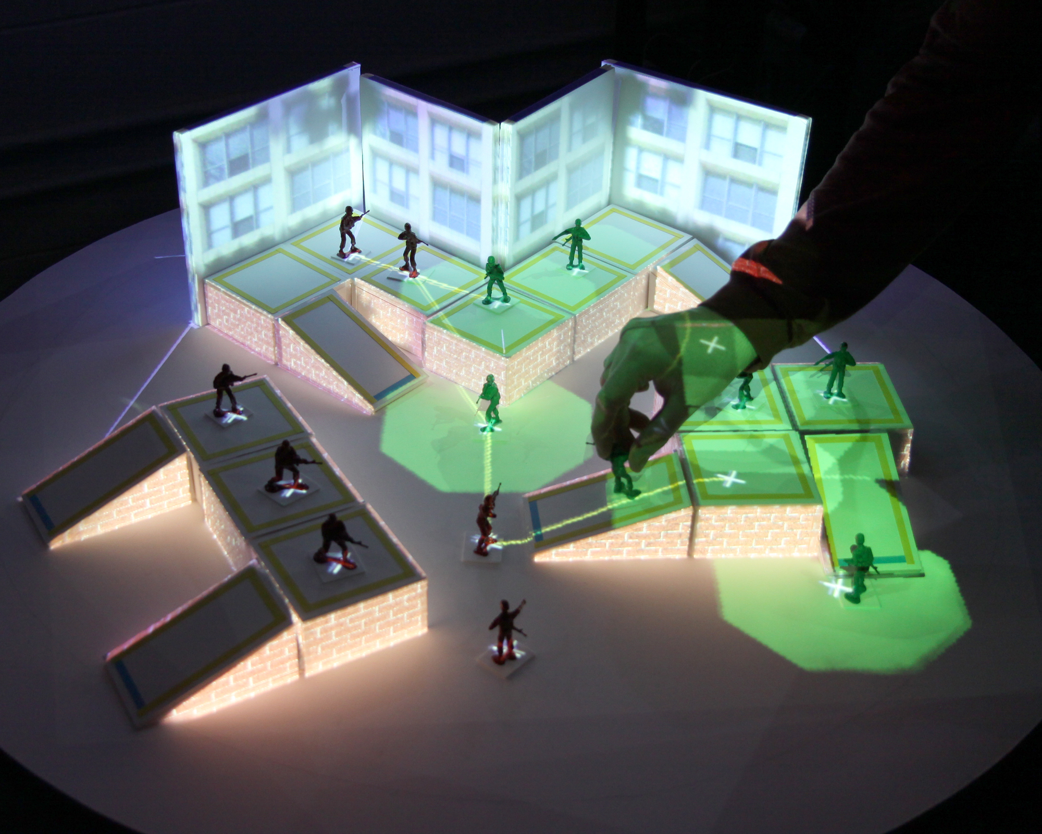
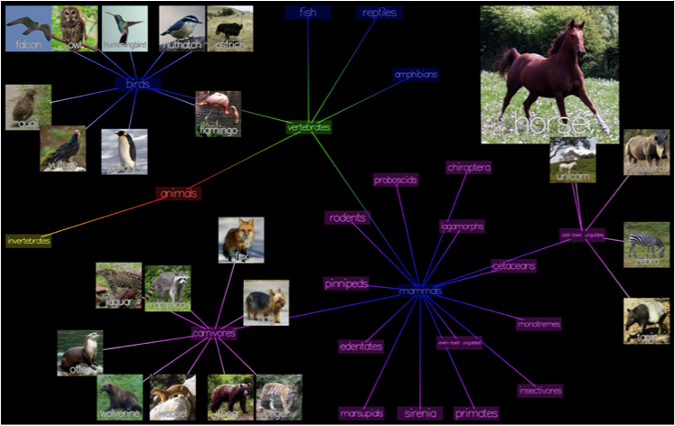
Collaborative Multi-Modal Interfaces

Slide 3
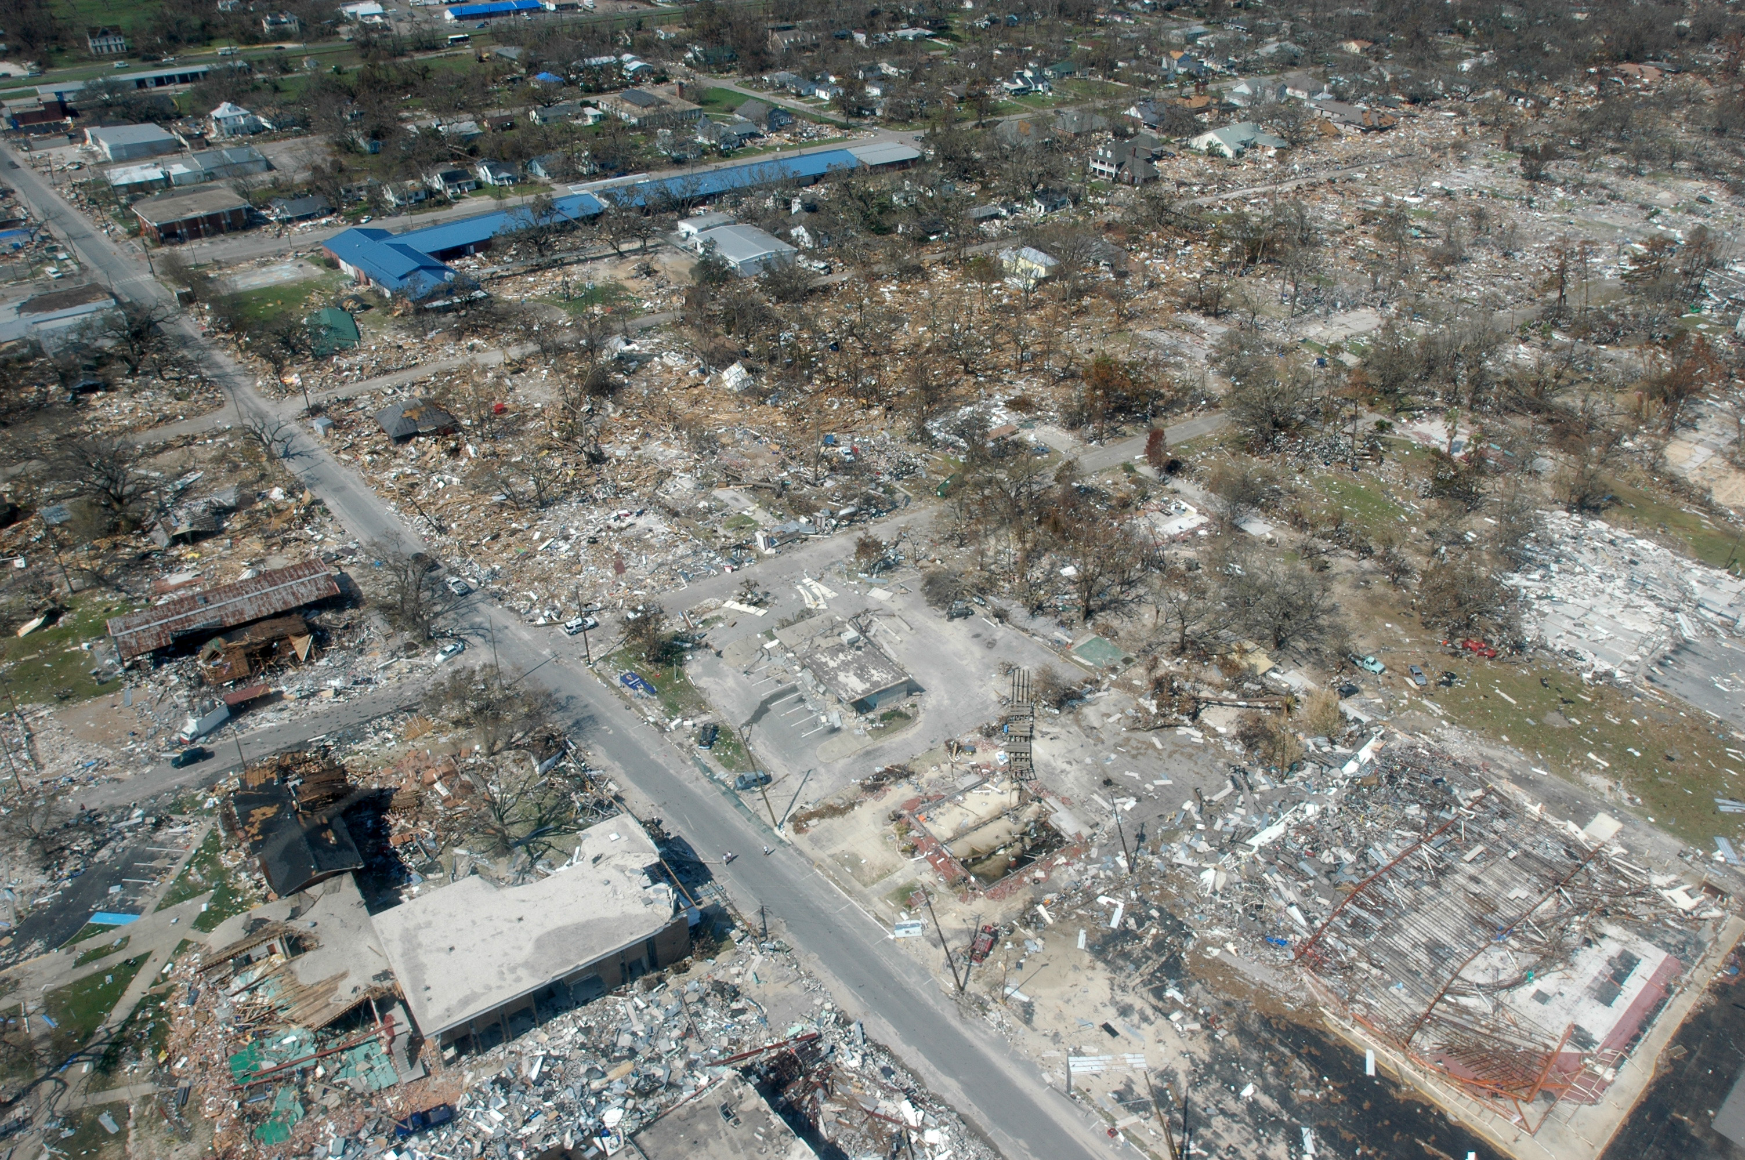
Hurricane Impact

Slide 4
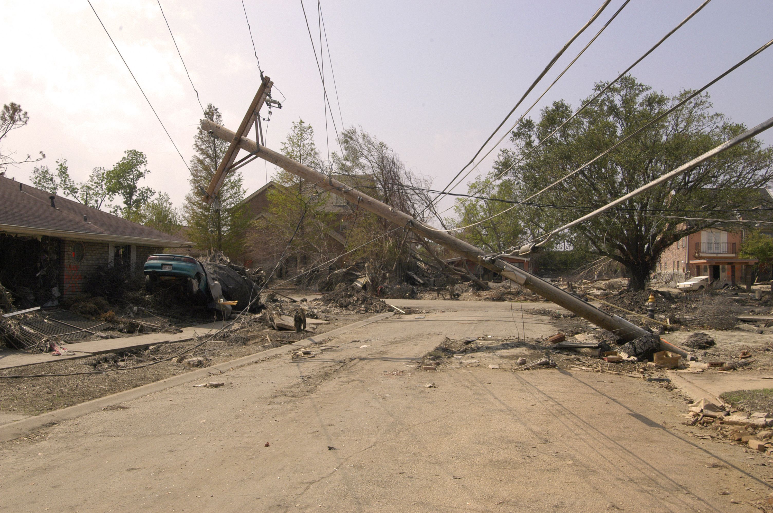
Interdependency of
Infrastructure Repair

Slide 5
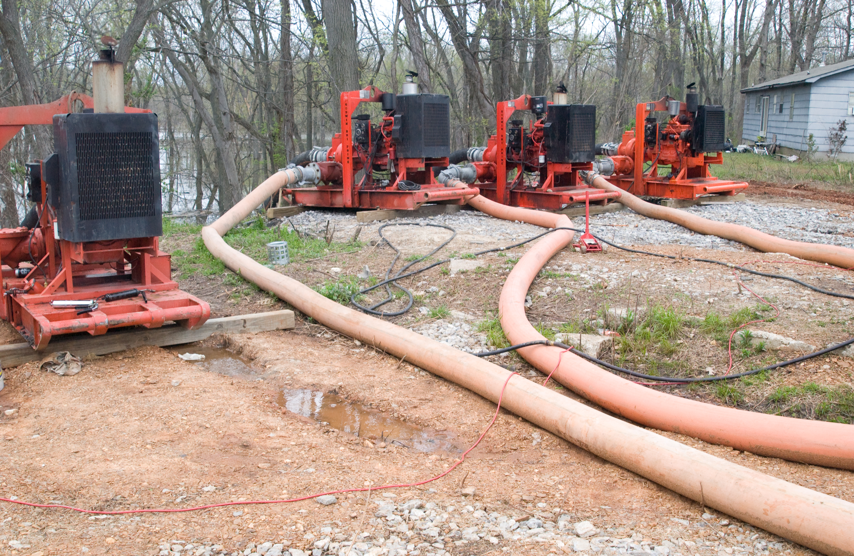
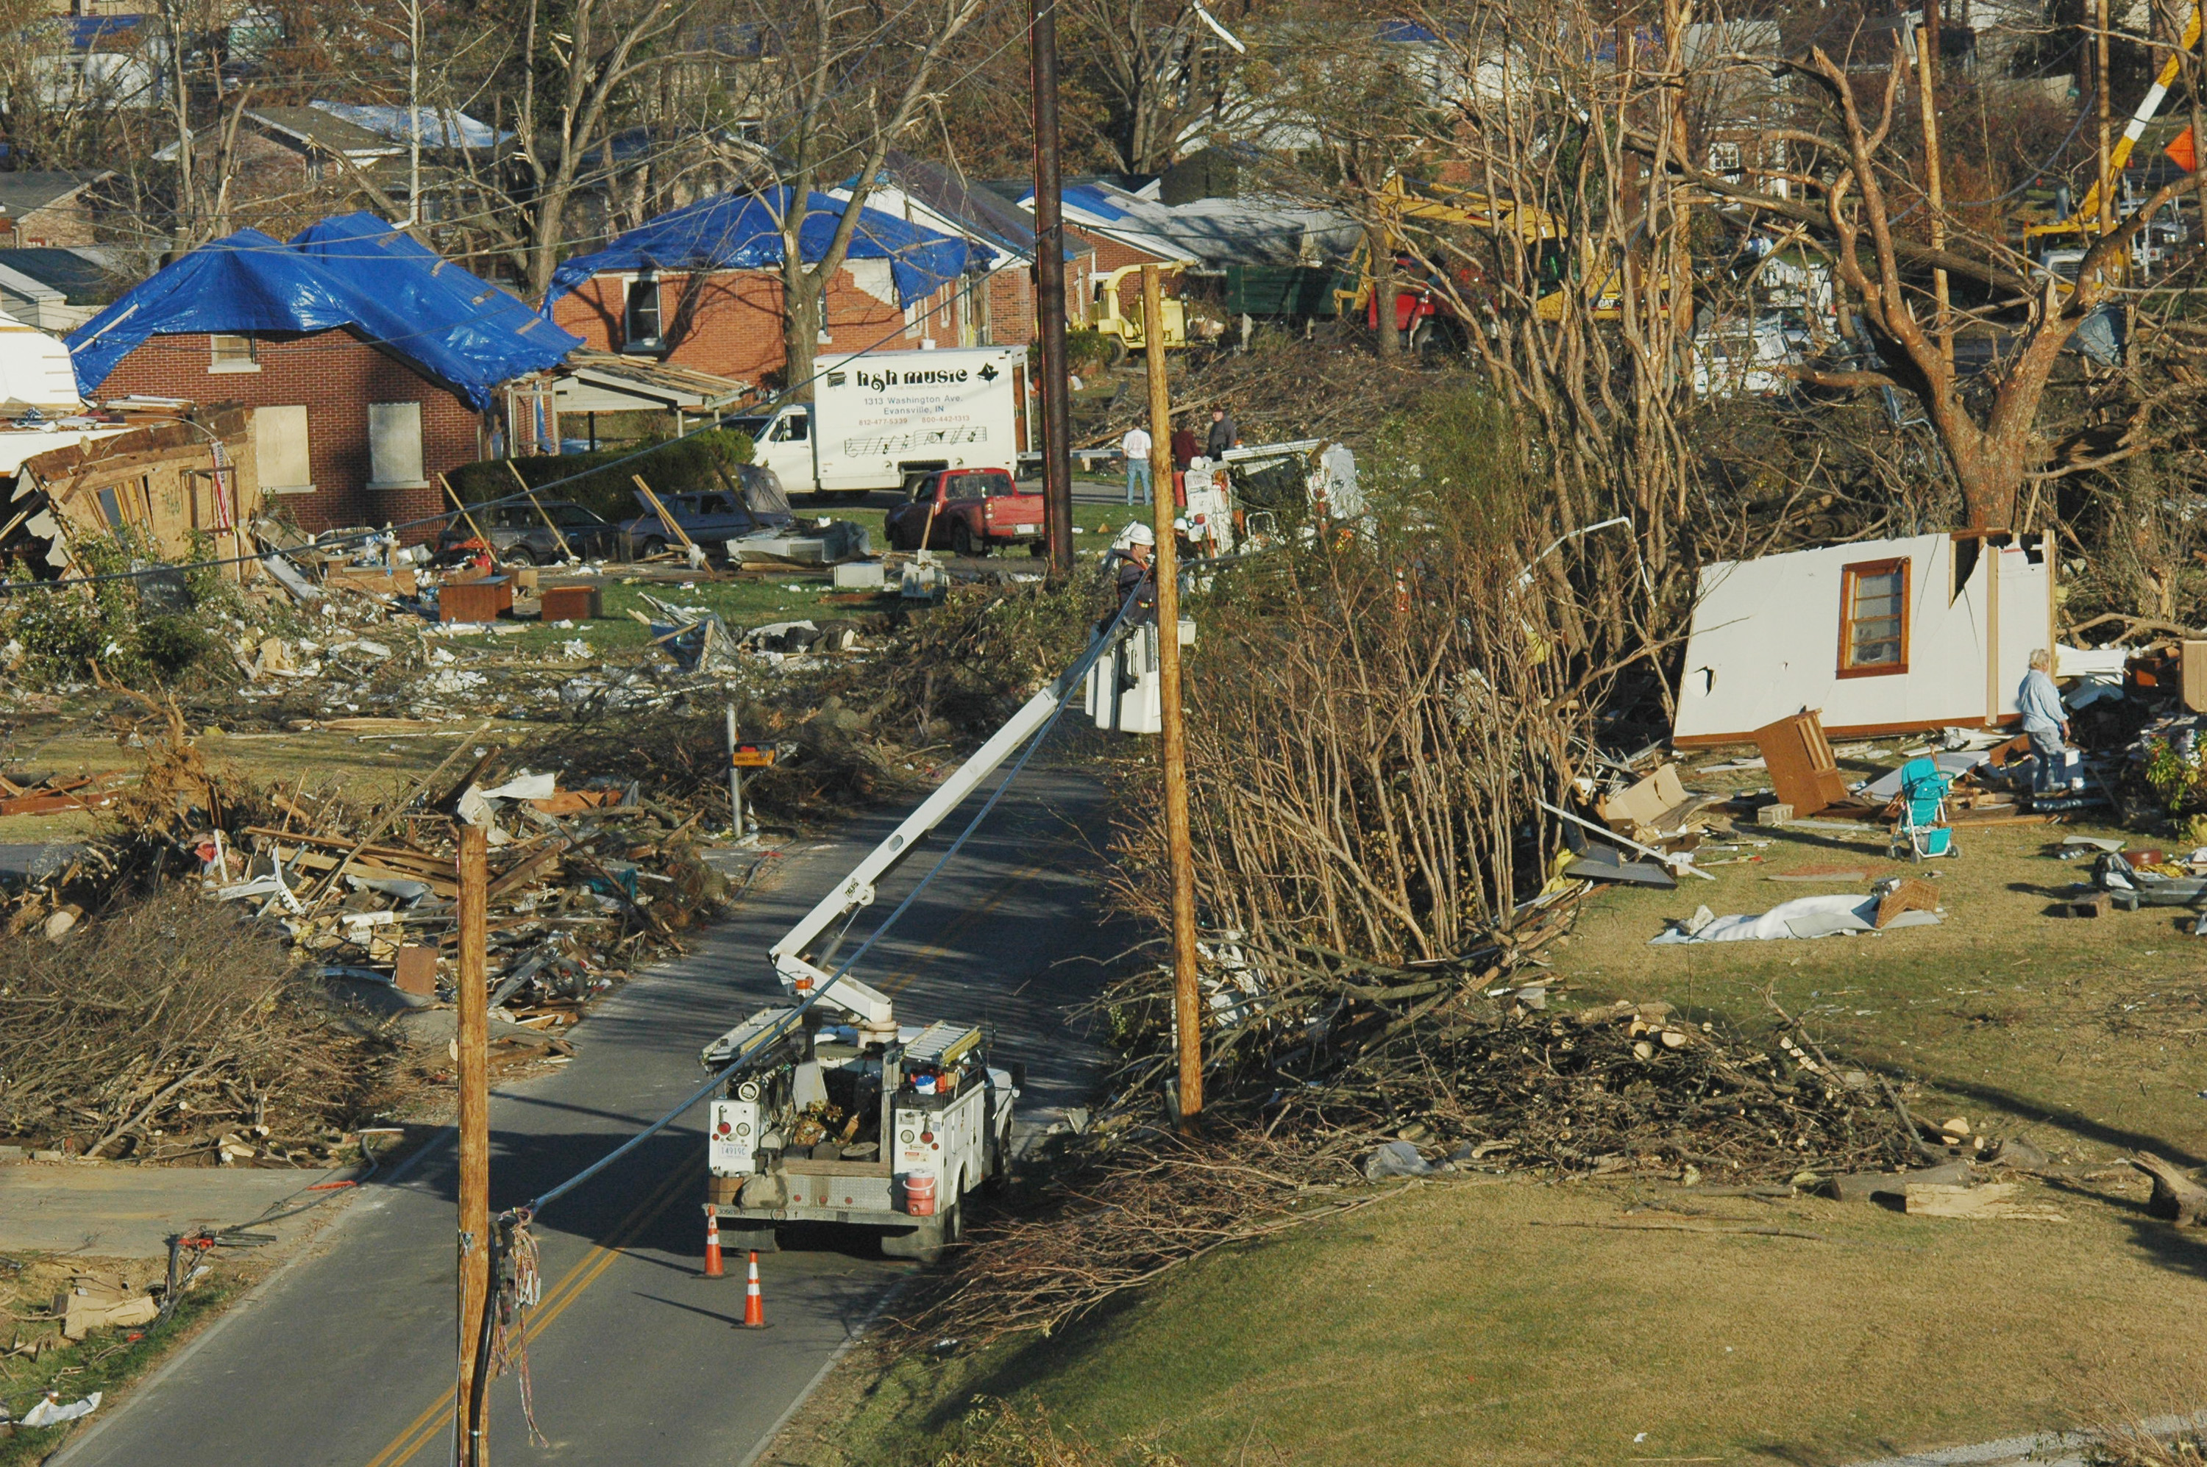
Restoration
temporary
equipment
repair existing or redesign network

Slide 6
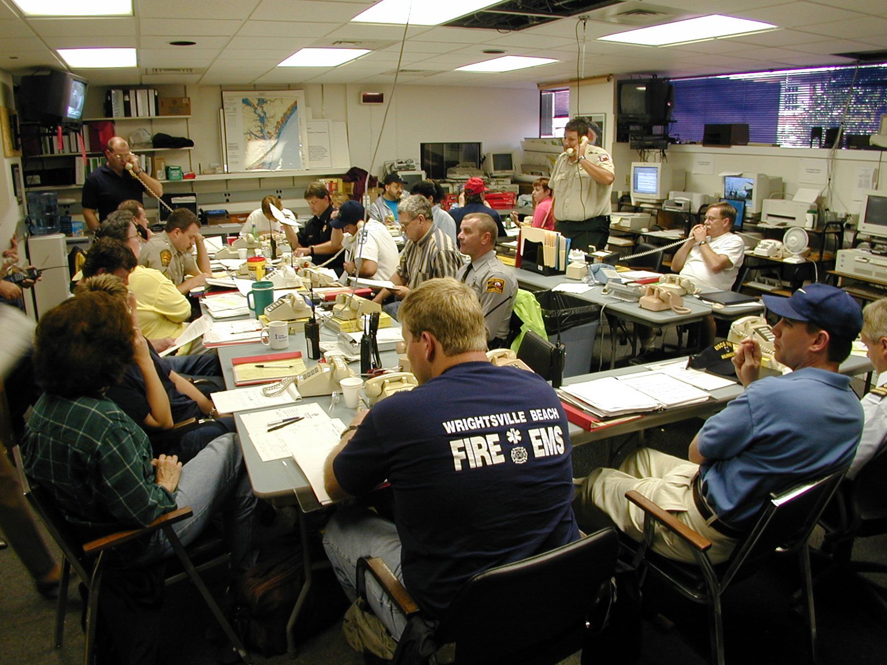
Collaboration & Decision Making
Emergency Operations Center (EOC)

