Slide 1

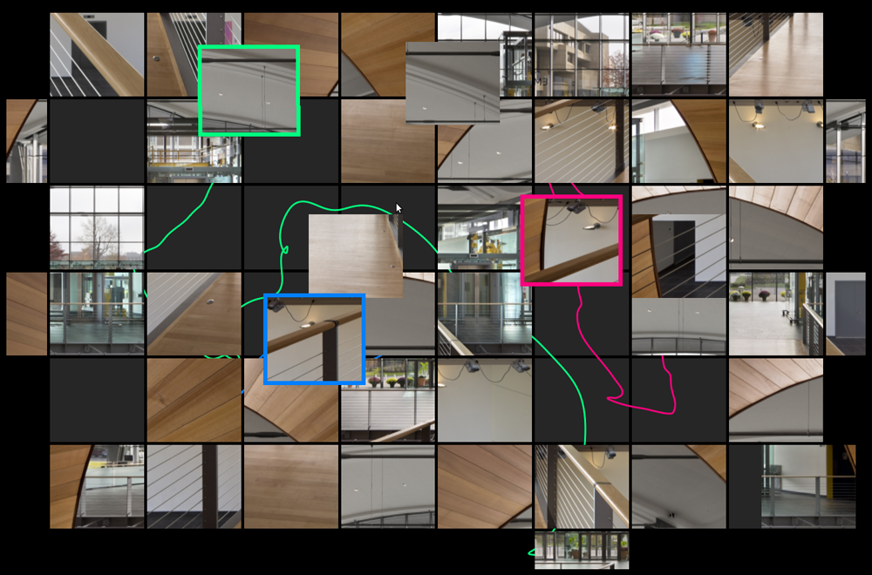
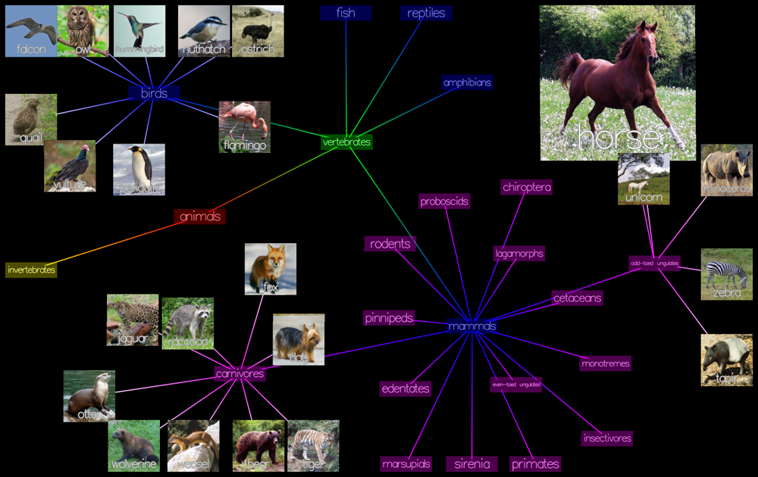
Immersive Data Visualization and Interaction in EMPAC
Barb Cutler, Assistant Professor, Department of Computer Science
Andrew Dolce, CS/GSAS undergraduate & CS Masters student
Christopher Stuetzle, CS Ph.D. student

Slide 2
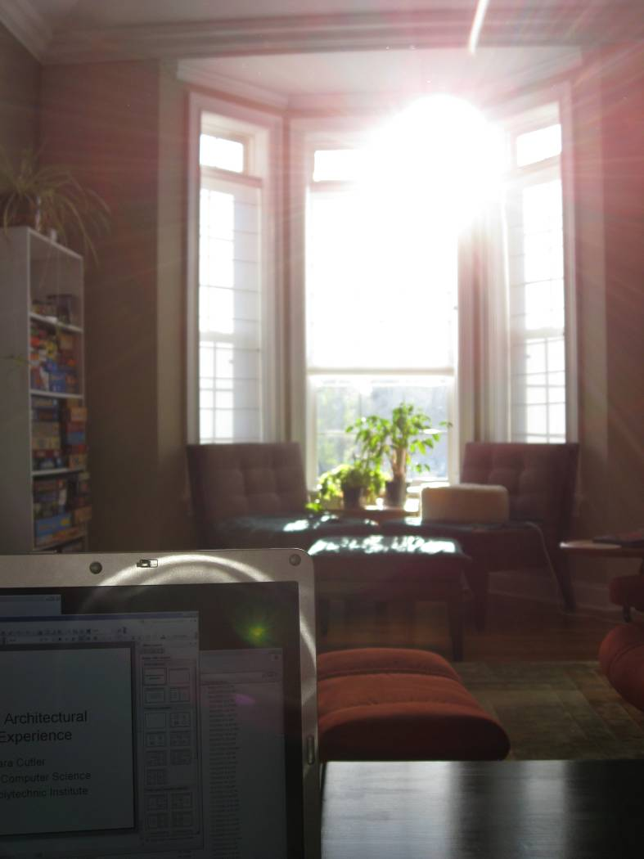
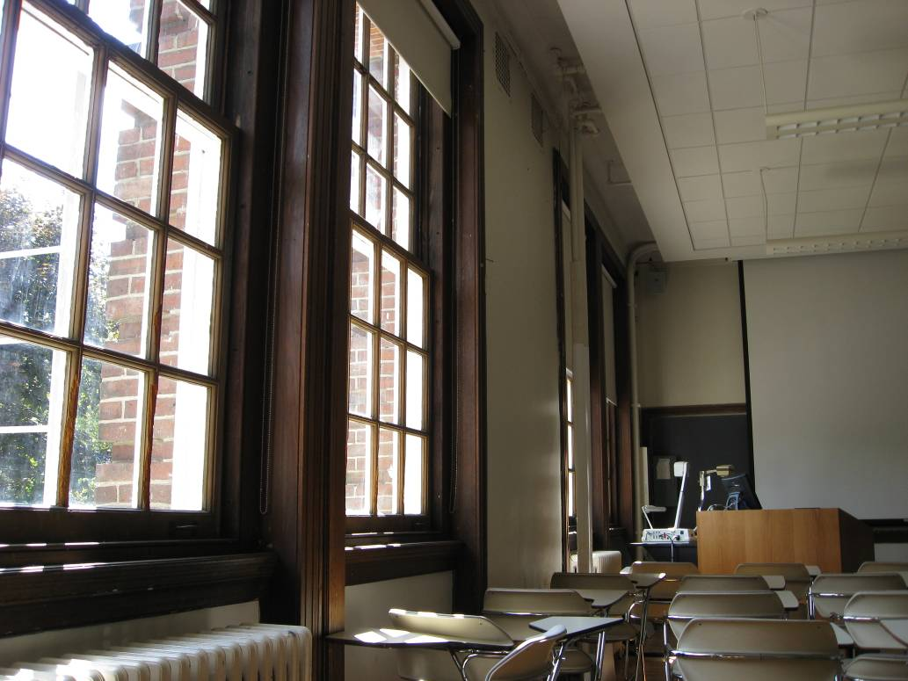
Architectural Daylighting
Design Challenges
Direct illumination
from the sun
Indirect illumination from
the sky & from scattering
Daily & seasonal
variations
Glare: too much
contrast can cause
discomfort and
reduce visibility

Slide 3
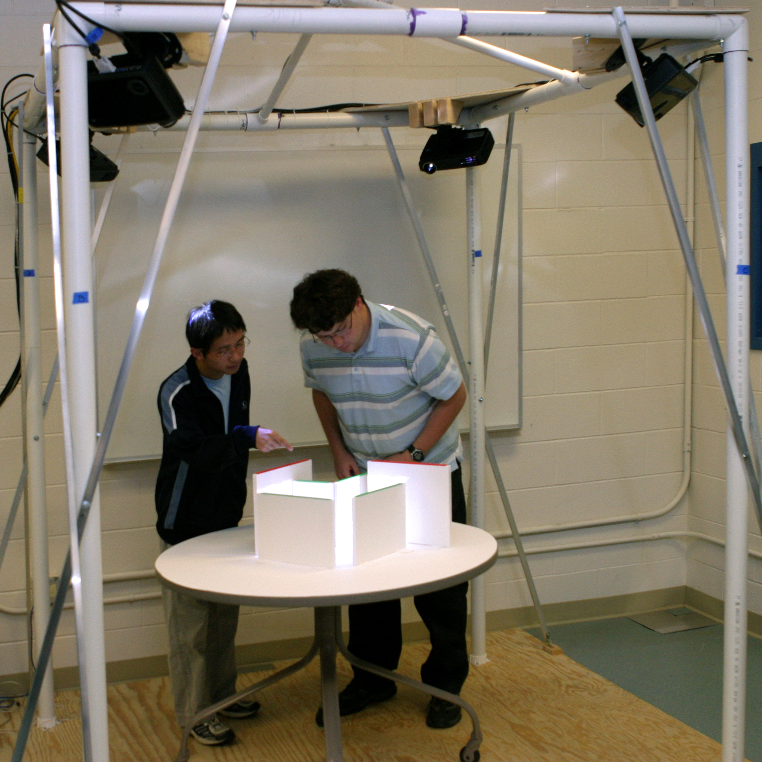
“Virtual Heliodon” for Daylighting Analysis
camera to
detect geometry
4 projectors to
display solution
design sketched with
foam-core walls

Slide 4
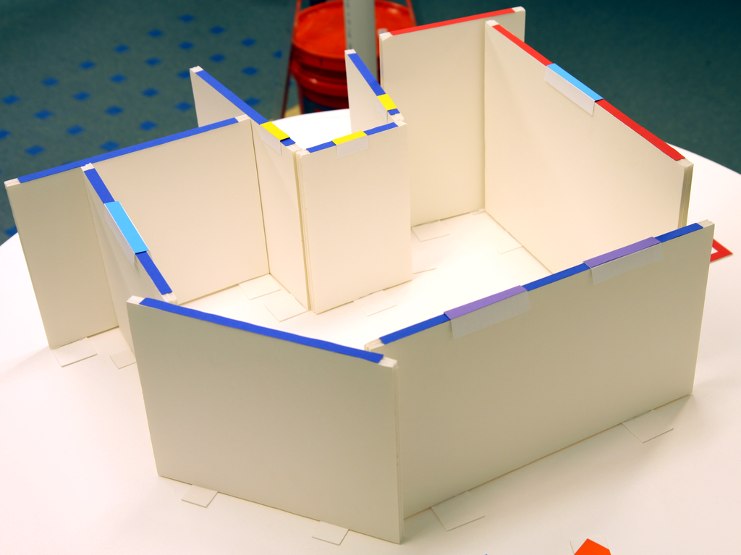
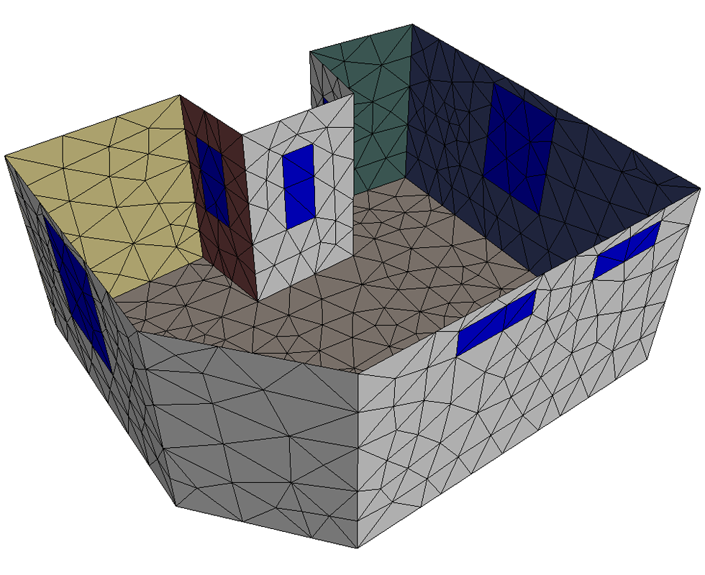
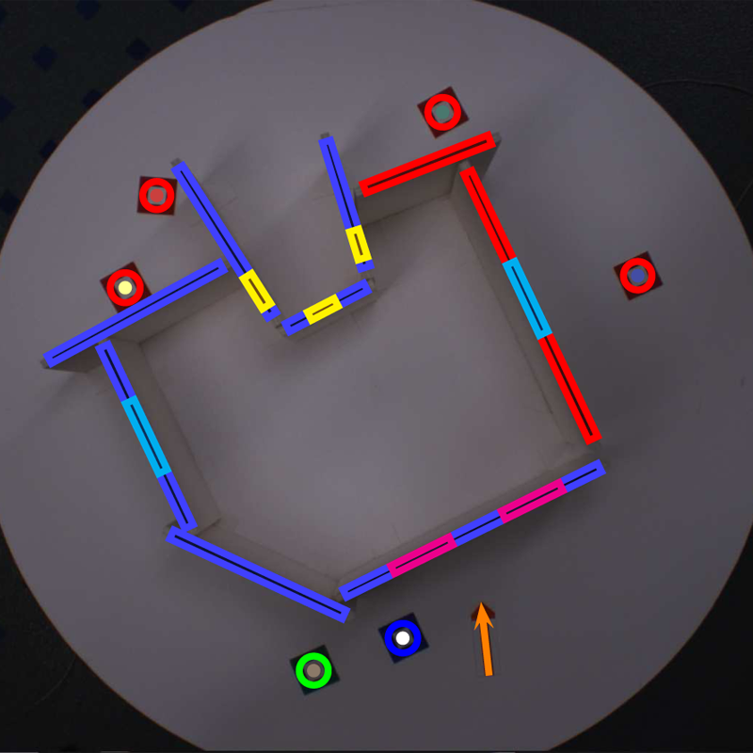
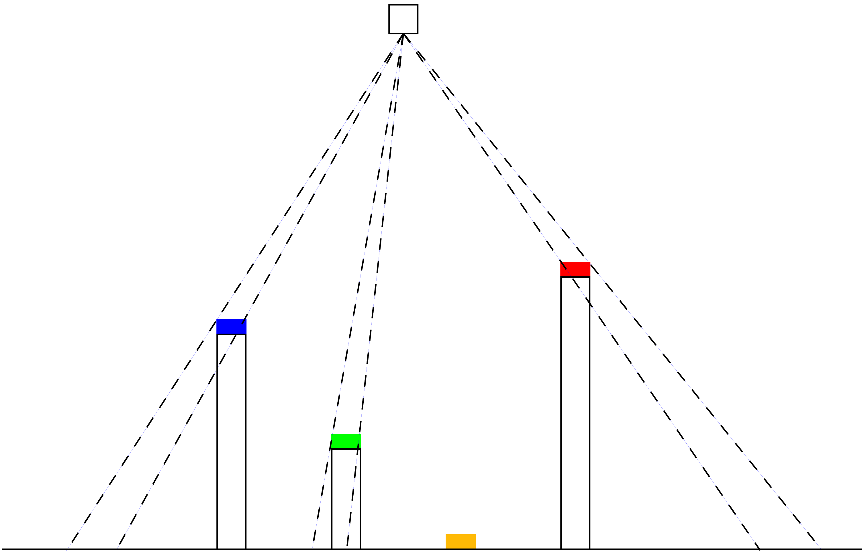
Tangible Interface for Architectural Design
Exterior & interior walls
Tokens for:
Windows
Wall/floor colors
North arrow
Overhead camera
Projection geometry
Inferred design

Slide 5
Virtual Heliodon: Spatially Augmented Reality for Architectural Daylighting Design
Yu Sheng, Theodore C. Yapo, Christopher Young, and Barbara Cutler
Proceedings of IEEE Virtual Reality 2009

Slide 6
“Multi-User Interactions for
Spatially Augmented Reality Games”
Andrew Dolce, Masters Thesis, June 2011

Slide 7
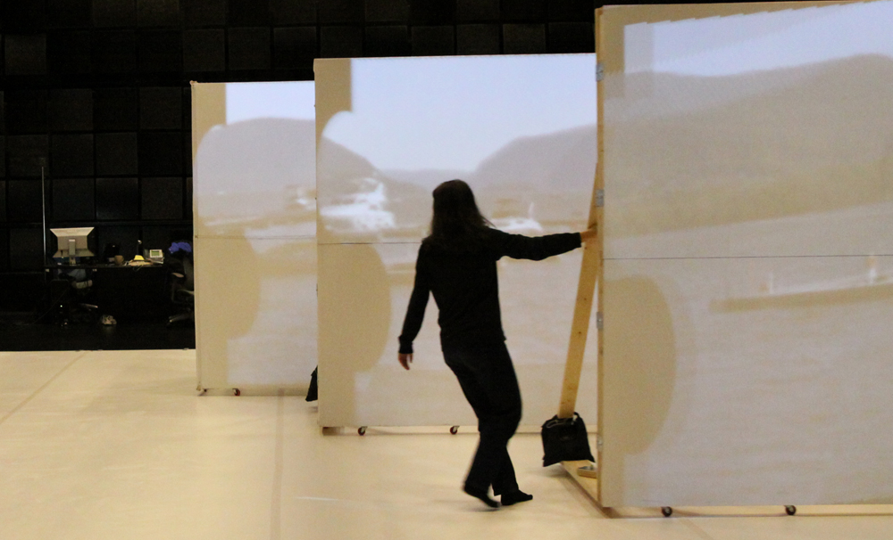
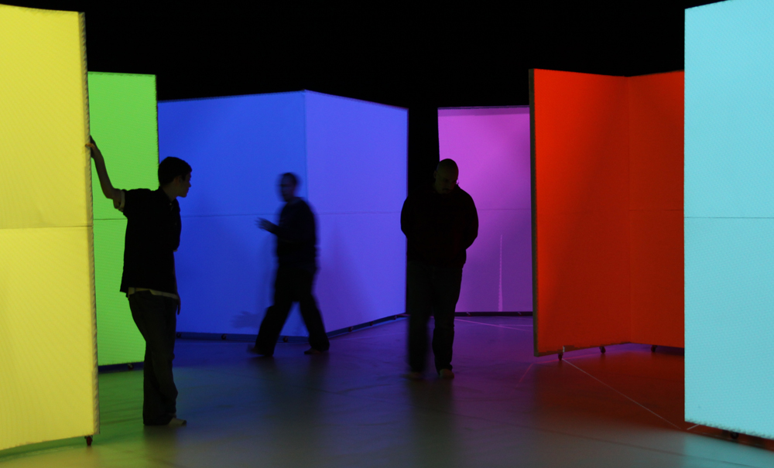
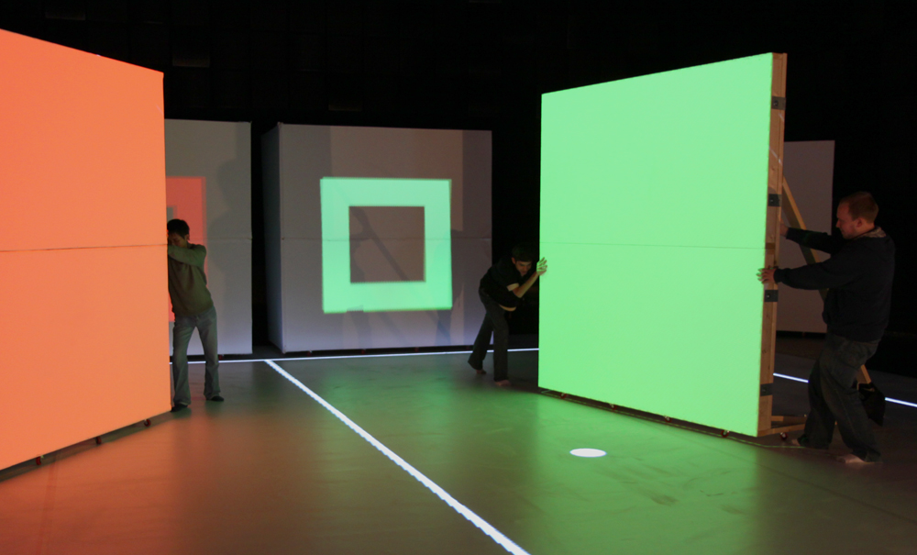
System Goals & Requirements
Spatially Augmented Reality
Large, human-scale
visualization environment
Multiple users view &
drive visualization
People move freely
within the space
Projection surfaces can
be moved interactively
Robust & real-time
tracking and display

Slide 8
“Dynamic Projection Surfaces for Immersive Visualization”,
Theodore C. Yapo, Yu Sheng, Joshua Nasman, Andrew Dolce, Eric Li, and Barbara Cutler,
PROCAMS 2010 IEEE International Workshop on Projector-Camera Systems, June 2010.

Slide 9
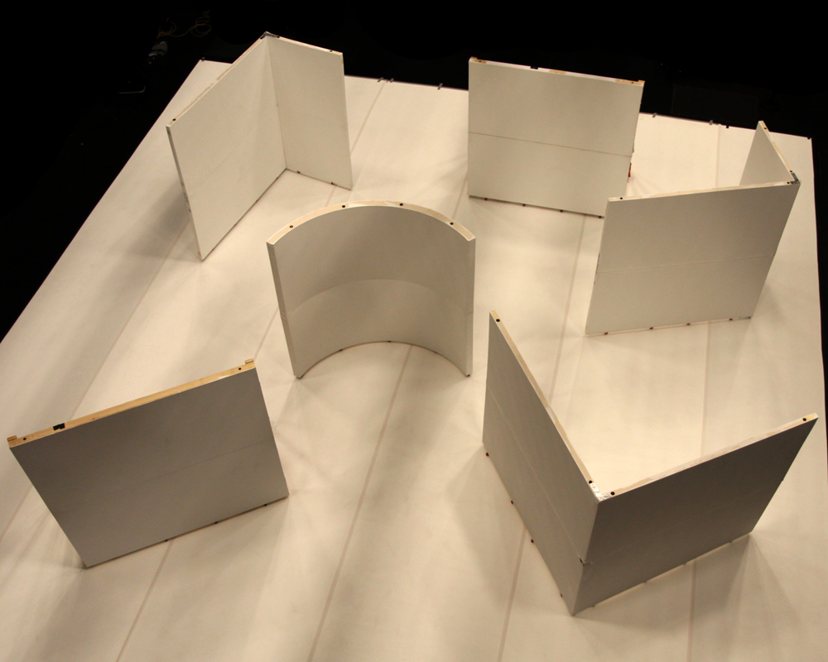
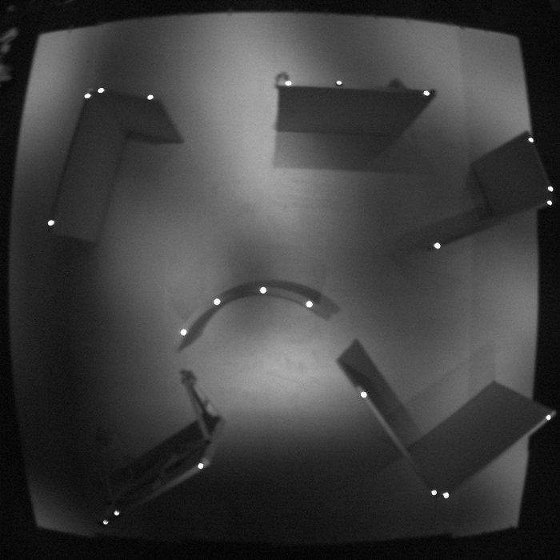
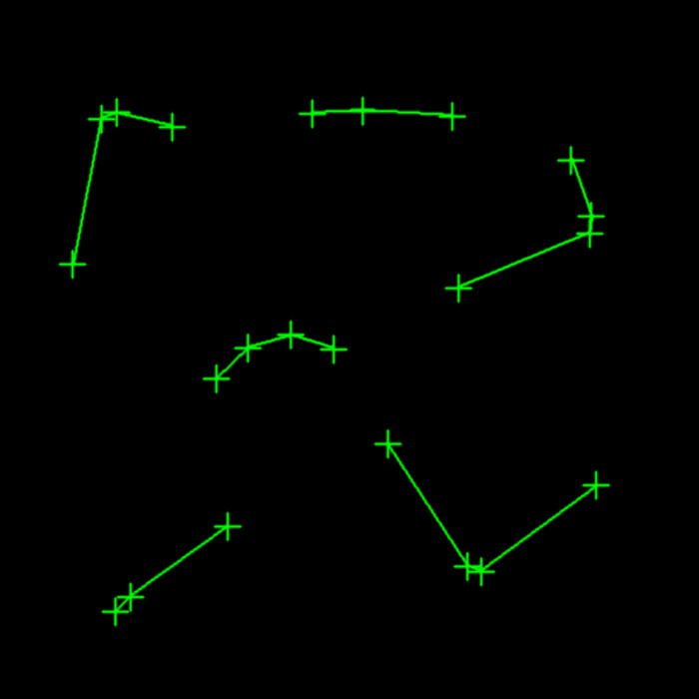
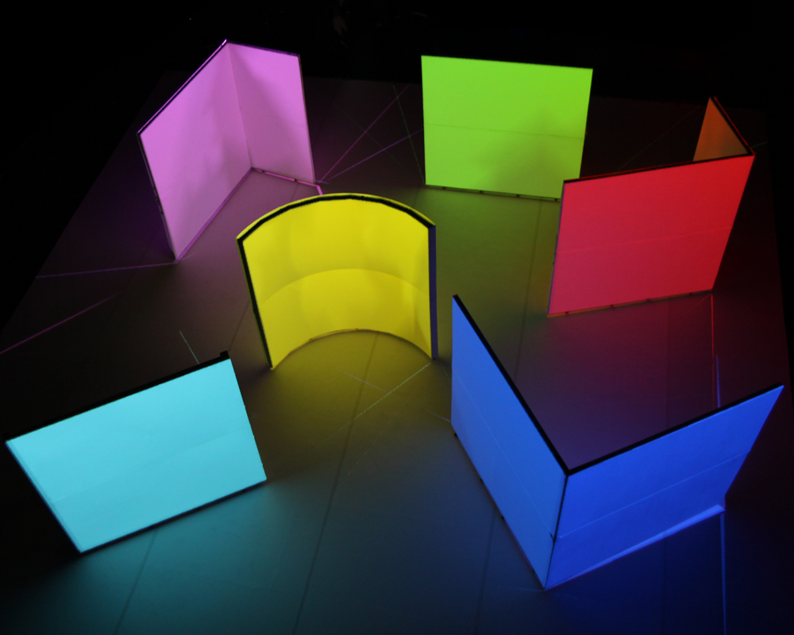
Full room lighting
Infrared camera image
Detected surfaces
Projection-applied “paint”

Slide 10
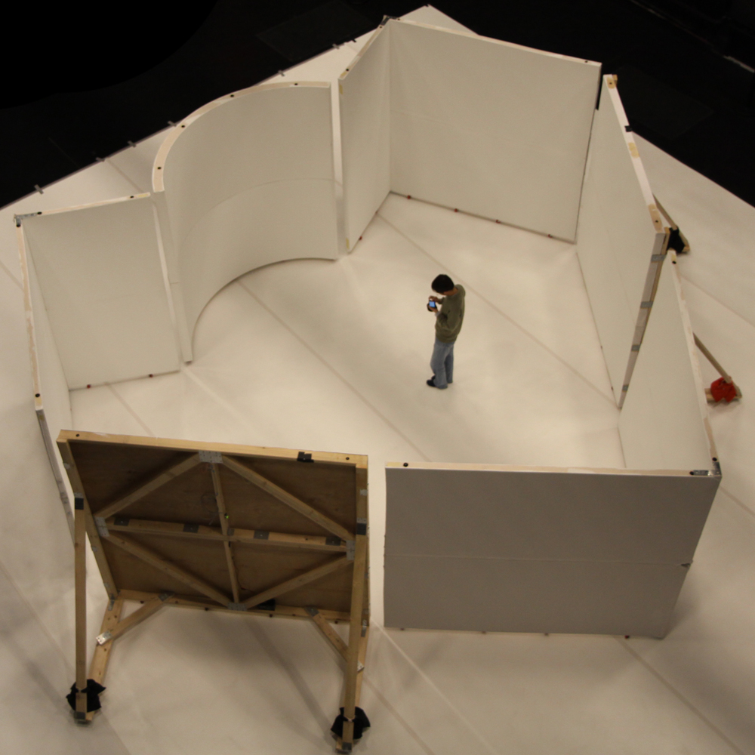
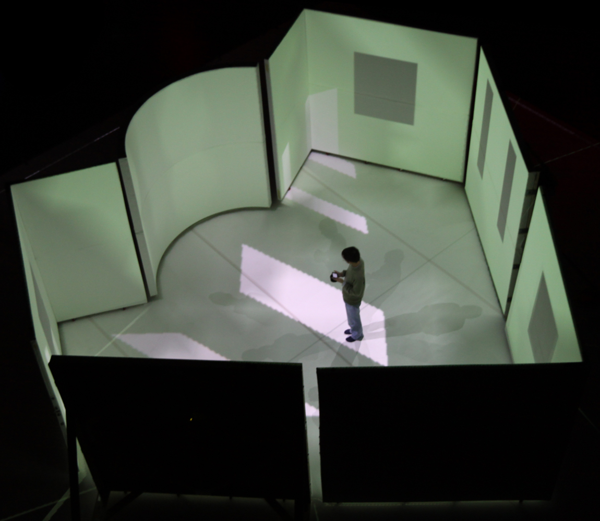

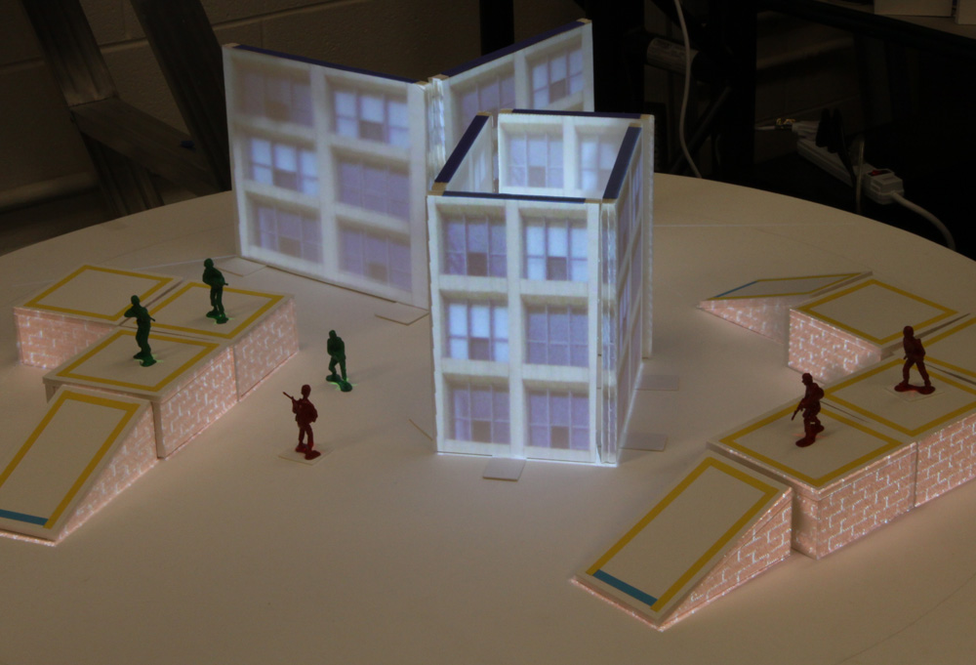
Applications
Education
& Training
Collaborative
design
environments
Data
exploration
and discovery
Entertainment

Slide 11
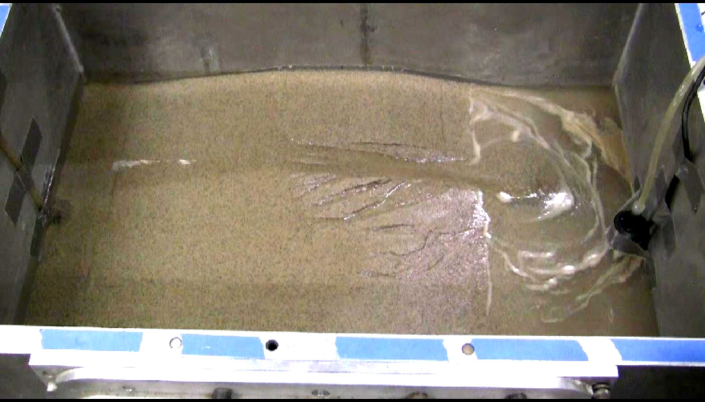
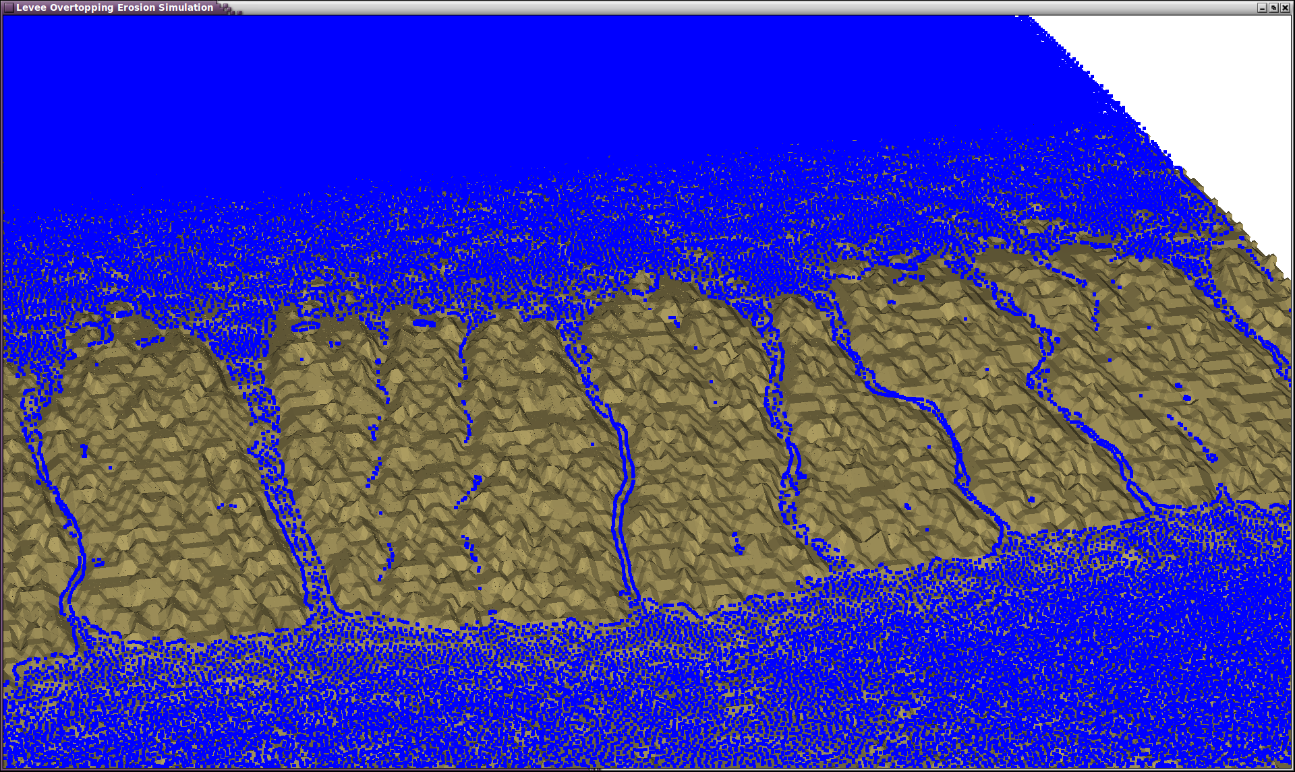
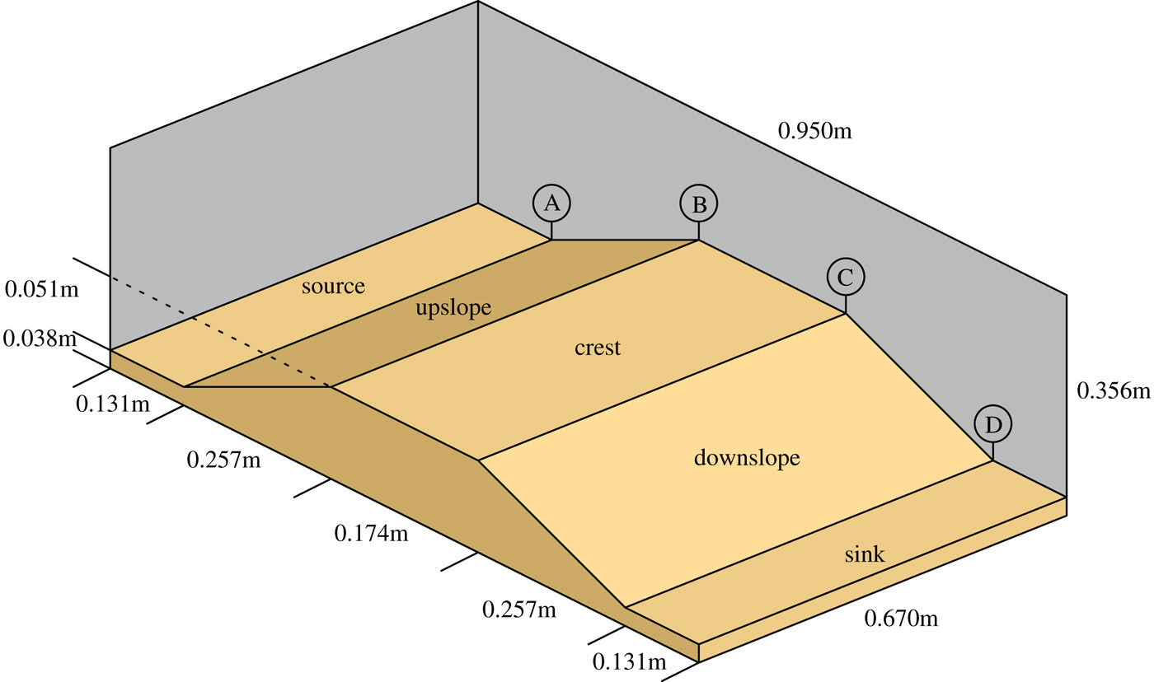
Erosion Simulation
& Visualization
Physically-accurate
fluid simulations of
rill & gully formation
leading to levee breach
“Quantitative Analysis of Simulated Erosion for Different Soils”
Zhongxian Chen, Christopher Stuetzle, Barbara Cutler, Jared Gross, W. Randolph Franklin, and Thomas Zimmie
ACM SIGSPATIAL Int. Conf. on Advances in Geographic Information Systems (ACM GIS), November 2010.

Slide 12
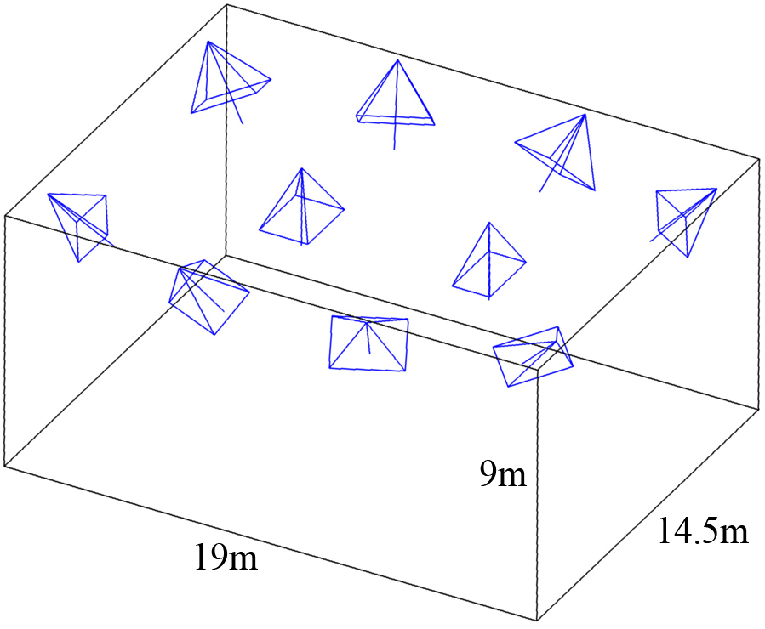
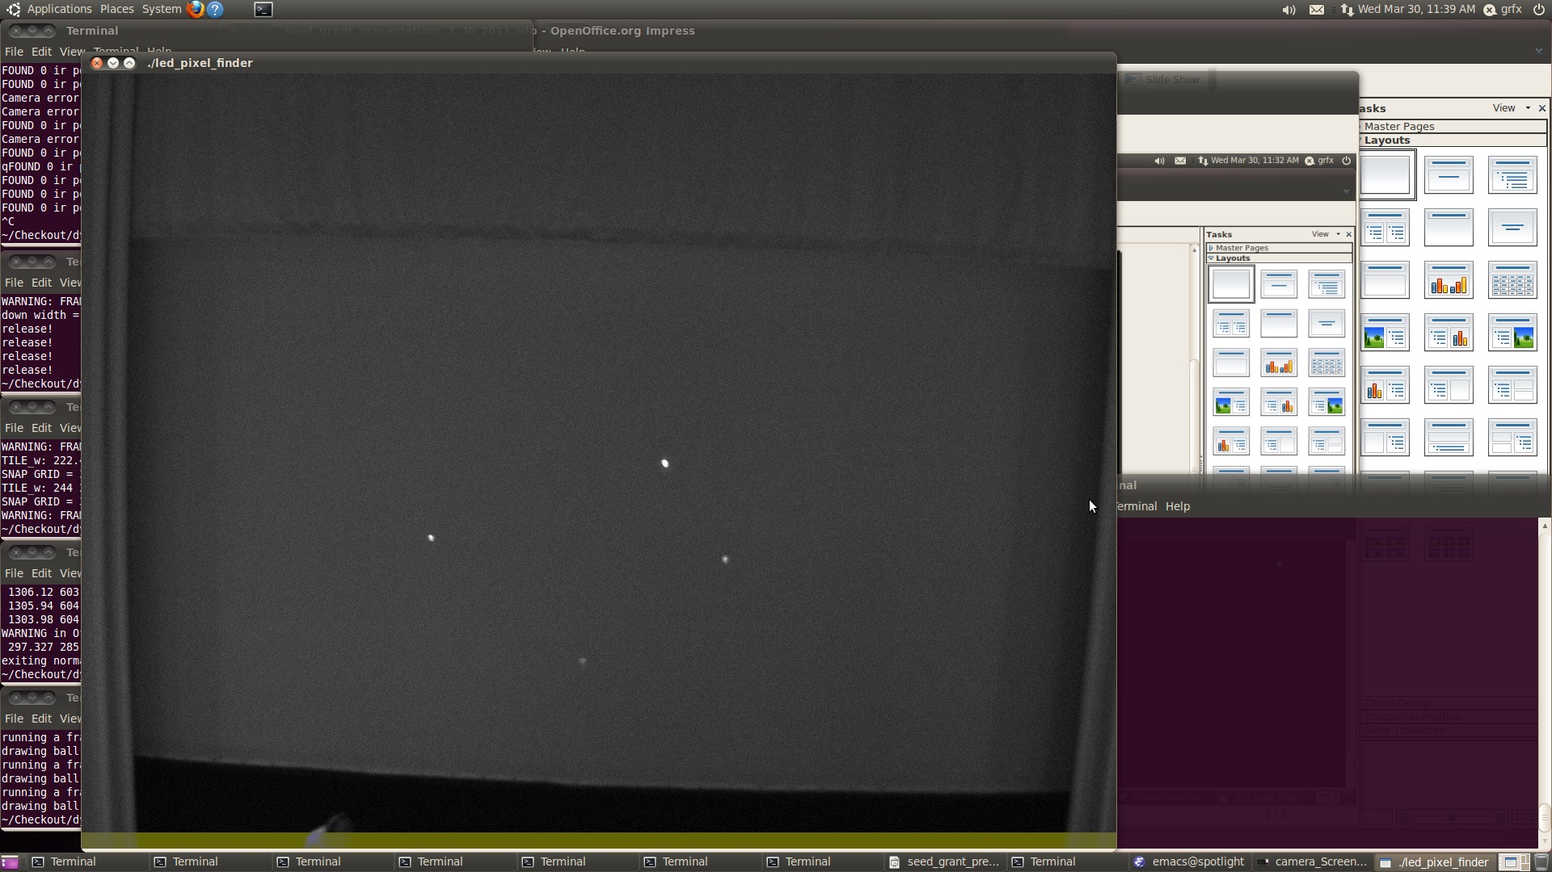
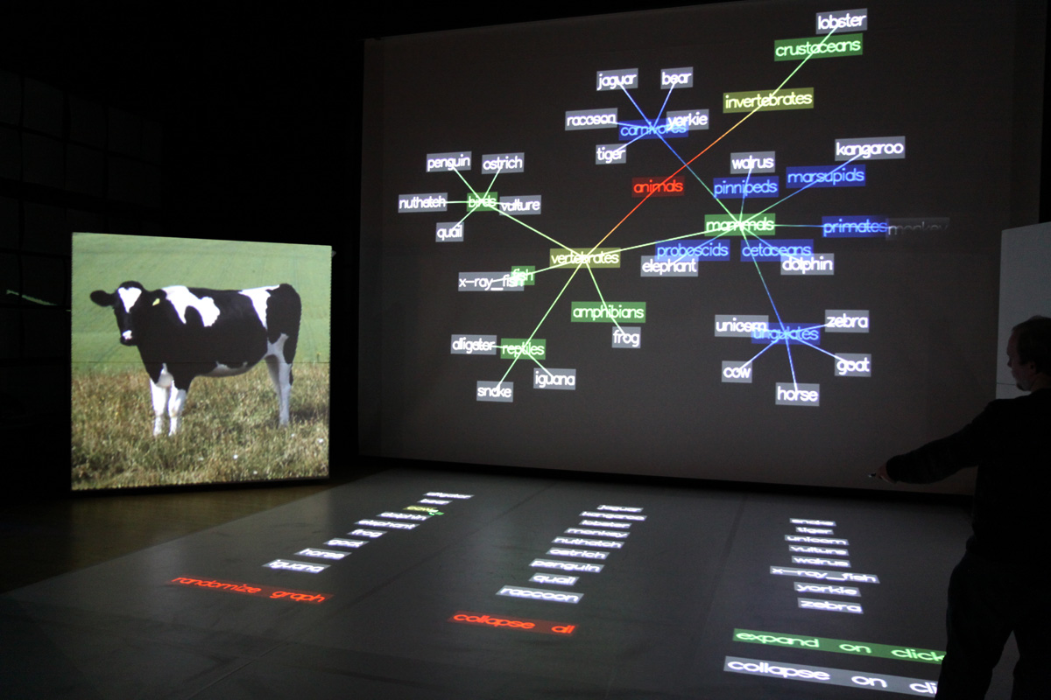
Systems Research Challenges
Detecting and tracking
queries from multiple users
Deploying in dynamic
multi-surface projection environments
Designing intuitive
multi-user interfaces
for visualization
and collaboration
Ensuring low latency
and robust operation
of the system

