Slide 1

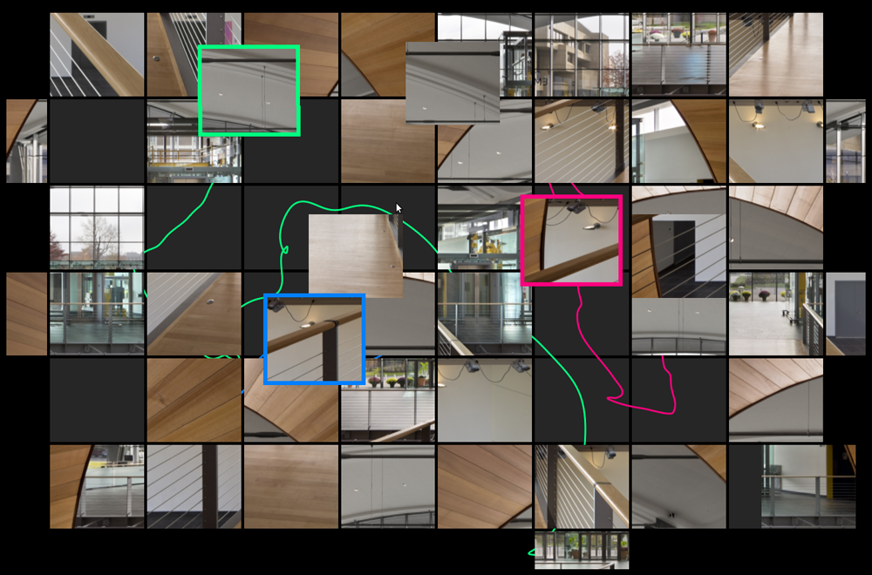
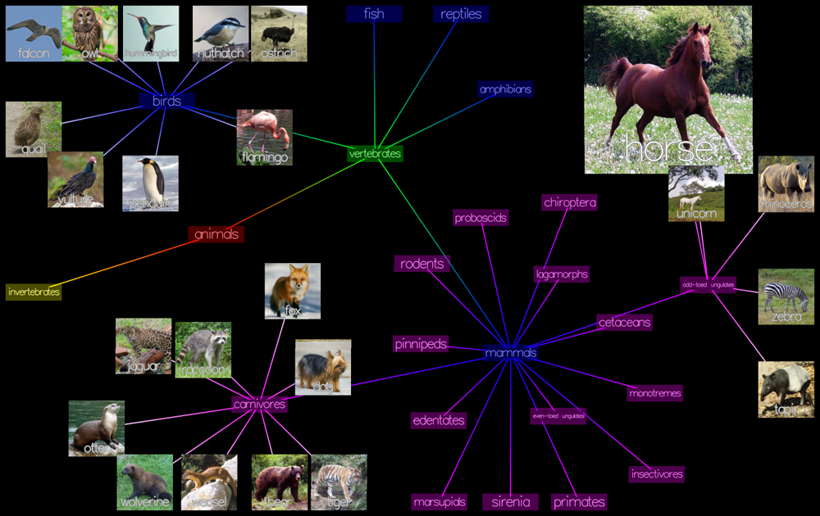
Immersive Data Visualization and Interaction in EMPAC
Barb Cutler, Andrew Dolce, Josh Nasman, Yu Sheng,
Ted Yapo, Eric Li, Eric Ameres, Mick Bello, & Eric Brucker
Department of Computer Science & EMPAC

Slide 2
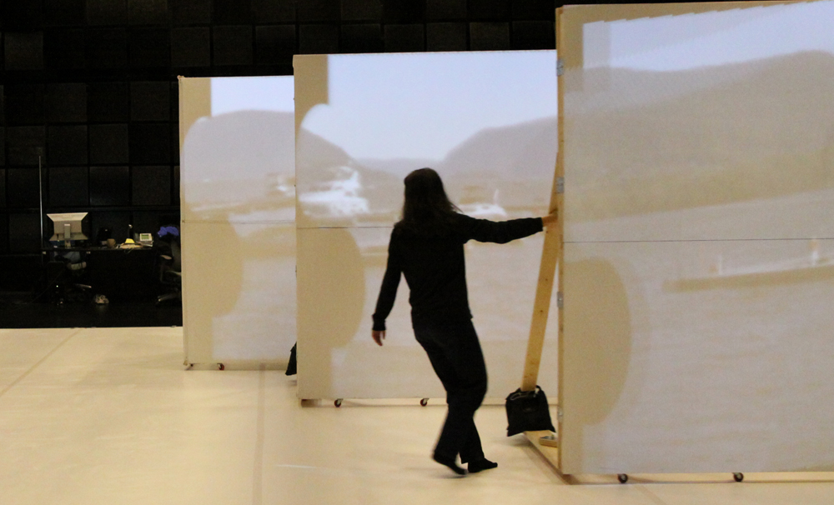
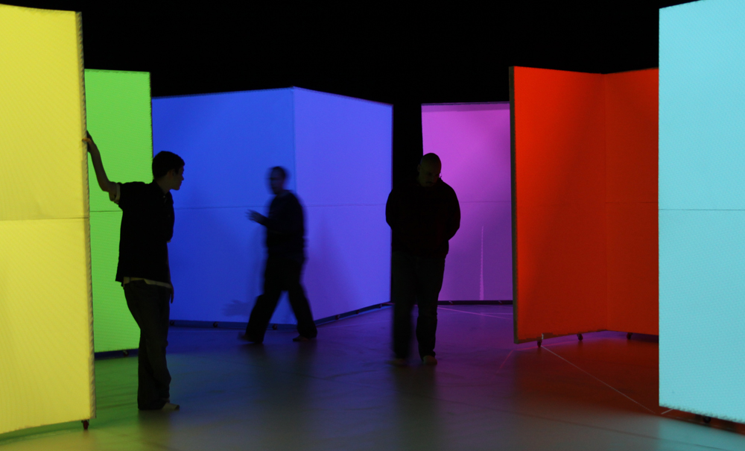
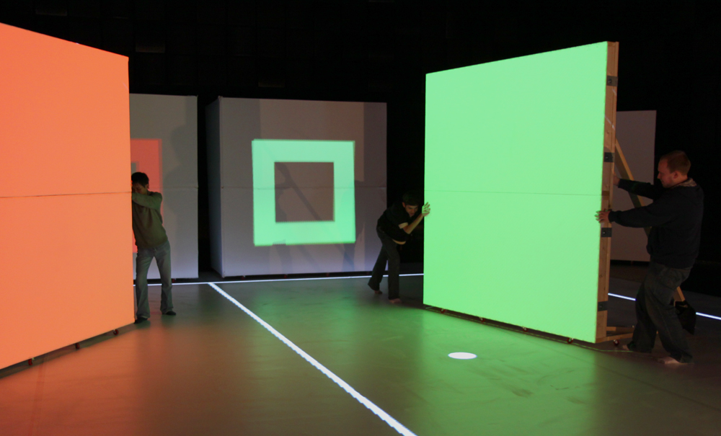
Our System Goals & Requirements
Spatially Augmented Reality
Large, human-scale
visualization environment
Multiple users view &
drive visualization
People move freely
within the space
Projection surfaces can
be moved interactively
Robust & real-time
tracking and display

Slide 3
“Dynamic Projection Surfaces for Immersive Visualization”,
Theodore C. Yapo, Yu Sheng, Joshua Nasman, Andrew Dolce, Eric Li, and Barbara Cutler,
PROCAMS 2010 IEEE International Workshop on Projector-Camera Systems, June 2010.

Slide 4
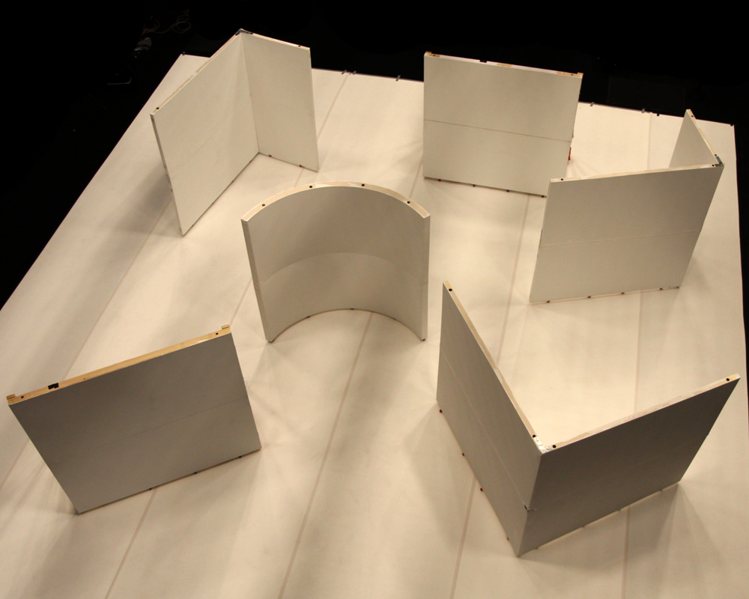
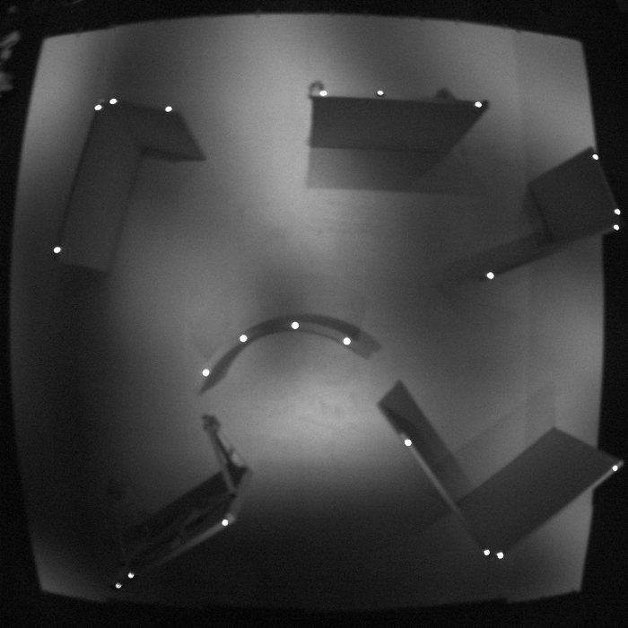
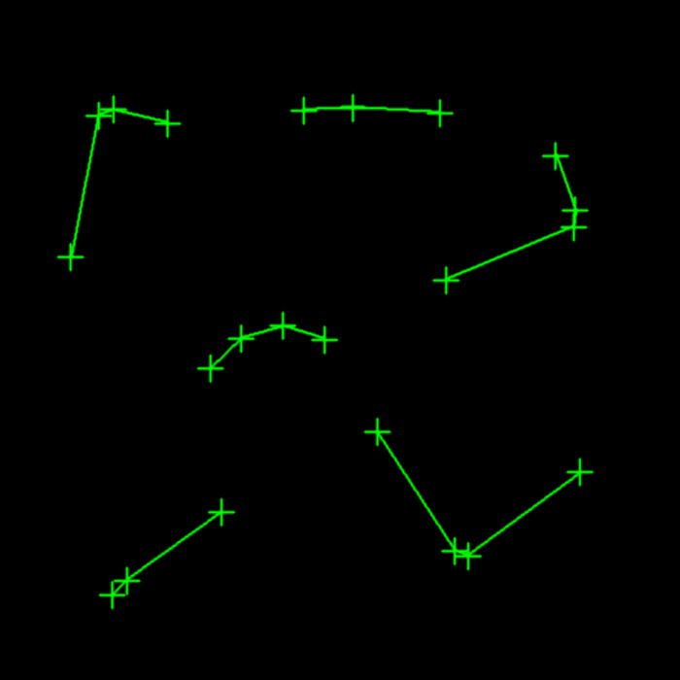
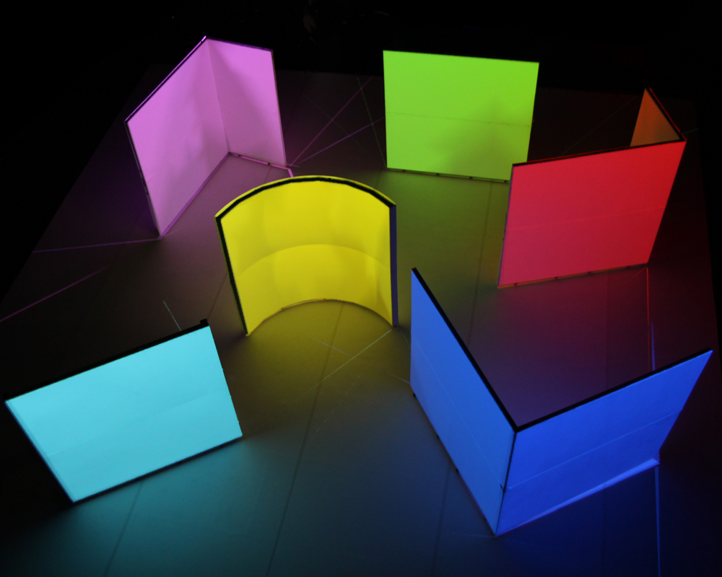
Full room lighting
Infrared camera image
Detected surfaces
Projection-applied “paint”

Slide 5
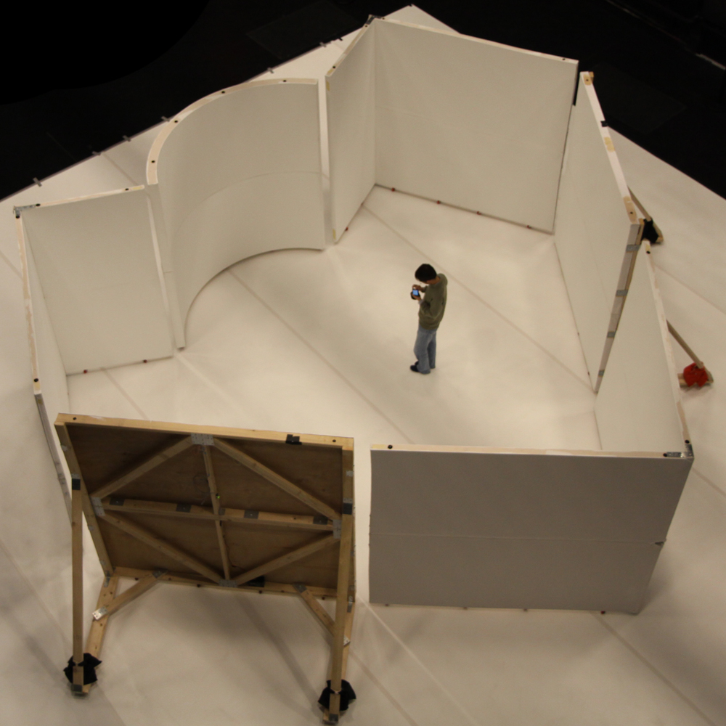
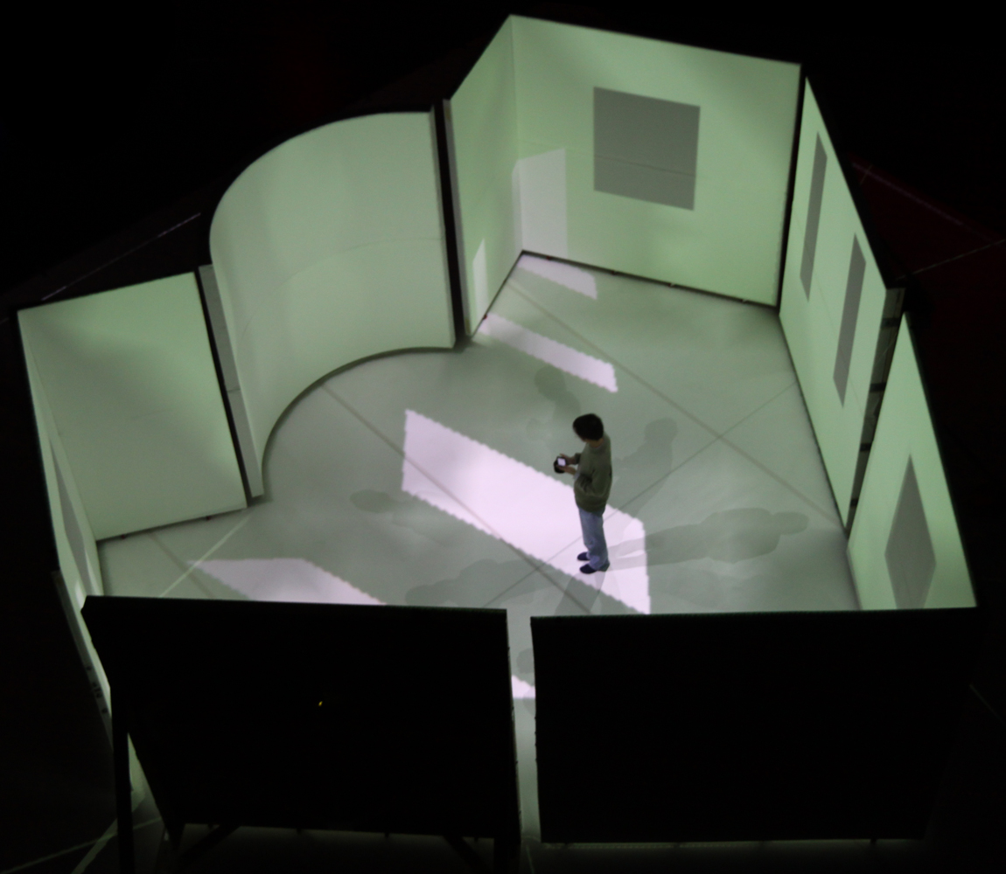
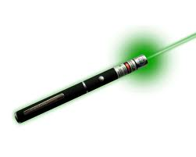
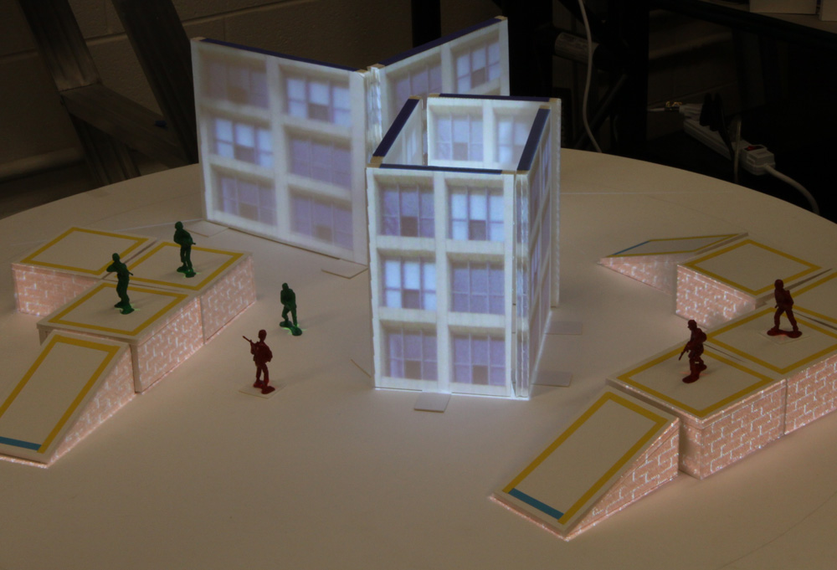
Applications
Education
& Training
Collaborative
design
environments
Data
exploration
and discovery
Entertainment

Slide 6
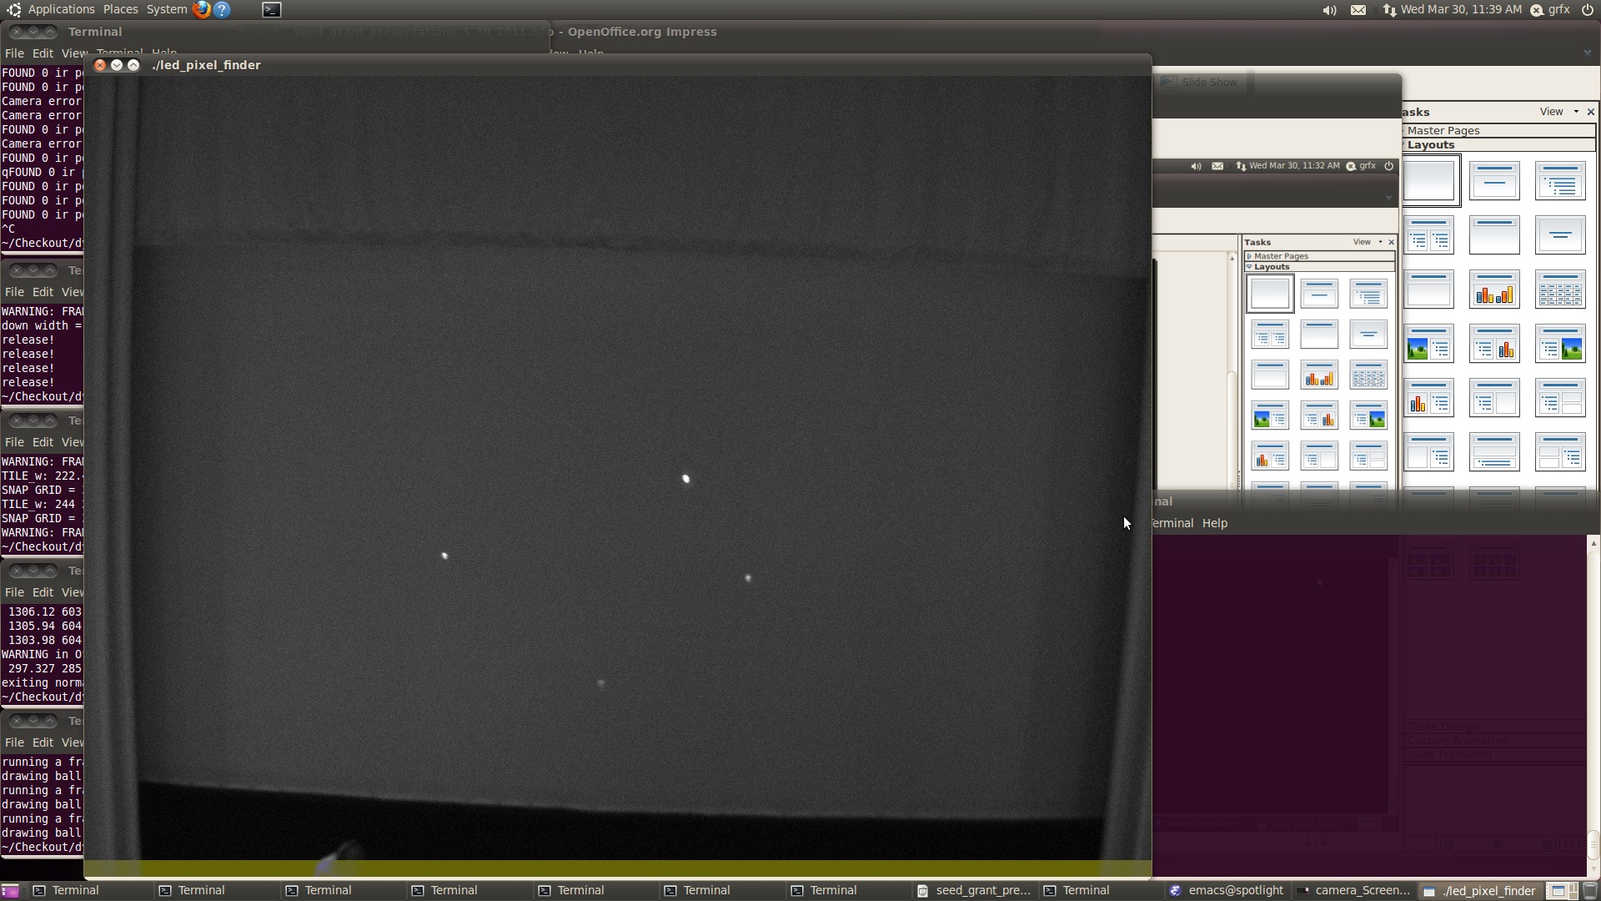
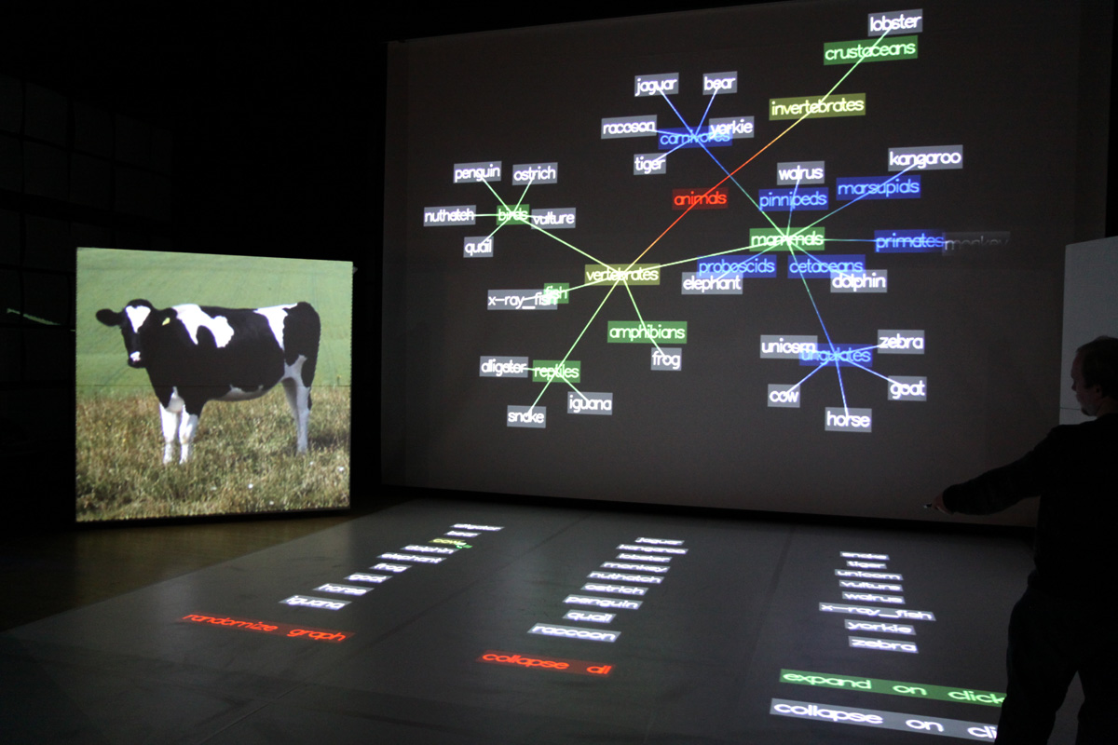
System Research Challenges
Detecting and consistently tracking queries from
multiple users
Deploying in both planar
and multi-surface projection
environments with
changing geometry
Designing intuitive multi-user
interfaces for visualization
and collaboration that require
minimal instruction to operate
Ensuring low latency
and robust operation
of the system

