Slide 1

ZIMBABWE NATIONAL GEOSPATIAL AND SPACE AGENCY
In Partnership with: Ministry of Transport & Infrastructural Development
Department of Roads
ROAD CONDITION SURVEY SYSTEM
TRAINING PRESENTATION
Mobile Application & Web Dashboard
Field Telemetry System v2.0 | Survey Year 2026 | Highways: A1 - A2 - A3 - A4 - A5
July 2026
INTERNAL USE ONLY - Zimbabwe National Geospatial and Space Agency (ZINGSA)

Slide 2
TRAINING AGENDA
What we will cover in today's session
1
System Overview - Purpose, architecture, and what the system does
2
Mobile App - Installation, navigation, and creating surveys
3
Asset Categories - 18 types of road assets you will survey
4
Survey Workflow - Step-by-step field data collection
5
GPS Capture & Photo Attachment - Best practices
6
Offline Mode - Saving drafts and managing the queue
7
Data Synchronisation - Uploading to the central server
8
Web Dashboard - Map, analytics, database, and export
9
Best Practices & Q&A
Zimbabwe National Geospatial and Space Agency (ZINGSA) | Roads Condition Survey System | v1.0 | July 2026

Slide 3
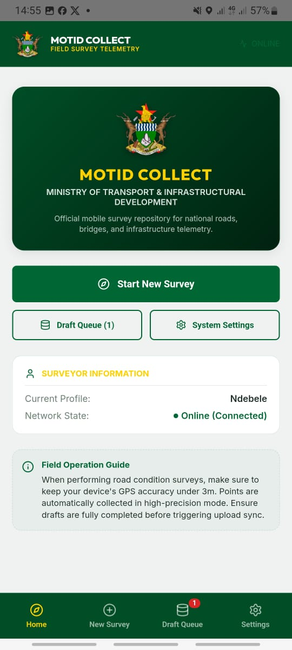
SYSTEM OVERVIEW
What is the Road Condition Survey System?
ZINGSA, in partnership with MOTID, has deployed the Road Condition Survey System - a national field telemetry platform for capturing, storing, and analysing road infrastructure condition data.
▶ Covers 18 types of road assets: roads, bridges, drainage, traffic assets, and amenities
▶ Field surveyors use an Android mobile app - works fully OFFLINE in remote areas
▶ Data syncs to a central server and visualised on an interactive web dashboard map
▶ Highways surveyed: A1, A2, A3, A4, A5 and provincial roads throughout Zimbabwe
▶ Integrated with Central Database for robust data management
GOAL: Build a comprehensive, up-to-date inventory of road asset conditions to support maintenance planning, budget allocation, and infrastructure reporting.
Zimbabwe National Geospatial and Space Agency (ZINGSA) | Roads Condition Survey System | v1.0 | July 2026

Slide 4
SYSTEM ARCHITECTURE
How the three components work together
MOBILE APP (Android)
BACKEND API (Python)
WEB DASHBOARD (Next.js)
==>
==>
Collect data offline GPS + photo capture Draft queue management Batch sync to server
Receive submissions Cache Central Database data REST API services Swagger docs
Interactive map view Analytics modules Data export tools Live data refresh
Zimbabwe National Geospatial and Space Agency (ZINGSA) | Roads Condition Survey System | v1.0 | July 2026

Slide 5
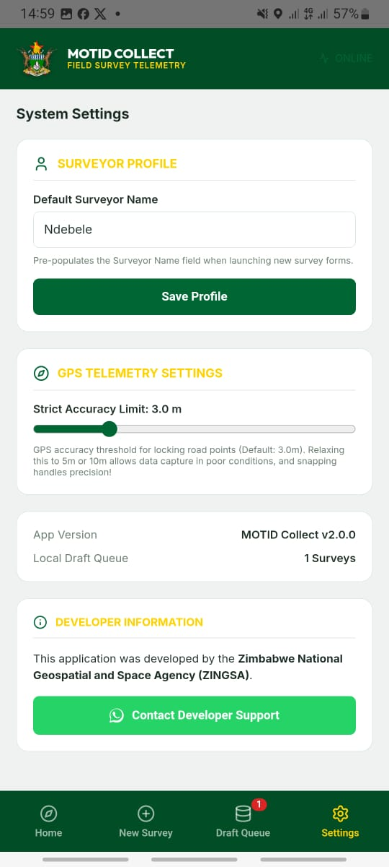
MOBILE APP - INSTALLATION
Getting the app onto your Android device
Obtain the APK File
STEP 1
Get roads.apk from your supervisor - no internet required
Enable Unknown Sources
STEP 2
Settings > Security > Enable 'Install from Unknown Sources'
Install the APK
STEP 3
Open the APK file using your file manager app and tap Install
Grant Permissions
STEP 4
Allow Camera, GPS/Location, and Storage when prompted
First Launch & Setup
STEP 5
Open settings tab, enter Surveyor Name and Server URL
Zimbabwe National Geospatial and Space Agency (ZINGSA) | Roads Condition Survey System | v1.0 | July 2026

Slide 6
MOBILE APP - NAVIGATION
Understanding the four main tabs
HOME
NEW SURVEY
QUEUE
SETTINGS
Welcome screen System status indicator Online / Offline badge Quick start guide
18 asset categories Colour-coded grid Tap to open survey form Auto-fills surveyor name
Drafts (editable locally) Queued (ready to sync) Sync All button Upload progress bar
Server URL Default surveyor name GPS accuracy limit Test Connection button
Zimbabwe National Geospatial and Space Agency (ZINGSA) | Roads Condition Survey System | v1.0 | July 2026

Slide 7
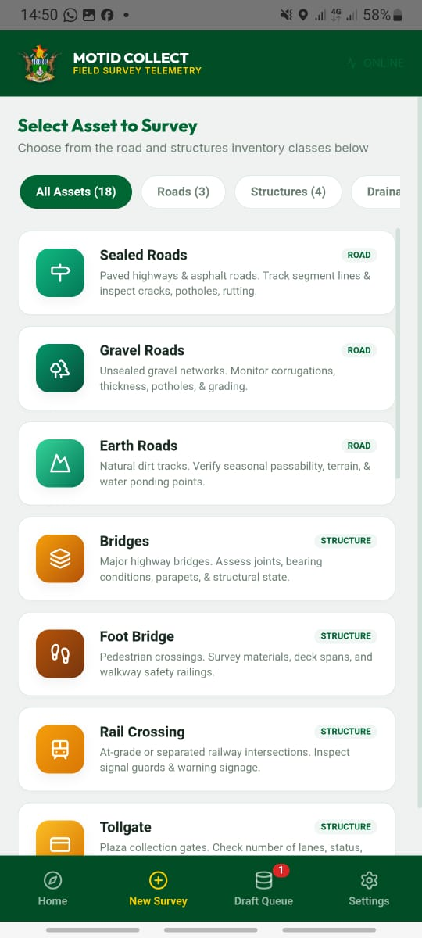
ASSET CATEGORIES
18 road asset types across 5 groups
ROADS
STRUCTURES
AMENITIES
DRAINAGE
TRAFFIC
Sealed Roads
Bridges
Lay-bys
Shelvets
Traffic Lights
Gravel Roads
Footbridges
Bus Stops
Culverts
Streetlights
Earth Roads
Rail Crossings
Junctions
Piped Causeways
Tollgates
Road Signs
Drifts
Grids
Zimbabwe National Geospatial and Space Agency (ZINGSA) | Roads Condition Survey System | v1.0 | July 2026

Slide 8
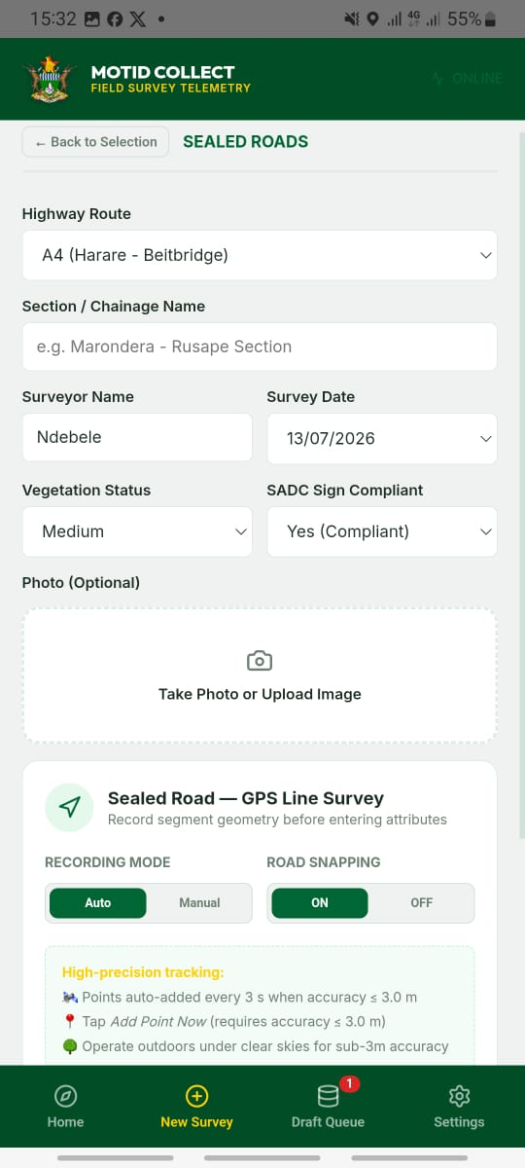
SURVEY WORKFLOW - ROADS
Key fields when surveying sealed & gravel roads
Field
What to Assess
Condition Options
Narrow Cracks
Hairline crack coverage of road surface
No Cracks / <5% / 5-15% / >15%
Wide Cracks
Alligator/wide crack coverage
No Cracks / <5% / 5-15% / >15%
Potholes/Patches
Pothole density & patching quality
Good / Fair / Poor / Very Poor
Rutting
Wheel track deformation depth
None / <5mm / 5-20mm / >20mm
Edge Breaks
Pavement edge deterioration
None / <50mm / 50-100mm / >100mm
Riding Quality
Overall vehicle ride experience
Good / Fair / Poor / Very Poor
Passability
When is the road passable?
All Year / Wet Restricted / Dry Only
Zimbabwe National Geospatial and Space Agency (ZINGSA) | Roads Condition Survey System | v1.0 | July 2026

Slide 9
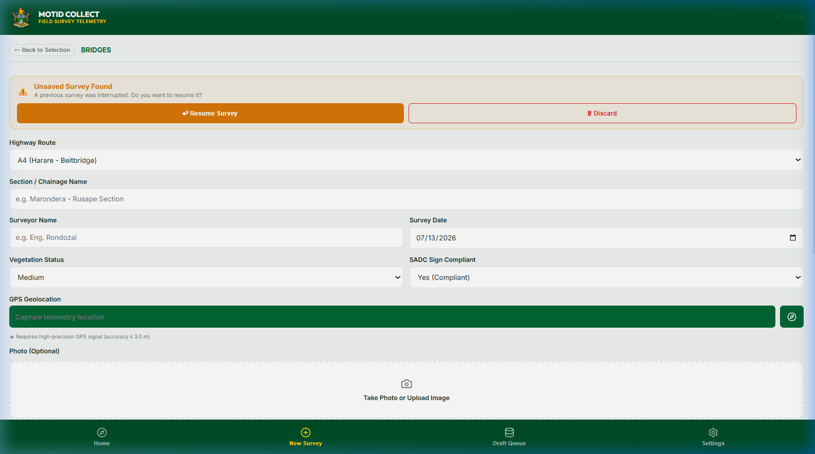
SURVEY WORKFLOW - BRIDGES
Assessing bridges, footbridges, rail crossings & tollgates
Structural Element
What to Inspect
Typical Conditions
Expansion Joints
Gaps between deck sections for movement
Good / Fair / Poor / Absent
Bearings
Load-transfer devices between deck & piers
Good / Fair / Poor / Failed
Parapets
Safety railings along bridge sides
Undamaged / Minor / Major / Missing
Chemical Effect
Rust, spalling, salt damage on structures
None / Minor / Severe
Vegetation Growth
Plants growing on the bridge structure
No / Minor / Severe
Drainage
Water runoff channels on bridge deck
Good / Blocked / Absent
Overall Condition
Holistic structural assessment
Good / Fair / Poor / Critical
Zimbabwe National Geospatial and Space Agency (ZINGSA) | Roads Condition Survey System | v1.0 | July 2026

Slide 10
SURVEY WORKFLOW - DRAINAGE
Culverts, shelvets, causeways, drifts, and grids
Asset
Key Fields
Common Issues to Note
Culverts
Class (pipe/box), material, serviceability
Blockage, siltation, cracked walls
Shelvets
Type (armco/masonry/concrete), condition
Cracking, siltation, displacement
Piped Causeways
Pipe material, pipe diameter, serviceability
Blocked pipes, scour at headwalls
Drifts
Surface material, passability, condition, width
Slab erosion, flood overflow marks
Grids
Material, operational status, condition
Broken bars, cleanout pit status
TIP: Always capture GPS coordinates precisely at the drainage structure opening - not at the road centreline. This ensures accurate map placement on the dashboard.
Zimbabwe National Geospatial and Space Agency (ZINGSA) | Roads Condition Survey System | v1.0 | July 2026

Slide 11
GPS COORDINATE CAPTURE
Capturing accurate location data in the field
1
App Warms Up GPS
The app starts warming up the GPS as soon as it launches - no action needed from you
2
Open the Form
Navigate to New Survey and open the form for your asset type
3
Tap 'Capture GPS'
The app shows real-time GPS accuracy in metres on screen
4
Wait for Lock
Stand still in an open area. Wait until accuracy is 3 metres or less
5
Coordinates Lock
Latitude & Longitude auto-populated. Green checkmark confirms successful lock
Zimbabwe National Geospatial and Space Agency (ZINGSA) | Roads Condition Survey System | v1.0 | July 2026

Slide 12
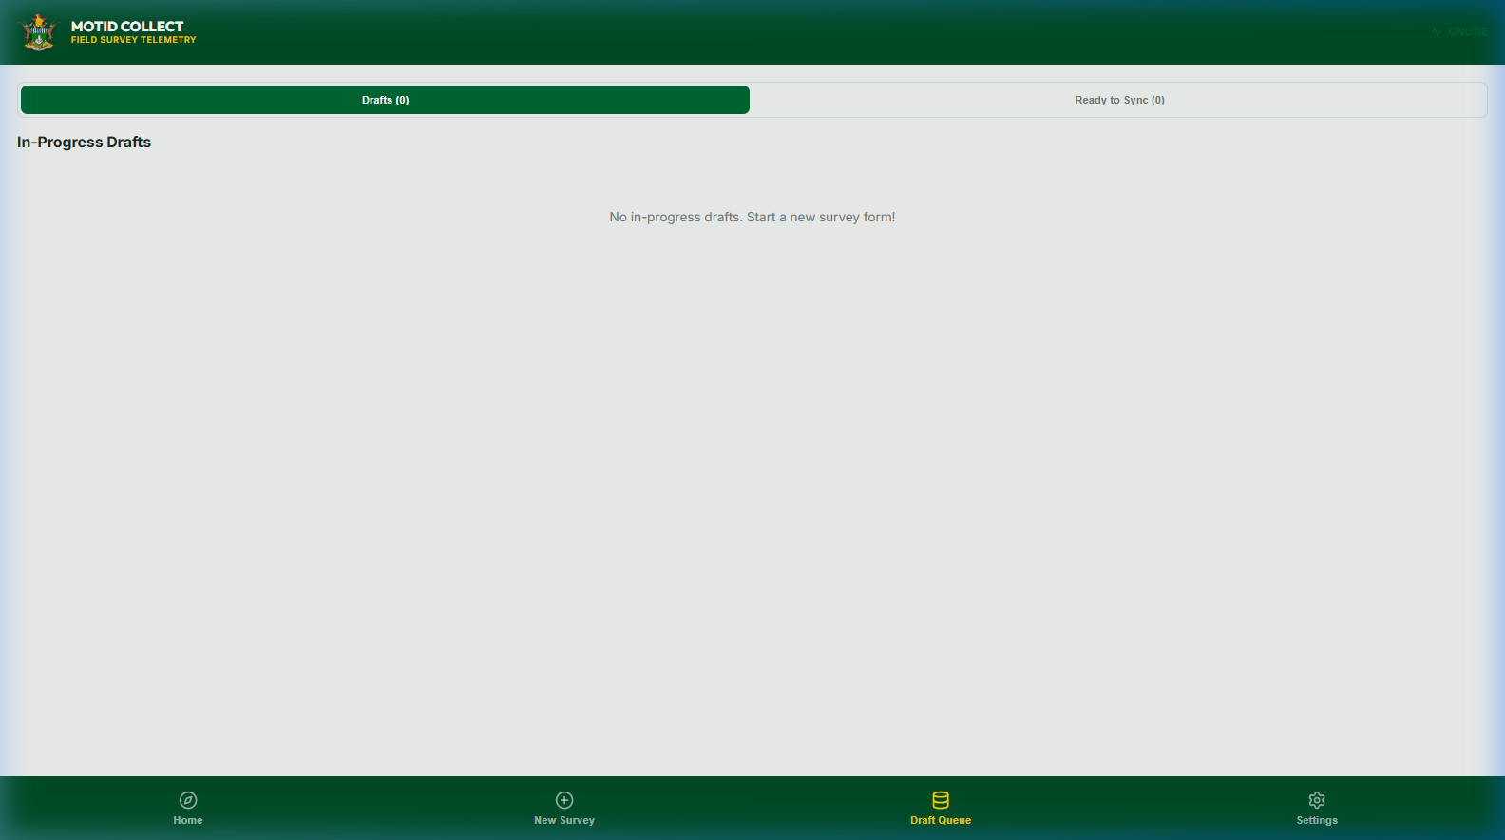
OFFLINE MODE & DRAFT QUEUE
Working in areas without internet connectivity
OFFLINE FEATURES
QUEUE STATUS TYPES
Meaning
Status
▶ All data stored on device - no internet needed
▶ Auto-save every 400ms while filling in form
▶ Crash recovery banner on relaunch
▶ GPS works independently of internet
▶ Works in remote rural areas without SIM
Draft
Saved locally - can still be edited
Queued
Ready for upload - awaiting connection
Synced
Successfully uploaded to server
WARNING: Do NOT close the app during an active sync. Wait for all records to show a green checkmark before exiting the app.
Zimbabwe National Geospatial and Space Agency (ZINGSA) | Roads Condition Survey System | v1.0 | July 2026

Slide 13
DATA SYNCHRONISATION
Uploading field data to the central server
CONNECT
Ensure your device has WiFi or mobile data (4G/3G)
OPEN QUEUE
Navigate to the Queue tab in the mobile app
REVIEW
Check all your surveys are in 'Queued' status (not Draft)
SYNC ALL
Tap the SYNC ALL button and wait for the progress indicator
CONFIRM
Each record shows a green checkmark when successfully uploaded
VERIFY
On the web dashboard, click Refresh Data to see new records on the map
Zimbabwe National Geospatial and Space Agency (ZINGSA) | Roads Condition Survey System | v1.0 | July 2026

Slide 14
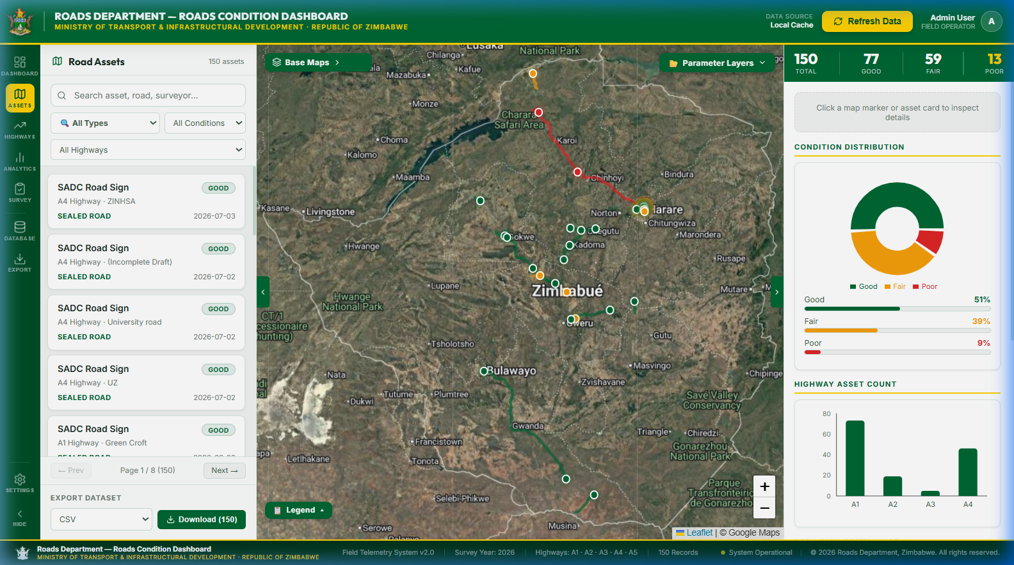
WEB DASHBOARD - OVERVIEW
The administrator's command centre
Accessed from any web browser. No installation required.
HEADER BAR
ZINGSA/Ministry branding, data source label, last sync time, Refresh Data button
LEFT NAV RAIL
Icon nav: Assets, Dashboard, Highways, Analytics, Survey, Database, Export, Settings
INNER PANEL
Collapsible left panel - asset list, road filter dropdown
MAP ZONE
Interactive Leaflet map with coloured asset markers - click to select a record
RIGHT PANEL
Collapsible right panel - selected record details, charts, condition summary
FOOTER BAR
System version, survey year, highway list, total record count
Zimbabwe National Geospatial and Space Agency (ZINGSA) | Roads Condition Survey System | v1.0 | July 2026

Slide 15
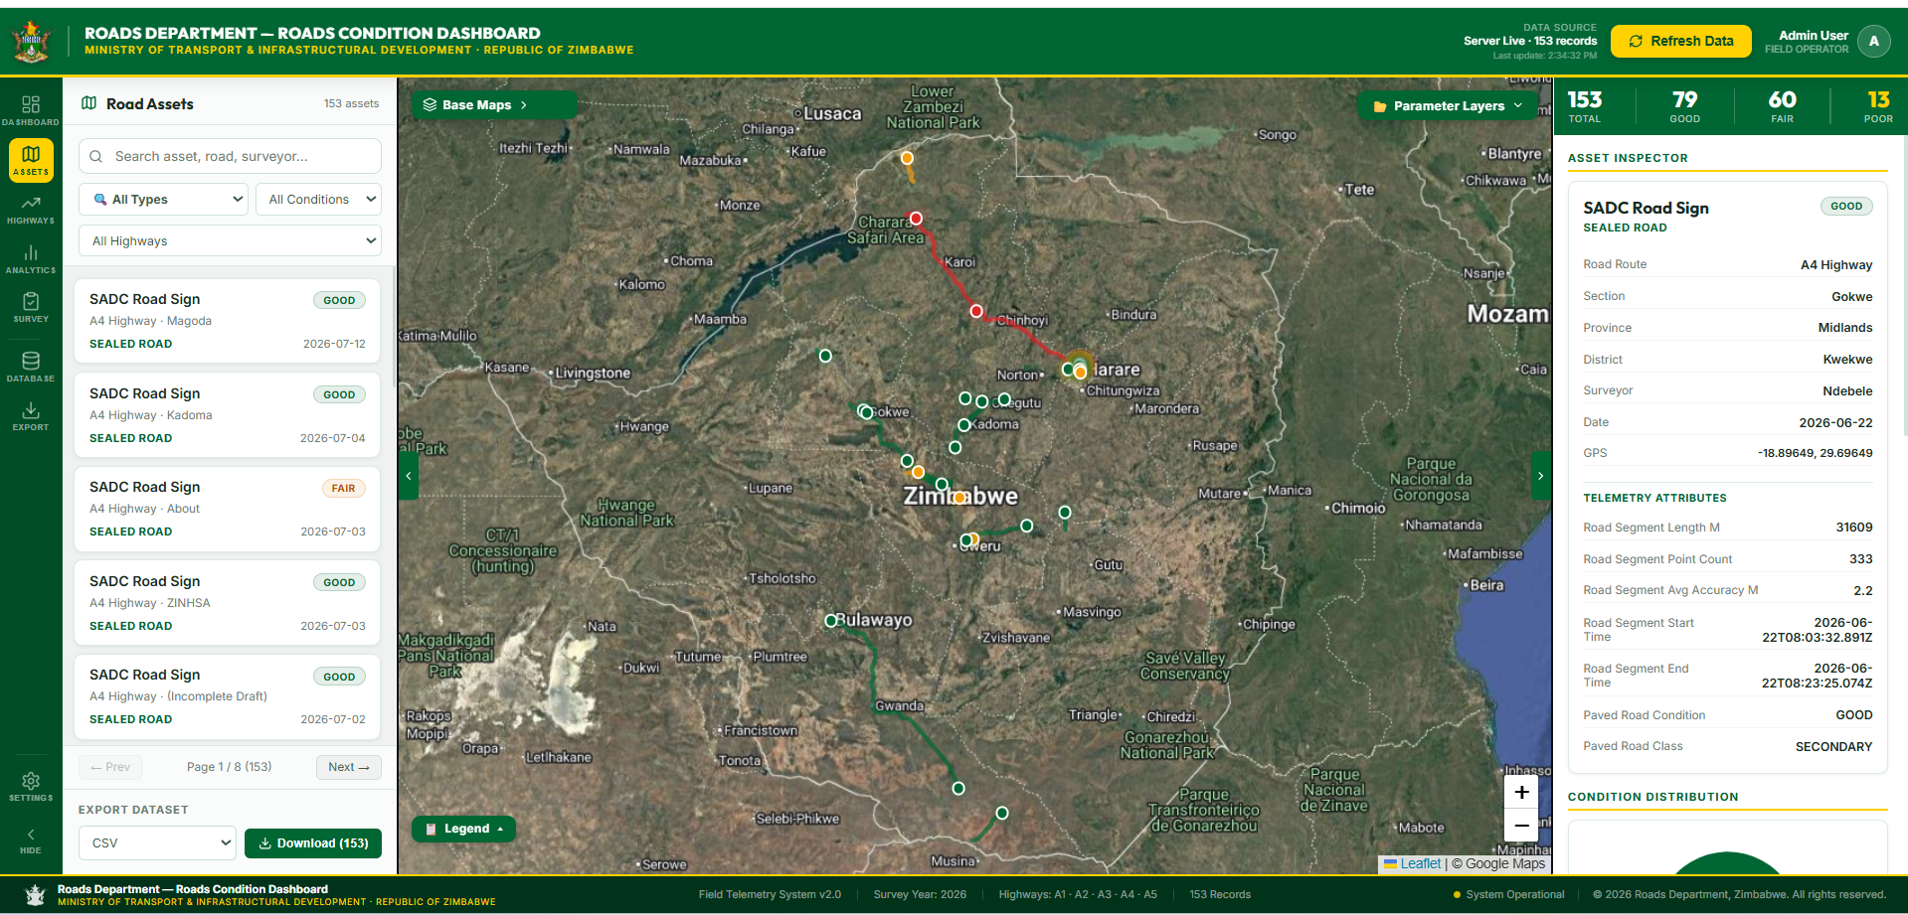
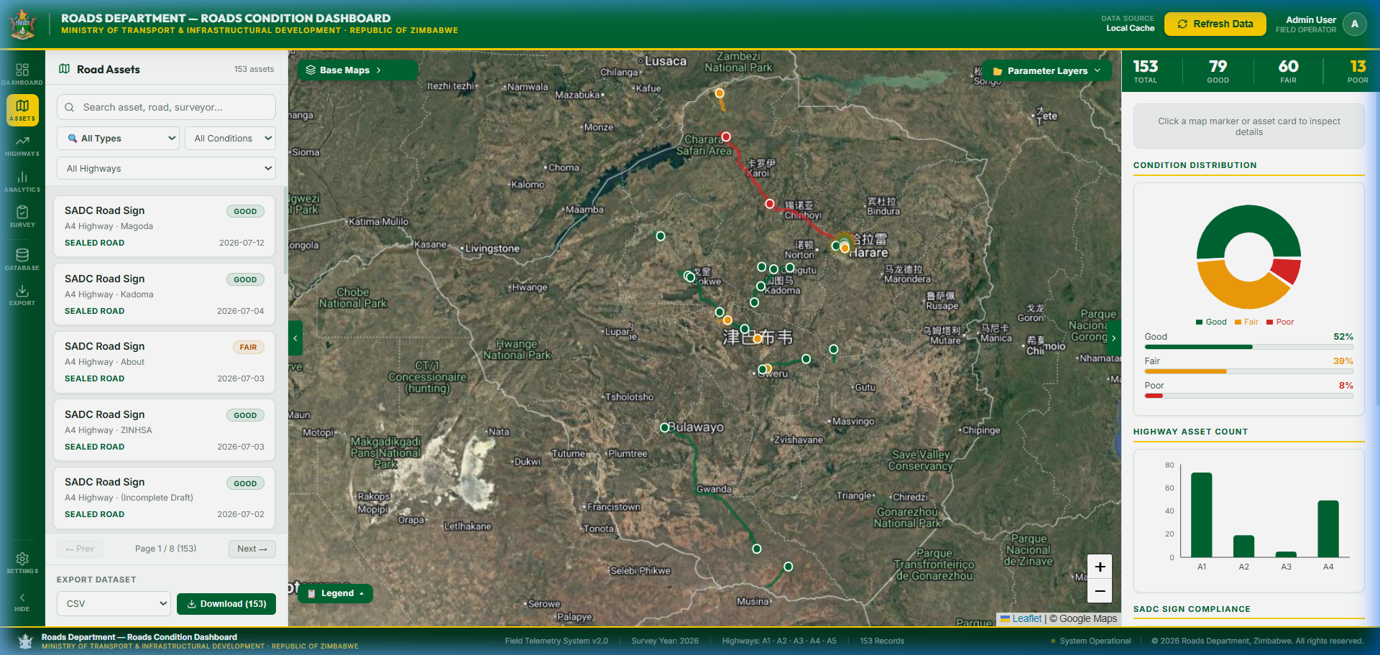
WEB DASHBOARD - MODULES
Six analysis modules for complete data visibility
DASHBOARD
HIGHWAYS
ANALYTICS
DATABASE
High-level KPI overview Total records by type Condition charts Highway coverage stats
Per-highway breakdown A1-A5 asset inventory Condition ratings Survey completion status
Advanced charts & graphs Defect frequency Riding quality Surveyor activity timeline
Raw data table Full field detail view Search & filter tools Drill-down per record
EXPORT
Download as CSV (Excel) JSON data export Formatted PDF report For briefings
SURVEY
Tabular record view Filter by type, road, date Inspect submissions Surveyor performance
Zimbabwe National Geospatial and Space Agency (ZINGSA) | Roads Condition Survey System | v1.0 | July 2026

Slide 16
DASHBOARD - DATA REFRESH
Understanding the two-phase data loading strategy
PHASE 1 - Instant Load
PHASE 2 - Server Fetch
Data Source Label
What It Means
▶ Locally cached data displayed immediately
▶ No spinner - dashboard usable instantly
▶ Source label shows: Local Cache
▶ Server data loads in background
▶ Merged with local records (no duplicates)
▶ Source label updates: Server Live
Local Cache
Loaded from browser local storage - no server contact yet
Server (Cached)
Backend's internal cache - not a live KoBoToolbox call
Server Live
Fresh data fetched directly from KoBoToolbox API
Offline Cache
Server unreachable - showing last known dataset
Zimbabwe National Geospatial and Space Agency (ZINGSA) | Roads Condition Survey System | v1.0 | July 2026

Slide 17
BEST PRACTICES
Tips for accurate and efficient surveys
MOBILE APP - FIELD TIPS
DASHBOARD - ADMIN TIPS
▶ Launch app before driving - GPS warms up en route
▶ Set your surveyor name in Settings once (pre-fills forms)
▶ Save a Draft before submitting as a local backup
▶ Charge device fully before heading to remote areas
▶ Take photos from 2-3m away to show full asset context
▶ Capture GPS while standing still at the asset
▶ Use the road name dropdown - never type free text
▶ Click Refresh Data after each field survey session
▶ Use Road Filter to focus on a specific highway
▶ Export CSV after each campaign for Excel archiving
▶ Map loads faster after first visit (cache is built)
▶ Use Analytics to identify high-defect road sections
▶ Check Database module to verify data quality
▶ Set OFFLINE_MODE=false in production for live data
Zimbabwe National Geospatial and Space Agency (ZINGSA) | Roads Condition Survey System | v1.0 | July 2026

Slide 18
TROUBLESHOOTING
Quick reference for common issues
Issue
Solution
Platform
GPS stuck at 'Waiting for signal'
Move to open area; Location must be ON in Android Settings
Mobile
App shows 'Offline' on WiFi
Check Server URL in Settings; tap Test Connection
Mobile
Sync fails - Network Error
Verify internet; check server is running; retry in 30s
Mobile
Lost draft after crash
Open any form - yellow recovery banner - tap Restore
Mobile
Dashboard map is empty
Click Refresh Data; verify backend is running
Dashboard
Data source shows 'Offline Cache'
Backend server down - contact ZINGSA ICT support
Dashboard
Duplicate records on map
Click Refresh Data - system auto-deduplicates
Dashboard
Export not downloading
Check browser download permissions; disable popup blocker
Dashboard
Zimbabwe National Geospatial and Space Agency (ZINGSA) | Roads Condition Survey System | v1.0 | July 2026

Slide 19
KEY TAKEAWAYS
1
The mobile app works FULLY OFFLINE - no internet needed to collect data in the field
2
Always warm up the GPS first and capture coordinates while standing still at the asset
3
Save a Draft before submitting - your data is always recoverable if the app crashes
4
Sync your queue when you have WiFi or 4G - batch upload is fast and reliable
5
The web dashboard shows ALL submitted records on an interactive map - click any marker for details
6
Use Analytics and Export modules to generate reports for management briefings
7
Contact ZINGSA ICT support if the server is unreachable - your local data is always safe
Zimbabwe National Geospatial and Space Agency (ZINGSA) | Roads Condition Survey System | v1.0 | July 2026

Slide 20
QUESTIONS & DISCUSSION
Thank you for attending this training session.
For technical support, contact the ZINGSA ICT Department.
ZIMBABWE NATIONAL GEOSPATIAL AND SPACE AGENCY (ZINGSA)
In Partnership with: Ministry of Transport & Infrastructural Development - Department of Roads
Road Condition Survey System | Field Telemetry System v2.0 | 2026
publicrelations@zingsa.ac.zw | www.zingsa.ac.zw

