Slide 1




From Zero to Query
Build, Secure & Deploy a Production-Ready GraphQL API in One Afternoon
Zeljko Kozina | JConf Dominicana 2026

Slide 2




ABOUT ME
Željko/ʒɛːʎko/Zhelyko/Zhellko/Jelhko
Your
photo
Java Developer | 15+ years in IT | GraphQL Ambassador
Day job
Consultant/contractor, mostly in financial sector.
Side quest
Maintain quite a few blogs and websites, mostly around APIs
Community
Speaker/blogger in the Java/JVM ecosystem.
DubJug member. GraphQL Ammbasador, GraphQL AI Working Group member

Slide 3
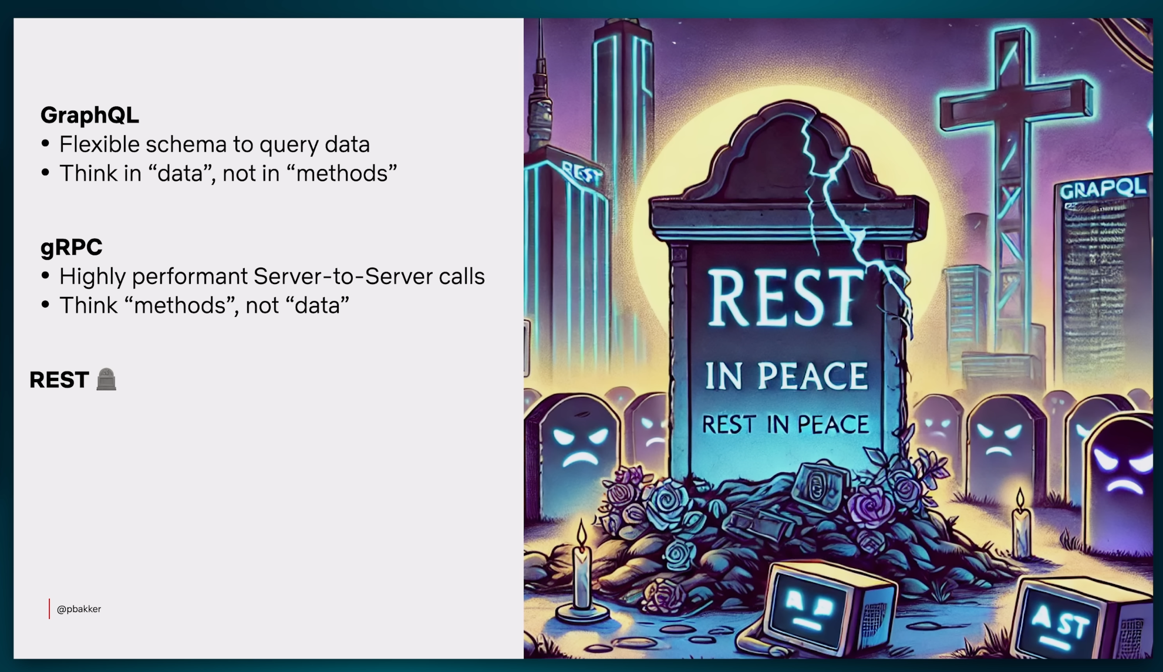

Slide 4
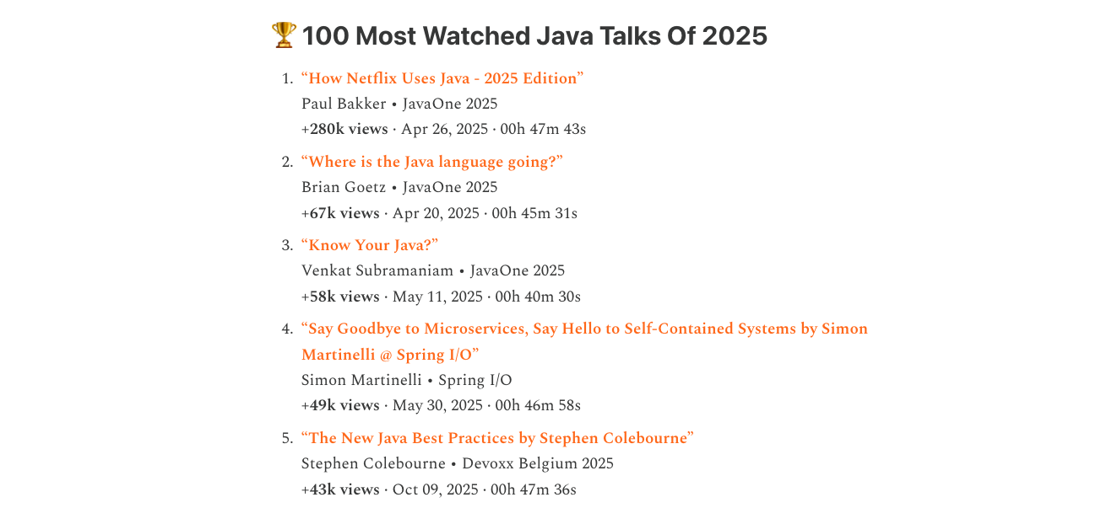

Slide 5
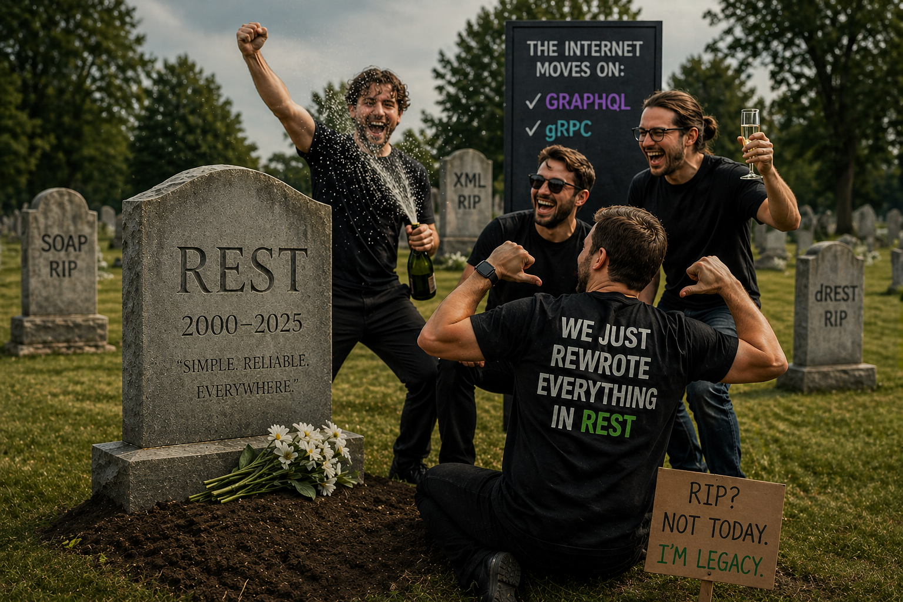

Slide 6


What Are We Actually Solving?
?
Data
Users

Slide 7
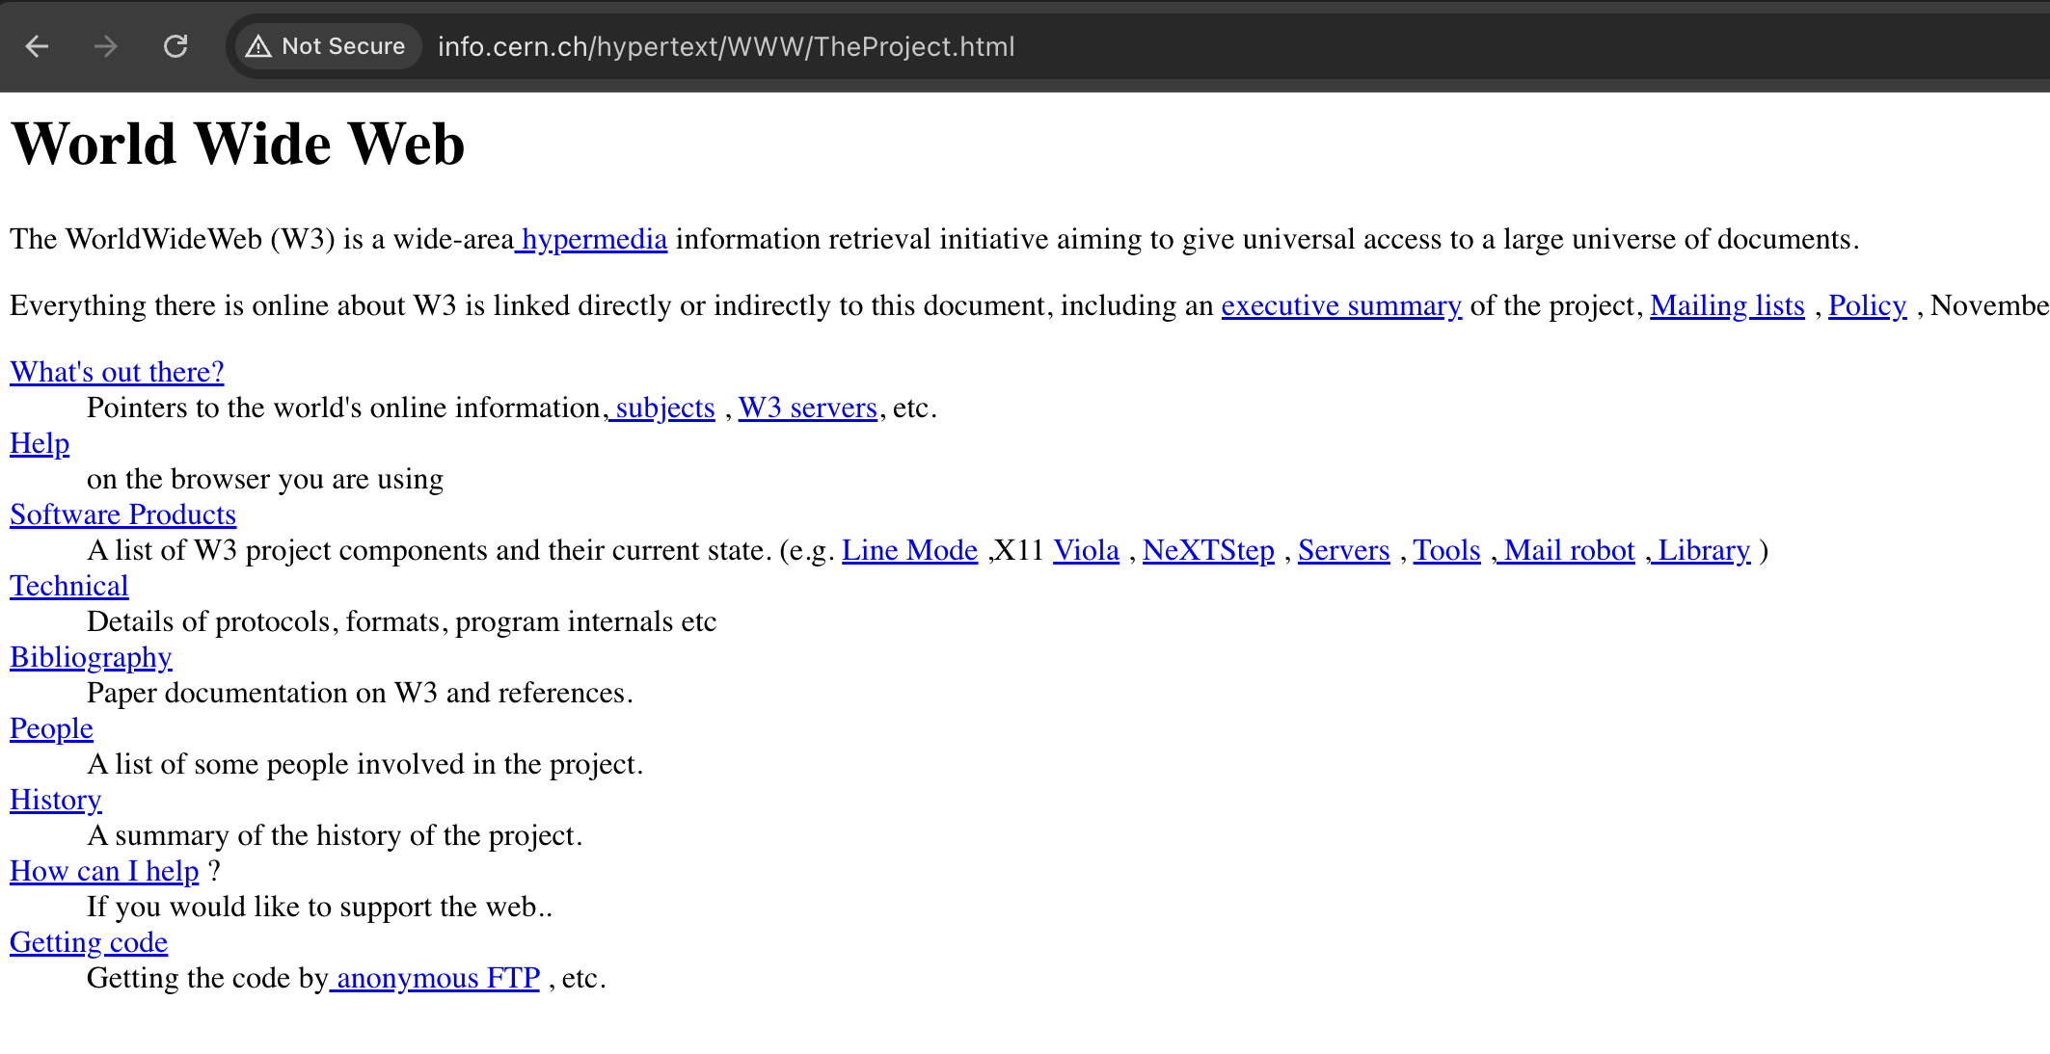

Slide 8




Static Pages - Server Rendered Era
Browser
Server (JSP)
Full HTML Page
Request page
Query DB + render HTML
Complete re-render
Every interaction = full page reload. The server did everything. Simple, but limiting.

Slide 9
Data is the new Oil
The Separation
REST Calls Per Page Load
HTML/CSS/JS handles presentation
REST APIs handle data
AJAX enables partial page updates
More APIs, more endpoints, more calls per page.
Notes:
REST 2000- Fielding
AJAX - 2005

Slide 10
The Search for Solutions
Microsoft
2007
IETF / Community
2013
Many teams
N/A
OData
JSON:API
BFF Pattern
Standardized query language for REST.
Filtering, pagination, expansion.
Spec for building JSON APIs with
sparse fieldsets and compound docs.
Dedicated API layer per client type.
Works, but doubles maintenance.
Ad-hoc / Custom
N/A
Netflix
2013
Facebook
2012
?expand & ?fields
Falcor
GraphQL
Custom query params to include
relations and filter fields. DIY GraphQL.
JSON Graph protocol. Single virtual
JSON resource. Later replaced by GraphQL.
Client-driven queries. Ask for exactly
what you need. One endpoint.
Notes:
Azure Services: Services like Azure DevOps Analytics and Azure Table Storage continue to offer OData-based endpoints for querying data
OData (Open Data Protocol) is very much still in use, particularly in large-scale enterprise environments and modern Microsoft-based ecosystems. While it is no longer the "trendy" choice for new consumer-facing web apps
SAP Ecosystem: SAP is "all-in" on OData. I
2008 — OpenAPI (REST, public)
▎ 2012 - API.NEXT (experience-driven endpoints)
▎ 2015 - Falcor (graph protocol)
▎ 2017 - Graph Monolith (single GraphQL server)
▎ 2019 - Federated GraphQL (
The Backend for Frontend (BFF) pattern was popularized by Sam Newman and engineers at SoundCloud around 2013-2015. While Sam Newman widely documented the pattern, it originated from efforts by developers like Phil Calçado at SoundCloud to solve API complexity issues for multiple frontends

Slide 11
Graph Query
Language
A query language for your APIs.

Slide 12
The REST Way
What REST actually returns vs what you need
GET /api/users/42
{ "id": 42,
"name": "Jane Smith",
"email": "jane@company.io",
"passwordHash": "bcrypt$2b...",
"role": "ADMIN", "salary": 95000,
"ssn": "XXX-XX-1234",
"address": { ... },
"preferences": { ... },
"createdAt": "...", "updatedAt": "..." }
GET /api/users/42/orders
[{ "id": 101,
"total": 49.99,
"status": "SHIPPED",
"paymentMethod": "visa_4242",
"trackingNumber": ..., ... }]
You needed: id, total
4 requests. 4 round trips.
~5% of the data actually used.
You needed: name, email (2 of 15+ fields)
All you wanted: "Jane Smith, jane@company.io, 2 orders totaling $128.98"

Slide 13
GraphQL Core Idea
You tell the server what you need. The response mirrors the request.
Request
Response
query {
user(id: 42) {
name
email
orders {
id
total
}
}
}
{
"user": {
"name": "Jane",
"email": "jane@co",
"orders": [{
"id": 101,
"total": 49.99
}]
}
}

Slide 14
GraphQL Goes Open Source
2012
Created internally at Facebook
Built in Hack (their PHP variant) for the mobile apps
2015
Open-sourced with a specification
Reference implementation: graphql-js (JavaScript)
2019
GraphQL Foundation formed
Under the Linux Foundation. No longer a "Facebook thing"
Today
Industry standard
Used by GitHub, Shopify, Airbnb, Yelp, and Netflix

Slide 15
GraphQL is a Specification
Just like Java: a specification with many implementations
GraphQL
Java
Specification
Specification
GraphQL Spec (spec.graphql.org)
JLS (Java Language Specification)
Reference implementation
Reference implementation
graphql-js (JavaScript)
OpenJDK
Other implementations
Other implementations
graphql-java, Apollo Server, Sangria (Scala), Hot Chocolate (.NET)...
GraalVM, Eclipse Temurin, Amazon Corretto, Azul Zulu...

Slide 16
GraphQL on the JVM
The community moved fast. Spring took a little longer.
2015
2021
2022
graphql-java
Netflix DGS
Spring for GraphQL 1.0
Released the same year as the spec. The JVM's GraphQL engine. Still the foundation of everything.
Netflix open-sources their annotation-driven framework, battle-tested at Netflix scale.
The official Spring integration goes GA. Spring was late, but did it right.
2024: Netflix announces DGS will converge with Spring for GraphQL. Two frameworks become one.

Slide 17
Spring for GraphQL Architecture
Server Transports
HTTP (Spring MVC / WebFlux)
WebSocket
RSocket
Spring Boot
Spring GraphQL
GraphQL Java Engine
Data Fetchers: @QueryMapping @SchemaMapping @BatchMapping
Data Sources: Database | Cache | External API | Microservice

Slide 18
It All Starts with a Schema
Written in Schema Definition Language (SDL)
type Query {
books: [Book!]!
bookById(id: ID!): Book
}
type Book {
id: ID!
title: String!
pageCount: Int
author: Author!
}
type Author {
id: ID!
name: String!
books: [Book!]!
}
Contract
The schema IS the API contract between client and server.
Type safety
Every field has a type. Errors caught at validation, not runtime.
Documentation
Self-documenting. GraphiQL builds an API explorer from it.
Introspection
Clients query the schema itself to discover operations.

Slide 19
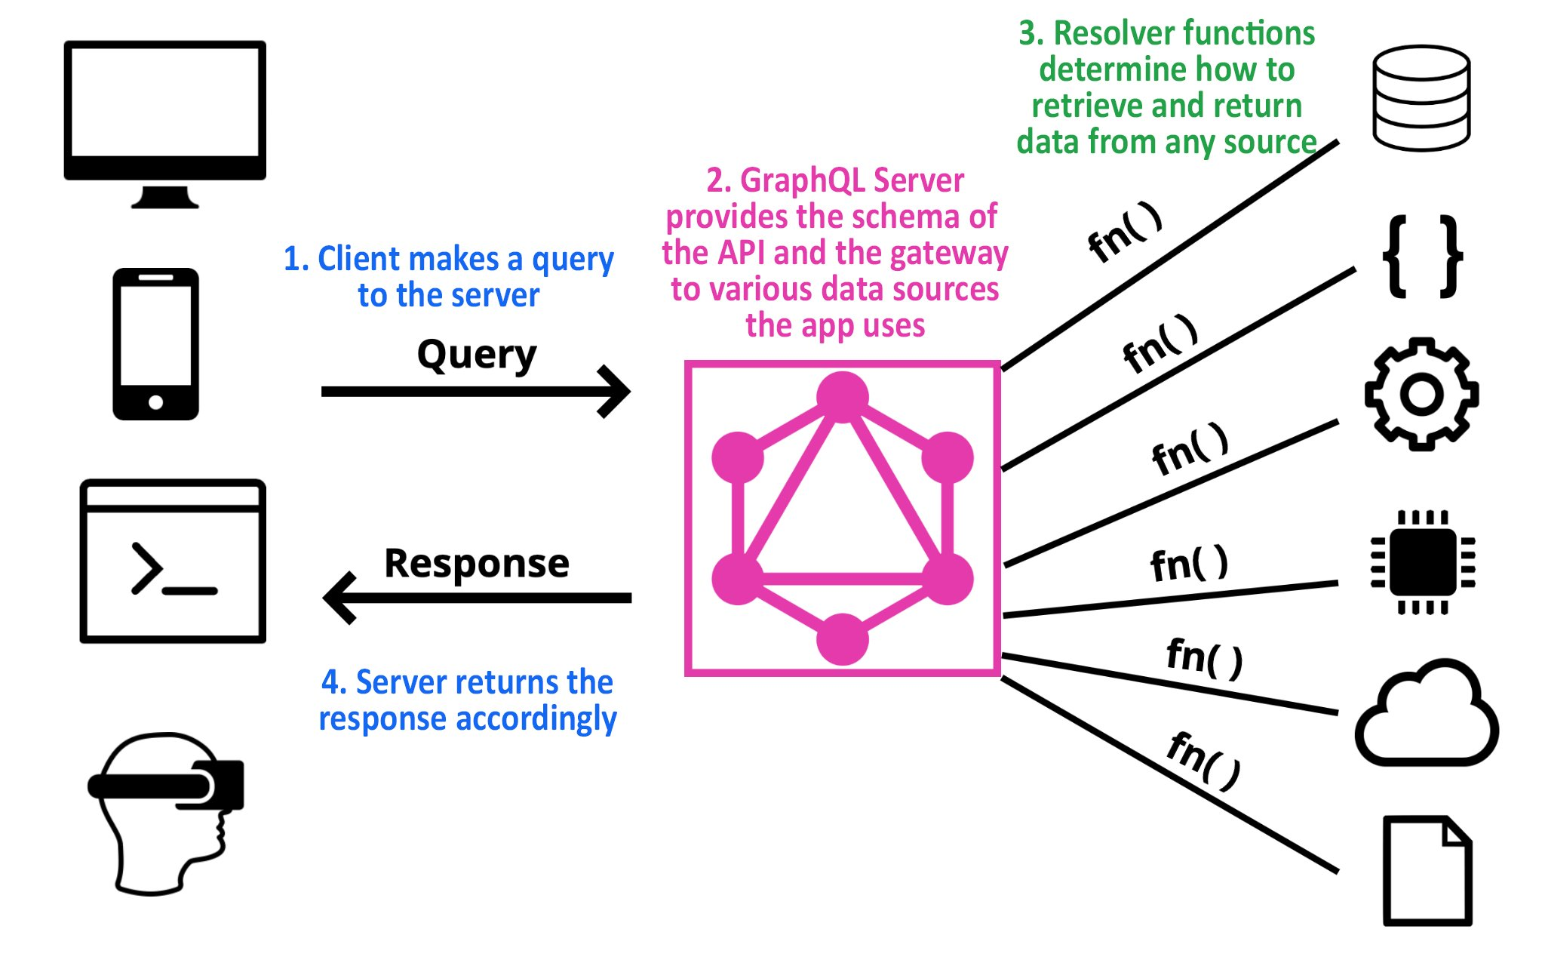

Slide 20
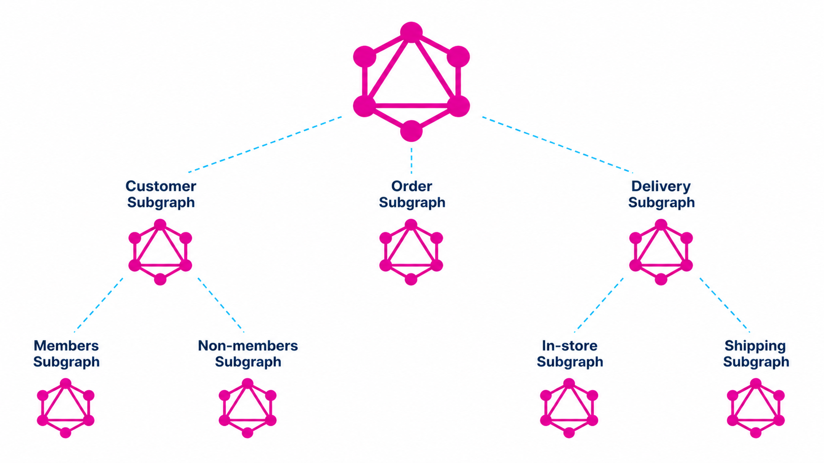
GraphQL Federation
One graph, many teams
This is what Netflix does. Each team owns its subgraph; the gateway composes one unified API.

Slide 21


INSERT FUNNY IMAGE: Demo gods, please be kind!
(Live demo starts here)
Slide 16 of 23

Slide 22
Questions?

Slide 23
THE WORKSHOP
What We'll Build: MovieDB
A movie and TV database with people, reviews, watch lists, and search
Spring Boot scaffolding is already in place: JPA entities, seed data, services, React frontend
The GraphQL API is what we add, live, class by class
Ten classes, each building on the last: from first query to subscriptions
Tech stack: Spring Boot 4 / Spring for GraphQL, Java 21, H2, React + Vite

Slide 24
SETUP
Get the Code
github.com/graphqlguy/graphql-jconfDominicana
main branch = the starting point (no GraphQL code yet, on purpose)
checkpoint_N branches = code at the end of each class, catch up any time
completed branch = the finished application
Backend: ./mvnw spring-boot:run, then GraphiQL at localhost:8080/graphiql
Frontend: cd frontend, npm install, npm run dev, then localhost:5173
Seed users: admin / admin123 (ADMIN) and user / user123 (USER)

Slide 25
CLASS 1 / 10
Your First GraphQL Service
As a product owner, I want visitors to browse our film catalogue: filtered, sorted, and paginated.
By the end of this class, you will have:
A running GraphQL endpoint with an interactive playground (GraphiQL)
Schema-first development: the schema is the contract, Java implements it
Queries with arguments, default values, and input types
Evolving an API without breaking clients, using @deprecated

Slide 26
CLASS 1 · CONCEPT
Queries: asking for exactly what you need
REST
GraphQL
GET /movies?genre=ACTION
// fixed response shape
// every field, every time
// new need = new endpoint
query {
movies(genre: ACTION) {
title
releaseYear
}
}
One endpoint. Arguments in the query. The client chooses the fields.

Slide 27
CLASS 2 / 10
Relationships & Nested Resolution
As the product owner, I want every film connected to its directors and cast, and people connected back to their work.
By the end of this class, you will have:
Entity relationships as nested fields in the schema
Default field resolution vs your first @SchemaMapping resolver
Reproduce the N+1 problem, then eliminate it with @BatchMapping
Junction types: relationships that carry data of their own

Slide 28
CLASS 2 · CONCEPT
Nested resolution & the N+1 problem
Without @BatchMapping
With @BatchMapping
query { movies { directors } }
1 query for movies
+ 1 directors query per movie (N)
Total: 1 + N queries
movies collected first, then...
1 query for movies
1 batched query for all directors
Total: 2 queries
Same schema. Same query. One annotation.

Slide 29
CLASS 3 / 10
Mutations
As the product owner, I want my team to add, correct, and remove titles themselves.
By the end of this class, you will have:
The Mutation root type and @MutationMapping resolvers
Response types that report success and failure as data
Input types for create and update, including partial updates
"Field omitted" vs "explicitly null" with ArgumentValue

Slide 30
CLASS 3 · CONCEPT
Mutations: one concept replaces four verbs
POST /movies
createMovie(input: ...)
PUT / PATCH /movies/42
updateMovie(id: 42, input: ...)
DELETE /movies/42
deleteMovie(id: 42)
Everything still travels through POST /graphql
Top-level mutation fields run sequentially, in the order written
The response is data you choose, not a status code

Slide 31
CLASS 4 / 10
Security
As the product owner, I want the platform open for browsing but locked for editing.
By the end of this class, you will have:
Spring Security's secure-by-default behavior
A SecurityFilterChain that permits exactly what the API needs
A login mutation that issues JWT tokens
Role-based authorization on sensitive mutations

Slide 32
CLASS 4 · CONCEPT
Security without URLs
Client
(JWT in header)
SecurityFilterChain
(authenticate)
Resolver
(role checks)
Data
One endpoint: no /admin/* URL rules to hide behind
JWT in the Authorization header: stateless authentication
Authorization happens at the resolver, per operation or per field

Slide 33
CLASS 5 / 10
Error Handling
As the product owner, I want the API to fail with clear, specific answers.
By the end of this class, you will have:
GraphQL vs REST failure: HTTP 200, the errors array, partial responses
Map domain exceptions to meaningful errors with a single handler
Classifications and structured extensions
Errors-as-data with typed enums

Slide 34
CLASS 5 · CONCEPT
Errors: no status codes, an errors array
HTTP 200 OK
{
"data": {
"movie": { "title": "Alien" },
"person": null
},
"errors": [{
"message": "Person 99999 not found",
"path": ["person"],
"extensions": { "classification": "NOT_FOUND" }
}]
}
Almost always HTTP 200
data and errors coexist: partial responses
extensions carry structured, machine-readable detail

Slide 35
CLASS 6 / 10
Input Validation
As the product owner, I want every input checked against published rules.
By the end of this class, you will have:
Three validation layers: schema directives, Bean Validation, service layer
Declarative constraints with schema directives
Rules visible through introspection, enforced before any resolver runs

Slide 36
CLASS 6 · CONCEPT
Validation: three layers
Schema directives: Shape: length, range, format. In the contract, visible via introspection, checked before any resolver runs.
input CreateMovieInput {
title: String!
@Size(min:1, max:200)
releaseYear: Int!
@Range(min:1888)
}
Bean Validation (@Valid): The same field-level constraints, on the Java records instead of the schema.
Service layer: Business rules that need database state or span multiple fields.
A graduated defense: reject malformed input early and cheaply, keep domain rules in the service.

Slide 37
CLASS 7 / 10
Search & Unions
As the product owner, I want one search box that finds films and people alike.
By the end of this class, you will have:
Typed search queries backed by the existing services
Union types: one field, several distinct result types
Inline fragments for per-type field selection

Slide 38
CLASS 7 · CONCEPT
Union types: one field, several types
union SearchResult = Movie | Person
type Query {
search(text: String!): [SearchResult!]!
}
query {
search(text: "alien") {
... on Movie { title releaseYear }
... on Person { name }
}
}
Use a union when the result types share no fields. The client picks per type with inline fragments.

Slide 39
CLASS 8 / 10
Custom Scalars & External APIs
As the product owner, I want the catalogue enriched beyond our own data.
By the end of this class, you will have:
Custom scalars from the extended-scalars library (DateTime, URL, CountryCode)
Calling an external GraphQL API from a resolver with HttpSyncGraphQlClient
Caching external results and failing gracefully

Slide 40
CLASS 8 · CONCEPT
Custom scalars: types beyond String
Built-in scalars
Extended scalars (library)
Int, Float, String, Boolean, ID
DateTime, Date, URL,
EmailAddress, CountryCode, Currency
That is ALL the specification guarantees.
The schema states what a value IS,
parsed and validated in one place.
scalar CountryCode country: CountryCode

Slide 41
CLASS 9 / 10
TV Shows, Interfaces & Watch List
As the product owner, I want TV shows in the catalogue and personal watch lists on top.
By the end of this class, you will have:
Interfaces: the fields a Movie and a TvShow have in common
When an interface beats a union
@oneOf input types: an argument that is exactly one of several things
A per-user, authenticated feature built on both

Slide 42
CLASS 9 · CONCEPT
Interfaces (and @oneOf inputs)
interface Title {
id: ID!
title: String!
releaseYear: Int
}
type Movie implements Title { ... }
type TvShow implements Title { ... }
input SubjectInput @oneOf {
movieId: ID
tvShowId: ID
}
# exactly one field must be set
Interface: shared fields guaranteed. Union: nothing shared. @oneOf: exactly one of these.

Slide 43
CLASS 10 / 10
Reviews, Authorization & Subscriptions
As the product owner, I want visitors to rate and review titles and see new reviews arrive live.
By the end of this class, you will have:
Object-level (ownership) and field-level authorization
The DateTime scalar in practice
Real-time updates over WebSocket with GraphQL subscriptions

Slide 44
CLASS 10 · CONCEPT
Subscriptions: the server calls you
subscription {
reviewAdded {
rating
comment
author { username }
}
}
Client
WebSocket
Server
events pushed as they happen, no polling
The third root type, next to Query and Mutation
A long-lived connection over WebSocket

Slide 45
Thank you
https://www.linkedin.com/in/zkozina

