Slide 1
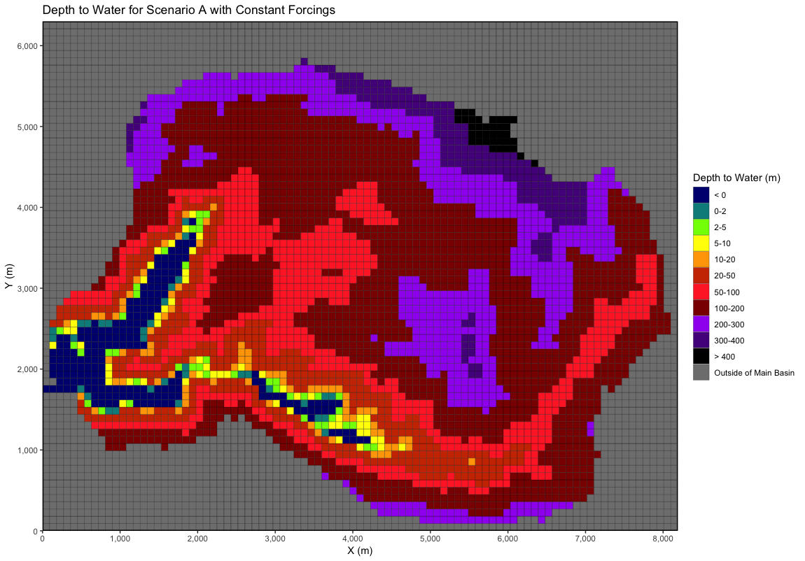
Scenario A after CLM spinup (A_v2)

Slide 2
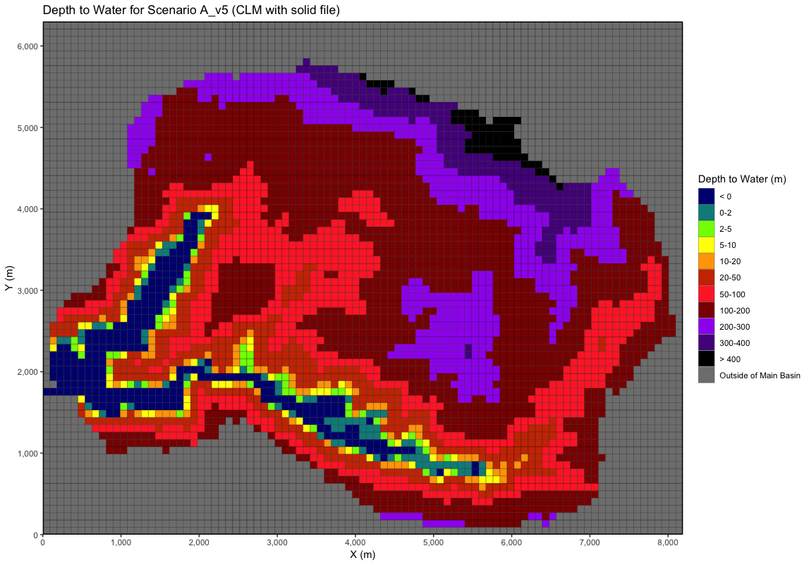
Scenario A after CLM spinup (A_v5)

Slide 3
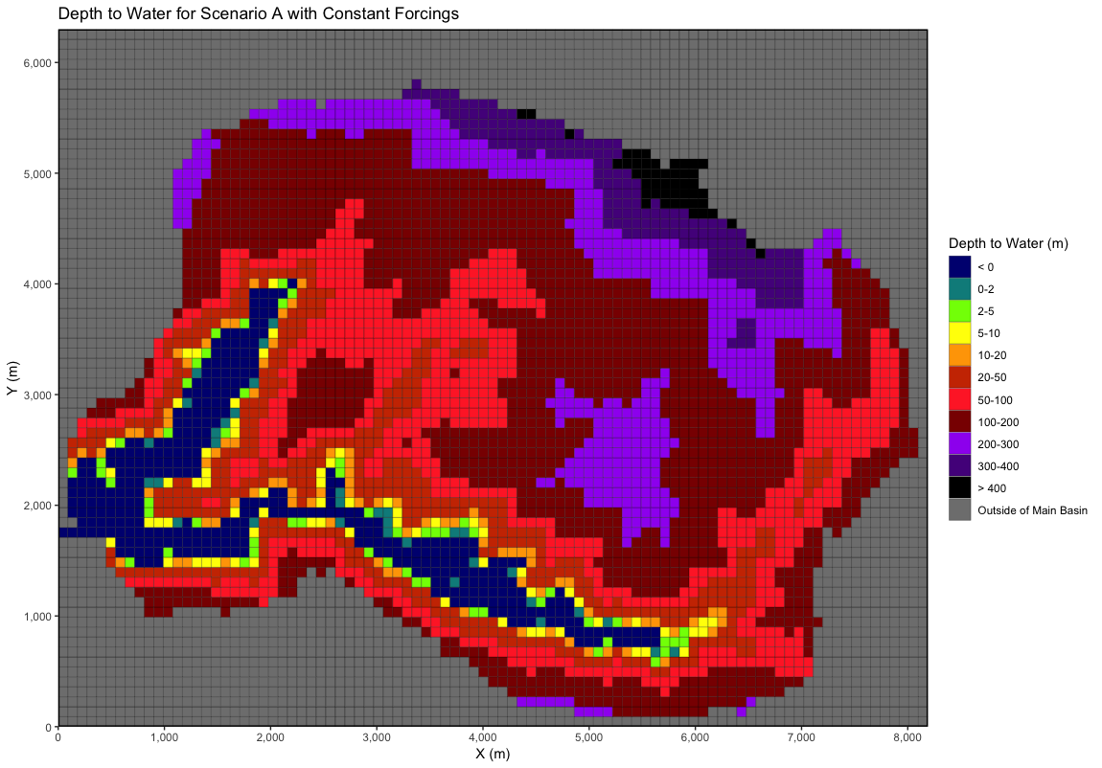
Scenario A with solid file – 1M hours with constant recharge (A_v4)

Slide 4
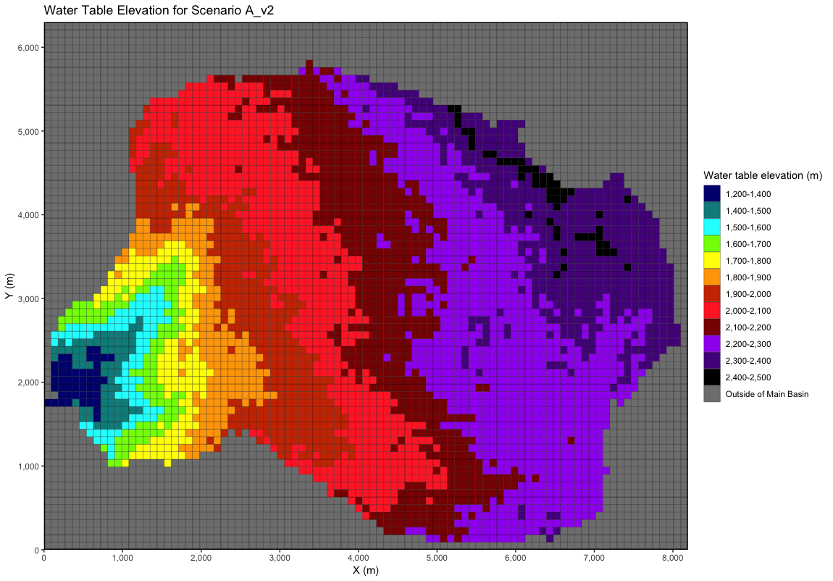
Scenario A after CLM spinup (A_v2)

Slide 5
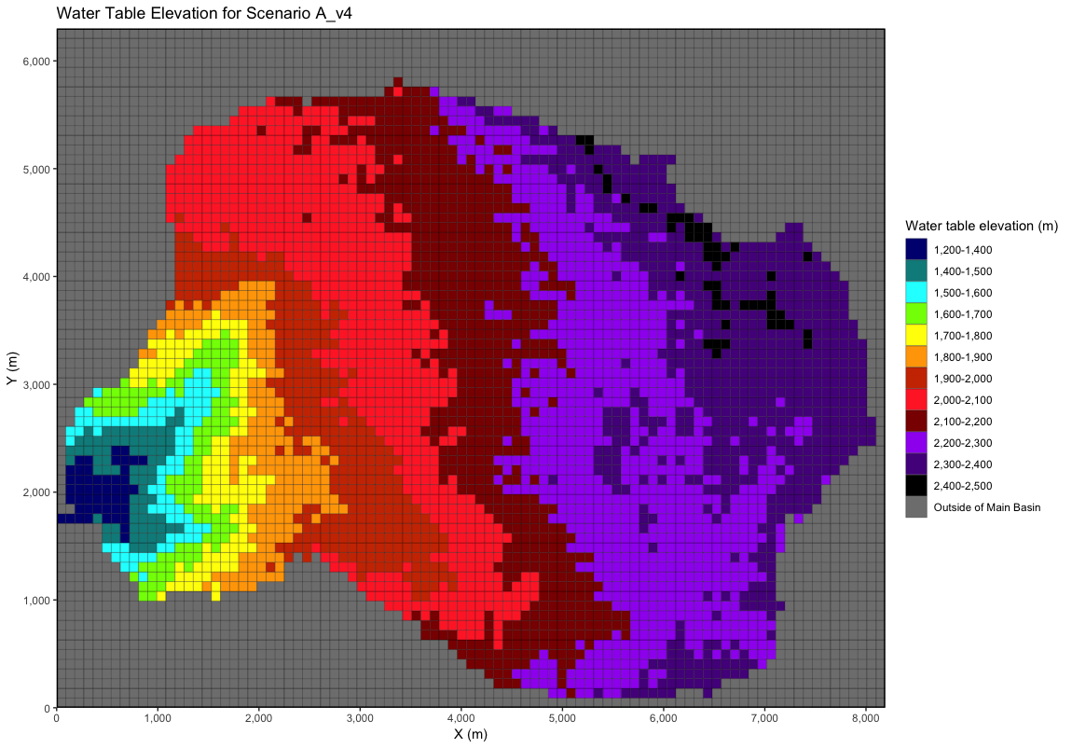
Scenario A with solid file – 1M hours with constant recharge (A_v4)

