Slide 1
APTIM PowerPoint Template Guidelines

Slide 2
About the Template & Formatting
About
Please use this template only to create your APTIM PowerPoint presentations. Do not share this template externally.
The most updated presentation template can be found on Marketing & Communication’s APTNet site.
Formatting
The presentation has pre-built templates. Use one of these template slides when creating a new slide. (See instructions on following slides.) They have been pre-built for the APTIM brand with fonts, colors, and graphics.
Font should be Arial.
Colors should follow the built-in APTIM color scheme. This palette can be found under View>Slide Master>Colors. Select “2025_APTIM_Colors” to set your default palette under the Home tab.

Slide 3
How to Use
How to Use
Save a copy of this PowerPoint template to your files to begin.
Do not modify the Slide Master.
Use the instructions on the following slides to build your presentation.
Remember to delete this slide and any other unused slides provided in this template upon submission or use.
Always use spellcheck.
Contact the Marketing & Communications Team
If you would like your final draft presentation to be reviewed for style, grammar, and/or design, please submit a Marketing & Communications request.
If there is a new slide that you would like to have created, please submit a request. Note that it will have to be approved to become part of the overall template.

Slide 4

Basics
Zoom View
Press and hold Ctrl key while turning the mouse wheel to zoom in or out.
Insert Slides
Under the Home tab, click the arrow next to New Slide. Then, choose from any of the APTIM THEME-branded slide templates.
Add Text
To use the default text styles in the template when pasting text from another source, right-click to show the Paste Options and select Keep Text Only.
Clear Formatting
To remove all formatting from selected text, press Control (Ctrl)+Space Bar.
Font Size
Standard font size is 18pt for body text. The font sizes for bullets are 18, 16, 14, and 12pt in descending order of indentation.
Please adhere to these sizes and do not increase or decrease the font sizes.
If your text is too lengthy to fit on the slide, edit the text or add another slide.
The absolute minimum font size is 14pt except for fourth- and fifth-level bullets.

Slide 5
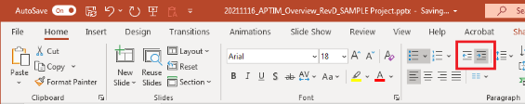
Bullets
Bullets
If your original text includes bullets, we recommend that you remove the bullets within the source document prior to copying and pasting into your PowerPoint.
Use the Decrease and Increase List Level buttons (to the right of Numbering on the Home tab) to create second-, third-, etc., level bullets.
Bullet Formatting
Follow the rules in the Bullets section of the APTIM Written Style Guide:
All bullets should start with a capitalized letter.
For lists with brief items of four words or fewer that are not complete sentences, follow the rules of title capitalization. Do not use punctuation. This is APTIM’s preference.
For lists with items of five words or more that are NOT complete sentences, do not use punctuation.
For lists with items that are complete sentences, use punctuation.

Slide 6
Insert Photos & Graphics
Insert Photos Within a Shape
To add a photo to fit within a shape on a template slide, place your cursor over the edge of the shape.
Right click.
Click the arrow next to Fill.
Click Picture.
Click From File.
Locate photo within files.
Click Insert.
To move the photo, right click on the photo and select Crop. Then drag the photo within the frame.
Keep Objects in Proportion when Resizing
Press and hold the Shift key while dragging one of the handles to keep an object, graphic, or photo in proportion while resizing it.
Draw Straight Lines
Press and hold the Shift key while inserting or drawing lines. This will keep your lines vertical, horizontal, or at a 45-degree angle.
Group & Ungroup Objects
To group objects, press Ctrl+G.
To ungroup objects, press Ctrl+Shift+G.

Slide 7
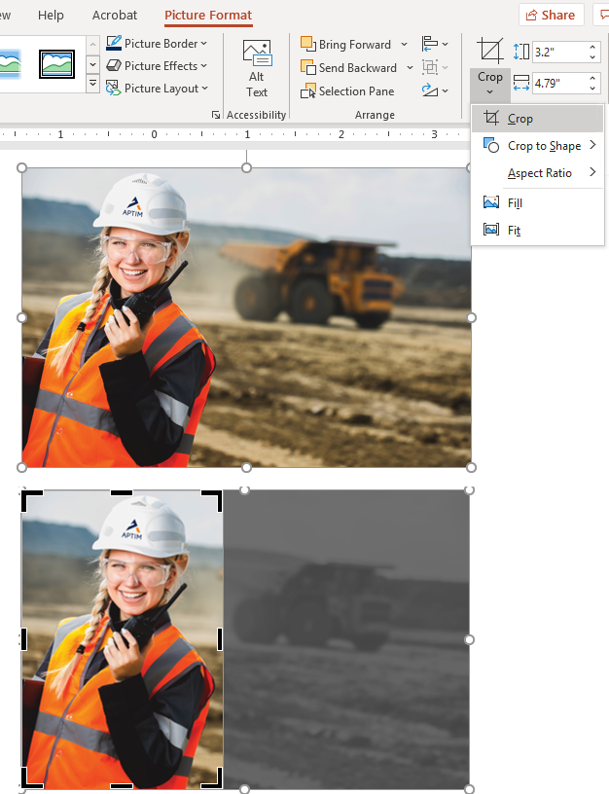
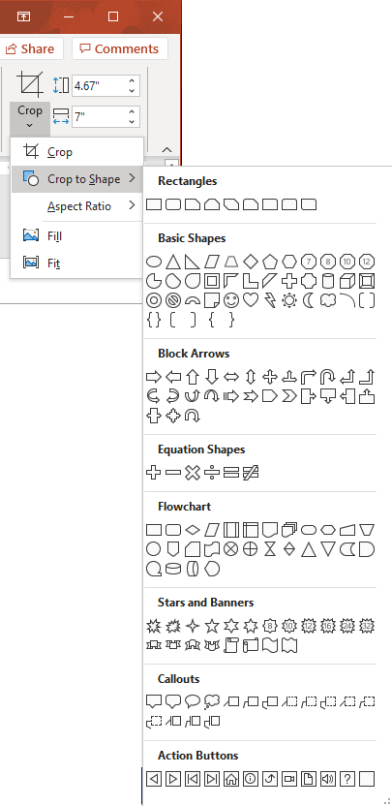

Crop Photos
Crop Photos
Click on the photo to Select it.
Click the Picture Format Tab.
Select the Crop tool in the Size Group.
A drop-down menu appears. Select Crop. The handles around the photo turn to black bars; when the cursor is moved over the handles, it changes to look like a “T.”
Click and drag the handles to show only the desired areas of the photo.
Click Crop again.
Crop Photos to a Shape
Follow steps 1–3 for Crop Photos.
From the drop-down menu, select Crop to Shape.
From the drop down, choose the shape.
Click Crop again.

Slide 8
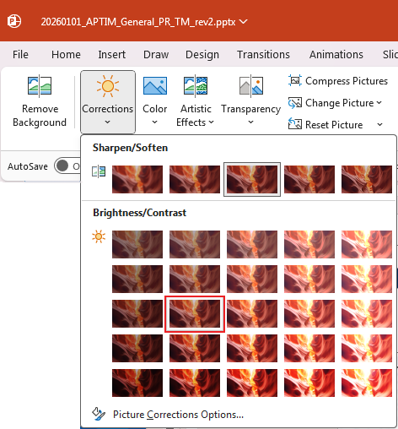
Adding Text Over a Photo
Adding Text Over an Image
If there is a need to add text over an image, the brightness and contrast may need to be adjusted so the text is legible.
Click on the photo to Select it.
Click the Picture Format tab.
Select Corrections.
Select Brightness -20% and Contrast: 0% (Normal)
Highlight your text box and change the color of the text to white on a dark image or leave as grey on a light image.

Slide 9
Presentation Title
Subtitle or Presenters
Date

Slide 13
Section Title
Section Subtitle if Needed

Slide 18
Elements to Pick Up/Use
“
“
00%
CALLOUT STATISTIC - DESCRIPTION
We take our responsibility to empower our team and reduce our organizational environmental footprint seriously, but the largest impact we have on the planet and its people is through the work our teams do every day. Every project we deliver has its roots in sustainability and resilience.
Mark Fallon APTIM Chairman & CEO
We take our responsibility to empower our team and reduce our organizational environmental footprint seriously, but the largest impact we have on the planet and its people is through the work our teams do every day. Every project we deliver has its roots in sustainability and resilience.
Mark Fallon APTIM Chairman & CEO
00%
CALLOUT STATISTIC - DESCRIPTION
”
”
00%
CALLOUT STATISTIC - DESCRIPTION

Slide 19
Sample Table
Table Title
Table Header | Table Header | Table Header | Table Header | Table Header
Table Text

Slide 20
Client Use Case: Why Michigan?
Michigan presents the strongest combination of regulatory need, storage demand, and pilot feasibility.
Why Michigan?✓ 2,500 MW statewide storage target
✓ DTE's IRP plans 760 MW storage by 2032 (2,900 MW total by 2042)
✓ Growing demand from electrification and data centers
✓ Utility-scale battery deployment already underway
Why Ann Arbor?✓ DTE service territory
✓ 50,000+ households
✓ Strong sustainability culture
✓ High solar adoption potential
✓ Pilot participation target = ~1% of households
Michigan's storage mandate, growing demand, and favorable customer demographics make Ann Arbor an ideal pilot location for a utility-owned residential battery fleet.
Confidential. Not to be copied, distributed, or reproduced without prior approval. © 2026 APTIM - All rights reserved.
15
Notes:
Talk about:
- PA 235
- DTE's storage requirements
- Why Detroit was not selected
- Why Ann Arbor provides higher probability of success

Slide 21
Michigan Pilot Deployment Model
This is exactly how the pilot would operate.
Participant Requirements• DTE customer
• Owner occupied
• Suitable roof condition
• Minimal shading
• South-facing roof preferred
• Long-term residency likelihood
Pilot Specifications• 500 qualified homes
• 6 kW solar / home
• 15 kWh battery / home
• 3-year pilot
• Utility-owned assets
THE PILOT FLOW
DTE Energy
Owns Assets
APTIM
Administers
Certified Installers
500 Homes
3 MW Solar + 7.5 MWh
APTIM leverages existing program administration, contractor management, inspection, and reporting capabilities to support DTE-owned distributed energy assets.
Confidential. Not to be copied, distributed, or reproduced without prior approval. © 2026 APTIM - All rights reserved.
16
Notes:
Explain:
- Why 15 kWh
- Why 6 kW
- Why 500 homes
- Why existing APTIM inspectors

Slide 22
Michigan Pilot Business Case
The pilot creates value for DTE, homeowners, and APTIM.
Project Investment
APTIM Revenue
Customer Benefits
500
Homes
3 MW
Solar Capacity
7.5 MWh
Battery Capacity
$34,500
Cost per Home
$17.25M
Gross CAPEX
$1.5M
Annual Contract
3 Years
Pilot Length
$4.5M
Total Revenue
✓ ~$700 annual savings
✓ 40-50% bill reduction
✓ Backup power
✓ No upfront investment
Launch a 500-home Ann Arbor pilot to demonstrate a scalable utility-owned solar and battery fleet model while supporting Michigan's long-term storage objectives.
Confidential. Not to be copied, distributed, or reproduced without prior approval. © 2026 APTIM - All rights reserved.
17

