Slide 1
Evolving Energy Programs Under Funding Uncertainty
Alexander Brown, Christian Gracia, Jenny Isham, Maija Miller, John Woods
August 5th, 2026

Slide 2
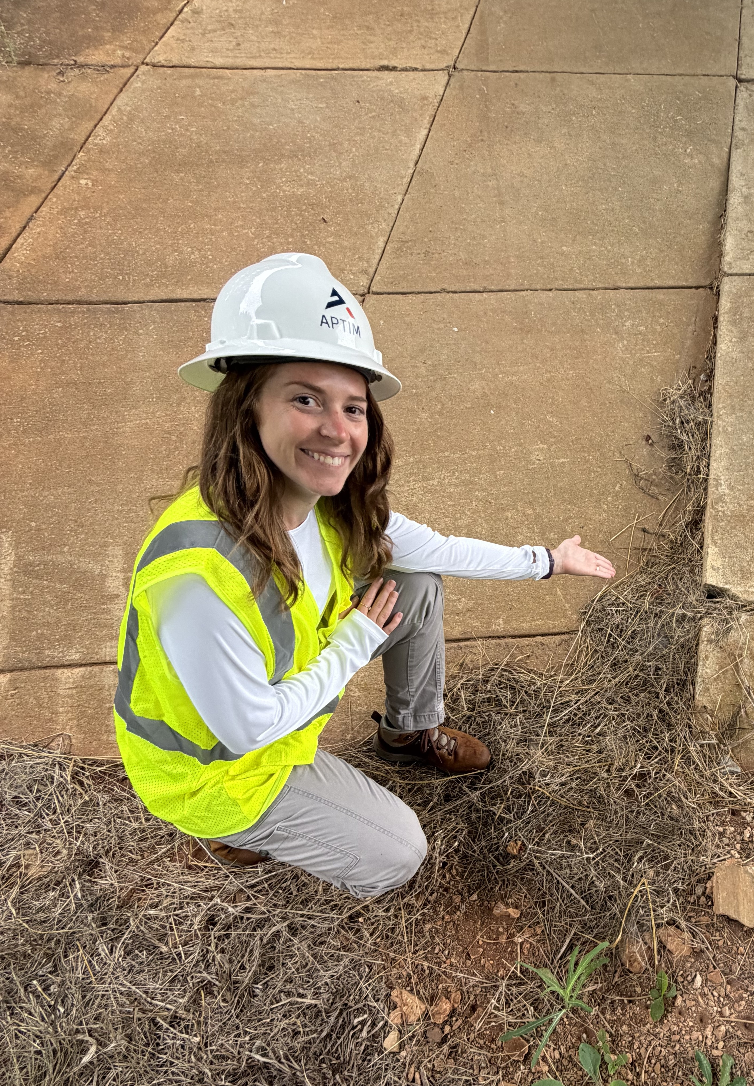

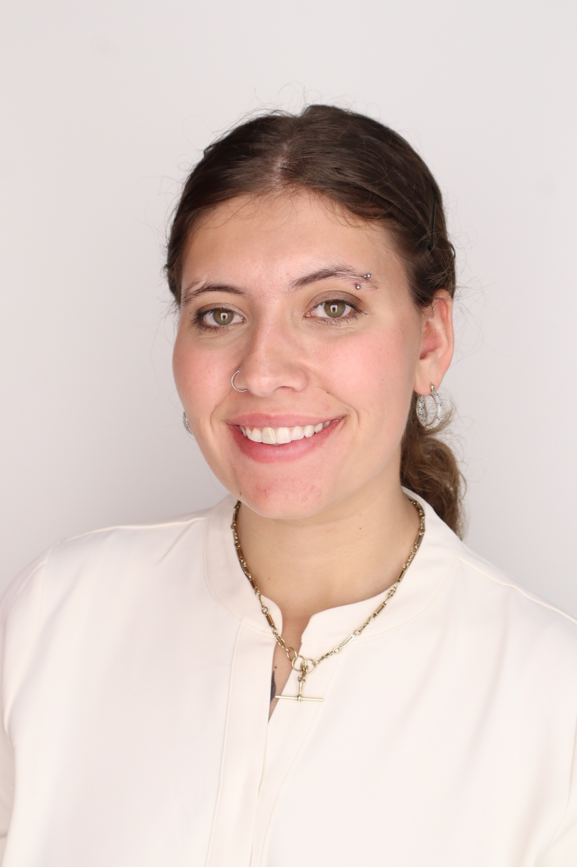
The Dream Team
Alexander Brown
Jenny Isham
Civil Engineering Intern
John Woods
Mechanical Engineering Intern
Knoxville, TN
Christian Garcia
Climate Resilience & Technology Intern
Maija Miller
Environmental Engineering Intern

Slide 3

What is the Problem?
Constraints
Federal Funding Uncertainty
Changing Incentive Structure
Operational Complexity
Aging Infrastructure
Utilities, states, counties, cities and program administrators have to balance growing expectations and growing constraints:
How could APTIM leverage its existing capabilities across consulting and management to help deliver effective programs under constrained funding?
Expectations
Energy Efficiency
Sustainability Initiatives
Grid Resilience
Electrification
Implementation Support
Cost Effective Solutions
Notes:
To Do:
Determine Speaker
Add Talking Points (Use animations to guide)

Slide 4
Pain Point
“…the US power sector is expected to require sustained capital investments over the next two to three decades. Investments could total as much as
$1.4 trillion from 2025 to 2030…”
What We Need?
Efficient Energy Usage
Resource Independence
Cost Reduction
Why We Need It?
AI Infrastructure
Climate Effects
Politics
Consequences
Grid Overload
Complex Solutions
Funding Pressure
Notes:
To Do:
Determine Speaker
Add Talking Points (Use animations to guide)

Slide 5
Key Goals
Utilities – focus area
Residential Solar and Battery Programs
APTIM to work as administer for these programs
Start with states that have begun the process of implementing similar programs
Small scale 1 to 3-year pilot programs could show what long-term implementation could look like
Notes:
To Do:
Determine Speaker
Add Talking Points (Use animations to guide/introduction to what the service concept is)

Slide 6
Service Concept: How It Works
Three roles, one flow -- the utility owns, APTIM administers, the household hosts
Hardware Maker
e.g., Tesla, Enphase
Manufactures the battery + solar hardware
Asset Owner + Dispatcher
The Utility
Finances, owns, rate-bases the fleet; earns regulated return; dispatches via software partner
Program Administrator (APTIM)
APTIM
Site selection, household recruitment, hosting agreements, contractor network, install QA, fleet reporting, compliance
→
→
Who pays: the utility recovers its investment from ALL ratepayers via rate base (standard cost-of-service regulation) -- not a special charge to the hosting household. The household's "payment" for hosting is free backup power and lower bills. This is NOT a Power Purchase Agreement -- the utility owns the asset directly, it does not buy output from a third-party owner.
Confidential. Not to be copied, distributed, or reproduced without prior approval. © 2026 APTIM - All rights reserved.
10
Notes:
To Do:
Reformat Slide
Determine Speaker
Create Talking Points
- Open items for RFP-stage negotiation: exact fee %, named installer network, interconnection process for utility-owned residential batteries (flagged as a regulatory question to work through with MPSC, not assumed).

Slide 7
Service Concept: Why It Holds Together
The fee model, the incentives, and the rollout design
How APTIM Gets Paid
Why All Parties Say Yes
Design & Rollout
Model: Base fee as % of program budget + performance bonus overlay
Precedent: APTIM's real Focus on Energy contract (2023-2026) uses this exact structure
Benchmark: Federal EECBG caps admin fees at 10% of funds -- a citable floor
Exact %: Negotiated at RFP stage, not fixed here
Utility: Meets storage mandate, grows rate base, cheaper than new peaker capacity
Household: Free backup power, zero upfront or monthly cost
APTIM: Recurring fee + Michigan market entry, filling an unadministered service niche
Regulator: Resilience delivered without a new tax; performance-linked fee keeps utility accountable
Cold weather: Thermally-managed battery chemistry, sized with a winter capacity buffer -- Michigan's worst outages are winter/ice-storm driven
Maintenance: Utility owns the fleet, so utility (via APTIM's contractor network) maintains it -- zero burden on the household
Pilot targeting: Phase 1 enrolls qualifying, stable homeowners to prove the model; Phase 2 expands to higher-need areas
Confidential. Not to be copied, distributed, or reproduced without prior approval. © 2026 APTIM - All rights reserved.
10

Slide 8
Prioritization Framework: Why Battery + Solar Administration
Approach Considered | 1-3 Yr Feasibility | Alignment with Prompt | Verdict
Broad "Program Resilience Toolkit" (multi-module: adaptation support, funding navigation, compliance/reporting, contractor continuity) | Medium -- every module individually feasible, but no single concrete offering | Partial -- leadership explicitly asked for a specific program, not a broad toolkit; prompt calls for a focused solution, not a general capability set | NOT SELECTED as standalone pitch
Utility-Owned Battery + Solar Fleet, APTIM-Administered | High -- matches an existing, proven APTIM capability | Full -- single client group (utilities), no new technology, leverages current APTIM capabilities, achievable in 1-3 years, scalable across states | SELECTED
Why We Didn't Stop at the Toolkit
• Not procurable: utilities buy defined programs through RFPs -- a toolkit isn't a bid, it's a brochure
• That seat is taken: CLEAResult and ICF already sell broad program advisory; the fleet-administration seat is empty
• Wrong answer to the prompt: a toolkit only helps manage shrinking grant budgets -- the fleet creates a NEW ratepayer-financed budget line federal freezes can't touch
• Revenue quality: toolkit sells consulting hours; the fleet earns recurring fees tied to 20-year infrastructure
• Leadership directive: one specific, concrete program -- not a capability list
Confidential. Not to be copied, distributed, or reproduced without prior approval. © 2026 APTIM - All rights reserved.
6
Notes:
SPEAKER NOTES -- Prioritization Framework
Flow: this slide exists to pre-empt the question 'why didn't you just pitch a broader capability?' before anyone asks it.
1. Walk the table left to right, land on SELECTED for the battery+solar fleet.
2. Then hit the five reasons in the callout, in order:
- Utilities procure through RFPs for defined programs -- there's no RFP category for a 'toolkit.'
- The broad-advisory market is already occupied (CLEAResult ~$528M revenue, ICF) -- competing there is a price war against incumbents who've run it for years.
- The prompt is about funding UNCERTAINTY. A toolkit only helps triage a budget that's already shrinking (cite: Louisiana ended its 2026 program, Duke withdrew 3 residential programs, CA paused a $290M rebate program). The fleet answers the uncertainty directly by moving the funding source to rate base, which a federal freeze cannot touch.
- Revenue quality: consulting hours end when the engagement ends. Recurring administration fees are tied to a 20-year physical asset.
- And directly: leadership (Samantha) asked for one specific, concrete program, not a capability list.
If asked 'why not both?' -- answer: the toolkit describes HOW APTIM operates internally; it is not a product a utility issues an RFP for.
[Placeholder -- swap in team-provided talking points when received.]

Slide 9

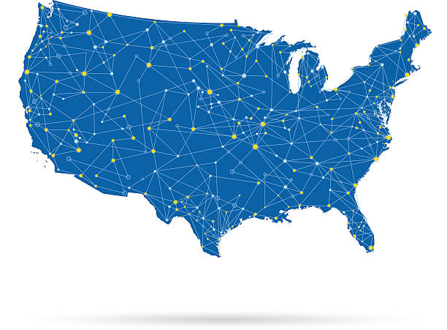
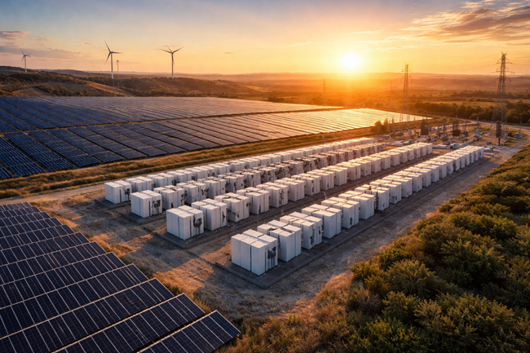
National Competitive Landscape
CLEAResult
Customer Acquisition and Participation
Large Contractor and Utility Networks
Focus on Large-Scale Program Implementation
ICF
Cost-Effective Program Design
Customer Targeting and Segmentation
Focus on Advanced Analytics and Program Optimization
Stantec
Grid and Infrastructure Engineering
Energy System Planning
Focus on Utility Infrastructure and DER Integration
Notes:
Highlighting aptim wins is good, fix sizing/format

Slide 10
Market Analysis: Opportunity Assessment
Overview:
Identify high-potential utility markets where APTIM can serve as Program Administrator
Benchmark: California
Mature solar + storage market and established utility programs
States Selected for Analysis
North Carolina
Michigan
Wisconsin

Slide 11
Market Analysis: State Opportunities and APTIM Role
State | Market Status | Challenge | Opportunity | APTIM Role
California | Mature
North Carolina | Growing | Managing load growth and distributed resource integration | Mature solar market with growing interest | Program design and implementation
Michigan | Emerging (Pilot) | Establishing regulatory and economic justification for programs | Utility and regulatory interest in storage, DER aggregation, and VPPS | Regulatory support, business case development, and pilot administration
Wisconsin |  | Lower customer awareness and early-stage market development | Emerging opportunity for residential storage and grid flexibility programs. | Customer recruitment, and program launch support
Notes:
Solid, maybe split into two slides with an intro to avoid overload (or add animations)
NOTE: Im not sure if this fits in before or after we address our solution, I am assuming before, just make sure not to have specific info about our solution if that is the case

Slide 12
Market Analysis: Market Size and APTIM's Goal
North Carolina
SOM – Duke Energy
SOM – DTE Energy, Consumers Energy
SOM – WE Energies
TAM – Duke, NC Electric Co-ops, Municipals
SAM – Duke Energy Carolinas, Duke Energy Progress
Michigan
TAM – DTE, Consumers, Co-ops, Municipals
SAM – DTE Energy, Consumers Energy
Wisconsin
TAM – WE Energies, Alliant, MGE, Co-ops
SAM – WE Energies, Alliant Energy, MGE
10+ Utilities
6-8 Utilities
4-5 Utilities
2 Utility wins in the next 3 years
Notes:
Very good they like this slide
NOTE: Im not sure if this fits in before or after we address our solution, I am assuming before, just make sure not to have specific info about our solution if that is the case

Slide 13
The Big Picture: How This Program Works
1. The Problem
Utilities must keep energy programs running, but federal funding is unreliable and mandates don't go away
2. The Fix
The UTILITY buys and owns a fleet of home batteries + solar --financed like any grid infrastructure, not a grant
3. The Roles
APTIM administers the program. The household just hosts the equipment -- $0 cost to them
4. The Outcome
Utility meets its resilience mandate and earns a return. APTIM gains a new revenue line. Household gets free backup power
→
→
→
In one sentence: APTIM administers a utility-owned battery + solar fleet -- the utility finances it, APTIM runs it, the household hosts it for free.
Confidential. Not to be copied, distributed, or reproduced without prior approval. © 2026 APTIM - All rights reserved.
9

Slide 14
Michigan specific
DTE
Other one

Slide 15
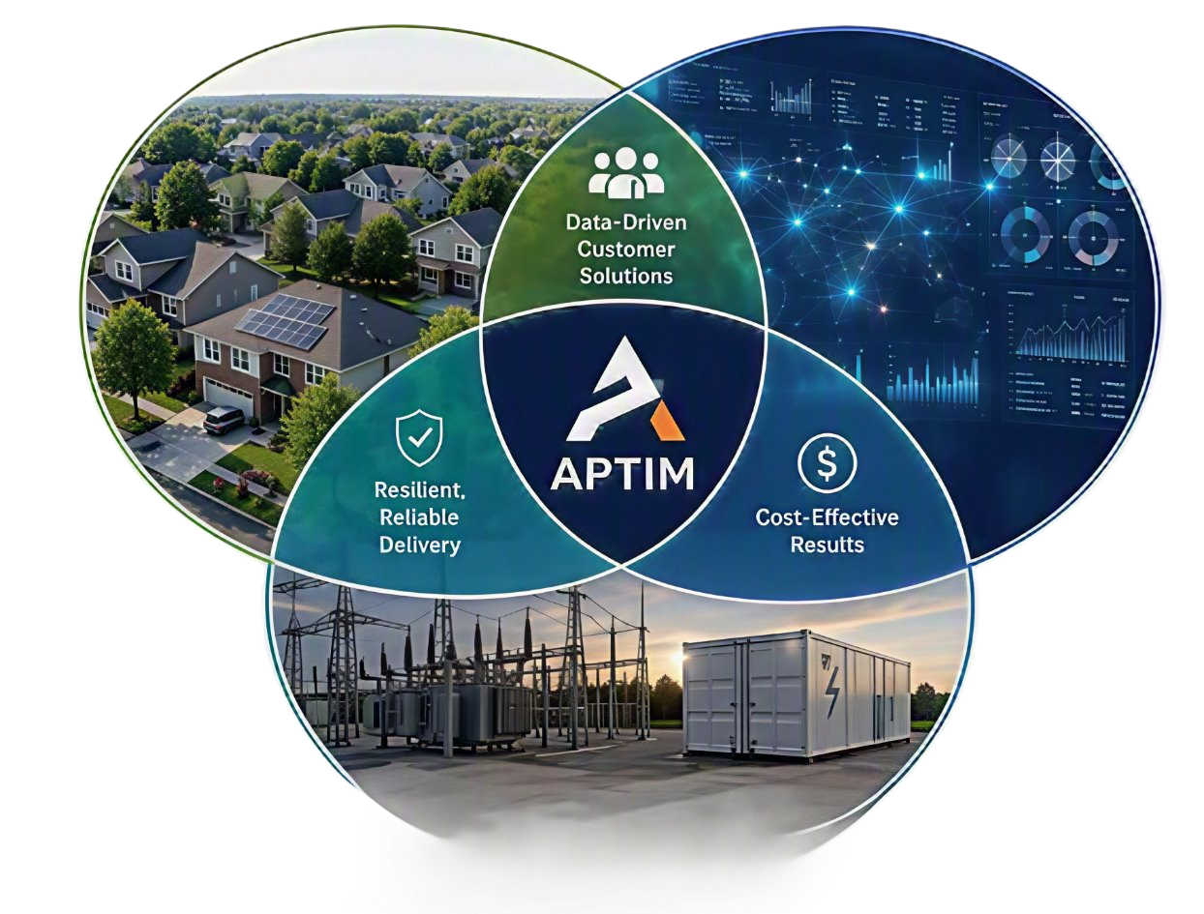
How APTIM Wins
Proven Large-Scale Delivery
Combines Implementation, Analytics, and Infrastructure Expertise
Proven Success in Resilience, Compliance, and Public-Sector Programs
Notes:
Highlighting aptim wins is good, fix sizing/format

Slide 16
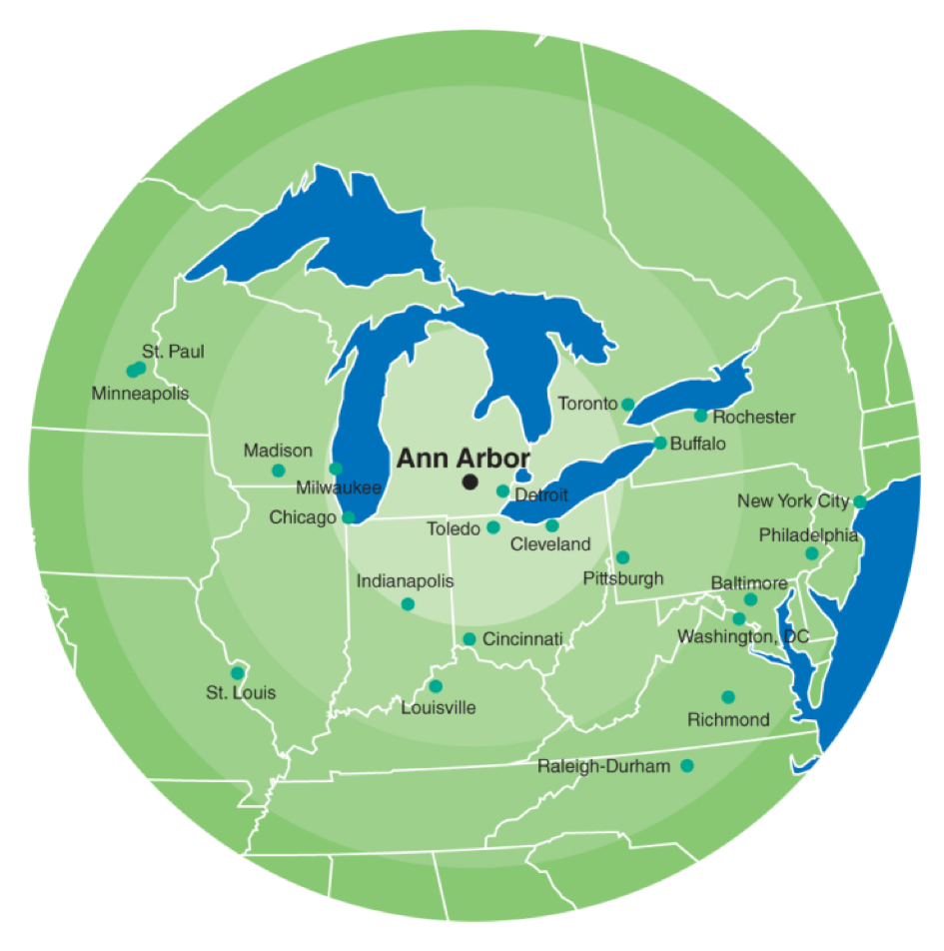
Why Michigan?
Why Michigan?
✓ 2,500 MW statewide storage target
✓ DTE identified storage need
✓ Growing demand from electrification and data centers
✓ Utility-scale battery deployment already underway
Why Ann Arbor?
✓ DTE service territory
✓ 50,000+ households
✓ Strong sustainability culture
✓ High solar adoption potential
✓ Pilot participation target = ~1% of households
Ann Arbor was selected to maximize pilot success, generate operational data, and reduce deployment risk before broader expansion
Confidential. Not to be copied, distributed, or reproduced without prior approval. © 2026 APTIM - All rights reserved.
15
Notes:
Talk about:
- PA 235
- DTE's storage requirements
- Why Detroit was not selected
- Why Ann Arbor provides higher probability of success

Slide 17
Client Use Case: Michigan
Legal Pathway
Legal Scorecard: Helps vs. Hurts
✓ MPSC precedent: 1,332 MW utility-owned storage approved (Mar 2026)
✓ PA 235 mandate: 2,500 MW statewide storage target by 2029
✓ Filing route: expedited DER pilot pathway (Case U-21653)
Helps our case | Cuts against us → our answer
PA 235 mandate: compliance demand exists regardless of federal funding -- the exact hedge the prompt asks for | 1,332 MW precedent is GRID-SCALE, not residential → the capped pilot is how the residential template gets set
U-20836 rejection was venue, not batteries -- the Commission invited standalone refiling with deferred accounting | Rate-fatigue politics: DTE under reliability criticism → pilot adds no new tax; fee is performance-linked
U-21653 expedited 90-day route exists and covers DER integration -- the invited venue now has a door | No existing interconnection category for utility-owned in-home storage → addressed via case-specific MPSC review under the U-21653 pilot pathway, not a pre-existing rule
De-risked: DTE's 2022 pilot rejection (Case U-20836) was about venue, not batteries -- the Commission encouraged refiling outside rate cases with deferred accounting. That refiling route now exists: U-21653.
Scope: Distribution resilience, not generation replacement -- DTE's IRP storage buildout replaces Monroe Power Plant (a separate coal transition). Our program fits inside DTE's existing $1B/yr Distribution Grid Plan to “detect, prevent and manage outages” -- a new tool inside a commitment DTE already made, not a competing ask.
Illustrative pilot sizing (Ann Arbor / DTE, team analysis): 500 homes | 6 kW solar + 15 kWh battery per home | 3 MW / 7.5 MWh fleet | ~$34,500/home ($17.25M CAPEX) | ~$700/yr customer savings, $0 upfront
Answers the prompt: no new technology | single client group | leverages APTIM capabilities | 1-3 year feasibility | scalable
Confidential. Not to be copied, distributed, or reproduced without prior approval. © 2026 APTIM - All rights reserved.
14
Notes:
SPEAKER NOTES -- Client Use Case: Michigan
This slide answers ONE question: is this legally buildable in Michigan, and what happens if someone pushes back? Win-the-bid and timeline content live on other slides (How APTIM Wins; Future/Scaling) -- don't re-argue them here, just bridge to them if asked.
LEGAL AUDIT (say this, don't read the table verbatim):
- Helps: PA 235 is the strongest citation -- mandate-driven demand exists regardless of federal money, which is the direct answer to the prompt. U-20836 + U-21653 together are the second-strongest: the Commission rejected the VENUE (a residential battery pilot bundled into a general rate case), not the concept, and told DTE to refile as a standalone pilot with deferred accounting. U-21653 (approved April 2025) is that exact venue.
- Hurts, with the answer built in: the March 2026 1,332 MW precedent is grid-scale, NOT residential -- don't oversell it; frame it as 'utility-owned storage is approvable in Michigan,' and our pilot sets the residential template. Rate-fatigue politics around DTE cuts against new spending -- answer is 'capped pilot, no new tax, performance-linked fee.' No interconnection template exists yet for utility-owned in-home equipment -- answer is that Michigan's MIXDG interconnection rules already name the utility as a possible interconnection customer.
CAVEATS TO CONCEDE GRACEFULLY IF PRESSED: deferred-accounting cost recovery under U-21653 is expected but not yet confirmed by an order; the PA 235 Dec 31 2029 date is a PETITION deadline, not a build deadline -- don't claim false urgency from it.
PILOT NUMBERS STRIP: these are Maija's team-built Ann Arbor sizing assumptions, not committed pricing -- if asked, say 'illustrative sizing for a 500-home pilot; actual fees are set at the RFP stage.' Do NOT cite '850+ MW' for DTE's storage need if it comes up elsewhere in the deck -- the confirmed IRP figure is 760 MW by 2032 (settlement: 780 MW by 2030), not 850+.
[Placeholder -- swap in team-provided talking points when received.]

Slide 18
Ann Arbor Deployment Model
Requirements
Deployment
Results
• DTE customer
• Owner occupied
• Suitable roof condition
• Minimal shading
• South-facing roof preferred
• Long-term residency likelihood
Homes | 500
Solar – Home | 6 kW
Battery – Home | 15 kWh
Solar – Fleet | 3 MW
Battery – Fleet | 7.5 MWh
Duration | 3 Years
DTE Energy
Owns Assets
APTIM
Administers
Certified Subcontractors
Installs
Participating Homes
Hosts
APTIM leverages existing program administration, contractor management, inspection, and reporting capabilities to support DTE-owned distributed energy assets.
Confidential. Not to be copied, distributed, or reproduced without prior approval. © 2026 APTIM - All rights reserved.
16
Notes:
he system was sized to be realistic and scalable. Each participating home receives a typical 6-kW rooftop solar system paired with a 15-kWh battery, providing both homeowner resilience and utility dispatch capability. Across 500 homes, that creates a 3-MW distributed solar fleet and 7.5 MWh of battery storage for DTE to leverage as a pilot-scale virtual power plant.

Slide 19
Business Case: Value Proposition
DTE Benefits
APTIM Benefits
Customer Benefits
(This is what AI gave me for them lol – Maija)
Supports PA 235 storage goals
Improves grid resilience
Generates operational fleet data
Expands distributed energy resources
Michigan market entry
Recurring contract revenue
Leverages existing capabilities
Scalable to future utility clients
~$700 annual savings
40–50% bill reduction
Backup power during outages
No upfront investment
Creates value for DTE, participating homeowners, and APTIM while advancing Michigan's long-term storage goals.
Confidential. Not to be copied, distributed, or reproduced without prior approval. © 2026 APTIM - All rights reserved.
17

Slide 20
Business Case: Financial Summary
DTE Benefits
APTIM Benefits
Customer Benefits
$17.25M Gross CAPEX
Solar Cost/Home = 6 kW × $3.50/W = $21,000
Battery Cost/Home = $13,500
Total Cost/Home = $34,500
500 Homes × $34,500 = $17.25M
3 MW Solar Capacity
500 Homes × 6 kW/Home
= 3,000 kW = 3 MW
7.5 MWh Battery Capacity
500 Homes × 15 kWh/Home
= 7,500 kWh = 7.5 MWh
$1.25M Estimated Annual Program Cost
Staffing ~ $ 950K
Overhead/Admin ~ $300K
Internal Hiring
$1.47M - $1.67M Suggested DTE Contract Ranges
15-25% Target Profit Margin
$220K – $417K Estimated Annual APTIM Profit
Based on negotiated contract
~$700 Annual Savings
Electricity Cost = $0.1932/kWh
~ 10 kWh/day Solar Offset
Up to 50% Bill Reduction
Solar + Battery Reduces Grid Dependence
Assume ~ 22.5 kWh/day Household Use
$0 Upfront Investment
DTE Owns Assets
DTE Covers Installation Costs
Source: EcoWatch Michigan Solar Guide
Launch a 500-home Ann Arbor pilot to demonstrate a scalable utility-owned solar and battery fleet model while supporting Michigan's long-term storage objectives.
Confidential. Not to be copied, distributed, or reproduced without prior approval. © 2026 APTIM - All rights reserved.
17
Notes:
Notes: Profit margin
- 15: Minimum
20: Recommended
25: Aggressive

Slide 21
Strategic Fit
Leverages Existing Capabilities - Existing utility expertise - Established contractor network - Proven customer engagement - Minimal new infrastructure
Expands Into New Markets - Limited direct competition - Utility battery fleet offering - Differentiated market position - Growing DER opportunity
Scales Through Existing Relationships
- Strong utility partnerships - Proven regional presence - Easier pilot deployment - Faster program expansion
Creates Resilient Revenue Streams
- Utility-funded model - Reduced grant reliance - More stable revenue - Supports grid resilience
Notes:
Practice timing of animations (applies to all of them whole presentation), condense paragraphs into bullet points, lots of words in screen, information is good to use in notes

Slide 22
Growth Timeline (Re format)
2026
Internal Development
2027
Ann Arbor Pilot Launch
2027-2030
Pilot Operation and Expansion Planning
Regional Expansion
- Finalize business case and service offering
-Secure APTIM leadership approval
- Partner with DTE and recruit 500 homes
- Monitor performance and customer participation
- Expand across additional DTE territories
- Begin installation and fleet deployment
2030+
- Build expansion case using pilot results
- Replicate model in WI, LA, and NC
Notes:
Maybe change formatting

Slide 23

Thank you!
Any questions?
Notes:
Notes: might be light on slides currently, talking fast when nervous makes it go by faster and we currently have 1-2 minutes per slide. Practice practice practice, if hitting 20 minutes in relaxed setting

Slide 24
Notes:
No work cited, make a running list of sources though so we can put them at the bottoms of tables (mainly graphs)

Slide 25

Thank you!
Any questions?
Notes:
Notes: might be light on slides currently, talking fast when nervous makes it go by faster and we currently have 1-2 minutes per slide. Practice practice practice, if hitting 20 minutes in relaxed setting

Slide 26
Business Case: Financial Summary
DTE Benefits
APTIM Benefits
Customer Benefits
500
Homes
3 MW
Solar Capacity
7.5 MWh
Battery Capacity
$34,500
Cost per Home
$17.25M
Gross CAPEX
$1.5M
Annual Contract
3 Years
Pilot Length
$4.5M
Total Revenue
✓ ~$700 annual savings
✓ 40-50% bill reduction
✓ Backup power
✓ No upfront investment
Launch a 500-home Ann Arbor pilot to demonstrate a scalable utility-owned solar and battery fleet model while supporting Michigan's long-term storage objectives.
Confidential. Not to be copied, distributed, or reproduced without prior approval. © 2026 APTIM - All rights reserved.
17

Slide 27
How APTIM Wins (Christian Slide delete if needed)
Proven Large-Scale Delivery
$3B+ in rebates delivered, $75M+ in annual incentives administered across multiple states
Integrated Capability
Combines program implementation, analytics, and infrastructure expertise no single competitor offers together
Track Record That Matters
Focus on Energy (Wisconsin) since 2010, Energy Smart (Louisiana) since 2017 -- proven resilience and compliance delivery
First Mover, Empty Market
No company today administers utility-owned residential battery fleets end-to-end -- APTIM would be first
Confidential. Not to be copied, distributed, or reproduced without prior approval. © 2026 APTIM - All rights reserved.
16
Notes:
Highlighting aptim wins is good, fix sizing/format

Slide 28
Market Analysis (Christian Quick Market slide, delete if needed)
Where APTIM already operates, and where the opportunity is emerging
APTIM's role
Market Comparisons
The funding gap is real and current:
• $8.8B IRA HOMES/HEAR rebates frozen Jan 2025 -- only 23 states live by Feb 2026
• 25C/25D consumer tax credits eliminated Dec 31, 2025
• 26 states + DC still have legal savings mandates utilities must hit regardless
Utilities are already reacting:
• Duke Energy (NC) withdrew 3 residential programs in 2025
• Louisiana ended its entire 2026 efficiency program
• California paused a $290M rebate program citing uncertainty
State | Market Status | Challenge | Opportunity
California | Mature | Highly saturated -- competitors entrenched | Reference case proving the model works
North Carolina | Growing | Solar adoption straining the grid | Duke PowerPair fully subscribed -- proves demand exists
Michigan | Emerging (pilot) | No residential storage program exists yet | Worst outages in the nation + statutory storage mandate
Wisconsin | Incumbent base | Focus on Energy budget already strained by demand | APTIM holds the administrator seat -- fastest expansion path
Notes:
Solid, maybe split into two slides with an intro to avoid overload (or add animations)
NOTE: Im not sure if this fits in before or after we address our solution, I am assuming before, just make sure not to have specific info about our solution if that is the case

Slide 29
Appendix
Don’t delete stuff just add it to appendix

Slide 30
Find some way to quantify how important each factor is (decision matrix?)
This will help the best concept be chosen and provide a concrete reason as too why
Make a list of factors: cost, ease, implementation timeframe, impact
Give each one a weight based on how import it is
Maybe interview APTIM people who make financial/program decisions to see what they find the be the most important thing
Rate each concept on each factor, include the weights, highest score wins

Slide 31



Competitive Landscape (update with research)
CLEAResult
APTIM
Stantec
Energy Efficiency & Sustainability Program Consultant
Largest energy efficiency implementer in North America
1,650 + active programs across the U.S and Canada
Utility, government, commercial, contractor, residential
Assessments, rebate, customer engagement, contractor networks, installations
Environmental, Sustainability, Resilience, & Infrastructure Solutions Firm
End-to-end consulting, implementation, and program administration
Utility, government, commercial, industrial and residential
Energy-efficiency, electrification, demand-side management, EV, storage, solar, and grid modernization programs
Engineering, Architecture & Environmental Consulting Firm
Global consulting firm with 34,000+ employees
Engineering, environmental consulting, infrastructure development, construction management, and sustainability services
Utility planning, grid modernization, and asset management
Notes:
Merge content from 10 with formatting of 8 and visuals, highlight aptim with a box or color etc

Slide 32
Competitive Landscape (update with new research)
Capability | CLEAResult | APTIM | Stantec
Energy Efficiency Programs
Rebate Administration
Government Programs
Environmental Services
Infrastructure Services
Engineering & Design
Scale/Market Reach
Core/primary service
Secondary service
Not offered/ weak service
APTIM occupies a middle ground between specialized program implementers and large consulting firms, leveraging its broad capabilities to provide integrated solutions that neither competitor offers independently.
Notes:
Compact the chart maybe

Slide 33
Goal of presentation
20 to 25 minutes
10 minutes Q&A
Could be people very knowledgeable about the subject so be prepaired
Audience: Various APTIM employees and leadership
Use a lot of images/visual items rather than massive blocks of text
Keep the audience engaged, tell a story from start to finish
Act as if the audience has no prior knowledge on your work/research (they don’t)

Slide 34
Given big blurb
Utilities, states, counties and cities face growing pressure to continue advancing
energy efficiency, electrification, resilience, and sustainability initiatives amid
changing federal funding availability, evolving incentive structures, and increasing
operational complexity. At the same time, customers continue to seek guidance,
implementation support, and cost-effective energy solutions.
How could APTIM leverage its existing capabilities across sustainability
consulting, customer engagement, and energy program management to
help utilities, states, counties, cities, or program administrators deliver
effective energy and sustainability programs under constrained or
uncertain funding conditions?

Slide 35
Given Scope Focus
Scope focus:
– Assume no invention of new technology!!
Us
– Focus on a single group (utility, state, county, city, or customer segment)
– Consider solutions that leverage current or APTIM-adjacent capabilities
– Allow for scaling, and should be achievable within the next 1-3 years, accounting for market conditions that may shift.

Slide 36
Given Output
Output:
– Problem Definition (Pain point)
– Market/Policy Analysis: (current state, changes impacting space)
– Competitive landscape: current providers of similar services, gaps in service, or inefficiencies of services.
– Prioritization framework of where to focus based on cost, ease, implementation timeframe and impact
– Strategic Fit (Why this works for APTIM)
– Service Concept, including revenue model, delivery model, scalability, costs, implementation requirements, and
operational risks.
– Pilot a client use case or business case to support your idea, detailing value, constraints and risks.
Intern gains: Evaluation of growth opportunities, market analysis skills, financial and service modeling, regulatory literacy,
energy business

Slide 37
Future/Scaling
Program will expand to multiple states that we already have programs in once successful
Use Michigan as a pilot case then pitch its success internally to APTIM and approve it for the next state
Cali, Wisconsin, Louisiana, North Carolina
Possible updates

Slide 38
Client Use Case: Why Michigan? (update/fix)
Michigan presents the strongest combination of regulatory need, storage demand, and pilot feasibility.
Why Michigan?
✓ 2,500 MW statewide storage target
✓ DTE identified 850+ MW storage need
✓ Growing demand from electrification and data centers
✓ Utility-scale battery deployment already underway
Why Ann Arbor?
✓ DTE service territory
✓ 50,000+ households
✓ Strong sustainability culture
✓ High solar adoption potential
✓ Pilot participation target = ~1% of households
Ann Arbor was selected to maximize pilot success, generate operational data, and reduce deployment risk before broader expansion
Confidential. Not to be copied, distributed, or reproduced without prior approval. © 2026 APTIM - All rights reserved.
15
Notes:
Talk about:
- PA 235
- DTE's storage requirements
- Why Detroit was not selected
- Why Ann Arbor provides higher probability of success

Slide 39
Michigan Pilot Deployment Model (update/fix)
Participant Requirements
• DTE customer
• Owner occupied
• Suitable roof condition
• Minimal shading
• South-facing roof preferred
• Long-term residency likelihood
Pilot Specifications
• 500 qualified homes
• 6 kW solar / home
• 15 kWh battery / home
• 3-year pilot
• Utility-owned assets
THE PILOT FLOW
DTE Energy
Owns Assets
DTE Energy
Owns Assets
APTIM
Administers
APTIM
Administers
3rd Party
Certified Installers
Certified Installers
500 Homes
3 MW Solar + 7.5 MWh
APTIM leverages existing program administration, contractor management, inspection, and reporting capabilities to support DTE-owned distributed energy assets.
Confidential. Not to be copied, distributed, or reproduced without prior approval. © 2026 APTIM - All rights reserved.
16
Notes:
Explain:
- Why 15 kWh
- Why 6 kW
- Why 500 homes
- Why existing APTIM inspectors

Slide 40
The Problem
Utilities, states, counties and cities face growing pressure to continue advancing
energy efficiency, electrification, resilience, and sustainability initiatives amid
changing federal funding availability, evolving incentive structures, and increasing
operational complexity. At the same time, customers continue to seek guidance,
implementation support, and cost-effective energy solutions.
How could APTIM leverage its existing capabilities across sustainability
consulting, customer engagement, and energy program management to
help utilities, states, counties, cities, or program administrators deliver
effective energy and sustainability programs under constrained or
uncertain funding conditions?

Slide 41
The Problem
Growing Expectations
Growing Constraints
Energy efficiency
Sustainability Initiatives
Grid Resilience
Electrification
Implementation Support
Cost Effective Solutions
Federal Funding Uncertainty
Changing Incentive Structure
Operational Complexity
Aging Infrastructure

Slide 42
Growing
Expectations
Sustainability Goals
Grid Resilience
Growing
Constraints
Federal Funding Avability
Aging Infrastructure
Increased operational complexity
Energy Efficiency
Incentive structure changes

Slide 43
Project Scope
Allow for scaling, achievable within 1-3 years
Assume no new invention of technologies
Focus on a single group
Leverage existing APTIM Capabilites
Scope focus:
- Assume no invention of new technology!!
Us
– Focus on a single group (utility, state, county, city, or customer segment)
– Consider solutions that leverage current or APTIM-adjacent capabilities
– Allow for scaling, and should be achievable within the next 1-3 years, accounting for market conditions that may shift.

Slide 44
Strategic Fit (format needs fix) (merge slides)
Leverages Existing Capabilities
APTIM already administers utility programs, manages contractor networks, engages customers, and delivers regulatory compliance reporting. The tools that already exist within the organization are utilized for the pilot program, minimizing the need for new operational capabilities.
Expands Into New Markets
There is little direct competition providing end-to-end administration of utility-owned residential battery fleets. This positions APTIM to establish a differentiated offering within the growing demand response and distributed energy resources market.
Scales Through Existing Relationships
APTIM already maintains trusted relationships with utilities through programs in Wisconsin and Louisiana. These partnerships provide a natural pathway to pilot, refine, and expand the utility-owned battery fleet model while reducing implementation challenges and accelerating adoption.
Creates More Resilient Revenue Streams
This program shifts funding away from grants and incentives toward utility infrastructure investments. Reducing reliance on uncertain federal funding creates a more stable revenue source while supporting grid resilience goals.

Slide 45
Client Use Case: Michigan
Walk through program implementation in Michigan
1-2 slides
Laws/utility workings, how we would pitch/win the bid
Implementation: third party installers, where the reseources come from/are paid for
Operation and maintenance: who operates, how often are replacements/duration of program
Cost: money, time, resources, manpower (how many aptim employees need to be hired?)
Example of our service concept in "action"
Interview APTIM people in the same sector/scope of work our idea would be useful for
Maybe get an old case study and apply our idea to it, see how much it would have benefited in the moment
Put example maybe of california
Notes:
One or two slides, build this choice into the entire presentation (market), how did we decide which state to launch in, maybe introduce service concept earlier, look at flow of informaiton, focus more on the short term success on why we chose michigan, negatives of other states can go on future timeline

Slide 46
Client Use – Why Michigan
Slide 15
Operational Story
Answer:
Why Michigan?
Why DTE?
Why Ann Arbor?
Who owns the assets?
How many homes?
How does implementation work?

Slide 47
Client Use – The Nitty Gritty
Capital cost
Administrative cost
APTIM revenue
Utility benefits
ROI
Success metrics
Honestly, the financial slide is likely where leadership will spend most of their questions.

Slide 48
Strategic Fit (format needs fix) (merge slides)
Leverages Existing Capabilities
Scales Growth In Existing Relationships
Creates Resilient Revenue
Expands Into New Markets
APTIM already administers utility programs, manages contractor networks, engages customers, and delivers regulatory compliance reporting. The tools that already exist within the organization are utilized for the pilot program, minimizing the need for new operational capabilities.

Slide 49
Strategic Fit (fix wording/choose format)
Leverages Existing Capabilities
APTIM already administers utility programs, manages contractor networks, engages customers, and delivers regulatory compliance reporting. The tools that already exist within the organization are utilized for the pilot program, minimizing the need for new operational capabilities.
Expands Into New Markets (update with market research)
There is little direct competition providing end-to-end administration of utility-owned residential battery fleets. This positions APTIM to establish a differentiated offering within the growing demand response and distributed energy resources market.
Scales Through Existing Relationships
APTIM already maintains trusted relationships with utilities through programs in Wisconsin and Louisiana. These partnerships provide a natural pathway to pilot, refine, and expand the utility-owned battery fleet model while reducing implementation challenges and accelerating adoption.
Creates More Resilient Revenue Streams
This program shifts funding away from grants and incentives toward utility infrastructure investments. Reducing reliance on uncertain federal funding creates a more stable revenue source while supporting grid resilience goals.
Bottom Text to highlight point
By combining existing capabilities, strong utility relationships, and a differentiated market position, APTIM can deliver a scalable solution that supports both utility resilience goals and long-term business growth.

Slide 50
Project Scope
Focus
Achievable in 1-3 years
Accounts for market shifts
Project Scope
Assume no new invention of technology
Leverage existing APTIM capabilities
Scaling
Utility
Customer
County/City/State
Complexity

Slide 51
Strategic Fit (edit with notes)
Leverages Existing Capabilities
- Existing utility expertise
- Established contractor network
- Proven customer engagement
- Minimal new infrastructure
Expands Into New Markets
There is little direct competition providing end-to-end administration of utility-owned residential battery fleets. This positions APTIM to establish a differentiated offering within the growing demand response and distributed energy resources market.
Scales Through Existing Relationships
APTIM already maintains trusted relationships with utilities through programs in Wisconsin and Louisiana. These partnerships provide a natural pathway to pilot, refine, and expand the utility-owned battery fleet model while reducing implementation challenges and accelerating adoption.
Creates Resilient Revenue Streams
This program shifts funding away from grants and incentives toward utility infrastructure investments. Reducing reliance on uncertain federal funding creates a more stable revenue source while supporting grid resilience goals.
Notes:
Practice timing of animations (applies to all of them whole presentation), condense paragraphs into bullet points, lots of words in screen, information is good to use in notes

Slide 52
APTIM PowerPoint Template Guidelines

Slide 53
About the Template & Formatting
About
Please use this template only to create your APTIM PowerPoint presentations. Do not share this template externally.
The most updated presentation template can be found on Marketing & Communication’s APTNet site.
Formatting
The presentation has pre-built templates. Use one of these template slides when creating a new slide. (See instructions on following slides.) They have been pre-built for the APTIM brand with fonts, colors, and graphics.
Font should be Arial.
Colors should follow the built-in APTIM color scheme. This palette can be found under View>Slide Master>Colors. Select “2025_APTIM_Colors” to set your default palette under the Home tab.

Slide 54
How to Use
How to Use
Save a copy of this PowerPoint template to your files to begin.
Do not modify the Slide Master.
Use the instructions on the following slides to build your presentation.
Remember to delete this slide and any other unused slides provided in this template upon submission or use.
Always use spellcheck.
Contact the Marketing & Communications Team
If you would like your final draft presentation to be reviewed for style, grammar, and/or design, please submit a Marketing & Communications request.
If there is a new slide that you would like to have created, please submit a request. Note that it will have to be approved to become part of the overall template.

Slide 55

Basics
Zoom View
Press and hold Ctrl key while turning the mouse wheel to zoom in or out.
Insert Slides
Under the Home tab, click the arrow next to New Slide. Then, choose from any of the APTIM THEME-branded slide templates.
Add Text
To use the default text styles in the template when pasting text from another source, right-click to show the Paste Options and select Keep Text Only.
Clear Formatting
To remove all formatting from selected text, press Control (Ctrl)+Space Bar.
Font Size
Standard font size is 18pt for body text. The font sizes for bullets are 18, 16, 14, and 12pt in descending order of indentation.
Please adhere to these sizes and do not increase or decrease the font sizes.
If your text is too lengthy to fit on the slide, edit the text or add another slide.
The absolute minimum font size is 14pt except for fourth- and fifth-level bullets.

Slide 56
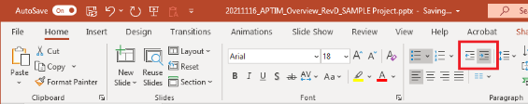
Bullets
Bullets
If your original text includes bullets, we recommend that you remove the bullets within the source document prior to copying and pasting into your PowerPoint.
Use the Decrease and Increase List Level buttons (to the right of Numbering on the Home tab) to create second-, third-, etc., level bullets.
Bullet Formatting
Follow the rules in the Bullets section of the APTIM Written Style Guide:
All bullets should start with a capitalized letter.
For lists with brief items of four words or fewer that are not complete sentences, follow the rules of title capitalization. Do not use punctuation. This is APTIM’s preference.
For lists with items of five words or more that are NOT complete sentences, do not use punctuation.
For lists with items that are complete sentences, use punctuation.

Slide 57
Insert Photos & Graphics
Insert Photos Within a Shape
To add a photo to fit within a shape on a template slide, place your cursor over the edge of the shape.
Right click.
Click the arrow next to Fill.
Click Picture.
Click From File.
Locate photo within files.
Click Insert.
To move the photo, right click on the photo and select Crop. Then drag the photo within the frame.
Keep Objects in Proportion when Resizing
Press and hold the Shift key while dragging one of the handles to keep an object, graphic, or photo in proportion while resizing it.
Draw Straight Lines
Press and hold the Shift key while inserting or drawing lines. This will keep your lines vertical, horizontal, or at a 45-degree angle.
Group & Ungroup Objects
To group objects, press Ctrl+G.
To ungroup objects, press Ctrl+Shift+G.

Slide 58
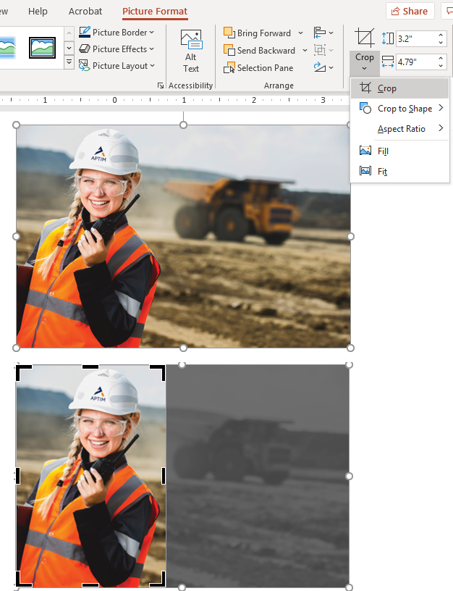
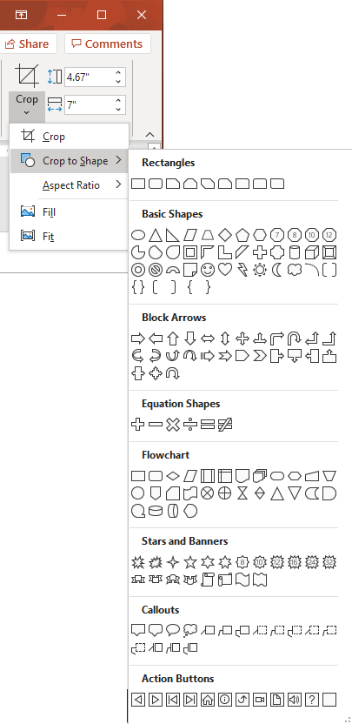

Crop Photos
Crop Photos
Click on the photo to Select it.
Click the Picture Format Tab.
Select the Crop tool in the Size Group.
A drop-down menu appears. Select Crop. The handles around the photo turn to black bars; when the cursor is moved over the handles, it changes to look like a “T.”
Click and drag the handles to show only the desired areas of the photo.
Click Crop again.
Crop Photos to a Shape
Follow steps 1–3 for Crop Photos.
From the drop-down menu, select Crop to Shape.
From the drop down, choose the shape.
Click Crop again.

Slide 59
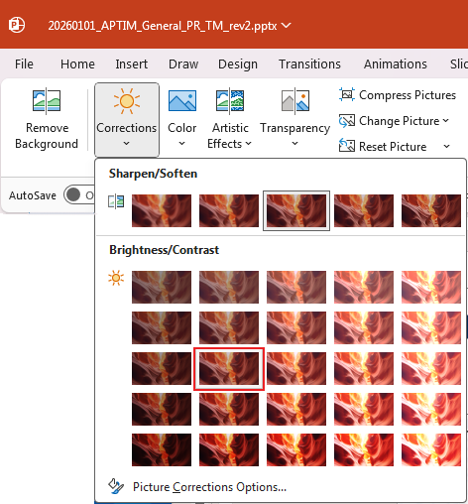
Adding Text Over a Photo
Adding Text Over an Image
If there is a need to add text over an image, the brightness and contrast may need to be adjusted so the text is legible.
Click on the photo to Select it.
Click the Picture Format tab.
Select Corrections.
Select Brightness -20% and Contrast: 0% (Normal)
Highlight your text box and change the color of the text to white on a dark image or leave as grey on a light image.

Slide 62
Section Title
Section Subtitle if Needed

Slide 66
Elements to Pick Up/Use
“
“
00%
CALLOUT STATISTIC - DESCRIPTION
We take our responsibility to empower our team and reduce our organizational environmental footprint seriously, but the largest impact we have on the planet and its people is through the work our teams do every day. Every project we deliver has its roots in sustainability and resilience.
Mark Fallon APTIM Chairman & CEO
We take our responsibility to empower our team and reduce our organizational environmental footprint seriously, but the largest impact we have on the planet and its people is through the work our teams do every day. Every project we deliver has its roots in sustainability and resilience.
Mark Fallon APTIM Chairman & CEO
00%
CALLOUT STATISTIC - DESCRIPTION
”
”
00%
CALLOUT STATISTIC - DESCRIPTION

Slide 67
Sample Table
Table Title
Table Header | Table Header | Table Header | Table Header | Table Header
Table Text

