Slide 1
Seminar Paper Presentation
Mario Wagner
Notes:
What is this paper about? -> Implemented passive learning approach called AALERGIA and tried to learn a non-deterministc Markov decision process with it

Slide 2
Motivation for Passive Learning
Issues with Active Learning
  Not all systems are available to query them
    Examples: Third party components, obsolete systems
  Not all systems can be queried
    Examples: Missiles, autopilot systems in act
  Not all aspects of a system can be invoked
    Self-destruction
Notes:
Examples:
Third party components, obsolete systems
2) Examples for non query:
missiles, autopilot systems in act
3) Examples for aspects of invokation:
self-destruction

Slide 3

Incentives for The Task
Many systems are modeled as Markov Decision Processes
  Robotics, finance, …
  Used to model non-autonomous (controlled) systems
  Can model both deterministic and non-deterministic behaviors
  MDPs are dense time models
Deterministic Systems
Non-Deterministic Systems
Mealy
MDP
Moore
PTA
DTMC
Notes:
Finance: deciding how much to invest in stock.
Robotics:
A dialogue system to interact with people.
Robot bartender.
Robot exploration for navigation.
An MDP is used to model non-autonomous (controlled) systems whose states are fully observable.
MDP is capable of modeling both deterministic and non-deterministic behaviors of the system
MDPs are dense time models
Moore can be deterministic and non determisitic
Mealy the output is dependend on the state and the input

Slide 4
Incentives for The Task
If necessary we can synthesize a Shield for MDPs
  Enforcing Safety Properties
Not all systems are modeled as an MDP
  We may make them safe with Shield synthesis if we could model check their safety aspects.
  To accomplish that we need to learn the system model
deterministic
System
Output
Shield
Modified Output
Input
Notes:
If necessary we can synthesize a Shield for MDPs
Enforcing Safety Properties
Not all systems are modeled as an MDP
We may make them safe with Shield synthesis if we could model check their safety aspects.
To accomplish that we need to learn the system model

Slide 5
Assigned Task
AALERGIA is only capable of learning discrete time models with deterministic behaviors
Question: Can we learn a discrete time model such that it preserves some behaviors of an MDP or an equivalent system?

Slide 6
AALERGIA [Mao et al., 2011]
Obtaining accurate system models manually is a time-consuming process
Passive learning → no interaction with the system!
AALERGIA offers automatic construction of a system model from observations of the original system
Learned model is a finite probabilistic automaton
LTL properties of learned system has the same properties as the original
Notes:
Obtaining accurate system models for verification is a hard and time consuming process – this is a hindrance for the industry, because the techniques are otherwise very powerful and useful
useful for: documentation, simulation, model-checking, performance evaluation and prediction, test generation and so on.
We dont assume that the system is available for testing or interactive data generation (→ no active learning)
With AALERGIA, an accurate system model can be automatically constructed from observations of the (black box) system
The learned final model is a finite probabilistic auntomata (a discrete time markov chain)
probabilistic automata are prefered to deterministic automata, because in a realistic situation, they are more suitable to model an accurate model of a systems observable (and possibly non-deterministic) behavior
As proven in the paper of Mao et al, in the large sample limit, the learned model of the original system has the same probabilities for linear temporal logic properties as the original system → it is possible to perform LTL model checking on the learned model and infer properties of the system

Slide 7
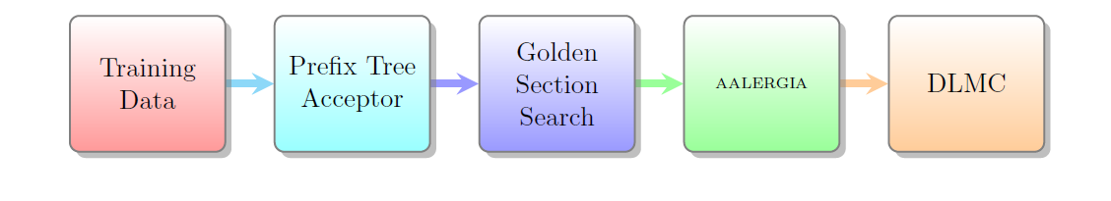
AALERGIA - Components
Notes:
Training data:
supplied in 2 comma seperated value (CSV) file, one containing the alphabet, the other one containing the training data (the traces of the system) → the training data is provided by a PRISM model
Frequency Prefix Tree Acceptor
After importing the data, a FTPA model is created
Golden Section Search
used to find an alpha value that optimizes the BIC score of the learned model
AALERGIA
the main part of the algorithm – Merges the states based on a compatibilitxy criterion
DLMC
in the end we get a determinstic labeled markov chain (DLMC)

Slide 8
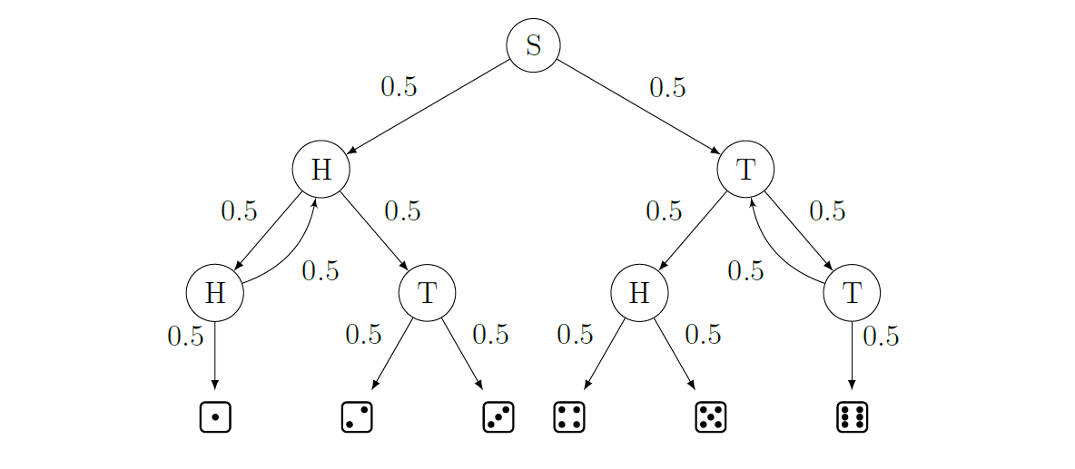
DLMC (Dice Model)
Notes:
Implemented in PRISM
Toss a coin at each step, gives us a 50 percent chance of transitioning to the next states
ends at the leafs of the tree, which is the dice value
->show on whiteboard what a typical path could look like S = {(SHHH1,1), (STT6,2)}→ first letters of the tuple show the path, 2nd number of the tuple shows the amount of times

Slide 9
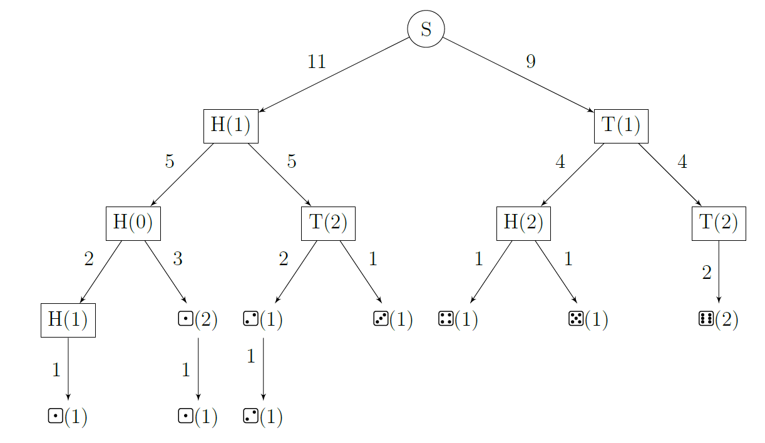
FPTA (Dice Model)
Notes:
show on whiteboard what a typical path could look like S = {(SHHH1,1), (STT6,2)}→ first letters of the tuple show the path, 2nd number of the tuple shows the amount of times
All states combined show the amount of the total in the transition (e.g. for 11 → take all states below it and count them) → number of occurrences
After this, a DFFA (deterministic frequency finite automaton) is created

Slide 10
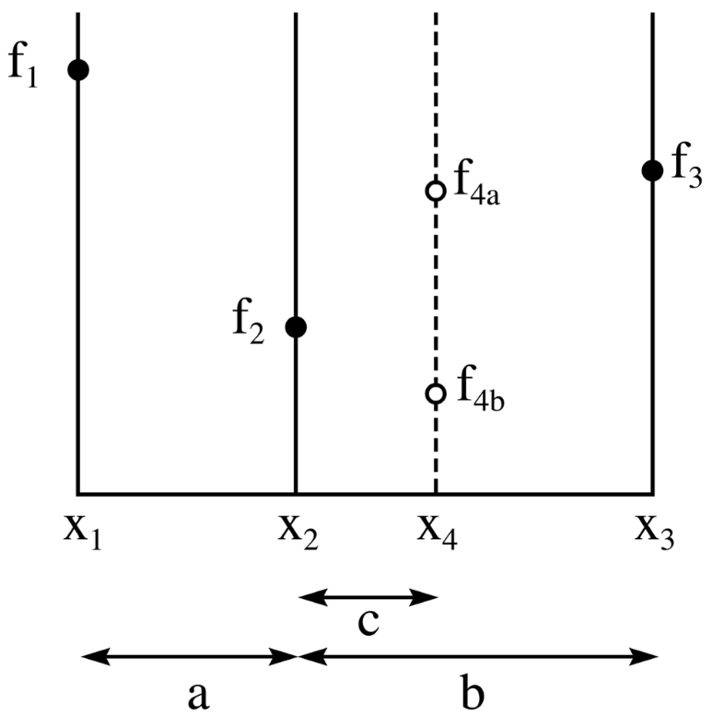
AALERGIA – Golden Section Search
used to find an extremum
We use the Bayesian information criterion (BIC) score to rate the ɛ we get
The algorithm suggets an ɛ with a high BIC score
Notes:
DRAW A PICTURE
algorithm tries to find the maxium between the 2 epsilon values
if it exists, the section that contains the maxium is chosen as new region and the search starts again with a maximum recursion dept of 3
in the end, a suggestion for a good epsilpon is proposed by the algorithm, it is used as input parameter for AALERGIA
BIC score is BIC = likelihood – ½ * Automata size * log(sample size)
(Calculate likelihood takes the new DPFA (deterministic, probabilistic finite automaton) and multiplies all the probabilities of all the traces together.)
(In statistics, a likelihood function (often simply the likelihood) is a function of the parameters of a statistical model given data.)

Slide 11
AALERGIA - Merging
RED/BLUE state-merging
Initial state is assigned to RED and successors are assigned to BLUE set
We loop through the BLUE states and check if we can merge any of the elements
  Merging is possible, if both states are compatible (bisimilar)
  The ɛ-value we calculated with the golden section search to approximate the compatibility
  If the merge happens, the size of the tree is reduced
  If not, the state gets promoted to the RED set and is excluded from the BLUE set
Merged FPTA is an automaton (including cycles)
Notes:
SHOW ON SLIDES
RED is a set of states thats already been revised
BLUE is a set of states that we need to look at

Slide 12
Case Study
“Formal methods for stability analysis of networked control systems with IEEE 802.15.4 protocol”
Bo Wu, Hai Lin, Michael Lemmon, 2014

Slide 13
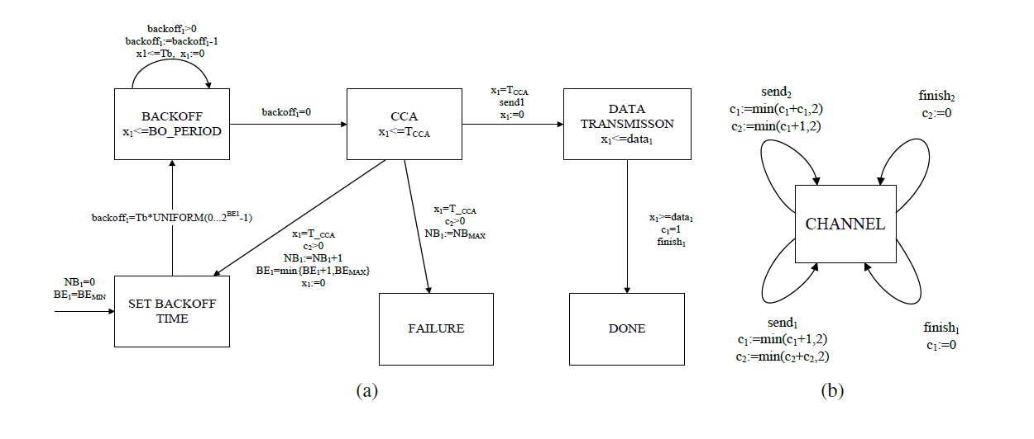
Case study: IEEE 802.15.4 Model
Source: Wu et al., 2014
Notes:
PRISM model, these kind of models have been proven to be useful for modelling and model checking the zigbee protocol
Show on board the most important parameters -> BE , BE_MIN, BE_MAX, NB, NB_MAX
Simple model of the IEEE 802.15.4 unslotted protocol
taken from WU et al, 2014 → they introduced it as a PTA and we had to model it as MDP → not possible to generate traces out of a PTA at the moment in PRISM
We used the digital clocks approach to convert the PTA to an MDP
In this model, we have 2 senders and 1 channel in parallel composition
Sending modules start their sending process at the same time
The protocol used is the unslotted CSMA/CA protocol
protocol uses a mechanism called exponential backoff, where a sender listens to the channel before attempting to send
We work with discrete time, the smallest time unit in our model is T_b
Start with initialising variables NB and BE => NB is number of times a backoff happened and is bounded by an upper bound (Bemax)
BE is the backoff exponent and is related to the random amount of time the sender waits before it attempts to listen to the channel again, BE = Bemin and bounded by Bemax
State CCA to listen to the channel, takes TB time

Slide 14

PRISM Model Checker
Probabilistic model checker
Formal modelling and analysis of random or probabilistic systems
Provides an own, simple language: „PRISM language“
Support for following probabilistic models:
  DTMC, CTMC, MDP, PA, PTA,...
LTL expressions can be used for model checking
We use it to:
  generate traces of the system we want to learn
  model check the systems with LTL
Notes:
PRISM is a probabilistic model checker
it is a tool for formal modelling and analysis of system that exhibit random or probabilistic behaviour
following probabilistic models are supported:
discrete-time Markov chains (DTMCs)
continuous-time Markov chains (CTMCs)
Markov decision processes (MDPs)
probabilistic automata (PAs)
probabilsitic timed automoata (PTAs)
Models are described via a PRISM language, a simple, state based language
the property specification language incorporates the temporal logics
PCTL (probabilistic computation tree logic)
LTL (linear temporal logic)
free and open source, licences under the GNU General Public License (GPL)
we use it for generating traces/trainings data and to model check the learned system

Slide 15
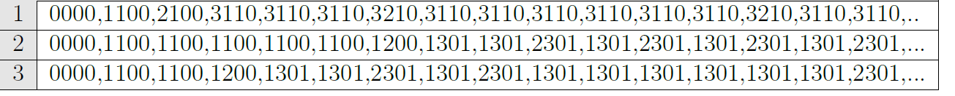
Generating traces out of the system
Generate traces with PRISM model
New Python tool was needed in order to generate many traces and parse the output
Alphabet is also created with the tool
How are the states in the model represented in the output?
Notes:
traces are generated with PRISM
A small python tool nhad to be implemented in order to generate the traces => with this, it was possible to generate many traces and it parsed the output to the desired CSV file
explain what the numbers in the traces file mean and how they represent the state of the system

Slide 16

Evaluation – Compare results
Is the proposed network stable or not?
  PR = The minimum probability of both stations successfully transmitting their packets within one sampling period
  LTL formula:
  Sampling Period is set to 80Tb
  Packet Length is set between 20-30Tb
In order to test the system → change Parameters for BE_{min}, BE_{max} and Nb_{max}
We used a count of 300 traces to generate the results

Slide 17
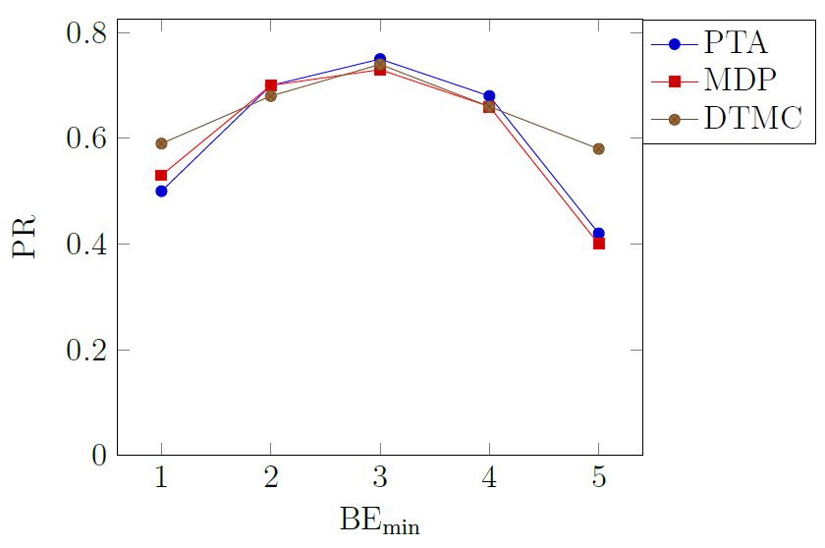
Evaluation – Compare results (1)
BE_{max} = 5 and NB_{max} = 4
BE_{min} is set between 1 and 5
Notes:
Maximum PR is achieved when BE_min = 3,
If Be_min is small, the backoff time will be short and it is likely that the channel is still busy when trying to send again, so NB_max is reached fast
If BE_min is too lage, it is likely that the process cannot finish in the given timeframe

Slide 18
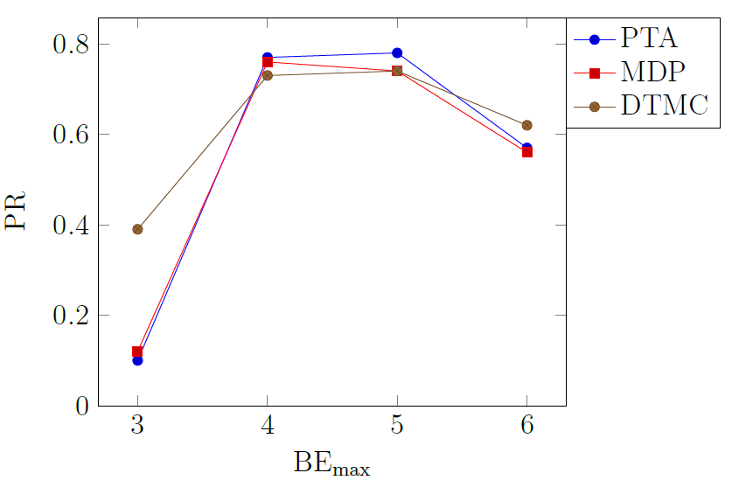
Evaluation – Compare results (2)
BE_{min} = 3 and NB_{max} = 4
BE_{max} is set between 3 and 6
Notes:
Maximum PR is achieved with BE_max = 4 and 5
similar situation to the picture before
If BE_max is small, the backoff time is too short and there are too many tries → the channel is not finished sending and NB_max is reached too soon
If BE_max is too big, it is likely that the sender waits too long and the channel cannot finish in the given timeframe

Slide 19
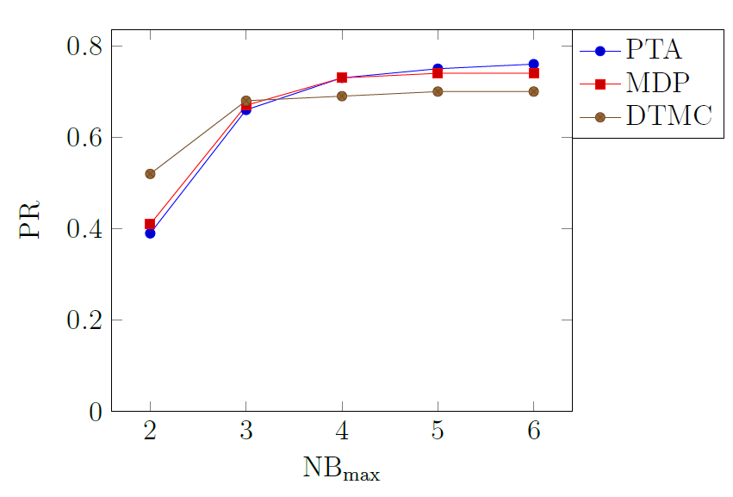
Evaluation – Compare results (3)
BE_{min} = 3 and BE_{max} = 5
NB_{max} is set between 2 and 6
Notes:
When NB_max is small, the maximum number of retries is reached very fast and the process fails
IF NB_max is larger, the process levels off quickly, because the timit limit stays this limits the sending process

Slide 20
Conclusion
We managed to learn the original PTA model of the parallel composition of 2 senders and one channel
When testing the LTL properties of the original system, results vary, some are very close to the original, some diverge from the original system
→ We do not know why this happens, therefore further research in the topic of sampling complexity is needed
We also suffer from state-space explosion: our original models consist of <20 states and the learned models consists of 400-500 states
Notes:
1) Higher level abstraction (MDP) -> Lower level abstraction (DTMC)
2) Sampling complexity

Slide 21
Thank you for your attention

