Slide 1
Robotics
Week 7

Slide 2
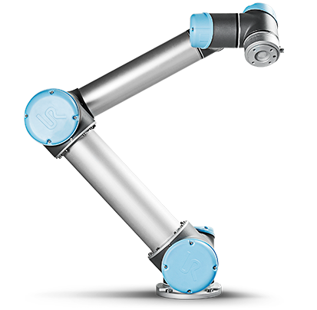
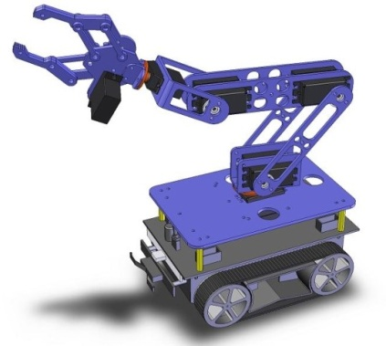
How to model a Robot?
Structure
Connected parts
links, connected by joints
Visualization
How do parts (links) look like
shape, size, color, mesh
Physics
Inertial
mass, moments of inertia

Slide 3
URDF
http://www.ros.org/wiki/urdf
Unified Robot Description Format
XML
Tree of links & joints
Perfect for serial robots or robotic arms
Not perfect for parallel robots (e.g. Delta)
Can only model one single robot
No environment (scene)
No teams

Slide 4
URDF
<robot name=“my_robot">
<link> ... </link>
<link> ... </link>
<link> ... </link>
<joint> .... </joint>
<joint> .... </joint>
<joint> .... </joint>
</robot>

Slide 5
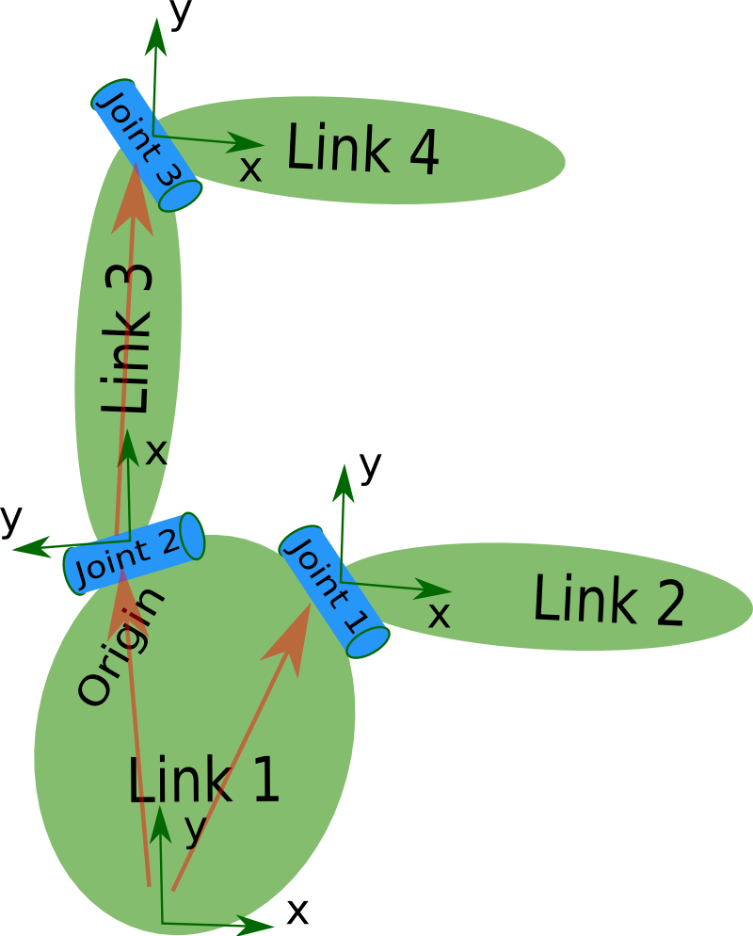
Links and Joints
<robot name=“my_robot">
<link name="link1" />
<link name="link2" />
<link name="link3" />
<link name="link4" />
<joint name="joint1" type=“fixed">
<parent link="link1"/>
<child link="link2"/>
</joint>
<joint name="joint2" type=“revolute">
<parent link="link1"/>
<child link="link3"/>
</joint>
<joint name="joint3" type=“revolute">
<parent link="link3"/>
<child link="link4"/>
</joint>
</robot>

Slide 6
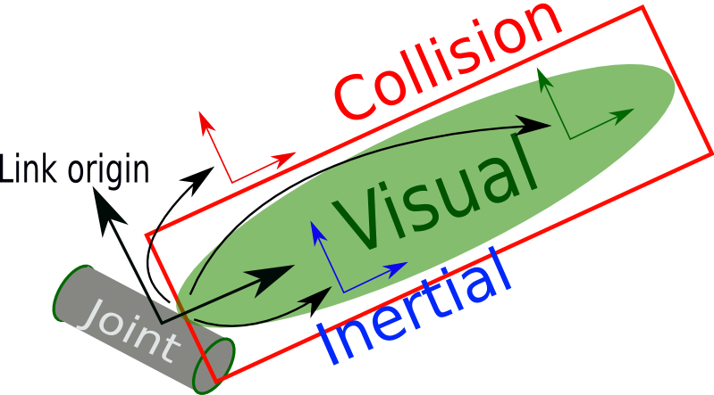
Link
Rigid body
<visual>
Geometry
box, cylinder, sphere
mesh (STL, DAE)
Material
color, image
<collision>
Simplified geometry for trajectory/collision calculations
<inertial>
Physical properties
mass, moments of inertia tensor

Slide 7
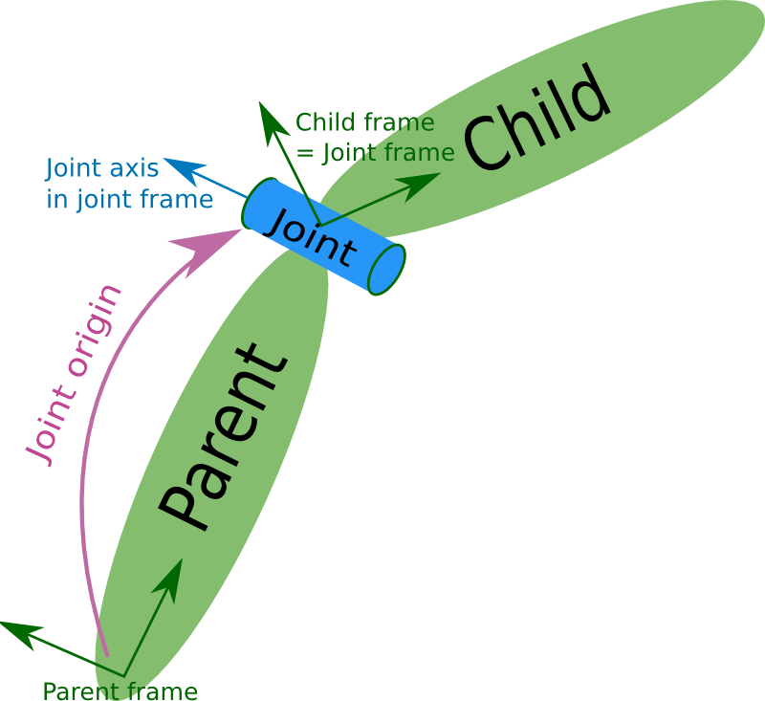
Joint
Joins 2 rigid bodies
type
Fixed
Revolute
Limits (lower, upper)
Continuous
No limits
Prismatic
Floating
Planar
<axis>, <limit>, …

Slide 8
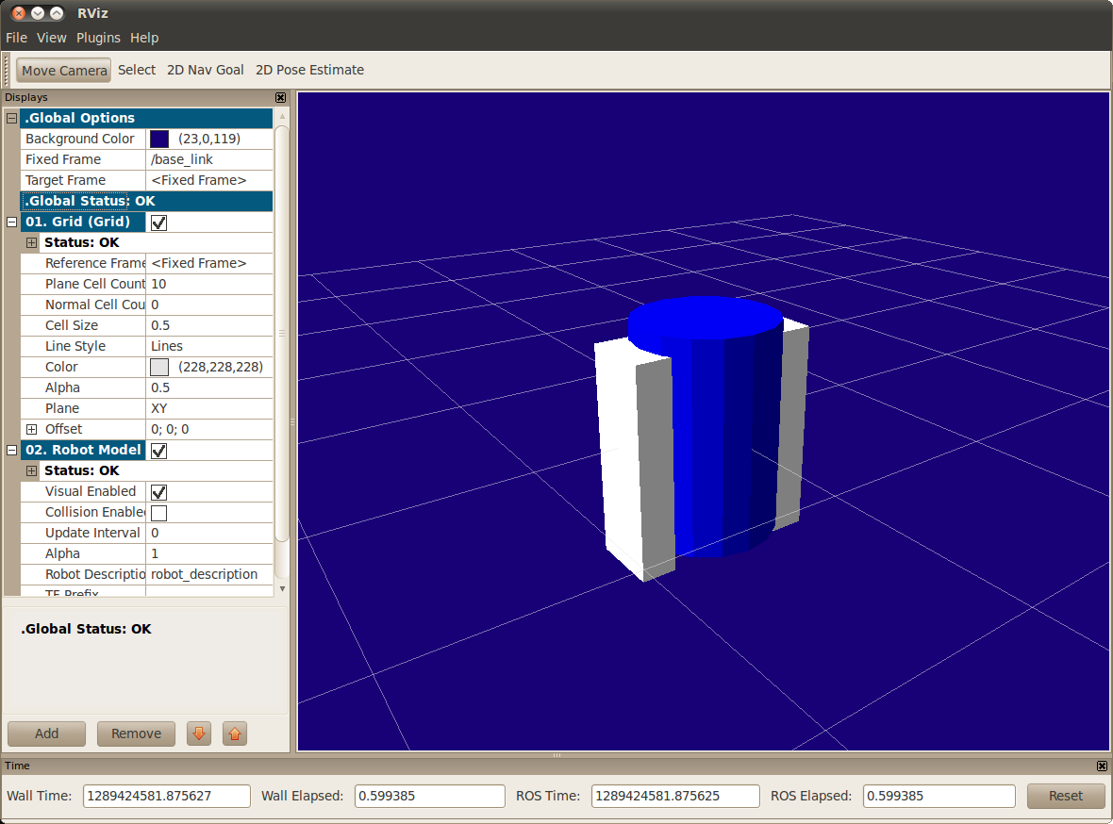
Example Link and Joint
<joint name="base_to_right_leg" type="fixed">
<parent link="base_link"/>
<child link="right_leg"/>
<origin xyz="0.22 0 .25"/>
</joint>
<link name="right_leg">
<visual>
<geometry>
<box size="0.6 .2 .1"/>
</geometry>
<origin xyz="0 0 -0.3“ rpy="0 1.57075 0" />
<material name="white">
<color rgba="1 1 1 1"/>
</material>
</visual>
</link>

Slide 9
XACRO
Problem: Complex URDF files
Solution: Macro’s ➔ XACRO
<xacro:property name="M_PI" value="3.1415926535897931" />
<xacro:property name="width" value=".2" />
<xacro:property name="bodylen" value=".6" />
<cylinder radius="${width/2}" length="${bodylen}"/>
<xacro:macro name="block" params="name">
<link name="${name}“> …. </link>
</xacro:macro>
<xacro:block name=“link1“
<xacro:block name=“link2"

Slide 10
Publish the robot model

Slide 11
robot_description
Launch file
URDF
Parameter_Server
(ROS Master)
robot_description

Slide 12
robot_description
Launching URDF file without XACRO
Launching with XACRO preprocessing
<param name="robot_description“
textfile="$(find …/urdf/myrobot.urdf"/>
<param name="robot_description“
command="$(find xacro)/xacro.py $(find …)/urdf/myrobot.xacro"/>

Slide 13
robot_description
Retrieving URDF file from parameter server
rosparam get -p /robot_description | tail -n +2 |cut -c 3- > robot.urdf

Slide 14
Visualization

Slide 15
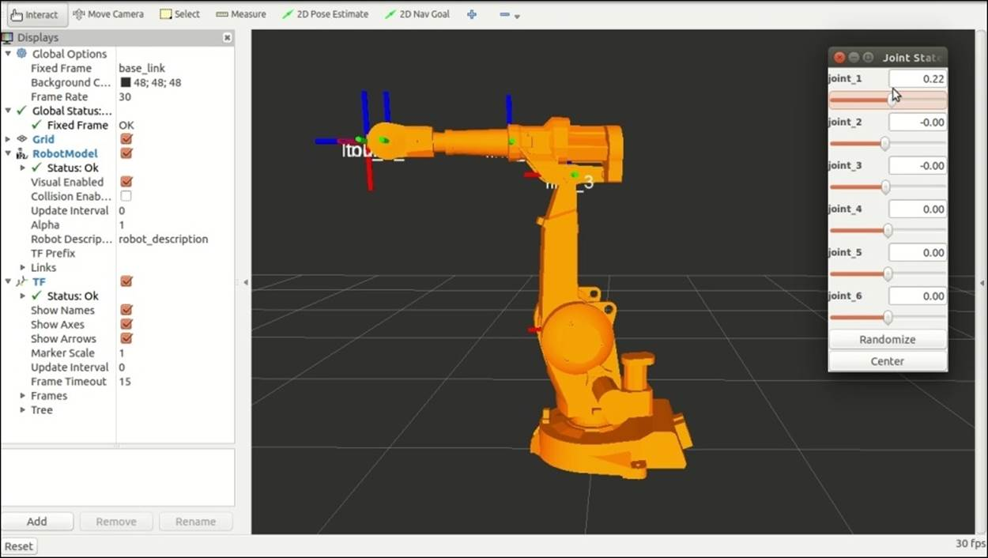
rviz

Slide 16
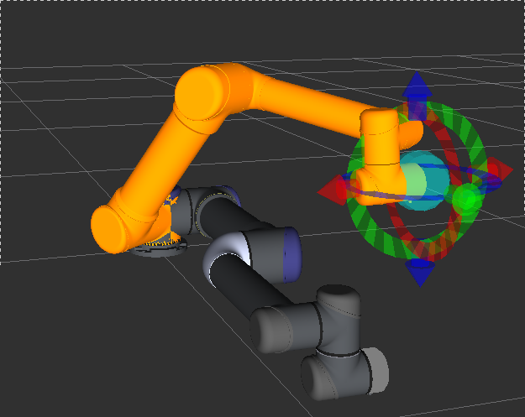
Robot Visualization
rviz
/tf
Parameter Server
robot_state_publisher
robot_description
/joint_states
control_node

Slide 17
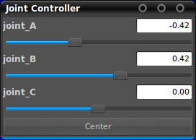
Test tool
joint_state_publisher
http://www.ros.org/wiki/joint_state_publisher
parameter: robot_description (URDF robot model)
publishes the state of non-fixed joints of a robot
topic: /joint_states (sensor_msgs/JointState)
GUI (optional)

Slide 18
URDF Visualization & Testing
rviz
/tf
Parameter Server
robot_state_publisher
robot_description
/joint_states
joint_state_publisher

Slide 19
URDF display launchfile
<launch> <arg name="model" default="$(find ...)/urdf/myrobot.urdf"
<arg name="gui" default=“True" /> <param name="robot_description“ textfile="$(arg model)"/> <param name="use_gui" value="$(arg gui)"/> <node name="joint_state_publisher"
pkg="joint_state_publisher"
type="joint_state_publisher" >
</node> <node name="robot_state_publisher"
pkg="robot_state_publisher" type=“robot_state_publisher" /> <node name="rviz" pkg="rviz" type="rviz"/> </launch>

Slide 20
URDF Visualization & Testing
urdf_tutorial launchfiles
roslaunch urdf_tutorial display.launch model:=myrobot.urdf gui:=true
roslaunch urdf_tutorial xacrodisplay.launch model:=myrobot.xacro gui:=true
https://github.com/ros/urdf_tutorial/tree/master/launch

Slide 21
simulation

Slide 22
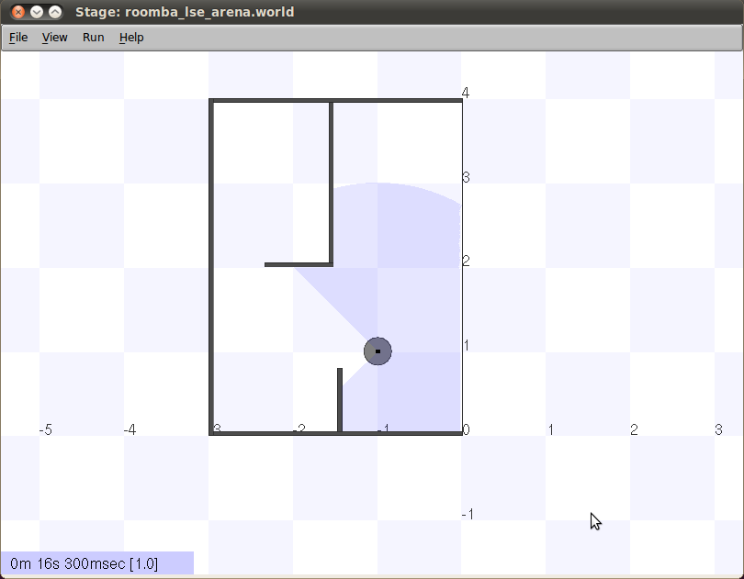
Stage
2D / mobile robots

Slide 23
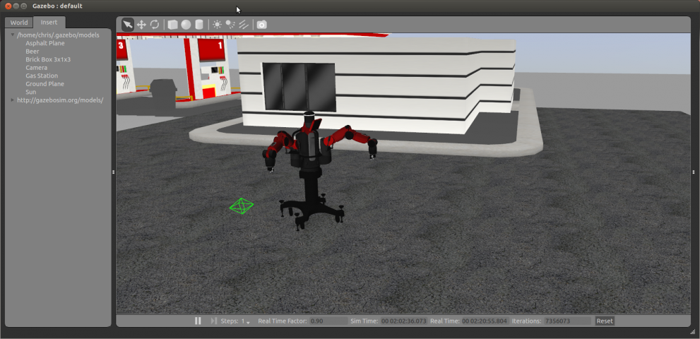
Gazebo

Slide 24
Gazebo
3D / all type of robots
Simulator Description Format (SDF)
solves the shortcomings of URDF
URDF: add <gazebo> elements
Transmission
Friction, stiffness, damping params
Plugins
ros_control
camera, kinect, laser
differential drive, skid steering drive, planar move
http://gazebosim.org/tutorials?tut=ros_urdf

