Slide 1
Robotics
Pose & Odometry

Slide 2
POSE
Robot’s position and orientation

Slide 3
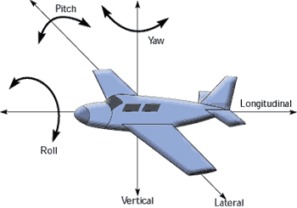
Pose
Robot’s posture in free space
Position
(x,y,z)
Orientation
Quaternion (x,y,z,w)
RPY(r,p,y)
Z
X
y
x
Y
z

Slide 4
Rotation
Any rotation can be defined by a rotation axis (x,y,z) plus a rotation angle (θ) around this axis
Quaternion
q = [x*sin(θ/2), y*sin(θ/2), z*sin(θ/2), cos(θ/2)]
x,y,z
θ

Slide 5
Quaternion
https://en.wikipedia.org/wiki/Quaternion
Better then RPY (Euler)
No “gimbal lock”
Better interpolation / extrapolation (SLERP)
Easier calculations
http://www.gamasutra.com/view/feature/131686/rotating_objects_using_quaternions.php
ROS Refs
http://answers.ros.org/question/9981/what-are-quaternions-and-how-can-iuse-them/
http://answers.ros.org/question/9772/quaternions-orientationrepresentation/

Slide 6
PoseStamped
http://ros.org/doc/api/geometry_msgs/html/msg/PoseStamped.html
Pose with reference coordinate frame and timestamp
Header
seq: <sequence number>
stamp: <timestamp>
frame_id: <reference coordinate frame>
Pose
Point position: x, y, z
Quaternion orientation: x, y, z, w

Slide 7
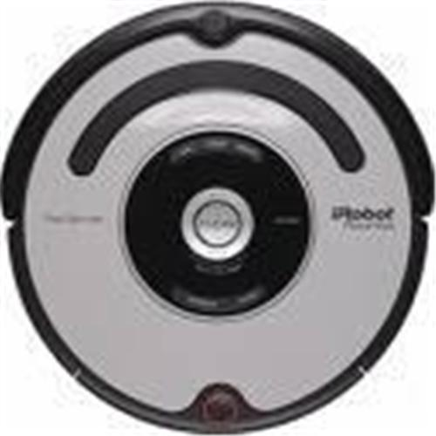
Pose in 2D
y_{r}
http://ros.org/doc/api/geometry_msgs/html/msg/Pose2D.html
Y-axis
θ (Yaw)
x_{r}
y
world
coordinate
frame
X-axis
x

Slide 8
Yaw to Quaternion in 2D
q= [0, 0, sin(θ/2), cos(θ/2)]
Special cases 0 0 0 1 Identity, no rotation 0 0 1 0 180° turn around Z axis 0 0 sqrt(0.5) sqrt(0.5) 90° rotation around Z axis 0 0 -sqrt(0.5) sqrt(0.5) -90° rotation around Z axis

Slide 9
Odometry
(?,?)
(0,0)
Keeping track of the robots’ pose (and speed.)

Slide 10
Odometry
http://ros.org/doc/api/nav_msgs/html/msg/Odometry.html
Estimate of Pose and Twist
using proprioceptive sensors (e.g. wheel encoders)
integration of distances while driving
Good for short term, relative position estimate.
Error / uncertainty grows while driving
systematic and non-systematic errors.
(x,y,…)
(0,0,..)

Slide 11
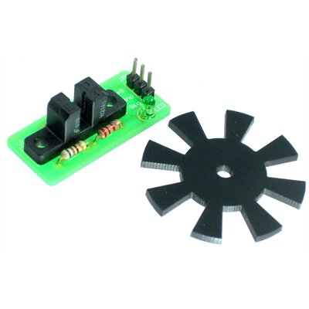

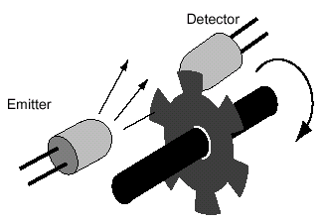
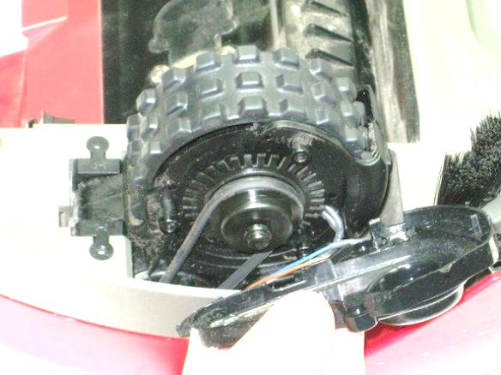
Wheel encoder
Provides amount of pulses per rotation

Slide 12
Odometry from encoder counts
while (true) :
dt = now() – last_time; last_time = now();
left_count= get_left_wheel_encoder_counts(); right_count= get_right_wheel_encoder_counts(); delta_distance = (right_count + left_count) * METERS_PER_COUNT / 2.0; delta_theta = (right_count- left_count) * METERS_PER_COUNT / WHEELBASE;
# current pose x += delta_distance * cos(theta); y += delta_distance * sin(theta); theta += delta_theta;
# current velocities vx = delta_distance / dt; vy = 0; omega= delta_theta / dt;

Slide 13
Odometry, Systematic Errors
Can be measured and accounted for in the model, a process known as calibration.
Two primary sources:
Unequal wheel diameters – lead to curved trajectory
Uncertainty about wheel base – errors in turn angle
Measurement and Correction
http://web.eecs.umich.edu/~johannb/paper58.pdf

Slide 14
Odometry, Non-systematic Errors
Error causes include uneven friction, wheel slippage, bumps, and uneven floors.
These errors can rarely be measured and incorporated into the model.

Slide 15
Odometry in practice
http://geology.heroy.smu.edu/~dpa-www/robo/Encoder/imu_odo/
http://wiki.ros.org/navigation/Tutorials/RobotSetup/Odom

Slide 16
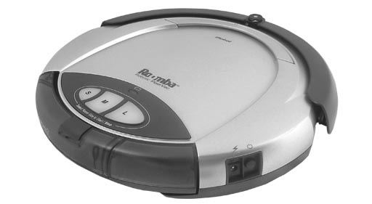
Robot Odometry in ROS
http://www.youtube.com/watch?v=S4EkL68uB0c
robot_node
Twist
Odometry
/cmd_vel
/odom
velocities
pose, velocities
wheel encoders

Slide 17
Enhanced Odometry
http://wiki.ros.org/robot_localization
IMU (GYRO/COMPASS)
GPS or VISION
orientation
pose
robot
_node
ekf _localization_node
/cmd_vel
/odom
pose, velocities
“Kalman filter”
driver
/odom/filtered

Slide 18
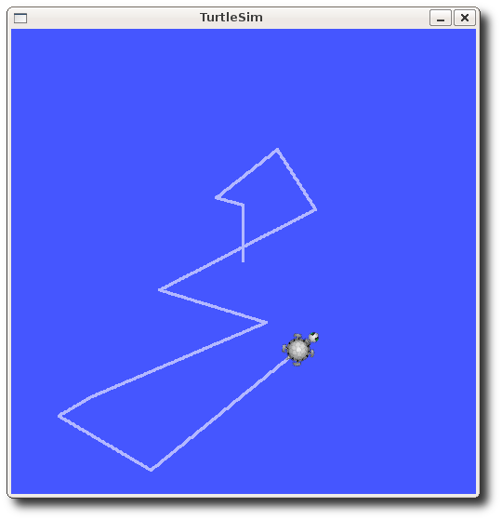
Simplified Turtlesim Odometry
http://wiki.ros.org/turtlesim
Twist
turtlesim_node
Pose
/turtle1/cmd_vel
/turtle1/pose
velocity
pose,velocity

Slide 19
Steering
How to move from current pose to a goal pose?

Slide 20
Point and Shoot
(x1, y1, th1)
Point
Turn (to point towards goal)
Shoot
Move (to goal)
Assume right heading (optional)
Turn (to correct heading)
(x2, y2, th2)

Slide 21
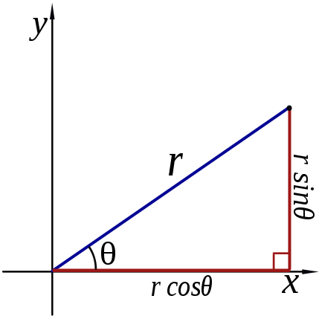
Polar coordinates
http://en.wikipedia.org/wiki/Polar_coordinate_system
Cartesian coordinates: (x,y)
Polar coordinates: (r,θ)
(x,y)

Slide 22
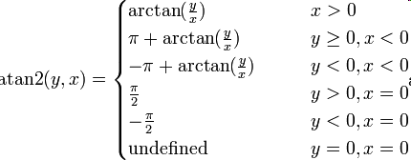
Polar coordinates - ATAN2
has multiple solutions
atan2 takes care of this

Slide 23
Smooth Trajectory
Use feedback control (“Servoing”)
Error: difference (linear and angular) between Goal Pose and Current Pose

Slide 24
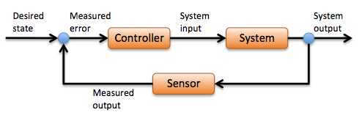
Feedback Control
Feedback loop to make error → 0
error = desired – measured
Proportional (P) controller: input = k*error
More advanced: PID controller
PID without a PhD
http://www.wescottdesign.com/articles/pid/pidWithoutAPhd.pdf
Improving the Beginner’s PID
http://brettbeauregard.com/blog/2011/04/improving-the-beginners-pid-introduction/

Slide 25

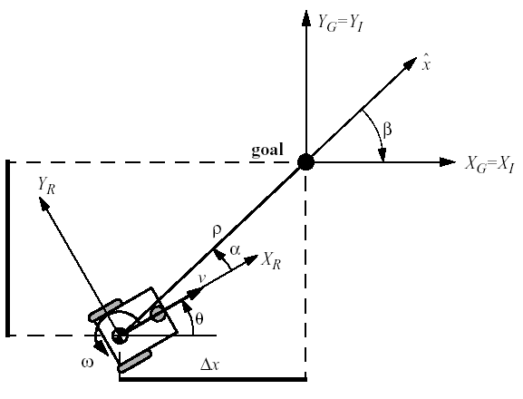

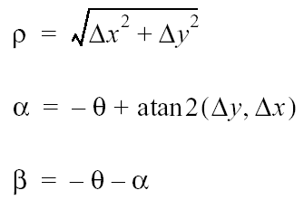
Smooth Trajectory
Control law:

