Slide 1
Robotics
Path Following

Slide 2
PATH FOLLOWING
How to follow a path?

Slide 3
Path
http://docs.ros.org/api/nav_msgs/html/msg/Path.html
An array of poses (waypoints) that represents a Path for a robot to follow
y
x
map

Slide 4
Map versus Robot coordinates
Robot needs waypoints in base_link coordinates
ROBOT
y’’
PATH
x’’
y’
base_link
y
x’
odom
x
map

Slide 5
First Idea
Steer from waypoint to waypoint?
Point-and-shoot
Servoing
Disadvantages
“Jerk”: stop and accelerate at each waypoint

Slide 6
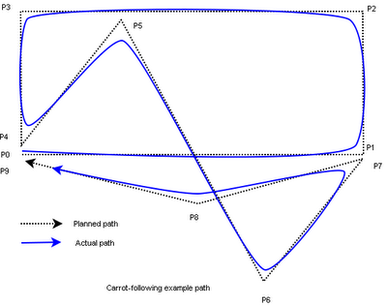
Better Idea
http://www.red3d.com/cwr/steer/PathFollow.html
Drive like humans do
Follow look ahead point (“carrot”)
Cutting corners !

Slide 7
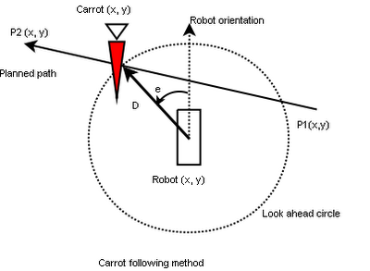
Follow-the-Carrot
Steer towards carrot: ω = k * e

Slide 8
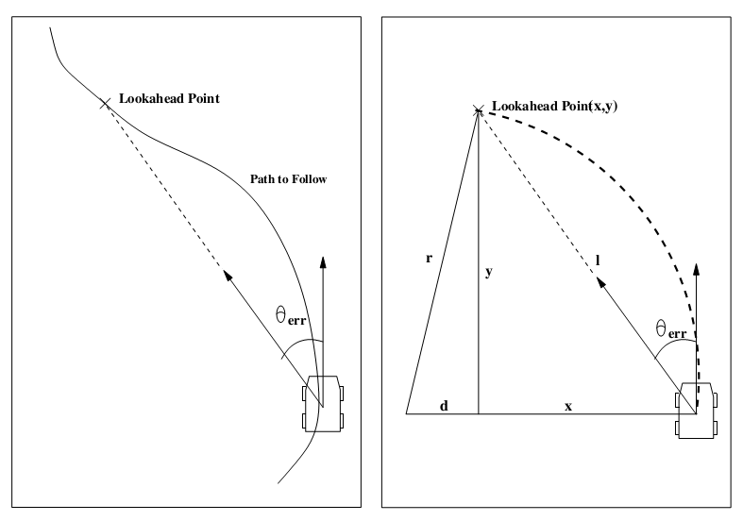
Other idea: Pure Pursuit
Choose ICC such that robot curves to carrot
Carrot
Carrot
R
L
x
ICC
y
ICC
R

Slide 9
Pure Pursuit
ω = C * v
C = (2/L² ) * y
C is the curvature = 1/R
y is the lateral error
L is the look-ahead distance

Slide 10
Pure Pursuit
Derivation
x²+y²=L² → x²=L²-y²
R=d+y → d=R-y → d²=R²-2Ry+y²
R² = d²+x² → R²=R²-2Ry+y²+L²-y² → R=L²/2y
C = 1/R = 2y/L²
v = ω * R → ω = C * v

Slide 11
And others …
To take care of specific robot limitations
That are specialized for a robot application
E.g. Robocup MSL

Slide 12
Navigation stack
goal
global_planner
?
Path
local_planner
?
Twist
cmd_vel

