Slide 1
Robotics
Week 11

Slide 2
How rosnodes work

Slide 3
Event driven
ROS is event-driven
Event ➔ Callback
Events
Subscriber receives new message
Service receives request
Timer reaches timeout

Slide 4
Spinning
http://wiki.ros.org/roscpp/Overview/Callbacks%20and%20Spinning
ROS relies on “spinning”
CallbackQueue
Queues all types of callbacks (Subscriber, Service, Timer,...)
ros::spinOnce()
Call all the callbacks currently waiting in the callback queue
ros::spin()
Keep spinning until node shutdown
Timers, Subscribers
callback
CallBackQueue
callback
spinOnce()

Slide 5
Two types of Time
Simulation Time
ros::Time
ros::Time::now()
ros::Duration
ros::Duration(1.0).sleep()
ros::Rate
ros::Rate r(10); // 10 hz
Wall Time: “real” wall clock time, from OS
ros::WallTime / ros::WallDuration / ros::WallTimer

Slide 6
Timed callbacks
http://wiki.ros.org/roscpp/Overview/Timers
ros::Timer
ros::Timer t = n.createTimer(ros::Duration(1.0), myCallBack);

Slide 7
Timed callbacks
Node
createTimer (duration,callback)
spin()
callback()
callback()

Slide 8
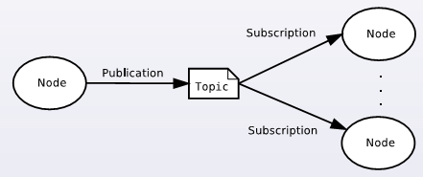
Message sending
Non-blocking (asynchronous)
No result

Slide 9
Message sending
// PUBLISHER
int main(…)
{
pub = n.advertise<msg>(“topic ", 1000);
ros::Rate rate(10); // 10 Hz
while (ros::ok()) {
pub.publish(msg);
rate.sleep();
}
return(0);
}
// SUBSCRIBER
void callback(msg)
{ … }
int main(…)
{
sub = n.subscribe(“topic”, callback);
ros::spin();
return 0;
}

Slide 10
Message sending
Publisher
Subscriber
subscribe(callback)
spin()
msg
publish(msg)
rate.sleep()
callback(msg)
msg
publish(msg)
callback(msg)
rate.sleep()

Slide 11
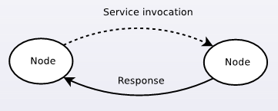
Service calling
Blocking (synchronous) → keep it short!
Result (respons)

Slide 12
Service calling
Client
Server
advertiseService(service, callback)
waitForService(service)
spin()
req
call(req, rsp)
rsp
callback(req,rsp)

Slide 13
Actionlib
When actions take long

Slide 14
What if callback takes a lot of time?
Examples
Moving the robot base to a target location
http://www.ros.org/wiki/move_base
Moving a robot arm to a target position
http://www.ros.org/wiki/move_arm
Complex, time-consuming calculation

Slide 15
Action
Takes relatively long time to execute
Can be monitored and canceled during execution
Delivers status and result
Goal
to pursue
Feedback
while progressing (periodic)
Result
upon reaching the goal

Slide 16
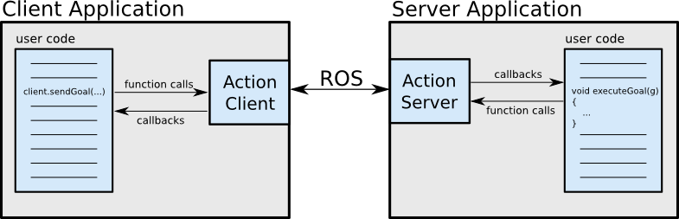
Action Library
actionlib

Slide 17
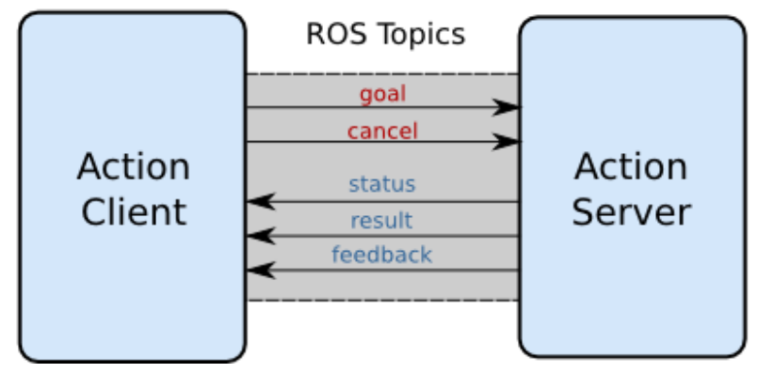
Action Library
Implemented using a set of predefined topics

Slide 18
Action
ActionClient
ActionServer
registerGoalCallback(callback)
waitForServer (..)
start()
spin()
goal
send_goal(goal)
feedback
callback(goal)
result

Slide 19
actionlib
http://www.ros.org/wiki/actionlib
Topic-based interface for pre-emptible actions
#include <actionlib/client/simple_action_client.h>
#include <actionlib/server/simple_action_server.h>
topics: /goal, /cancel, /status, /result, /feedback,
Depends on following packages
actionlib
actionlib_msgs
NameOfAction.action (to be placed in “action” directory)
Goal --- Result --- Feedback

Slide 20
Topics vs Services vs Actions
http://answers.ros.org/question/11834/when-should-i-use-topics-vs-services-vs-actionlib-actions-vs-dynamic_reconfigure/

