Slide 1
Robotics
8

Slide 2
Arms, Legs, manipulator movement

Slide 3
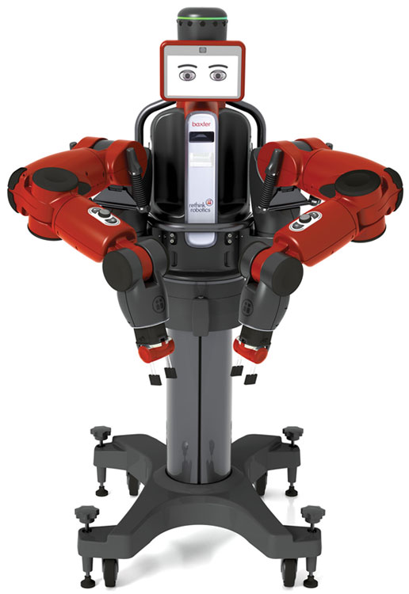
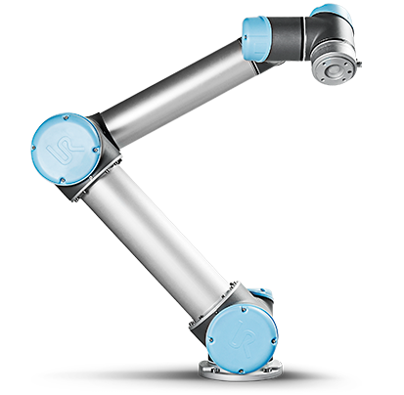
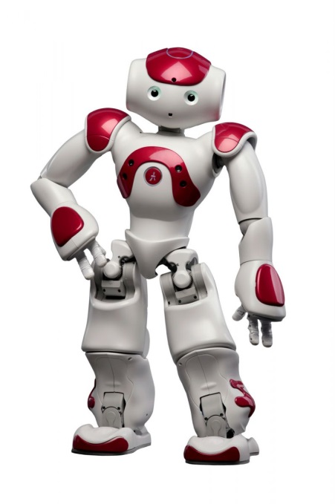
Manipulators, Arms, Legs

Slide 4
Kinematics
Forward (Direct) Kinematics
FK
Configuration Space
Carthesian Space
q3
Joint Positions
(q1,q2,q3,…)
q2
Tool Pose
(x,y,z), (x,y,z,w)
q1
Inverse Kinematics
IK

Slide 5
1 DOF example
FK: angle (Θ) ➔ position (x,y)
IK: position (x,y) ➔ angle (Θ)
(x,y)
d
θ

Slide 6
2 DOF example
FK: angles (Θ1, Θ2) ➔ position (x,y)
θ₂
d₂
(x,y)
d₁
θ₁

Slide 7

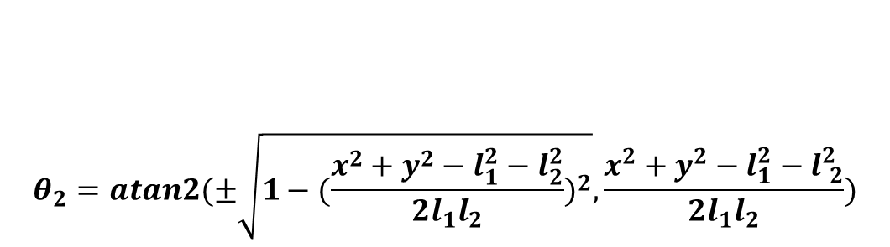
2 DOF example
http://www.hessmer.org/uploads/RobotArm/Inverse%2520Kinematics%2520for%2520Robot%2520Arm.pdf
IK: position (x,y) ➔ angles (Θ1, Θ2)
d₂
(x,y)
d₁
$\begin{matrix} \\ \\ \begin{aligned}θ_{1}=atan2(y,x)−atan2(k_{2,}k_{1}) \\ \end{aligned}\end{matrix}$ $\begin{matrix}{\begin{aligned} \\ k\end{aligned}}_{1}=l_{1}+l_{2}cosθ_{2} \\ \\ \begin{aligned} \\ k_{2}=l_{2}sinθ_{2}\end{aligned}\end{matrix}$
Two solutions!
$$\begin{matrix} \\ \\ \\ \\ θ_{2}=atan2(±\sqrt{1−{(\frac{x^{2}+y^{2}−l_{1}^{2}−l_{2}^{2}}{2l_{1}l_{2}})}^{2}},\frac{x^{2}+y^{2}−l_{1}^{2}−l_{ 2}^{2}}{2l_{1}l_{2}})\end{matrix}$$

Slide 8
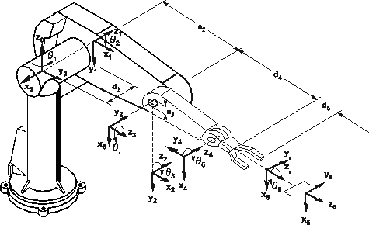
6 DOF example: PUMA 560
How do we tackle this one?

Slide 9

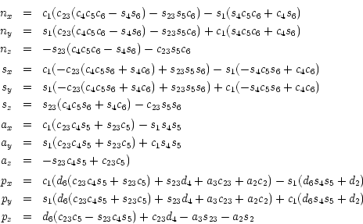
Puma 560
FK:

Slide 10
Inverse kinematics in ROS
Iterative IK solver ➔ KDL
http://wiki.ros.org/orocos_kdl
Generic, for any robot
Default in ROS
Analytic IK solver ➔ IKFast
http://openrave.org/docs/latest_stable/openravepy/ikfast/
Generates a C++ file with an analytic solution
Only for a specific robot
Much Faster

Slide 11
Motion Planning
goal pose
Motion Planning
(q1, q2, q3, q4, q5, q6)
Control

Slide 12

MoveIt!
http://moveit.ros.org/
MoveIt!
Motion planning
Obstacle (and self-collision) avoidance
“Collision-aware IK”
Trajectory Execution
MoveIt! Setup Assistant
Configure MoveIt! for a new robot and interact with a visualized model of the robot in Rviz.
Input: URDF model.

Slide 13
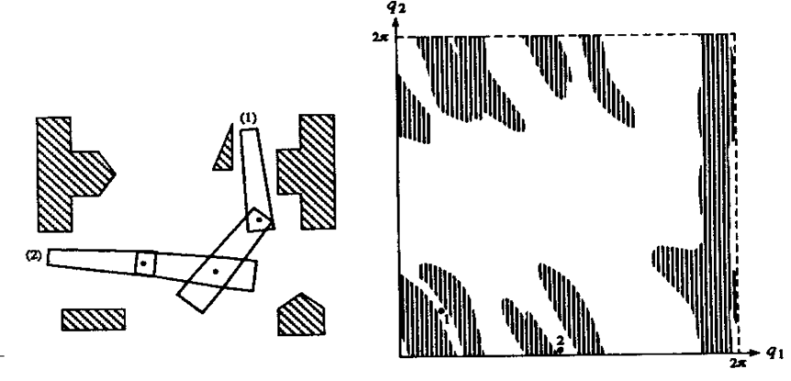
Workspace vs Configuration Space
Carthesian (Work) Space
Robot has shape
Configuration Space
Robot is point
y
x

Slide 14
Motion Planning steps
Translate goal pose from Carthesian to Configuration Space
In Configuration Space search appropiate trajectory (sequence of trajectory points) from current pose to goal pose.
No collision with obstacles and self
Within constraints (Velocity/Acceleration limits

Slide 15
OMPL: Open Motion Planning Library
Sampling-based motion planning algorithms
E.g. Rapidly-exploring Random Tree (RRT)
Find a path to the goal in a probabilistic way.

Slide 16

ROS Industrial
http://rosindustrial.org/
http://wiki.ros.org/Industrial

Slide 17
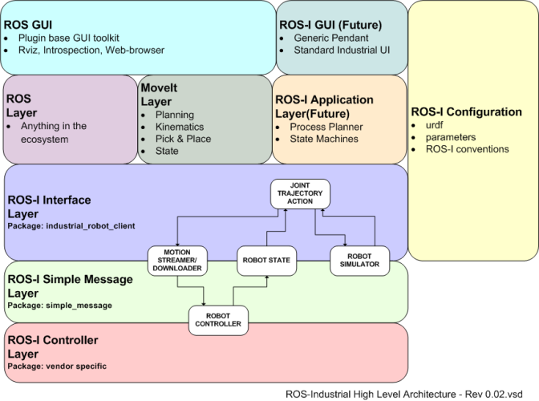
ROS Industrial Stack

Slide 18
Industrial Arm control in ROS
http://wiki.ros.org/Industrial/Industrial_Robot_Driver_Spec
move_group
JointTrajectory
FollowJointTrajectoryFeedback
JointTrajectoryPoint
JointState
industrial_robot_controller
simple_message protocol
Robot Arm Controller

Slide 19
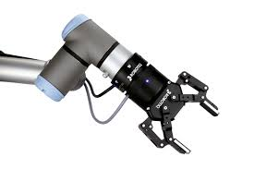
Gripper
GripperCommand
gripper_controller

Slide 20
Video
Baxter Research Robot MoveIt! Tutorial
https://www.youtube.com/watch?v=1Zdkwym42P4

