Slide 1
Robotics
Navigation

Slide 2
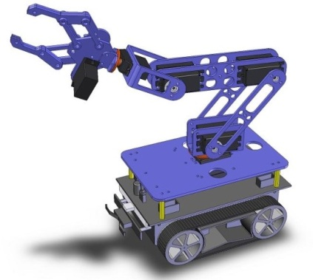
Making the robot more intelligent
actionlib
/goal
Planning
Localization
Mapping
TF
/cmd_vel
/odom
Control

Slide 3
Learning goal
apply ‘Probablistic Robotics’ concepts like ‘Occupancy Grid Map’, ‘Bayes (Kalman, Particle) Filter’, and ‘SLAM’ by making a mobile robot drive autonomously, using existing ROS localization, mapping & navigation nodes

Slide 4
Navigation
Where am I going ?
Goal
How do I get there ?
Plan a path to the goal, avoiding fixed obstacles
Go there !
Control the Robot Base and avoid new obstacles

Slide 5
Path Planning
Search path through free space in Map
Free space
Forbidden region

Slide 6
Workspace

Slide 7
Problem
Robot is not a “point in space”
Has footprint

Slide 8
Configuration space
“inflation”

Slide 9
Discretization

Slide 10
Problems
New and removed obstacles
Humans
Furniture

Slide 11
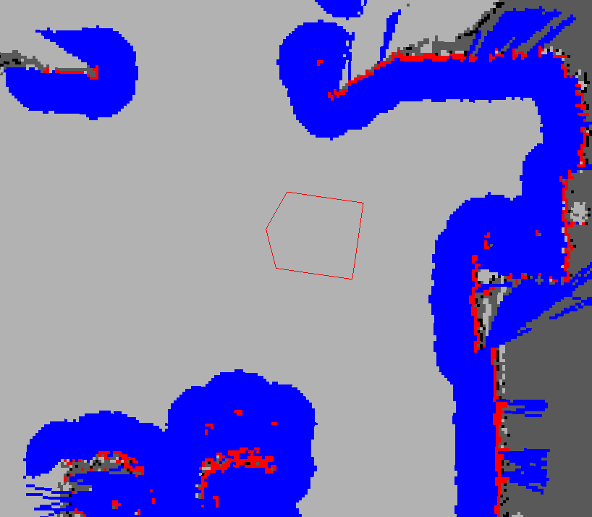
costmap
http://www.ros.org/wiki/costmap_2d
Stores information about obstacles
Inputs
Sensors (dynamic: laserscan, pointcloud)
Map (static)
Inflates obstacles
To avoid contact with robot

Slide 12
ROS Navigation stack
move_base
goal
map
PLANNER
global_planner
global_costmap
Path
CONTROLLER
local_planner
local_costmap
laserscan
pointcloud
odom/tf
/cmd_vel

Slide 13
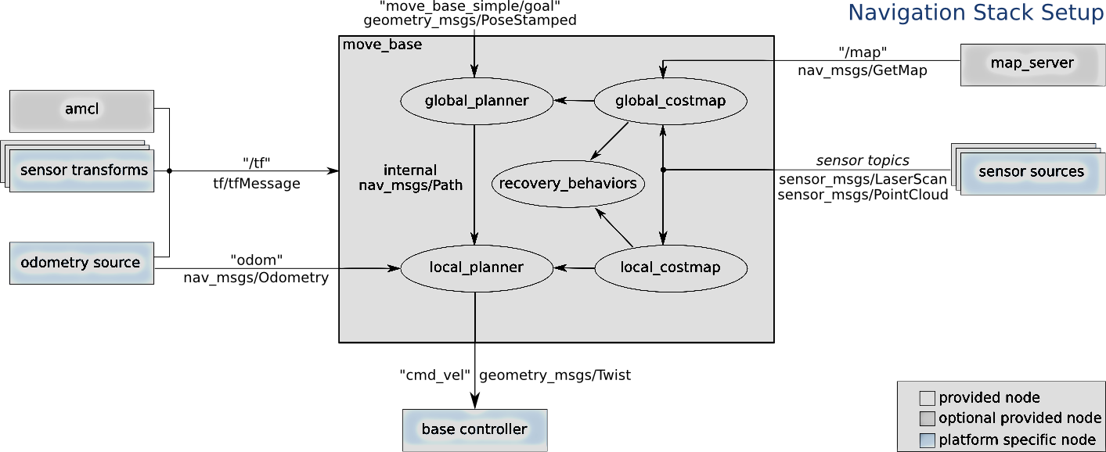
ROS Navigation stack
http://www.ros.org/wiki/navigation
http://www.ros.org/wiki/turtlebot_navigation

Slide 14
global_planner
Uses global costmap derived from Map
Computes long-term, global plan
Optimistical, i.e. unaware of new obstacles and of robot’s actual footprint and dynamics (speed/acceleration limitations )
Algorithm
Shortest path
Dijkstra (default), A*, D*, Wavefront

Slide 15
Example: Wavefront global planner
2
1
2
3
1
0
1
1
2
2
2
3
3
3
4
5
4
4
Notes:
15

Slide 16
local_planner
Uses local costmap, updated by obstacle sensors
Controller
Computes a short-term, local plan
Stays close to path, but avoids obstacles dynamically
Adheres to dynamics of the robot (min/max speed , acceleration)
Sends velocity commands to the mobile base of the robot
Algorithms
Trajectory scoring
DWA, Trajectory rollout
or…roll your own

Slide 17
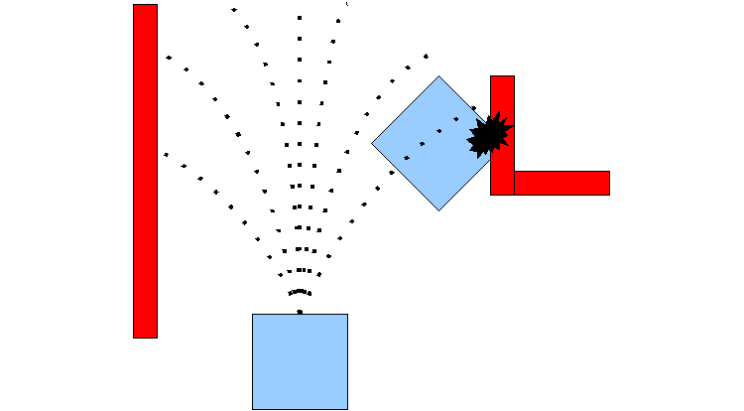
DWA local planner
Dynamic Window Approach
Predict (simulate) outcome of sample velocities
Score each and pick the highest-scoring

Slide 18
Plug-in approach
global_planner and local_planner are plug-ins
Can write your own…

Slide 19
Advanced topics
Motion Planning (3D Configuration space)
Robotic arms
Humanoids
Book
Planning Algorithms http://msl.cs.uiuc.edu/planning/

