Slide 1
Robotics
Week 15

Slide 2
Robot Control Architecture
Deliberative Control
Think hard, act later.
Reactive Control
Don’t think, (re)act.
Hybrid Control (3-layer)
Think and act independently, in parallel.
Behavior-Based Control
Think the way you act.

Slide 3
Deliberative Control
Sequential behaviors
Think / Plan
Perceive
Follow Plan
Sensors
Actuators

Slide 4
Big Robot Control Architecture
Knowledge,
Mission
Data Base
Commands
Localization
"Position"
Cognition
global
Map Building
Global Map
Path Planning
Features
Path
local
Information
Local Map
Path
Extraction
Execution
Perception
Raw data
Commands
Motion Control
Sensing
Acting
Real World
Environment

Slide 5
Control Trade-offs
Thinking enables planning to reach complex goals efficiently and to learn from the past
BUT
To think, the robot needs a lot of information storage and processing power
Thinking is relatively slow.
Thinking too long can be dangerous (e.g., falling off a cliff, collisions, etc.).

Slide 6
Small Robot
What if we have no smart sensors?
No Laser Range Finder
No Kinect
Not even a Webcam
Only: contact (bumper, whiskers), light, sound,…
What if we have “small brains” ?
Can not maintain a Map
Can not Localize
Can not Plan

Slide 7
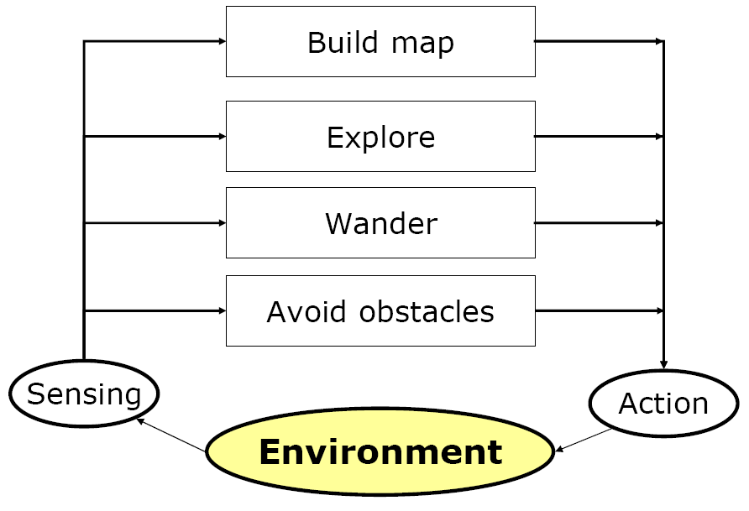
Behavior Based Control
Behaviors
Sensors
Actuators

Slide 8
Behavior Based Control
Concurrent behaviors
Simple but extendable
react fast using concurrent behaviors
do complex tasks and store world models using a network of behaviors

Slide 9
Network of Behaviors
Sensor
Behavior
Sensor
Behavior
Behavior
Actuator
Behavior
Actuator

Slide 10
Behavior
Unit of control
if (isTriggered()) → doBehave()
Achieves or maintains particular goal
e.g. wandering, wall-following, escaping, homing, follow-target, recharge, grab-object, plan
Takes inputs from sensors and from other behaviors and send outputs to actuators or other behaviors

Slide 11
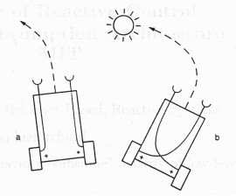
Emergent Behavior
What an external observer sees a robot doing
Emerging from
interaction with the Environment
interaction of Behaviors
May sometimes be surprising or unexpected

Slide 12
An Example
A robot that water plants around a building
Behaviors: avoid-collision, find-plant, check-if-dry, water, refill-reservoir, recharge-batteries
Complex behaviors may consist of internal behaviors themselves
find-plant: wander-around, detect-green, approach-green, etc.
Multiple behaviors may share the same underlying component behavior
refill-reservoir may also use wander-around

Slide 13
Problem
Concurrent behaviors may want to send commands to the same Actuator
Behavior
Behavior
Actuator
Behavior

Slide 14
Arbiter
Behavior
Behavior
Arbiter
Actuator
Behavior

Slide 15
Problem
What if we have multiple shared Actuators?

Slide 16
Small Robot BBC Implementation
while(1) {
readSensors();
if ( triggered1() ) { doBehavior1(); }
else if ( triggered2() ) { doBehavior2(); }
else if ( triggered3() ) { doBehavior3(); }
else if …
writeActuators()
}

Slide 17
Small Robot BBC Implementation
while(1) {
readSensors();
if ( triggered1() ) { doBehavior1(); }
if ( triggered2() ) { doBehavior2(); }
if ( triggered3() ) { doBehavior3(); }
…
arbitrate();
writeActuators()
}

Slide 18
ROS Implementation
Think about it yourself!

