Slide 1
Robotics
Localization & Mapping

Slide 2
LOCALIZATION (continued)
Where am I?

Slide 3
Pose Estimation
Calculate Believe of the robot about its pose x from its recorded motions and from the measurements it makes in its environment
BEL(x) = P(x|U,Z)
U: motions (odometry)
Z: measurements (distances, features/landmarks)

Slide 4
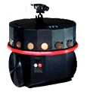
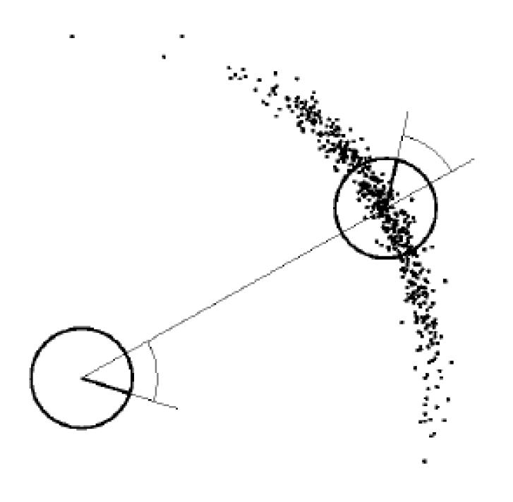
Bayes filter
Motion model: P(x_{t}|u_{t}, x_{t-1})
Probability of x, given previous x and motion u
Measurement model: P(z_{t}|x_{t})
Probability of measuring z when in position x
x_{t}
u_{t}
x_{t-1}
z_{t}
x_{t}

Slide 5
Bayes filter
Prediction using motion model
Correction using measurement model
Prediction
motion action: u
Increases uncertainty
Bel’(x)
Correction
measurement: z
Decreases uncertainty
Bel(x)
BEL(x)

Slide 6
Bayes Filter
Prediction
Correction
Motion model
Measurement model

Slide 7
Types of Bayes filters
Kalman filters (EKF, UKF)
Limited to linear, Gaussian models
Continuous. No jumps (“kidnapping”) allowed
Particle filters (Monte Carlo filters)
Any linear or non-linear model
Jumps (“kidnapping”) allowed

Slide 8
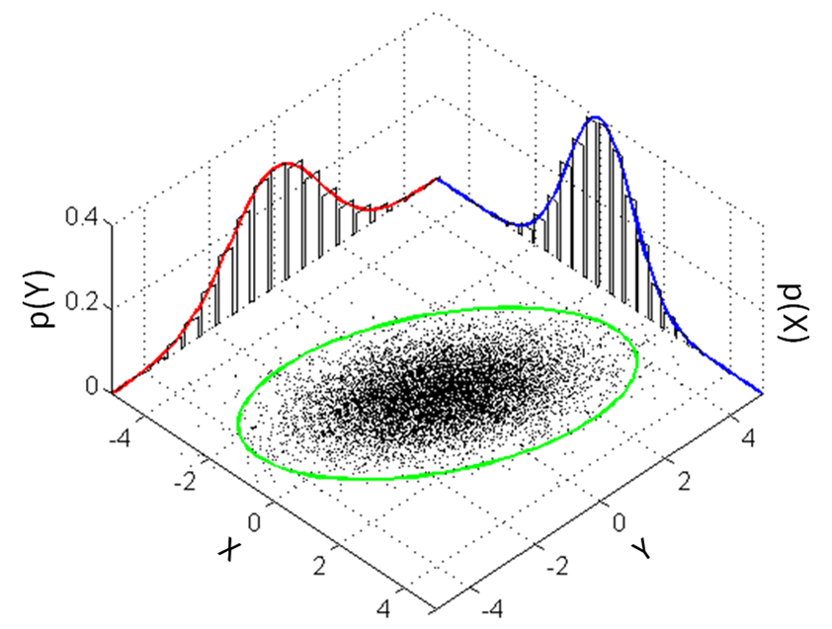
Particle filter
Represent Probability Density Function by particles
Each particle is a sample
Higher probability → more samples

Slide 9
Monte Carlo Localization
Particle filter
Each particle is a hypothesis about the robots pose
Bayes filter: “survival of the fittest”
Move each particle using the Motion model
Measurement model gives each particle a weight
Resample (=select & clone) particles based on weight
Probable particles have highest chance to survive

Slide 10
Monte Carlo Localization (MCL)

Slide 11
AMCL
http://www.ros.org/wiki/gmapping
Adaptive Monte Carlo Localization
/tf
map → odom
AMCL
/particlecloud
/scan
/amcl_pose
laser_drivers
rviz
map
map_server

Slide 12
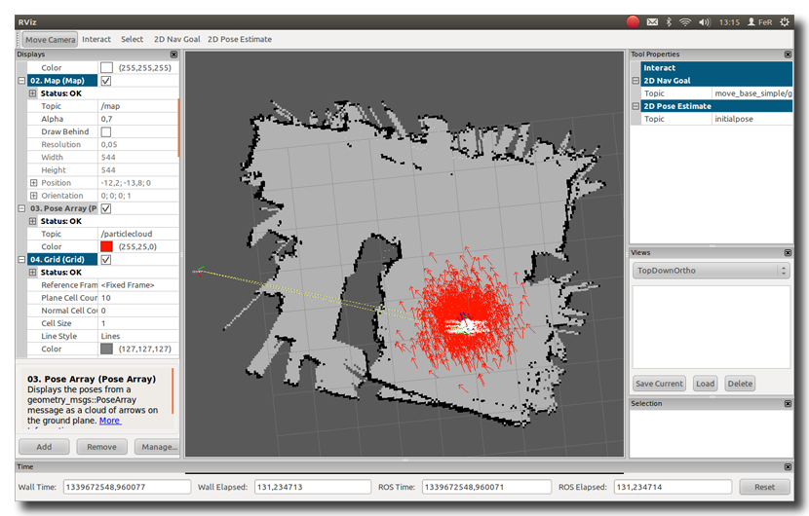
AMCL visualization in RVIZ

Slide 13
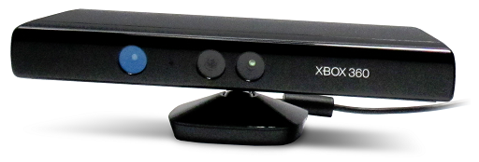
Turtlebot: Faking a Laser Scanner
http://ros.org/wiki/openni_camera
http://www.ros.org/wiki/pointcloud_to_laserscan
openni_camera
/camera/depth/points
pointcloud_to_laserscan
/scan

Slide 14
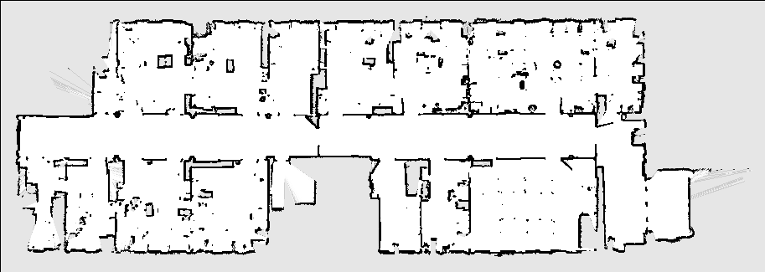
Mapping
How to make a map?

Slide 15
What if we do not have a map?
Let the robot make one
Drive it around to learn
Random walk
Teleoperated
Problem
To make a map we need the robots location
But…to localize we need a map

Slide 16
SLAM
Simultaneous Localization and Mapping
Statistically estimate P(X,m|U,Z)
Bayes filter
Each particle represents a possible map
Survival of the fittest

Slide 17
GMAPPING
http://www.ros.org/wiki/gmapping
SLAM
/tf
map → odom
slam_ gmapping
/map_metadata
/scan
/map
laser_drivers
map_saver

