Slide 1
Skew-Resilient Parallel Hash Joins
via Adaptive Fine-Grained Scheduling
Course Instructor : Dr. Biju R Mohan
Presented By:
Rohith A M 241AI030
Shriya Bharadwaj 241AI039
Walke Arya Anand 241AI044
Kolanti Dharmesh 241AI019

Slide 2
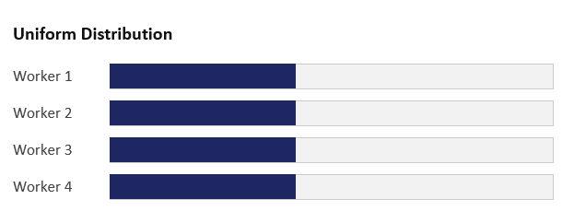
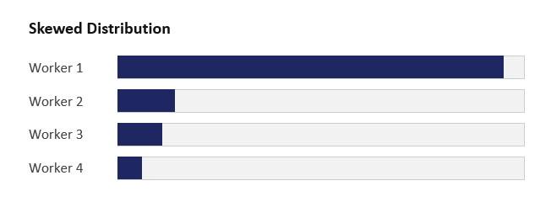
Why This Problem Needs Parallelism
The base operation
Where it breaks
Join keys are rarely uniform. Under Zipf-like skew, a handful of partitions end up with far more tuples than the rest but a static, coarse assignment of partitions to threads has no way to react to that.
A hash join builds a hash table on the smaller relation R, then probes it with every tuple of S. This is the operator our whole project is built around.
Hardware-conscious approach
On multicore CPUs, radix-partitioned hash joins are a well-established approach: split R and S into partitions using hash bits, making each local hash table smaller and more cache-friendly.
One thread's partition dwarfs the rest it becomes the straggler everyone waits on.
Balanced partitions
Skewed partitions
Each thread gets roughly equal work barriers cost little idle time.

Slide 3
DATASETS
Dataset Type: Synthetic relational datasets generated in C++ to enable controlled, reproducible experiments.
Input Relations: Two relations, R (Build Relation) and S (Probe Relation), used for an equi-join.
Dataset Size: Up to 5 million tuples per relation in the main benchmark.
Key Distribution: Uniform and skewed probe-side key distributions are used to study workload imbalance.
Skew Levels: Zipf-like skew parameter {0, 0.5, 0.75, 1.0, 1.25, 1.5, 1.75}.
Key Range: 1,000,000; Radix Partitions: 1,024 (two 5-bit partitioning passes).

Slide 4
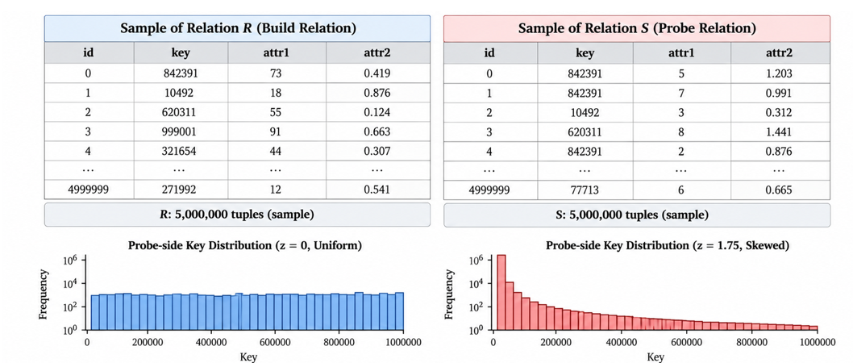
DATASETS ILLUSTRATION

Slide 5
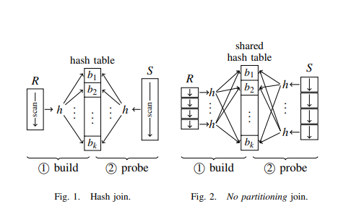
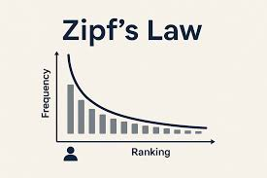
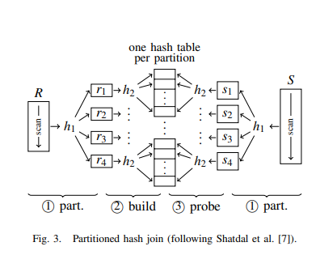
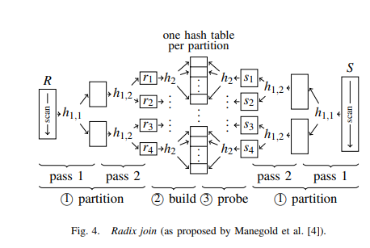
ILLUSTRATION

Slide 6
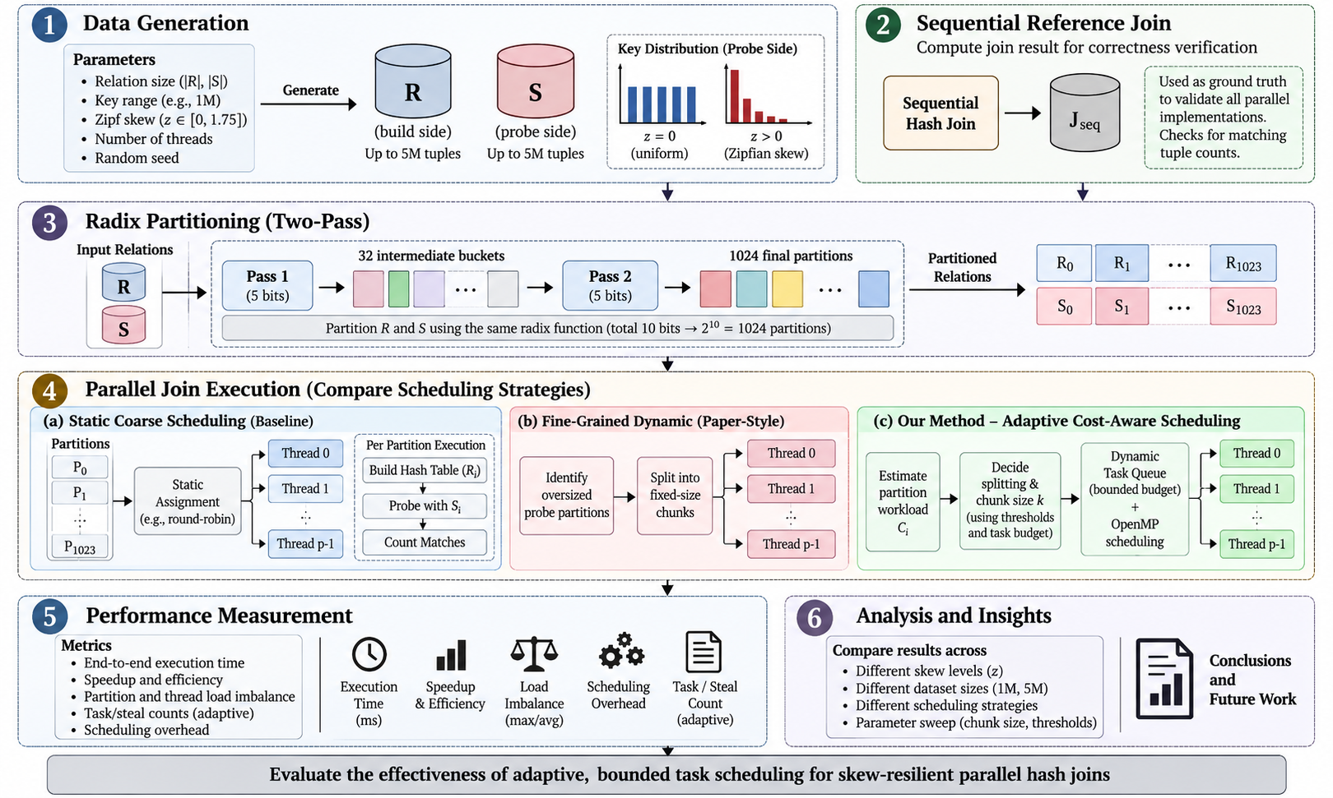
Methodology

Slide 7
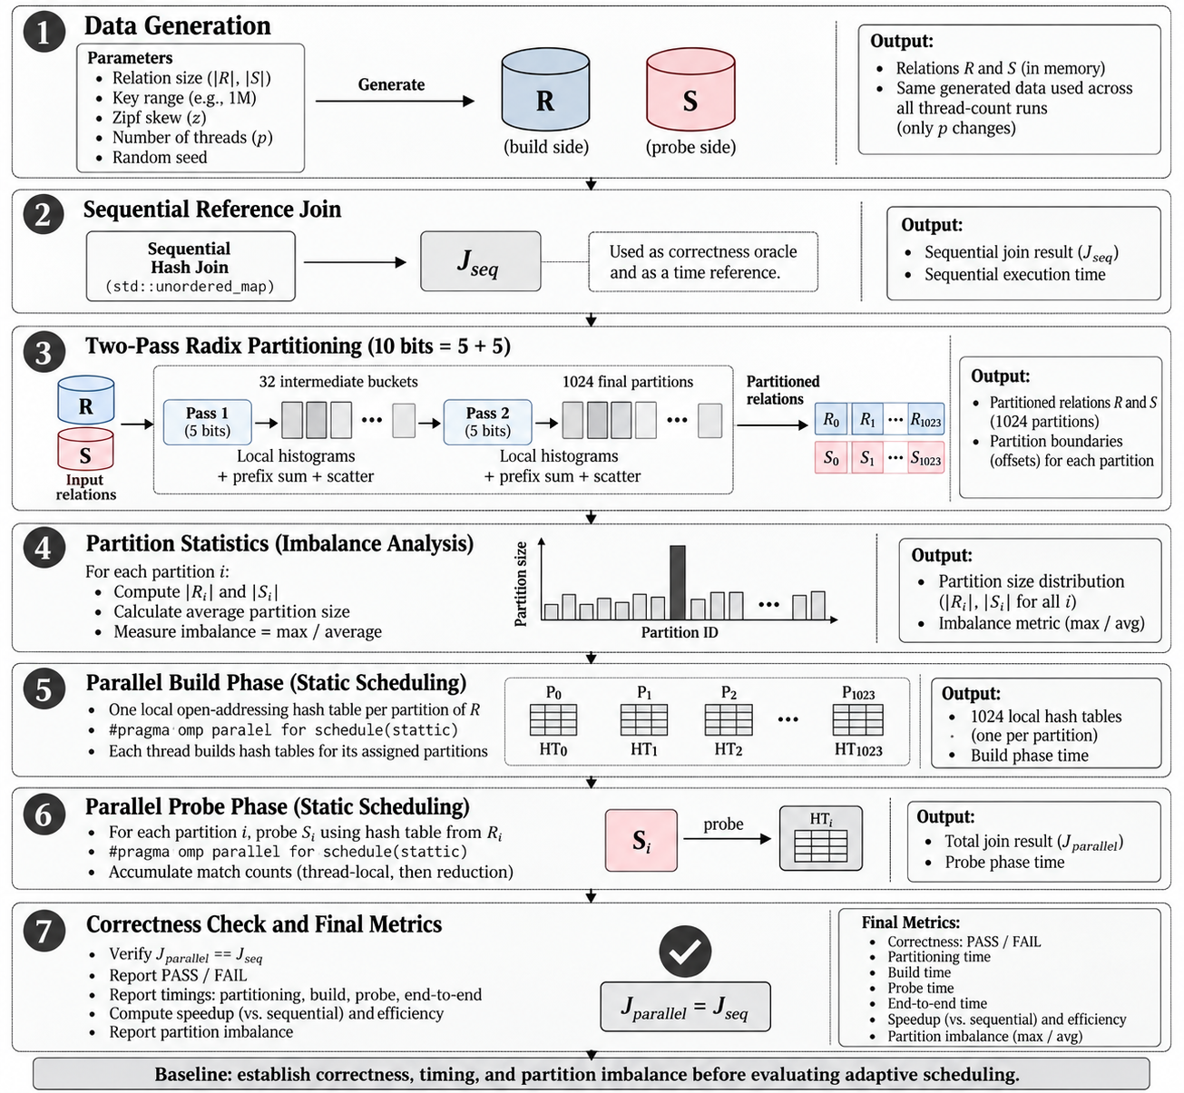
Methodology for Baseline Implementation

Slide 8
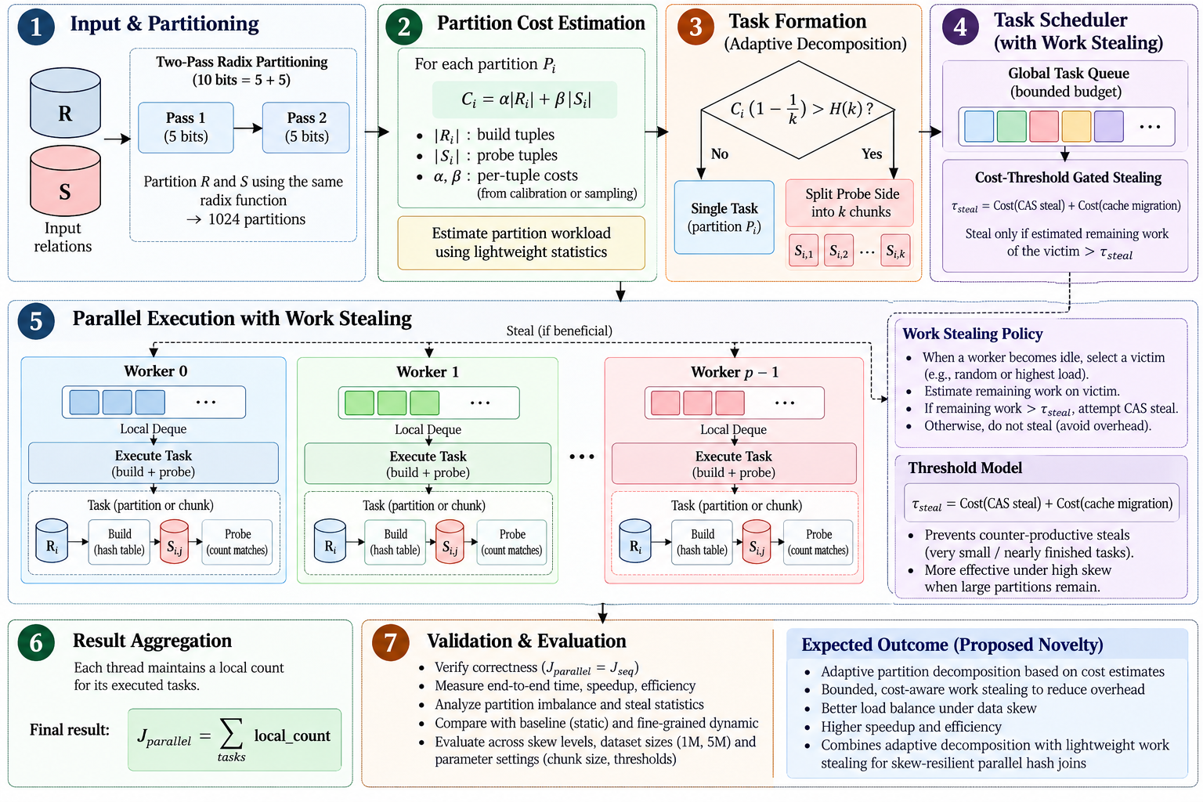
Methodology for Proposed Novelty

Slide 9
Evaluation Metrics and Expected Analysis
Evaluation Metrics
End-to-End Execution Time: Primary metric to determine whether the proposed scheduling policy improves overall hash-join performance.
Relative Performance Improvement (%): Quantifies runtime reduction against static coarse and fine-grained dynamic baselines.
Partition Imbalance: Maximum-to-average probe-partition size ratio to quantify workload skew.
Task Count and Scheduling Overhead: Measures whether bounded task budgeting reduces excessive task creation and its associated overhead.
Correctness: Compare parallel join results with the sequential reference implementation to ensure identical results.
Speedup and Parallel Efficiency: Evaluate parallel execution relative to sequential execution and the number of threads used.

Slide 10
Justification of Metrics and Expected Analysis
Metric | Why it is needed | Expected analysis
Time and speedup | The end goal is shorter runtime; also comparable with Balkesen et al. | Gain over static baseline grows with z; no loss at z = 0
Imbalance λ | Time alone cannot show idle workers; λ isolates the straggler cause | λ near 1 at high skew, large for static scheduling
Max/Avg partition size | Explains where and why skew hurts | Gains appear once the ratio is large (z ≥ 0.75)
Overhead and steal stats | Adaptivity is not free; tests the τ_steal gate | Near-zero stealing at z = 0; overhead small vs. gain at high z
Correctness | Speedups mean nothing if results differ | PASS on every run
Are they enough? Together they cover the goal (speed), the cause (imbalance), the cost (overhead) and validity (correctness).
Limitation: speedup vs. the sequential reference is confounded, since the sequential join also speeds up under skew. We therefore also report gain over the static-parallel and Balkesen-style baselines.
Negative result: if overhead outweighs the benefit at low skew, we report where stealing should be switched off.

