Slide 1
Jasmine
BDD for JavaScript
Notes:
Who here has used Jasmine before?

Slide 2
today?
So where are we
Notes:
A quick reflection on where we are today

Slide 3
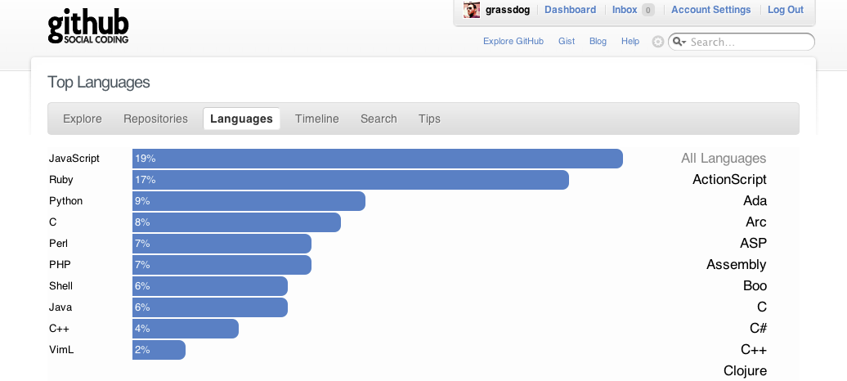
A straw poll
Notes:
You know the story. XMLHttpRequest. Ajax. Rich internet applications. HTML 5. etc…
Not the most accurate of measurements but the point remains. Now there are large amounts of JavaScript everywhere.

Slide 4


Large amounts of JS in the front end
Notes:
We’re all here because writing a modern application with the widest reach and the richest experience usually require Javascript.

Slide 5


And increasingly in the back end
Notes:
I will mainly be speaking about client side javascript. Even though a lot of the fundamentals apply anywhere.

Slide 6
Tooling and frameworks are starting to catch up
Notes:
There was an initial explosion of code there is a second explosion in frameworks.
On the front end we have frameworks such as Sammy.js, and Backbone.js for example to help us organize our code.
Jasmine is BDD testing framework.

Slide 7
Why use TDD with Javascript?
JavaScript is a real language. Treat it as such
Specification of your code's behaviour
Concern yourself with interface before implementation
Create code that is more modular, flexible, and reusable
Build up a regression test suite
Notes:
Mention Crockford. Familiar syntax so people just open their text editor and start firing away.
Careful when we build back ends. We should be just as careful with front ends
Encourages your to write your JS objects independent of your page markup. More than one client. Your app and your spec. Therefore they are more reusable.
Executable specification documentation.
Drive out the design
Testable code is often more modular (nicely namespaced), and because it’s driven from the client perspective first more reusable
Regression tests that can be integrated into your CI build
It is a development process that relies on the repetition of a very short development cycle: first the developer writes a failing automated test case that defines a desired improvement or new function, then produces code to pass that test and finally refactors the new code to acceptable standards. Red. Green. Refactor.

Slide 8
Jasmine
Created by Pivotal Labs
Heavily inspired by RSpec
http://pivotal.github.com/jasmine/

Slide 9
Why Jasmine?
Fast
Easily integrated
Runs anywhere JavaScript runs
RSpec-like syntax
Supports testing of asynchronous code
Vibrant community
Notes:
I was accustomed to using Rspec with rails and decided that to use Jasmine for the front end.
Integrates well with Ruby. Rails. Node. Or as a standalone page.
It does not rely on browsers, DOM, or any JavaScript framework.
Easy to integrate into CI builds.
Community of plug ins and extensions

Slide 10
code
Let’s see some

Slide 11
Integration
With a rails project integration use the jasmine gem
gem install jasmine
rails generate jasmine:install
rake jasmine
rake jasmine:ci
https://github.com/mhevery/jasmine-node
http://rudylattae.github.com/jasmine-species
Notes:
jasmine-node – will run all *.js and *.coffee files in the spec/ directory
jasmine-species – adds other BDD constructs to Jasmine. Features. Summaries. Scenarios. Contexts. Given With Then. Nice report viewer. etc…

Slide 12
Some extensions
https://github.com/mhevery/jasmine-node
http://rudylattae.github.com/jasmine-species
Notes:
jasmine-node – will run all *.js and *.coffee files in the spec/ directory
jasmine-species – adds other BDD constructs to Jasmine. Features. Summaries. Scenarios. Contexts. Given With Then. Nice report viewer. etc…

Slide 13
Jasmine Ajax
API testing with Jasmine
Mock http requests for both JQuery and Prototype
Define responses with various error codes and content and set expectations on your code in Jasmine
https://github.com/pivotal/jasmine-ajax
Notes:
Test your interactions with external APIs. Mock interface.

Slide 14
Jasmine JQuery
A set of custom jQuery matchers
toHaveHtml(string)
toBeHidden()
toBeSelected()
spyOnEvent($('#some_element'), 'click');
An API for handling HTML fixtures in your specs
loadFixtures('myfixture.html');
$('#my-fixture').myTestedPlugin();
expect($('#my-fixture')).to...;
https://github.com/velesin/jasmine-jquery

Slide 15
Generating fixture data
DRY
Use your application to generate fixture data from actual views
Load this fixture data from the Jasmine server
Run tests
http://bit.ly/bY1CA2
https://github.com/pivotaljb/js-fixture-example
Notes:
Even if you separate out your objects there are some tests you will want to perform where you integrate with view data.

Slide 16
Thanks
https://github.com/grassdog/jasmine-talk
@grassdog

