Slide 1


Image processing of the Cloud Chamber
G. Martinez, G. Grasseau

Slide 2
Introduction (1)
Data acquisition
A basic webcam, generally used for video conferencing, performs the image/data acquisitions
This choice restricts the control of the camera : exposure time, focal/zoom, …
The data acquisition speed depends on the camera response, the usb speed, and the computer power (cpu and disk performance)
Python code
Using the OpenCV library, the acquisition python script, called webcam-dacq.py is rather simple.
The main parameter is the time delay TimeDelay to adjust the average frequency of the data acquisition
The images are stored in JPEG format with the name pattern ./DACQ/img_xxx.jpeg

Slide 3
Introduction (2)
Processing generalities The processing must take into account of optical/acquisition processes and physical phenomena in the experimental setup.
Physical phenomena
Vanishing track: a particle tracks appear quite instantaneously (t < 1 sec.) in the cloud chamber and take few seconds to disappear/disaggregate.
Split track: a track can be split in several chunks mainly when the track cloud disaggregate
Track drift: during the track/cloud disaggregation the cloud drift
Optical/acquisition
Light distribution: the light distribution is far being homogeneous. It is very difficult to have homogeneous lighting.
Light fluctuations: during the acquisition sequence the captured light by the camera can fluctuate.
Camera distortion: because of the camera’s wide-angle lens the images are spatially distorted. Up to now no satisfying corrections have been found.

Slide 4
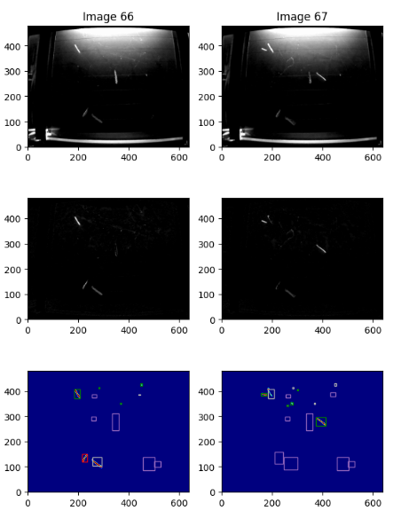
Algorithm
Raw images
Rq: Non uniform light intensity
Raw Images
New tracks (here 2)
Vanishing clusters (here 2)
Image difference
Remove intensity fluctuation
Cluster drift and new clusters
Cluster selection
Purple frames: Dead Zones
Green frames: new clusters
Red frames: selected clusters
White frames : not selected clusters. Previous clusters with are selected.
Rq: Small clusters are removed
Image difference
Cluster selection

Slide 5
Algorithm skeleton
def process( self, img, img_count, plot=True):
self.updateDeadZone(self.newDeadZones, img_count)
diffImg = self.diffPrevImg(img, store=True)
binaryImg = self.filterCutOff( diffImg, self.pBinaryCutOff)
grpImg, clusterList = self.clusterize( binaryImg, diffImg, img_count)
self.prevClusterList, …, self.newDeadZones = self.timeSelection( self.prevClusterList, clusterList, driftMax= self.pDriftMax)
. . .
return

Slide 6
Main algorithm parameters
def __init__( self, img, nFigRow=2, nFigCol=2):
# Building Clusters
self.pBinaryCutOff = 40
self.pFuseFrameDistance = 3.5
self.pFuseDistance = 3.5
self.pMinClusterArea = 9
# Dead Zone (DZ)
self.pDZIntersectionRatio = 0.15
self.pDZTimeLimit = 6
# Drift
self.pDriftMax = 15
self.pMaxDistanceForSameCluster = 1.5

Slide 7
Main class data members/variables
def __init__( self, img, nFigRow=2, nFigCol=2):
...
# Image, previous image
self.prevImg = img; self.diffImg = 0 self.imgMean = 0
# Clusters
self.grpImg = 0
self.prevClusterList = []
# Use for drawing
self.drawXXXYY = []
# List of all identified cluster during the processing
self.finalClusterList = []
# Dead zones
self.deadZones = []
self.newDeadZones = []

Slide 8
Calibration
Camera distortion
because of the camera’s wide-angle lens the images are spatially distorted
Main ideas
Draw/get a grid on a paper
Take an image of the grid
Identifying line intersections (not easy)
Make a transformation map pixel -> cm.
Linear approximation for any pixel in the image (should be sufficient)
Light intensity calibration ?
Light distribution: the light distribution is far being homogeneous. It is very difficult to have homogeneous lighting.
First steps
Software Installation
Check the processing on new data (FdS)
Draw/get a the grid on paper
Data acquisition on the grid paper.

