Slide 1
New Coffee Shop Location
Steven Asten

Slide 2
Contents
Problem and Hypotheses
Data dictionary
Exploratory Data Analysis (EDA)
Visualizations
Machine Learning
Conclusion

Slide 3
Problem
Find an available storefront property in DC area which would be suitable for a new coffee shop.

Slide 4
Hypotheses
If I can find where people are coming from when they visit coffee shops, then I can look for a geographical area with a large presence of these features, and this location would be suitable for a new coffee shop.
If I can predict characteristics of a coffee shop-goer (including age, income, means of transportation), then I can find a geographical area with the most of this type of person, and this would be a suitable location for the new coffee shop.

Slide 5
Data Dictionary - Yelp API
Data ID | Data Type | Data Description
Business_id | String | unique id
Name | String | Business’ name
Neighborhood | String | Neighborhood’s name
Address | String | Full address of business
City | String | City
State | String | 2-char state abbreviation
Postal code | String | 5-char postal code
Latitude | Float | Latitude
Longitude | Float | Longitude
Categories | Array | List of categories

Slide 6
Data Dictionary - Foursquare
Data ID | Data Type | Data Description
user_id | Integer | Unique ID
utc_time | Datetime | Full datetime timestamp
latitude | Float | Latitude of checkin
longitude | Float | Longitude of checkin
venue_category | String | Category description
country_code | String | Abbreviated country

Slide 7
Data Dictionary – 2016 ACS Dataset
Data ID | Data Type | Data Description
zip_code | String | Zip code
population | Integer | Total Population of zip code
median_age | Integer | Median age of zip code
mean_income | Float | Mean income of zip code
percent_public_transport | Float | Percentage of people who use public transportation as a primary means of transport

Slide 8
Exploratory Data Analysis
Foursquare dataset contained Latitude and Longitude, no other location data. Reverse geocoding 3-million records unrealistic.
Python package “reverse_geocoder” returns county
Zillow Neighborhood Shapefile returns name of neighborhood
Convert neighborhood names to zip code
Yelp dataset missing data
Yelp API 50 results per query, 5000 queries per day

Slide 9
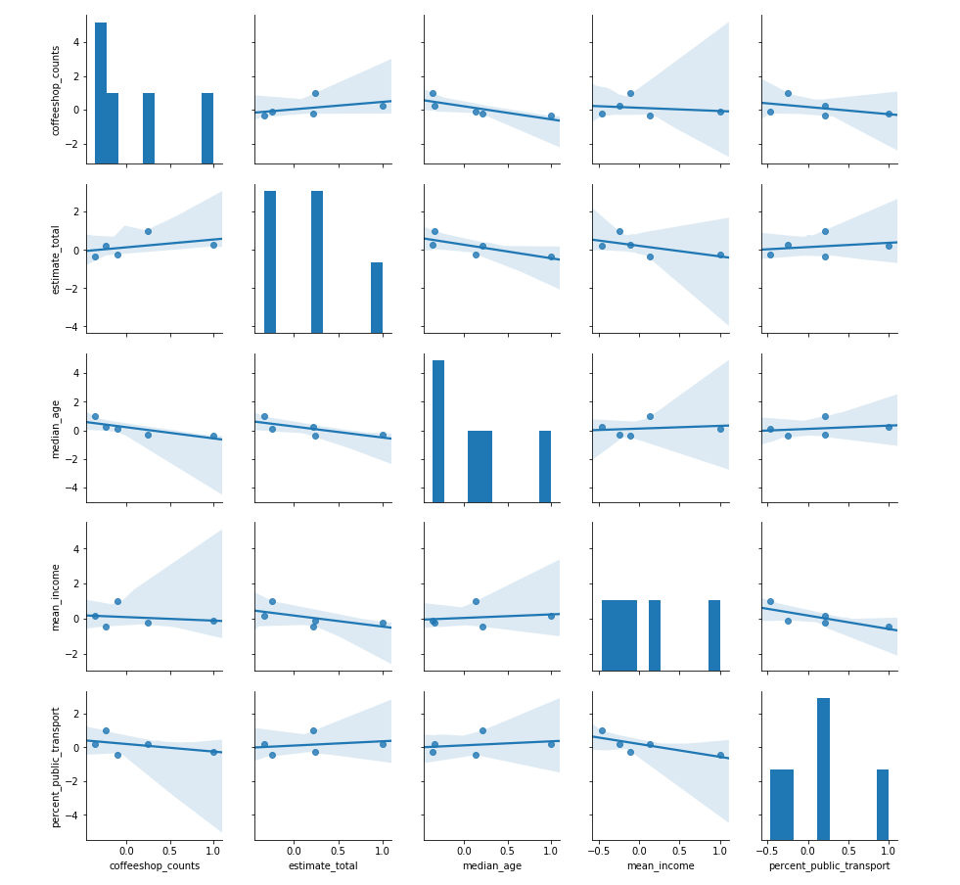
Visualizations 1
Correlations between count of coffee shop visits and zip code demographic features

Slide 10
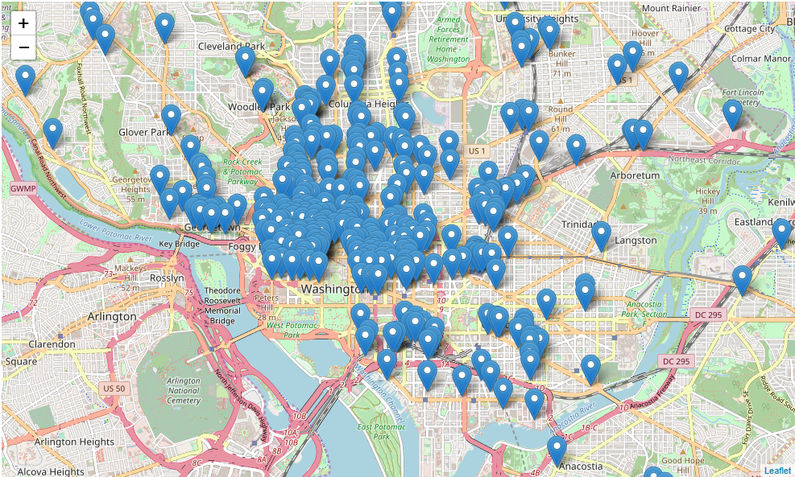
Visualizations 2
All coffee shops in DC plotted on interactive Folium map

Slide 11
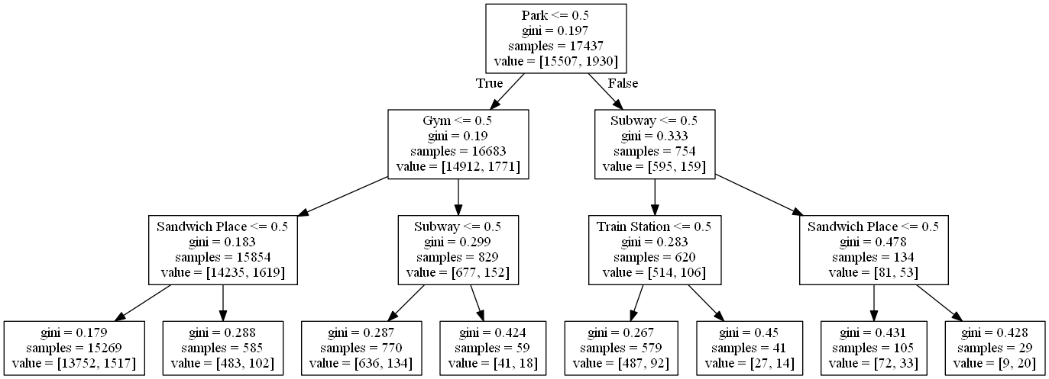
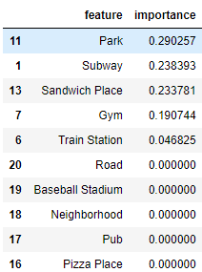
Machine Learning 1
Model 1: Decision Tree. Transposed top 23 categories to columns with binary values and used a Decision Tree to predict where people are coming from when they go to coffee shops.

Slide 12
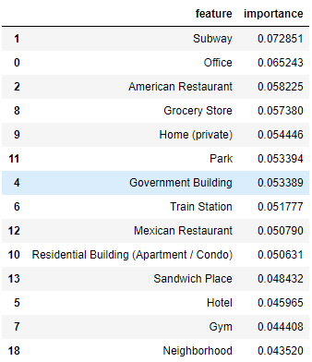

Machine Learning 2
Model 2: Random Forest
Model 3: Linear Regression. I found that Median Age and Percentage of people who use Public Transport were most correlated with coffee shop check-ins, so I used these two features in my linear regression model.
As median age increases by 1 year, number of coffee shop check-ins decreases by 21.

Slide 13
Machine Learning Performance
Models run on Foursquare Dataset | Model | Accuracy
 | Decision Tree | Baseline ≈ 88% Modelled ≈ 88%
 | Random Forest | Baseline ≈ 88% Modelled ≈ 89%
 | Gradient Boosting | Baseline ≈ 88% Modelled ≈ 89%
Models run on ACS dataset | Model | RMSE
 | Linear Regression | Baseline: 243.6 Modelled: 117.9

Slide 14
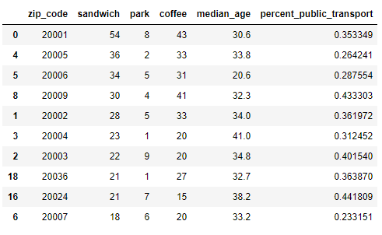
Conclusion 1
Hypothesis 1: People who visit coffee shops also visit parks and gyms, and they use public transportation. They do not like sandwich shops.
Hypothesis 2: Lower median age results in a higher number of coffee shop visits.

Slide 15
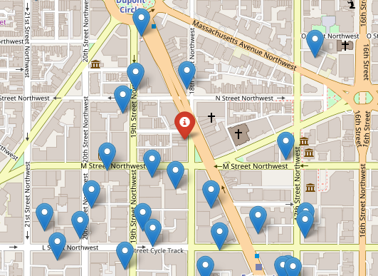
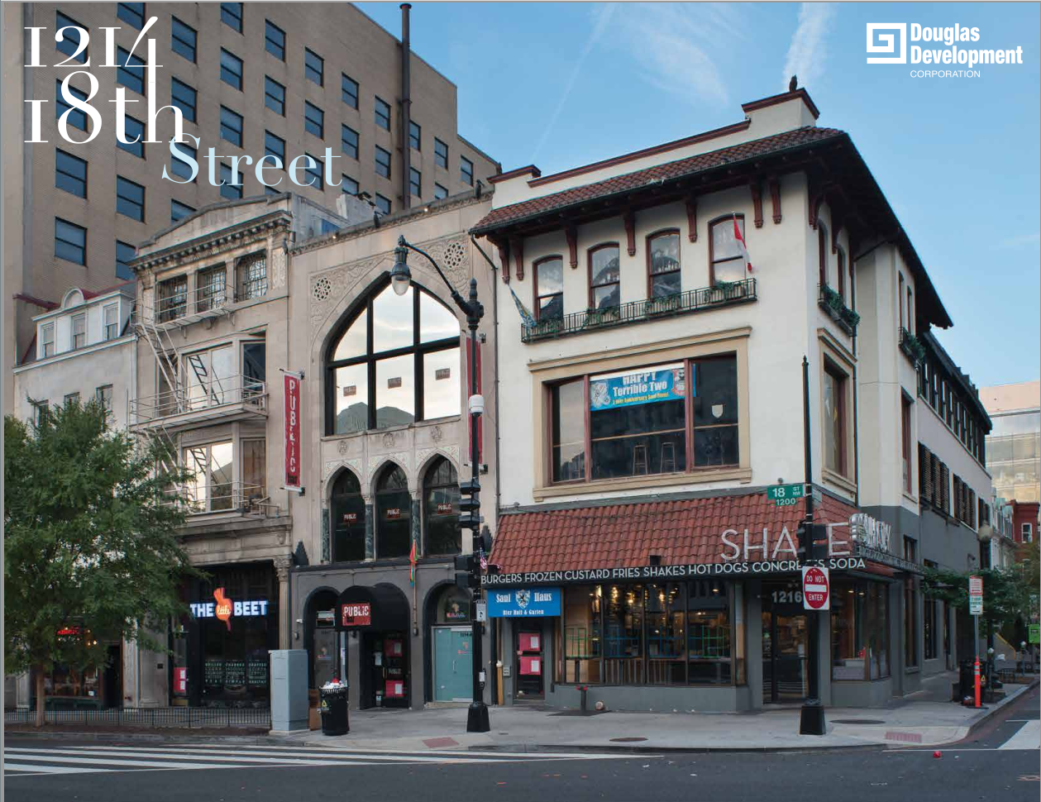
Conclusion 2

Slide 16
Appendix
GitHub Repo: https://git.generalassemb.ly/astensteven/project-final
Yelp API Docs: https://www.yelp.com/developers/documentation/v3
Foursquare Data: https://sites.google.com/site/yangdingqi/home/foursquare-dataset
ACS Data: https://factfinder.census.gov/faces/nav/jsf/pages/download_center.xhtml
Zillow Neighborhood Shapefiles: https://www.zillow.com/howto/api/neighborhood-boundaries.htm
Reverse Geocoder: https://github.com/thampiman/reverse-geocoder
Property Listing: http://www.cityfeet.com/cont/listing/retail-space-for-lease/1214-18th-st-nw-washington-dc-20036/CS4135317

