Slide 1
New Coffee Shop Location
Steven Asten

Slide 2
Contents
Problem and Hypotheses
Data dictionary
Exploratory Data Analysis (EDA)
Visualizations
Machine Learning
Machine Learning Performance
Conclusion and location recommendation
Appendix

Slide 3
Problem
Find an available storefront property which would be suitable for a newly established coffee shop.

Slide 4
Hypotheses
If I can find where people are coming from when they visit coffee shops, then I can look for a geographical area with a large presence of these features, and this location would be suitable for a new coffee shop.
If I can predict characteristics of a coffee shop-goer (including age, income, means of transportation), then I can find a geographical area with the most of this type of person, and this would be a suitable location for the new coffee shop.

Slide 5
Data dictionary
Yelp API
Foursquare Dataset
American Community Survey (ACS) Dataset

Slide 6
Data Dictionary - Yelp API
Data ID | Data Type | Data Description
Business_id | String | unique id
Name | String | Business’ name
Neighborhood | String | Neighborhood’s name
Address | String | Full address of business
City | String | City
State | String | 2-char state abbreviation
Postal code | String | 5-char postal code
Latitude | Float | Latitude
Longitude | Float | Longitude
Categories | Array | List of categories

Slide 7
Data Dictionary - Foursquare
Data ID | Data Type | Data Description
user_id | Integer | Unique ID
utc_time | Datetime | Full datetime timestamp
latitude | Float | Latitude of checkin
longitude | Float | Longitude of checkin
venue_category | String | Category description
country_code | String | Abbreviated country

Slide 8
Data Dictionary – 2016 ACS Dataset
Data ID | Data Type | Data Description
zip_code | String | Zip code
population | Integer | Total Population of zip code
median_age | Integer | Median age of zip code
mean_income | Float | Mean income of zip code
percent_public_transport | Float | Percentage of people who use public transportation as a primary means of transport

Slide 9
Exploratory Data Analysis
Foursquare dataset contained Latitude and Longitude, no other location data. Reverse geocoding 3-million records unrealistic.
Python package “reverse_geocoder” returns county
Zillow Neighborhood Shapefile returns name of neighborhood
Convert neighborhood names to zip code
Yelp dataset missing data
Yelp API 50 results per query, 5000 queries per day

Slide 10
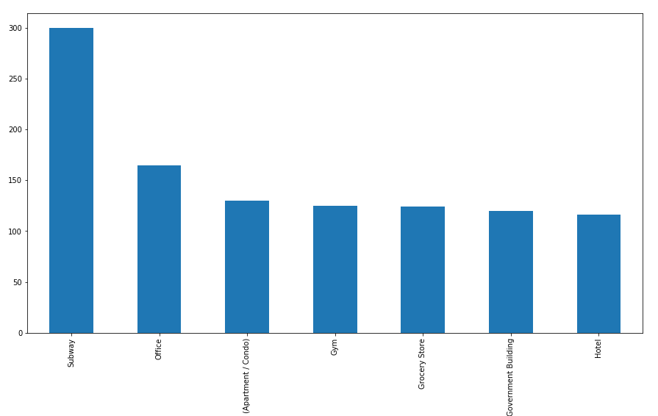
Visualizations 1
Top 7 categories people who visit coffee shops visit on the same day

Slide 11
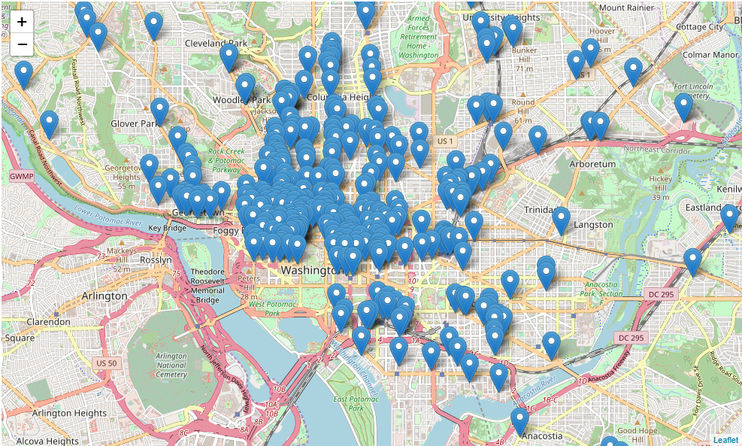
Visualizations 2
All coffee shops in DC plotted on interactive Folium map

Slide 12
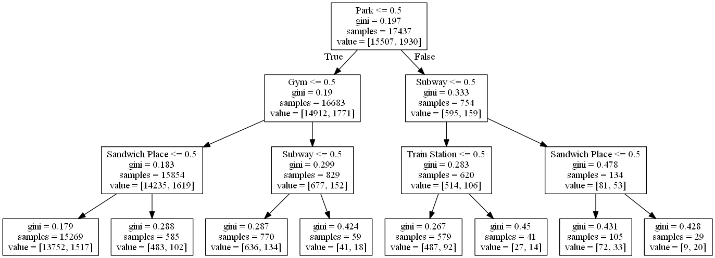
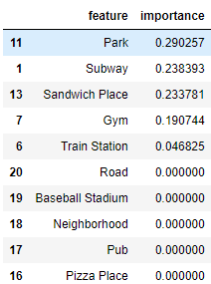
Machine Learning 1
Model 1: Decision Tree. Transposed top 23 categories to columns with binary values and used a Decision Tree to predict where people are coming from when they go to coffee shops.

Slide 13
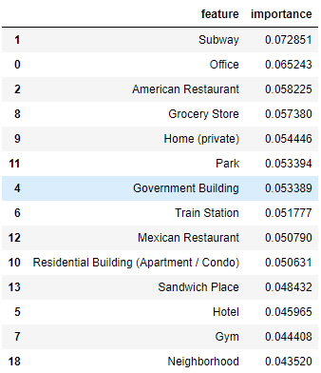

Machine Learning 2
Model 2: Random Forest
Model 3: Linear Regression. I found that Median Age and Percentage of people who use Public Transport were most correlated with coffee shop check-ins, so I used these two features in my linear regression model.
As median age increases by 1 year, number of coffee shop check-ins decreases by 21.

Slide 14
Machine Learning Performance
Models run on Foursquare Dataset | Model | Accuracy
 | Decision Tree | Baseline ≈ 88% Modelled ≈ 88%
 | Random Forest | Baseline ≈ 88% Modelled ≈ 89%
 | Gradient Boosting | Baseline ≈ 88% Modelled ≈ 89%
Models run on ACS dataset | Model | RMSE
 | Linear Regression | Baseline: 243.6 Modelled: 117.9

Slide 15
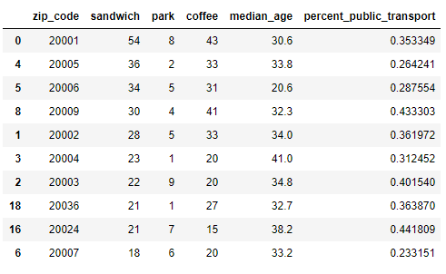
Conclusion 1
Hypothesis 1: People who visit coffee shops also visit parks and gyms, and they use public transportation. They do not like sandwich shops.
Hypothesis 2: Lower median age results in a higher number of coffee shop visits.

Slide 16
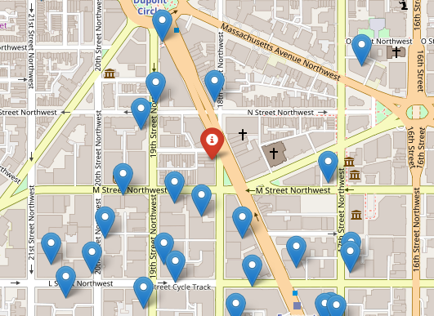
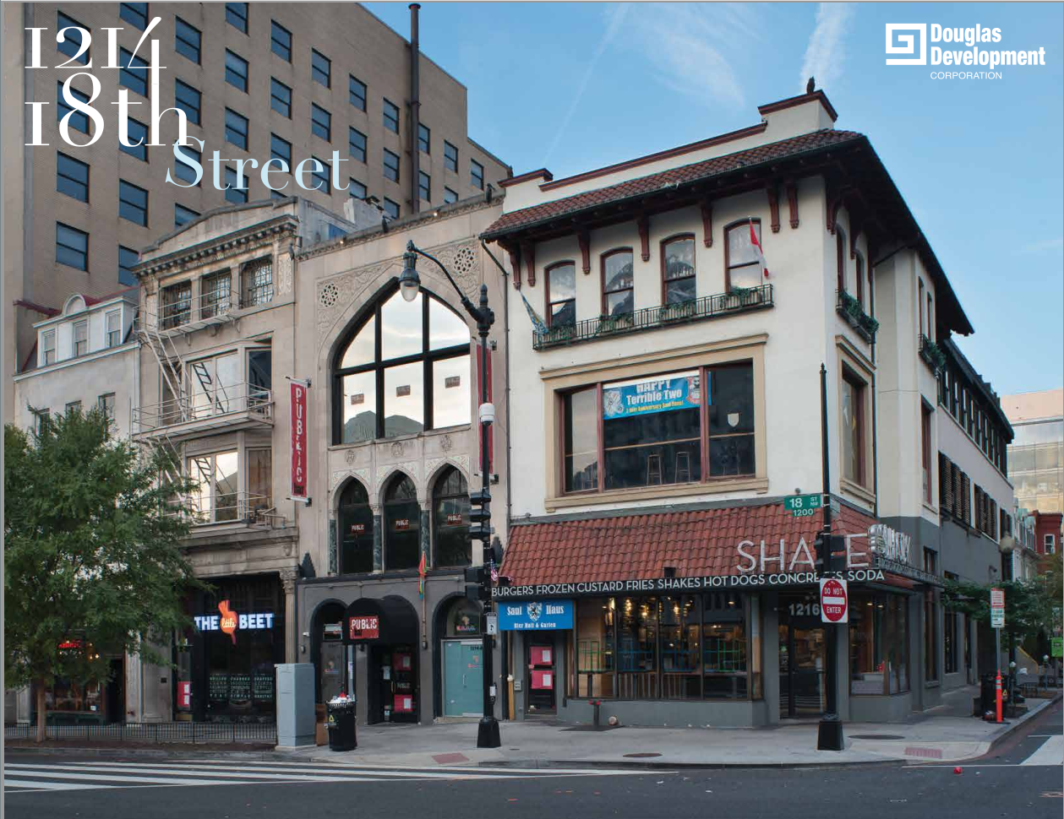
Conclusion 2

Slide 17
Appendix
GitHub Repo: https://git.generalassemb.ly/astensteven/project-final
Yelp API Docs: https://www.yelp.com/developers/documentation/v3
Foursquare Data: https://sites.google.com/site/yangdingqi/home/foursquare-dataset
ACS Data: https://factfinder.census.gov/faces/nav/jsf/pages/download_center.xhtml
Zillow Neighborhood Shapefiles: https://www.zillow.com/howto/api/neighborhood-boundaries.htm
Reverse Geocoder: https://github.com/thampiman/reverse-geocoder
Property Listing: http://www.cityfeet.com/cont/listing/retail-space-for-lease/1214-18th-st-nw-washington-dc-20036/CS4135317

